Slide 1
Validation of Geant4 against the TARC benchmark:
Testing neutron production, transportation and interaction
TARC – experimental set-up and aims
Geant4 simulation
Comparing data with simulation
  Energy-time correlation
  Absolute Fluence
  Radial Distributions
Resurrection from 2008-today…
Summary and Conclusions
Alex Howard, ETH Zürich

Slide 2
Motivation for TARC Comparison
2008
The production, interaction and transport of neutrons is important in a number of applications:
  Background radiation studies
  Radiation effects (single event upsets in electronics)‏
  Background and spill-over (LHC experiments)‏
Validation with TARC offers testing of Geant4 physics over a broad energy and process range
  Neutron production from ~GeV protons
  Secondary neutron production
  Thermalisation and capture
  Absolute fluence measurement

Slide 3
Geant4 Physics Modelling
2008
The Geant4 BERTINI and BINARY cascade physics models were chosen for simulating hadron production
  Both of these include nuclear de-excitation models
The low energy neutron_hp package was used below 20 MeV for neutrons:
  Neutron interaction
  Transportation
  Elastic scattering
  Capture
Other “standard” Geant4 processes are included for elastic (hadrons), electromagnetic (all), stopping (hadrons)
Using physics lists QGSP_BERT_HP and QGSP_BIC_HP

Slide 4
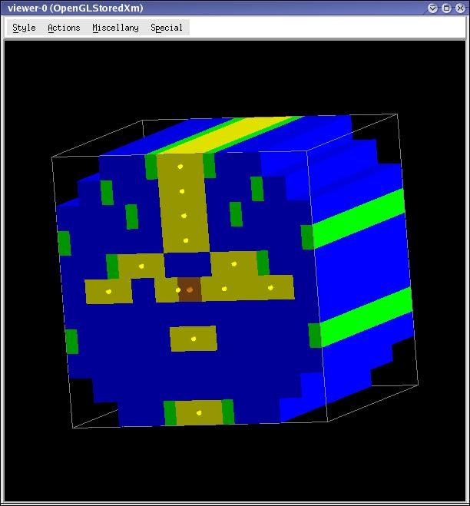
The TARC Experiment
2008
Neutron Driven Nuclear Transmutation by Adiabatic Resonance Crossing (Cern 96-97)‏
2.5 or 3.5 GeV/c proton beam.
334 tons of Pb in cylindrical 3.3m x 3.3m x 3m block.
The lead is 99.99% pure.
Beam enters through a 77.2mm diameter blind hole, 1.2m long.
12 sample holes are located inside the volume to measure capture cross-sections on some isotopes.

Slide 5
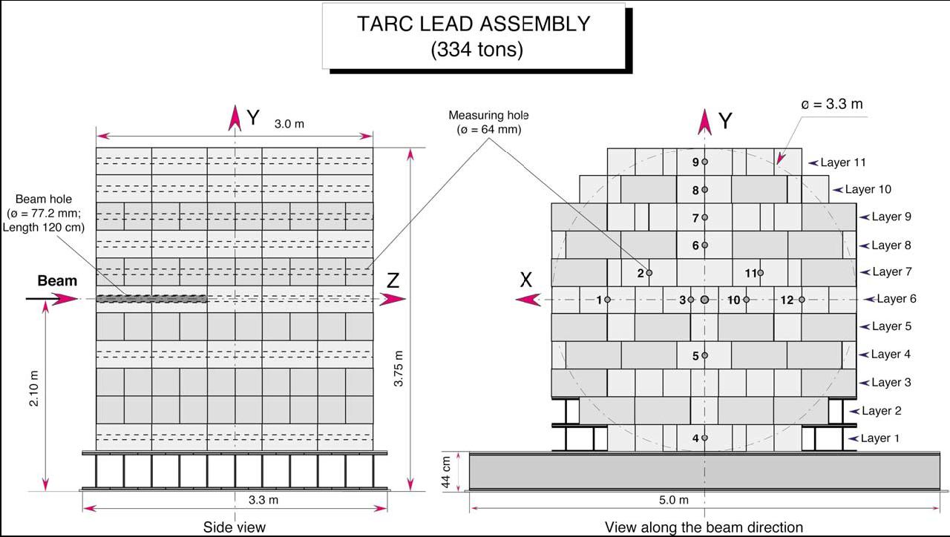
TARC – experimental set-up
2008

Slide 6
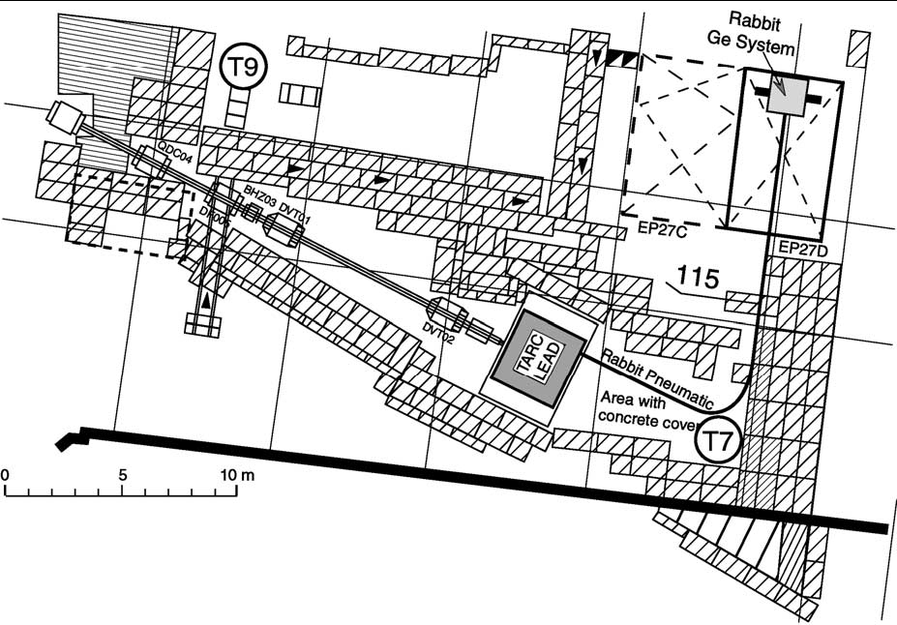
Data taken 1996-1997, final publication 2002

Slide 7
TARC – neutron validation and aims
2008
Validates spallation neutron production from 2.5 and 3.5 GeV/c protons on pure lead
Validates energy-time relationship and thermalisation of neutrons
Absolute Neutron fluence spectrum from spallation production
Aims of experiment:
  neutron production by GeV protons hitting a large lead volume;
  neutron transport properties, on the distance scale relevant to industrial applications (reactor size);
  Measures capture cross-sections on a number of specific isotopes - efficiency of transmutation of ⁹⁹Tc and ¹²⁹I.

Slide 8
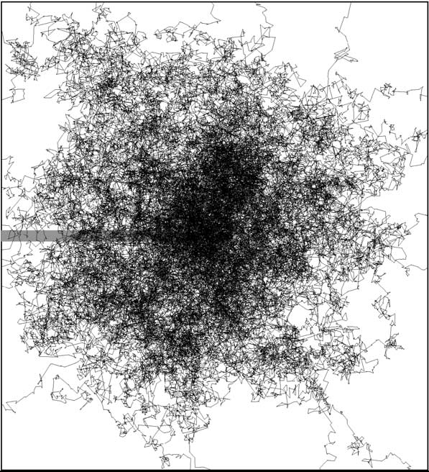
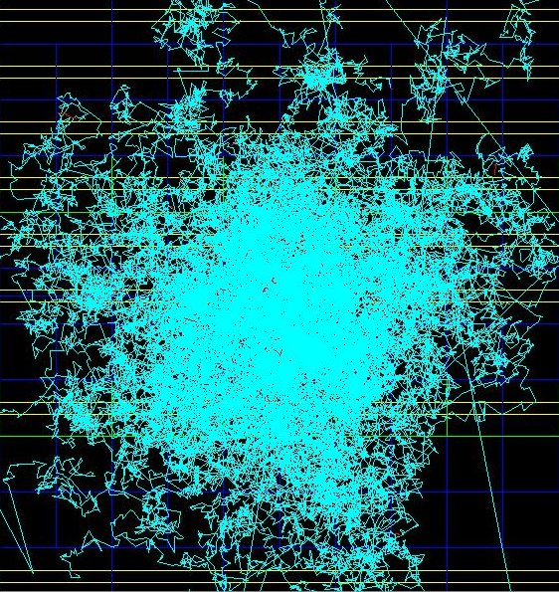
TARC simulation – single event
3.5 GeV/c proton on natural lead
2008
TARC original simulation
FLUKA and custom transport
Geant4 – Bertini Cascade
neutron_hp

Slide 9
Neutron-energy time correlation
2008
A first test of neutron transportation in Geant4 is to look at energy-time correlation
Due to the highly elastic nature of neutron scattering in lead and the high nuclear mass, there is a correlation between the neutron energy and its time of observation. This is particularly true at low energy, approximately independent of the initial neutron (and proton) energy
This has been verified experimentally and by TARC's own simulation (FLUKA + EA custom)‏
TARC measurements were carried out by measuring the time of capture on different resonant isotopes and by measuring the prompt signal in ³He gas counters
In Geant4 this relies heavily on the high precision neutron_hp model for neutrons < 20 MeV

Slide 10
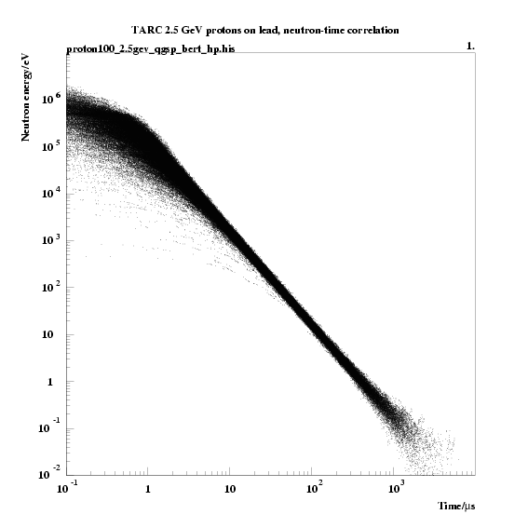
Neutron Energy-Time Correlation
2008
Geant4
Bertini + neutron_hp
Neutron energy and time are stored for the flux through a given radial shell
Reasonable agreement with expectation, although the low energy population is quite different between physics list (as expected)‏
Geant4

Slide 11
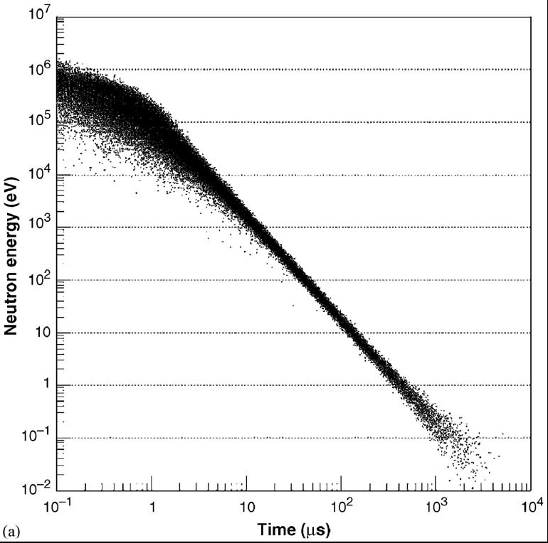
Neutron Energy-Time Correlation
2008
Neutron energy and time are stored for the flux through a given radial shell
Reasonable agreement with expectation, although the low energy population is quite different between physics list (as expected)‏
Geant4
Bertini + neutron_hp
TARC Paper
TARC simulation
Geant4

Slide 12
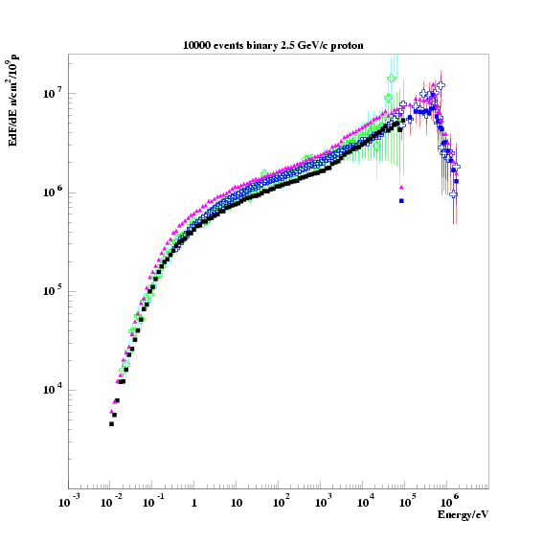
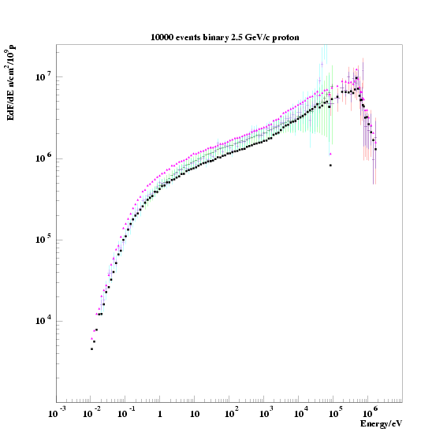
Absolute Fluence Distribution @ 45.6cm
2008
TARC data are measured at one position
Spectral fluence is determined from the energy-time correlation with cross-checks (lithium activation and ³He ionisation detectors)
TARC data are unbinned
E dF/dE
Simulated fluence is calculated by measuring the neutron track length through a spherical shell of radius 45.6cm
Measure counts in bin
  divide by bin width
  multiply by mean energy

Slide 13
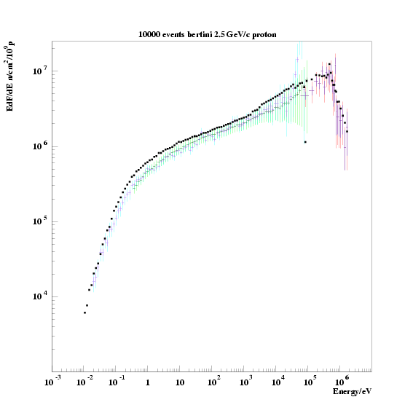
Fluence Bertini cascade
2008

Slide 14
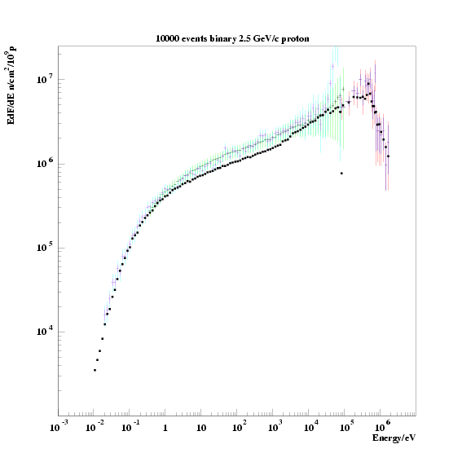
Fluence Binary cascade
2008

Slide 15
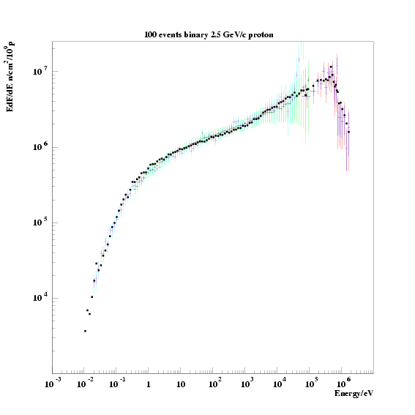
Fluence Binary cascade – Improved PreCompound
2008
2008
Old model
NEW PreCompound

Slide 16
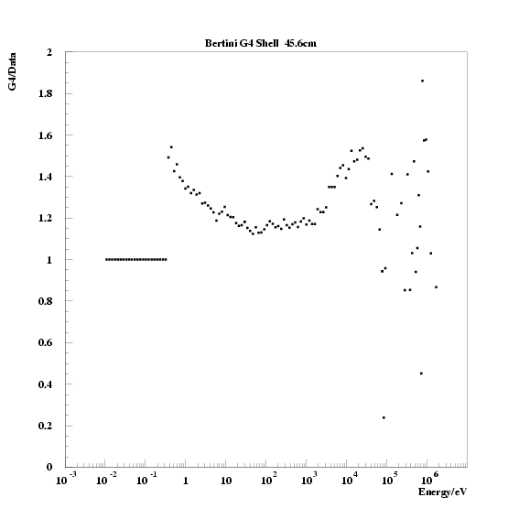
Ratio Plots of fluence G4/Data – Bertini
2008
Geant4/Data
Ratio of
4π shell : Data
Two-sets of data
Approximately 20-60% overestimated
Dominated by systematic errors of experiment
Shell approach better
Sub-structure – due to bertini?
Neutron Energy /eV

Slide 17
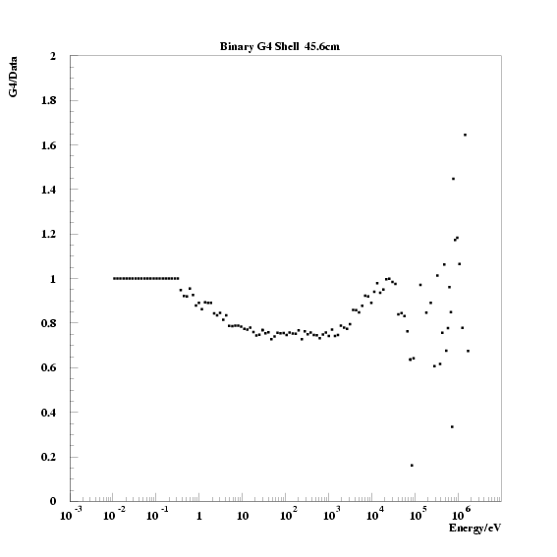
Ratio Plots of fluence G4/Data – Binary
2008
Geant4/Data
Ratio of
4π Shell : Data
Approximately agrees (<20% under-estimated)‏
Dominated by systematic errors of experiment
Neutron Energy /eV

Slide 18
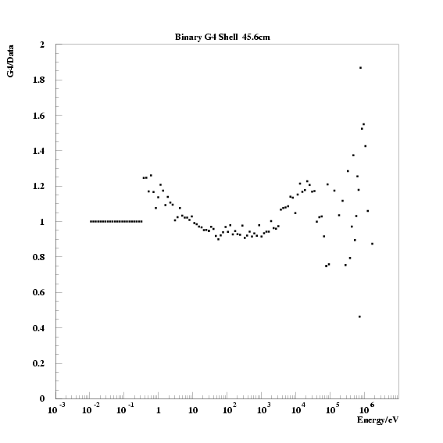
Ratio of fluence G4/Data – Improved PreCompound
2008
Geant4/Data
2008
Old model
NEW PreCompound
Neutron Energy /eV

Slide 19
Radial Fluence Distributions
2008
TARC measured the radial dependence of the neutron fluence in order to measure the slowing down within the lead volume with protons at 3.5GeV/c (slightly higher than fluence data)‏
In Geant4 a sequence of parallel shell volumes were created at different radii according to the experimental measurements (CPU efficient)‏
Fermi Age Theory predicts that the flux should be isotropic and TARC experimental data (+/- z-values) supports this over the energy range investigated

Slide 20
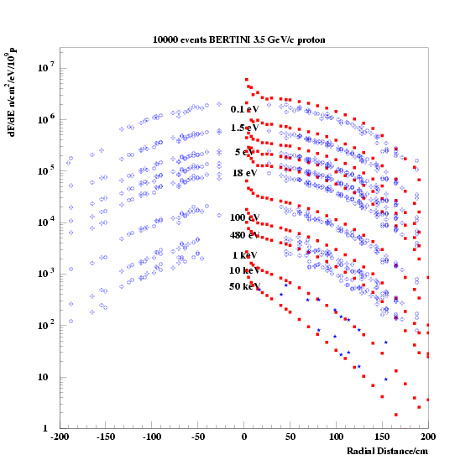
Radial Fluence Distribution - BERTINI
2008

Slide 21
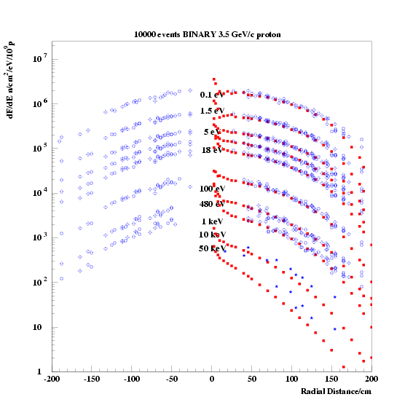
Radial Fluence Distribution - BINARY
2008
Simulation in red
Data in Blue
Agreement very good

Slide 22
2015…
NOW
Code is running
Some challenges with:
  Analysis
  MT
  Macros to compare data

Slide 23
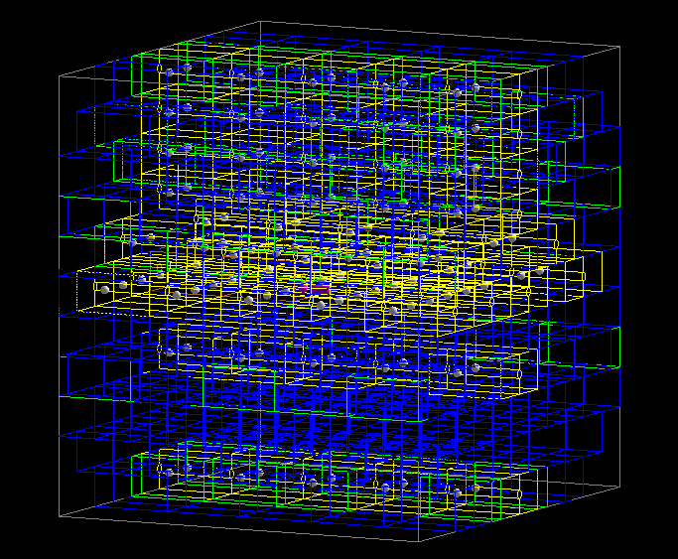
1 event
NOW

Slide 24
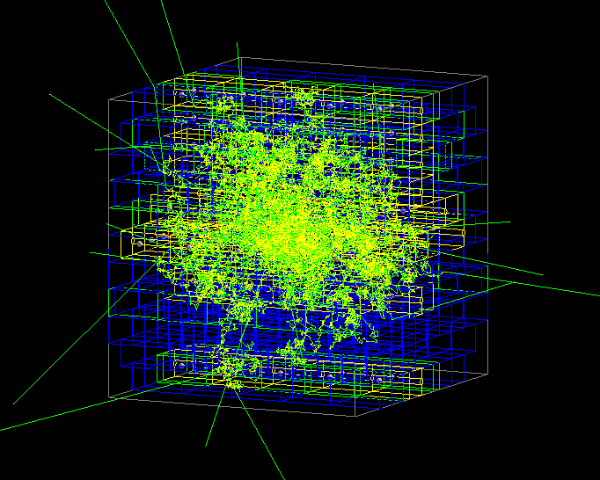
1 event
NOW

Slide 25
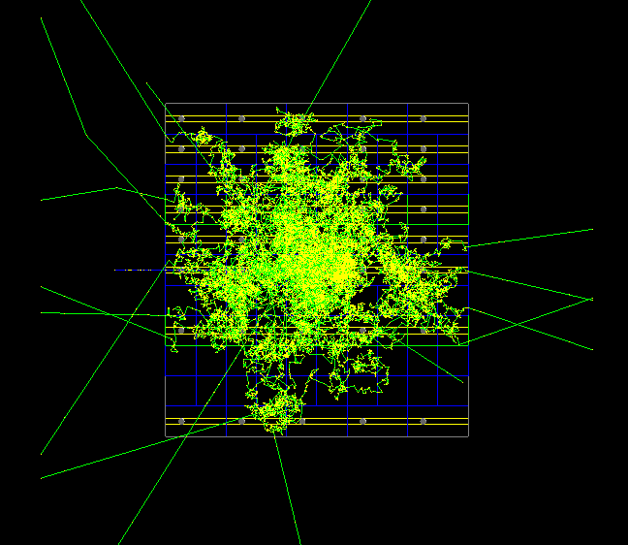
1 event
NOW

Slide 26
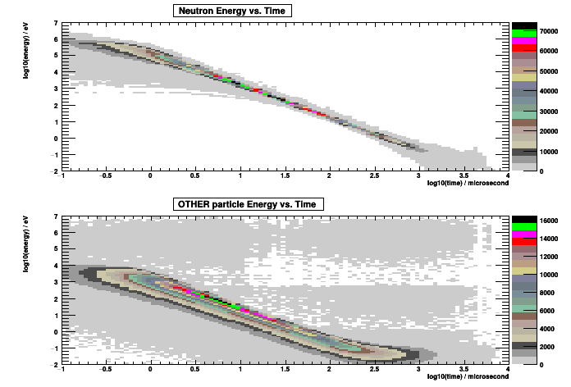
Energy vs. Timing plot - Bertini
NOW

Slide 27
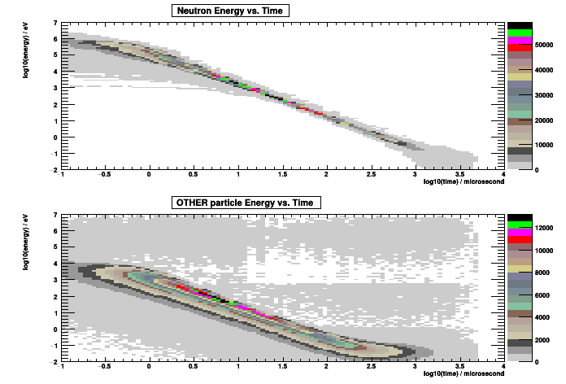
Energy vs. Timing plot - Binary
NOW

Slide 28
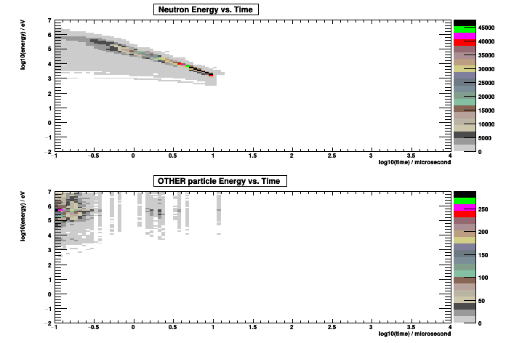
Energy vs. Timing plot - QBBC
NOW

Slide 29
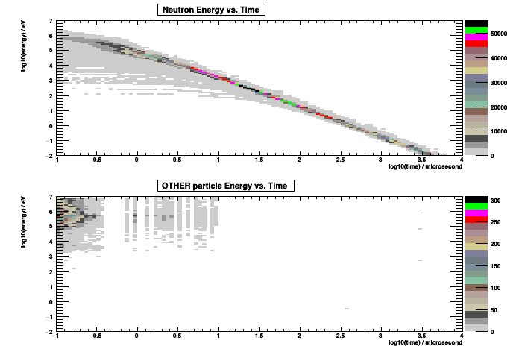
Energy vs. Timing plot – QBBC
No killer!
NOW

Slide 30
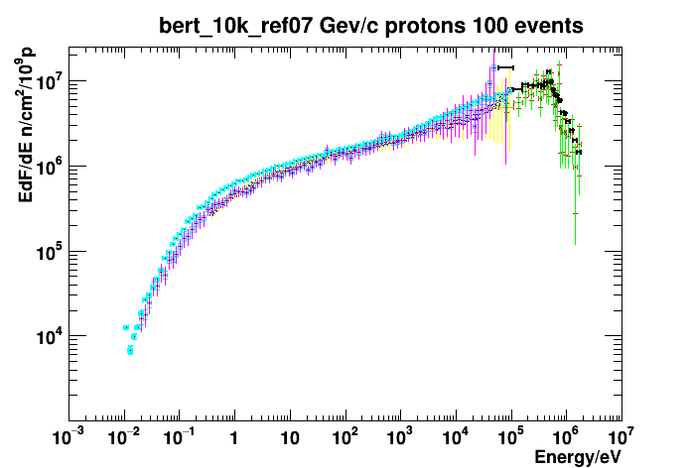
Fluence – Bertini – 10k events
NOW
G4 in cyan and black (sorry)

Slide 31
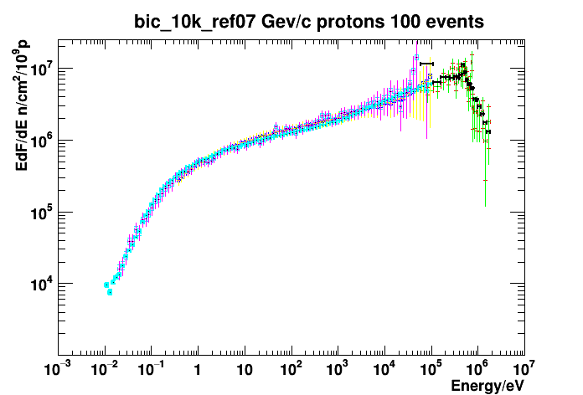
Fluence – Binary – 10k events
NOW
G4 in cyan and black

Slide 32
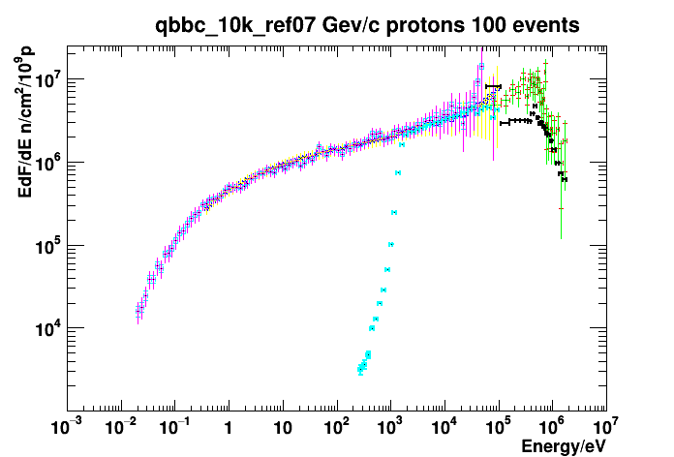
Fluence – QBBC – 10k events
NOW
G4 in cyan and black

Slide 33
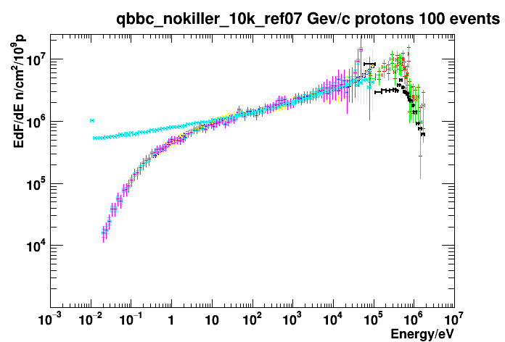
Fluence – QBBC no killer – 10k events
NOW
G4 in cyan and black

Slide 34
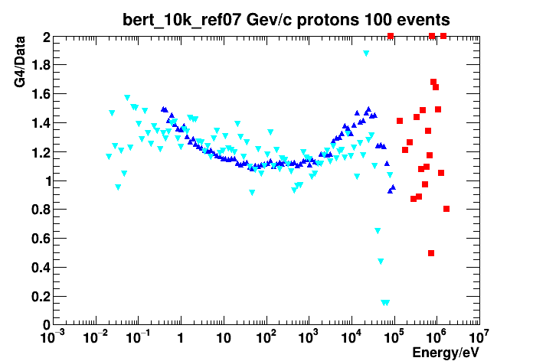
Ratio – Bertini – 10k events
NOW

Slide 35
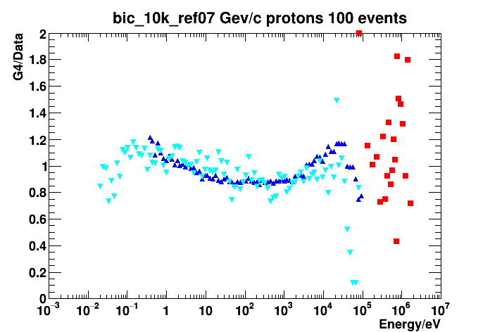
Ratio – Binary – 10k events
NOW

Slide 36
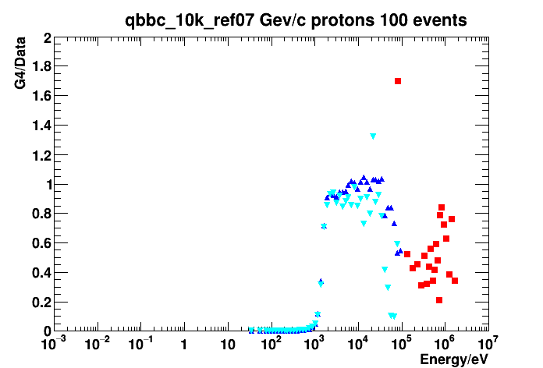
Ratio – QBBC – 10k events
NOW

Slide 37
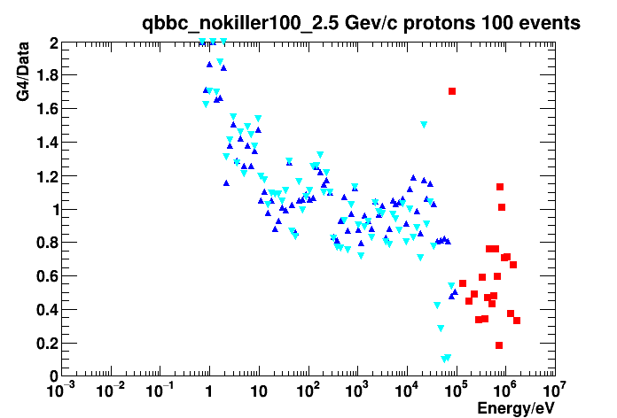
Ratio – QBBC no killer – 10k events
NOW

Slide 38
Memory Leaking…
Bertini running on my laptop:

Slide 39
Memory Leaking…
Binary running on my laptop:

Slide 40
Run times
Binary and BIC same at 2.5GeV/c
Bertini 30% slower at 3.5GeV/c
QBBC 15 times faster (killer)
And 7 times faster (no killer)

Slide 41
Future Work
Radial distributions – ROOT issue (plotting is fun!)
Higher statistics – memory leaks?
Ref09 – memory leak is worse
  Can’t run more than 100 events on 40 threads (CSCS cluster)
Test other models/physics lists
Create a proper (code refactor) test/validation suite

Slide 42

Thank you for your attention…

