Slide 1
Separating p’s, π’s, and K’s
Summary of TRD session
M. L. Cherry
Louisiana State university
CERN, Oct. 2, 2015

Slide 2
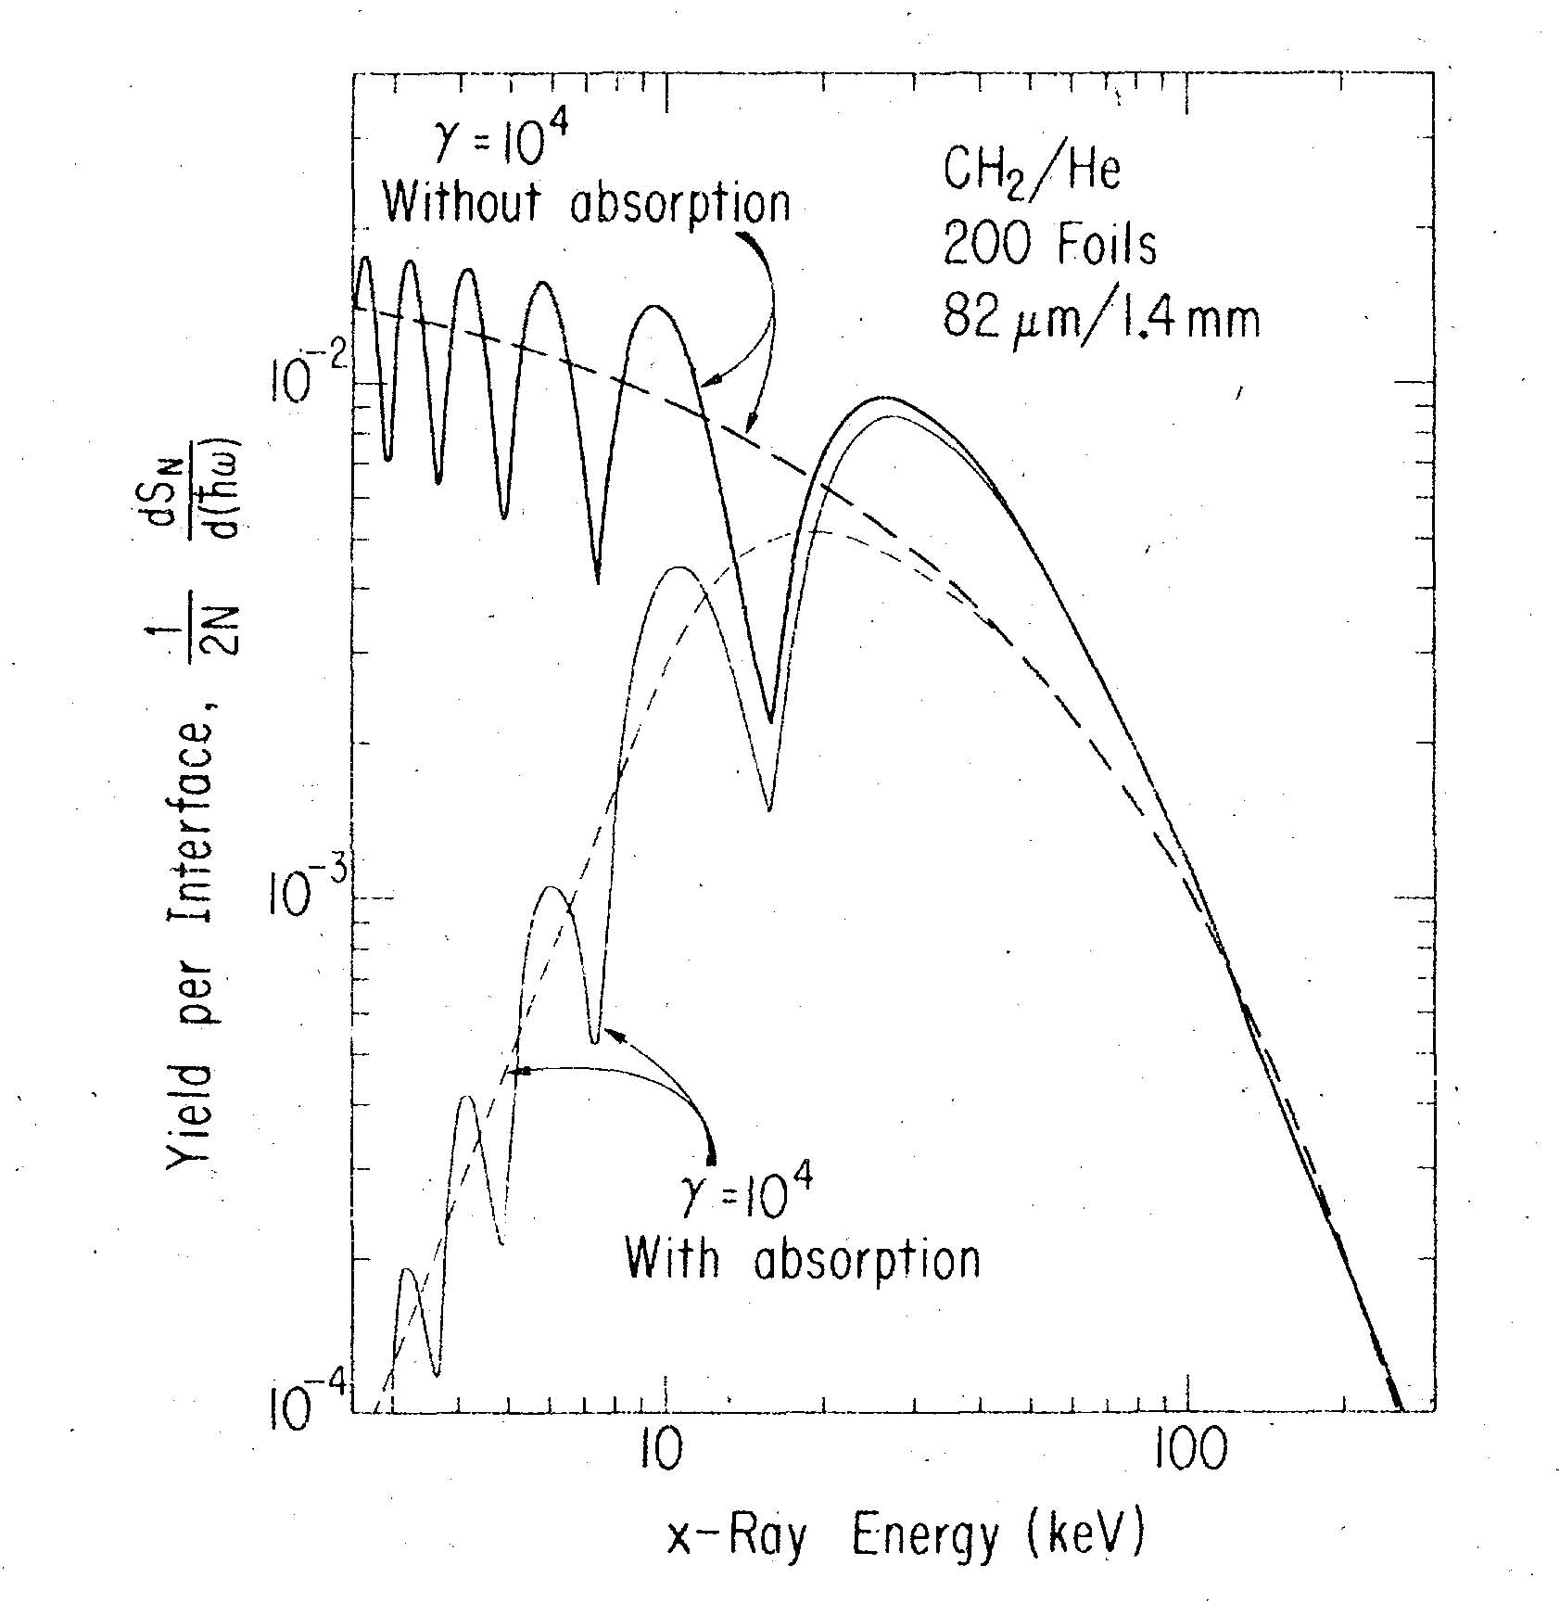
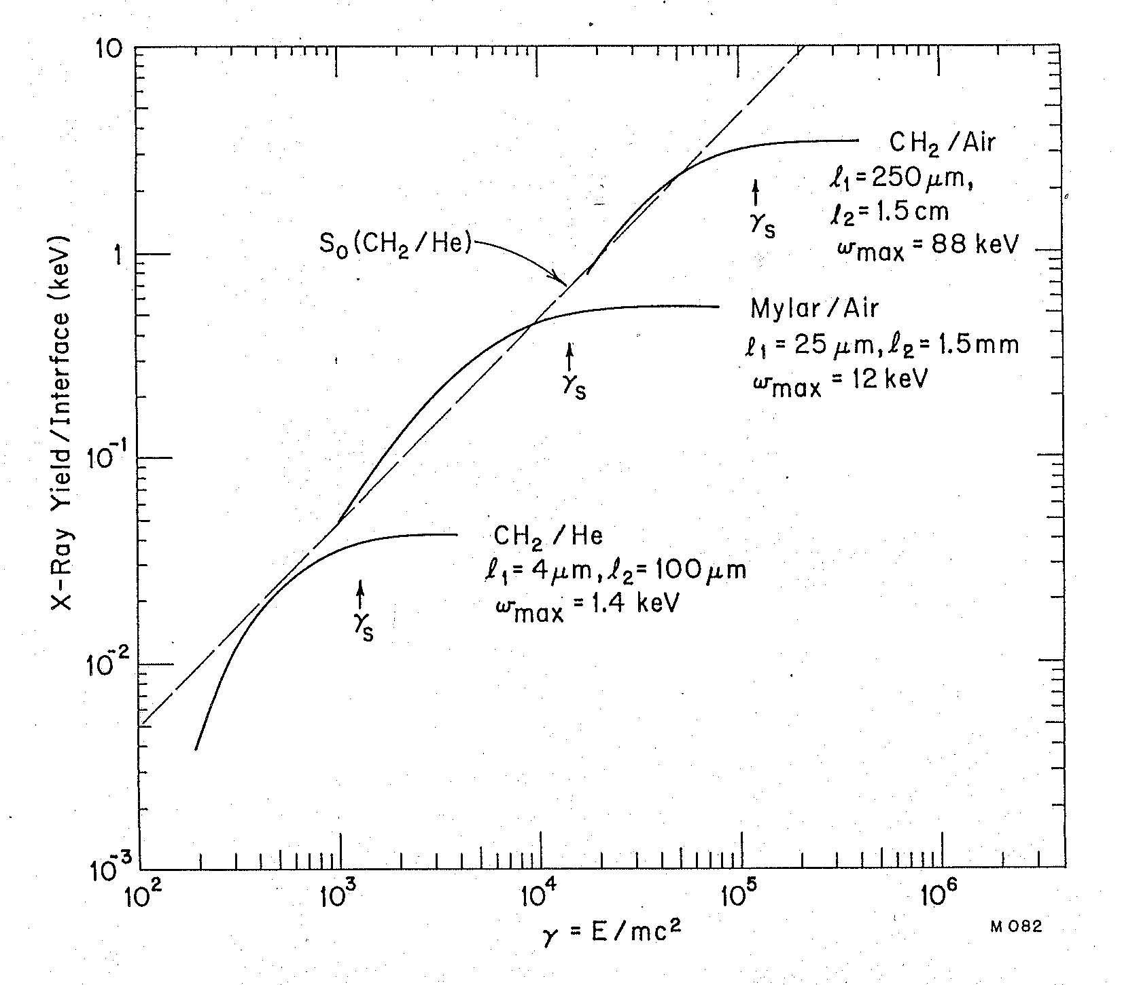
8 TeV pions: γ = 57300
2 TeV protons: γ = 2130

Slide 3
Design criteria for tuning a high energy TRD:
X-rays are emitted at energies below gw₁.
Highest frequency maximum in interference pattern occurs near
w_{max} = l₁w₁²/2pc
Total TR yield ~ g up to saturation energy
g_{s} = 0.6 w₁(l₁l₂)^{1/2}/c
Questions:
Emphasize high frequencies where dependence on particle energy is highest, or
Emphasize lower energies where K-edge absorption is not such a large factor?
Use multiple detectors tuned to individual particle species, or just one configuration?
For a fixed length detector, as g_{s} goes up, # of photons decreases unless w₁ increases.

Slide 4
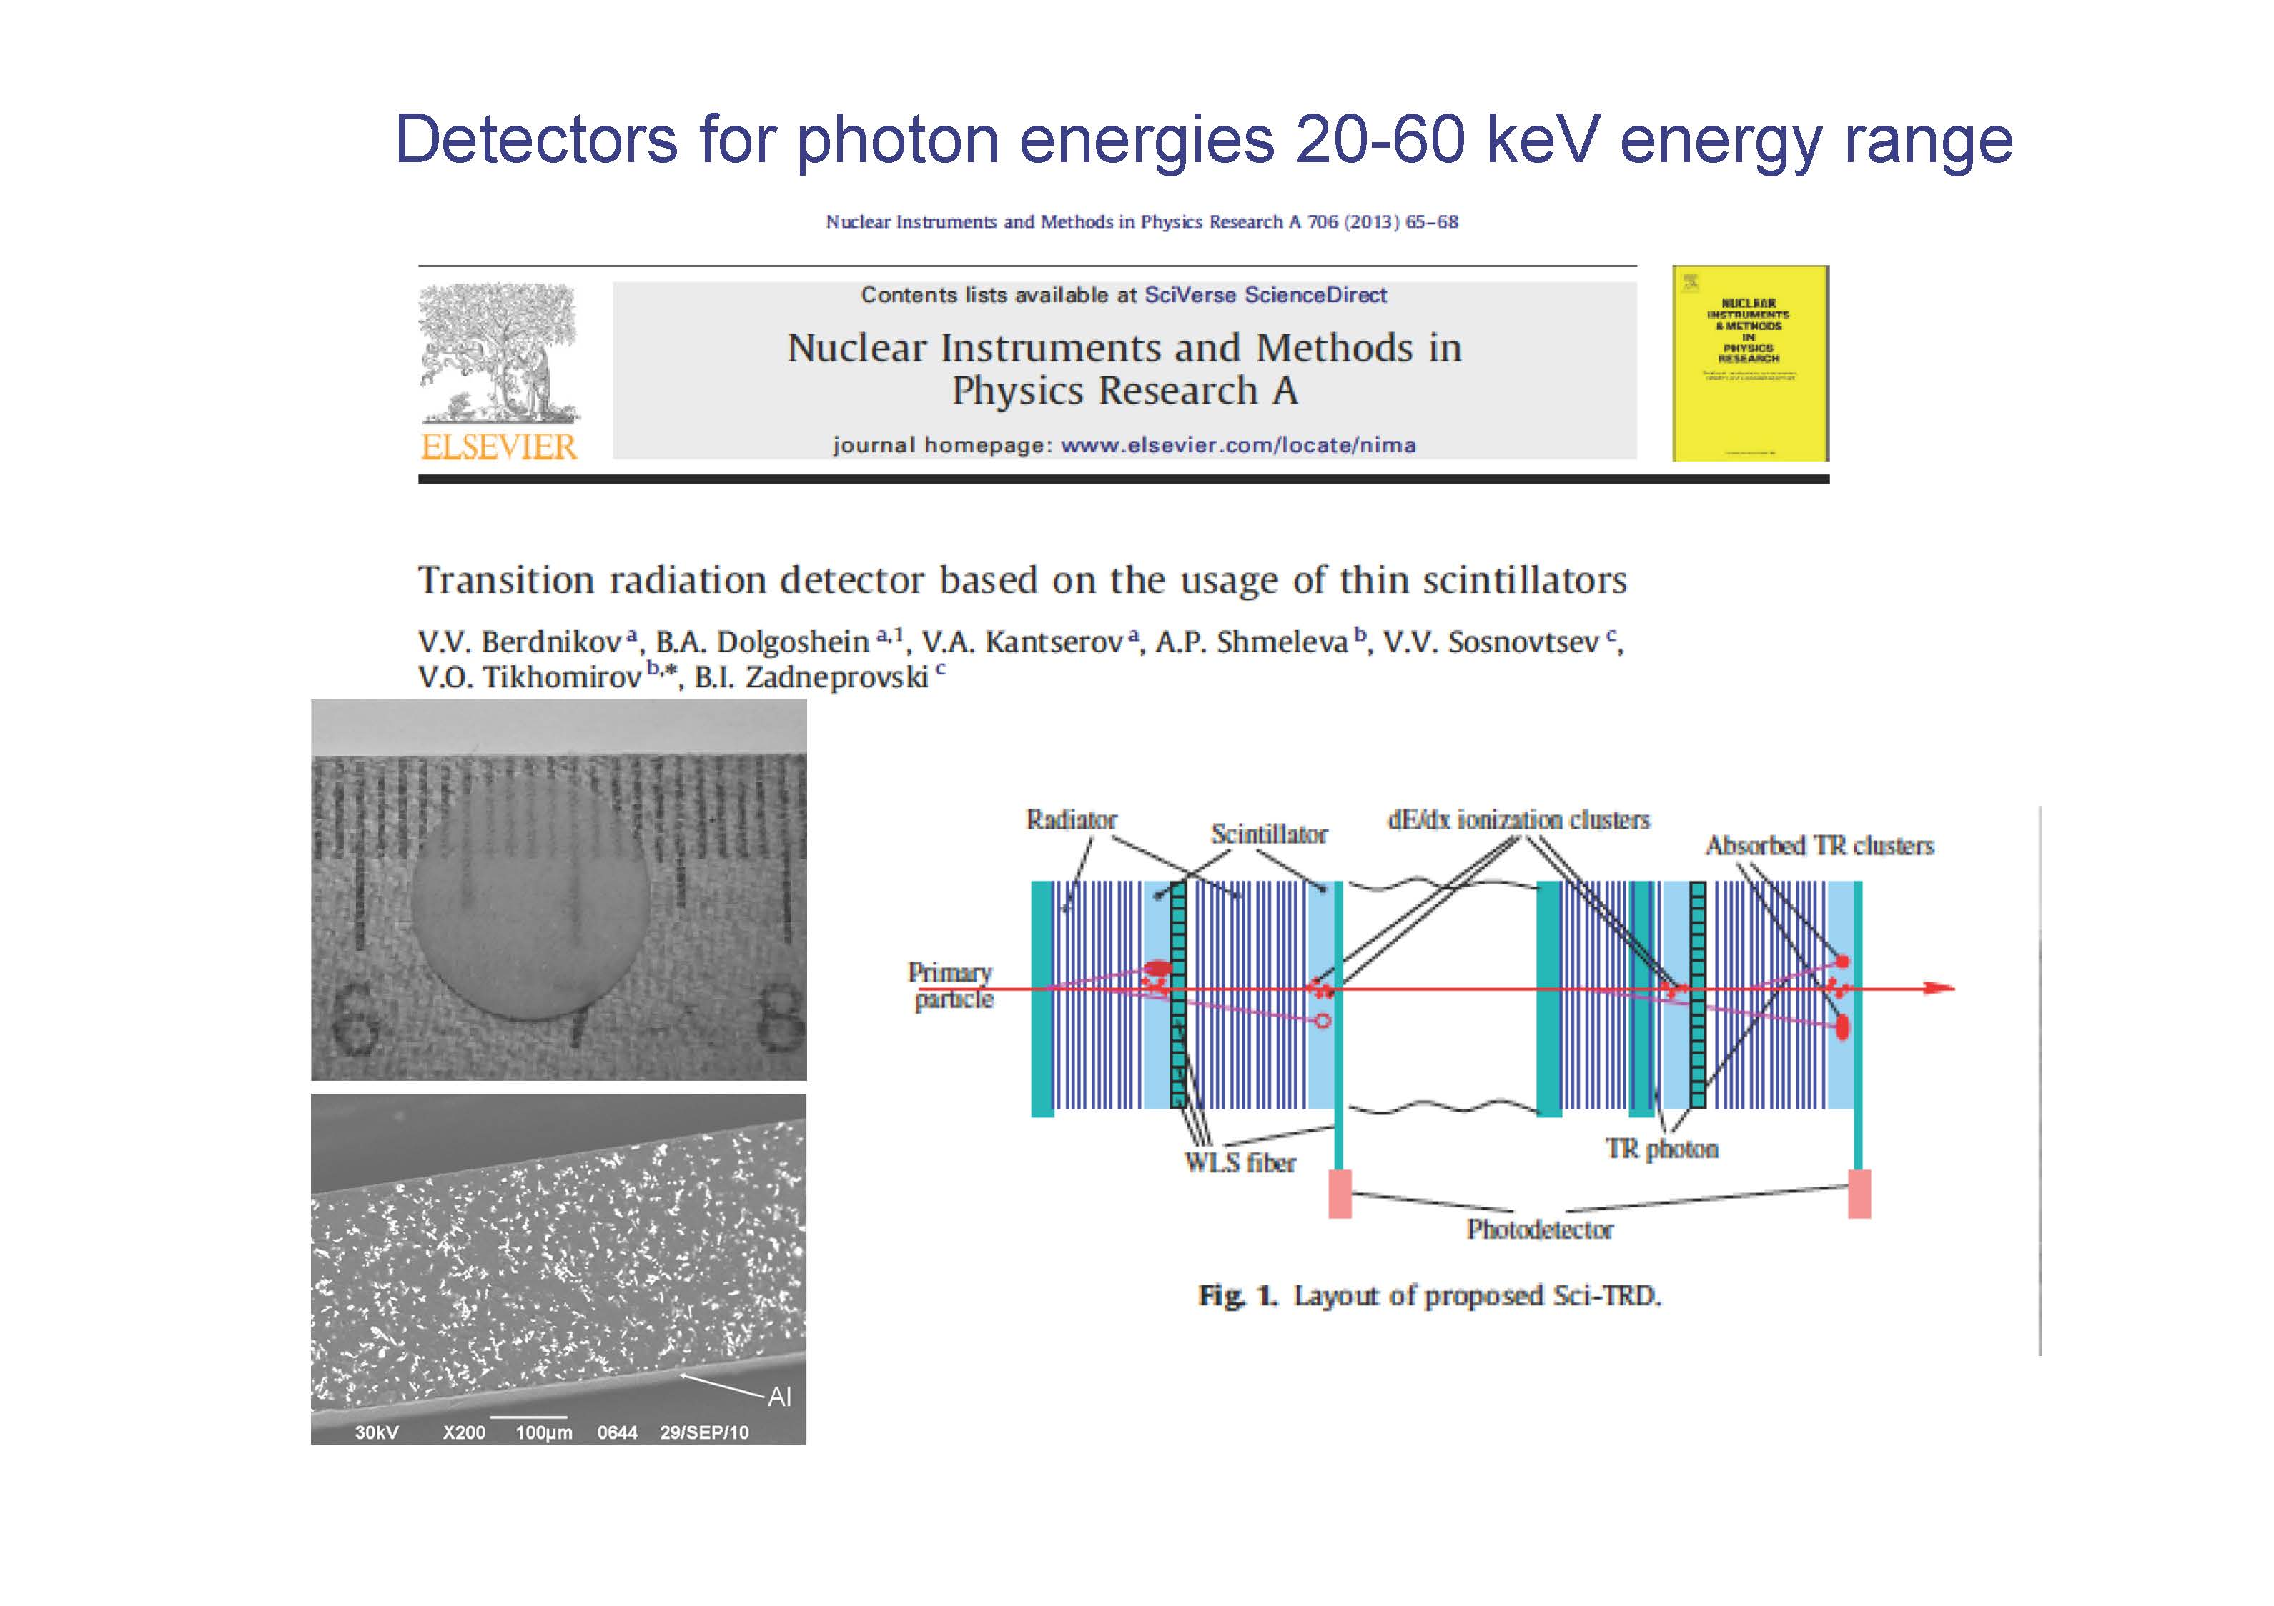
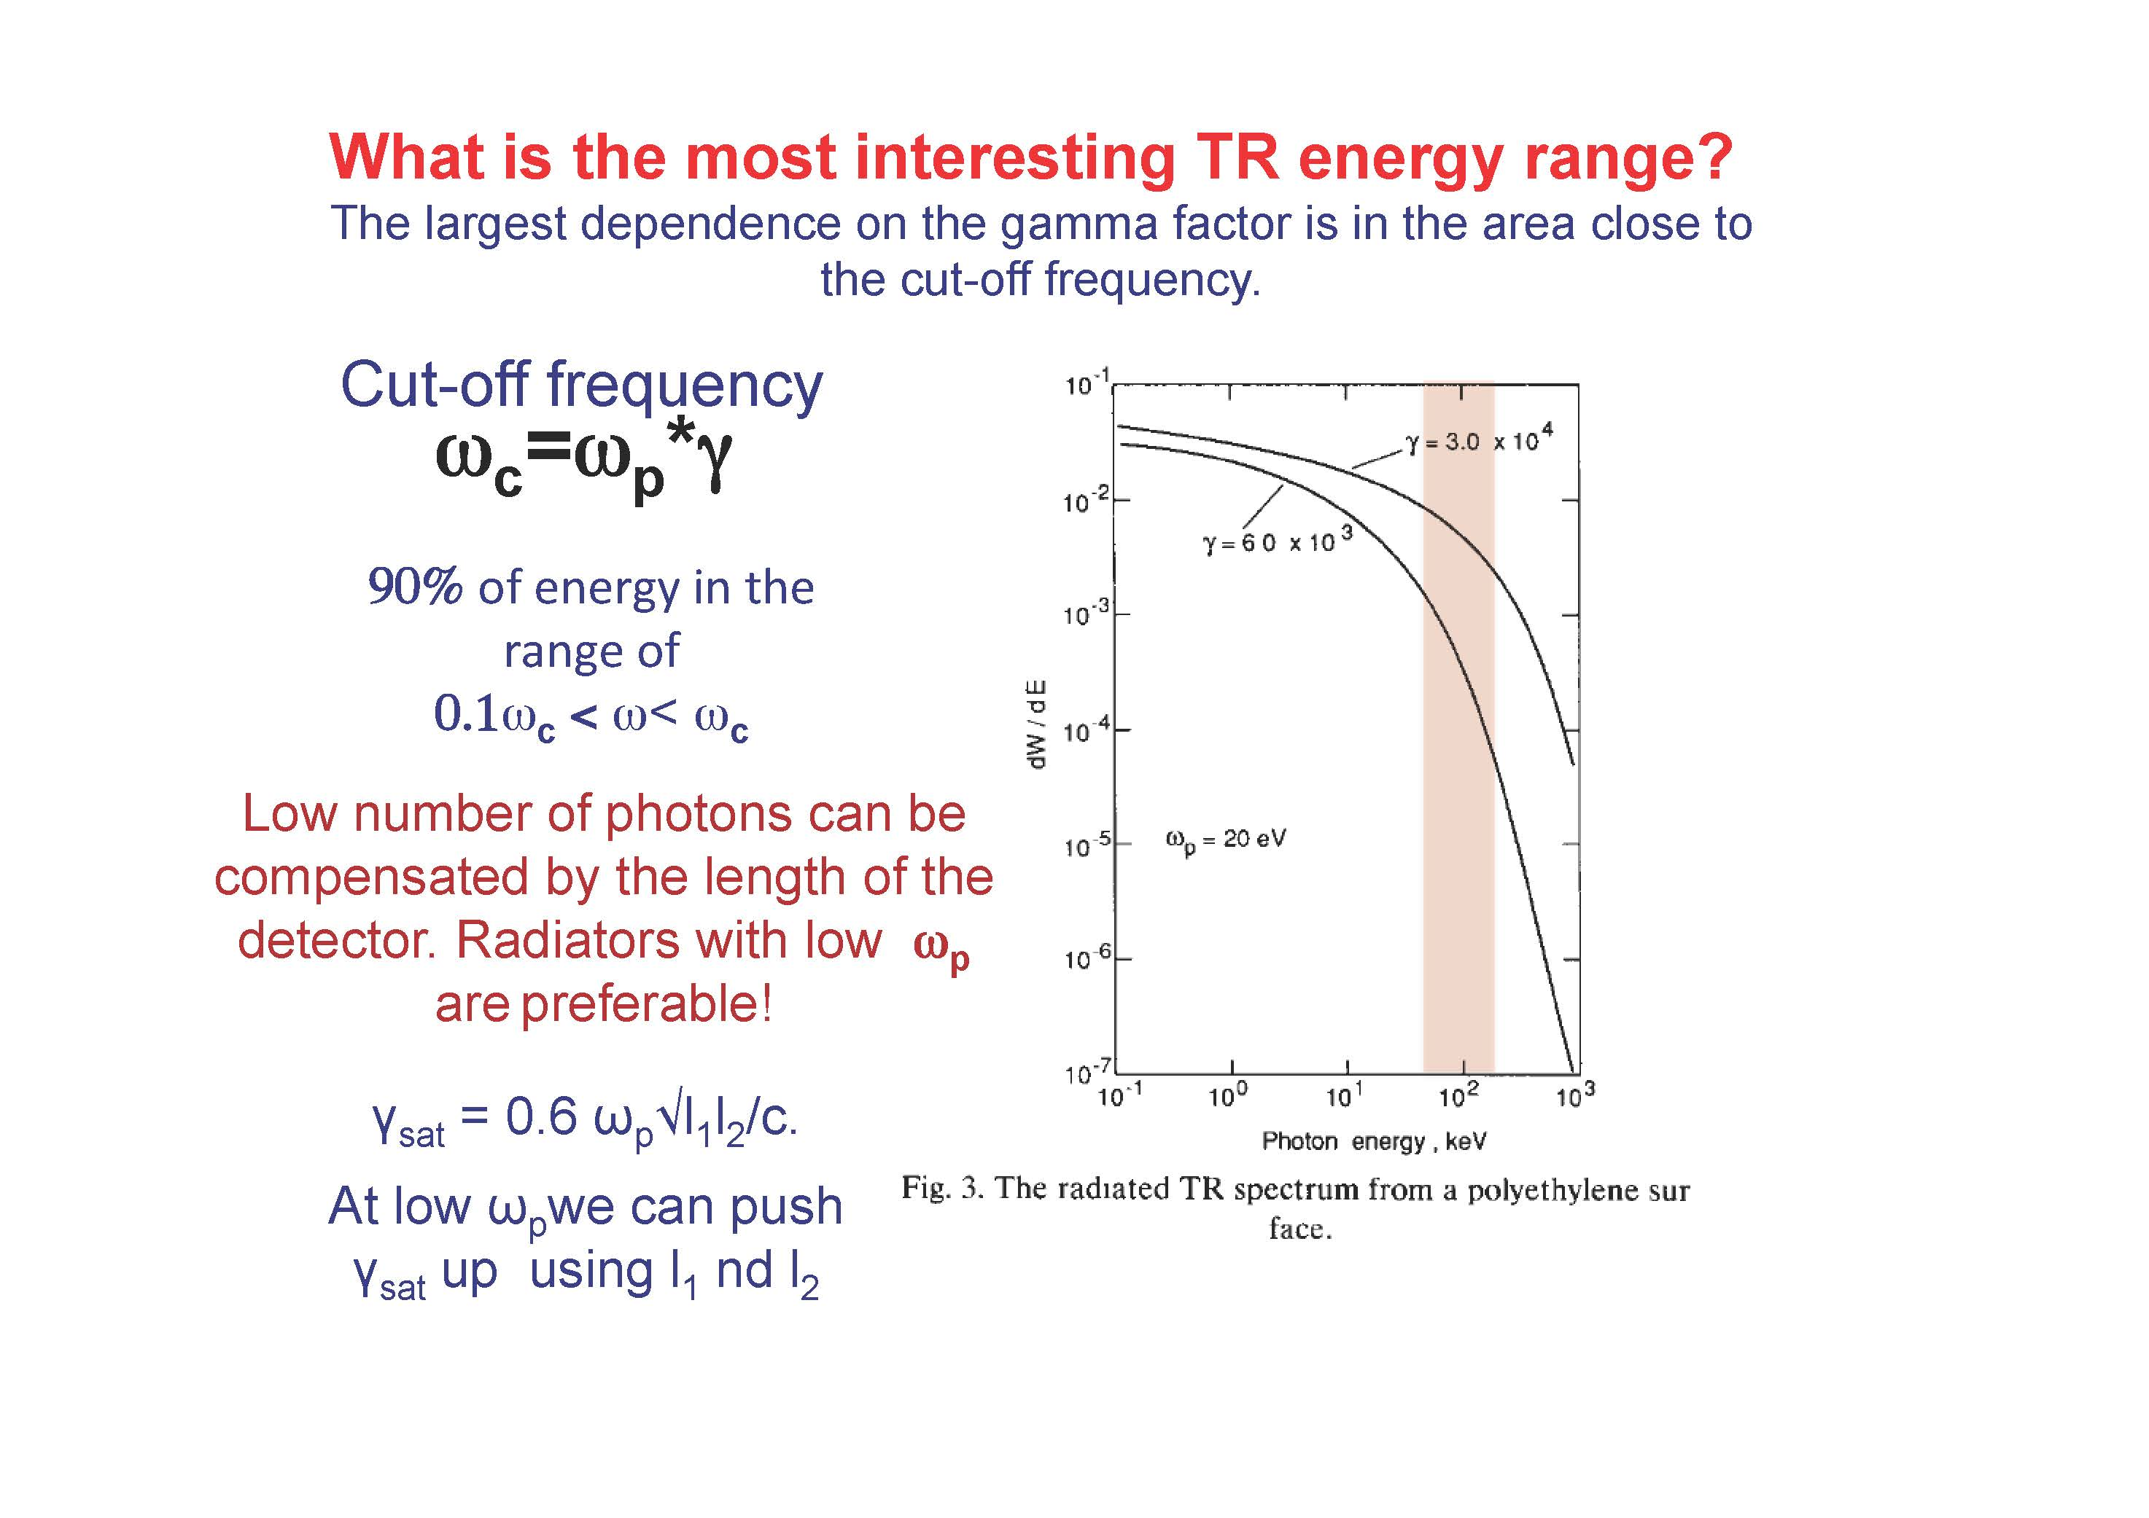

Slide 5
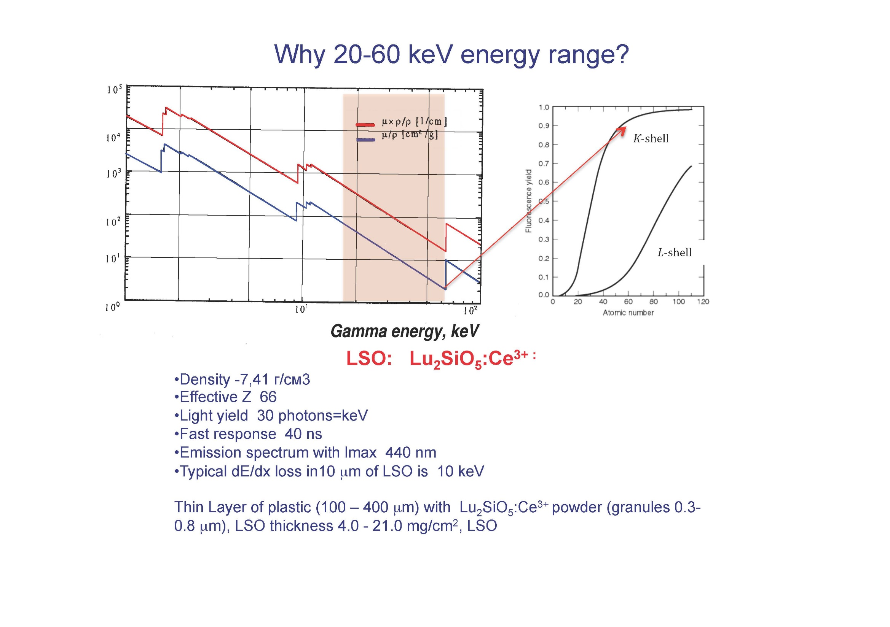

Slide 6
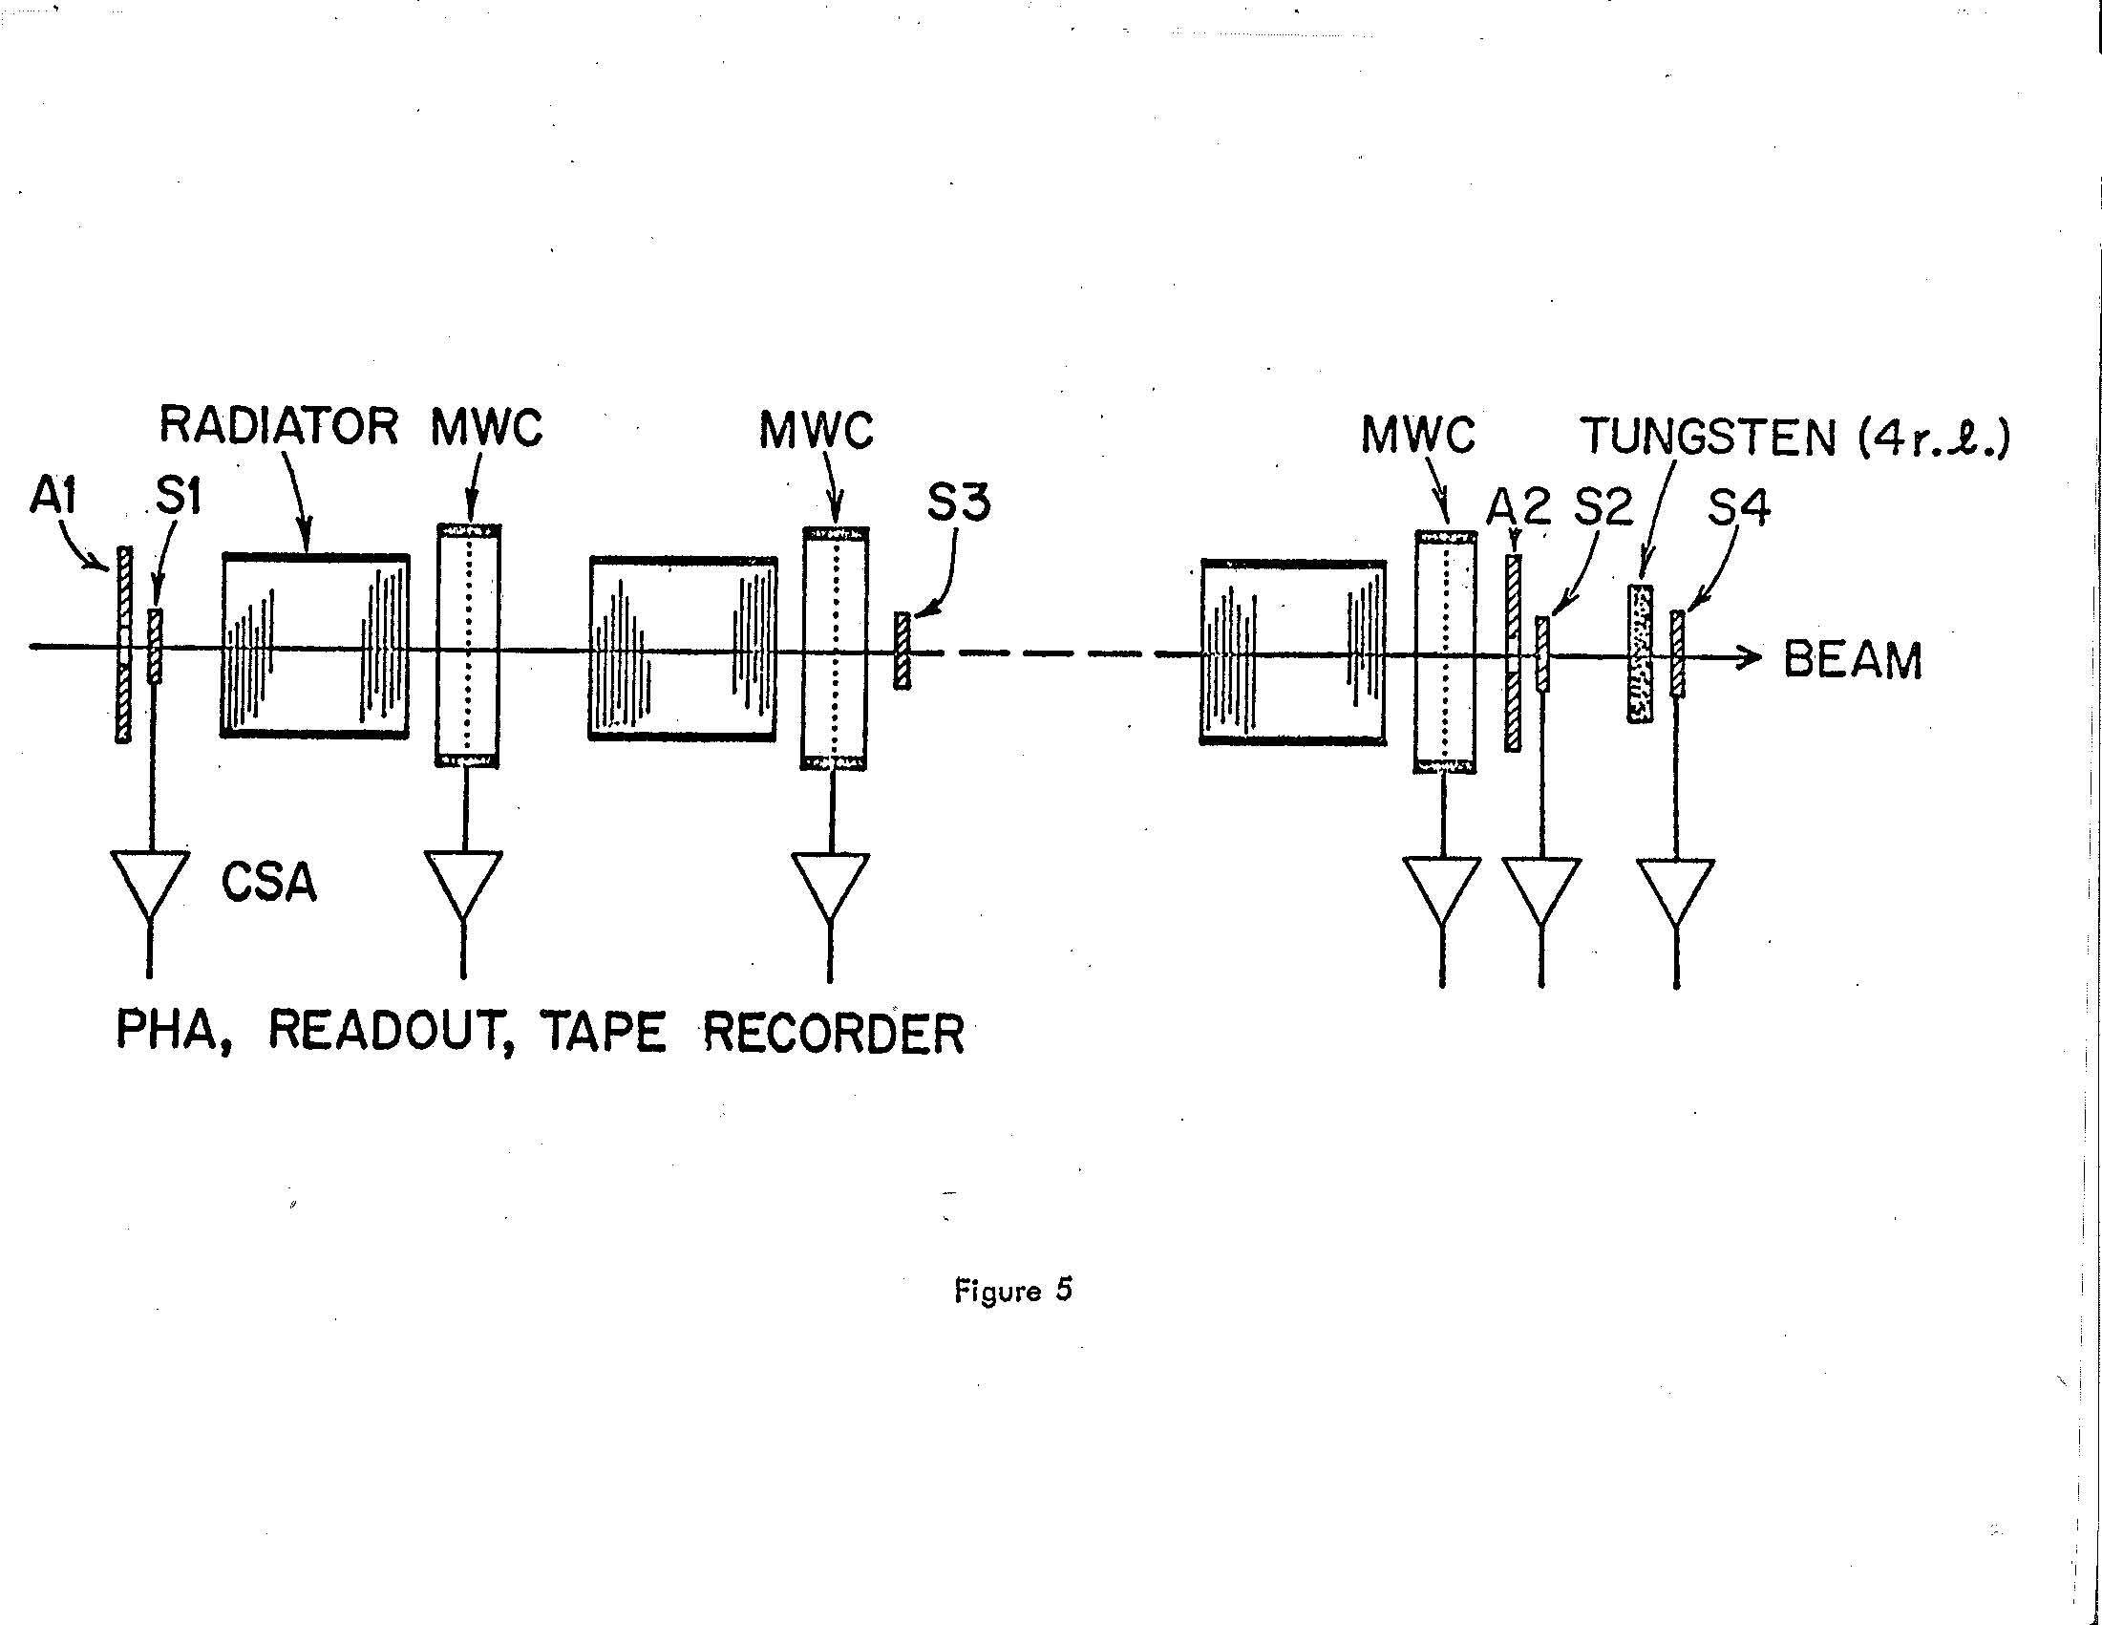
Separating electrons and pions
SLAC, 1973

Slide 7
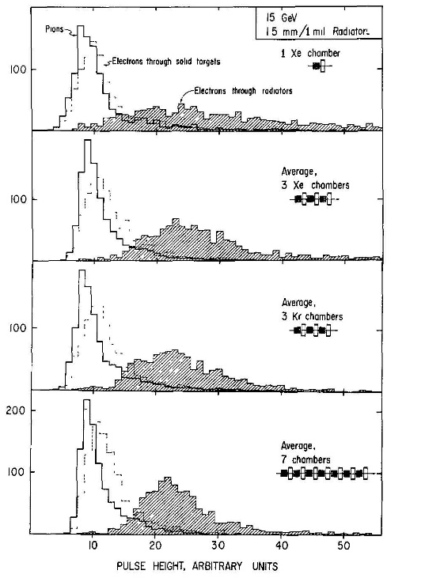
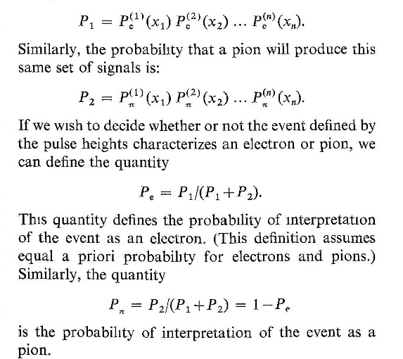

Slide 8
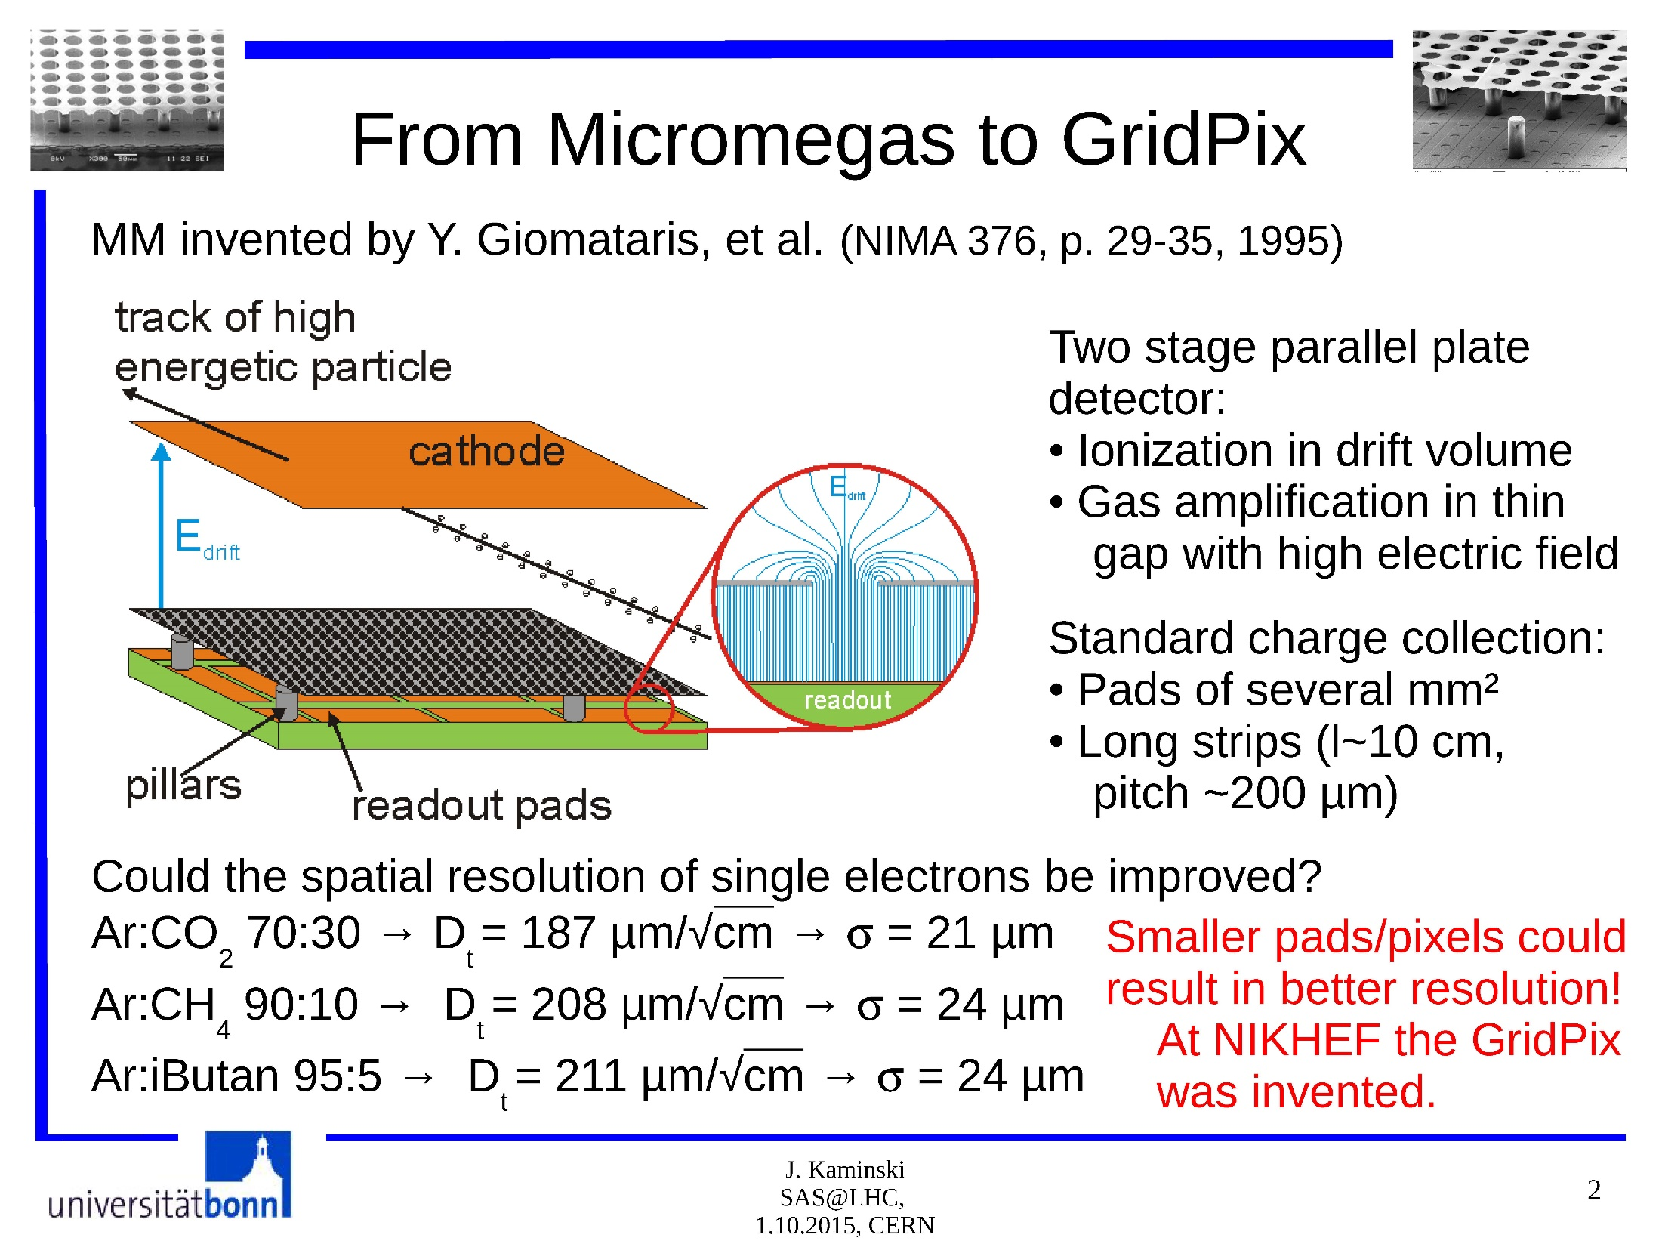

Slide 9
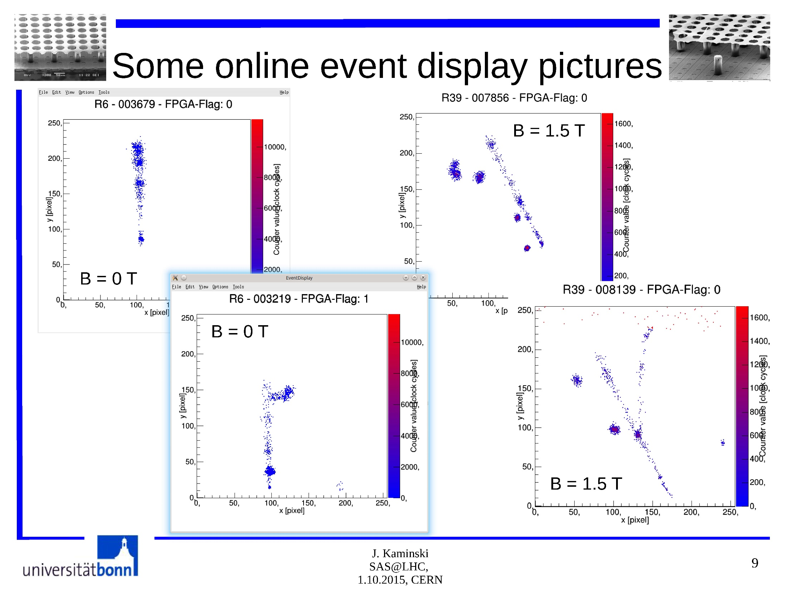

Slide 10
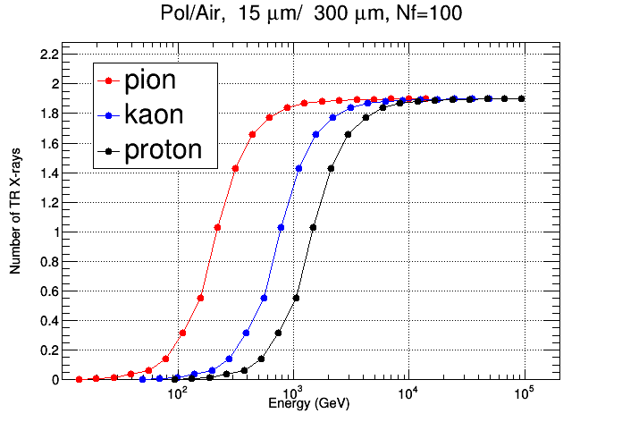
- 200 ?
-we assume that the collected photons are ≈ 2 per TRD set at best
→ we need 50 sets ( each with 200 foils radiator) to get 100 TR photons

Slide 11
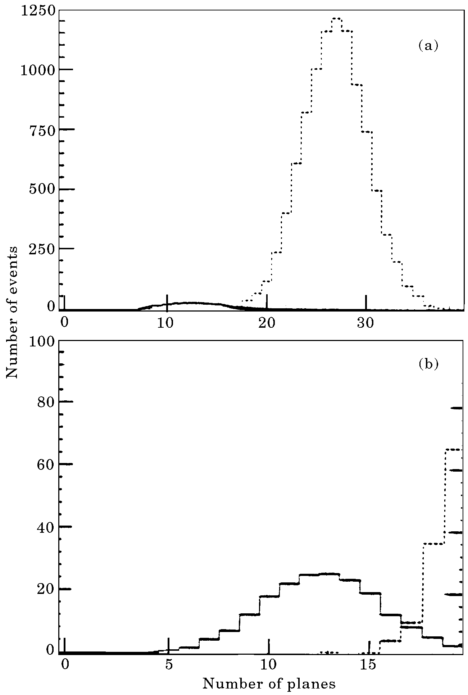
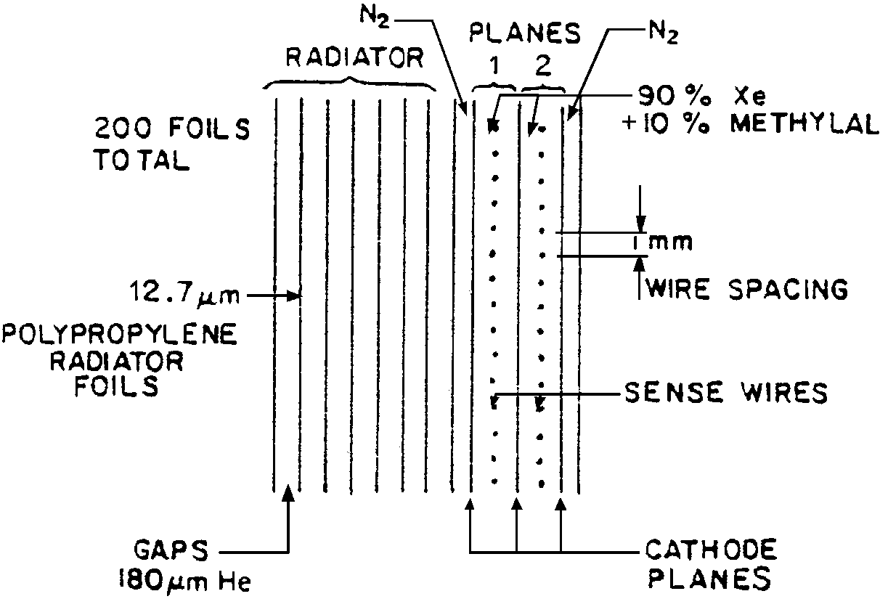
Fermilab E 769 @250 GeV (1991)
24 sets - L = 2.79 m
π contamination =2% @ 87% p acceptance
simulation at @ 500 GeV/c k(2%) π (98%)
π contamination = 3% @ 90% k acceptance
k/p separation ability not quoted…
kaons
pions

Slide 13
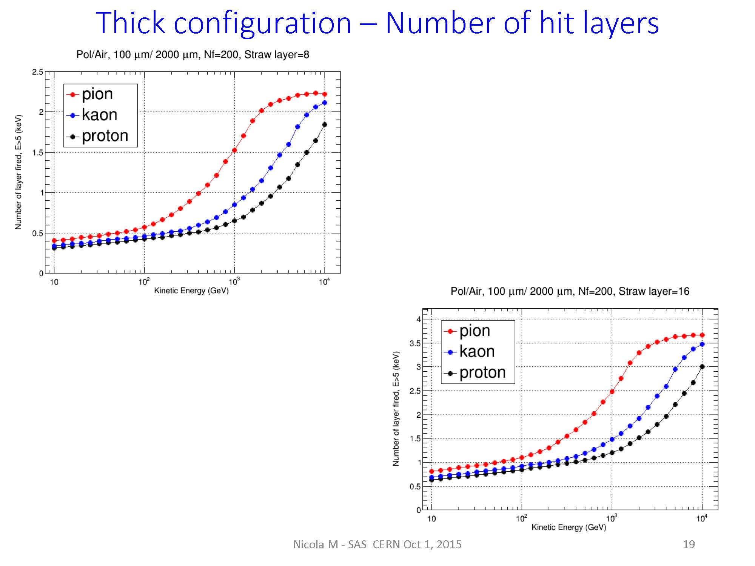
Straw tube simulation results

Slide 14
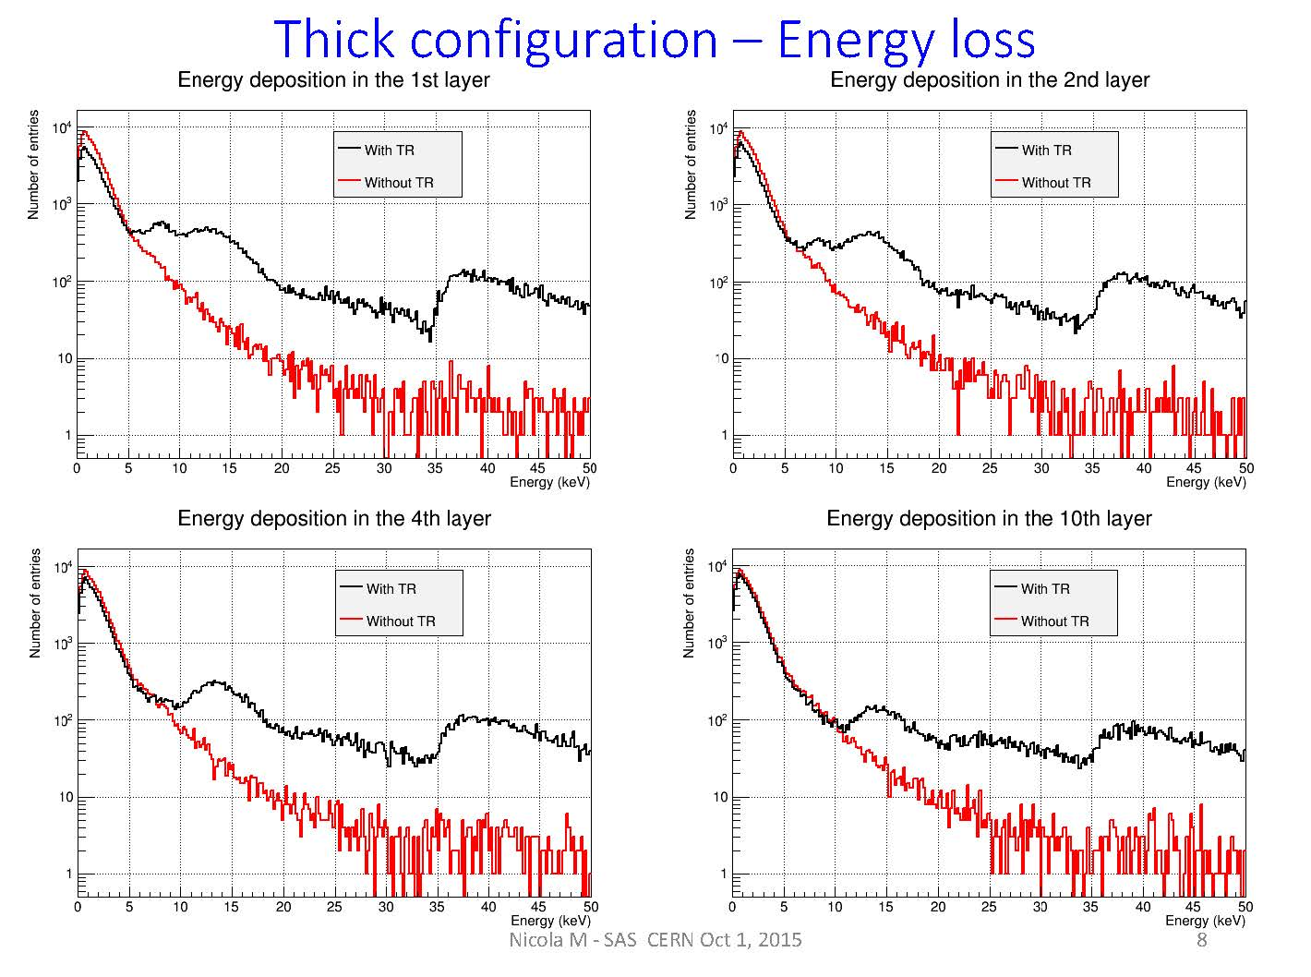

Slide 15
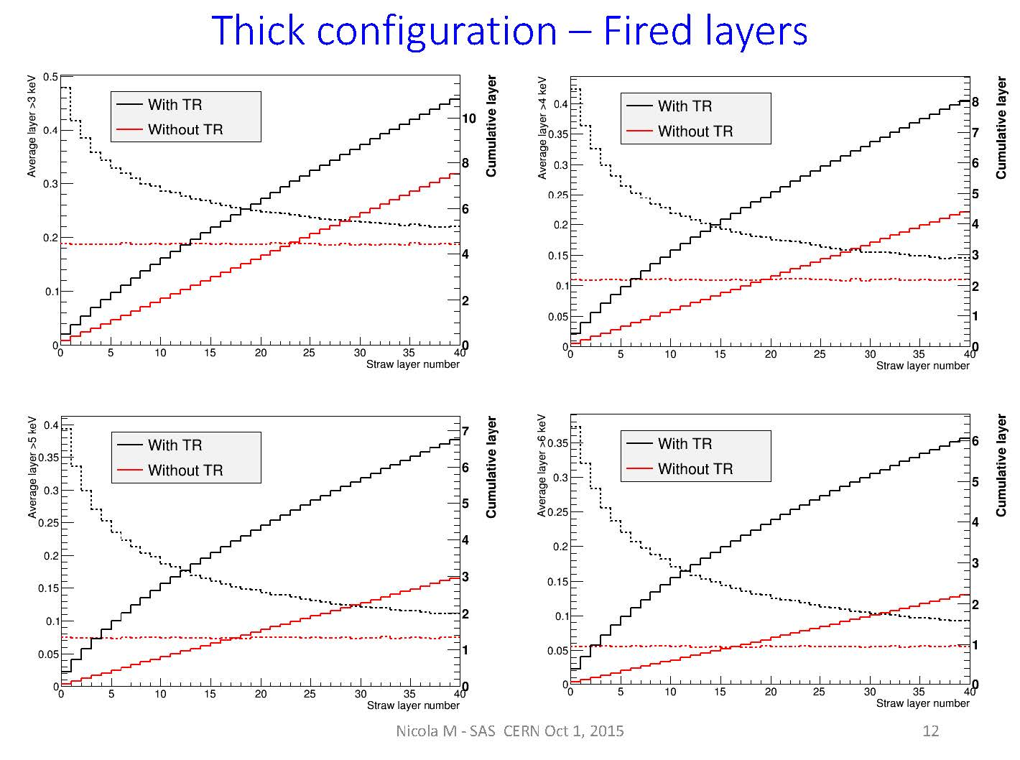

Slide 16
Example radiator/detector configuration #3:
20 modules
N = 50 teflon foils, ω₁ = 28.5 eV
foil thickness l₁ = 50 μ, spacing l₂ = 6 mm
ω_{max} = 32.7 keV γ_{s} = 4.8 x 10⁴
Total length 6.3 m Thickness 11 g
Modules 1-10: 1 cm Xe Modules 11-20: 2 cm Xe
Include Compton + photoelectric cross sections
Account for feedthrough from one module to next

Slide 17
78% pion efficiency
2.2% of K’s incorrectly identified as π’s
0.02% of p’s incorrectly identified as π’s
55% proton efficiency
4.2% of K’s incorrectly identified as p’s
0.8% of π’s incorrectly identified as p’s

Slide 19
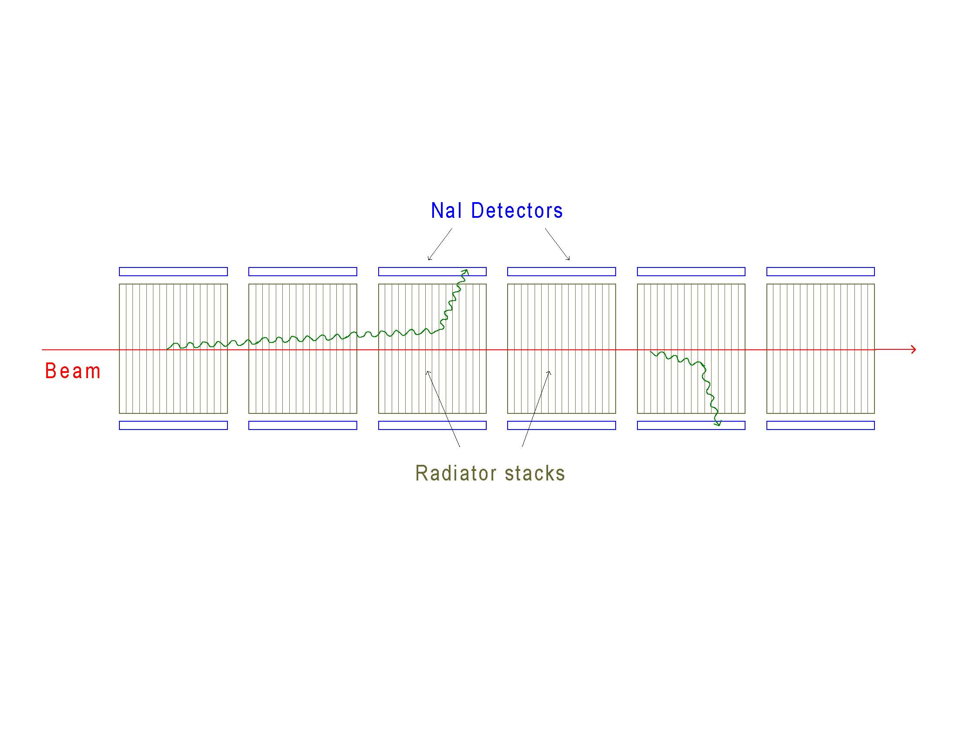
“Standard” configuration – SLAC test w/plastic foils/foam, Xe
. …………..
Compton scatter configuration – CERN test w/Al honeycomb, NaI

Slide 20
Measured spectrum, 150 GeV/c electrons with
Al honeycomb radiator (upper curve) and solid background plates (lower curve)

Slide 21
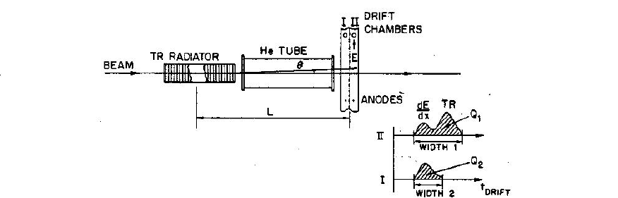
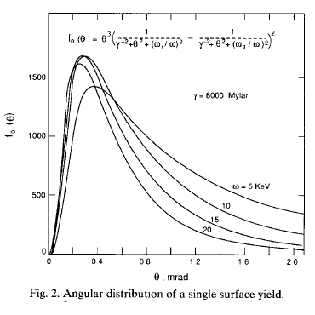
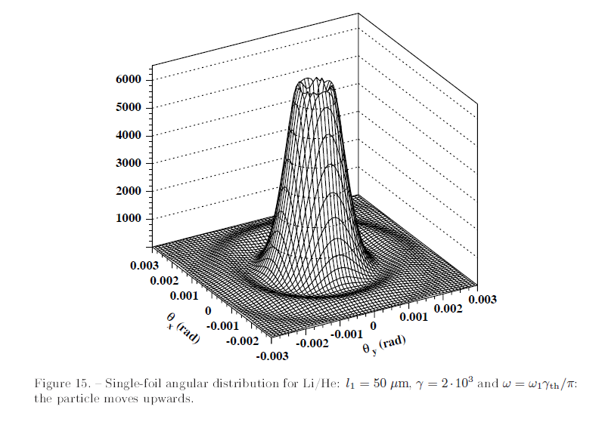
M.Deutschmann et al.
Partice identification using the angular distribution of transition radiation
N.I.M. 180 (1981) 409-412
≈ 1/γ ◊Δx ≈ 0.1−1 mm
for γ = 10.000 -1000
beware: θ _{mult. scatt.} ?
50-70 cm
Single surface
γ = 6000
Single foil
γ = 2000

Slide 22
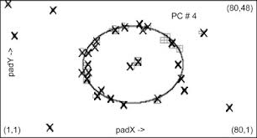
Can we envisage a
“miniaturized”
ring imaging TRD = RITRD?
now we have more advanced pixel detectors !
(see next talk)
-we can collect with 10 sets radiator/pixel detector ≈ 20 TR photons (better than a conventional RICH) to overlay on a unique frame to reconstruct a ring
-conventional 15 μ foil radiators to let any hadron to radiate + 1 m “espansion distance” in helium→ L ≈ 10 m, still long, but X₀ and λ_{Ι} will be negligible!
-pixel size 50μ x 50 μ? (spatial resolution optimized by centroid calculation)
-the momenta , namely the rings radii per each kind of particle, are fixed by the calorimeter: at 1 m of espansion distance →
R_{p} = 1mm @ γ= 1000 (1 TeV proton) or R_{k} = 0.5mm @ γ= 2000 (1 TeV kaon)

Slide 23
Questions that we need answered:
What p-pi-K identification/rejection performance is required?
What is energy range?
What energy resolution is required?
How much physical space is available, lateral and along the beam?
What is maximum amount of material allowed in beam?
How many particles expected per event, what event rate?

