Slide 1
Spectrometer Solenoid Recovery:
Options for Moving Forward
Mark Palmer
Fermilab
October 26, 2015
[with added slide 13]

Slide 2
Introduction
As noted, SSD-M1 failed during magnet training quench on September 13, 2015
Critical Questions for Moving Forward:
  Can we operate MICE Step IV with the SSD as is?
    The August 2014 re-baseline constrained the optics to the extent that we do not believe that the Cooling Demonstration configuration can operate without restoring the lost match coil functionality
  Do we have a viable path to repair the magnet?
  How long is a repair or alternative mitigation? And can it fit within the time frame (by end US FY17) for deploying the cooling demonstration?
  What is the required cost of a repair or alternative mitigation? Does it fit within the contingency held within the US construction budget?
  Given the known “features” of the SS magnets (e.g. training behavior), are there steps in a repair that can significantly mitigate risk, overall experimental schedule, training schedule, and/or training costs?

Slide 3
Outline
Addressing the Key Questions
  Step IV?
  Repair Path?
  Schedule?
  Cost?
  Risks?
Potential Technical Paths Forward
Process Moving Forward
Conclusion
a Discussion

Slide 4
1. Step IV?
  Can we operate MICE Step IV with the SSD as is?
Optics designs sufficient for characterizing absorber materials are in hand (assuming SSD M2 coil is operational):
  Critical SSD checks:
    SSD E-C-E quench and reasonable response of vessel
      a He vessel and feedthrough integrity satisfactory
    SSD M2 low current checkout
      No anomalous resistive behavior observed
      Next step is a careful ramp to high current
  Viable optics and likely viable magnet with M2 and E-C-E coils
Plan is to proceed with modified Step IV run plan for ~1 year
  Time to prepare for a repair
Answer: YES
  Caveats:
    Still need to validate magnet at currents required by alternative optics
    Need to confirm that we have a power supply configuration that is “safe” for operations

Slide 5
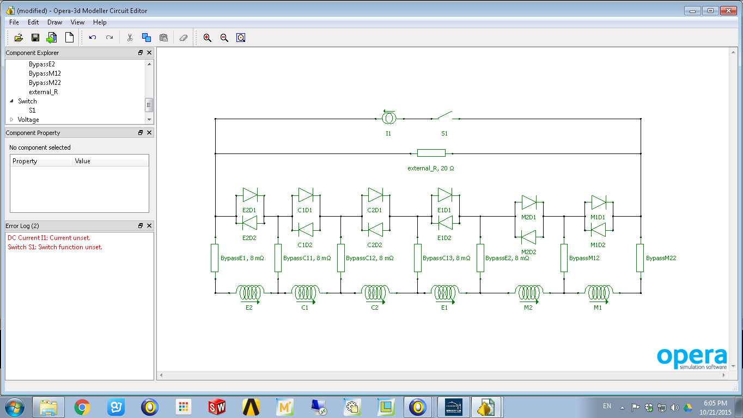
PSU Configuration (Preliminary)
Heng Pan (LBNL)
Quad model built in VF
Quench initiated in the inner layer of the E2 coil.
All coils are powered by a single powers supply.
A 20 Ω external resistor goes across all the coils.
Switch opened when the overall voltage across the E2 coil exceeds 0.2V.

Slide 6
Current Decay & Hot Spots
Heng Pan (LBNL)
C coil also has the highest hot spot temperature among the coils.

Slide 7
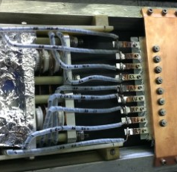
2. Repair Path?
  Do we have a viable path to repair the magnet?
Both magnets previously rebuilt
  One previous failure very similar in
  scope to present case
  A plausible repair path exists based
  on previous repair and our present
  understanding of the September 13th failure
Answer: YES
Remaining question is whether a
repeat of that rebuild is a “sufficient”
and/or best option
  Proposals to build an “improved” bobbin
    Build and test prior to removal of magnet from channel (risk reduction)
    Vacuum impregnated coils (vs. wet layup)
    Active quench protection (heaters)
  Insert separate function magnet in lieu of repair

Slide 8
Schedule?
Baseline estimate of repair schedule:
  Based on prior experience with previous repairs
  Assume magnet available (i.e. warm and ready to remove from channel) on August 1, 2016
    Base estimate for disassembly, cold mass repair and re-assembly:
    8 months base + 3 months contingency
    Transport: 1.5 months (if repair not carried out locally)
    Installation, pump-down, cool-down and training at RAL (assuming optimal installation/commissioning support): 2 months
    a October 15, 2017
Answer: MAYBE
Notes:
Installation: 2 weeks (optimal)
Pump-down + Cool-down: 5 weeks
Training: 2 weeks
Total 2 months

Slide 9
Cost?
Baseline Repair (very preliminary)
  Air Shipment (required to achieve schedule): $100K rnd-trip
  Cold mass removal, repair, re-installation:
  $700K base cost +35% contingency = $950K
  LHe costs (cool-down+training):
  18 x 500L x 7000GBP/dewar x 1.55$/GBP = $200K
  Misc. other costs = $100K
  Total: ~$1.35M
US Funding Availability
  In $18M FY15-17 ramp-down plan, US project has
  ~$1.3M in unallocated management reserve
  Potentially would be forced to reduce US experimental support in FY17 (particularly since no experimental running would take place)
Answer: Probably

Slide 10
Risk?
Do we have a safe way to operate the two spectrometer solenoids as presently configured (assuming no further QA issues)? Maybe
Can risks be mitigated by the repair strategy?
  Re-do SSD cold-mass QA (except for winding)
  Improve stabilization of existing leads/bus work
  Add additional protection features
Yes
By addressing the above issues, do we convince ourselves that the magnet will be robust in operation? Maybe
Overall Answer: Maybe

Slide 11
Potential technical paths forward

Slide 12
Potential Technical Paths Forward
Option 1 – Repeat previous repair scenario
  Assumptions
    NO changes to magnet design
    Repair starts at conclusion of Step IV running
    Suitable repair team available – magnet moved to team location
  Schedule
    Magnet could be at RAL for installation/commissioning prior to end of US FY17. Would fully become RAL responsibility at end of US FY17.
  Cost
    Nominally appears to use 100% of MAP management reserve funds. Plausible.
  Risk
    QA issues (believed to be known) could be addressed
    Surprises when cold mass is inspected?
    Are we comfortable with sticking to the current design untouched?

Slide 13
NOTE: You may hear a so-called “Option 0” referred to which is:
  Run the Cooling Demo with SSD “as is”.
  I don’t believe the optics team has any solution with the capability to achieve the Cooling Demo goals – for instance:
Filamentation
Resolution
Statistics

Slide 14
Potential Technical Paths Forward
Option 2 – Fabricate new cold mass
  Assumptions
    Only allow modest changes to cold mass design
      Examples:
        Minor change in bobbin length to control thermal distortion
        Allow for vacuum-impregnation of coils
        Allow for addition of active quench heaters
    Integration with existing cryostat starts at conclusion of Step IV running
    All required superconductor is on hand (enough SC is in FNAL storage to wind 2 new cold masses)
  Schedule
    Cold mass fabrication could start as soon as revised drawings approved.
    Budgetary quote from Al forging vendor indicates 10 week delivery.
    With SC on hand, new cold mass could be machined, wound and outfitted before August 1, 2016 (preliminary estimate of 8 months)
    Potentially could be cold-tested/trained in dewar in advance of
    August 1, 2016 (a realistic schedule needs to be confirmed)
      Could also be carried out while magnet disassembly under way
    Final Installation
      Installation of prepped cold mass would likely save ~2 months in baseline disassembly/reassembly schedule for magnet (vs. slide 8)
      A trained cold mass would likely save ~3 weeks in training time (vs. slide 8)
      Consistent with completion before end of US FY17

Slide 15
Potential Technical Paths Forward
Option 2 (cont’d) – Fabricate new cold mass
  Cost
    Very preliminary estimate of $500K to prepare a new cold mass with SC on hand
    Would we want to wind 2 cold masses as risk mitigation???
    Would still require most of the $700K base cost estimate to disassemble/reassemble the magnet
  Risk
    A chance to address identified risks with minimal modifications
    Testing before installation would provide certainty – however, only one chance is realistic unless 2 bobbins are prepped
    Opportunity – Potential reduction in training costs (save ~$150K)
    Opportunity – Possibility of retrofitting existing SSD cold mass as a spare after SSD repair complete

Slide 16
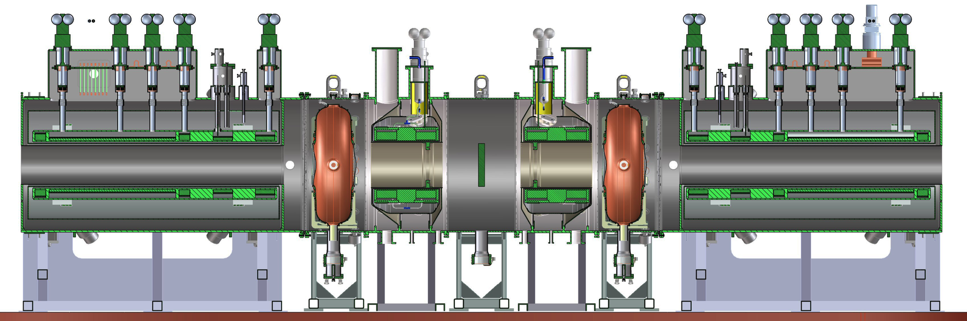
Potential Technical Paths Forward
Option 3 – Do NO repair and instead insert another solenoid in the cooling channel
SS
SSD
Demonstration of Muon Ionization Cooling (Re-baseline)
Insert 1- or 2-coil solenoid here
and develop new match optics
without SSD M1.

Slide 17
Potential Technical Paths Forward
Option 3 (cont’d)
  Assumptions
    Magnet can handle longitudinal forces of cooling channel
    Magnet cryostat can be modified for integration into cooling channel
    Magnet bore is sufficiently large
    Magnet cooling can be managed in the RAL Hall
    (Is there a magnet available which can be operated without a refrigerator system?)
  Schedule
    One year to prep magnet
    One year to prep PRY modifications
    Installation should be fast
  Cost
    Would require further modification to the PRY extension
    Would require additional design and fabrication work to integrate the new magnet
  Risk
    Modest as long as both SSU and SSD operating reasonably thru Step IV
Possibilities: MuCool Test Area Magnet; new FC

Slide 18
Potential Technical Paths Forward
Option 4 – Cut SSD open and repair
  Assumptions
    Would require acquisition of used refrigerator because thermal losses likely to exceed what could be handled with cryocoolers
    Would require modifications to work with refrigeration system
  Schedule
    Relatively fast assuming that refrigeration system could be installed/commissioned during Step IV running
  Costs
    TBD
    Utilize surplus refrigerator system to control overall costs
  Risks
    Not clear that this could be done safely without damaging the cold mass support structure

Slide 19
Potential Technical Paths Forward
Option 5 – Construction of new SS magnet
  Assumptions
    Would allow for implementation of (some) lessons learned
    Would not allow for a major change in configuration to a more reliable magnet style (e.g. high current SC cable with refrigerator)
  Schedule
    Difficult to imagine a scenario, with proper contingency assessment, that could deliver a magnet in time
  Costs
    Difficult to imagine a scenario where costs would not be significantly higher than a simple repair
  Risks
    Depending on scale of modifications from present design, would require an entirely new test program

Slide 20
Potential Technical Paths Forward
Any other ideas???

Slide 21
Process Moving Forward
We have just recently finished the initial assessment of SSD
  Reasonable confidence that we have a self-consistent understanding of the failure
  Full confidence not achievable until we are able to inspect the cold mass directly
We are presently assembling the information required for a full technical evaluation of repair options
  Initial considerations are “wide open”
  By mid-November must have a focused and realistic recovery plan

Slide 22
Process Moving Forward
Next Step:
  Technical Review targeted at November 23-24 at FNAL
    Identify the desired baseline recovery plan
    Preliminary cost
    Preliminary schedule
    Identification of required magnet team
    Target at least one alternate plan
    Have 1 session of open discussion (avoid missed options)
  Fully document baseline option to submit to MPB sub-committee on the mid-December timescale
    Present resource-loaded schedule and full risk assessment
    Obtain approval to move forward
    May need preliminary approval for long lead items

Slide 23
Conclusion
3 critical areas:
  Cost
  Schedule
  Risk mitigation
Executing a repair similar to those done previously nominally fits within the US program’s constraints
Looking forward to the committee’s comments on the possible routes presented
  Need guidance for what to prepare for the November technical review

Slide 24
Now open for Discussion

