Slide 1
LS2 Days
José Miguel JIMENEZ
Jean-Philippe TOCK
Katy FORAZ
Thomas OTTO
Ana-Paula BERNARDES
Rachelle DECREUSE-MICHAUD

Slide 2
Long Shutdown 2 (LS2) Project
Project Scope & Mandate of LS2 coordinator (1/2)
The project scope covers all activities carried out and resources needed in the context of Long Shutdown 2 over the whole CERN accelerator facilities.
The mandate of the project coordinator includes:
Prior to the start of the LS2, the definition of main works to be achieved over the LS2 and of potential options based on priorities given to activities. This study shall highlight in particular LS2 duration and resources needed for each option and be presented to the Directorate by mid-2016 for final decision;
The definition of a CERN-wide “resource-loaded planning”, ensuring the compatibility of resources and planning across the LHC Machine and LHC Experiments;

Slide 3
Long Shutdown 2 (LS2) Project
Project Scope & Mandate of LS2 coordinator (2/2)
The mandate of the project coordinator includes: (cont.)
The preparation, coordination and follow-up till completion of all LS2 activities in the frame of the LIU, HL-LHC Projects and other CERN approved projects. Work packages will define:
  The work absolutely essential to achieve the LS2 objectives (activities which will bear a priority 1), which execution will be closely followed up by the LS2 coordinator;
  The work which can be postponed to the LS3 (activities which will bear a priority 2), which impact on LS3 will be assessed by the LS2 coordinator.
The flexibility to use the end-of-year technical stops before and after the LS2 to decrease the load of the LS2 is left at the discretion of the LS2 coordinator and is also part of the scope of the project.

Slide 4
Long Shutdown 2 (LS2) Project
Project Priorities
LS2 Priorities are, by decreasing priority:
  1. Safety
  2. Reliability of the accelerator complex
  3. Approved projects¨
  4. Non approved projects

Slide 5
Long Shutdown 2 (LS2) Project
Project Team
Project Leader José Miguel JIMENEZ
Project Office Manager Jean-Philippe TOCK
Project Planning Manager Katy FORAZ
PLAN Data Quality Manager Rachelle DECREUSE-MICHAUD
Project Safety Coordinator for LHC Thomas OTTO
Project Safety Coordinator for Injectors Ana-Paula BERNARDES
Still to be defined Hardware Commissioning in:
  Injectors, TBD (one-for-all, -by-machines, -by Complex, team?)
  LHC, TBD

Slide 6
Long Shutdown 2 (LS2) Project
Project Meetings
Executive LS2 Meeting
with representatives of Projects, Experiments, Departments and HSE Unit
  8th January 2016
LS2 Committees (LSC) as done for LS1
  20th November 2015
    Mandate, Memberships, standard agenda,…
    Feedback from LS2 days.
    Plan status
    Announcement of Chamonix 2016 LS2 session
  4th December 2015
    Reminder of scope
    Preparation of Chamonix (LIU/HL-LHC, non-/LHC Exp, PLAN+Schedule, Safety)
    Priorities
  Monthly meeting after Chamonix
    Increasing recurrence right before and during YETS / EYETS / LS2

Slide 7
Long Shutdown 2 (LS2) Project
Reporting line & Collecting information
LS2 Coordinator will report:
  On a strategic level to the CERN A&T Director
  On a technical level to the LMC and IEFC if impacting Machines
Collecting information
  Done through bi(multi)lateral meetings with Experiments, Groups, Teams and Projects
  Using PLAN tool already successfully used for LS1
  Learning from LS1 experience…
  2 Major meeting planed
    LS1 Debriefing Day planed on 1st trimester’15
    LS2 Day kick-off planed 29-30 Sept’15

Slide 8
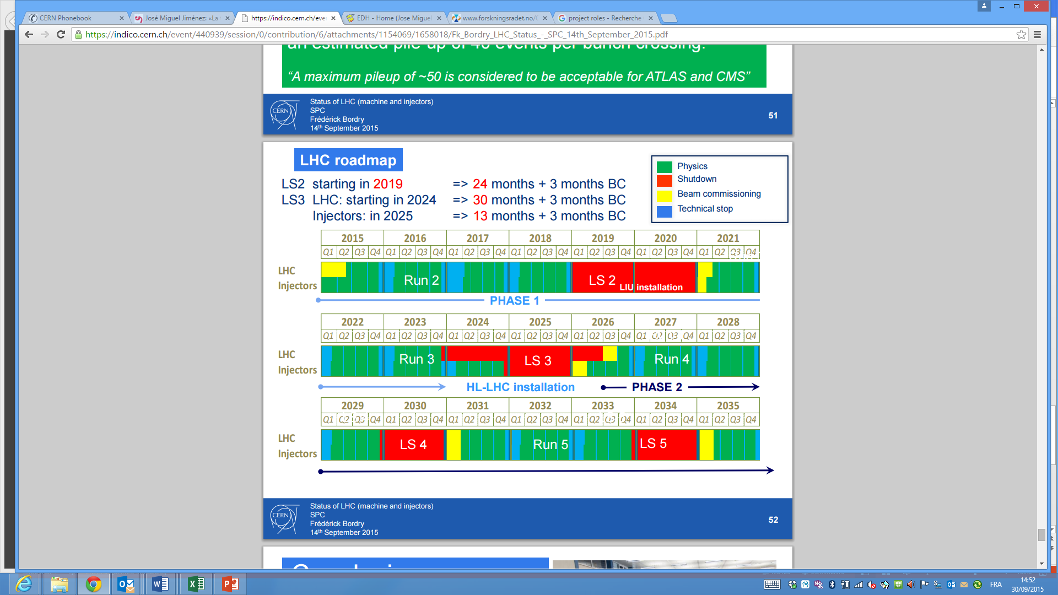
Long Shutdown 2 (LS2) Project
Main dates and milestones

Slide 9
Long Shutdown 2 (LS2) Project
Main dates and milestones
Main milestones:
  LS1 Post Mortem: 1st trimester’15
  Start date: Mid December 2018;
  Duration: 24 months (end 2020)
  Yearly “LS2 day” as of 2015
  Activities declared in Plan by end’15 both for injectors and LHC;
  March’16, definition of activities for EYETS 2016;
  Mid’16, definition of activities for YETS 2017 and LS2;
  Preliminary “final” validation: mid 2017.
LS1
Post
Mortem
LS2
Day
LS2
Day
LS2
Day
PLAN
is made
available
Consolidated
List of tasks
to Director A&T
1st step
final
validation
Final
validation

