Slide 1
Recommissioning Plans of Machines and Experimental Areas for beam after LS2
B. Mikulec on behalf of the
Injector Recommissioning Working Group (IRWG)

Slide 2
Introduction
Injector restart analysis after LS1 during Chamonix 2014
End of 2014 the IEFC issued a mandate to create an ‘Injector Recommissioning Working Group’ covering all accelerators (excluding LHC) and experimental areas:

Slide 3
IRWG – Composition
  Chair/Deputy/Sc. Secretary: V. Kain/B. Mikulec/B. Lefort
  10 meetings so far: https://indico.cern.ch/category/6174/
  Core team:
    2 representatives from each machine and experimental area plus EN-MEF representatives, M. Tavlet (DSO of BE) and M. Vanden Eynden (CO3 committee leader)

Slide 4
Post-LS1 Analysis
  Recommissioning after LS1 analysed for each machine/experimental area
    What worked well?
    Which phases and how were they organised?
    Which procedures/documentation were available and applied?
    Where were the main problems? Why?
    → MANY common issues identified!
  Currently defining concerted approach
    Learn from each-other; include some good LHC practices
    Define how to test, what to test, when to test and who should test
    Formalise testing and follow-up → Procedures and Checklists

Slide 5
Post-LS1 Analysis: Some Common Issues (1)
  Partial testing; missing or incomplete procedures/checklists
    Magnet polarity checks not routinely done in all machines
    Optics not updated (e.g. after new installations or modified alignment)
    Missing references, e.g. for BI systems
    …
  Readiness date of main services, access, EIS, controls tools/system often too late to allow for sufficient testing
  Testing started too late
  Single-expert systems critical

Slide 6
Post-LS1 Analysis: Some Common Issues (2)
  Interfaces not sufficiently tested
    Between systems, e.g. access <-> equipment
    Between machines, e.g. PS <-> SPS
  Priority issues LHC <-> Injectors and proton <-> ion machines
  Insufficient communication of modifications of equipment and controls to OP and often no consultation
  …
  ‘The essential element is continuous communication between all the partners all the time…’

Slide 7
Main Proposed Changes for Long Shutdowns
  Preparation and Use of Checklists
    Members of IRWG prepare draft checklists for their machine/experimental area by the end of the year
      To be completed and verified before/during 2016 restart
      Base EYETS restart on these checklists
      Will be stored on EDMS after each LS for reference
  1 (2) person per machine/facility responsible for machine preparation throughout the LS
    Follow activities, track progress, note modifications (HW+controls)
    Organise coordination meetings with experts before test period; discuss modifications, readiness, pre-requisites for tests etc.
    Organise tests in collaboration with EN Machine/Facility Coordinator
  Start testing earlier with equipment experts: ‘Full’ vertical slice with ‘all’ interfaces

Slide 8
Introduce Machine Preparation Phase
Machine/Facility Coordinator’s Point of View
Machine Preparation
Beam
Equipment Expert’s
Point of View
Shutdown
Hardware Tests
Checkout
Beam
Access
Restricted Access
No Access foreseen
time
Deadline: Controls Readiness
  Machine preparation tests coordinated by OP (or ABP/MEF for linacs/EA)
    New role of ‘Recommissioning Coordinator’: EDMS 1540465
    Coordination of punctual Dry Runs with equipment experts and MEF; incorporate into MEF planning
  HW test period: Daily morning meetings with equipment experts, MEF and OP for progress report and day-planning; OP gives access
  Aim: Test this new arrangement during EYETS 2016/17

Slide 9
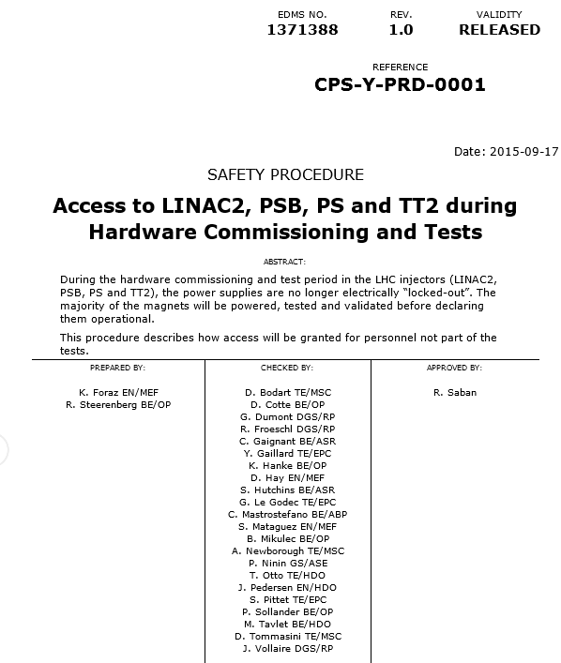
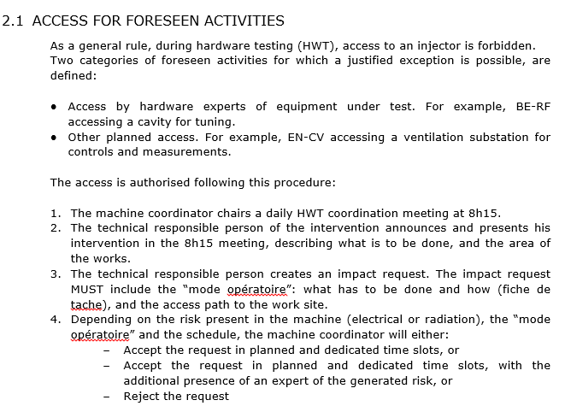
Machine Preparation Phase - Safety
  Need to assure safety during Hardware Tests
    New EDMS procedure for Linac2, PSB, PSB and TT2
    Access mode ‘Special Permit’
    IMPACTs for HW test period
    Habilitation Electrique to be clarified

Slide 10
Approach for Modifications
  Changes to HW baseline can be followed through ECRs
  NEW: Within CO3 committee implement as well strict control change rules and procedures for important equipment controls upgrades, making use of an ‘ECR-like’ mechanism
    Draft ‘Controls Change Request’ being prepared within CO3
    ‘Controls Change Request’ will be elaborated in collaboration with equipment expert, CO and OP/ABP representatives
      Will contain OP/ABP requirements and list of interfaces to different controls services (HW, SW, databases) and OP applications
  If possible, introduce test modes in equipment for realistic testing without beam
  Foresee where possible a staged deployment interleaved with Dry Runs to catch potential issues early

Slide 11
Checklists per Machine/Facility
  EDMS document under preparation for each Machine/Facility individually due to the peculiarities of each

Slide 12
Summary
  LS1 analysis performed within IRWG for Linac2/3, LEIR, PSB, ISOLDE, PS, East/North Area, AD and SPS
    Restart with beam after LS1 mostly according to milestone, but performance ramp-up only slowly due to many issues → should be improved for future Long Shutdowns
  A report with the findings and proposals will be submitted end of this year and presented at the IEFC

Slide 13
Summary and Outlook
  Main proposed improvements:
    Introduce a ‘Machine Preparation’ phase organised by a ‘Recommissioning Coordinator’ (new role under approval)
    New safety procedures for equipment tests in ‘Special Permit’ access mode → earlier testing and identification of issues
    Punctual dry runs should already be included in shutdown schedule and represent milestones for OP and equipment experts
    Communication of deadlines for each system has to be improved (inter-dependencies)
    ‘Controls Change Requests’ for major equipment controls upgrades
    OP/ABP/MEF comprehensive recommissioning checklists
  This new approach should be tested during EYETS 2016/17.

Slide 14
Conclusion
  COMMUNICATION, COORDINATION AND COLLABORATION BETWEEN ALL PARTIES IS THE KEY FOR SUCCESS!

