Slide 1
Industrial Control Activities Forecast
Philippe Gayet on behalf of EN-ICE

Slide 2








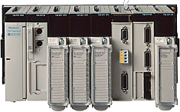

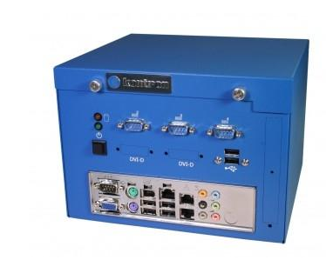
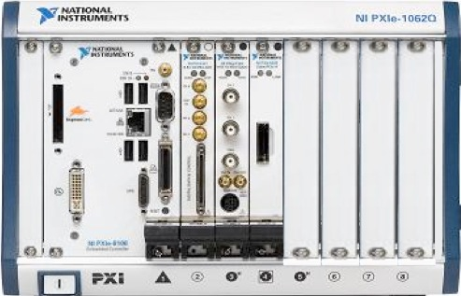
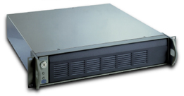
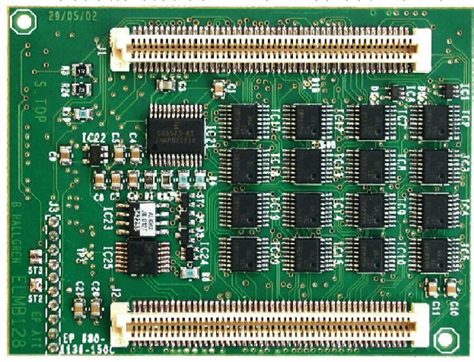




ICE Covered Area (not Floe)
Enterprise computers
ç
WEB
server
GPN
Technology support
Servers
HMI
Labview
WTS
ICE frameworks
CO
Frameworks
Applications
TN-EN
Support
PLC
PXI
cRIO
OPC
FEC
Fieldbuses
WorldFIP
I&0 and devices
HV power supplies
ELMB

Slide 3
Industrial control ecosystem evolution
LS1
LS2
2013
2014
2015
2016
2017
2018
2019
2020
2021
2022
LINUX
Windows
Technology evolution
SLC5 support
SLC6 support
Centos7 support
Notes:
We are now in operation LHC
New time sharing
Control evolution shall be done in dedicated period according to necessity of upgrade impact on operation
TS minor bug fixing
CB follow up of components evolutions (OS, soft version (WINCC-OA, Labview,) upgrade or consolidation
LSB major evolution large Hardware revamping
In all case all evolution shall not introduce regression

Slide 4
Industrial control ecosystem evolution
LS1
LS2
2013
2014
2015
2016
2017
2018
2019
2020
2021
2022
LINUX
Windows
Wincc-OA
LabVIEW
PLC
tool
RADE
UNICOS/JCOP (SCADA)
UNICOS CPC
Technology evolution
STEP 7
TIA Portal
UNITY
ICE duty is to keep the Industrial control systems applications resilient to these evolutions
Notes:
We are now in operation LHC
New time sharing
Control evolution shall be done in dedicated period according to necessity of upgrade impact on operation
TS minor bug fixing
CB follow up of components evolutions (OS, soft version (WINCC-OA, Labview,) upgrade or consolidation
LSB major evolution large Hardware revamping
In all case all evolution shall not introduce regression

Slide 5
Expected evolution till LS2
PLC
  SIEMENS
    Hardware:
      Not expected any announcement on S7-300/400 series. Still in production with new models coming during these years.
    Software:
      TIA portal can be used from V13 and it is recommended for new projects. Step7 can be still used for legacy or existing projects.
    Recommendations :
      S7-200 PLCs phased out. Need upgrade of installations
      New Hardware S7-1X00 PLCs can be used and are supported by ICE
      In case of upgrades, please target projects that contain PLCs not compatible with TIA portal
  SCHNEIDER
    End of production for the Premium PLCs expected before LS2. (end of support 8 years later)
    New series Modicon M340 and M580 are available and can be installed at CERN
    Recommendations:
      Upgrade the Premium high-end to the new M340/580 PLCs depending on your plant. Guidelines will be provided.
      Twido PLCs phased out. Need upgrade of installations
      Analyze your Premium installations and decide on their life expectation about their upgrade
  NEW TENDER in 2016 to validate the present choice and/or open to other brands
Technology evolution

Slide 6
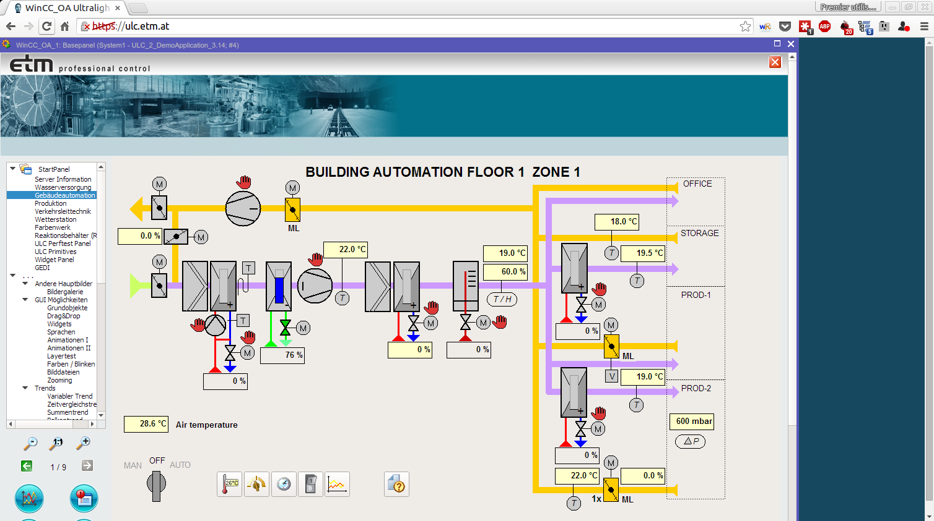
Expected evolution till LS2
National Instruments
  LabVIEW
    Version evolution (1 per year supported 4 years)
    Future version evolution of LabVIEW has a concern on backward compatibility and may induce additional resources for migration
    National Instruments is committed to keep LabVIEW in production for the next 20 years
  PXIe and cRIO
    PXIe Part of the study of CO3 on new frontend selection
    NI Linux RT and White Rabbit on PXIe
  NI Contract renewal foreseen in 2017
Siemens/ETM WINCC OA
  New versions that will probably require OS upgrades
    EYETS : 3.14 LS2: 3.17
  Additional functionalities
    Improvement of performance for the data Archiving and LHC Logging
    Improvements of the User Interface (Layout management, …)
    Remote (web) access already available and need to be tested
  Contract extension for the next 5 years presently under discussion
    Siemens is committed to keep WINCC OA in production at least for 10 years and to provide support for 20 years
Technology evolution

Slide 7
Expected evolution till LS2
OPC
  OPC-DA should phase out for LS2 OPC: DA->UA Migration
    OPC server development insourced (JCOP decision) :
      OPC-UA servers must be written for CAEN, Wiener, ISEG, Siemens TSPP, Schneider TSPP
      Better integration of OPC-UA with CMW
CAN
  Hardware interfaces upgrade
    Support of SYSTEC USB-CAN and AnaGate Ethernet-CAN gateways
    Replacement of USB-CAN interfaces to Ethernet-CAN gateway when possible
  Software Upgrade to use CAN with OPC-UA
  Evolution of ELMB (to be decided in JCOP workshop)
DIP
  API migration to JAVA 8
  Reinforce DIP Name Server functionality
  Evolution of the underlying protocol DIM (CERN in house development) to OPC-UA to be discussed in JCOP Workshop
  Tools to monitor the activity of clients and servers, i.e. the status of the publications
Technology evolution

Slide 8
Industrial control ecosystem evolution
LS1
LS2
2013
2014
2015
2016
2017
2018
2019
2020
2021
2022
LINUX
Windows
Wincc-OA
LabVIEW
PLC
tool
RADE
UNICOS/JCOP
(SCADA)
UNICOS CPC
PLC HW
Technology support
STEP 7
TIA Portal
UNITY
Premium
Twido
S7 300/400
S7-200
Schneider Modicon XXX
Siemens S 1X000
Present version
CPC 5
CPC 6
Notes:
We are now in operation LHC
New time sharing
Control evolution shall be done in dedicated period according to necessity of upgrade impact on operation
TS minor bug fixing
CB follow up of components evolutions (OS, soft version (WINCC-OA, Labview,) upgrade or consolidation
LSB major evolution large Hardware revamping
In all case all evolution shall not introduce regression

Slide 9
Foreseen ICE frameworks versions
LS1
LS2
2013
2014
2015
2016
2017
2018
2019
2020
2021
2022
LINUX
Windows
Wincc-OA
LabVIEW
PLC
tool
RADE
UNICOS/JCOP
(SCADA)
UNICOS CPC
PLC HW
Technology support
ICE frameworks
STEP 7
TIA Portal
UNITY
Premium
Twido
S7 300/400
S7-200
Schneider Modicon XXX
Siemens S 1X000
Present version
CPC 5
CPC 6
Notes:
We are now in operation LHC
New time sharing
Control evolution shall be done in dedicated period according to necessity of upgrade impact on operation
TS minor bug fixing
CB follow up of components evolutions (OS, soft version (WINCC-OA, Labview,) upgrade or consolidation
LSB major evolution large Hardware revamping
In all case all evolution shall not introduce regression

Slide 10
Framework Evolution
JCOP-UNICOS are unified in a single Supervision Framework (name to be chosen)
  Additional Functionalities
    Homogenization of alarm display in coherence with LASER
    Event replay
    Reporting for all applications (e.g. number of alarms per day, statistics on data rates, etc)
    Deploy web remote access
    Long list of minor new functionalities required by our large community of users.
    New drivers required for legacy or new installations (BACnet, IEC61850, etc)
UNICOS CPC
  NO Major Version but :
    Baseline upgrades of applications (not compulsory but recommended)
    CPC5 End of Life early LS2 (if not before)
RADE
  Upgrade to last version of CERN Middleware and services
  Automation of deployments
  New version of RADE compatible to LabVIEW evolution and maximizing backward compatibility will be developed to reduce migration workload
Frameworks

Slide 11
Application developed by ICE (1)
Cryogenics
  Migration to M580 (1 FTE for 26 weeks)
    TS3 : non-critical applications as soon as material is received. A stop of the PLC has to be programmed with operation. (5 week)
    YETS : critical application without Profibus, to be programmed with operation. Impact on production. (4 week)
    LS2 : critical application with fieldbus. Needs new Ethernet IP cards (available in 2016) and recommissioning of all I/O on fieldbus. Process to be stopped 2 or 3 days. (17 week)
  New projects: Redundancy of the LHC warm compressors, Small liquefier for the existing storage tanks, new mobile refrigerator ???
CIET
  Introduction of new VFT (Virtual flow meters) devices, study to include PA sensors diagnostics (expert view).
GCS
  New or Upgrade of Gas systems
    Modifications to be done on existing gas systems
    New gas systems to be developed (list not defined yet by PH-DT)
    Any new gas systems will be developed with Modicon series (M340/M580) and Ethernet/IP as fieldbus
    Replacement of existing Premium Schneider PLCs with Modicon series (M340/M580) and Ethernet/IP is considered
Applications

Slide 12
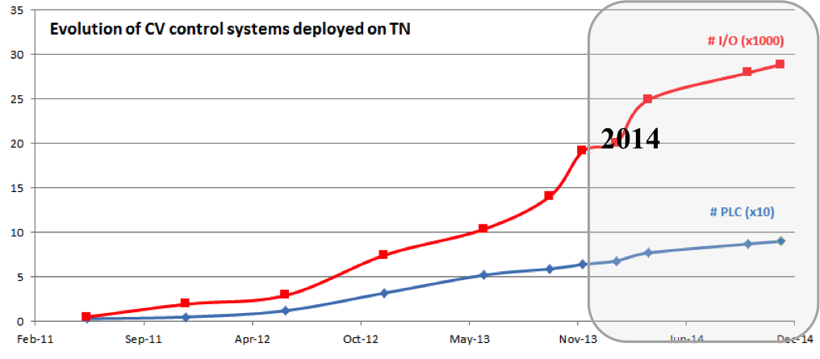
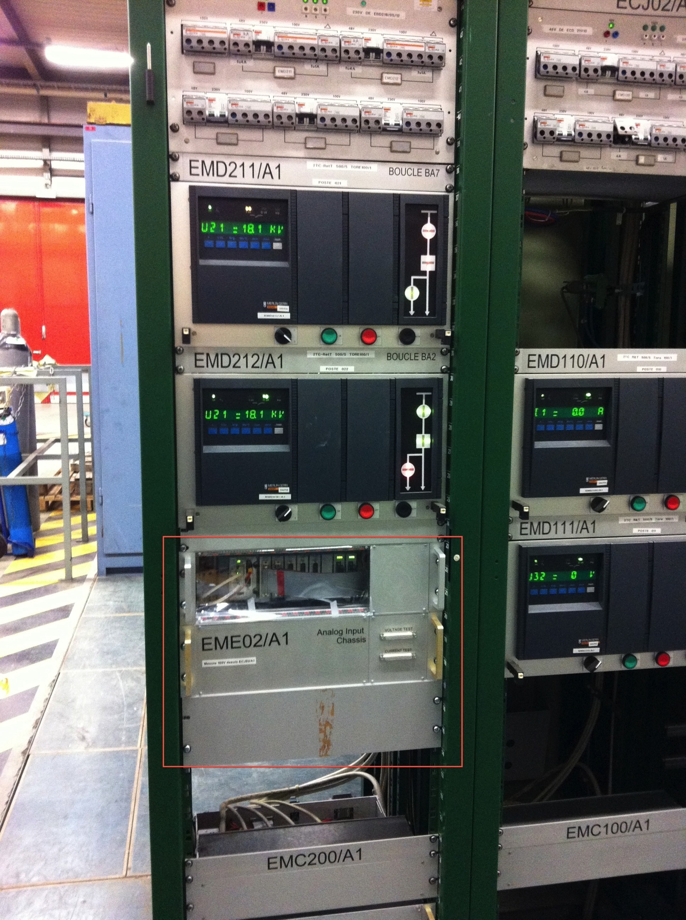
Application developed by ICE (2)
Cooling and ventilation (5 FTE per year)
  Pursue the program of migration toward UNICOS of existing installation
    100 applications already in operation
    43 potential consolidation projects on which 35 are approved by CV
  Include 15 new Projects (
  Migration program expected to extend till LS3
Electrical Infrastructure
  Finalisation of PSEN
    Disaster recovery center
  RTU replacement project Decision in December
  Oscillo-perturbography using LabVIEW, and cRIO
    Scalability test (50+ systems)
    Mass deployment from now to LS2
SURVEY (0.4 FTE )
  Likely to develop the inclination sensors devices
Applications

Slide 13
Application developed by ICE (3)
QPS
  Upgrade of IPQ, IPD and IT protection systems: new signals, re-configuration of field-bus networks, new API for QPS client
  Deployment of protection systems for 11 T magnets: new signals, re-configuration of field-bus networks, new API for QPS client (not yet clear whether 11T magnets will be installed during LS2)
  (Induced task but not really LS2 activity): Test benches SM18 and B180: in case we connect to standard QPS supervision (not foreseen at the start-up)
PIC/WIC
  Nothing foreseen on PIC so far.
  WIC: 7 New applications:
    Transfer lines Linac4 - PSB (Booster),Transfer lines PSB – PS, TT2, TT10, AD (Experimental area), SM18/FAIR, depending on the final solution chosen.
DSS
  Re-engineering of the application components according to ICE standard
  Deployment of the reengineered systems
Applications

Slide 14
Application developed by ICE (4)
LabVIEW Applications
  Post Mortem/Hardware Commissioning ACCTEST integration (13 applications) and configuration database
  LINAC 4 emittance measurement
  TIM Survey multi alignment system (PXI)
  HLS system, robot controlled
  PXI-Spectrum
  HTS cable test system in SM18, HTS magnet tests system in Cluster D, SM18
  RP-TIM Tunnel Inspection system (to equip 4 trains)
  RF cavity test applications
  Magnet test applications
  Vacuum applications
  ISOLDE Off-line separator application renovation
  …
Applications

Slide 15
User applications support known today
Cryogenics experimental areas
  Development of several installations
  CPC5 re-engineering applications
Vacuum
  Co-development of the VAC UNICOS package (need to establish a clear project roadmap)
  Support deployment of UNICOS applications
LHC Experiments
  RACK Control to be refurbished (collaboration with EN-EL)
  PH-DT
    CPC5 re-engineering applications & Deployment of the re-engineering project (could be done before LS2)
    Detector cooling
      Need to define Support for CO@ cooling
      Quid of CFC cooling that are approaching obsolescence???
TE- ABT : Hardware and timing for PS kicker systems upgrade
TE-EPC : migration to UNICOS
…
Support

Slide 16
Improved Services
SCADA Applications Service
  Review of current architecture for each of the application domains in view of improving them for operation/maintenance/performance
  Reduce further version upgrade impact.
    Ultimate goal : upgrade fully transparent for critical applications
  Automated Application migration tools
PLC Tools & Services
  Monitoring of all PLCs by agent to improve diagnostics
  PLC deployments with New Version control tool
  Asset management of PLC and PXI components in INFOR EAM
Data analytics tools to assist the operators/engineers in collaboration with IT and BE-CO:
  Alarm analysis, cryogenics oscillations, etc…
  Data analytics as a service
Consultancy
  Advanced control (regulation tuning, MBPC,…), Formal validation and Simulation
Support

Slide 17
Summary
No technological revolution but permanent evolution
  No major end of life issues even in the HL-LHC perspective
  Please follow the recommendations.
No Major Framework evolution for UNICOS/JCOP more uncertainties for LabVIEW that may impact RADE and applications
  Use the frameworks they will make you life easier in case of technological evolutions
  Follow the supported versions
  ICE may handle the migration of your applications or assist your group using the standard tools in the migration process
(Too?)Many applications to be developed for various groups or by equipment groups that need our support.
  If you feel that you need support please contact us ASAP.
  Some projects need decisions
  Additional request from this workshop have to be evaluated
  Close collaboration with equipment group are mandatory to establish early and adapted planning
  Careful resources planning and optimization needed to complete the picture.
Technical Evolutions need to be approved in Ad Hoc Committees : CO3 or JCOP

Slide 18
Thank you for your partnership!!

