Slide 1
Controls Renovations and End of Life (EoL) plan of major components of the controls infrastructure
Eugenia Hatziangeli BE-CO
Input from C. Dehavay, E. Gousiou, I. Kozsar, M. Pace, E. Said, T. Wlostowski, CO3 members, P. Charrue, C. Roderick, J. Serrano, K. Sigerud, M. Vanden Eynden

Slide 2
Contents
Post ACCOR Renovations and End of Life (EoL) of major Controls components
Controls Consolidations & Renovations

Slide 3
Post ACCOR Renovations and EoL - Context
25th June [CO3]
  BE-CO proposal for End of Life & support (OS, GM/SLEQUIP, FESA2, RDA2, …)
1st September
  Renovation roadmap provided by EQP Groups
17th September [CO3]:
  Debriefing + outline of mismatch between EOL and roadmaps + agreement

Slide 4
CO Roadmap - EoL and Support
End of FESA2
End of RDA2 & PROXY
End of FESA2
framework support
End of non InCA framework support
End of FESA2 dev. tools support
End of GM & SLEQUIP
Freeze of GM executable
End of XMOTIF
LHC start
CTF stop
End of 32-bit machines
2015
2016
2017
2018
LS2: 2019-2020
YETS 2015-2016
  Freeze of all GM executable
End 2016
  All FE installations and non-InCA JAVA AP framework for CTF will be stopped end 2016
Mid of LS2
  No 32-bit OS machines (LynxOS + Linux)
  No RDA2 communication & proxies
  No GM or FESA2 executable
  No SLEQUIP
  No X/MOTIF AP

Slide 5
Renovation Roadmaps by EQP Groups
Roadmap received for almost all systems
  Detailed planning available for each FE
  More than 900 FEs concerned
  Roadmap provided by 10 EQP Groups
    BE-BI (370 FEs): first feedback received but detailed roadmap expected end 2015
    EN-EL (2 FEs): under discussion
Compilation of all roadmaps done
  One document with shared access to come soon for approval
We are grateful for the excellent effort put in by all equipment groups

Slide 6
Alignment of Renovation Plans & EoL (1/2)
BE-CO EoL: freeze all GM executable by YETS 2015
  CO proposal is not accepted for ABT, BI, RF
    GM code should stay editable until LS2 to accommodate OP/MD requests
    CO now in discussion with the Eq. groups to see how to facilitate this request
CO EoL: All FE installations and non-InCA JAVA AP framework for CTF will be stopped end 2016
  No objection from EQP & OP groups

Slide 7
Alignment of Renovation Plans & EoL (2/2)
CO EoL: Stop of RDA2/FESA2/32bit OS/GM/SL/XMotif by mid LS2
  EQP Renovation roadmaps are compliant with CO EoL at 95%
    For the most obsolete systems [GM, SLEQUIP], some renovation takes place late (LS2)
  Very few renovations are not compliant with EoL
    SPS BLM (10 FEs, LynxOS): renovation planning is LS3
    Legacy B-TRAIN (~6 FEs) requested to be kept operational beyond LS2
      BE-CO ready to help them so they could deploy 4 new systems during LS2: LEIR, AD, PSB and CPS
    In discussion now with corresponding groups to see how BE-CO can help

Slide 8
CO Tools for Renovation
Massive Class/Device migrations (GM -> FESA, FESA2 -> FESA3) will take place until LS2
  CO tools (FESA instantiation, CCDB migration) to be extensively used
FESA Migration tools
  Available in Eclipse since end 2014
  FESA3 is stable -> priority can be increased on tools improvements, if required
  Contact fesa-support for help & feedback on improvements
Controls Configuration Service (CCS) tools
  Presentation/demo of the new migration tools: October 2015
  On-demand training sessions between CCS Support and EQP developers
  Developers with new class design should contact CCS Support for migration tests on our testbed
User feedback on tools improvements is essential as soon as possible

Slide 9
Post ACCOR Renovations and EoL
Summary
We have now an agreed roadmap with all Eq. groups for the remaining post ACCOR renovations (900 FEs) and EoL of controls components
  EDMS, shared-access document will be available soon
Remaining actions
  BI roadmap by end 2015
  CO ⬅➔ Eq. groups discussions on GM support until LS2
  Dedicated meetings with Eq. groups to address the few renovations not compliant with EoL (SPS BLMs, B-TRAINs)
Developers should provide feedback to Configuration Service and FESA tools for needed functionality

Slide 10
Contents
Post ACCOR Renovations and End of Life (EoL) of major Controls components
Controls Consolidations & Renovations

Slide 11
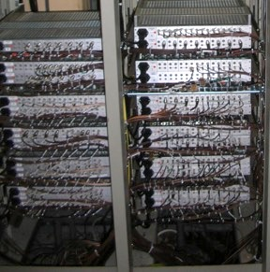
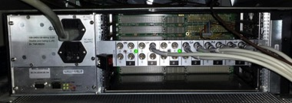
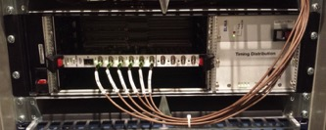
Renovation of Timing Pulsed Distribution Network
Aim : Replace obsolete 40y old cards TTL-BLO and RS485 (400) with
new VMEbus crates + modules + diagnostics
CTARA
CTDAH
Activity | Impact
Ethernet socket | EN/EL, IT/CS
HW production : TTL-BLO : 500 CTARA + 500 CTDAH done RS485 : Design to be completed | Design : BE/CO/HT Production : TE/MPE/EM Asset InforEAM: GS/ASE
Planning, Commissioning | EN/MEF, BE/OP, LS2 CO Coordinator
Budget
400 KCHF request to Consolidation Budget covering:
ELMA contract for VMEbus crates (to be extended) VMEbus cards proto from BE-CO-HT Work will be done by BE-CO FSUs
Planning
Small nodes during TS
Medium nodes during EYETS 2016-17, YETS 2017-2018
Big nodes during LS2

Slide 12
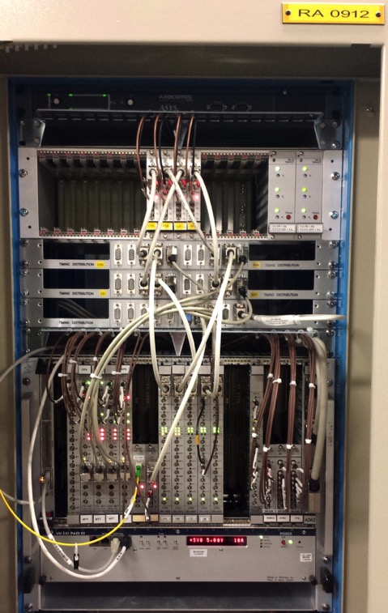
GMT Central Timing Renovation
Aim : renovate the GMT Central Timing with White Rabbit (WR)
Why : driven by lack of stocks of current GMT receivers (CTRx) (>1000 installed)
    stock 200 remaining – 50/y consumed –> lack of components
Activity | Impact
Fibers + Ethernet sockets | EN/EL, IT/CS
HW production WR Switches : launch additional production WR HW modules (Timing Master + CTR WR version) : First design in 2016 | Design : BE/CO/HT Production : TE/MPE/EM Asset InforEAM : GS/ASE
Planning, Commissioning | EN/MEF, BE/OP, LS2 CO Coord
Budget
Covered by our operational budget
White Rabbit modules and switches Cabling and sockets Work will be done by BE-CO FSUs
Planning
Develop hybrid GMT/WR master and hook the existing timing distribution to its GMT output. Then have a parallel WR distribution to gradually migrate front ends to WR => This would allow us to recuperate the CTR modules in those front ends to replenish the stock
YETS 2017-2018 : Deploy pilot for proof of design before LS2
LS2: Low intensity migration of part of LIC towards WR to recuperate CTRx stock

Slide 13
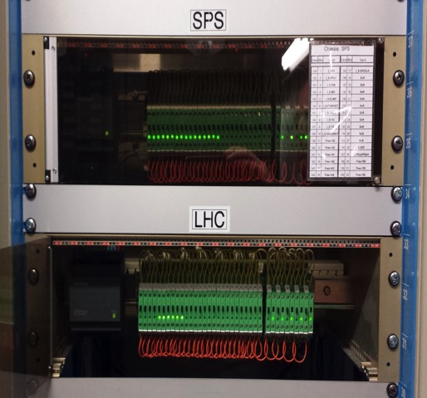
Renovation of GMT External Conditions
Aim : replace the old GMT “external conditions” infrastructure with WR
Why : present installation on unreliable legacy hardware with long coax cables and unreliable contact interfaces – already issues – anticipate further degradation
Activity | Impact
Fibers + Ethernet sockets | EN/EL, IT/CS
HW production WR Switches : launch additional production WR contact interface : New design BE-CO Fellow will work on translation of the on/off switch to WR contact interface | Design : BE/CO/HT Production : TE/MPE/EM Asset InforEAM: GS/ASE
Planning, Commissioning | EN/MEF, BE/OP, LS2 CO Coord
Budget
200 KCHF in consolidation request
White Rabbit modules and switches Cabling and sockets BE-CO FSU Jobs
Planning
Take the opportunity to make installation more coherent => need discussions with equipment groups
Migration during LS2

Slide 14
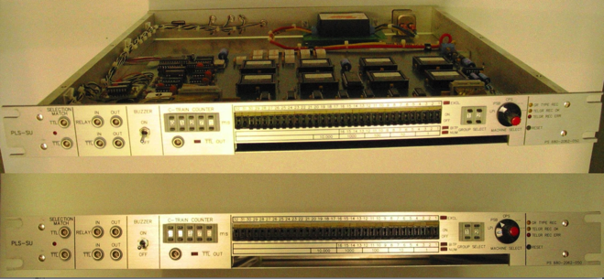
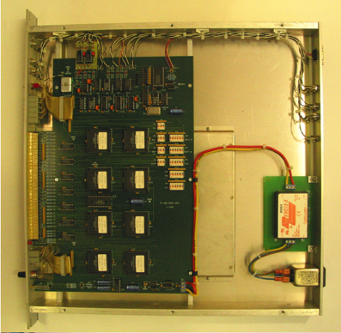
Timing PLS-SU Receivers
Aim : Replace these very old modules used by equipment specialists to diagnose timing locally, with a physical knobs and buttons and LEDs interface.
Why : Legacy hardware which we cannot produce any more - no stock problem
Activity
Possible replacement using a software-based system
Need prior discussions with the users
No cabling work is required
Planning
Migrate some of the PLS-SU boxes before LS2
Perform a larger migration during LS2
Budget
200 KCHF request to Consolidation Budget

Slide 15
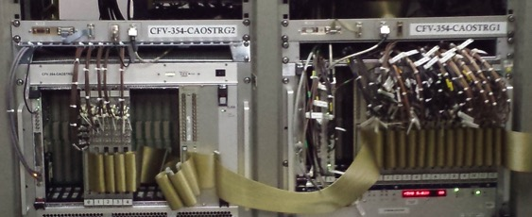
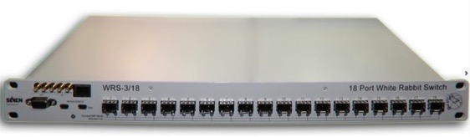
OASIS – Consolidation of Oasis Triggers
Aim: Replace OASIS trigger system by WR
Why : obsolete hardware – not enough stock of legacy CTC modules spares (components are not available)
Activity | Impact
Fibers + Ethernet sockets | EN/EL, IT/CS
HW production WR switch TDC Mezzanines & Fine Delay | Asset InforEAM: GS/ASE
Planning, Commissioning | EN/MEF, BE/OP, LS2 CO Coord
Planning
Prototype in next 2 years
LS2: Full renovation
Budget
Money already obtained from the consolidation project
Hardware is in process to be procured

Slide 16
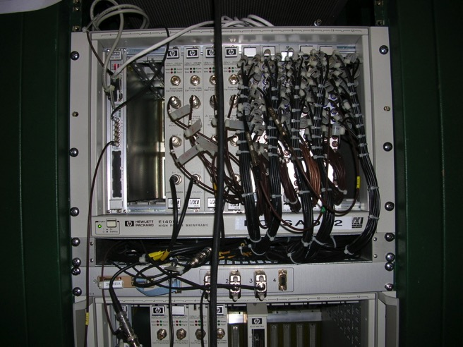
OASIS - Eradication of VXI systems
Aim : Replace OASIS VXI systems by WR
Why : VXI systems are >10years, very expensive,
performance problems (not enough memory, not enough samples)
Activity | Impact
Fibers + Ethernet sockets | EN/EL, IT/CS
HW production SVEC + FMC/ADC Mezzanine | Asset InforEAM : GS/ASE
Planning, Commissioning | EN/MEF, BE/OP, LS2 CO Coord
Planning
EYETS 2016-17 : Partial renovation
LS2: Full renovation
Budget
Money already obtained from the consolidation project
Hardware is in process to be procured

Slide 17
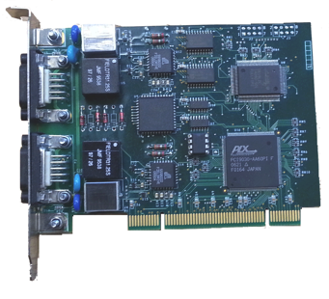
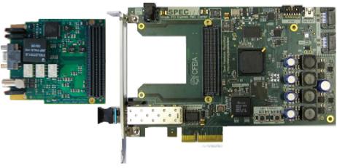
LHC WorldFIP Infrastructure
Aim : install the new in-house bus arbiters cards and associated high-level libraries to replace the WorldFIP Bus Arbiters (WorldFIP master) for all LHC systems (Power converters, QPS, Cryogenics, ..)
Alstom PCI BA
Activity | Impact
HW production Bus Arbiter PCI cards done | BE/CO/HT + TE/MPE/EM
New device driver + SW libraries: Proof-of-concept OK | Power Converters, Cryogenics, QPS, Survey, Beam Instrumentation
Agreement + Testing : Backwards compatible layer for clients who keep the old API Encourage clients towards the new API | Power Converters, Cryogenics, QPS, Survey, Beam Instrumentation
Planning, Commissioning | EN/MEF, BE/OP, LS2 CO Coord
FMC mezzanine board, to be plugged on the PCIe carrier (SPEC)
Planning
Deploy the new master in selected places before LS2 to get confidence and a general replacement during LS2 : TS 2016: install few non critical pilot(s) in LHC EYETS 2016-17: install few pilot(s) LS2: Full replacement
Budget
400 KCHF allocated in consolidation covering cards production FSUs Job
Cu/Optical repeaters were already insourced (GOFIP) and we plan to insource the Cu/Cu repeaters before LS2 to ensure adequate stock. No need to replace the existing ones so far as they are not giving any problem

Slide 18
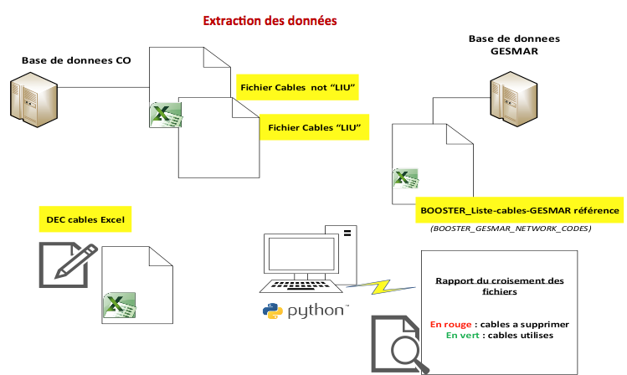
Removal of Obsolete Cables
133 obsolete control cables will be removed from the Booster (out of 1540) in 2015-16 YETS
  Cables checked against CO DB & GESMAR
  More obsolete cables should be in the paper lists (not in GESMAR)
Possible Improvements
  Move all information from paper to digital (big gain as paper contains the oldest cables)
  Put fiber optic cables in a DB
  Asset management of the cables and GESMAR could be part of the Asset management system
  Electronic follow up of all (de)cabling demands would ease the work progress follow up from the clients
An excellent initiative in the form of a WG was put in place up by EN/EL to establish a single common method/process for cable disconnection with all users and BE-CO is participating

Slide 19
Other Hardware Upgrades in a glance
System | Aim | Motivation | Performed by | Potential impact | Impact on | When
SPS Intercom | Replace the present infrastructure with new technology | Old technology and spare parts - will not survive after LS2 | GS-ASE + BE-CO (public address ++ system) | Change of habit | SPS Operations | LS2
CCC Consoles | Replace the consoles installed early 2015 and recycle them in the local CRs | Regular technological upgrade (working lifetime of 3-4 years) | BE-CO | Minimal to none | CCC Operators | End LS2
CCR Backend Servers | 3 first days of the year for system maintenance and upgrades of all the servers | Dedicated end of year maintenance | BE-CO | Minimal to none |  | YETS 15/17 EYETS 16 LS2
Database servers and storage | Replacement certain hardware + additional disk storage | Regular end of maintenance replacement | IT-DB BE-CO | None |  | LS2

Slide 20
Upgrades of Control Software Services
System | Aim | Motivation | By | Potential impact | Impact on | When
Layout Services new database & tools | New approach: distributed data management (enable eq. groups to manage their data reliably using new CO provided tools) | Layout Database Scale & Scope has evolved significantly over last 12 years Current system, tools and approach have reached their limits | CO-DS | Generic access user/passwd will be replaced by specific per system user/passwd | Current programmatic users of the Layout database will be impacted | Production in 2018
DIAMON | DIAMON with ALARM functionalities | To simplify alarm definitions and allow immediate upgrades of alarm configuration | CO-IN | Minimal to none | Deployments in close collaboration with all users | TS, YETS 15/17, EYETS
CMW | New version of RBAC server New version of CMW<->DIP Gateways -> RDA3 driven by DB config. New major version of CMW Directory Server | Server independence from online DB access Ensure consistency of deployed configuration Easier to evolve and maintain | CO-IN | Minimal to none |  | EYETS, YETS 17

Slide 21
Upgrades of Control Room Applications
System | Aim | Motivation | By | Potential impact | Impact on | When
LSA DB | To automate import of new FESA class versions | OP request to automate the propagation of changes from CCDB to InCA/LSA | CO-APs | Applications accessing or changing settings via LSA/InCA. | OP applications developers | YETS 2015-2016
Settings Management | Consolidate and simplify the high level Settings Management | Reduce complexity overall by extracting the exceptional cases | CO-APs | All applications depending on APs public APIs | Application developers | LS2

Slide 22
Controls Consolidations/Renovations
Summary
LHC WorldFIP Bus Arbiters (FIP master), concludes the insourcing of WorldFIP technology inside BE-CO
Timing Distribution Network (cabling requests)
GMT Central Timing and External Conditions (cabling requests)
OASIS Triggers and VXI systems (cabling requests)
Removal of 133 obsolete cables in PSB (cabling requests)
  Improvements to cabling data management & workflow would greatly facilitate (de)cabling needs
Upgrades of the hardware infrastructure, controls software services and high level applications
  Work is planned and coordinated with the users
  Impact on most work is estimated low
The BE-CO work planning is followed up by the LS2 CO coordinator in close collaboration with the EN/MEF planning team

