Slide 1
Main MPE Activities during YETS/EYETS/LS2 and the Provision of Resources
Andrzej Siemko

Slide 2
Outline
ELQA during LS2
  AVAILABLE MANPOWER VS QUANTITY OF WORK DURING LS2
Upgrade of DQYPQ “Quadrupole Yellow Racks”
Upgrade of QPS systems
Maintenance of Energy Extraction Systems
  13 kA EE
  600 A EE
Deployment of WIC interlocks in PS
LHC magnet circuit re-commissioning, including powering tests

Slide 3
Scenario assumed for ELQA activities during LS2
- ELQA campaign at cold before warm up of magnets for LS2 activities
- ELQA campaign at warm before start of LS2 activities
- ELQA (AIV, MIC & DOC) for 5 to 10 magnets to be replaced and NC diagnostics
- ELQA campaign at warm before cool down after LS2
- Final ELQA campaign at cold before powering tests

Slide 4
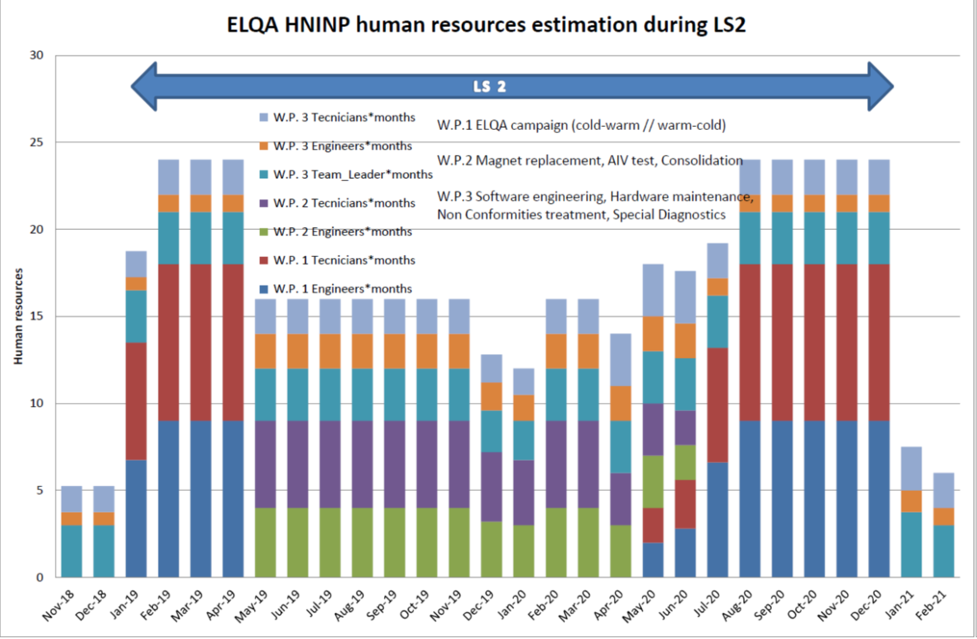
ELQA during LS2 – external resources

Slide 5
ELQA during LS2 – required resources (total)

Slide 6
ELQA – external resources
Three contacts with HNINP, Cracow for upgrading the ELQA test systems for LS2 are signed and running
One additional contract with the same Institute for assistance during TS, YETS and EYETS is signed and also operational
Contracts for the resources for LS2 ELQA activities are not yet signed, but preliminarily agreed with HNINP
  Total cost nearing 3 MCHF

Slide 7
Upgrade of DQYPQ “Quadrupole Yellow Racks”
  Similar to DQYPB “Dipole Yellow Racs” performed during LS1.
  “HL-LHC ready” principle (i.e. no more changes required for covering the future needs)
  It concerns less equipment (396 units instead of 1232), but the required expert level resources are similar
  Includes replacement of the existing version of the QDS detection crate by a new - including next generation detection systems, enhanced quench heater supervision, fully redundant powering and advanced options for crate supervision and maintenance.
  Includes DQHDS pulse current measurement transformers and a re-designed electrical shuffling module (DQLIM).
  Similar number of contracts with industry as the DYPB upgrade of LS1.

Slide 8
Quench Protection Upgrades
IPQ, IPD & IT protection
  Upgrade of IPQ, IPD and IT systems to dedicated bus-bar splice protection and diagnostics, add enhanced quench heater circuits supervision, improve DQHDS trigger, elaborate a safe remote power cycle option.
600 A protection DAQ & current sensors
  Upgrade of DAQ systems and crate supervision. Possible upgrade of current sensors for measuring directly the derivative of the current.
HiLumi 11 T magnets
  Deployment detection and supervision systems for the new 11T magnets, including a revised bus-bar protection.
Monitoring and protection of conical joints
  Installation of new detection electronics to monitor the resistance of conical joints used in the warm cabling of the LHC main circuits

Slide 9
Maintenance of Energy Extraction Systems
13 kA EE systems
  Extensive maintenance campaign, similar to LS1
  External resources are mandatory – contracts are not yet established, but underway
600 A EE systems
  To some degree a less extensive maintenance campaign as compare to LS1
  External resources are nevertheless mandatory – contracts are not yet established

Slide 10
Magnet Interlock consolidation in PS complex
MPE is committed to continue deployment of generic, COTS based Warm Magnet Interlock System (WIC)
  >33 instances already deployed in LHC, TI2, TI8, SPS, AWAKE, HighRadMat, TT10/20, PSB, LINAC4, HIE-ISOLDE, LINAC3 and LEIR
3 families of legacy interlock systems still remain today (PS, North Area + AD/TT2/East Area/…)
Aiming for coherent consolidation plans in-line with EPC and MSC
  complete main proton chain by end of LS2 (including PS, L4-PSB-PS transfer lines, TT2/nTOF/TT10, East Area?)
  remaining EXP areas by LS3 (AD, North Area, BA80)
  Detailed discussions ongoing in view of EYETS and LS2 activities

Slide 11
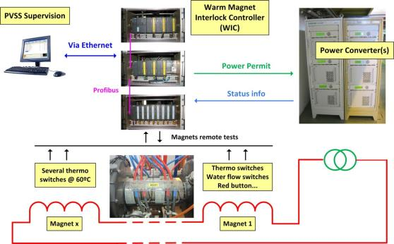

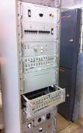

Magnet Interlock consolidation in PS complex (contd.)
WIC installation – generic solution
Standardized interlock system for normal conducting magnets based on Programmable Logic Controllers (PLC):
  Collects inputs from thermo-switches, flow switches and internal PC faults
  Provides Permits to the power converter and beam interlock system
Configuration DB
Replaced by
Legacy magnet interlocks for PS mains and auxiliaries

Slide 12
LHC magnet circuit re-commissioning, including powering tests
Similar campaign to LS1
  Will require external expert level resources with experience from previous LHC campaigns
  At present it is much less evident to find such resources

