Slide 1
HL-LHC
ACTIVITIES DURING LS2
Paula Álvarez López,
on behalf of the HL-LHC Project team

Slide 2
Agenda
HL-LHC baseline evolution
Overview of LS2 installation works on the LHC Layout
LS2 installation works detailed by WP
Wrap up: summary of all LS2 works for HL-LHC

Slide 3
BASELINE as of September 2014 (Chamonix Session)

Slide 4
Equipment on the Beam | Tunnel equipment | Vert. J | Surface Eq. | Dis.
Interaction Region and MS
IP 1,5
P
I
C
BIS
Magnet system
MQXFA MQXFB, MBXF, MBRD, MQYY,
Q5 1.9, Q6 1.9
MCBXFB, MCBXFA, MQSXF, MCTXF, MCTSXF, MCDXF, MCDSXF, MCOXF, MCOSXF, MCSXF,MCSSXF, MCBRD, MCBYY
CB
Cryoplant
IP 1,5
Cryo line IR+MS
Warm compressor and other surface eq.
Alignment
QPS2
TAXS, TAXN
EE
Collimation (TCTPM, TCL, TCLM, TCTP)
DF(X-M) +
SC Link DSH (X-M)
DFH(X-M) +
Power converters
Beam vacuum
Beam diagnostic
BPMSQW, BMPSQ, BPMSQT, BMLC
Rad-hard electronics for
BLM and BPM
RF system
Loads, circulators, RF power, LLRF, HVPS, central LLRR
Crab Cavity Cryomodules
CC diagnostic and protection
SC link/
Powering arc
IP 1,5
DS Collimation pp (TBC RUN II)
IP 1,5
Cryo-bypass + TCLD
H.F. dipoles
DFA+
SC Link DSHA
DFHA +
Power converters
DS Collimation for ion
IP 2
Cryo-bypass + TCLD
H.F. dipoles
HL-LHC Baseline
DS Collimation pp (TBC RUN II)
IP 7
SC link/powering
IP 7
HL-Baseline & LS2
Cryo-bypass + TCLD
Hor. SC Link
DSH + DFA
Susceptible to LS2
H.F. dipoles
Power converters

Slide 5
Equipment on the Beam | Tunnel equipment | Vert. J | Surface Eq. | Dis.
Collimation upgrade
P
I
C
BIS
Secondary TCSPM
IP 3, 7
Primary TCP TCPP
IP 3 ,7
TCSG, TCLA, TCAP
IP 3, 7
TCSP
IP 6
Injection protection
IP 2, 8
TDIS
TCLIA, TCLIB (TBC)
TCDD TCDDM (TBC)
TCLIM (TBC)
MKI (TBC)
Beam diagnostic
IP 4
Cryoplant
IP 4
Fast wire scanners BWSF
New light extraction line BSRT
Cryoline for RF
CB
Warm compressor and other surface eq.
Beam gas vertex detector BGV
Q5 at point 6
IP 6
Dump (TBC)
IP 6
TCDS (TBC)
HL-LHC Baseline
MKB, TDE (TBC)
HL-Baseline & LS2
High rad warm magnets (TBC)
IP 7
Susceptible to LS2
TAXN for LHCb
IP 8

Slide 6
BASELINE TODAY, SEPTEMBER 2015

Slide 7
Equipment on the Beam | Tunnel equipment | Vert. J | Surface Eq. | Dis.
Interaction Region and MS
IP 1,5
P
I
C
BIS
Magnet system
MQXFA MQXFB, MBXF, MBRD, MQYY,
Q5 1.9, Q6 1.9
MCBXFB, MCBXFA, MQSXF, MCTXF, MCTSXF, MCDXF, MCDSXF, MCOXF, MCOSXF, MCSXF,MCSSXF, MCBRD, MCBYY
CB
Cryoplant
IP 1,5
Cryo line IR+MS
Warm compressor and other surface eq.
Alignment
QPS2
TAXS, TAXN
EE
Collimation (TCTPM, TCL, TCLM, TCTP)
DF(X-M) +
SC Link DSH (X-M)
DFH(X-M) +
Power converters
Beam vacuum
Beam diagnostic
BPMSQW, BMPSQ, BPMSQT, BMLC
Rad-hard electronics for
BLM and BPM
RF system
Loads, circulators, RF power, LLRF, HVPS, central LLRR
Crab Cavity Cryomodule
(SPS Test)
CC diagnostic and protection
SC link/
Powering arc
IP 1,5
DS Collimation pp (TBC RUN II)
IP 1,5
Cryo-bypass + TCLD
H.F. dipoles
DFA+
SC Link DSHA
DFHA +
Power converters
DS Collimation for ion
IP 2
Cryo-bypass + TCLD
H.F. dipoles
HL-LHC Baseline
DS Collimation pp (TBC RUN II)
IP 7
SC link/powering
IP 7
HL-Baseline & LS2
Cryo-bypass + TCLD
Hor. SC Link
DSH + DFA
Baseline, now postponed
H.F. dipoles
No longer baseline
Power converters

Slide 8
Equipment on the Beam | Tunnel equipment | Vert. J | Surface Eq. | Dis.
Collimation upgrade
P
I
C
BIS
Secondary TCSPM
IP 3, 7
Primary TCP TCPP
IP 3 ,7
TCSG, TCLA, TCAP
IP 3, 7
TCSP
IP 6
Injection protection
IP 2, 8
TDIS
Upgrade of 18kW refrigerator
TCLIA, TCLIB
IP 4
New transportable refrigerator
TCDD TCDDM
Mask for D1
TCLIM
MKI prototype
Beam diagnostic
IP 4
Cryoplant
IP 4
Fast wire scanners BWSF
New light extraction line BSRT
Cryoline for RF
CB
Warm compressor and other surface eq.
Beam gas vertex detector BGV
Q5 at point 6
IP 6
Dump (TBC)
IP 6
TCDS (TBC)
HL-LHC Baseline
MKB, TDE (TBC)
HL-Baseline & LS2
High rad warm magnets
IP 7
HL-Baseline but postponed
TAXN for LHCb
IP 8
No Baseline
Mask for D1
IP 8

Slide 9
LS2 INSTALLATION OVERVIEW

Slide 10
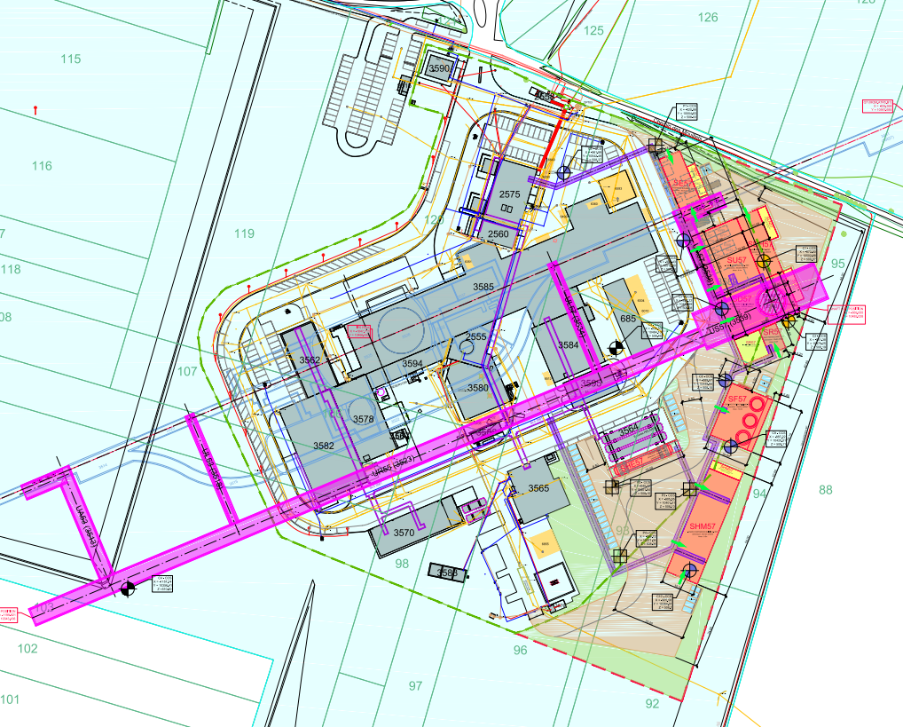
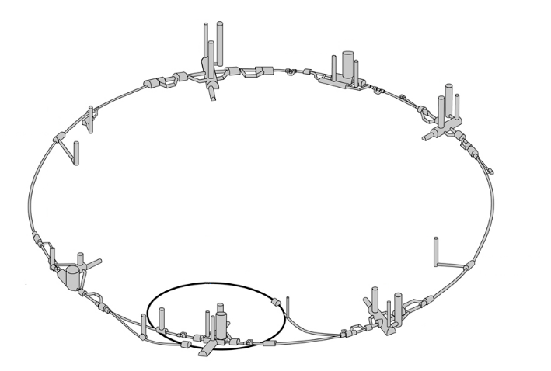
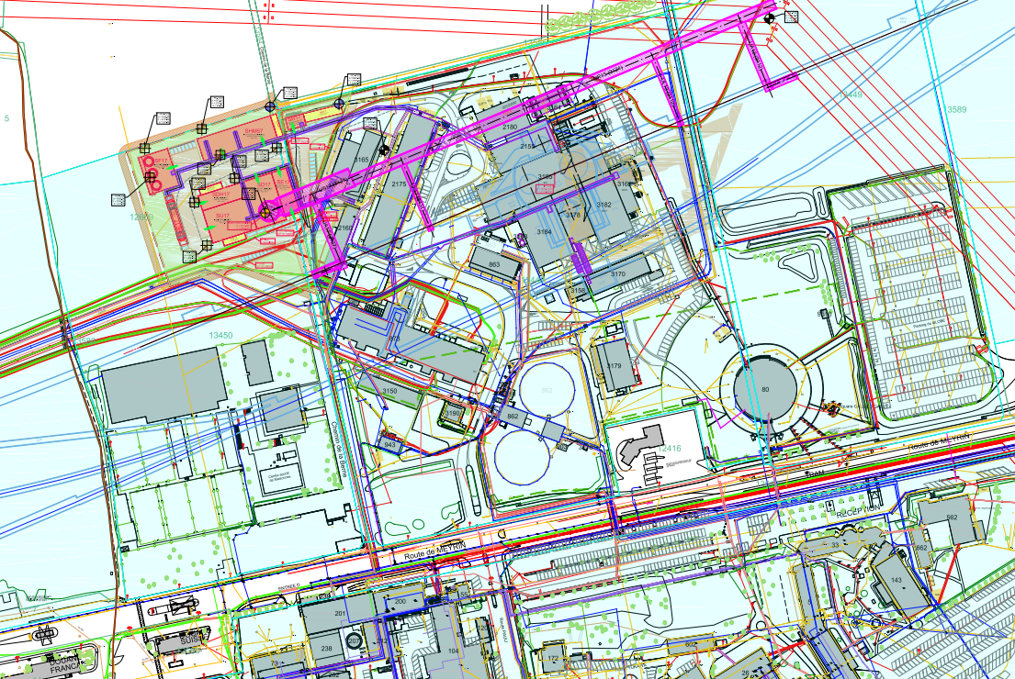
Installation Overview for LS2
New transp. refrigerator
Prep. works halo diagnostic systems
New Q5
In-situ a-C coating
High bandwidth pick-ups
TCSPM
Mask for D2
Fast wire scanners
TDIS
Cryo-bypass+TCLD
TAXN
BGV
Mask for D1

Slide 11
LS2 INSTALLATION WORKS DETAILED BY WP

Slide 12

WP3 – IR Magnets
Equipment | Quantity | Location
Q5 | 2 units | P6
Q5

Slide 13
WP4 – Crab Cavities & RF: SPS Tests
Equipment | Quantity and period | Location
Prep. Works (RF & Cryo lines, movable table) | EYETS 2016 | SPS-LSS6
Cryomodule 1 | 1 proto in YETS 2017 | SPS-LSS6
Cryomodule 2 | 1 proto in LS2 | SPS-LSS6
RF system Installation | YETS 2017, LS2 | SPS-LSS6
Crab cavity cryomodule
RF system

Slide 14
WP5 – Collimation
Equipment | Quantity | Location
TCSPM | 1 prototype | P7
Wire collim. | Up to 4 | P1, P5
Intervention for crystal collimation | - | P7
Cryo-bypass + TCLD | 2 units | P2
TCSPM | 8 units | P7
Hollow e-lenses | Prep. works | P4
EYETS 2016
YETS 2017
Cryo-bypass+TCLD
TCSPM
Hollow e-lens prep. works

Slide 15
WP8 – Collider-Experiment Interface
Equipment | Quantity | Location
TAXN for LHCb | 2 units (1 per IP side) | P8
Mask for D2 | TBC | P8
TAXN
Mask for D2

Slide 16
WP9 – Cryogenics
Equipment | Location
Upgrade of 18kW refrigerator | P4
New transportable refrigerator | P4
New transportable refrigerator

Slide 17
WP 12 – Vacuum
Equipment | Location
In-situ a-C coating | P2, P8
Works for other WPs¹ | P2, P4, P6, P7, P8
¹ EQUIPMENT REQUIRING VACUUM INTERVENTION
WP3 | Q5 | P6
WP5 | By-pass collimator + TCLD | P2
WP5 | Hollow e-lens | P4
WP5 | TCSPM | P7
WP8 | TAXN | P8
WP8 | Mask for D2
WP13 | Fast wirescanners | P4
WP13 | BGV | P4
WP14 | TDIS | P2,P8
WP14 | Mask for D1 | P2, P8
In-situ a-C coating

Slide 18
WP 12 – Vacuum
Equipment | Location
In-situ a-C coating | P2, P8
Works for other WPs¹ | P2, P4, P6, P7, P8
¹ WPs AND EQUIPMENT REQUIRING VACUUM INTERVENTION
WP3 | Upgrade of Q5 in P6 | P6
WP5 | By-pass collimator + TCLD and Empty Cryostat | P2
WP5 | Hollow e-lens & Crystal collimation works | P4
WP5 | New secondary collimator TCSPM | P7
WP8 | TAXN | P8
WP8 | Mask for D2 | P8
WP13 | Fast wirescanners | P4
WP13 | Beam Gas Vertex Detector (BGV) | P4
WP14 | TDIS | P2,P8
WP14 | Mask for D1 | P2, P8
In-situ a-C coating
Courtesy:
V. Baglin

Slide 19
WP 13 – Beam diagnostics
Equipment | Quantity | Location
Beam gas vertex detector | 1 proto. | P4
Fast wire scanners | 1 proto. | P4
High bandwidth pick-ups | 1 (SPS)+ 2 proto. | P4
Prep. works for halo diagnostic systems on synchroton light monitor | - | P4
Fast wire scanners
BGV
High bandwidth pick-ups
Prep. for halo diagnostic systems on synchroton light monitor

Slide 20
WP 14 – Beam transfer & Kickers
Equipment | Quantity | Location
MKI prototype | 1 | TBC
Injection absorber (TDIS) | 6 units | P2, P8
Mask for D1 | 2 units | P2,P8
Upgrade of control system: LBDS MKD generator upgrade MKD controls upgrade
EYETS 2016 (tbc)
TDIS
Mask for D1

Slide 21

WP 17.1 – Civil Engineering:
Building description | P1 | P5 | Location
Shaft | PM17 | PM57 | UNDERGROUND
RF gallery side 17 | UA17 | UA57
Cryogenic cavern | US17 | US57
Water cooling station cavern/area | UW17 | UW57
SC cryo-link gallery | UL17 | UL57
Power converter gallery | UR15 | UR55
Personnel/safety gallery | UPR15 | UPR55
SC cryo-link gallery | UL13 | UL53
RF gallery side 13 | UA13 | UA53
Helium tank platform | SHE17 | SHE57 | SURFACE
Ventilation building | SU17 | SU57
Electrical building | SE17 | SE57
Head shaft building | SD17 | SD57
Compressor building | SHM17 | SHM57
Extension to technical galleries | SL11/13 | SL5/51
New technical gallery | SL16/17 | SL56/57
Cooling towers | SF17 | SF57
Helium unloading towers | SDH17 | SDH57
Nitrogen tank platform | SLN17 | SLN57
Rectifier building | SR17 | SR57
Pre LS2
Post LS2

Slide 22
WPs with no installation works during LS2
WP6A, WP6B: no installation works foreseen before LS3
WP11: Two complete units (15 m long) will be manufactured and tested before LS2. Whether the installation will happen in LS2 or in a subsequent slot (either LS3 or an EYETS during Run3) will be decided in 2016. Refer to Lucio’s presentation.
WP7: Energy Extaction (EE) and Quench Protection (QDS) systems linked to 11 T and triplets production. Other works (mainly consolidation) are planned for LS3.

Slide 23
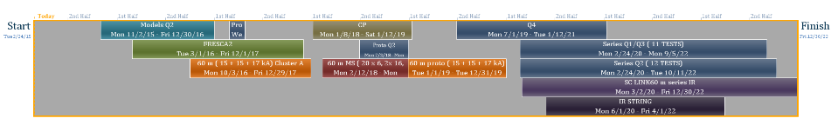
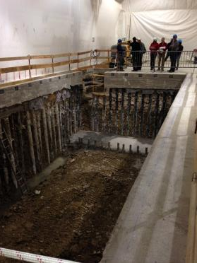
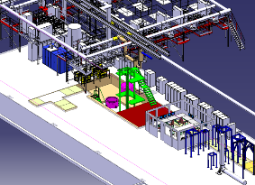
SM18: Timeline for the different tests for HL-LHC magnets
2015 2016 2017 2018 2019 2020 2021 2022
Planning has been kept as last year for what concerns modifications of test benches.
The first milestone is November 2015 for the model magnet testing.
The vertical test bench capable to test partially this models will be delivered only in May 2016 and for full test in September 2016 cluster D. (See photo on the civil engineering work that is ongoing in SM18).
Courtesy:
M. Bajko

Slide 24
WRAP UP: SUMMARY OF ALL LS2 WORKS

Slide 25
Description | WP | Period | Location | Risk
Preparation works for Crab Cavity installation | 4 | EYETS 2016 | SPS – LSS6
Installation of TCSPM prototype | 5 | EYETS 2016 | P7
Installation of wire collimators | 5 | EYETS 2016 | P1, P5
MKI Prototype | 14 | EYETS 2016 | TBC
Installation of CC Cryomodule (DQW) & RF | 4 | EYETS 2017 | SPS – LSS6
Preparation works for crystal collimation | 5 | EYETS 2017 | P7
Change of Q5 | 3 | LS2 | P6
Installation of CC Cryomodule (RFD) & RF | 4 | LS2 | SPS – LSS6
Installation of Cryo-bypass + TCLD | 5 | LS2 | P2
Installation of TCSPM series | 5 | LS2 | P7
Preparation works for hollow e-lens | 5 | LS2 | P4
Installation of TAXN for LHCb | 8 | LS2 | P8
Installation of Mask for D2 | 8 | LS2 | P8
Upgrade of 18 kW refrigerator | 9 | LS2 | P4
New transportable refrigerator | 9 | LS2 | P4
In-situ a-C coating | 12 | LS2 | P2, P8
Fast wirescanners | 13 | LS2 | P4
Beam gas vertex detector | 13 | LS2 | P4
High bandwidth pick-ups | 13 | LS2 | P4
Prep. Works Halo diagnostic systems on synchroton light monitors | 13 | LS2 | P4
TDIS Installation | 14 | LS2 | P2, P8
Mask for D1 | 14 | LS2 | P2, P8
Upgrade of control system | 14 | LS2 | -

Slide 26
THANK YOU ALL FOR YOUR ATTENTION!
…and big thank you to all WP leaders and engineers for their contribution!

Slide 27
EXTRA SLIDES

Slide 28
WP11 – Current baseline and options for installation:
Location | Installation | Quantity
P2 | LS3 | 2 unit *
P7 | LS3 | 2 or 4 units (tbc)
P1, P5 (Option) | LS4 | Max. 8 units
* 1 unit = 2 MBH + 1 BPC
LS3 Installation (P2, P7)
OPTION: LS4 Installation (P1, P5)

Slide 29
WP Interfaces
 | WP1 | WP2 | WP3 | WP4 | WP5 | WP6A | WP6B | WP7 | WP8 | WP9 | WP 10 | WP 11 | WP 12 | WP 13 | WP 14 | WP 15 | WP 16 | WP 17
WP1 |  | ✓ | ✓ | ✓ | ✓ | ✓ |  | ✓ | ✓ | ✓ | ✓ | ✓ | ✓ | ✓ | ✓ | ✓ | ✓ | ✓
WP2 | ✓ |  | ✓ | ✓ | ✓ | ✓ |  | ✓ | ✓ | ✓ | - | ✓ | ✓ | ✓ | ✓ | - | - | -
WP3 | ✓ | ✓ |  | - | ✓ | ✓ |  | ✓ | - | ✓ | ✓ | - | ✓ | ✓ | ✓ | ✓ | ✓ | ✓
WP4 | ✓ | ✓ | - |  | ✓ | - |  | ✓ | - | ✓ | - | - | ✓ | ✓ | - | ✓ | ? | ✓
WP5 | ✓ | ✓ | ✓ | ✓ |  | ? |  | ✓ | ✓ | ✓ | ✓ | ✓ | ✓ | ✓ | ✓ | ✓ | ✓ | ✓
WP6A | ✓ | ✓ | ✓ | - | ? |  |  | ✓ | - | ✓ | ✓ | ✓ | ✓ | - | - | ✓ | ✓ | ✓
WP6B
WP7 | ✓ | ✓ | ✓ | ✓ | ✓ | ✓ |  |  | ✓ | ✓ | ✓ | ✓ | ✓ | ✓ | ✓ | ✓ | ✓ | ✓
WP8 | ✓ | ✓ | - | - | ✓ | - |  | ✓ |  | - | ✓ | - | ✓ | ✓ | ✓ | ✓ | - | ✓
WP9 | ✓ | ✓ | ✓ | ✓ | ✓ | ✓ |  | ✓ | - |  | ? | ✓ | ✓ | ✓ | - | ✓ | ✓ | ✓
WP10 | ✓ | - | ✓ | - | ✓ | ✓ |  | ✓ | ✓ | ? |  | ✓ | ✓ | ✓ | ✓ | - | - | -
WP11 | ✓ | ✓ | - | - | ✓ | ✓ |  | ✓ | - | ✓ | ✓ |  | ✓ | ✓ | - | ✓ | ✓ | ✓
WP12 | ✓ | ✓ | ✓ | ✓ | ✓ | ✓ |  | ✓ | ✓ | ✓ | ✓ | ✓ |  | ✓ | ✓ | ✓ | - | -
WP13 | ✓ | ✓ | ✓ | ✓ | ✓ | - |  | ✓ | ✓ | ✓ | ✓ | ✓ | ✓ |  | ✓ | ✓ | - | ✓
WP14 | ✓ | ✓ | ✓ | - | ✓ | - |  | ✓ | ✓ | - | ✓ | - | ✓ | ✓ |  | ✓ | ✓ | ✓
WP15 | ✓ | - | ✓ | ✓ | ✓ | ✓ |  | ✓ | ✓ | ✓ | - | ✓ | ✓ | ✓ | ✓ |  | - | -
WP16 | ✓ | - | ✓ | ? | ✓ | ✓ |  | ✓ | - | ✓ | - | ✓ | - | - | ✓ | - |  | -
WP17 | ✓ | - | ✓ | ✓ | ✓ | ✓ |  | ✓ | ✓ |  | - | ✓ | - | ✓ | ✓ | - | -
WP1 | Management
WP2 | Accelerator physics
WP3 | Magnets
WP4 | Crab cavities
WP5 | Collimation
WP6 | Cold powering
WP7 | Machine protection
WP8 | Collider Experiment Interface
WP9 | Cryogenics
WP10 | Energy Deposition & Absorber Coordination
WP11 | 11-T Dipole Magnets
WP12 | Vacuum
WP13 | Beam Diagnostics & Instrumentation
WP14 | Beam Transfer and Kickers
WP15 | Integration & (De)-Installation
WP16 | Hardware commissioning
WP17 | Infrastructure, Logistics and Civil Engineering
Courtesy: C. Parente

Slide 30
WP17 Interface Matrix
 | WP 17.1 | WP 17.2 | WP 17.3 | WP 17.4&5 | WP 17.6 | WP 17.7 | WP 17.8 | WP 17.9 | WP 17.10
WP1 | ✓ | ✓ | ✓ | ✓ | ✓ | ✓ | ✓ | ✓ | ✓
WP2 | - | - | - | - | - | - | - | - | -
WP3 | - | ✓ | - | - | ✓ | ✓ | ✓ | ✓ | ✓
WP4 | ✓ | ✓ | ✓ | ✓ | ✓ | ✓ | ✓ | ✓ | ✓
WP5 | - | ✓ | ✓ | ✓ | ✓ | ✓ | ✓ | ✓ | ✓
WP6A | ✓ | ✓ | - | ✓ | ✓ | ✓ | ✓ | ✓ | ✓
WP6B | ✓ | ✓ | ✓ | ? | - | ✓ | ? | ✓ | ✓
WP7 |  | ✓ | ? | ✓ | ? | - | ✓ | ✓ | ✓
WP8 | - | ✓ | ✓ | ✓ | ✓ | ✓ | ? | ✓ | ✓
WP9 | ✓ | ✓ | ✓ | ✓ | - | ? | ✓ | ✓ | ✓
WP10 | - | - | - | - | - | - | - | - | ✓
WP11 | - | ✓ | - | - | ✓ | ✓ | ✓ | ✓ | ✓
WP12 | - | ✓ | ✓ | ✓ | ✓ | ✓ | ? | ✓ | ✓
WP13 | ✓ | ✓ | - | - | ✓ | - | ? | ✓ | ✓
WP14 | - | ✓ | ✓ | ✓ | ✓ | ✓ | ? | ✓ | ✓
WP15 | ✓ | ✓ | ✓ | ✓ | ✓ | ✓ | ✓ | ✓ | ✓
WP16 | ✓ | ✓ | ✓ | ✓ | ✓ | ✓ | ✓ | ✓ | ✓
WP17.1 | P | ✓ | ✓ | ? | ? | ✓ | ? | ✓ | ✓
WP17.2 | ✓ | P | ✓ | ✓ | ? | ? | ? | ✓ | ✓
WP17.3 | ✓ | ✓ | P | - | - | ? | ? | ✓ | ✓
WP17.4&5 | ? | ✓ | ✓ | P | - | ? | ? | ✓ | ✓
WP17.6 | ? | ? | - | - | P | ? | ? | ✓ | ✓
WP17.7 | ✓ | ? | ? | ? | ? | P | ? | ✓ | ✓
WP17.8 | ? | ? | ? | ? | ? | ? | P | ✓ | ✓
WP17.9 | ✓ | - | ✓ | ✓ | ✓ | ✓ | ✓ | P | ✓
WP17.10 | ✓ | ✓ | ✓ | ✓ | ✓ | ✓ | ✓ | ✓ | P
WP17.1 | Civil Engineering
WP17.2 | Electrical Distribution
WP17.3 | Cooling and Ventilation
WP17.4 | Acces & Alarms
WP17.5 | Technical Monitoring
WP17.6 | Survey & Alignment
WP17.7 | Transport
WP17.8 | Upgrade of Test Facilities for HL-LHC
WP17.9 | Logistics & Storage
WP17.10 | Safety
Source: HL-LHC Conceptual Specs.

Slide 31
P1 Layout

Slide 32
P5 Layout

