Slide 1

HL-LHC baseline
Lucio Rossi - CERN

Slide 2
Main Goals of HL-LHC
The main objective of HiLumi LHC Design Study is to determine a hardware configuration and a set of beam parameters that will allow the LHC to reach the following targets:
A peak luminosity of 5×10³⁴ cm⁻²s⁻¹ with levelling, allowing:
An integrated luminosity of 250 fb⁻¹ per year, enabling the goal of 3000 fb⁻¹.
This luminosity is more than ten times the luminosity reach of the first 10 years of the LHC lifetime.
Concept of ultimate performance (Oct.2013, ECFA & RLIUP) defined:
L_{peak} ≅ 7.5 10³⁴ cm⁻²s⁻¹ and Int. L ∼ 4000 fb⁻¹
LHC should not be the limit, would Physics require more…

Slide 3
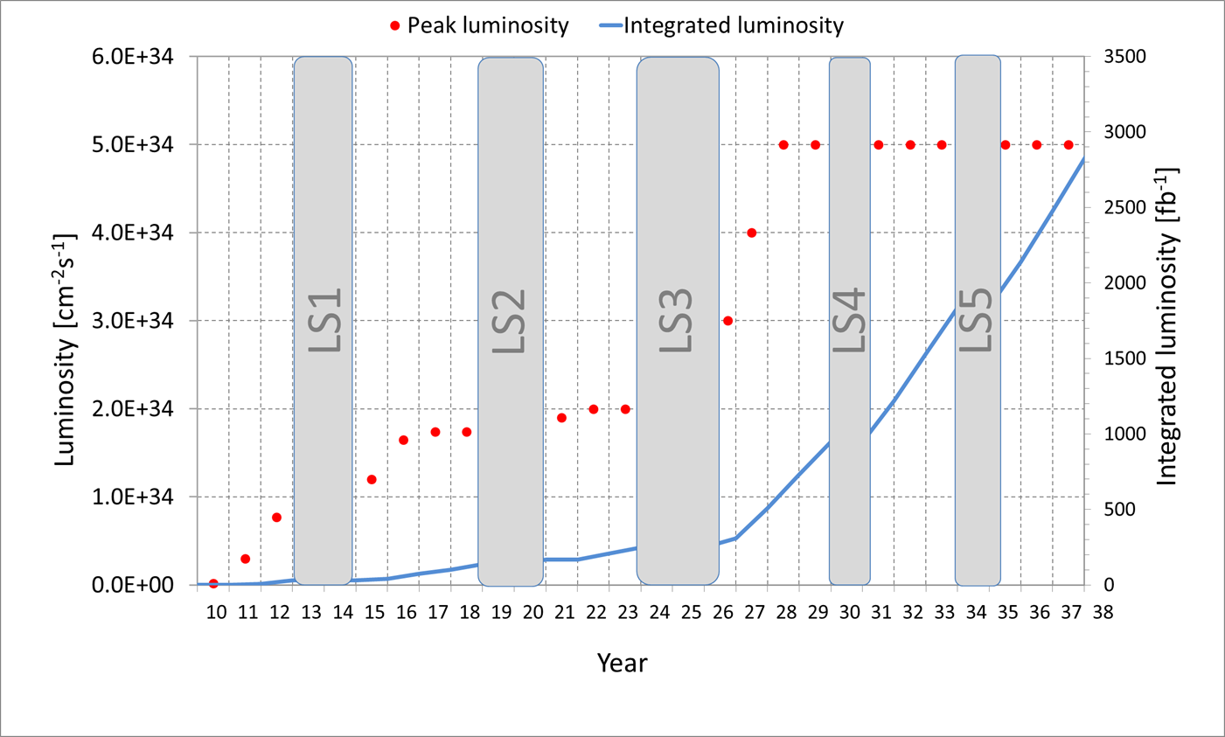
Nominal upgrade parameters
3000 fb⁻¹ would be reached in 2038
LHC/HL-LHC luminosity by M. Lamont
Nominal lumi paramters
L = 5 10³⁴ cm⁻²s⁻¹
Int. L = 3000 fb⁻¹
Pile up μ ∼ 140

Slide 5
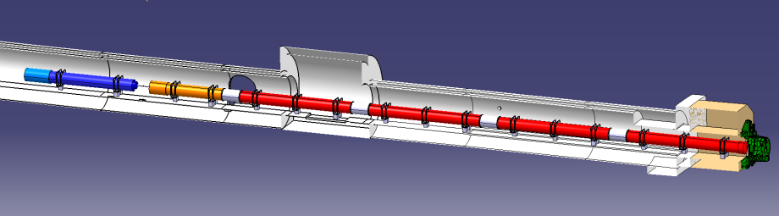





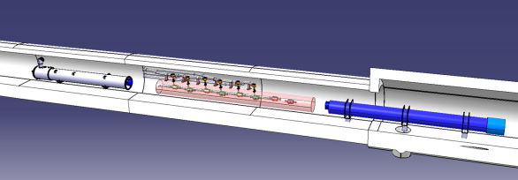


Cahngin IR in IP1 and IP5 counting on many In-kind contributions
ATLAS
CMS
Q1-Q3 : R&D, Design, Prototypes and in-kind USA
D1 : R&D, Design, Prototypes and in-kind JP
MCBX : Design and Prototype ES
HO Correctors: Design and Prototypes IT
Q4 : Design and Prototype FR
CC : R&D, Design and in-kind USA
CC : R&D and Design UK

Slide 6
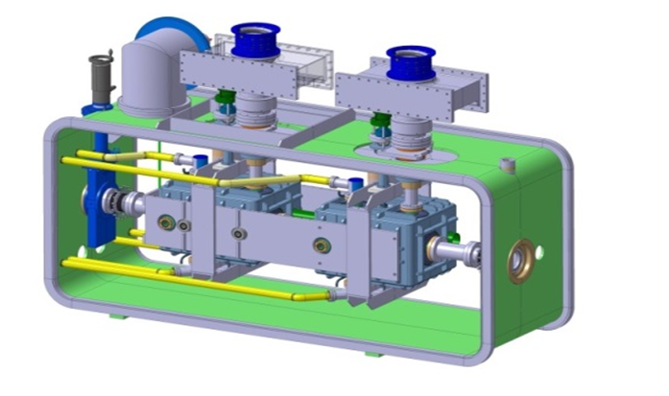
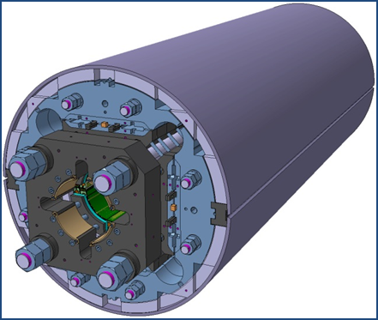
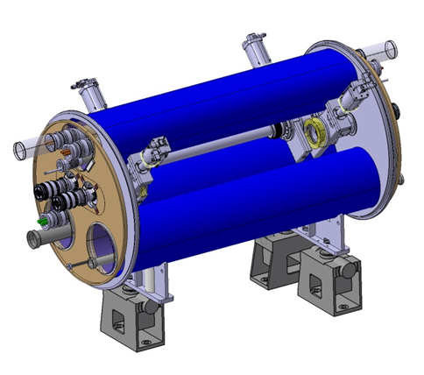
The largest accelerator in construction
ATLAS
CMS
Dispersion Suppressor (DS)
Matching Section (MS)
Interaction Region (ITR)
Modifications
In IP2: new DS collimation
In IP7 new DS collimation with 11 T
Complete change and new lay-out
TAN
D2
CC
Q4
All correctors
Q5 (present Q4)
New Q5 in P6
New collimators
Complete change and new lay-out
TAS
Q1-Q2-Q3
D1
All correctors
Heavy shielding (W)
Cryogenics, Protection, Interface, Vacuum, Diagnostics, Inj/Extr… extension of infrastr.
> 1.2 km of LHC !!

Slide 7
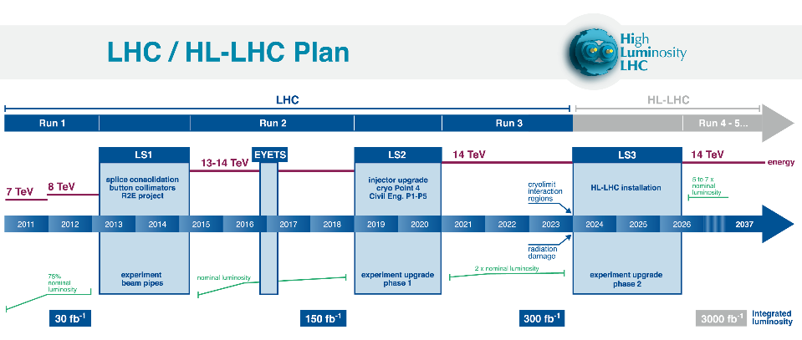
But very little for LS2…

Slide 8
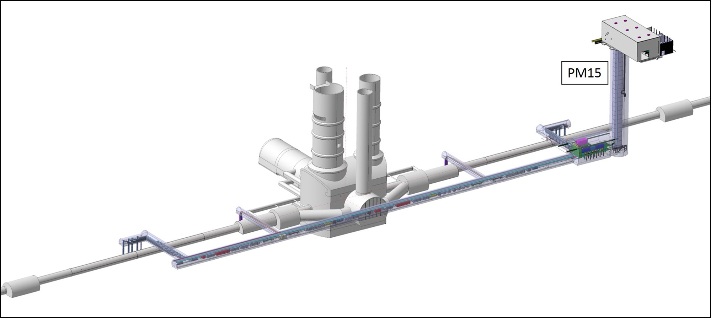
For HL-LHC LS2 will be the period of D(TH)RILLING!

Slide 9
However we will not be idle…
Before LS2:
    SM18 upgrade – critical for HL-LHC – will be going on (use of CERN services)
    Test of CC in SPS (2016 EYETS for infrastructure and 2017 YETS for installation of a cryomodule).
    New collimators with LRBB compensating wires for test
    Preparation C.E.
During LS2:
    New Q5 in LSS6 for ATS optics, more installation of CC in SPS for test
    New DS collimator in Left and Right of P2. for ions, with by-pass
    Modification of Cryo in P4 for testing SCRF cavities separately from Arc Magnets
    Coating –in situ- of ITR P2 and P8 for fighting e-clouds! (minimizing radiation dose to pepole)
    Installation of other equipment as prototypes or test before large installation in LS3

Slide 10
The uncertainty: 11 T
After C&S Review of March 2015, revision of needs for 11 T in IR2 for ions.
    Collimator with Cold2Warm2Cold by-pass can be put in the connection cryostat
    However, pending a quench test with ions (not done in Run1) and pending a quench test with prpton at high energy for P7 (where also there si uncertainty if the 11 T are need before LS3 or not).
We ask to keep open the possibilty to install 2 units of 11 T around P2 or P7 in case of need in the second part of LS2.
The issue will be defined at Chamonix 2016 or in Spring 2016 at latest.

Slide 11
More material and plan in Paula’s presentation!
Thanks

