Slide 1
CMS activities: 2015 – end LS2
Austin Ball, CERN.
with thanks to many who provided input.

Slide 2
Introduction
1
CMS work in this period falls into 3 categories
Completion of the upgrade started in LS1 (which we refer to as “Phase 1”)
designed for 2 x 10³⁴, 500fb⁻¹
(in aspects needing Technical Sector support 85% completed)
Consolidation and upgrade of detectors to meet HL-LHC performance and timescales
(which we refer to as “Phase 2”)
(includes consolidation, upgrade or end-of-life replacement of associated infrastructure
e.g. detector construction, test & maintenance facilities & services like cooling, electricity)
Maintenance of the existing apparatus and its supporting systems (typically 50% of all tasks)

Slide 3
CMS Upgrades for HL-LHC
2
Technical Proposal: https://cds.cern.ch/record/2020886?ln=en
10 year programme,
integrated with:
Ongoing operation,
Maintenance
Phase 1 completion
Budget scale approval
sought at RRB next month
Most detector upgrade
or revision (eg new
Tracker, Endcap Calorimeter)
will happen in LS3
Target ~ 30 month duration of LS3 can only be met by:
--> pre-empting large amount of infrastructure & prep work to Run 2/3 and LS2
--> advancing some detector upgrades (endcap μ) to LS2 as well

Slide 4
CMS activity 2015-2018
3
YETS 2015-16: Change in HF electronics (delivery permitting)
Lower HF’s Snagging from LS1: eg YE4+ opening test, RE4+ repair, smoke det.
Open YE4+ Magnet Cryo: valve change on intermediate cryostat (UXC)
(Yoke closed) cold box cleaning, PORS replacement.
Detector & services maintenance (the earlier the better) with yoke closed Detector Cooling: supervision upgrade + sectioning of rack circuits.
EYETS 2016-17: Replace pixel tracker with Phase 1 pixel tracker (CO₂ cooled – PH-DT)
Full opening of Install “demonstrator” for additional muon station GE1/1 (GEMs)
Endcaps Source scans of endcap Hadron Calorimeter (check rad damage).
Check options for barrel RPC major revision in LS2
Demonstrator for new yoke opening system
Minimum essential detector/services maintenance (the earlier the better).
Install prototype cooled freewheel thyristor on M1 magnet (N.Area H2)
During Run2: Replace PM54 elevator (outside technical stops)
(2016-2018) Construct surface “battery barn”: for UPS upgrades
YETS 2017-18: Install 2nd UXC crane
Detector closed Install cooled freewheel thyristor for magnet.

Slide 5
EYETS in UXC (16 weeks + lab closure)
4
Needs: Rigging, Survey, Transport, BP & Vacuum, FSU, Safety Coord at LS1 levels.
Early services maintenance to avoid impeding commissioning

Slide 6
CMS activity LS2
5
Full opening: Install revised opening system
Many logistic Replace all beampipe except central section & test RP shielding
configurations Upgrade readout of endcap muon stations ME2/1,3/1,4/1 (UXC,SX5) Install new muon station GE1/1 (transport from Prevessin, fibre readout)
Finish Hadron Calorimeter Phase 1 upgrade: HF electronics
HB/HE phototransducers
Possible replacement of HE megatiles (depending on YETS 16-17 meas)
VAX/TAS region prep for HL-LHC revision in LS3
3-year detector maintenance (40-50% of total activity)
Major infrastructure revisions: Underground HVAC control, control room HVAC.
Chilled water (increase capacity)
Water production & distribution control system
Pneumatic control compressed air system
DAQ UPS (1.5MVA) DSS/RSS upgrade?
3-year services maintenance as LS1
Surface buildings Construction/completion of SX5 extension
Complete SCX control room consolidation

Slide 7
LS2 Opening Sequence ~ 12 weeks + 3 contingency
6
Contingency for possible work on opening system
Needs: Rigging, Survey, Transport, BP & Vacuum, FSU, Safety Coord at LS1 levels.

Slide 8
LS2 Closing Sequence ~ 29 weeks + 5 contingency
7
Contingency for possible LS3 prep work on TAS/VAX etc
Needs: Rigging, Survey, Transport, BP & Vacuum, FSU, Safety Coord at LS1 levels.

Slide 9
Detector maintenance and upgrade
8
Cycle through barrel wheel access
Limited access to endcaps
Cycle through endcap disk access
Barrel closed
About 70 weeks available: - comfortable for standard programme
- quite tight if major calorimetry work (HE megatile replacement)
Needs: Rigging,Survey,Transport (incl GE1/1 Prevessin to P5), FSU, Saf. Coord at LS1 levels.

Slide 10
Magnet power and cryogenics
9
Maintaining solenoid performance at 3.8T over the next 2 decades is imperative.
Effective lifetime prolongation requires early action
LS1 : improvements focussed mainly on the surface plant:
redundancy in the compressor system (hot spares)
powering redundantly from the machine and general services networks
but the coldbox risks have clearly been underestimated (see last 5 mo)
Future programme, up to end LS2 : as presently defined, focuses on:
-simulation and measurement to understand/mitigate the ageing processes
-control system upgrade (LS2), eg auto-restart of hot spare compressor
-eliminating slow discharges due to transient power converter faults
(cooled freewheel thyristor – YETS 16-17 and LS2)
Add more to cover risks over extended lifetime:
-eg reliability/redundancy of coldbox, current leads etc (see next slide)
-redundancy from P5 HL-LHC cryo by LS3 (requires cryo transfer line)
make provision during HL-LHC LS2 works at P5.

Slide 11
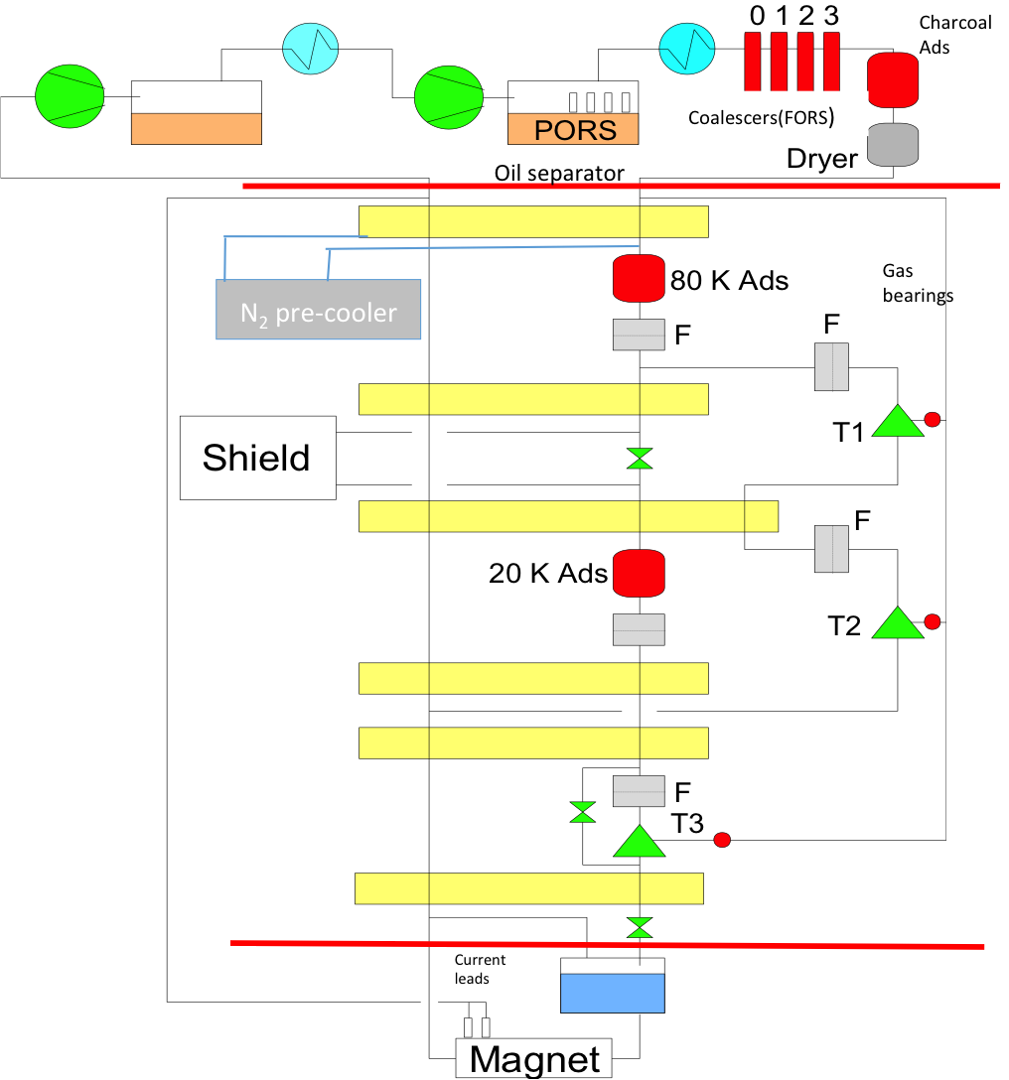
Magnet Cryogenics
10
recent events show that magnet cryo system remains a point of great vulnerability for CMS
(many thanks again to EN,TE and PH for their extraordinary recent efforts)
bottom up risk (re-)analysis for all magnet systems to be done (Jim Strait)
Recent additions to Magnet project: (TE-CMS)
Sept 2015: Replace warm He transfer lines
Construct 2 spare Ads80K tanks, pre-filled
& pre-flushed to remove carbon dust.
YETS: Re-design & replace the
2015-16 primary oil recovery system. (PORS)
Deep clean the Cold Box and thermal screen
Replace damaged Cryo valve in UXC dewar
Proposed addition:
LS2/3:Backup cryo-line from new HL-LHC cryo
Other options:
Possible replacement of CB or its components
Possible construction of spare current leads

Slide 12
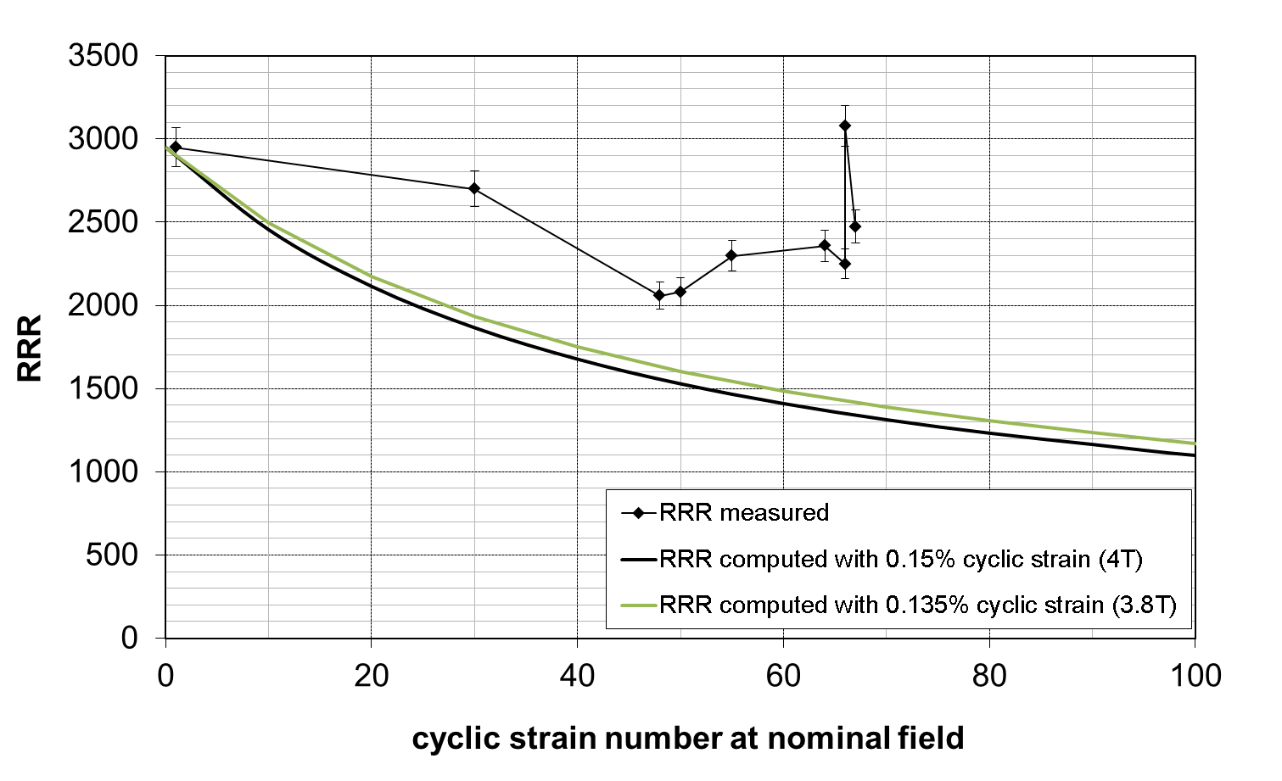
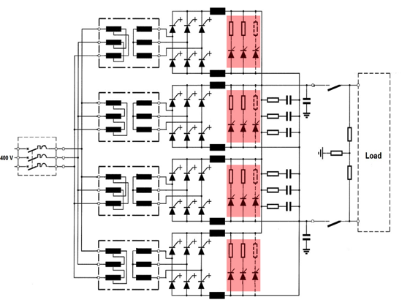
Magnet :reliability & minimal on-off cycles
11
Maintaining magnet performance at 3.8T over the next 2 decades is imperative
On-off cycles are bad for the magnet eg
(Target: 5/year, no FD. Will exceed in 2015)
RRR predicted to reduce with on-off cycles;
eventually (250 cycles?) will not sustain 3.8T
Measured RRR evolution not as simulated
but recovery due to LS1 warm up reversed.
Phase 2 upgrade (delayed from Phase 1)
“Cooled Freewheel thyristor”
draft tech spec/costing written with TE
UPS/diesel
protection of
FWT cooling
vital
Immune to power converter faults (power, cooling)
Field decays with time constant ~25 hours.
Prototype on M1 magnet in 2016,
Implement in CMS during LS2
.

Slide 13
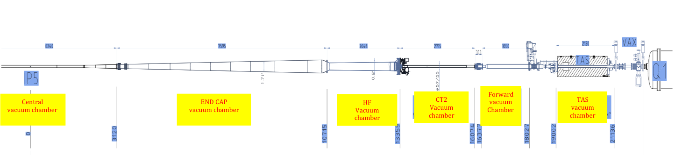
Beampipe
12
The beampipe today
η =4.9 cone
LS1 improvements: physics performance motivated :
Central pipe (Be) reduced to minimum feasible radius (pix layer 1 closer to i/p)
LS2: Three motivations for change
(i) LHC: mandatory replacement of TAS and CT2 to match higher aperture of quads
(ii) ALARA: replace all SS beampipes with Al 2219 alloy (factor ≥ 5 x less activation)
(iii) Possible decreased cone angle (η =5.54) to allow calorimetry extension.
Engineering/simulation jointly with TE-VSC (initially for η =5.54): Order in 2016 !!!
Plan: Change all pipes (ex central) to Al 2219 in LS2 (reduced dose-rates at LS3 kick-off).
Caveats: TAS change in LS2 shown not to be feasible: new schedule challenge for end LS3
Can we maintain current (new) central pipe radius < HL-LHC TAS aperture?
If not, need adapter module at 3.1m compatible with present & future pipes

Slide 14
Beampipe: existing & high η geometries
13
Examining feasibility of the high η geometry (CMS +TE-VSC)
main issues: feasibility of manufacture & coating, mechanical & vacuum stability
must be ordered in 2016 for delivery in 2018

Slide 15
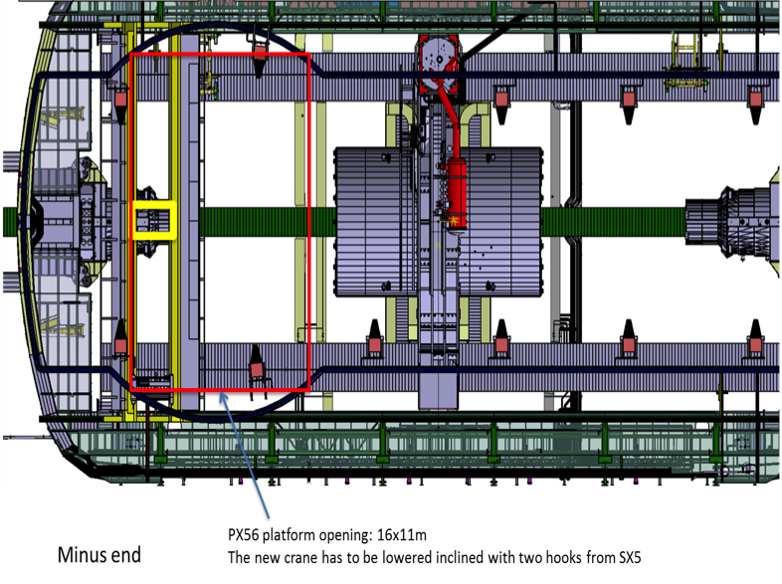
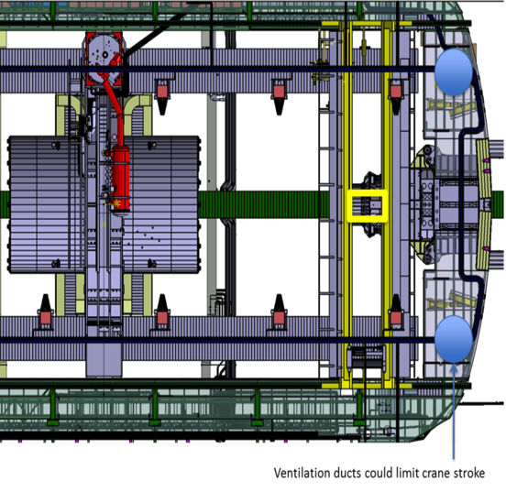
P5 Infra: UXC cranes
14
2nd crane bridge: (based on LS1 experience)
Single crane limits parallel work streams at –z and +z
--> install 2nd bridge with 5 ton hook
-old carriage still able to transfer 20t load thru ± 18m.
--> nacelle linked to crane bridge desirable
(safer than suspended cage- needs permit for each use)
Prelim design (EN-HE) & integration (CMS) study done
(includes visit and analysis by manufacturer)
Aiming for installation in YETS 2017-18 if possible – net benefit in LS2.
otherwise at LS2 start
5t only
20t + 5t

Slide 16
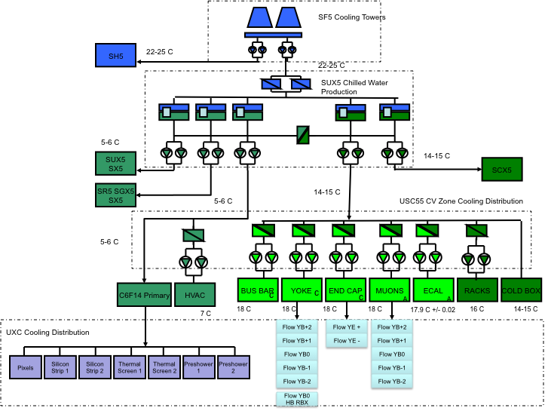
P5 Infra: Cooling system
15
LS1: SCX -->1 MW for HLT farm - done
Detector cooling has no spare capacity
For HL-LHC:
--> need 1.5 MW more chilled water capacity
0.4MW (Tracker + Pixel)
0.6MW (ECAL + HCAL lower temp)
(include 0.15MW option to surface)
0.5MW (provision for HGC)
Mixed water capacity considered adequate
(especially since/if some dets move to chilled)
Needed near start of LS3 (test/commissioning)
Implement (or set up implementation) in LS2?
Chilled Water 6º
Mixed Water 13º
1.0 MW
0.2 MW
2.6 MW
0.85 MW
key meeting last week with EN-CV to confirm details:
to check : cooling tower capacity adequate?
: no special end-of -lifetime issues to continue through HL-LHC era?

Slide 17
CMS Detector Cooling: present and future
16

Slide 18
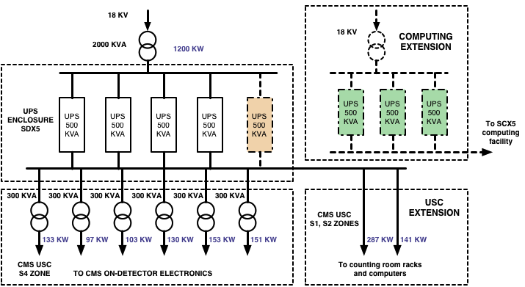
P5 Infra: Electrical system
17
CMS specific changes: extension of UPS (glitch immunity/graceful shutdown)
LS1: 4 x 500kVA detector UPS
done n+1 redundancy (+ 1 spare ready)
1200kVA used
300kVA margin (eg for rad dam)
Pre-LS2: Add 3 x 500kVA for comp farm
n+1 redundancy
needed asap for reliability and
lower mortality fault recovery
Move 80kVA control room system
out of control room.
LS2/3: Go to 5 x 500 kVA detector UPS
(maintain n +1 redundancy)
to supply Phase 2 detectors
- already obsolete
- in ventilation building
- battery safety issues
(being reviewed with HSE)
New system
may require
new isolated
“barn”.
Discussions with EN-EL ongoing
To Check: mods to P5 elec system to support Phase 2 infrastructure (cooling)
existing UPS is obsolete and may need total replacement – no provision yet.
may require new “barn” even Pre-LS2.

Slide 19
P5 Infra: other common systems
18
Detector Gas systems (muon detectors):
infrastructure to support new endcap muon systems (GE1/1 and ME0)
end-of-lifetime replacement of general diagnostics & some infrastructure
gas purity analysers, programmable logic controllers the
entire network using pressurized nitrogen for pneumatic gas valve control.
consequences of CERN policy to reduce greenhouse gas emissions 80% by LS3.
recuperate (though not necessarily to re-use) the vented gas (notably RPC’s)
validate and deploy alternative gas mixtures with a lower impact.(GWP)
CMS + PH-DT specialist group
Dry Gas system: (detector environment control)
-LS1: “membrane plant” (dry air/dry N2 locally extracted) + revised dry air flushing
-pre-LS3: 2nd membrane plant of very similar capacity for HGC calorimeter
and/or colder ECAL/HCAL (could EN adopt this technology now?)
Rationalisation of “pneumatic control” compressed air supply (EN)
HVAC: Major revision of control systems planned by EN-CV in LS2
To check - exclusion periods for USC/UXC work. Vent mode with min ΔP to detectors.
any end of lifetime replacements necessary for HL-LHC era?

Slide 20
Test/surface facilities at CERN
19
Test beam zones, irradiation facilities, cosmic stands, temp cycling etc at CERN:
LS1 : main work was refurbishment of M1 magnet (3 T in H2 line)
For HL-LHC: revision/replacement of ageing infrastructure
904 electronics integration centre:
For HL-LHC: rack/lab-unit cooling system ageing - to be replaced by new system (GS)
provision for detector assembly (eg HGCAL, new muon stations)
may require revision of building infrastructure (GS)
904/892/27/186 detector development labs and assembly facilities
refurbishment of common, CMS-owned or CMS-specific infrastructure
904 R-002 occupancy will become critical (+ needs refurbishment)
Pt5 workshops : mechanical & electro mechanical
machine & work-area replacement, & refurbishment – advice needed (EN)

Slide 21
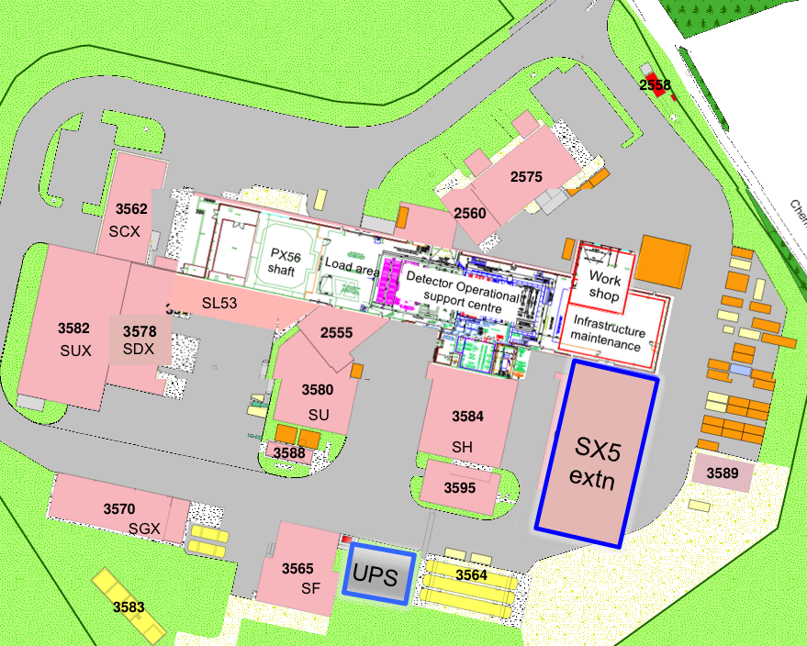
Surface facilities: P5 site
20
SX5 + extension (& UPS barn?)
SX5 extension: (needed by end LS2)
-re-house workshop areas,
-re-house storage for critical tooling
-self-supporting self-propelled gantry
Assuming turnkey solution (GS)
as for building 3594 completed in LS1.
(CMS takes care of fitting-out/oversight)
SX5: extend detector labs & RP zone
into space freed up by re-housing.
-provide space for EB revision & Phase 2
endcap calorimeter final assembly.
-mech. work & services installation (EN)
Caveats: -UPS barn may be reqd
-synergy with HL-LHC Civ. Eng. plan?
-no provision yet for storing ME1/2, ME1/3
removed while endcap cal replaced in LS3

Slide 22
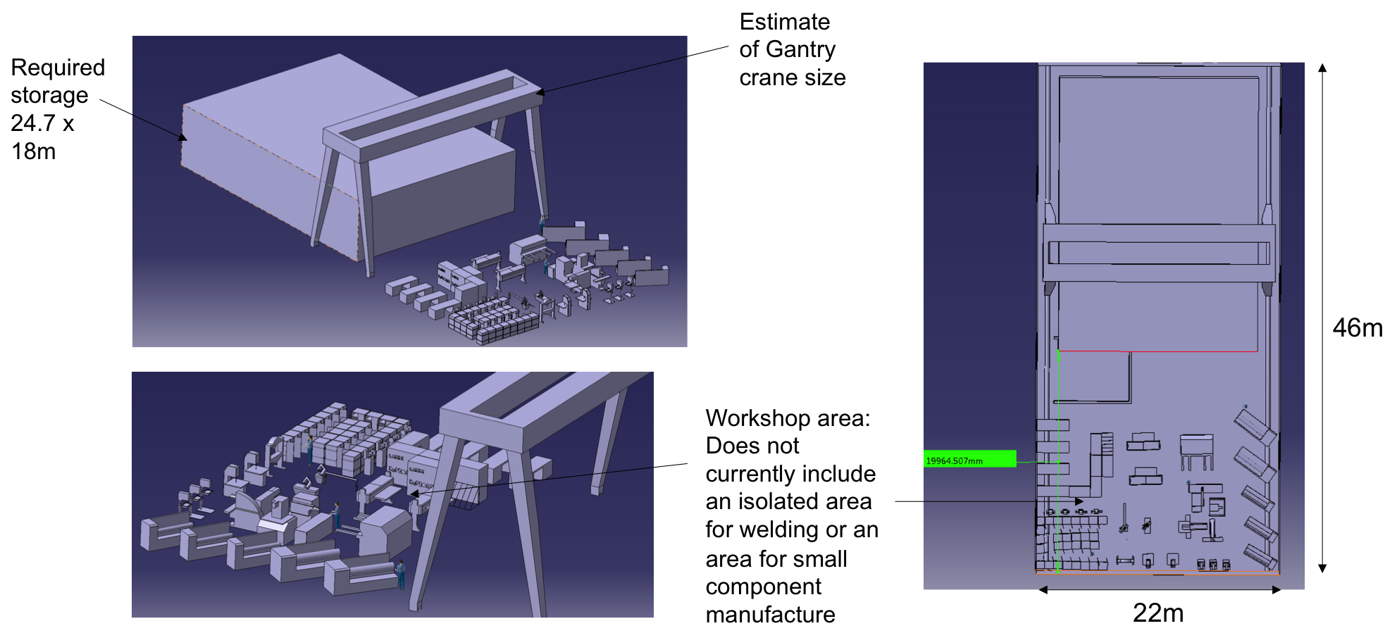
SX5 extension: detail
21
Workshop machine list established : replacement/ refurbishment of existing machines
to conform with latest regulations under study.
Storage volume estimated in detail : about 500m2 needed

Slide 23
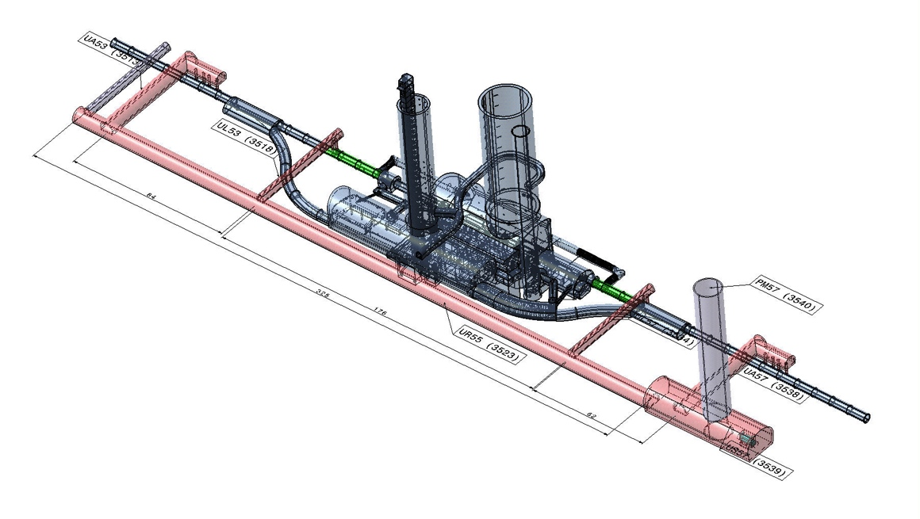
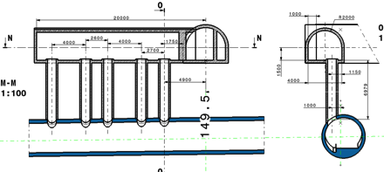
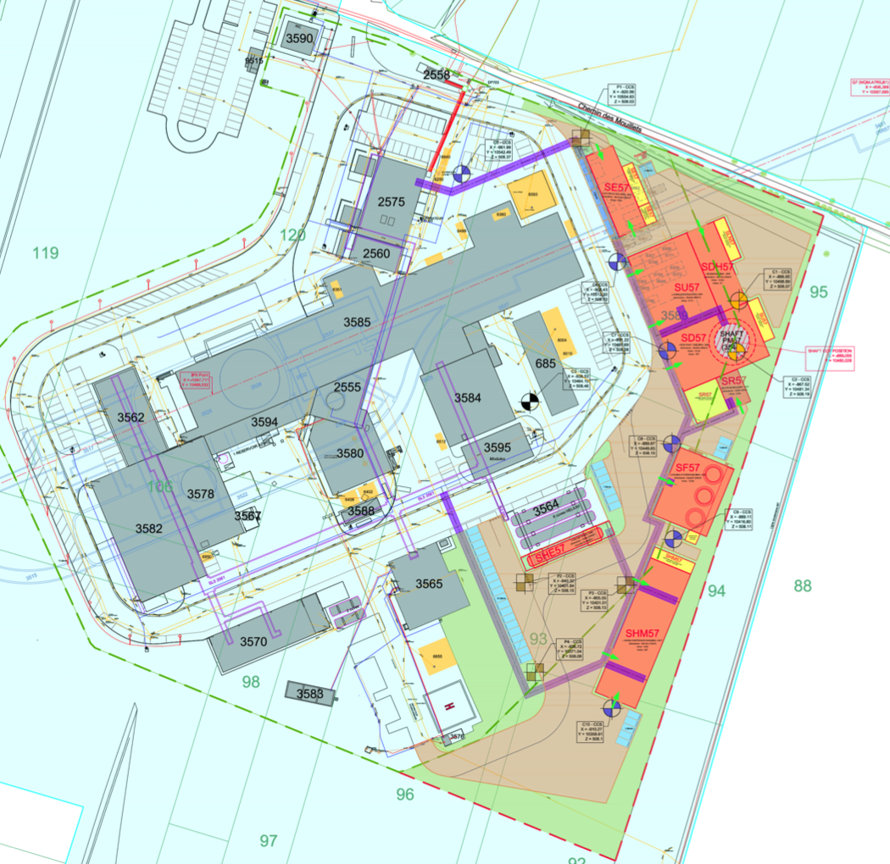
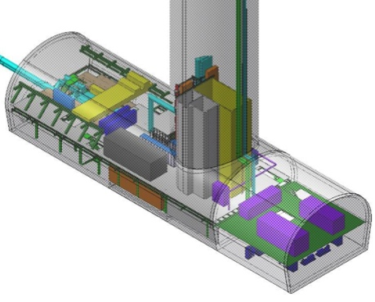
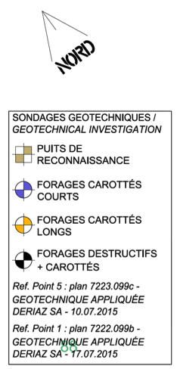
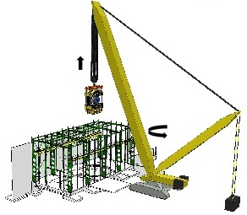
HL-LHC works at P5: LS2
22
CMS has to co-exist with (& try to profit from) large scale Civ Eng
Underground works done during LS2.
Very recently revised, all CMS barracks to go
-on-site storage space?.
Aim to get new buildings
for CMS on this plan before
discussions with French authorities
Also bear in mind endcap replacement in LS3
-passage needed for crawler crane

Slide 24
Conclusion
23
Period up to end of LS2 is vital for the HL-LHC upgrade of CMS in LS3,
as well as for finishing the upgrades needed to get to LS3
YETS 2015-16 -focused on magnet cryo consolidation
EYETS 2016-17 -focused on pixel tracker replacement, will be very intense and
requires careful choreography
-strong support required from the Technical Departments
YETS 2017-18 -use for infrastructure preparations to be optimised
LS2 -will require support similar to LS1 from Technical Departments
on-detector planning OK for known baseline, but could fill-up easily
Infrastructure/ facilities consolidation/upgrades
at P5 need to be in place by the end of LS2
to be ready for detector elements arriving at P5 before LS3
elsewhere even earlier (eg assembly/testing labs)

Slide 25
Main themes arising from LS1 experience
perhaps the moment to recall from “LS1 days”……
24
LS1 was (mostly) a spectacular success…but
project engineering/supervision resources insufficient
from tech spec to completion on site
shortfall in provision for “host lab” responsibilities
expt collaborations will not be able to compensate indefinitely
re-examine definitions/provision with Tech sector & PH
“limits of supply” of tech depts to be re-discussed/re-optimised.
(tech sector + expts + PH)
cost control scrutiny and oversight could/must be improved
experiment budgets (from outside CERN) keenly scrutinised
frame contract system & internal (monopoly) market flawed
(award of contracts still under-weights technical advice)

