Slide 1
BE-ABP Flash Presentation
R. Scrivens & G. Arduini
+ C. Carli, R. Corsini, E. Metral, M. Giovannozzi, A. Lombardi, S. Radaelli

Slide 2
Accelerators and Beam Physics
The following will be mentioned:
  Beam Physics Support
  LHC collimation consolidation
  Injectors
  Low Energy REX and ELENA

Slide 3
Beam Physics – Equipment Design
ABP is in many cases leading the specification of the LIU and HL-LHC equipment, writing some ECRs, as well as managing some of the projects (LIU-PS, LIU-IONS).
All equipment to be installed in the accelerator should be assessed for its impact on the beam dynamics. For example:
  Impedance (simulation/calculation and impact).
  Machine aperture.
  Electron Cloud (SPS and LHC).
Please allow sufficient time for the calculations to be done.
Use the PLAN tool to add a request for assessment by ABP.
Please do not wait until the ECR is issued to discuss this with us!
Similarly, equipment non-conformities can be assessed for their impact on the beam.

Slide 4
LHC
BE-ABP hosts the LHC collimation project (production by EN-STI).
Collimation consolidation programme for LHC treated here.
Only a fraction are approved at the moment by the cons project.
A small number of collimators will be installed. The installations are fast (thanks to the plug-n-play developments) will not be the driver of any LS2 schedules in the tunnel.

Slide 5
LHC collimation
 |  | Consolidation approved? | Units | LHC Installation dates?
 | Recovery of collimator 5th axes for TCT's in IR1/5 | Y | 12 | YETS15-16
 | Robust TCT collimators for IR1/5 | N | 4 | LS2
 | Control system consolidation | N | -
 | Primary collimator spares | N | 8 | LS2
 | Passive absorbers in IR7 for MQW consolidation | N | 2 | LS2

Slide 6
Injectors and Experimental Areas
Linac4 Connection – ABP beam commissioning
    Commissioning of 160 MeV beam through LT-LTB-LBE lines mid LS2 (includes PS switchyard). Linac4 restarting mid 2nd year. See Julie’s presentations.
Linac2
  Part of transfer line to be removed for Linac4 connection. The rest of the installation is mothballed until after LS2.
  Source maintenance to be performed at each year end TS.

Slide 7
Injectors and Experimental Areas
Linac3 – ABP provide the technical co-ordinator.
  YETS2015 – 100ms quadrupoles and RF, Magnet interlocks, low energy modifications (delay critical in the workshop), diagnostics improvements.
  LS2 – Removal of asbestos (PS-CONS), ventilation renovation (PS-CONS), not yet approved.
  LS2 – Consolidation proposal to build Linac3 spare drift tubes and install in LS2 (end), not yet approved and a low priority – could wait until LS3.
  Source maintenance to be performed at each year end TS.
  Restart of source early in 2016 (LIU Ion upgrade commissioning) and 2017 (Xe beam commissioning). See IEFC-150.
REX – Possible upgrade of the Electron Beam Ion Source solenoid to a 5T unit – external funding being sought. Installation proposed for LS2.

Slide 8

ELENA
Installation of ring and lines until spring/summer 2016
  Workload for many groups over YETS 2015/16 and thereafter
  Followed by ELENA ring commissioning mainly with external source in parallel to AD physics run
Two Scenarios for the replacement of the magnetic lines from AD to the experiments by electrostatic lines from ELENA
  Baseline: activity takes place starting in November after the 2016 run until autumn 2017
    Heavy workload for many groups during EYETS 2016/17 and thereafter
    (removal of existing magnets, instrumentation, vacuum equipment, supports, cables, power converters … followed by installation cables, supports, electrostatic transfer elements, vacuum equipment, instrumentation …)
    Tight planning aiming at commissioning new lines and a brief 100 keV antiproton physics run for all experiments by the end of 2017
  Plan B with ELENA ring commissioning not sufficiently advanced: postpone to LS2
    Heavy workload for many groups during LS2
    Control system availability to commission new lines using beam from the external H- and proton source during LS2
  => When do we have to take the decision to keep the baseline or to delay new lines to LS2?
    Early enough to leave groups time for planning (latest decision without additional cost?)
    Not too early to leave enough time for ELENA commissioning

Slide 9
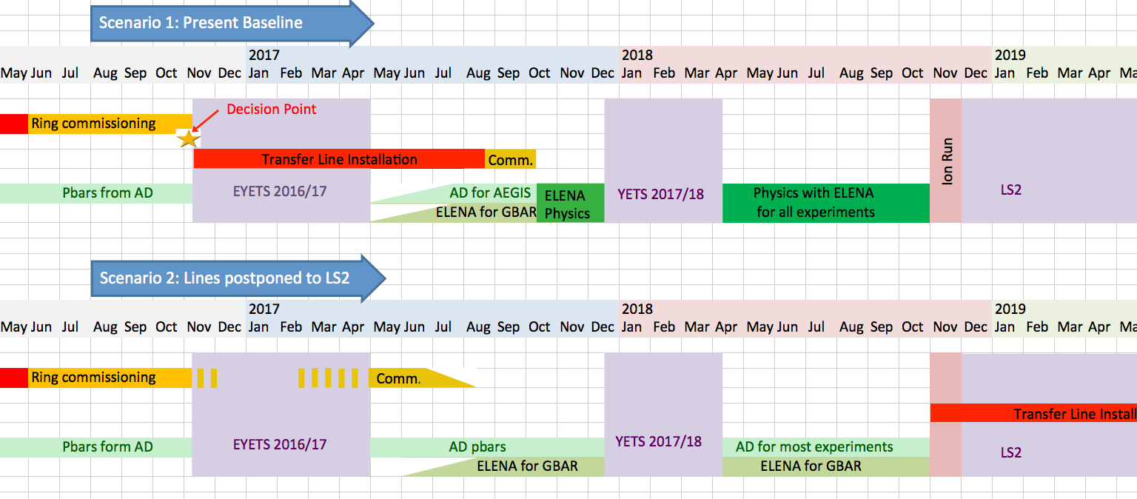
ELENA
Earlier reasonable decision point to be discussed and agreed
Except AEGIS still with
magnetic line from AD
With confirmation of later LS2 start
=> More attractive to install new lines in 2017
provided ELENA is ready (otherwise most
experiments see 100 keV antiprotons from 2020 on)
Detailed planning not yet available
(dates guessed)

