Slide 1
TE-EPC Activities during LS2
V. Montabonnet on behalf of TE-EPC group

Slide 2
Contents
Activities
  Projects
  Consolidation
  Under approval
Resources availability
Logistics
Interfaces / interferences
Conclusions

Slide 3
LS2 Master Schedule

Slide 4
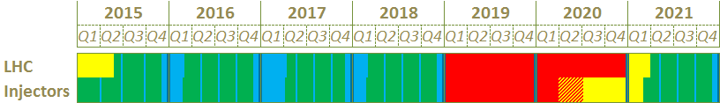
Master schedule up to LS2
Courtesy J. Coupard
Activities independent from the operation (i.e. surface)
Long Shutdown
Commissioning
Operation
Technical Stop
YETS 2015
*EYETS 2016
YETS 2017
LS2
1
2
3
4
3 periods are available for works before the Long Shutdown 2 (LS2)
*: The connection of the Linac4 to the PS Booster is foreseen for the LS2 but all equipment need to be ready by the end of 2016 in case of an early full connection.

Slide 5
LS2
Project Activities

Slide 6
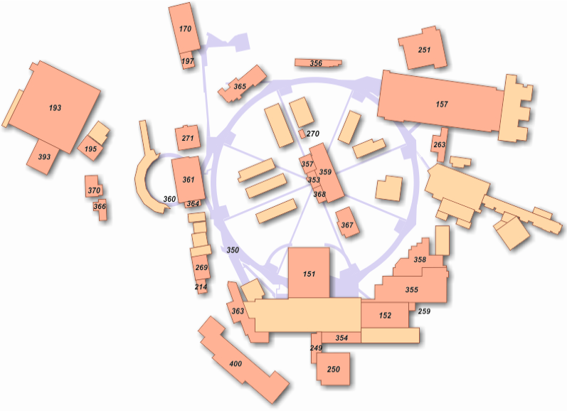
LIU project
LINAC4, PS Booster, PS machine and TT2
Courtesy J. Coupard
independent
1
YETS 2015
More than 200 Racks*
Rack* = Rack Equivalent (0.6m)
2
EYETS 2016 *
3
YETS 2017
PS injection septum + bumper
4
LS2
PS
Injection low beta quadrupoles
Injection bumpers
PSB
Injection DHZ/DVT correctors
(BCER) [5 racks*]
365
Injection stripping foil chicane
(BRF2) [3 racks*]
Injection Qstrip (BCER, BAT) [5 racks*]
Dipoles (BCER)
PS
High energy dipole [1 rack*]
245
* Injection stripping foil chicane
(BRF2) [48 racks*]
* Distributor BI.DIS (BCER, BAT)
to be removed
* Injection BI.BVT (BHP) [5 racks*]
* Injection QNO Quad. (BCER) [5 racks*]
* Injection DHZ/DVT correctors
(BCER) [5 racks*]
* Injection septa (BRF2) [5 racks*]
Transfer bending Upgrade
(BHP) [17 racks*]
MPS+ Trims (245)
PSB under studies
Finemet RF cavities
(BRF1 & BRF2)
361
TT2
Complete renovation
[100 racks*]
Linac3
Quadrupole [4 racks*]
LIU Ions
* LBS bending magnet
Linac transfer line (LT, LTB, BI)
* Bendings [06 racks*]
351
PS
IPM magnets [1 racks*]
Linac4
* LBE magnets
PS
Low energy focusing quad. [7racks*]
Chromaticity sextupoles [3 racks*]
Under studies:
Position for the PS septum PI.SMH42, bumper PI.BSM41,42,43,44
Position for the PS low beta quadrupole
Low energy dipole [13 racks*]
Low energy focusing quad [7racks*]
Low energy skew quad [1 rack*]

Slide 7
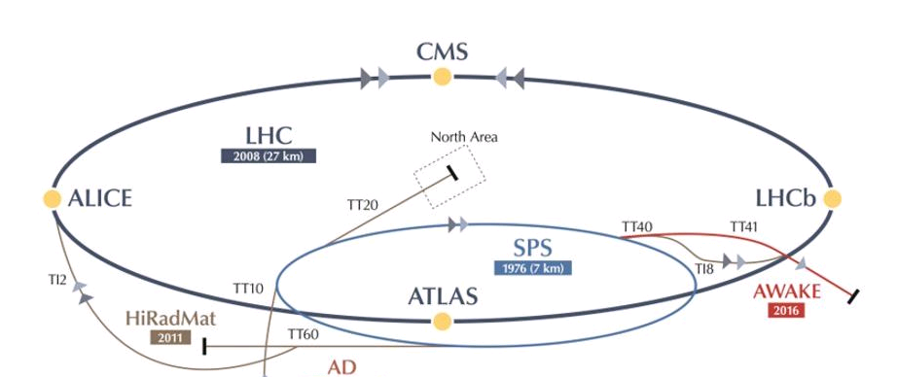
LIU SPS project / AWAKE project activities
SPS machine
independent
1
YETS 2015
2
EYETS 2016
3
YETS 2017
4
LS2
LIU SPS TCDI [SR2]
1x New RQIF.28800 Power Converter [COMET-2p]
1x New MQIF.29000 Power Converter [COMET-2p]
LIU SPS TCDI [SR8]
1x new MQIF.87000 Power Converter
[LEP Reno from TI2]
1x new MQID.87100 Power Converter
[LEP Reno from TI2]
AWAKE Proton Line [BB4]
Installation Date: < 02/2016
2x New Power Converters [SPS Reno]
1x New Power Converter [COMET]
AWAKE Electron Line
Installation Date: 12/2016 – 03/2017
35 Circuits – Still under discussion

Slide 8
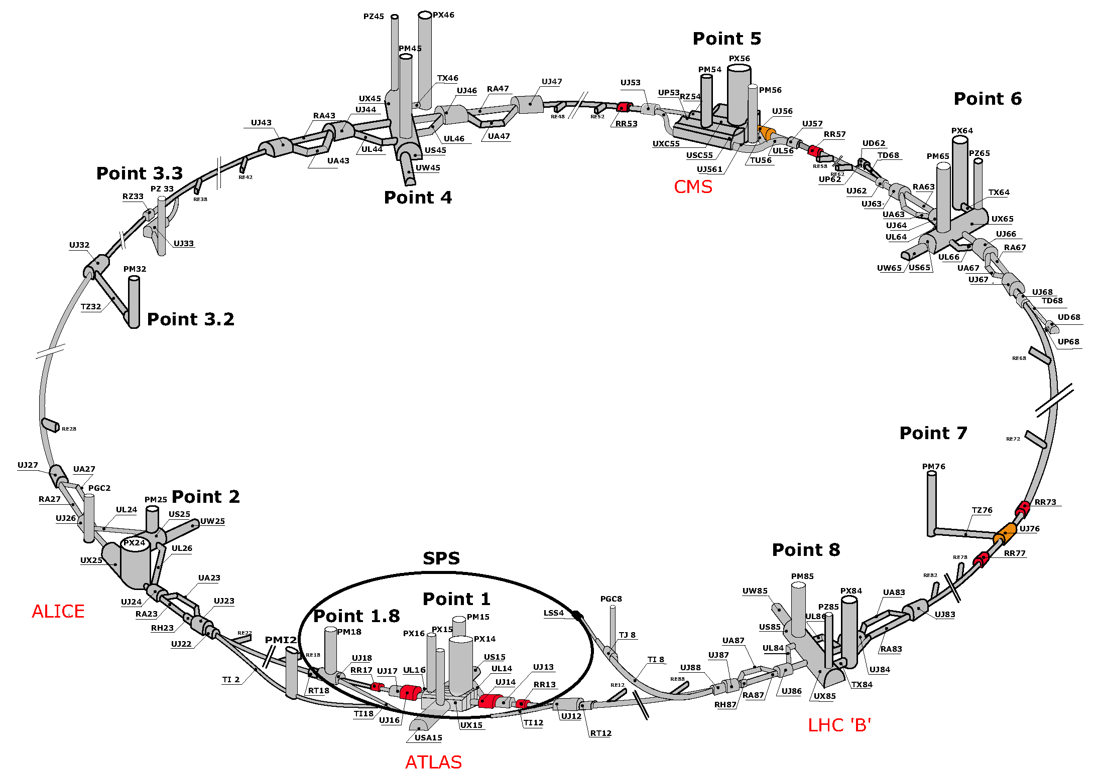
LHC project
independent
1
YETS 2015
2
EYETS 2016
3
YETS 2017
SE5
4
LS2
SR3
R2E Project
1100x New FGC Control Upgrade in RR & Tunnel [FGCLite]
120x New LHC600A Power Converter for RR [R2E-LHC600A-10V]
1500x New LHC4-6-8kA Modules for RR [R2E-LHC4-6-8kA-08V]
Total = [120 Racks + 400 Palettes] (Removal & Installation)
New equipment but compatible with existing equipment - Only Transport service will be needed !
LHC-FMCM RD1.LR1 & LR5 / RD34.LR3 & 7
4x new Power Converters [SATURN]
Total = 20 Racks*
Rack* = Rack Equivalent (0.6m)
SR7
SR1

Slide 9
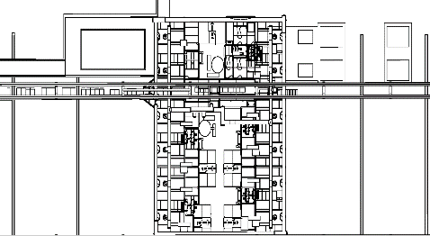
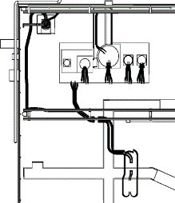
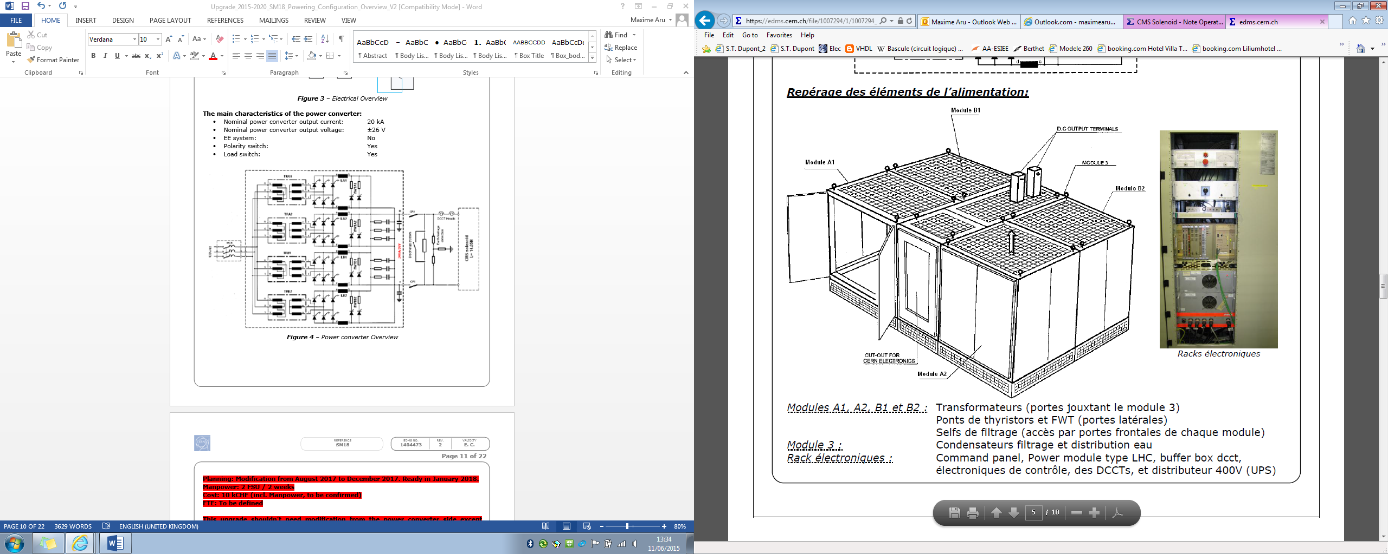
HL-LHC project
SM18 Test Bench Upgrade
independent
1
YETS 2015
HL-LHC String
2x New Power Converter 16.5kA (Q1-Q3 and Q2a-Q2b circuits)
1x New Power Converter 13kA(D1 circuit)
3x New Power Converter 2kA(Q3-Trim and corrector circuits)
1x New Power Converter 0.3kA(Q2-Trim circuit)
7x New Power Converter 0.2kA (corrector circuits)
2x New Power Converter 0.12kA (corrector circuits)
2
EYETS 2016
3
YETS 2017
4
LS2
Under discussions
SC link
4
5
STRING
Cluster D
1
2
Cluster A
Cluster E
Cluster B
Cluster F
3
Cluster C
Cluster A
1x [20kA/±61V] (upgrade of RM.A)
2x New Power Converter 2kA/10V [COMBO]
Cluster C
1x New Power Converter [20kA/±26V] [CMS type]
2x New Power Converter [2kA/10V] [COMBO]
SC Link
3x New Power Converter [20kA/8V]
4x [±600A/±12V] (old cluster F and A)
Cluster D
1 x [30kA/±16V] (RM.D + RM.F in parallel)
Cluster D
Cluster A
SC link
Cluster C
HL-String
1
2
4
3
5
S1-2016
S2-2016
S1-2017
S2-2017
S1-2018
S2-2018
S1-2019
S2-2019
S1-2020
S2-2020
S1-2021
S2-2021

Slide 10
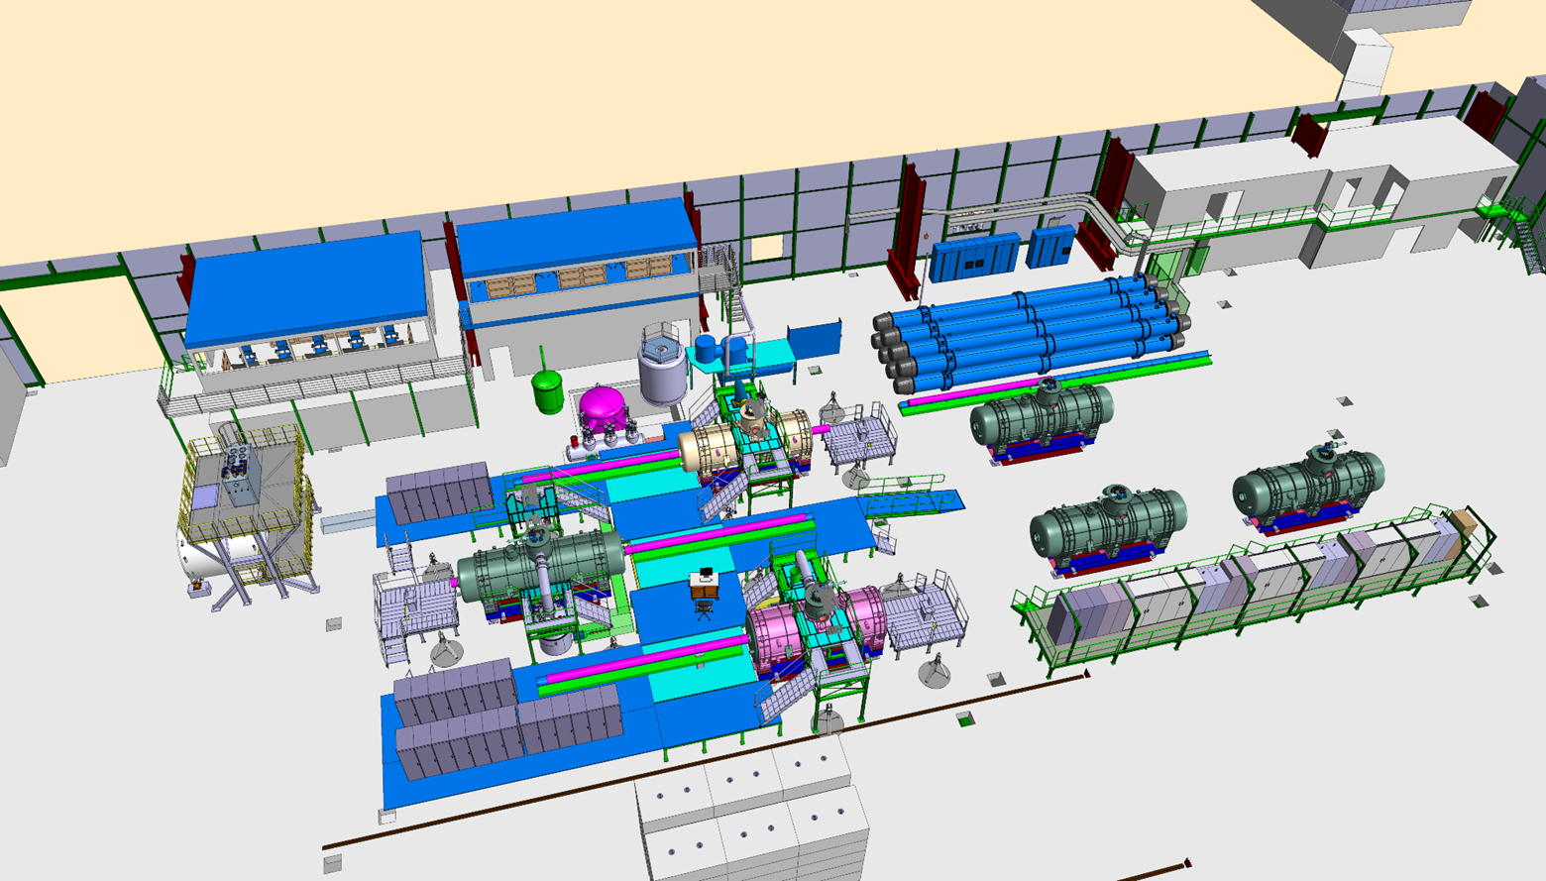
S-FRS Project
independent
1
YETS 2015
2
EYETS 2016
3
YETS 2017
4
LS2
Installation Date: 04/2016 – 05/2016
6x ±600A-±40V circuits [LHC600A-40V]
3x [±500A/±120V]-2MJ circuits [COMET-2p – 2MJ]
9x Load Commutator Switches
Total = 15 Racks Equivalent (0.6m)

Slide 11
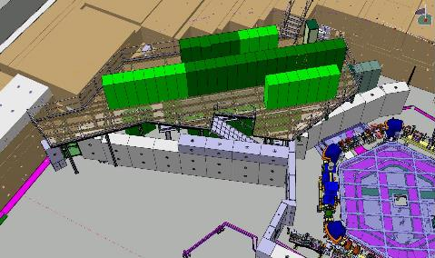
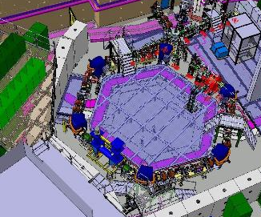
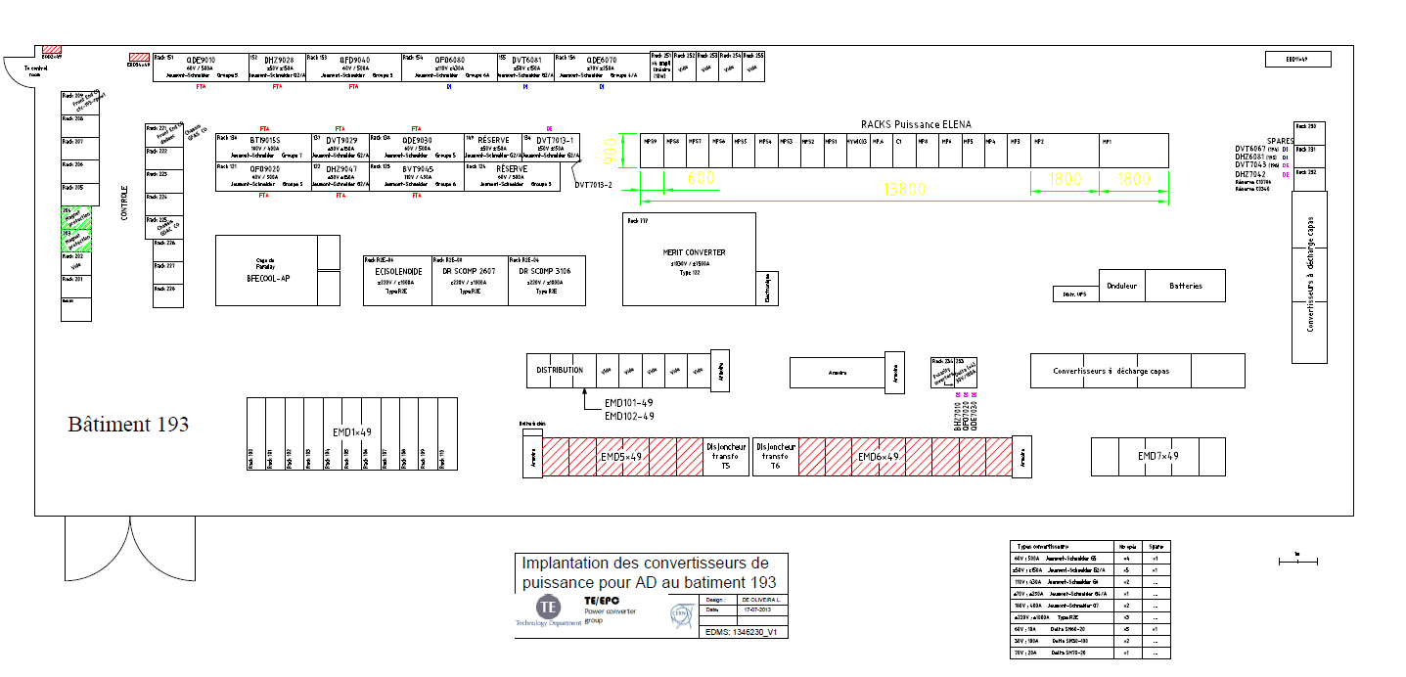
ELENA
Without Electron Cooler
independent
1
YETS 2015
2
EYETS 2016
3
YETS 2017
4
LS2
ELENA PHASE 1 w/o electron cooler
Installation Date: 02/2016
42 new Power Converters [CANCUN-50S, COMBO-DELTA, APOLO-2P with spares]
68 Electrostatic Circuits
Total = 13 Racks Equivalent (0.6m)
Upper Platform [COMBO-DELTA, HV]
ELENA PHASE 2
Installation Date: 01/12/2016 – 01/08/2017
302 Electrostatic Circuits [High Voltage Power Converters]
Total = 03 Racks Equivalent (0.6m)
AD Powering Room
CANCUN-5S, APOLO

Slide 12
LS2
Consolidation Activities

Slide 13
Consolidation project
RF
independent
1
YETS 2015
2
EYETS 2016
3
YETS 2017
4
LS2
PSB RF Cavities Power Converters
  included in LIU Project ; see Slide 7
HighVoltage PS RF Cavities Power Converter
  5 new Power Converters in Bld. 355/R-021
  Total : 5x [2700 mm x 800mm]
HighVoltage SPS RF Cavities Power Converter [SPS-200]
  13 new Power Converters in Bld. BA3
2
EYETS 2016
4
LS2
4
LS2

Slide 14
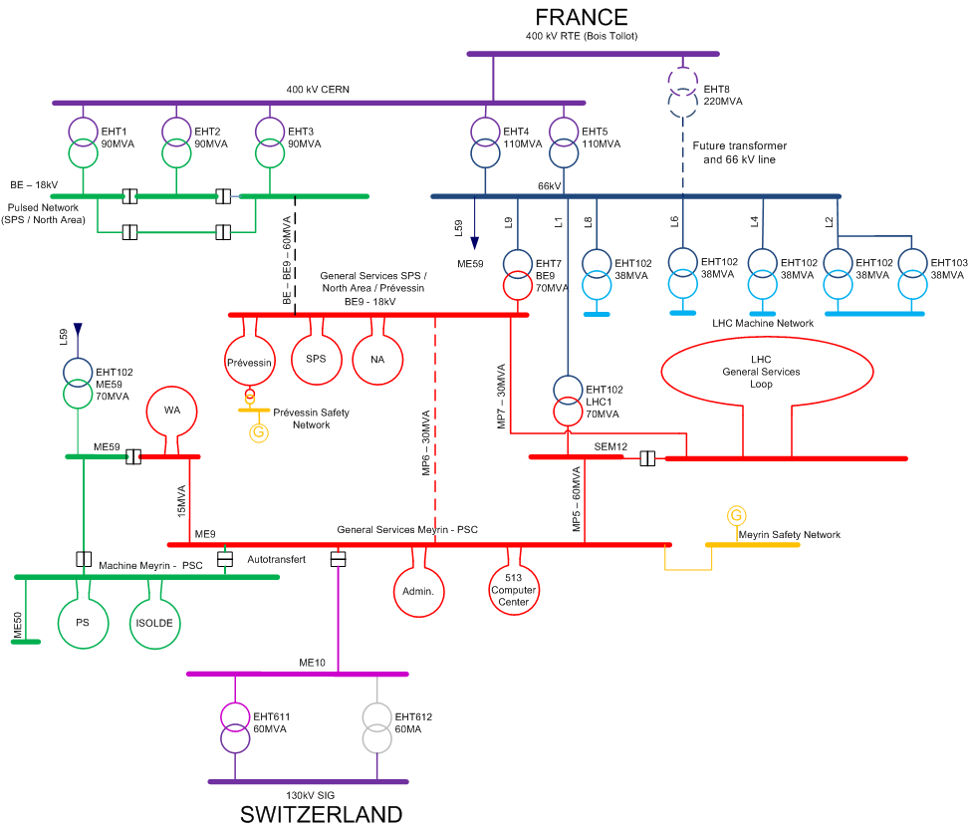
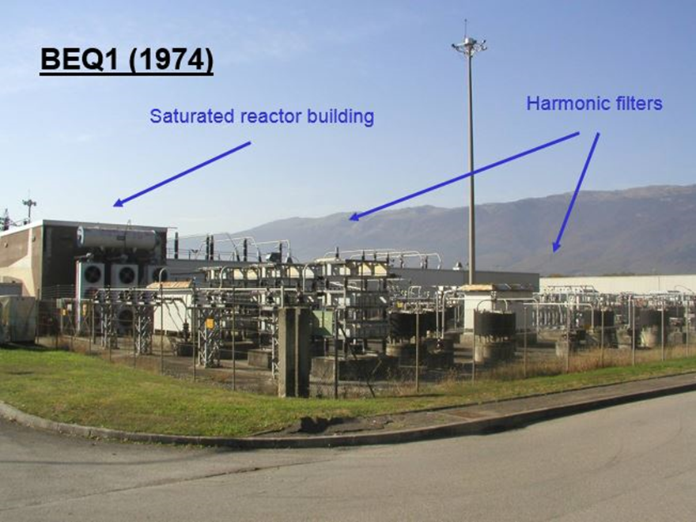
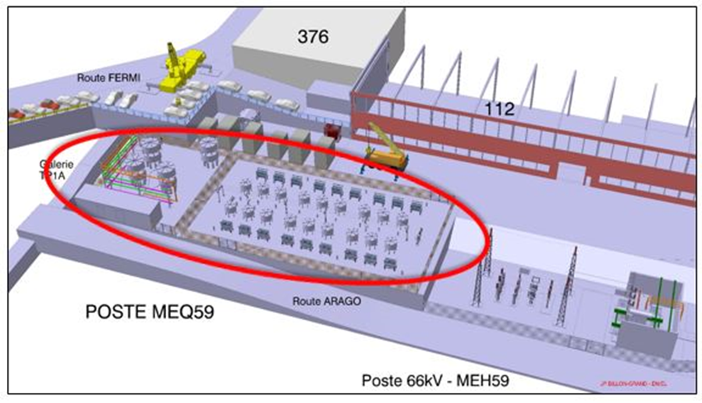
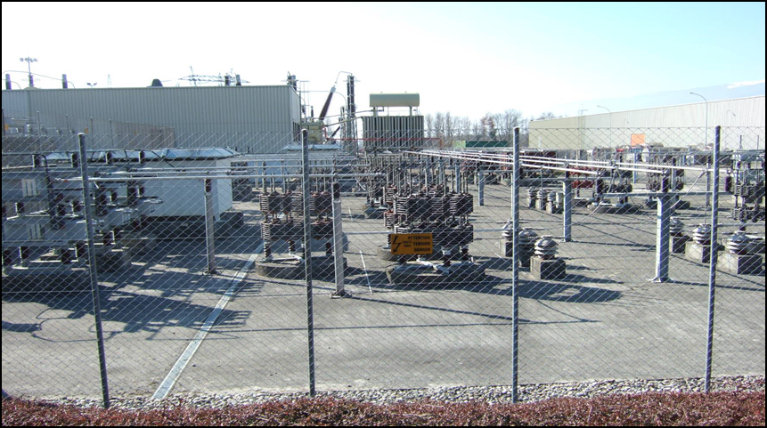
Consolidation project
Electrical Power Quality
independent
1
YETS 2015
2
EYETS 2016
3
YETS 2017
4
LS2
5
LS3
New BEQ1 Static Var Compensator [SPS Machine]
New MEQ59 Static Var Compensator [Meyrin Machine]
needed when the Machine and General Service networks will be divided into separate networks
Under approuval
SPS BEF4 Stable Filters Consolidation
[non-pulsing network]
LHC Static Var Compensator Consolidation
Meyrin Filters consolidation
4
4
5
5

Slide 15
Consolidation project
Under approval
independent
1
YETS 2015
2
EYETS 2016
3
YETS 2017
4
LS2
LINAC2 part (LINAC4 to PS Booster) - 48x New Power Converters
PS - 13x New Capacitor Discharge Power Converters
PS Injector Converter Control – New Electronics for 100 Power Converters to standardize one control over the Injector Chain
Quantity = converters not covered by LIU / Consolidation projects
SPS COD - 300x New Power Converters (Electronics & Power included)
SPS Aux Power Converter Control - New Electronics for 200 Power Converters to standardize one control over all the Injector Chain
AD - 25x New Capacitor Discharge Power Converters
East Experimental Area - 59x New Power Converters
nTOF - 7x New Power Converters
North Experimental Area – 1x New Power Converter for COMPASS Spectrometer

Slide 16
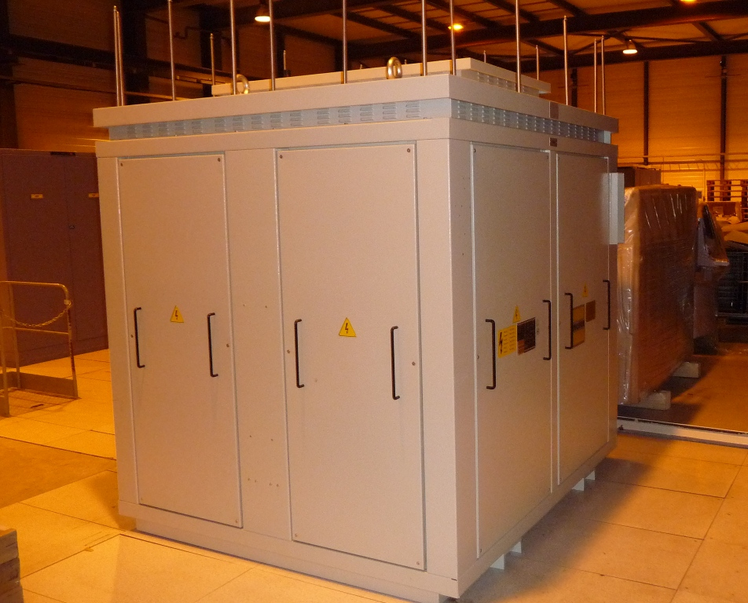
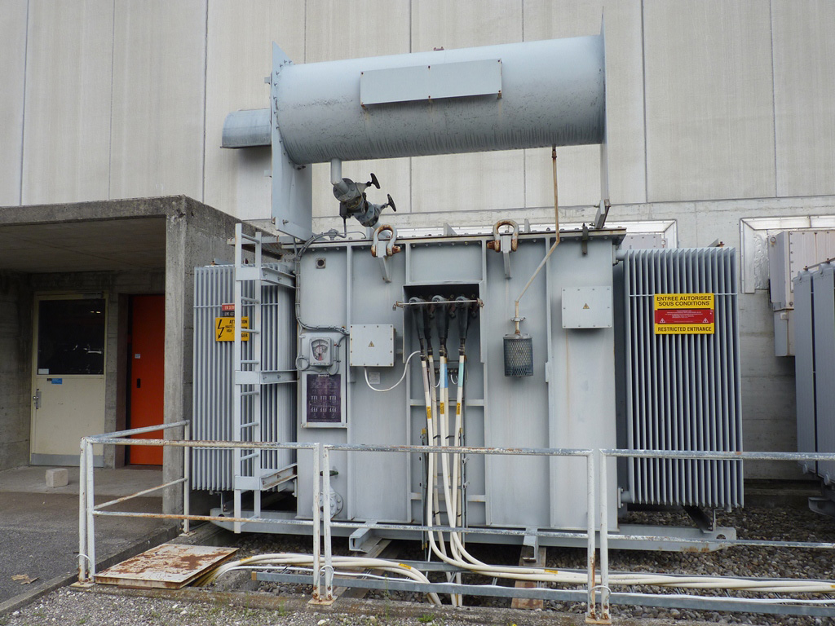
Consolidation project
Under approval
independent
1
YETS 2015
2
EYETS 2016
3
YETS 2017
4
LS2
Oil transformer consolidation [Total Quantity : 202]
  Over a period of about 10 years
  Replacement of oil transformers by cast resin transformers when possible
  Consolidation of LHC RF oil transformers and transformers with high power ratings and their oil retention system
5
LS3
Cast Resin Transformer Type
Oil Transformer Type

Slide 17
LS2
Preventive Maintenance Activities

Slide 18
  Maintenance Activities
  Preventive Maintenance
Recurrent Preventive Maintenance Activities during LS
  Few impact on other activities / groups
  Shall be integrated in the Coordination Schedule for access and service readiness
  List
    Current Calibration Measurement Campaign for all accelerator complex
    Equipment's fans replacement
    Transformer maintenance
    Visual inspection
    ……

Slide 19
LS2
Resources / Organization

Slide 20
  Resources availability
  Versus Activities
Project & Approved Consolidation Activities
  Manpower available
Consolidation Activities under approval
  Synergy could be found during the procurement of equipment with approved activities
  Nevertheless, additional manpower will be needed
Unforeseen Activities or New Projects
  No doubt that the activity list will increase depending on operational issues found during Run 2. Depending of the volume and priority, additional manpower will be needed.
  New Project will not be possible to manage up to LS2

Slide 21
  Resources availability
  Versus Planning
Machines | Opening of the machine (weeks) not including the xmas break of 2 weeks
 | YETS 2015 | EYETS 2016 | YETS 2017
PSB | 10 | 13 | 8
PS | 8 | 13 | 8
SPS | 8 | 11 (BA1) - 13 | 7 (BA1) – 8
LHC | 10 | 16 | 10
Manpower during INSTALLATION and COMMISSIONING
EDMS 1470895: Length of the YETS 2015-2016 / EYETS 2016-2017 / YETS 2017-2018
  Lot of activities concentrated in short periods
  Need flexibility for increasing manpower during these periods, mainly through Field Support Unit (FSU)
  Need optimization at the level of the LS2 coordination to optimize the group load by resources leveling across ALL facilities (Injector, LHC and Experimental Areas)
  Need to be aware in advance of any change of planning

Slide 22
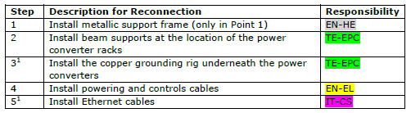
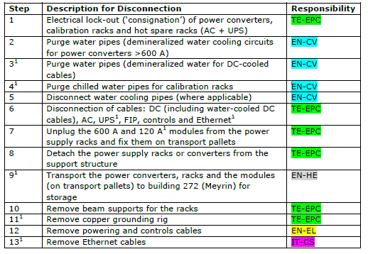
  Resources organization
  Versus Planning & Activities
For efficiency and manpower estimation/optimisation, TE-EPC needs :
During INSTALLATION phase, a detailed schedule with the different steps to performed across the different groups (who is doing what when)
During (Re)COMMISSIONING phase,
  the planning of the Individual System Tests period dedicated to TE-EPC group taken into account the readiness of the services, access, control, EIS …..
  the clarification of TE-EPC contribution during the Circuit (Re)Commissioning

Slide 23
  Logistics
  Storage
Irradiated Equipment
  Some equipment removed from the LHC tunnel for consolidation could be activated after Run2
  Need dedicated radioactive storage place
  Need area for repairing / testing irradiated electronics (blg. 867)
Storage
  TE-EPC will need buffer area to store
    converter parts received from industry before their test and integration in the power converters
    the power converters ‘ready for installation’ before their final installation in the machines
  Around 1000m² needed

Slide 24
  Interface / Interference
Interference - Any change of the interfaces with an impact on the power converters should be agreed with TE-EPC group especially for the CONTROL part (BE-CO)
Structure
EIS
Handling
Interface
  New Power converters imply service support (transport, infrastructure structure) and in most of cases upgrade or consolidation of cooling, electricity distribution and cabling
  Reminder : TE-EPC contributes to the definition of the cables BUT is neither responsible of the ‘Demande de Cables’ nor the different cables needed to interconnect the different systems
Control
Magnets
Power Converter
PIC / WIC
Cooling
Electricity
Ventilation

Slide 25
  Interface
  Definition / Database
    Interface
      Need a clear overview of the different systems per circuit
    Not clear who is doing this definition / coordination
      Need a clear definition of the interface between systems per circuit
        Interconnection as cabling, cooling are discussed during Integration meeting
Databases – Need a good support for
  the definition of the Functional Positions and the layouts of the new circuits through the Layout Database
  managing the change especially in Injector Complex
  the equipment code definition through the Naming Service

Slide 26
Conclusions
High volume (bigger than LS1) of activities for TE-EPC group with high technical challenge in some case
Few margins to complete unforeseen activities during LS2
No margin for new projects
LS2 can only be successful with a global planification and coordination for the entire facilities
YETS 2015
*EYETS 2016
YETS 2017
LS2
1
2
3
4
Long Shutdown
Commissioning
Operation
Technical Stop
ELENA
AWAKE
Installation
S-FRS
SM18 Upgrade

Slide 28
Additional Activities
mentioned during LS2 Days

Slide 29
HL-LHC project
LS2 Work Packages
independent
1
YETS 2015
2
EYETS 2016
3
YETS 2017
4
LS2
WP3 - New Q5 magnets in LSS6 for ATS Optics
  2x New Power Converters (Integration not yet started)
11T Dipole uncertainty
  “We ask to keep open the possibility to install 2 units of 11T around P2 or P7 in case of need in the second part of LS2.The issue will be defined at Chamonix 2016 or in Spring 2016 at latest.”
  Lucio’s presentation
  2x New Power Converters (Integration not yet started)

Slide 30
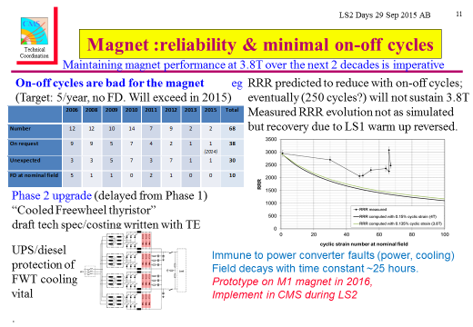
LHC project
CMS
20kA Free-wheel Thyristor

Slide 31
Others
Recommissioning Plans of Machines and Experimental Areas for beam after LS2

