Slide 1
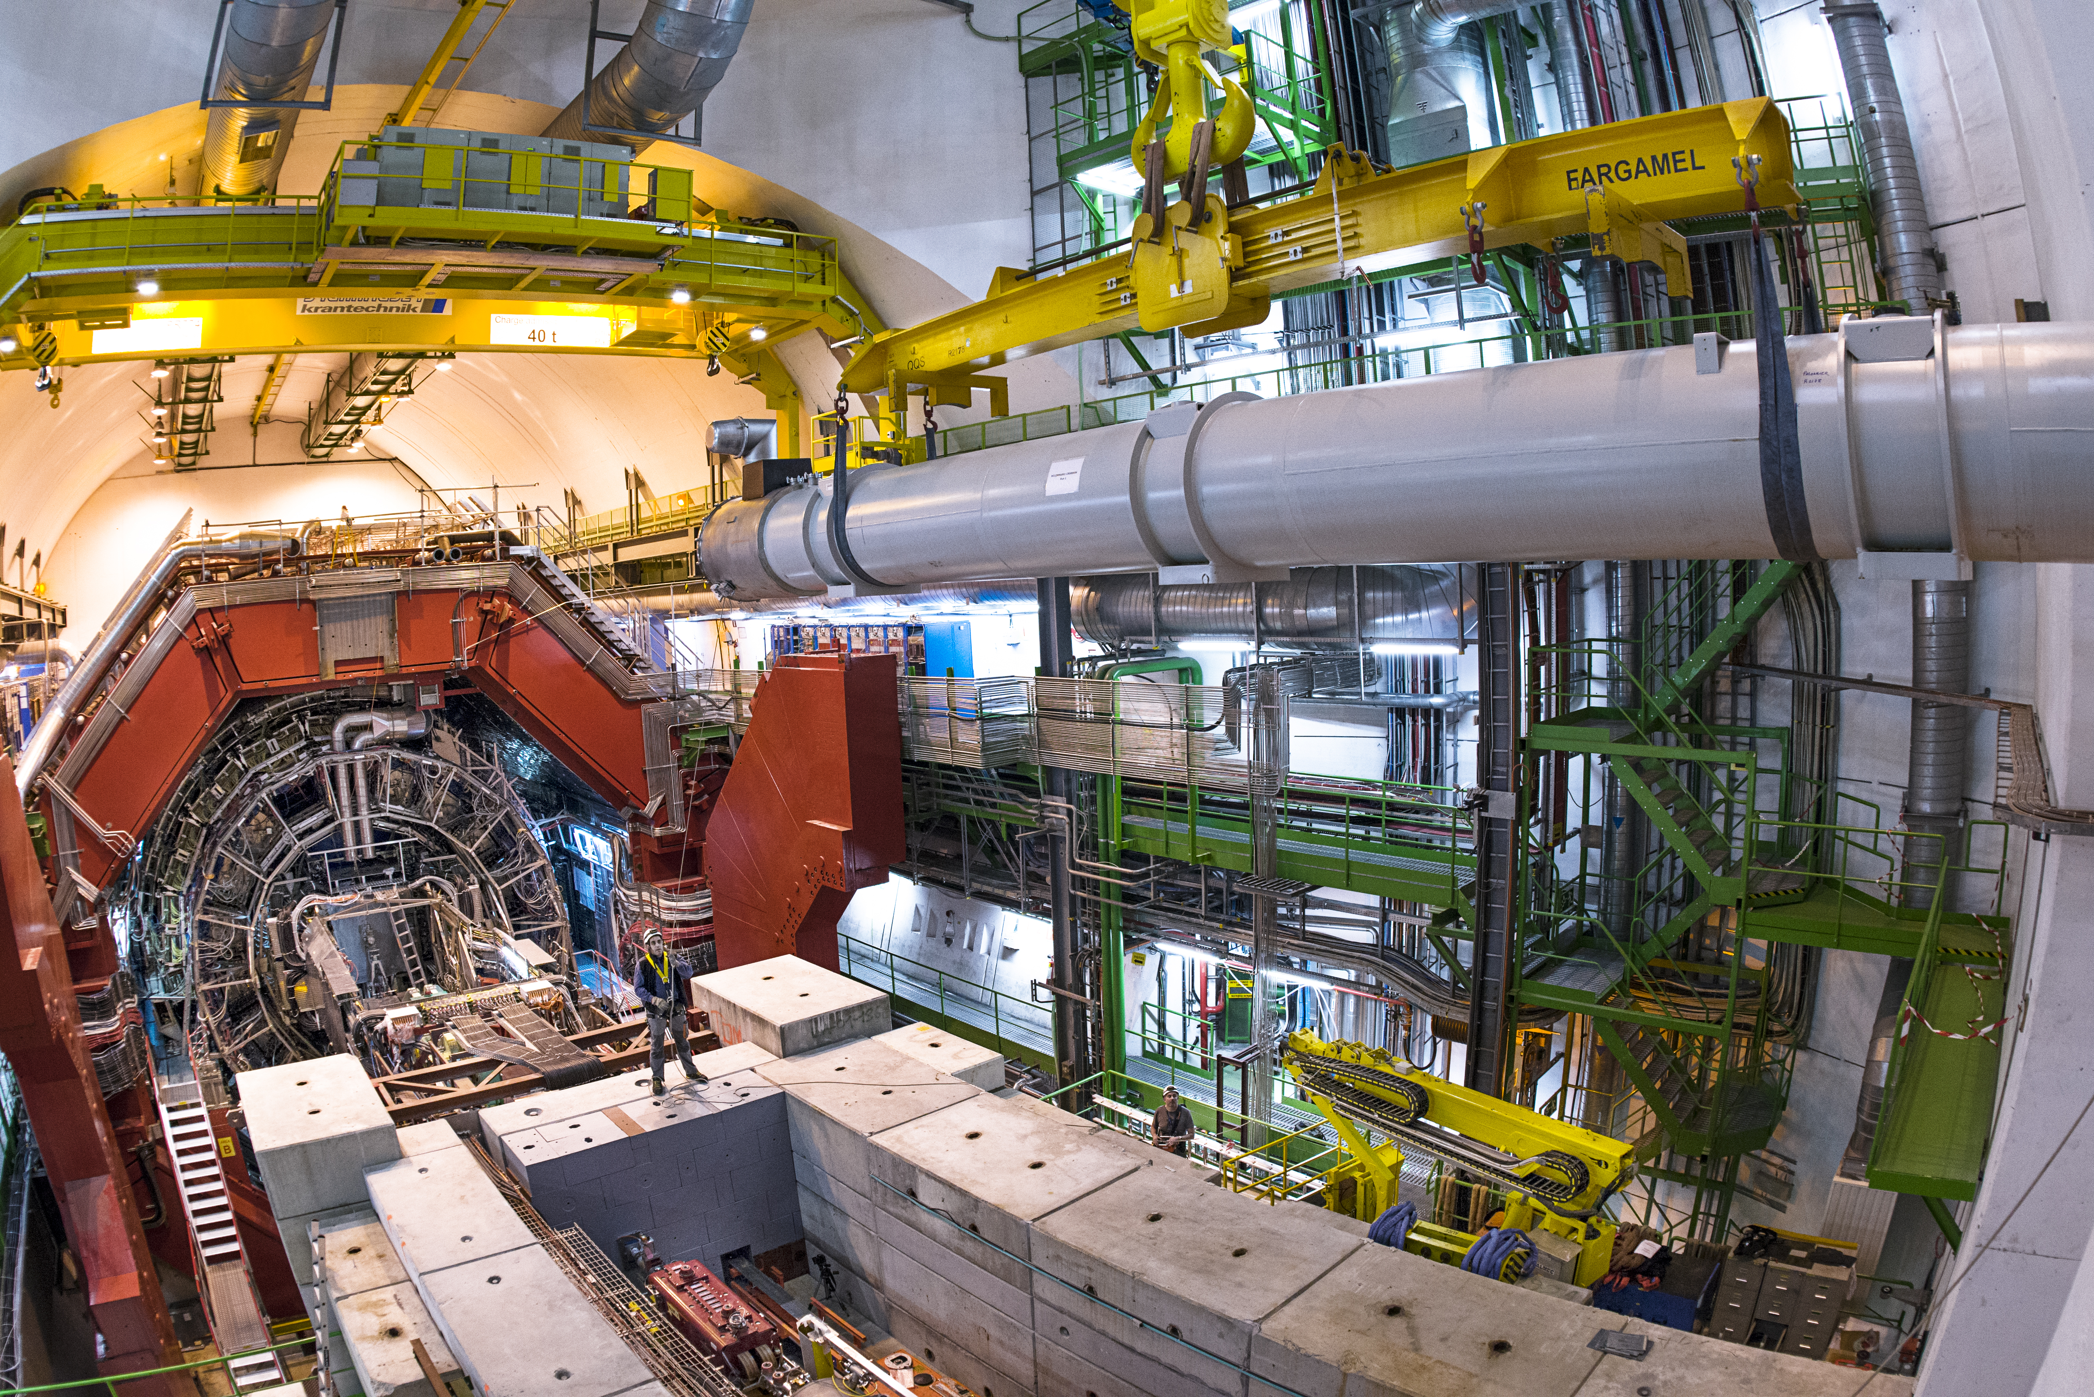
Transport and Handling in LS2
Caterina Bertone EN-HE

Slide 2
Some consolidated works for transport
Injectors (LIU+consolidation):
  LINAC4: connection for PSB
  PSB: refection of Injection and Extraction line + replacement of some elements in the ring
  PS: coils consolidation of 43 units (~50%)
  SPS: External dump in BA5, RF upgrade in pt3, crab cavities installation, aC coating…
AWAKE: electron line
East Area upgrade: major overhaul of the area
Complete revision of ATLAS-CMS-LHCb-ALICE
LHC (HI-Lumi+consolidation)
  TAN and TAS (pt1 and 5)
  Coating of triplets (in situ?)
  Cryoplant installation in pt4 (TX45)
  ~20 cryomagnets to be remplaced (arc and LSS, HI lumi and Consolidation)
  Collimators upgrade (injection line and arc)+cryocollimators
  Support to Hi LUMI worksites

Slide 3
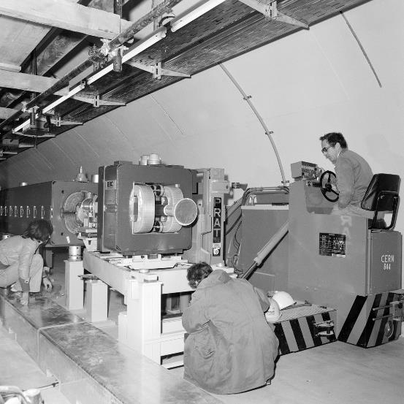
Main concerns
Managing high peaks of personnel
Managing underground and surface logistics
Availability of handling machines (number and age)

Slide 4
Peaks of personnel
LS2 looks much more intense then LS1 (few activity in experimental area, and lower anywhere else, especially injectors).
Peak of 100 persons in LS1 during magnet exchange (June 2013= DYPB exchange + LHC shielding + cryomagnets+R2E)
Peak of 120-150 persons actually foreseen for LS2.
Transport and handling contract just renewed and will cover LS2 entirely
Actual manpower: 47 persons. Increase of 200% should be well prepared (training, knowledge of the tunnel) meaning accepting to invest money BEFORE the beginning of LS2

Slide 5
Underground logistics
Intensive campaigns of works on magnets have strong consequences on tunnel logistics
  PS renewal of magnets (43): removal + reinstallation of a magnet takes 1,5 days, no more than 2 magnets can be moved at a time,
  SPS coating and consolidation project: even if a part of work is done in situ, upstream and downstream magnets have to be removed plus welding/coating machines will occupy the transport zone: quite a traffic!
  LHC (+HI LUMI) logistics to be verified: for example the high jumper magnets need to go through ALICE (low beta platform) like Q5L8: to be negotiated with them and planified to limit the disruption on ALICE planning (grouping of the high jumper magnets?)

Slide 6
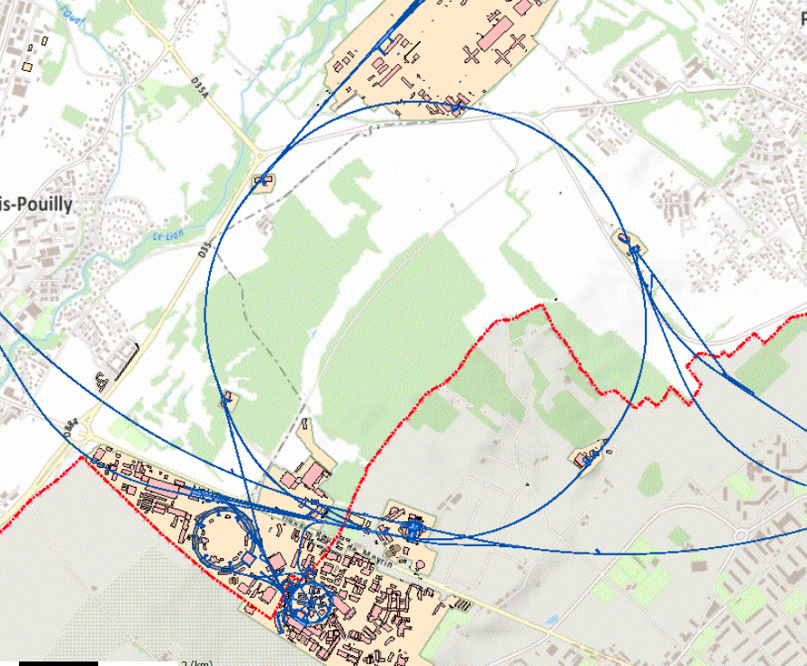

SPS logistics during LS2
RP Workshop
Prevessin (FR)
BA3
BA2
BA4
BA1
BA5
BA7
BA6
RP Waste
Meyrin (CH)

Slide 7
Road transport of radioactive items
ADR-UNO standard is governing the road transport of radioactive goods
This standard is very stringent and the way to qualify the RP category is done by activation (and not dose)
Not possible to make a rapid evaluation of the activation of goods to be transported by road at CERN (needs spectro and perfect knowledge of the isotopes inside any good)
As a function of activation, the transport is categorised. The higher category, the most heavy constraints over the transport itself (needs of shielding, certified containers….)
Impossible to put big accelerator components (like SPS magnets) in containers that follow the ADR rules (even contradictory to the ALARA principle for short trips like CERN)
CERN is negotiating special agreements with ASN (FR) and OFSP (CH) to make an equivalence between the prompt dose measurement and the activity but the road is still long and any category of big items shall be studied and get agreement to the authorities independently. This concerns big magnets and shielding blocks, for example
  this could seriously restrict the logistics and hamper the LS2 program

Slide 8
Status of handling machines
All machines in house
Some are old (like PS and SPS) ageing from the beginning of accelerators
New machines with identical dimensions and characteristics are sometimes not possible (regulation have changed ex. the cabin or crane arm)
Few constructors still accept to make prototype machines for 1 or 2 sold (cost of the studies)
Renovation and deep consolidation (as new) is the chosen strategy and looks like the only possible
More units of the same will be needed for LS2 identical to existing: ‘CE-like’ marking and design responsibility on CERN shoulders

Slide 9
Future steps
LS2 program is being clarified in the very last weeks and thanks to LS2 days
Revision of our fleet, resources and needs for studies (and $$) in the next few months
Thanks for contacting us very soon on your LS2 projects so that we can be ready in time to help you

Slide 10
Conclusions
For the time being no showstopper has been identified
No ‘big machines’ to be developed from now to LS2 (MAFI-like)
Some simplified machine will be needed (for crabs in SPS, TAN etc) but short design and procurement time (1 year at most)
If the coating of the triplet in LHC would need the extraction of the magnets (even only transfer to transport zone), the compatibility between the actual handling procedures (long presence of operators in situ) and the prompt dose has to be assessed: could induce the need of optimisation or modification of existing machines
BUT… all of our recent and old machines will be used full time: big consolidation to be foreseen and buy extra of some of them (especially for SPS)!

Slide 11
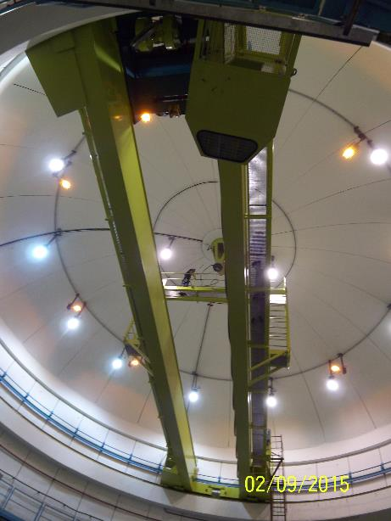
EN-HE projects
And, for those that are interested in EN-HE own projects:
  Replacement of 12 LEP lifts before and during LS2,
  2 new lifts for HI LUMI (depending on planning),
  BA3 + 3 BAs lifts else, the most useful for LS2,
  Consolidation and replacement of all strategic cranes before LS2 (SM18, EHN1, PSB, BB5, SX8, 7 BAs, BA80, ECA4, b. 911, ECX5, EHN2, HIE-ISOLDE, AD),
  Consolidation of all transport machines to be ready for LS2.
  If logistics storages will be needed on top of SPS shafts, an extra mobile crane (~100t) would be needed: tbv
These, as the projects of each group, should be taken into account in the planning

Slide 12
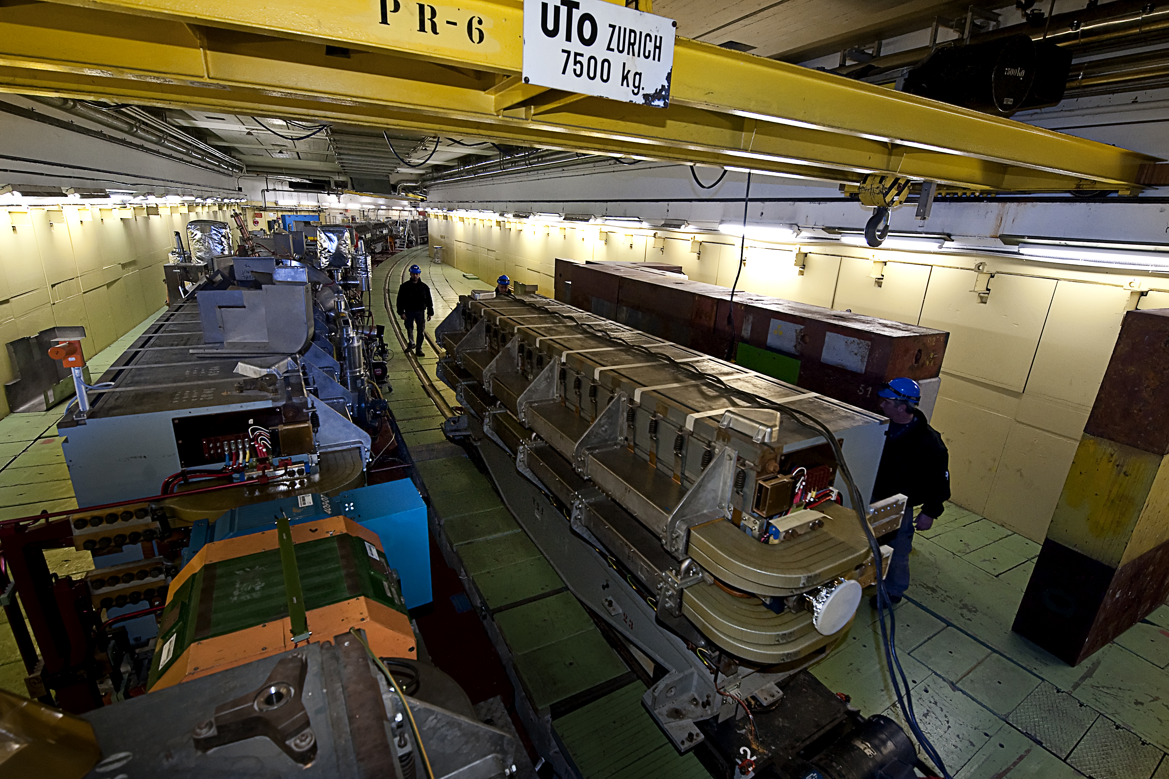
Thanks you!

