Slide 1
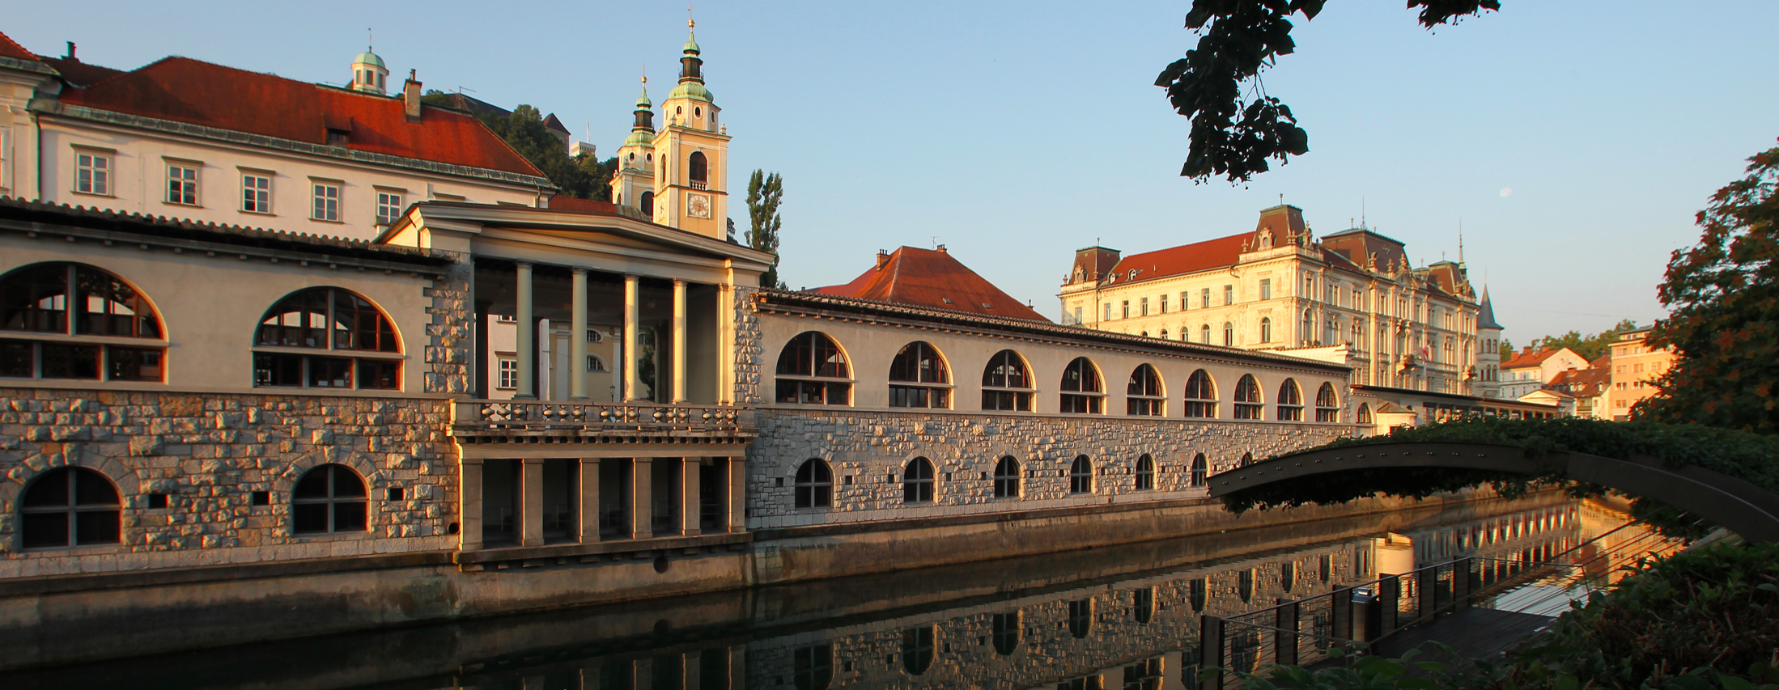
Lepton Photon 2015
Status Report

Slide 2
Total: ~220
Attendance
by country

Slide 3
Talks/Posters
57 posters
61 talks

