Slide 1
NA CONS
Work document for 3 August 2015
Situation and items for 2016

Slide 2
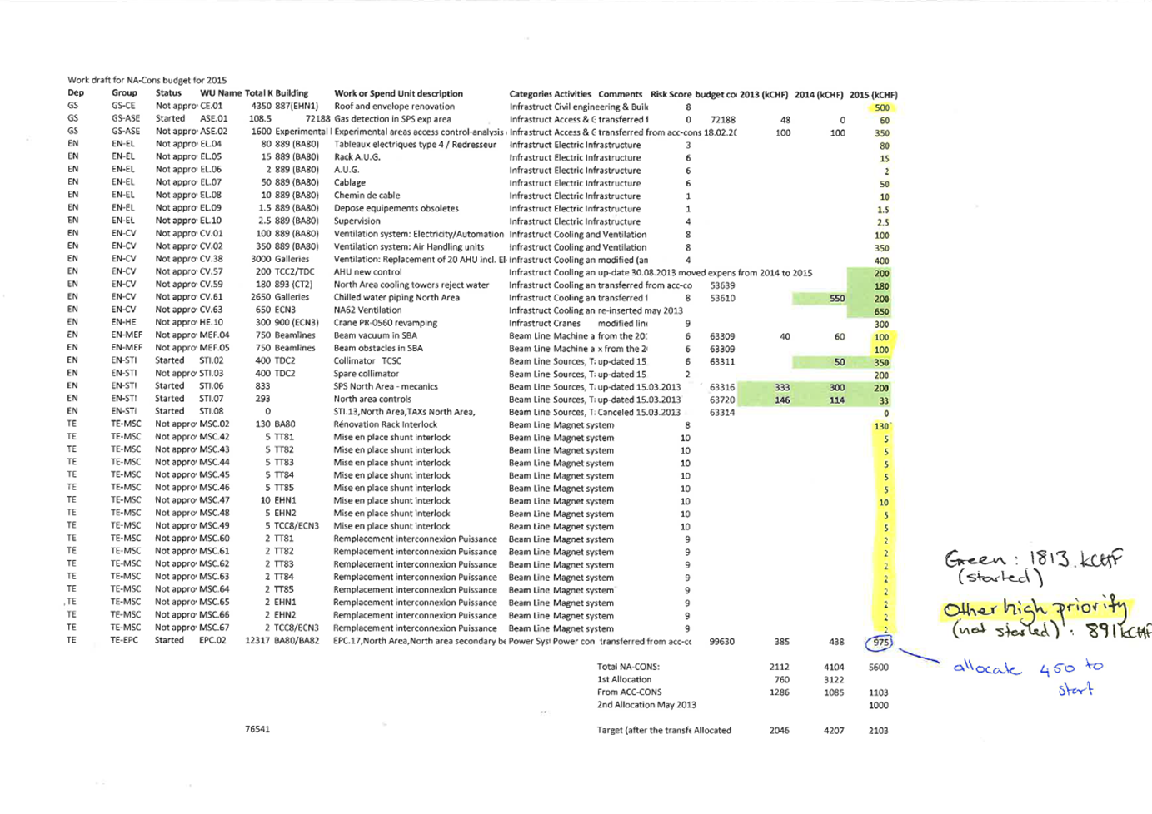

Slide 4
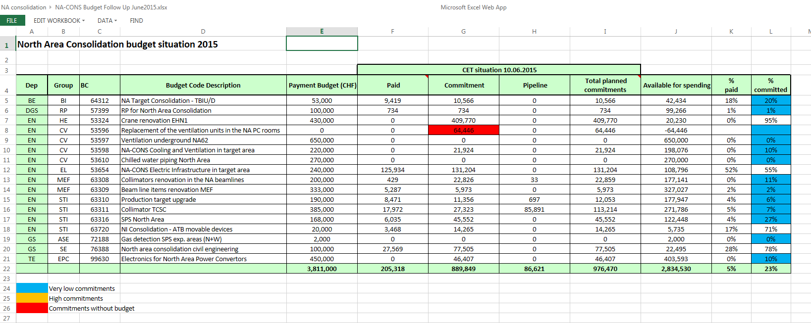

Slide 5
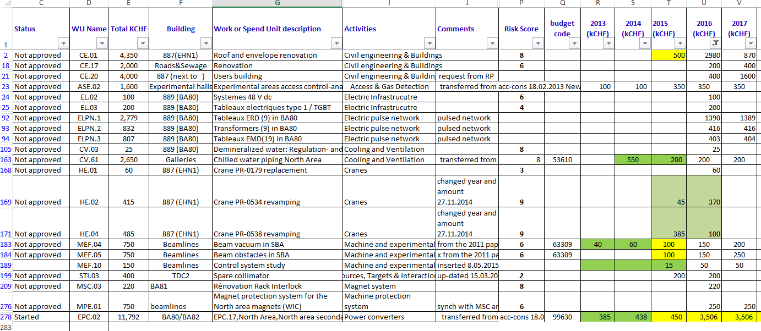

Slide 6
