Slide 2
Ions: Updates on LIU baseline and options (incl. staged implementation), parameter reach, schedule
S. Gilardoni for LIU-ION group
In collaboration with:
G. Bellodi, C. Carli, J. Jowett, M. Bodendorfer, D. Manglunki et al.
HL-LHC – LIU Joint Meeting – 15 Oct. 2015

Slide 3
Clarification of the scope (pending confirmation from HL-LHC)
Follow-up after C&S review: running scenario after Alice upgrade as requested by ALICE (see ALICE LOI CERN-LHCC-2012-012):
2020 – Pb–Pb 2.85 nb-1
2021 – Pb–Pb 2.85 nb-1
2022 – pp reference run
2023,2024 – LS3
2025 – Pb–Pb 2.85 nb-1
2026 – ½ Pb–Pb 1.5 nb-1 + ½ p–Pb 50 nb-1
2027 – Pb–Pb 2.85 nb-1
In total ~ 4 runs to cumulate 10 nb⁻¹ starting integrating the 10 nb⁻¹ after LS2, i.e., 2021.

Slide 4
New calendar for ions run
Most recent calendar shared with HL-LHC (see John’s presentation)
Same as before but 1 year later
2021 - Pb-Pb 2.85 nb-1
2022 - Pb-Pb 2.85 nb-1
2023 - pp reference run
2024, 2025.6 - LS3
2027 - Pb-Pb 2.85 nb-1
2028 - ½ Pb-Pb 1.5 nb-1 + ½ p-Pb 50 nb-1
2029 - Pb-Pb 2.85 nb-1
2030 LS4

Slide 5
Timelines of LIU
LIU (machine and simulation) studies during Run 2 until LS2
Key dates for pending decisions until 2016
LIU installations and hardware work mainly during LS2
Beam commissioning of LIU beams
Pb ion beams need to be ready by 2021 ion run
Proton beams during Run 3 to be ready after LS3
Run 3
Run 2
Run 3
Run 2
LS 2
LS 2
PHASE 1 with LIU studies, installation and beam commissioning
Run 4
Run 3
LS 3
Run 4
HL-LHC installation
PHASE 2
LS 4
LS 5

Slide 6
Post LS2 Scheme
max. 13 injections
LEIR
Baseline requirements:
Maximize number of bunches in LHC with 50 ns bunch spacing
Slip stacking in SPS
Increase at maximum the intensity per bunch.
More intensity from LEIR
More intensity from L3 and increased rep. rate
Transverse emittance is less important than intensity
Twice 8x10⁸ ions/bunch
200ns
PS
100ns
100ns
SPS
~2μs
50ns spacing
1.55 10⁸ ions @ injection
LHC
max. 1248
50ns spacing

Slide 7
Impact of need of 50 ns
Only way to get it:
100 ns from the PS → bunch splitting @ low energy
Not possible to split at high energy because too close to transition
PS optics not so flexible to change gamma transition as for the SPS.
Less intensity per bunch compared to 200 ns or 100 ns spacing with no splitting (as for protons 25 – 50 ns)
Not possible so far to double the intensity per bunch extracted by LEIR to maintain the same intensity as the 200/100 ns with no splittings
Slip stacking in SPS
Bunch spacing changed from 100 @ injection to 50 ns in intermediate porch to avoid spending too long time @ low energy
Obs: 25 ns not possible because would require bunch splitting in PS.

Slide 8
Ion project baseline life-time
SPS
Design
Procurement
Installation
Commissioning
LEIR
Performance improvements
Performance improvements
Performance improvements
Xenon Run
Design
Procur.
Linac3
Inst.
Comm.
Performance improvements
Performance improvements

Slide 9
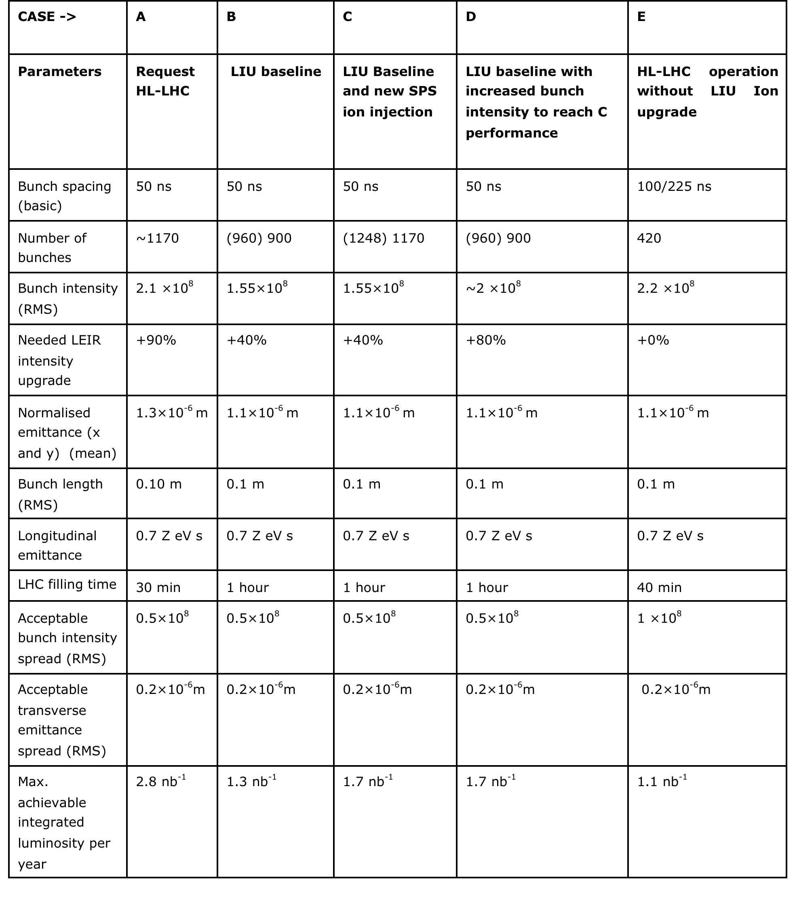
Parameter table @ SPS extraction
HL-LHC parameters based EDMS document 1525065 v.0.3
(evolving document)
Production scheme with goal of matching requested beam param.
EDMS document 1533832 LIU of beam parameter in preparation, in collaboration with John.
(evolving document)
Obs: TDR in preparation

Slide 10
Parameter table, closer look with Lumi full model
See John’s talk
Maximum achievable integrated luminosity with current baseline : 1.17 nb⁻¹/y Maximum achievable integrated luminosity with upgraded SPS kicker : 1.67 nb⁻¹/y

Slide 11
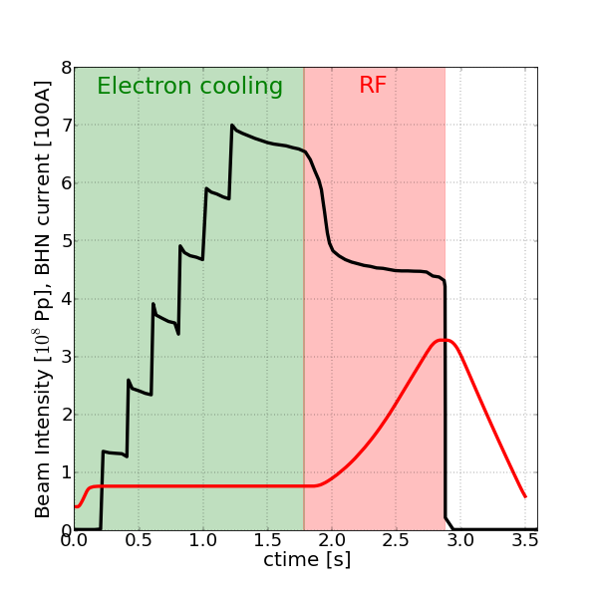
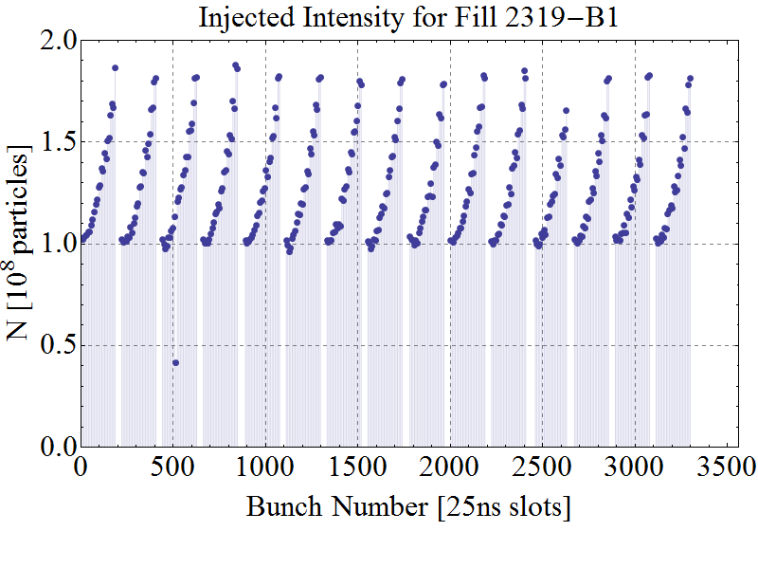
Main complex limitations (where we are a good fraction of our resources)
Linac3 reduced maximum current
Larger number of injections in LEIR → longer cycles → longer SPS FB
LEIR maximum intensity due to losses at capture
Limiting maximum performances of the complex
Losses/emittance degradation at SPS FB due to IBS-TSK-like effect
Intensity decreases along the batch with footprint remaining on LHC specific luminosity

Slide 12
Linac3
Intensity from the Linac limited due losses between source and LEBT
Emittance from the source too large compared to the acceptance of the RFQ
longstanding issue for device measuring emittance from the source
An initial 20% improvement in transmission in the low energy part of the Linac expected by installing new electrostatics lens (einzel lens) and increasing aperture between source and first solenoid
Work to be done during YETS 2015-16
Linac improvement studies from early 2016, maximum gain beyond 20% will be probed, brainstorming started to possible studies.
Revising BI requirements for studies
100 ms rep. rate operation to increase injection rep. rate in LEIR
Upgrade of power converters advanced to YETS 2015-16
100 ms operation limited before LS2 because of cooling and ventilation consolidation needed, but test periods already in 2016

Slide 13
The Pb⁵⁴⁺ life-cyle in LEIR
LIU Ions goal
?
(Coasting beam)
Asymptotic int. lim.
max. extr.:
5.8x10⁸ Pb⁵⁴⁺/bunch
BHN current [1000A]
Extraction
@ 2880ms
B-field

Slide 14
LEIR performances
Performances limited at beam capture for unclear reasons
- direct space charge + resonances preferred mechanism, test starting this month for transverse emittance control
- not clear sign of beam instabilities observed
- chromaticity correction did not improve losses
- local vacuum degradation seems excluded from past desorption studies
Studies limited in time because
- machine model including impedance, e-cooler and precise optics not
available → planning for 2016 development
- machine availability limited to Pb ion run (see Django’s talk), reason of early start
in 2016.
- tried to make best use of Ar run for studies. Will do the same also for Xe.
Same resources running the machine (for Ar post LS restart and new particle) and studying performance limits.
100 ms injection to increase intensity before acceleration
- e-cooling providing double current for faster cooling rate (proved with Ar).
Already tested for maximum current, cooling rate not yet.
- full tests planned for 2016

Slide 15
2015 planning: Ar until April – Pb in LEIR since July
Argon run

Slide 16
Planning of LEIR studies
Activity | 2015 |  |  |  |  |  |  |  |  |  |  |  | Status
 | J | F | M | A | May | Jun | Jul | A | S | O | N | D
LEIR startup
LEIR for collider
Polarity check |  |  |  |  |  |  |  |  |  |  |  |  | HW prepared, but effect of chroma from Ar run ad now Pb
Optics measurements (LOCO) |  |  |  |  |  |  |  |  |  |  |  |  | Not started, need stable injection
Find refuting tests for working hypothesis |  |  |  |  |  |  |  |  |  |  |  |  | Done
Space Charge & Intrabeam scattering - experiment |  |  |  |  |  |  |  |  |  |  |  |  | Not started, need nominal intensity
Space Charge & Intrabeam scattering - simulations |  |  |  |  |  |  |  |  |  |  |  |  | Ongoing
Desorption effects
Impedance model |  |  |  |  |  |  |  |  |  |  |  |  | Postponed next year, no fellow found
Transverse Damper - optics |  |  |  |  |  |  |  |  |  |  |  |  | Done
Transverse Damper - system |  |  |  |  |  |  |  |  |  |  |  |  | Ongoing, found doubts for transient during bunching
Magnetic model |  |  |  |  |  |  |  |  |  |  |  |  | Ongoing
Instabilities - experiment |  |  |  |  |  |  |  |  |  |  |  |  | Not started, need nominal intensity
RF during capture |  |  |  |  |  |  |  |  |  |  |  |  | Ongoing, started during setting up
electron cooling |  |  |  |  |  |  |  |  |  |  |  |  | Doubling the current tested, now cooling rate
100 ms operation |  |  |  |  |  |  |  |  |  |  |  |  | Next year as planned
Transverse emittance blow-up |  |  |  |  |  |  |  |  |  |  |  |  | Christian will start working on that soon
Some precision studies LIU-specific delayed due to recent limited machine performance Limited resources re-centered on recovering injection efficiency
(see Django’s talk)

Slide 17
2016 Ion Schedule driven by LIU studies
Draft 2016

Slide 18
PS
- No limits identified so far for PS
- RF gymnastics are similar to the one of protons and already implemented in the past
- 100 ns beam already produced in the PS this year (See Django’s talk)

Slide 19
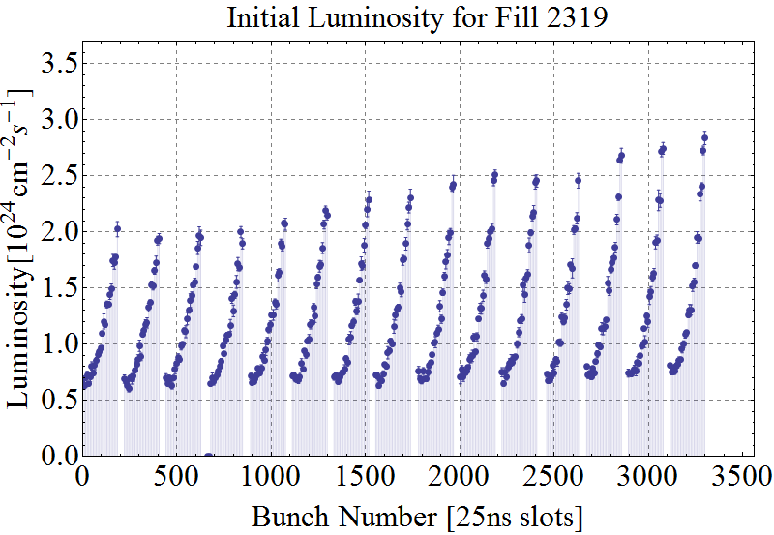
Limitation of SPS long injection flat bottom
Two effects observed on luminosity:
Slope imprinted by SPS injection plateau.
Slope imprinted by LHC injection plateau.
Initial Luminosity
ATLAS data
LHC
SPS
From M. Schaumann

Slide 20
Discussion on IBS-TSK
Observation from last run not conclusive on source of losses @ SPS injection.
Losses along the batch seems to be more caused by IBS or Touschek-like effect mixed with direct space-charge and RF-noise (most recent studies in 2012-13)
Consequence for 2015 studies (see Elena’s talk also):
Needs more data that can be taken, at least initially, parasitically on operational beam, with 100 ns to be compared with 200 ns bunch spacing
Interesting to measure with different bunch-length from PS (by adjusting final rotation with more 80 MHz cavities) and/or intensities
Profiting from:
Q20 (but eventually we could propose to study a Q19 or a Q18)
Improved RF noise from Ar run
Test with double harmonics injection in the SPS to inject in larger buckets

Slide 21
SPS Slip stacking
RF confirmed that slip stacking in the SPS should work, with only final efficiency/beam parameters to better determined by further simulations
- No first principle identified by which scheme should not perform
Lack of manpower being identified within the RF group
Resources will be available starting early 2016 for:
start developing of LLRF HW for slip-stacking
First conceptual design included in the TDR
Investigate also what can be done before LS2 with a single beam control instead of the two proposed for final LLRF
assess expected performances of slip stacking via simulations
study final bunch rotation needed with Q20 to match LHC longitudinal acceptance

Slide 22
Slip stacking tests in 2015
Tests can be done before only with one batch (flat top, flat bottom) to:
Investigate the beam life time without the phase loop (PL)
unpredicted behavior of the PL during the slip stacking procedure
might be necessary to operate without PL
Define the aperture limitation ΔR
Test and optimize the designed RF programs regarding the particle losses and the final longitudinal emittance
(see Elena’s talk)

Slide 23
100 ns SPS kicker
First feasible option to bridge the gap with HL-LHC request is implementing the 100 ns kicker injection in SPS to increase number of bunches.
Technically feasible for first YETS after LS2, preliminary design in TDR
- decision has to be taken end of this year/beg. next year
- Main show stoppers to be probed:
- resources limited in ABT (not included in planning) and possibly in EN/STI
- Technical feasibility of the 100 ns (reason for present proto-typing)
- budget of ~ 3 MCHF not in LIU anymore, part of the budget cut, more precise budget to be assessed

Slide 24
Risk if LEIR intensity not improving
So far, no clear understanding of losses
- Ar run showed losses at capture as for Pb
In parallel, trying to improve the loss decay in the SPS due to long waiting time at low energy
- with Linac3 at injecting at 100 ms and an improvement of the Linac current we could hope to shorten the LEIR cycle to 2.4 s (as in LHC Design Report).
→ Shorter flat bottom at SPS injection → less batch degradation
First feasible option to bridge the gap with HL-LHC is clearly implementing the 100 ns kicker injection in SPS.
If LEIR problem is solved then (ultra-stretched scenario):
- profit from full intensity from the Linac and shorter cycles
- full intensity from LEIR
- Improved IBS-TSK limit and/or short SPS cycle
- 100 ns injection in SPS
Reachable parameters not evaluated yet, goal for 2016, to reduce even further gap with HL-LHC requests

Slide 25
Other brainstorming ideas (from 2010)
Disclaimer: proposed as study case in 2010 but no resources available to proceed with them
Limitations (likely):
In LEIR: for intensity per batch (some efforts to “see” nominal intensities ejected due to direct space charge forces?)
In the SPS: for intensity per bunch (direct space charge?), duration of accumulation plateau (ions diffusing out of bucket?)
Additional Linac3 RF tanks (to increase the Energy):
Additional tanks after stripper
Mitigation of space charge effects in LEIR for more bunches/PS cycle
Upgrades of LEIR injection line, possibly increase of LEIR to PS transfer energy
Stripper after additional tanks (increases charge state):
Mitigation of intensity limitations in LEIR and SPS
Still upgrades of LEIR injection line …
Cost, resources and time line not really compatible with upgrade program
Lower frequency RF system in SPS (in addition to 200 MHz) to mitigate SPS intensity limitations
For longer bunches at PS to SPS transfer
To revive the bunchlet scheme and recombine bunches
Already discarded for protons

Slide 26
Conclusions
So far not possible to bridge the gap between the HL-LHC request and LIU-ION goals in terms of beam parameters.
Coherent planning of studies in L3, LEIR and SPS proposed
Difficult so far to reach critical mass for resources available. Same resources on machine operation and machine study for LEIR. Improving in 2016 for SPS, less clear for LEIR.
LEIR study requires running machine with Pb, since machine model not sufficiently precise in many aspects
Impedance model → 2016
Optics/Space-charge simulations→ available but to be improved
All schemes are based on the improvement of LEIR extracted intensity
Studying improvement of the lifetime in the SPS and/or shorter cycles in LEIR to reduce spread along the batch.
This latter will be a plus anyhow in case of LEIR baseline parameters will be reached.
Clearly important to improve current from the Linac3

Slide 28
Backup slides

Slide 29
Planning for studies and HW implementations
 | 2015 |  |  |  | 2016 |  |  |  | 2017 |  |  |  | 2018
 | Q1 | Q2 | Q3 | Q4 | Q1 | Q2 | Q3 | Q4 | Q1 | Q2 | Q3 | Q4 | Q1 | Q2 | Q3 | Q4
LHC operation
Ion operation with Pb
Ion operation with other ions
Linac3 studies
Linac3 implementations (LEBT changes, 100 ms)
More intensity from Linac
Linac3 tests 100 ms
LEIR studies with Pb
e-cooler tests with Pb
Decision on ecooler
SPS test on 100 ns PFL//PFN
SPS feasibility test with slip stacking
SPS slip stacking (after LS2)
IBS studies - emittance evolution vs intensity

Slide 30
Linac3 low energy modifications

Slide 31
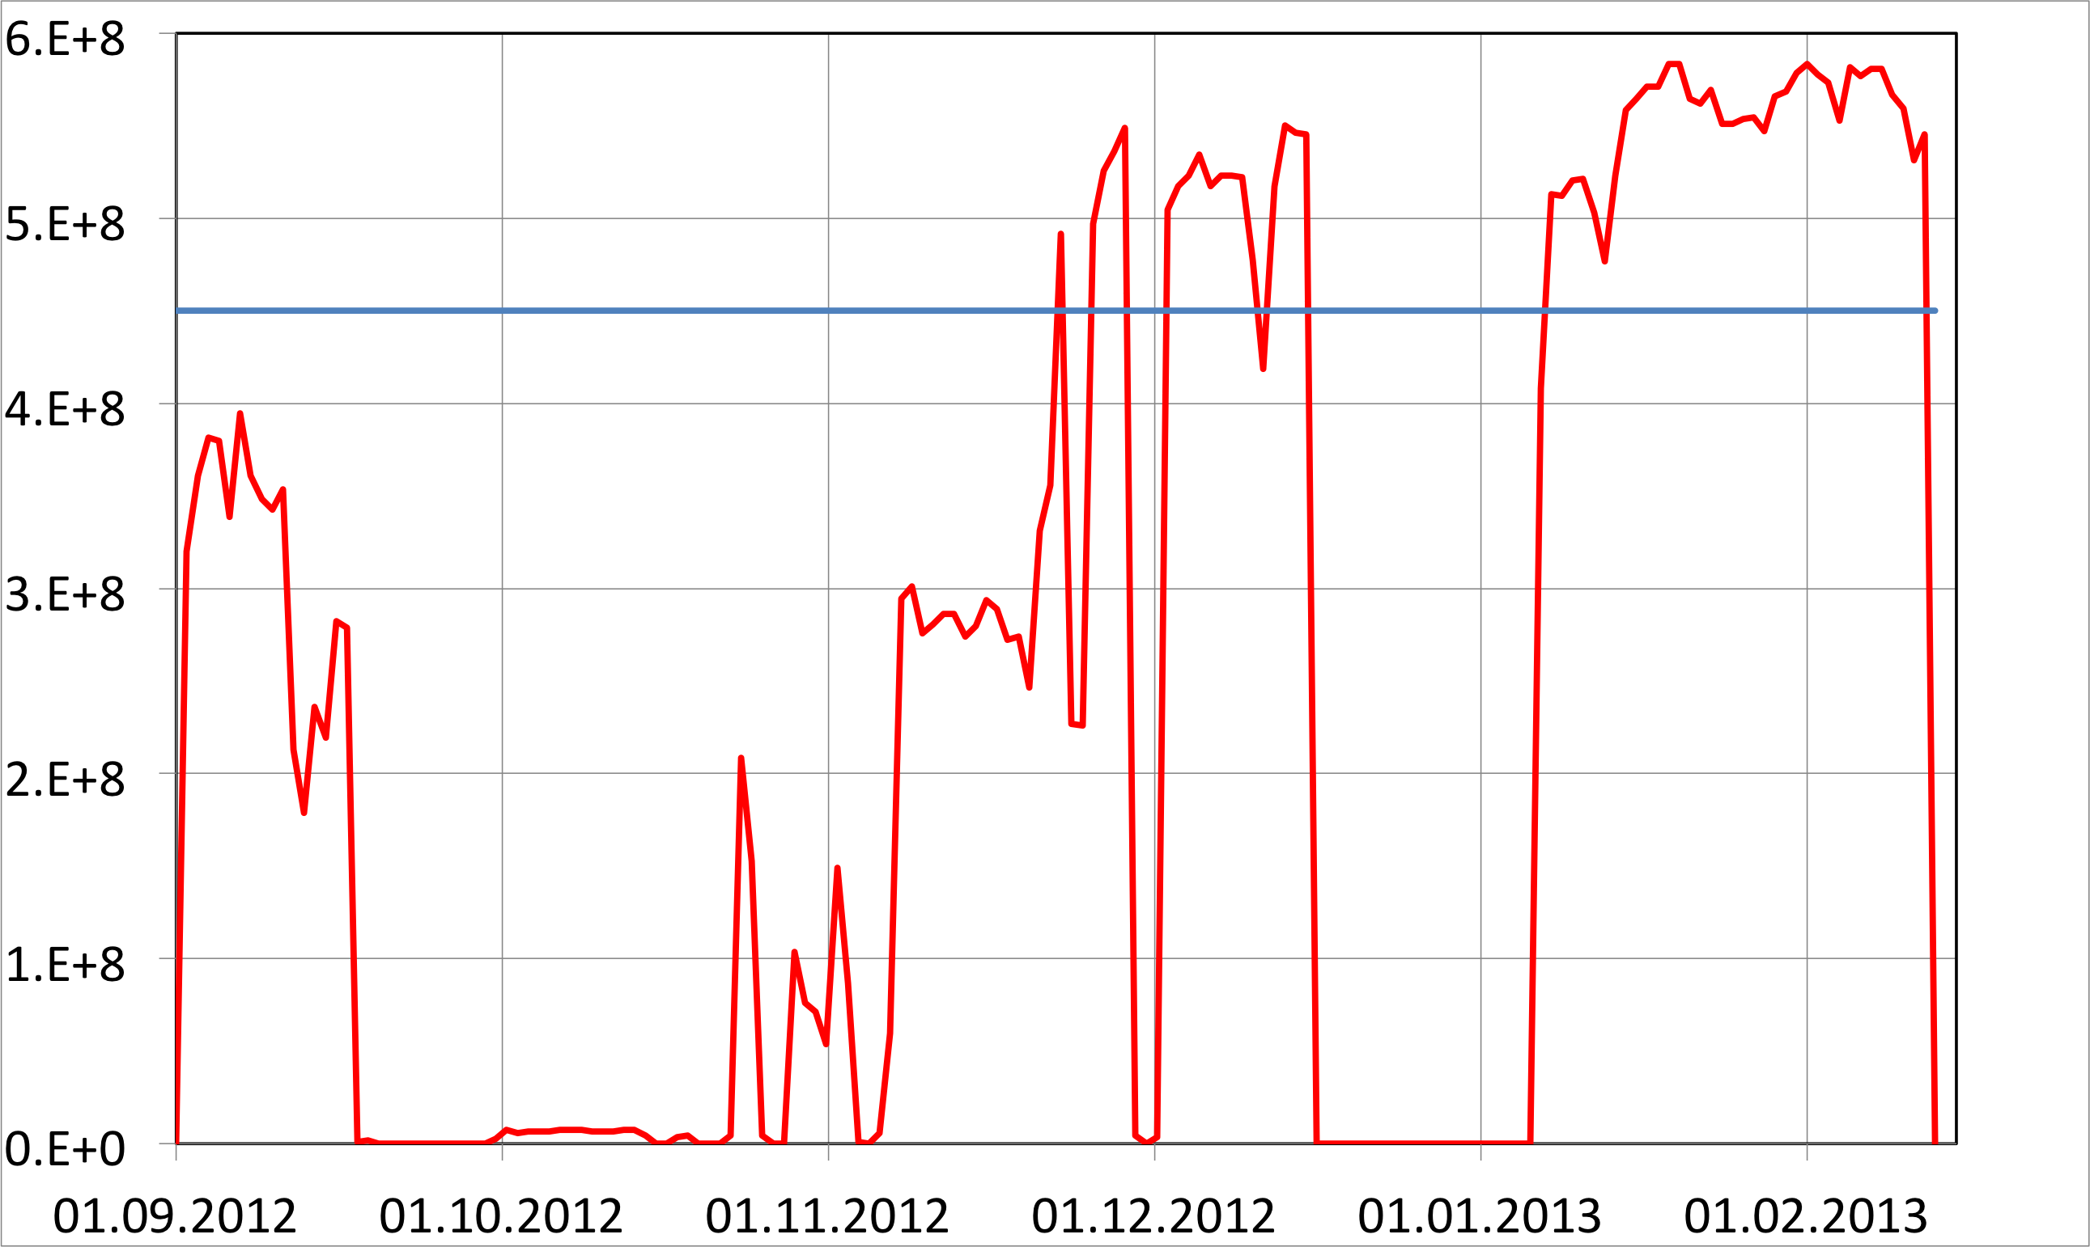
What intensity did LEIR extract in 2013?
Pb⁵⁴⁺/bunch
Goal (4.5E8/bunch)
Xmas
Tech stop

Slide 32
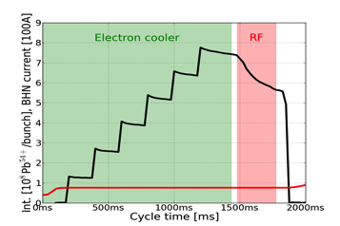
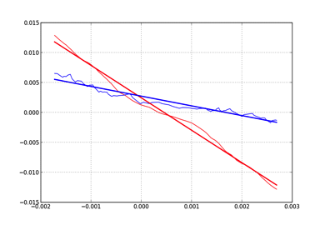
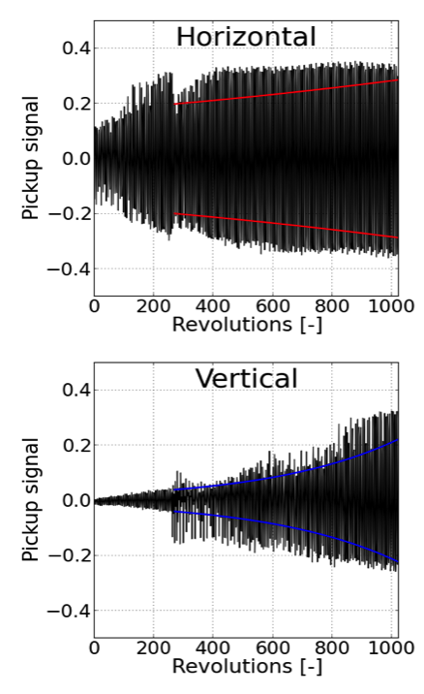
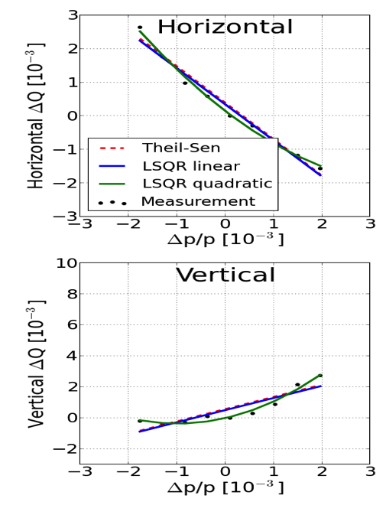
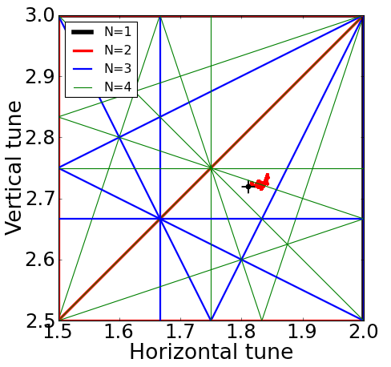
Findings
Clues from measurements:
Working point on 4th order resonance
Transverse instability at RF capture
Positive chromaticity in the vertical plane (2013)
Beam loss associated to RF-capture rather than mag. Ramp
Negative chromaticity in both planes (Ar, 2015)
4.
BHN current [100A]
5.
2.
Ar 2015
3.
1.
2013

Slide 33
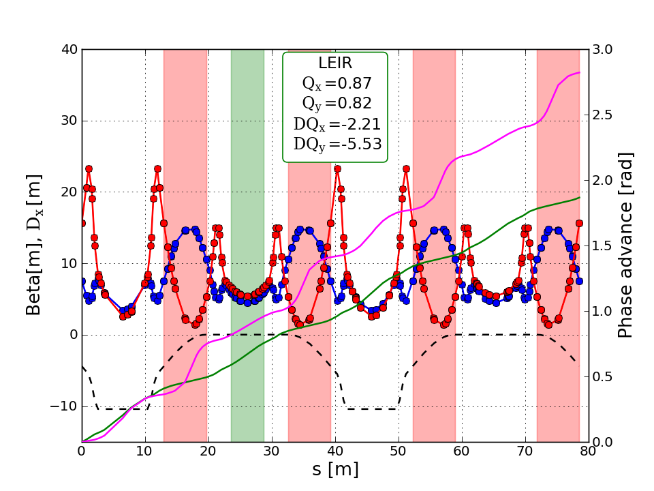
Pb⁵⁴⁺ MADX-PTC simulations with operational parameters
Electron cooler
μ_{y}
Injection
β_{x}
Extraction
μ_{x}
β_{y}
D
Bend
Bend
Bend
Bend

Slide 34
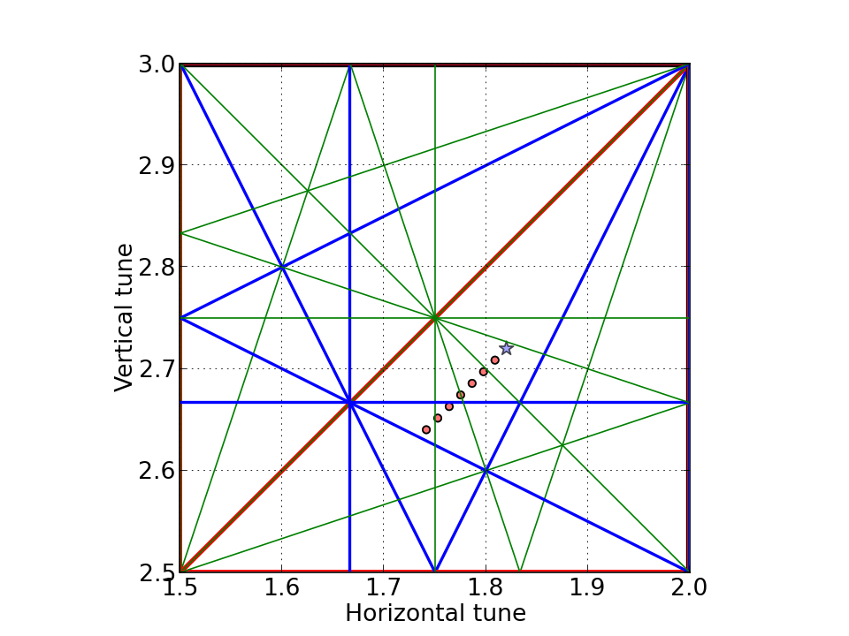
Resonance lines diagram of LEIR
Q_{x} - Q_{y} = -1
2Q_{x} - Q_{y} = 1
4Q_{y} = 11
Q_{x} + 3Q_{y} = 10
3Q_{y} = 8
2Q_{x} + 2Q_{y} = 9

Slide 35
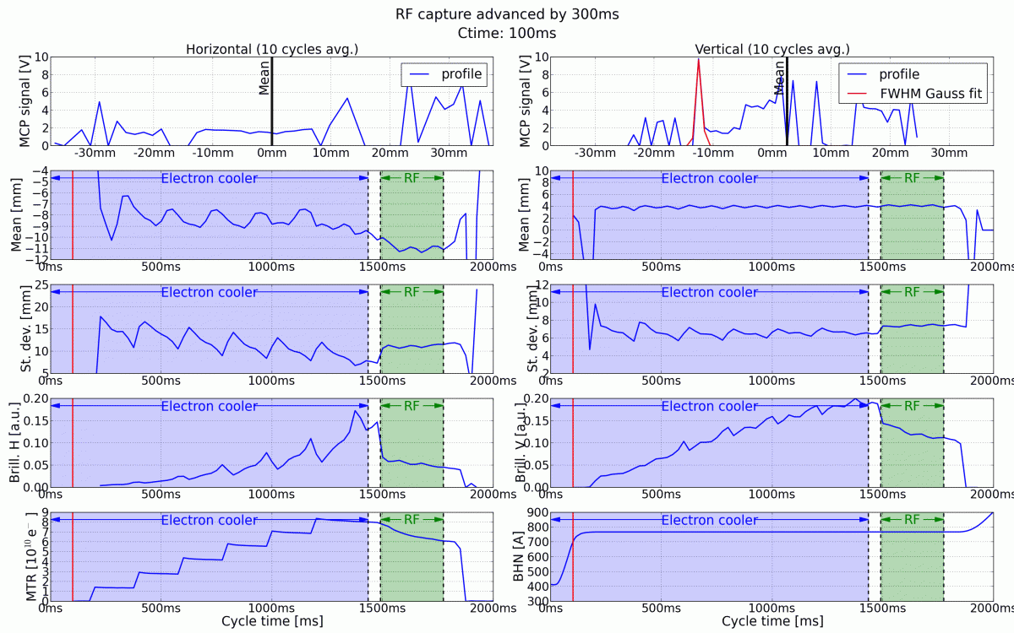
2013:

Slide 36
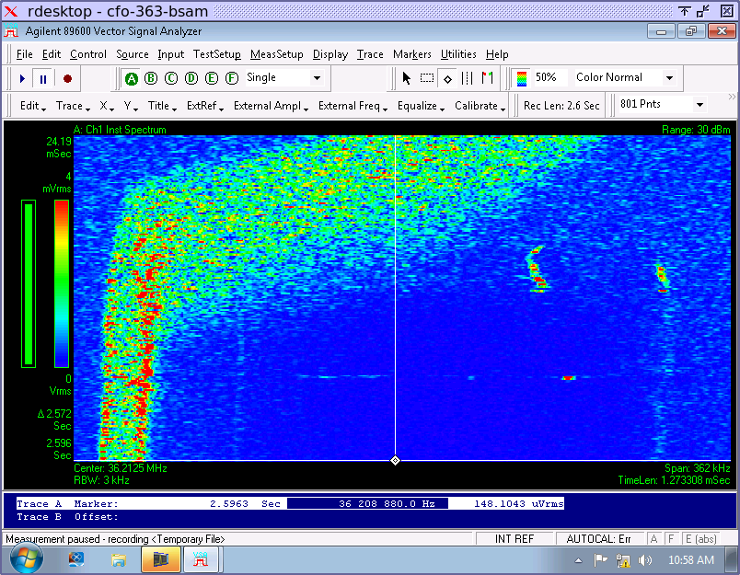
e-Cooler: Electron beam from 200mA to 335mA (with Ar)
Injection
Time
Cooled and dragged beam
200mA
Momentum

Slide 37
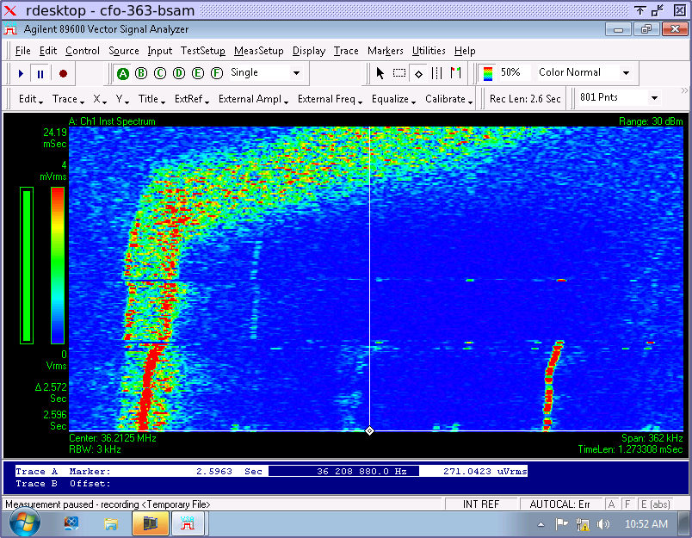
e-Cooler: Electron beam from 200mA to 335mA (with Ar)
Cooled and dragged beam
Time
335mA
Momentum

Slide 38
SPS-slip stacking: news from the past (PS)
From Philippe

