Slide 2
Joint LIU – HL-LHC meeting Session 3 – Shutdown planning LIU Project Julie Coupard
In collaboration with the Facility Coordinators of the PSB, PS&TT2 and SPS machines: David Hay, Simon Mataguez, David Mcfarlane
Julie Coupard, LIU – HL-LHC Meeting, 15th October 2015

Slide 3
Content
Master Schedule of the LIU Project
Activities and Schedule
Linac2-3-4 + transfer lines LT, LTB and BI
PSB machine + transfer lines BI and BTP and BTM
PS machine and TT2 + transfer line BTP
SPS machine + transfer lines TT10, Ti2 and Ti8
Status of preparation
Conclusions
Reference: LS2 Days, Scope & Objectives of the LS2 - LIU Activities during LS2 https://indico.cern.ch/event/436424/
To note: Detailed injectors beam commissioning timeline, with all beam types details, will be covered in another LIU dedicated meeting

Slide 4
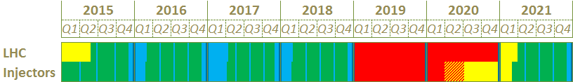
Master schedule of the LIU Project
Activities independent from the operation (i.e. surface, Linac4…)
Long Shutdown
Commissioning
Operation
Technical Stop
YETS 2015
*
YETS 2017
LS2
EYETS 2016
1
2
3
4
3 periods are available for works before the Long Shutdown 2 (LS2):
Some activities will be anticipated wrt the availability of the equipment involved and machines operation
Decabling campaign will start for the obsolete systems (ref. Sebastien’s talk)
*: The connection of the Linac4 to the PS Booster is foreseen for the LS2 but all equipment need to be ready by the end of 2016 in case of an early full connection.
Machines | Opening of the machine (weeks) not including the xmas break of 2 weeks
 | YETS 2015 | EYETS 2016 | YETS 2017
PSB | 10 | 13 | 8
PS | 8 | 13 | 8
SPS | 8 | 11 (BA1) - 13 | 7 (BA1) - 8
EDMS 1470895: Length of the YETS 2015-2016 / EYETS 2016-2017 / YETS 2017-2018
Access constraints defined with the Facility Coordinators

Slide 5
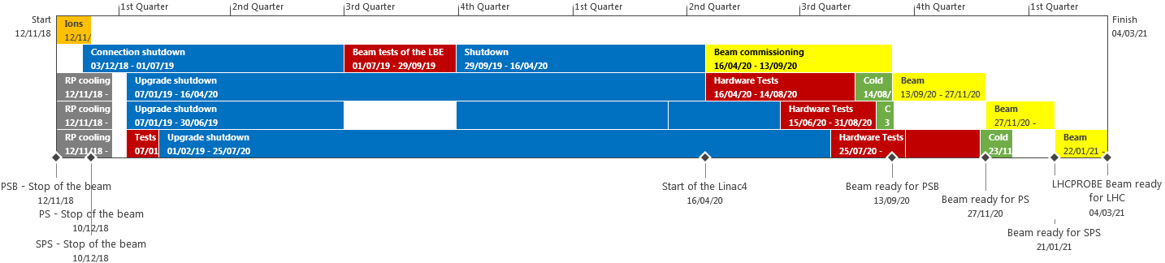

Master schedule of the LIU Project
L4
7 months
PSB
15.5 months
PS
11.5 months
SPS
18 months
The machine schedules are defined individually and need to be combined in order to level the resources.
Start of LS2 for the injectors:
Surface activities for Linac2, Linac4 and PSB machines will start in November 2018, during tunnel RP cooling.
All other surface activities for PS and SPS will start at the end of the ion run, in December 2018.

Slide 6
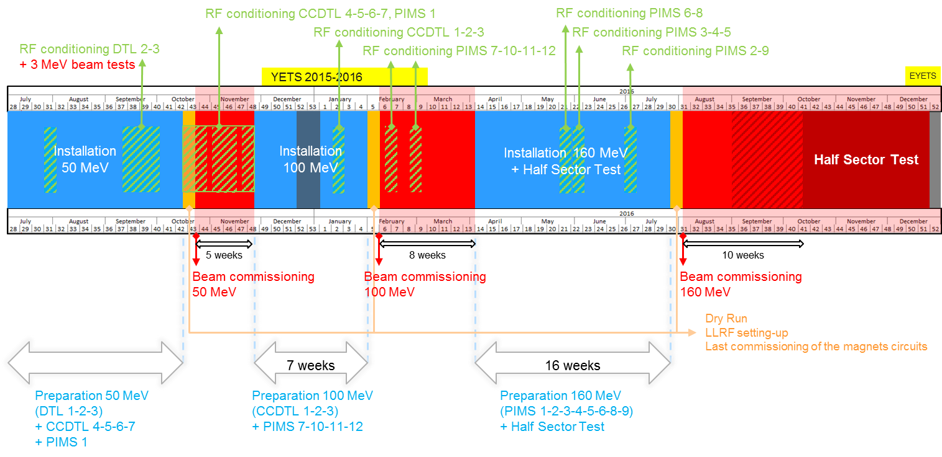
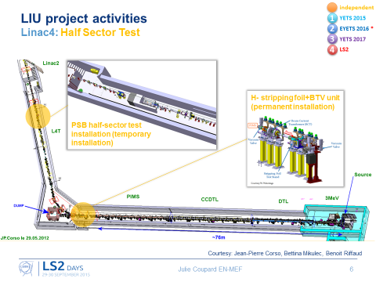
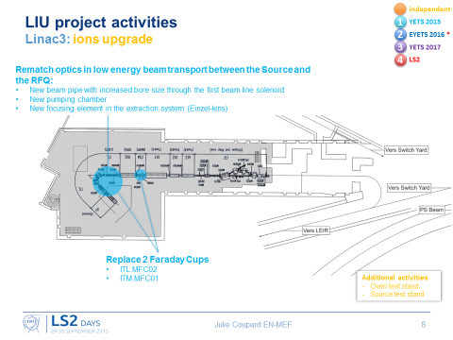
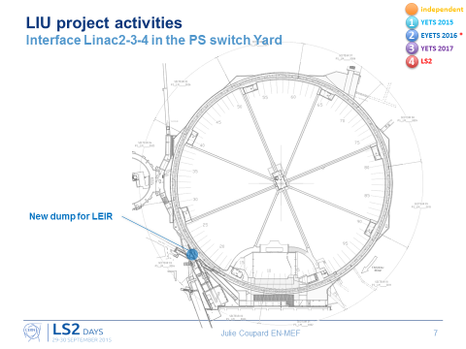
Activities and Schedule Linac2-3-4 + transfer lines LT, LTB and BI
Linac4
Installation phase for 100 MeV is in parallel of the YETS 2015-2016
Installation phase 160 MeV during the 2016.
Linac3 & LEIR
LIU-IONS upgrade will be done during the YETS 2015-2016 and EYETS 2016-2017

Slide 7
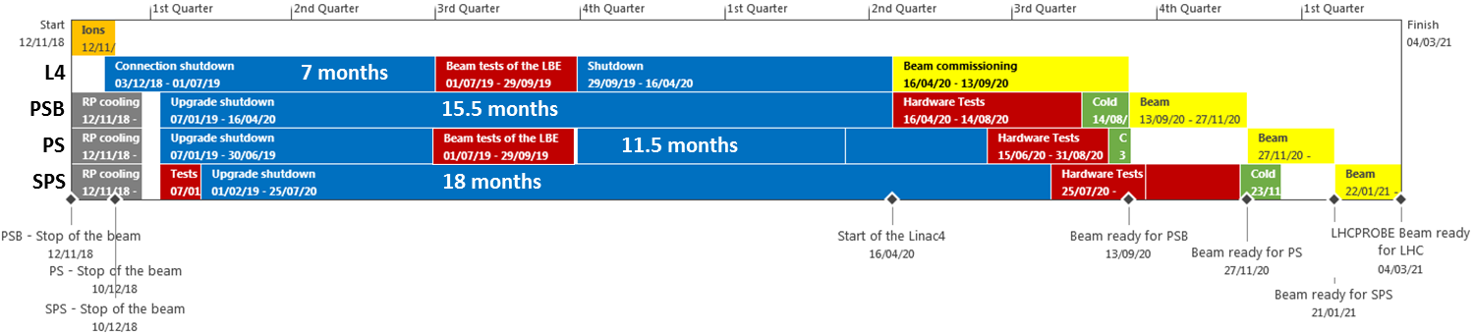
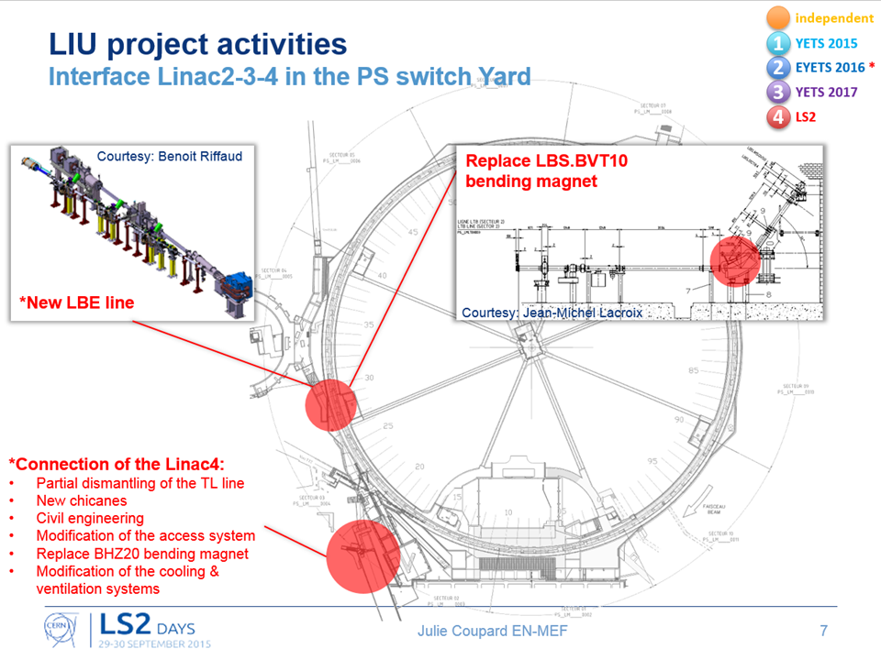
Activities and Schedule Linac2-3-4 + transfer lines LT, LTB and BI
7 months
During the connection of the Linac4 to the PSB, many works will be carried out in the interface with Linac2 and the PS switch yard.
It is important to define if:
The services of Linac2 can be considered as obsolete and dismantled, especially in the room of building 363 in order to define the new layout of racks for the power converters.
The Linac2 area should remain accessible during the Run 3 after the LS2.

Slide 8
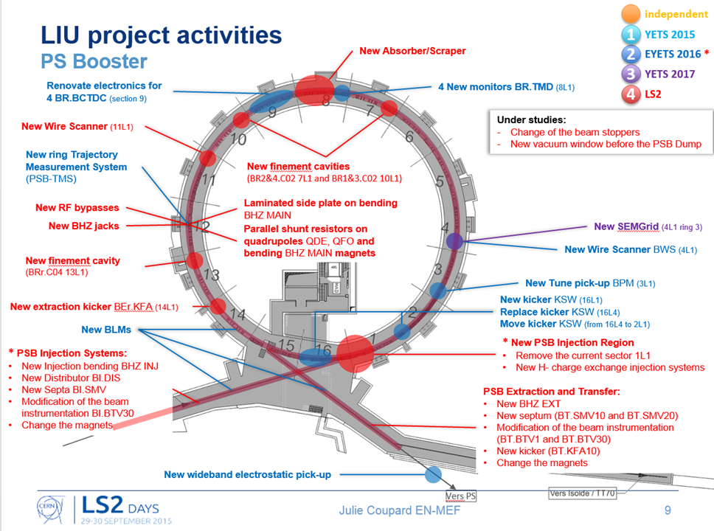
Activities and Schedule PSB machine + transfer lines BI and BTP and BTM
Connection of the Linac4
LS2 (*)
The connection of the Linac4 to the PS Booster is foreseen for the LS2 but all equipment need to be ready by the end of 2016 in case of an early full connection.
Decabling/Cabling campaigns
Consolidation
LS2
PS Access system evolutions
Additional consolidation works (?)
Cooling and Ventilation (risk of asbestos) (?)
…

Slide 9
Activities and Schedule PSB machine + transfer lines BI and BTP and BTM
15.5 months
Critical tasks identified
Decabling/cabling campaign for the PSB rough estimation to be studied with safety aspects such as RP, electrical
Option 1: 20 weeks for decabling + 38 weeks for cabling in one shift = 14.5 months
Option 2: 9 months with two shifts
Consolidation of the PSB ventilation systems (risk of asbestos) = impact planning
Courtesy Georgi Georgiev

Slide 10
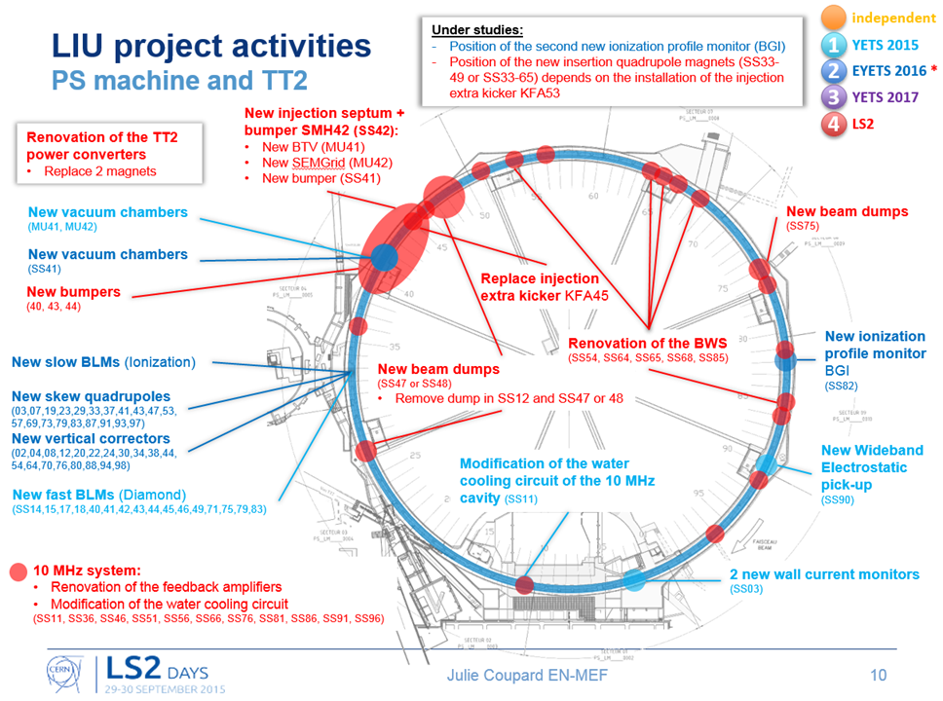
Activities and Schedule PS machine and TT2 + transfer line BTP
Decabling/Cabling campaigns
Consolidation works (?)
Renovation of 43 quadrupole magnets in TT2 (?)
Refurbishment of 44 main units with new PFW (?)
Consolidation of the PS ventilation systems: removal of air cooling pipe (risk of asbestos) (?)
…

Slide 11
Activities and Schedule PS machine and TT2 + transfer line BTP
11.5 months
Critical tasks identified
Consolidation of the magnets (if validated)
Refurbishment of 44 main units with new PFW = 12 months
Courtesy Simon Mataguez

Slide 12
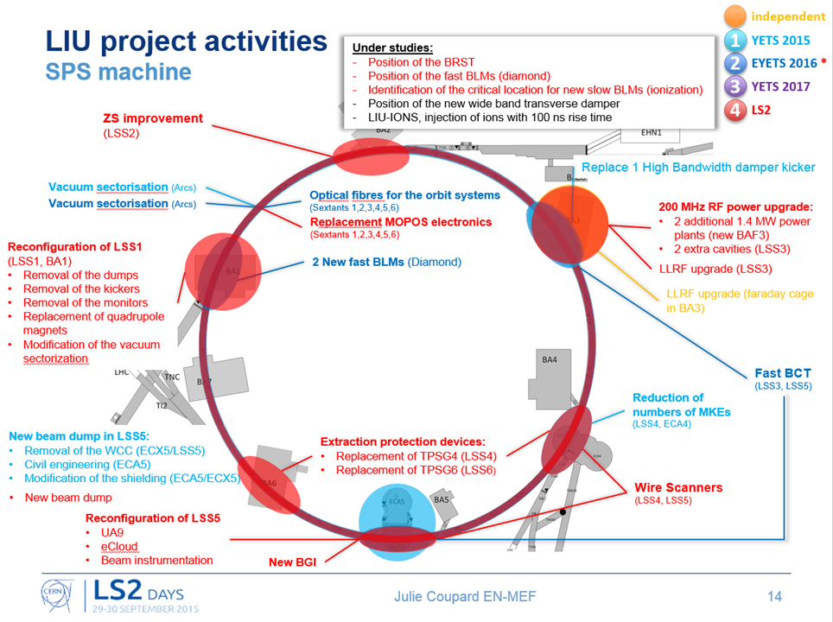
Activities and Schedule SPS machine + transfer lines TT10, Ti2 and Ti8
aC coating
EYETS 2016-2017:
pilot (up to 1 arc) for coating QFs and QF SSS, in synergy with impedance reduction;
A few (4) MBB half-cells coated in-situ, to prototype the ‘final’ cleaning and coating technology;
Replacement of some (10%) standard 156 mm drifts with coated chambers.
LS2:
Complete coating of remaining QFs and QF SSS, in synergy with impedance reduction;
Pilot (1 arc) MBB coating, to debug full-scale logistics and quality control;
Replacement of remaining 156 mm standard drifts with coated chambers.
Decabling/Cabling campaigns
HL-LHC
YETS 2015-2016:
High band-with pick-ups in LSS4
EYETS 2016-2017 & YETS 2017-2018:
Crab-cavities in LSS6
Consolidation
LS2:
Renovation of the access system
Consolidation of the electrical substation SPS 4-6-3

Slide 13
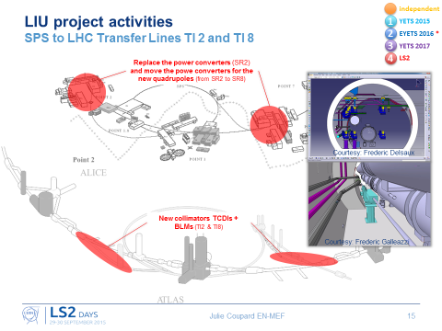
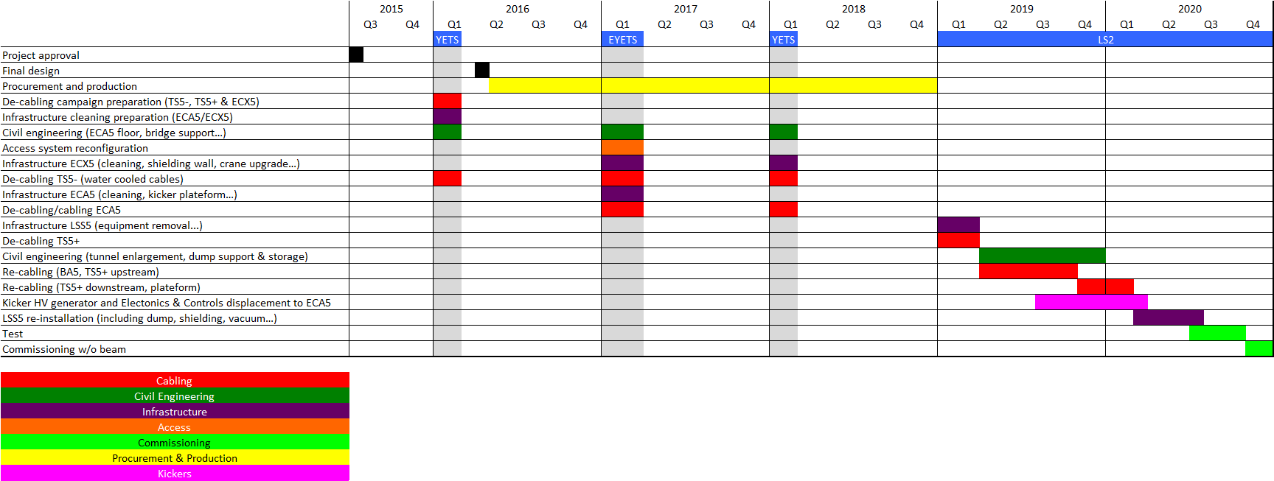
Activities and Schedule SPS machine + transfer lines TT10, Ti2 and Ti8
18 months
Critical tasks identified
Installation of the new beam dump in LSS5
aC coating
Courtesy Etienne Carlier

Slide 14
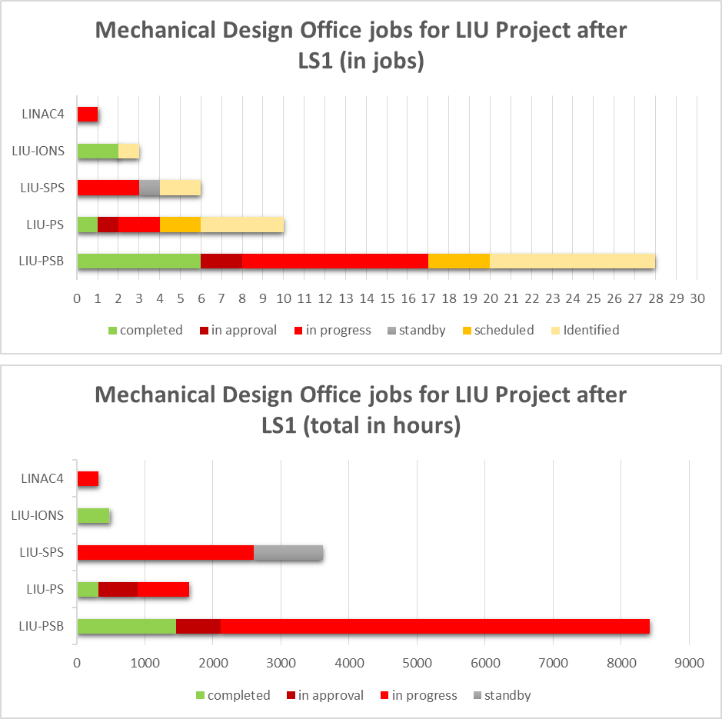
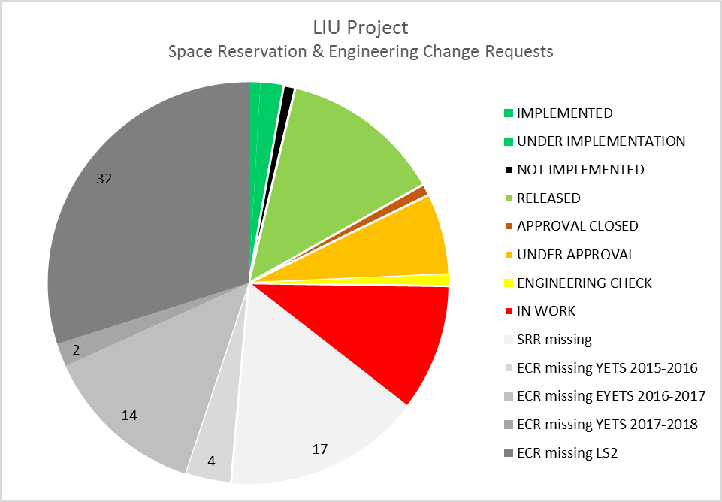
Status of preparation
Close collaboration with EN-MME design office
Lots of integration studies in progress
Follow-up on the ECR before installation
23-Sept-2015

Slide 15

Conclusions
The (E)YETS before the LS2 will focus on the decabling campaigns. ref. Sebastien’s talk
Co-activities between the decabling campaigns and the works scheduled during the (E)YETS to be carefully identified → close collaboration between EN-MEF and EN-EL.
It is important to defined which announced consolidation works are validated.
The length of the LS2 gives more time for the PSB but the LIU-PSB is still on the critical path.
The LIU Project will be completed during the LS2 but
aC coating in the SPS:
Run3: Evaluation of whether these improvements, plus some improvements to the transverse damper, are already enough to reach the performance target
LS3: If required, coating of remaining MBBs around the machine

Slide 17
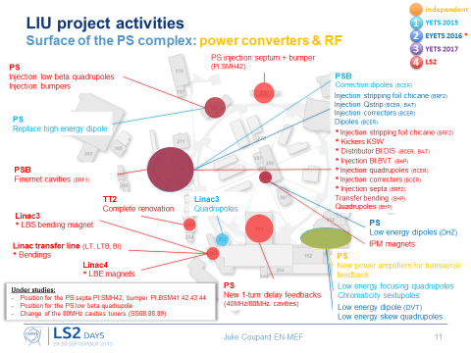
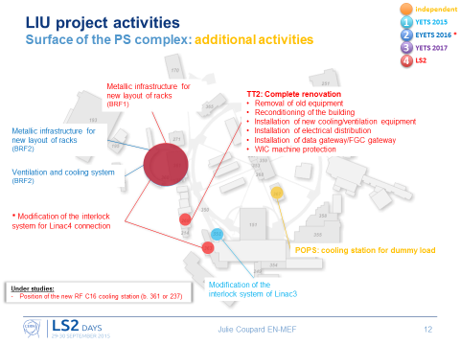
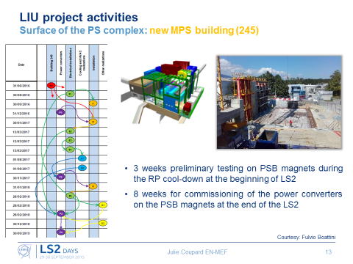
Activities and Schedule Surface

Slide 18
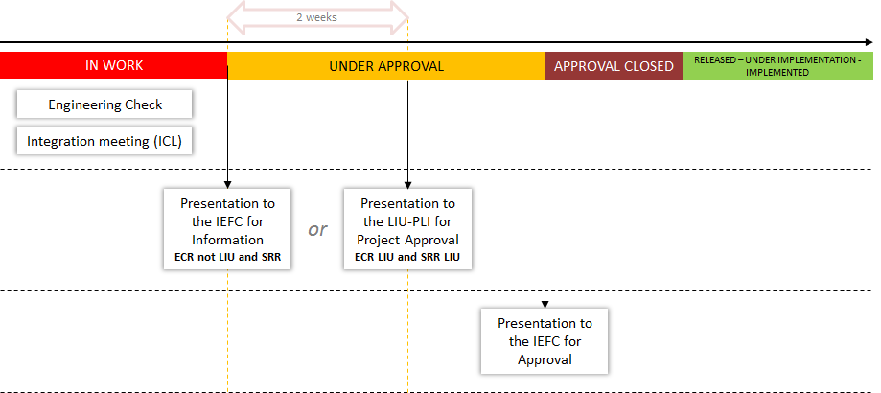
Back-up slides Process of the Space Reservation and Engineering Change Requests for the injectors

Slide 19
LIU Project LS2 schedule
LS2 – update time estimation
Linac4 :
7 months for the connection + 3 months for beam tests in the LBE line + 6.5 months of shutdown (=no work) + 5 months of beam commissioning = 21.5 months
PSB :
1.5 months of RP cooling + 15.5 months of work in the machine + 5 months of hardware tests and cold check out = 22 months
+ 2.5 months of beam commissioning (LHCPROBE)
PS :
1.5 months of RP cooling + 11.5 months of work in the machine (+ 3 months of machine closed because of the Linac4 beam test in the LBE line) + 3 months of extra-time + 3 months of hardware tests (11 weeks) and cold check out (2 weeks) = 22 months
+ 1.5 months (6 weeks) of beam commissioning (LHCPROBE)
SPS :
1.5 months of RP cooling + 4 weeks of magnets tests + 18 months of work in the machine + 5 months of hardware tests (2 months + 2 months of extra-time) and cold check out (4 weeks) = 28.5 months
+ 1.5 months (6 weeks) of beam commissioning (LHCPROBE)
/!\ DSO tests for the SPS = +1 week
L4
7 months
PSB
15.5 months
PS
11.5 months
SPS
18 months
11 weeks
4 weeks

