Slide 1

CERN-MEDICIS
An update
Thierry Stora, EN-STI

Slide 2
The Scope
Biomedicine
Innovative protocols (Surgery/brachytherapy/combination)
Innovative isotopes for imaging and treatment
Studies on cells, animals (« preclinical »)
possibly extended to clinical phases
(needs upgrades, but this can be reached)
Field of Application | Radiation | Chemical elements | Half lives
PET | β⁺ | Alkaline earth Halogen Lanthanide Transition metals … | 10’s min. Hours Days Months
SPECT | γ
TAT | α
Beta therapy | β⁻
Auger therapy | e⁻

Slide 3
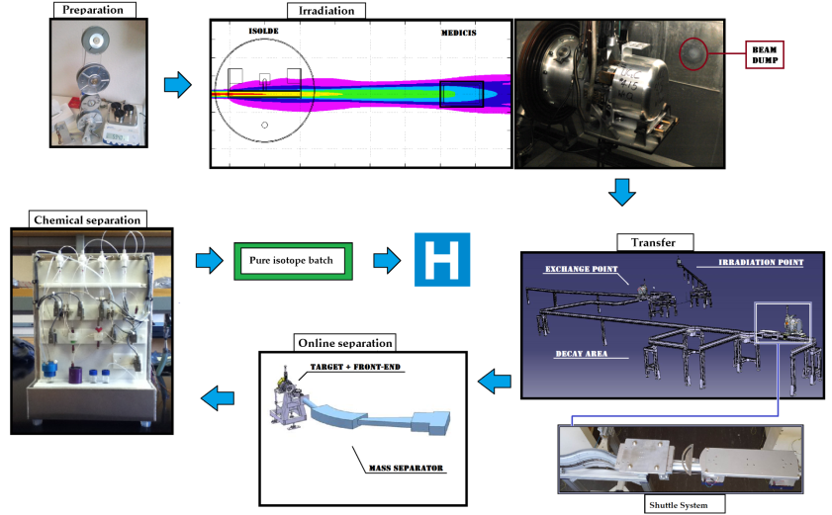
Why CERN-MEDICIS could be done *?
* Without an additional proton driver
Offline separation

Slide 4

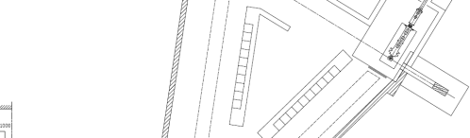
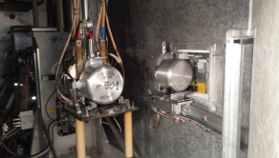
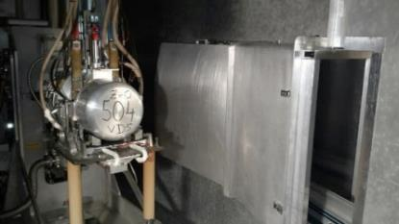
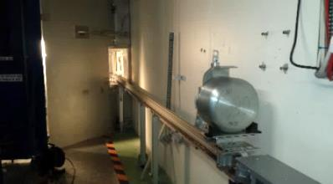
Irradiation station commissioned with beam
M. Vagnoni (EN-STI fellow), et al.
Proton Beam
HT
Cover grounded
During last 2015 Isolde beam time (CRIS)
Tests with protons:
Done successfully !
& RIB separated 1 week later
on GPS

Slide 5
The building extension
Temporary shielding removed
And final shielding/access under way

Slide 6
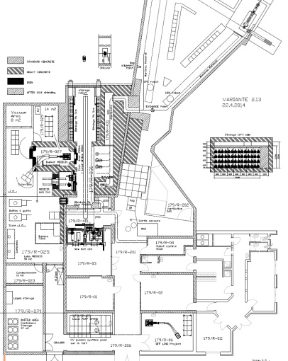


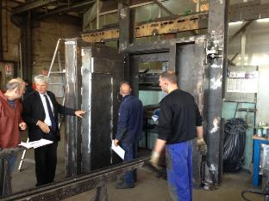
The building extension
J.L. Grenard, K, Kershaw et al.
Storage shelves (V. Barozier & Y. Gavrikov)
Robot hardware installed
Last shielded door

Slide 7
The nuclear ventilation

Slide 8
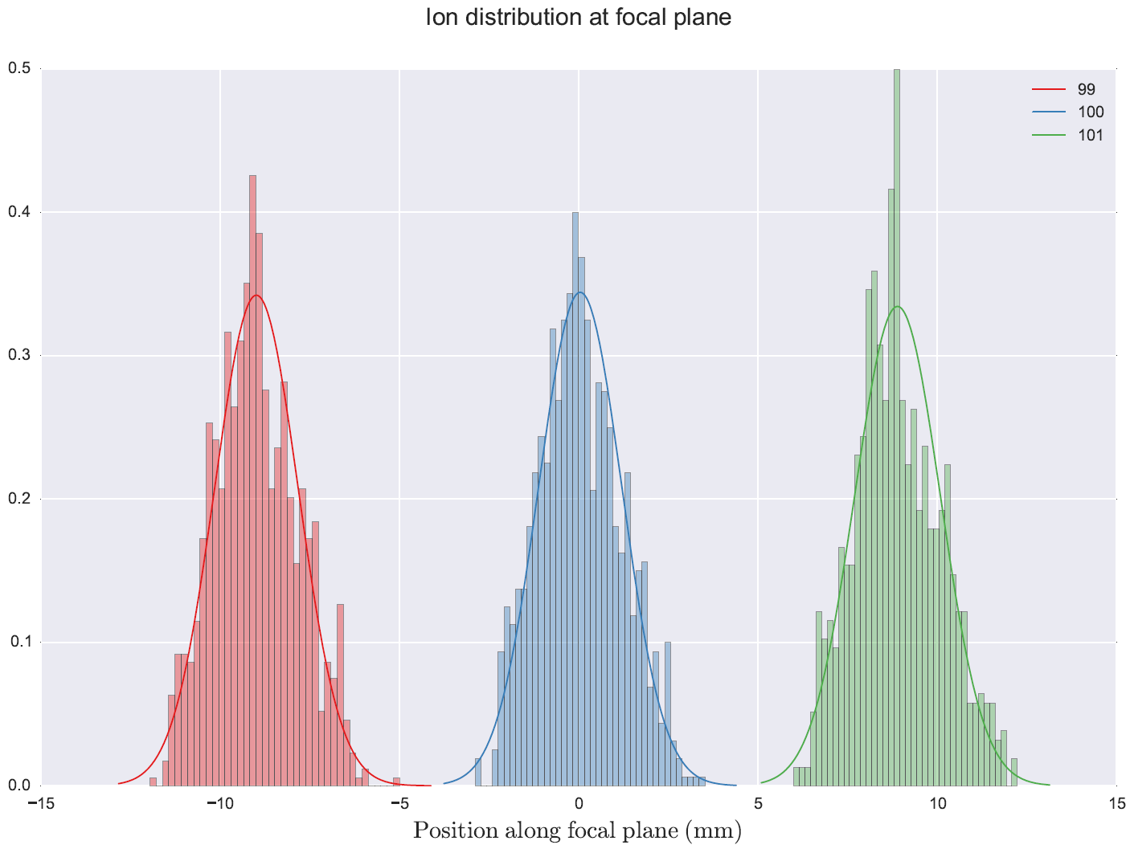
The Mass separator
LISOL dipole ready for shipment
In Louvain La Neuve
Separator in CERN-MEDICIS
Configuration (Y. Martinez)
Conceptual design – collection chamber (A. Brown)

Slide 9
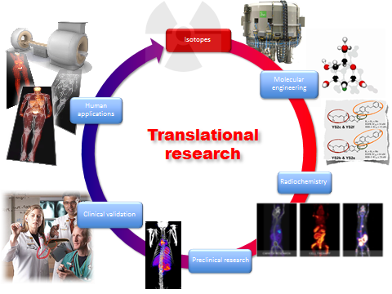
The scientific case
Courtesy prof. Ratib, in the context of the CERN-MEDICIS project

Slide 10
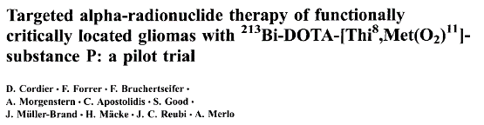
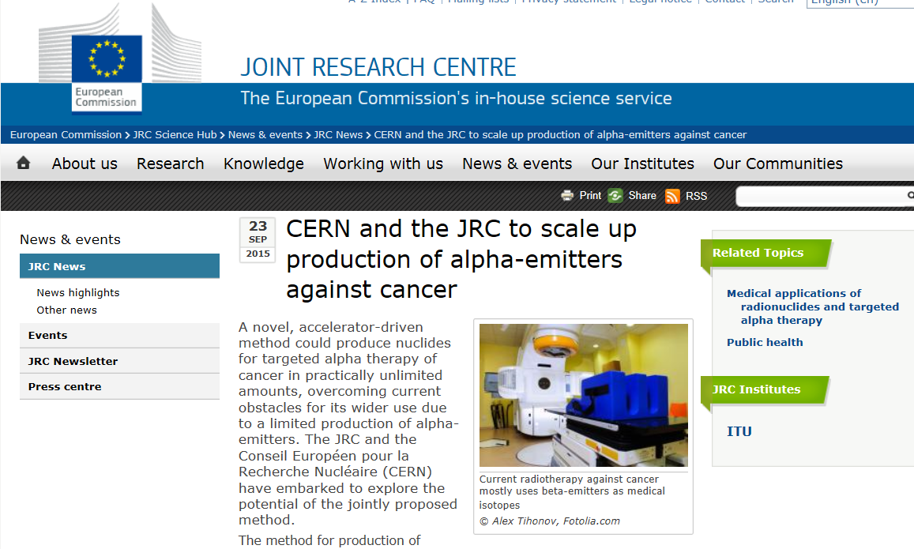
Collaboration with JRC-ITU
Intracavity injection
+resection of Glioblastoma

Slide 12
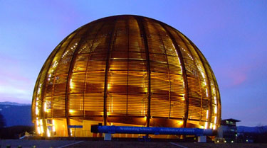
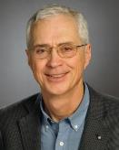
Outreach
1st yearly Grace-MEDICIS collaboration/public lecture
took place on 15th October 2014
The 2nd one is in preparation:
Prof. W. Weber, Memorial Sloan Kettering Cancer Center New York
Prof Doug Hanahan
Director ISREC Lausanne
AACR’s Lifetime Achievement Award

Slide 13
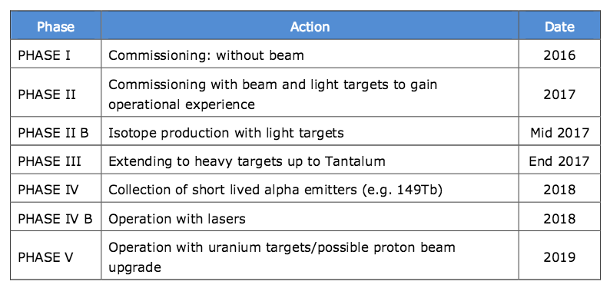
Tentative planning
(*)
* Preferable but may be hard to achieve

Slide 14

MEDICIS-PROMED
« MEDICIS-Produced radioisotope beams for medicine »
www.cern.ch/medicis-promed

Slide 15




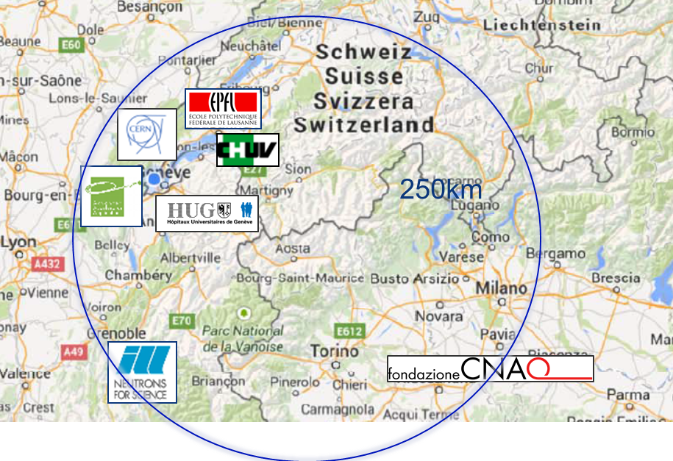
The intersectorial distributed network
The intersectorial
“regional” network
CERN, HUG, CHUV, EPFL
AAA, ILL, CNAO

Slide 16
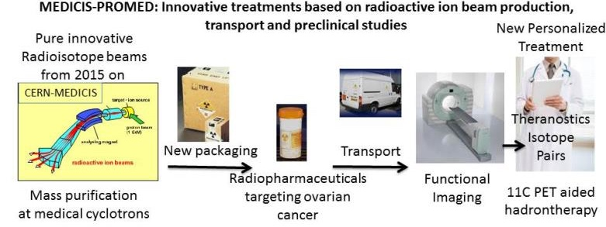
Overview of the Research Network
>7/15 young researchers have been hired : recruitment → Dec 2015
Medical coordination : PhD, MD J. Prior, CHUV

Slide 17
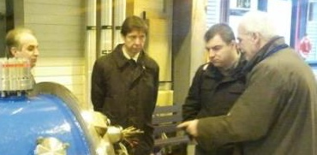
Training : Events and models
Kick-off week – CERN (EU) 1st half feb 2016, and ICTR-PHE 2016
General training 1 – Manchester (UK)
Workshop on functional multimodal SPECT/PET imaging – Lausanne/Geneva (CH)
Specialized training 2 – Leuven (BE)
Summer school 1 at CNAO – Pavia (IT).
Summer school 2 at C2TN-IST – Lisbon (PT)
K. Novoselov, Graphene Institute – Physics Nobel Prize 2010 – Scientific Innovation and Advanced Materials
U. Koester, ILL- chairman of the NuPECC working group for Nuclear Physics for Medicine-Radioisotope production– Production of medical radioisotopes
P. Van Duppen, KUL – Adv ERC – Radioactive Ion Beams and Lasers
S. Buono, AAA – Radiopharmaceuticals marketing and Entrepreneurship
G. Coukos, CHUV – Adv. ERC – Immunotherapy and cancer treatment
P. Lecoq, CERN – Adv ERC – Detectors and Medical imaging
K. Noda-san – NIRS – PET-aided hadron therapy with carbon ions
Program cohesion : Oxford University Said Business School (ECTS, PhD)

Slide 18



And many orthers
Thank you, questions , comments ?

Slide 19
Some yield estimates

