Slide 1
How to handle a radioactive nucleus: a LEGO robot for ISODLE
S. Qureshi, J. Hayes, T. Cocolios, E. Nichols
03-12-2015

Slide 2
The Brief
10 LEGO Mindstorm Education sets
In celebration of ISOLDE’s 50th anniversary
To engage at least 60 schoolchildren aged 14-16 to promote careers in science
Initial ‘robot competition’ fell through
Repurposed into a transferrable and mobile robotics workshop

Slide 3
Designing LE-MITH
Limited by the pieces included in each set
Based on the included model, first design had a few flaws
Unique short-action lever was designed to execute compound movements
Design must be simple enough to produce instructions
Notes:
In order for the workshop to be as adaptable as possible, no additional pieces were used outside those included in the base Education set. This is so that the workshop may be easily implemented at a new location.
As the workshop was to last 2-3 hours, students cannot build robots during the session. Focus was on programming.

Slide 4
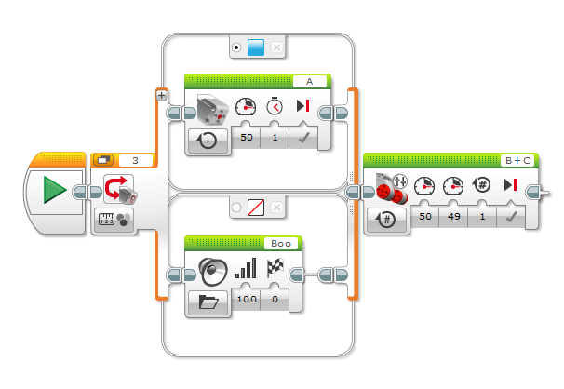
Programming LE-MITH
Implemented using proprietary language
Uses pictograms and simple variables to introduce the concept of programming
Workshop content
delivered through
IDE using included
teaching tools

Slide 5
Delivering LE-MITH
15 minute presentation about nuclear physics
Tackles misconceptions about the nuclear industry
To date:
  13 volunteers trained to run sessions
  2 sessions delivered
  Additional training session booked
  Interest expressed from 15 further schools

Slide 6
Participant Feedback
Statement | Score /28
“I would recommend this workshop to a friend.” | 27
“I enjoyed this workshop.” | 24
“I now understand the importance of robots in the nuclear industry.” | 21
“The session has improved my programming skills.” | 20

Slide 7
Future Scope
Flexible – can be adapted, e.g. Mars rover theme.
In current state, workshop can be implemented remotely
Capacity to expand designs of both LE-MITH and new, more complex robots.
Will continue into 2016 despite end date.

Slide 8
