Slide 1
XRootD Release 4.4
New Features
ATLAS TIM
CERN
June15-17, 2016
Andrew Hanushevsky, SLAC
http://xrootd.org

Slide 2
Release 4.4
Includes several significant features
  This presentation does not cover all of them
    Focus here is on ATLAS
Three main features
  Proxy async I/O
  Disk Caching Proxy
  Metalink file support

Slide 3
Proxy Server Async I/O
Proxy now handles async I/O requests
  Previously converted async to sync I/O
Motivation
  Improve streaming performance of xrdcp
  Improve Disk Caching Proxy performance
    Certain background operations (e.g. pre-fetch)
  May require tuning to get best performance
    See xrootd.async directive

Slide 4
Proxy Server Async I/O (continued)
Considerations
  This must not be disabled in the config file
    Default is on but many sites turned it off
      Historic problems with now unused Globus libraries
      Remove xrootd.async off
  XRootD POSIX interface extended
    Added additional callback based methods
      Non-standard API but meant for internal use only
        Proxy is based on XRootD POSIX interface
      Interface is still ABI compliant

Slide 5
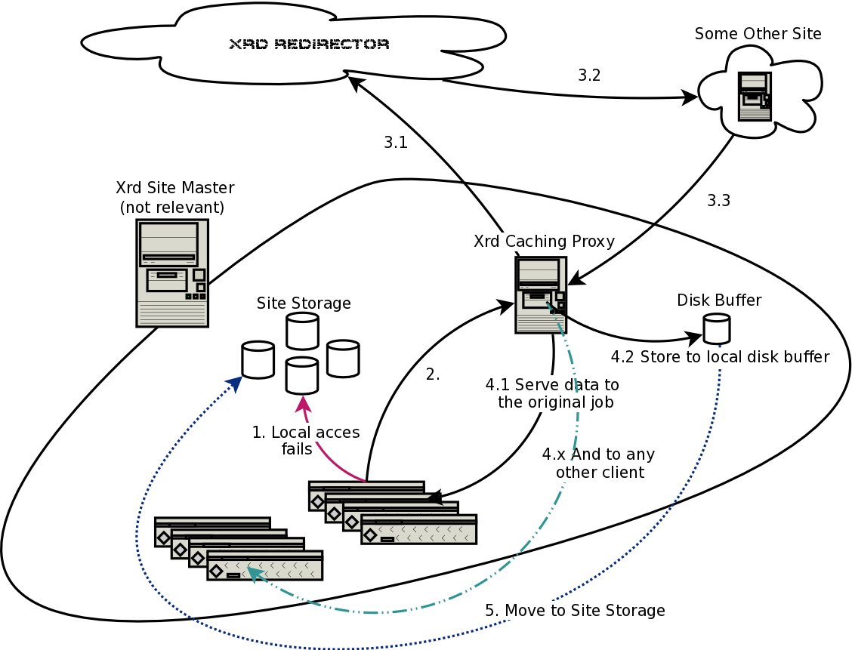
Disk Caching Proxy I
File or block
level caching

Slide 6
Disk Caching Proxy II
High potential to solve vexing problems
  Reduced remote latency for user analysis
  Just in time data
    Avoids pre-placement delays
  Optimized disk space utilization
Cached data access via xroot and http
Currently being tested at scale
  MWT2, SLAC, University of Notre Dame

Slide 7
Disk Caching Proxy Deployment
Target sites without ATLAS managed disk
  Opportunistic sites
  OSG diskless sites
  Pacific Research Platform sites (NSF funded program)
    NASA, NREN, U Washington, UC School System
      Includes University California LHC sites (3 ATLAS T3’s)
    Interconnected via CalREN, ESNET, & Pacific Wave
      Sites and networking may expand

Slide 8
Metalink File Support I
XRootD client handles metalink files
  Version 4 with “.meta4” suffix
    RFC 5854
  Version 3 with “.metalink” suffix
    www.metalinker.org/Metalink_3.0_Spec.pdf
All relevant tags are supported
  hash, size
  url (including type, preference and priority)

Slide 9
Metalink File Support II
Metalink file is processed when…
  Source input to xrdcp
  When opened by the XRootD client
Metalinks treated as a virtual redirector
  Provides consistent interchangeable context
    Metalinks and redirectors are equivalent

Slide 10
Metalink File Support III
Consistent context is critical
  Automatically uses new performance features
Key performance features on the horizon
  Source server real-time optimization
    Largely based on CMS developed code
  Multi-source parallel copy via xrdcp
    Based on advanced torrent-like algorithms
      Avoids a slowdown tail in the copy

Slide 11
Release 4.4 Status
Disk Caching Proxy Largest feature in 4.4
  Holding off until all known edge cases solved
    We want a stable release at the get-go
This is producing a delay in 4.4 launch
  Willing to split release (i.e. 4.4 and 4.5)
    Depends if other features are wanted now!

