Slide 1
Work Flow Management Software
.
Introduction
ATLAS Distributed Computing TIM
June 14, 2016
Fernando Barreiro and Alexei Klimentov

Slide 2
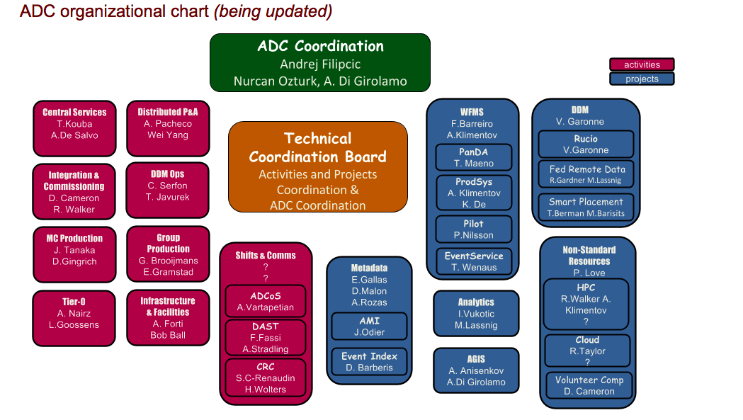
ADC Organization since mid April 2016
WorkFlow
Management
Software
https://twiki.cern.ch/twiki/bin/viewauth/AtlasComputing/AtlasDistributedComputing
Additional coordination layer to group individual projects
  WFM software box includes monitoring and packaging
  pilot is a new ‘box’ in org.chart

Slide 3
WFM System Software Project: Organization and Primary Goals
Workflow Management Software project has been proposed by the ADC Management in March. ADC Management also defined its main components; project structure was finalized in April.
The project will bring together developers from different projects and areas. It is aiming to:
  propose and implement a coherent WFM strategy for various workflows
  simplify the operational burden
  avoid duplication and overlaps in software development
The project will also address issues with monitoring, packaging and WMF software releases

Slide 4
WFM Software Project Organization: Key Components
PanDA (T. Maeno)
ProdSys (K. De, A. Klimentov)
Pilot (P. Nilsson)
Event Service (V. Tsulaia, T. Wenaus)
Monitoring (S. Padolski)
Packaging (F. Barreiro, R. Mashinistov)
Machine Learning for ProdSys2 (A. Klimentov)

Slide 5
WFM Software Project Organization (cont’d)
Important events (March - June)
  ProdSys2 technical meeting in March SW&C week https://indico.cern.ch/event/503575/
    TTC
    #Tag
  2 days PanDA Workshop held in April https://indico.cern.ch/event/520093/
    Internal review to plan our activities and see where to focus the effort
      Pilot2.0
      Monitoring performance
      PanDA beyond ATLAS
  Data Knowledge Base kick-off meeting (May)
    https://indico.cern.ch/event/527581/
      “spread sheets” evolution ☺
  WFM/DDM review (May)
    See Simone’s slides
  Yoda working meeting in June ADC TIM weekend
    Harvester
      Probably KD will invent another name (see f.e. https://www.getharvest.com )
WFMS weekly meetings on Thu with focus topics

Slide 6
This Year New and/or Hot Topics
#Tag
Task Time To Complete (TTC)
Pilot2.0
“spread sheets”
World Cloud and global shares
ML for ProdSys2 anomaly detection (R&D, WLCG R&D + LHCb, CMS)
Monitoring performance
HPC workflow and HPC “monitoring”
Harvester
Beyond ATLAS and LHC
  PanDA for COMPASS and et al
  BigPanDA + Titan project

