Slide 1
David Cameron
ARC Control Tower

Slide 2
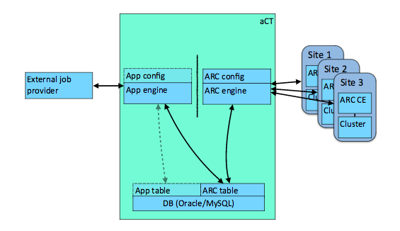
Need for ARC Control Tower
The pilot model does not work well for NDGF
  Requires middleware on the WN, outbound connectivity, synchronous data-staging
Put a service in between Panda and ARC CE
  A “fake fat pilot” pulling jobs, sending them to ARC and dealing with communication with Panda
  Started as ATLAS-specific project, now generic

Slide 3
aCT “Truepilot” mode
aCT has expanded outside NorduGrid
For sites running ARC CE who do not need the full “native” mode with staging etc we provide truepilot mode
  Non-NorduGrid sites who use ARC as a drop-in replacement for CREAM
aCT fetches the payload and submits it to the ARC-CE
ARC-CE submits the batch job with predefined payload, requirements and priority
Pilot on the worker node does the same as on the conventional pilot sites, but skips the fetching of payload from PanDA
aCT sends heartbeats to Panda up until job is running, then leaves it to pilot

Slide 4
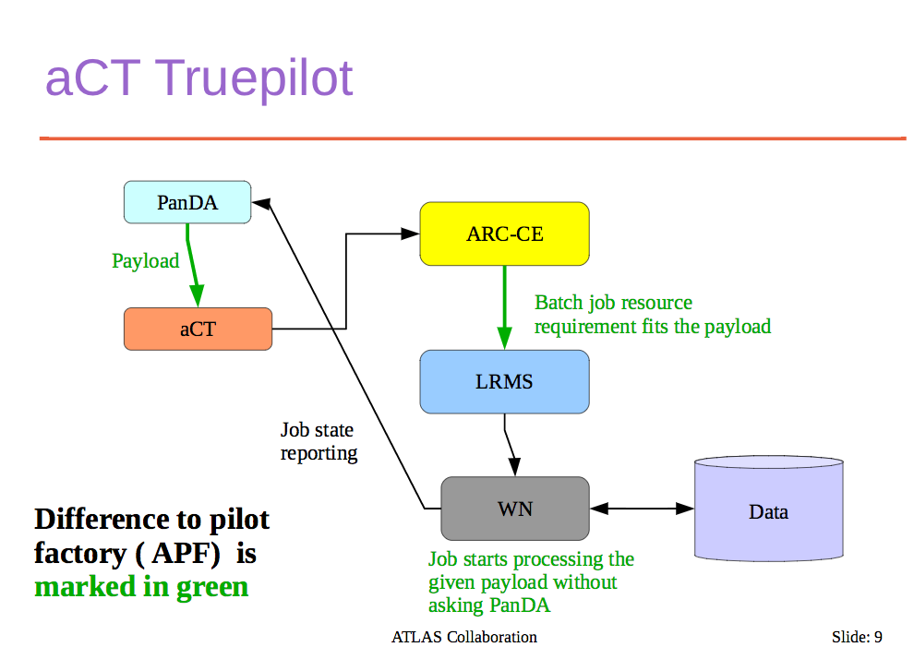
A. Filipcic, CHEP 2015

Slide 5
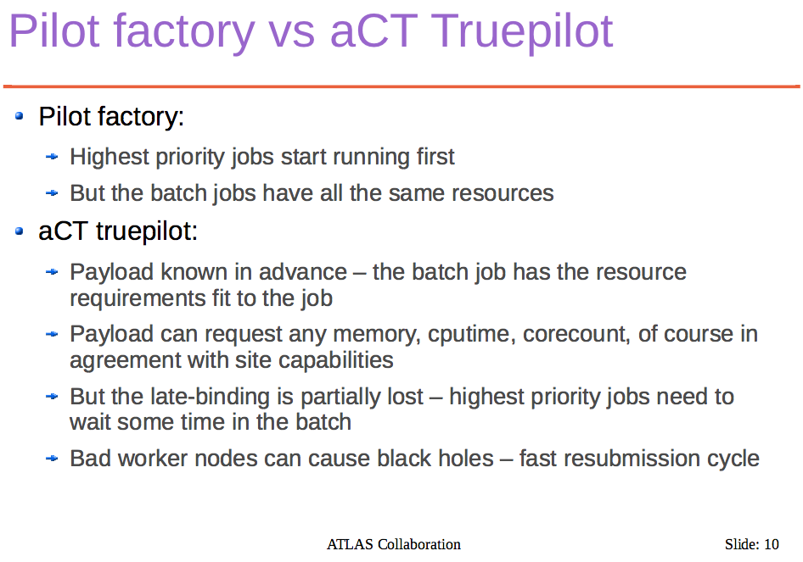
A. Filipcic, CHEP 2015

Slide 6

Summary of aCT/ARC modes
1. APF
2. NorduGrid
3. aCT Truepilot
CERN
CERN
Panda
CERN
APF
Panda
aCT
Panda
aCT
pilot
Site
Site
ARC CE
ARC CE
Data
Site
ARC CE
Data
WN
Data
WN
WN

Slide 7
Site experience: NDGF
“We at NDGF would like to express our satisfaction with aCT, and since we are a time-shared resource, we don't like late binding in general”

Slide 8
Site Experience: LRZ (Munich)
“aCT allows us to have a single pqueue, safe in the knowledge that only jobs that need more memory will reserve it”
“Also the walltime limit is set per job, so run away jobs will not use some high default, like 96hrs.”
“On the HPC-side we cannot run without aCT, for data i/o and lack of outbound IP”
“The latencies from not having pull pilots are rarely noticeable, but for example I would not force an urgent task to LRZ if I am looking at the minute level for a result. Having the priority respected in the BS is important”

Slide 9
aCT service and sites
4 machines at CERN
  2 prod: large physical machines, one master, one hot spare
  2 dev: VMs, for development and testing
Databases:
  Prod machines: MySQL DB on demand service from CERN IT
  Dev machines: local MySQL
Serving ~15% of all ATLAS jobs:
  ND, DE T2s, RAL, TW, BOINC, …
Very basic monitoring:
  https://voatlas403.cern.ch/data/aCTReport.html
Source code (5k lines of python): https://gitlab.cern.ch/arc/aCT

Slide 10
aCT and APF
aCT can trivially reproduce APF functionality
  With added knowledge on site status from site infosys (eg free slots)
  Pilots can be submitted based on what’s really waiting in panda
  Using a flexible stateful DB instead of Condor state machine

Slide 11
Future plans / discussion
We see no technical limitation in serving all ATLAS jobs with aCT
aCT is actively developed and closely integrated with ADC
If ATLAS wishes to expand use of aCT then we will commit to integrating other CEs (eg HTCondor)
Is late-binding really an issue?
  Only if the site is not good enough – with a reliable high-throughput site delay should be minimal
  The Grid always has intrinsic latencies (multiple systems interacting, crons, messaging, data transfer) so late-binding doesn’t solve everything
  Perhaps the Grid itself is unsuitable for the highest-prioirity tasks

Slide 12
References
CHEP papers:
  http://iopscience.iop.org/article/10.1088/1742-6596/664/6/062042/pdf
  http://iopscience.iop.org/article/10.1088/1742-6596/664/6/062042/pdf
CHEP talks:
  https://indico.cern.ch/event/304944/contributions/1672319/attachments/578552/796696/chep2015act.pdf
  https://indico.cern.ch/event/304944/contributions/1672645/attachments/578833/797024/ARC_Control_Tower_-_CHEP2015v5.pdf
Operations twiki:
  https://twiki.cern.ch/twiki/bin/view/AtlasComputing/ARCControlTower

