Slide 1


Mapping Dark energy with fundamental couplings
COSMO-15 - Warsaw
Ana Catarina Leite
Carlos Martins
Relevant references:
  Amendola et al. Phys. Rev. D 86, 063515 (2012)
  Leite et al. Phys. Rev. D 90, 063519 (2014);
  Leite and Martins, Phys. Rev. D 91, 103519 (2015);

Slide 2


Echelle SPectrograph for Rocky Exoplanet- and Stable Spectroscopic Observations
380-700nm spectral coverage
High resolution and stability (Laser Frequency Comb)
80% Rocky Planets, 10% Varying Constants, 10% to be decided: ToO + Exquisite Science
α measurements from absortion systems in Quasar Spectra
Priority Sistems:
  Uncertainty lower than 10ppm
  Measurements with anchors and sensitivity transitions (ΔQ)
  Brighteness
  Sky position
  Simplicity of the spectra

Slide 3





Formalism
Coupling between the scalar field and the electromagnetism
$${\text{L}}_{фF}=−\frac{1}{4}B_{F}(ф) F_{μν}F^{μν}$$
Gauge kinetic function is linear
$B_{F}\left(ф\right)=1−$ζ k ($ф−ф_{0})$
$$\frac{∆α}{α}≡\frac{α−α_{0}}{α}=ζ k(φ−φ_{0})$$
For a flat Friedmann-Lemaître-Robertson-Walker Universe with a canonical scalar field
$${\dot{φ}}^{2}=\left(1+ω\left(z\right)\right)ρ_{φ}$$
$$φ(z)−φ_{0}=\frac{\sqrt{3}}{k}\int_{0}^{z}{\sqrt{1+ω(z)}{\left(1+\frac{ρ_{m}}{ρ_{φ}}\right)}^{−1/2}\frac{dz}{1+z}}$$

Slide 4
Previous work

Slide 5




Principal Component Analysis
$$L({\text{ω}}_{i})=\sqrt{\frac{2π}{A}} exp\left[−\frac{1}{2}\sum_{i,j=1}^{N}{{(μ − μ_{F})}_{i} {D_{ij}^{}}^{−1}{(μ − μ_{F})}_{j}}\right]$$
Likelihood function
Fisher’s Matrix
Dark energy parameterization, ω(z)
$${D_{ij}^{}}^{−1}={C_{ij}^{}}^{−1}−\frac{1}{A}\sum_{k,l=1}^{N}{{C_{kj}^{}}^{−1}{C_{li}^{}}^{−1}}$$
$$A=\sum_{i,j}{{C_{i,j}^{}}^{−1}}$$
$$F_{kl}=−{\left.\frac{∂^{2}\ln{L}}{∂{\text{ω}}_{k}∂{\text{ω}}_{l}}\right|}_{{\text{ω}}^{F}}$$
$$ω\left(z\right)=\sum_{i=1}^{N}{ω_{i}θ_{i}(z)}$$
$$ω\left(z\right)=\sum_{i=1}^{N}{α_{i}e_{i}(z)}$$

Slide 6
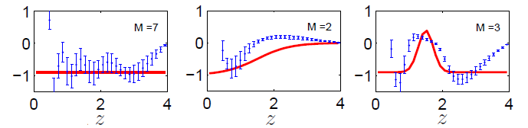
Sample Result
Baseline
- ESPRESSO: N=30 ; 𝜎_{Δ𝛼/𝛼}=6×10⁻⁷
- ELT-HIRES: N=100; 𝜎_{Δ𝛼/𝛼}=1×10⁻⁷
Baseline
- ESPRESSO: N=30 ; 𝜎_{Δ𝛼/𝛼}=6×10⁻⁷
- ELT-HIRES: N=100; 𝜎_{Δ𝛼/𝛼}=1×10⁻⁷
Ideal
- ESPRESSO: N=100; 𝜎_{Δ𝛼/𝛼}=2×10⁻⁷
- ELT-HIRES: N=150; 𝜎_{Δ𝛼𝛼}=3×10⁻⁸
Nº of nights needed to achieve an uncertainty equal to that expected from a SNAP-like dataset of 3000 Type Ia supernovas,

Slide 7
Supernova Surveys
Figure of Merit = 1/(σ₁σ ₂)
LOW (SNAP) - 3000 SN - z: 0 - 1.7
MID (EUCLID) - 1700 SN - z: 0.75 - 1.5
ELT - 50 SN - z: 1 - 5
TMT - 250 SN - z: 1 - 3

Slide 8
Supernova Surveys
Figure of Merit = 1/(σ₁σ ₂)
LOW (SNAP) - 3000 SN - z: 0 - 1.7
MID (EUCLID) - 1700 SN - z: 0.75 - 1.5
ELT - 50 SN - z: 1 - 5
TMT - 250 SN - z: 1 - 3
Supernova type Ia + α meaurements (ESPRESSO, HIRES)

Slide 9
Supernova Surveys
Figure of Merit = 1/(σ₁σ ₂)
LOW (SNAP) - 3000 SN - z: 0 - 1.7
MID (EUCLID) - 1700 SN - z: 0.75 - 1.5
ELT - 50 SN - z: 1 - 5
TMT - 250 SN - z: 1 - 3
Supernova type Ia + α meaurements (ESPRESSO, HIRES)
Euclid survey

Slide 10
Supernova Surveys
Figure of Merit = 1/(σ₁σ ₂)
LOW (SNAP) - 3000 SN - z: 0 - 1.7
MID (EUCLID) - 1700 SN - z: 0.75 - 1.5
ELT - 50 SN - z: 1 - 5
TMT - 250 SN - z: 1 - 3
Supernova type Ia + α meaurements (ESPRESSO, HIRES)
Euclid survey
ELT and TMT gains

Slide 11
Supernova Surveys
Figure of Merit = 1/(σ₁σ ₂)
LOW (SNAP) - 3000 SN - z: 0 - 1.7
MID (EUCLID) - 1700 SN - z: 0.75 - 1.5
ELT - 50 SN - z: 1 - 5
TMT - 250 SN - z: 1 - 3
Supernova type Ia + α meaurements (ESPRESSO, HIRES)
Euclid survey
ELT and TMT gains
High number of measurements vs redshift coverage

Slide 12
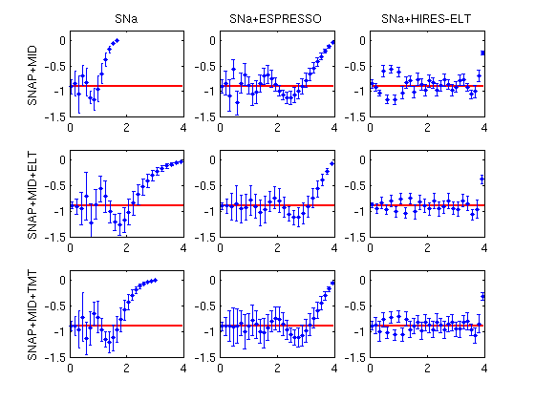
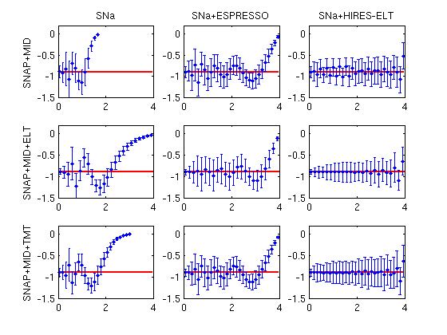
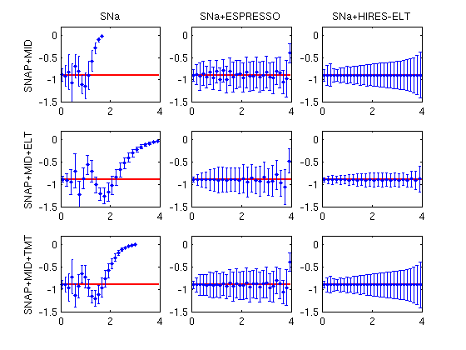
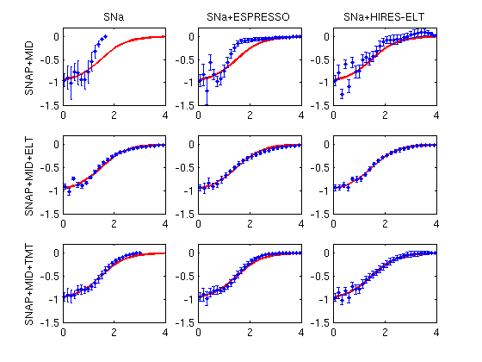
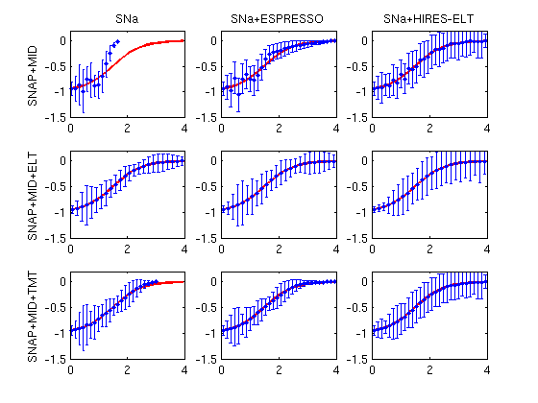
Supernova Surveys
Baseline scenario
Ideal scenario
Risk method
Normalization method
z
Truncation methods:
  Risk vs Normalization
z
z

Slide 13
Supernova Surveys
Baseline scenario
Ideal scenario
Risk method
Normalization method
z
Truncation methods:
  Risk vs Normalization
Scenarios:
  Baseline vs Ideal
z
z

Slide 14
Supernova Surveys
Baseline scenario
Ideal scenario
Risk method
Normalization method
z
Truncation methods:
  Risk vs Normalization
Scenarios:
  Baseline vs Ideal
Importance of high redshift (TMT vs ELT)
z
z

Slide 15

Conclusions
Measurements of $α$ can be used to constrain dark energy, complementing supernovas with the advantage of a larger redshift lever arm
Dark energy equation of state reconstruction improves when we combine the Supernova datasets with $α$ measurements
ELT will be important to reconstruct the equation of state at high redshift ($z >2$)
Existing VLT datasets, although not ideal, give clues on what we will be able to achieve with future Spectrographs

