Slide 1
Polarization Study for CEPC
DUAN, Zhe (IHEP)
Apr 14th, 2016
Acknowledgements:
M. Bai, D. P. Barber, and E. Forest.
FCC Week 2016, April 11-15, Rome.

Slide 2
Outline
Motivation
Analytical Analysis of CEPC polarization
Simulation Tool Development
Conclusion

Slide 3
Motivation
Energy calibration with polarized beam @ LEP was a major achievement from both accelerator and particle physics point of view.
CEPC pre-CDR focused on accelerator design for 120GeV, with an appendix considering Super-Z option(U. Wienands & M. Sullivan).
More detailed study of operation for Z & W are supposed to be contained in CEPC CDR, where beam polarization is one important aspect.

Slide 4
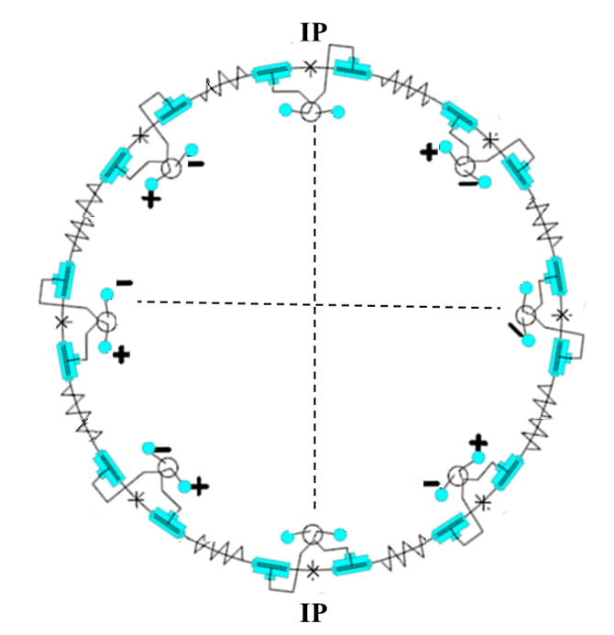
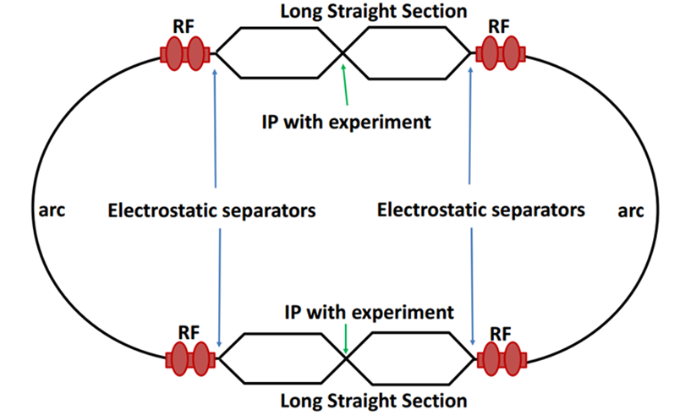
CEPC schemes regarding energy calibration
Single ring (pretzel orbit)
  Similar to LEP
  Energy calibration of one beam
  Energy calibration only after physics
Partial double ring^{[1]}+crab waist
  Similar to FCC-ee
  Energy calibration of both beams possible
  Beam energy monitoring throughout each fill with non-colliding bunches
[1] M. Koratzinos, Proc. IPAC 2015. He named this idea as the “bowtie” scheme.

Slide 5
CEPC self-polarization parameters (54km)
Wangdou 20160325 & Wangdou 20160329
Parameters | Single Ring Z | Partial Double Ring Z | Partial Double Ring W
beam energy(GeV) | 45.5 | 45.5 | 80
radius of curvature(km) | 6.1 | 6.1 | 6.1
circumference(km) | 54 | 54 | 54
momentum compaction factor | 3.4e-5 | 3.5e-5 | 2.4e-5
energy spread(MeV) σ_{ε} | 22.75 | 22.75 | 72.
synchrotron tune Q_{z} | 0.097 | 0.039 | 0.057
polarization build-up time(hour) | 44.9 | 44.9 | 2.67
spin tune spread σ_{ν}=aγ σ_{ε} | 0.052 | 0.052 | 0.16
modulation index σ=σ_{ν} /Q_{z} | 0.530 | 1.34 | 2.86
It was experimentally shown in LEP increased energy spread leads to reduced equilibrium polarization.
According to A. Blondel, 52MeV is tentatively regarded as the maximum energy spread allowing useful polarization for beam calibration. Need detailed simulation to justify.

Slide 6
CEPC self-polarization parameters (88km)
Wangdou 20160329
Parameters | Partial Double Ring Z | Partial Double Ring W
beam energy(GeV) | 45.5 | 80
radius of curvature(km) | 9. | 9.
circumference(km) | 88 | 88
momentum compaction factor | 1.9e-5 | 1.9e-5
energy spread(MeV) σ_{ε} | 18.2 | 56.
synchrotron tune Q_{z} | 0.027 | 0.052
polarization build-up time(hour) | 159 | 9.5
spin tune spread σ_{ν}=aγ σ_{ε} | 0.041 | 0.127
modulation index σ=σ_{ν} /Q_{z} | 1.51 | 2.42
It was experimentally shown in LEP increased energy spread leads to reduced equilibrium polarization.
According to A. Blondel, 52MeV is tentatively regarded as the maximum energy spread allowing useful polarization for beam calibration. Need detailed simulation to justify.

Slide 7
CEPC self-polarization parameters (100km)
Wangdou 20160329
Parameters | Partial Double Ring Z | Partial Double Ring W
beam energy(GeV) | 45.5 | 80
radius of curvature(km) | 11 | 11
circumference(km) | 100 | 100
momentum compaction factor | 1.3e-5 | 1.4e-5
energy spread(MeV) σ_{ε} | 16.8 | 52.
synchrotron tune Q_{z} | 0.0194 | 0.038
polarization build-up time(hour) | 270. | 16.1
spin tune spread σ_{ν}=aγ σ_{ε} | 0.038 | 0.118
modulation index σ=σ_{ν} /Q_{z} | 1.97 | 3.10
It was experimentally shown in LEP increased energy spread leads to reduced equilibrium polarization.
According to A. Blondel, 52MeV is tentatively regarded as the maximum energy spread allowing useful polarization for beam calibration. Need detailed simulation to justify.

Slide 8
Polarization wigglers
5~10% polarization is needed for energy calibration. ~ 1/10 polarization build-up time is needed. Polarization wigglers can further boost the process.
LEP type polarization wiggler is assumed,
B+ / B- = 6.25.
~ 40min to reach 10% polarization.
In partial double ring scheme, a scheme similar to FCC-ee can be adopted. A small fraction of non-colliding bunches, after 45min, every 10min one bunch is depolarized to continuously monitor beam energy.
1 wiggler costs 8% SR power;
2 wigglers cost 10% SR power;
12 wigglers cost 20% SR power.

Slide 9
Longitudinal Polarized e+/e- colliding beams
SLC vs. LEP
Longitudinally polarized e+ / e- beams @45GeV, tentatively speaking, pol > 40% is needed.
Self-polarization needs too long time. Injection of pol e+/e- beams is needed.
A whole chain of polarized beam generation, transportation, acceleration and storage is needed.

Slide 10
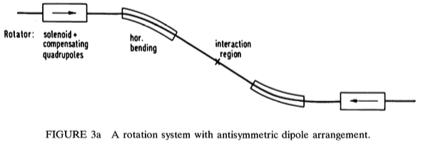
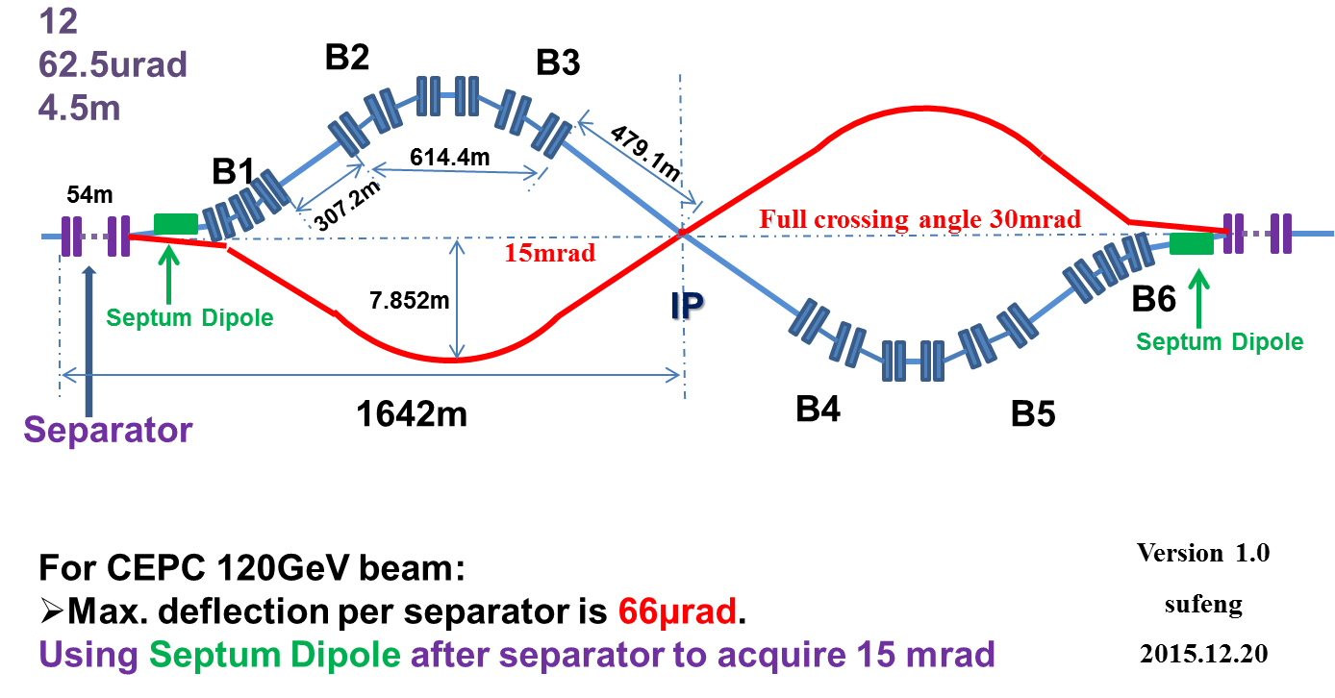
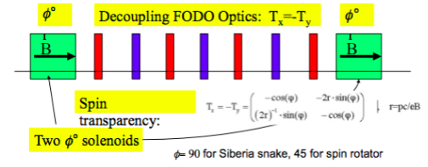
Longitudinal polarization maintenance @Z-pole
π/2 spin rotation around vertical direction requires a 15mrad horizontal bending @ 45GeV. (I. Koop HF2014)
CEPC partial double ring scheme is compatible with such a layout & spin rotator design.
Solenoid section can be spin matched.
Spin matching requires spin transparency btw two solenoid sections.
D. P. Barber, et. al. PA, 17 (1985) 243.
Courtesy of SU, Feng.
I. Koop, talk on SuperB Workshop, SLAC (2006).

Slide 11
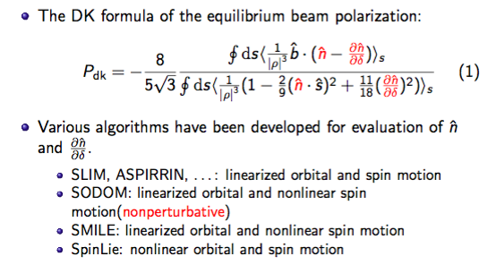
Simulation of equilibrium beam polarization

Slide 12
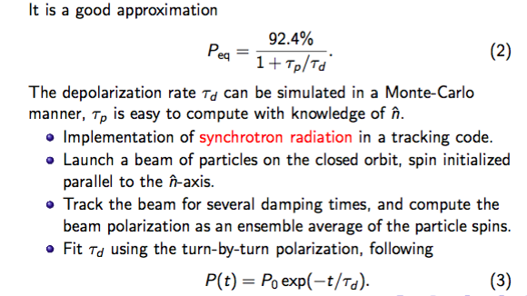
The Monte-Carlo approach^{[1]}
[1] J. Kewisch, R. Rossmanith, and T. Limberg, Phys. Rev. Lett. 62, 419 (1989).

Slide 13
Polarization Simulation with PTC
  Polymorphic Tracking Code(PTC) ^{[1]} is capable of orbital & spin tracking, as well as normal form analysis of one turn map.
Lattice imperfection & correction can be implemented with MADX or BMAD and exported to PTC format. Fortran scripts are developed calling PTC as a library.
Equilibrium polarization calculation including linear spin resonances:
  First order normal form to obtain & , then apply DK formula.^{[2]}
Equilibrium polarization calculation including linear & nonlinear spin resonances.
  Monte-Carlo simulation of depolarization rate, similar to SITROS & SLICKTRACK.
  This is essential for higher beam energy as in CEPC and FCC-ee.
[1] F. Schmit, E. Forest and E. McIntosh, CERN-SL-2002-044, 2002.
[2] E. Forest, KEK Report KEK-2010-39, 2010.

Slide 14
Benchmark with first order spin resonance only
Courtesy of V. Ptitsyn
One version of VEPP-2M lattice, solenoid around IPs are not spin matched and lead to reduced polarization near resonances.
ASPIRRIN does not take into account of synchrotron motion.

Slide 15
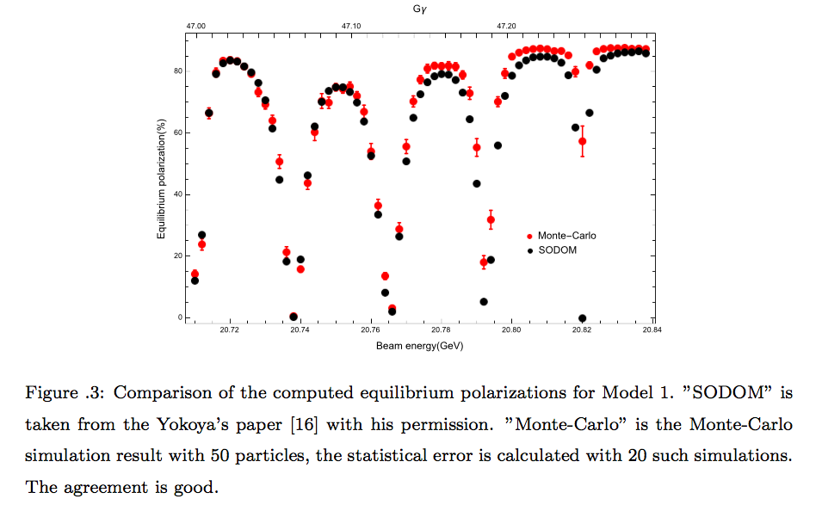
Benchmark against SODOM
A model ring (2112m) of FODO cells with several vertical bend.
Qx/Qy/Qz = 0.265/0.380/0.0623.
It took around 1 minute to track a particle for 3000 turns(5 damping time) on Hopper cluster @NERSC.

Slide 16
Comparison of Monte-Carlo simulation code
Code\features | orbit map | Photon emission | Speed
SITROS | 2nd order matrix | “Big photon” localized at several points
SLICKTRACK | 1st order matrix | “Big photon” localized at several points
PTC | nonlinear symplectic integrator | at each integration step of each dipole. | much slower compared to the others.
It is not clear now if the more precise treatment in PTC have large effects on the simulation results.
The lumped treatment in SITROS & SLICKTRACK can also be implemented within PTC with some effort.

Slide 17
Conclusion
For CEPC partial double ring scheme, continuous monitor of both beam energies is possible as in FCC-ee.
At what larger ring size can CEPC achieve useful polarization at W needs more simulation justification.
Simulation tool based on PTC has been developed and benchmarked.
Simulation study of a model ring for CEPC is under way.

Slide 18
Backup

Slide 19
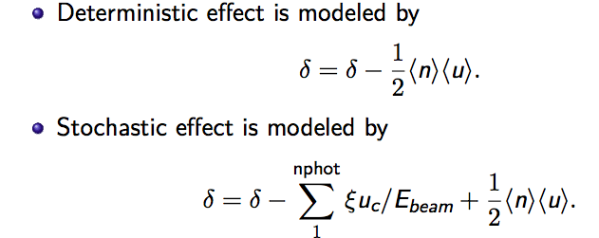
Monte-Carlo simulation based on PTC
Symplectic integrator for orbit & spin motion
Modeling of synchrotron radiation (Added)
GEANT 4 implementation
Poisson distribution

Slide 20
Courtesy of D. Abell
synchrotron radiation photons emitted at each integration step. Normally only photon emission in dipoles are taken into account.

