Slide 1
Beam-beam and electron cloud effects in FCC-ee
K. Ohmi (KEK)
FCC week 2016, 11-15 Apr, 2016
Thanks to W. Chou, K. Oide, D. Shatilov, Y. Zhang, D. Zhou, F. Zimmermann

Slide 2
Introduction
Beam-beam simulations
  Strong-strong simulations for luminosity prediction
  Coherent instability
  Collective emittance growth
Study of electron cloud effects
  FCC-ee TLEP-Z,W,H,t
Study of ion instability
  FCC-ee TLEP-Z

Slide 3
Parameters for FCC-ee’s; CEPC and TLEP
 |  | CEPC | TLEP-Z | TLEP-W | TLEP-H | TLEP-t
Circumf | C (km) | 54 | 100 | 100 | 100 | 100
Energy | E (GeV) | 120 | 45.5 | 80 | 120 | 175
No. bunches | N_{b} | 49 | 90300 | 5162 | 770 | 78
Bunch pop | N_{e} (10¹¹) | 3.8 | 0.33 | 0.6 | 0.8 | 1.7
emittance | ε_{x}(nm)/ε_{y}(pm) | 6.1/18 | 0.09/1 | 0.27/1 | 0.61/1.2 | 1.3/2.5
Beta at IP | β_{x}(m)/β_{y} (mm) | 0.8/1.2-3 | 1/2 | 1/2 | 1/2 | 1/2
Synchro. tune | ν_{s} | 0.18 | 0.015 | 0.037 | 0.056 | 0.075
Bunch length | σ_{z,SR}/σ_{z,tot}(mm) | 2.3/2.6 | 2.7/5.0 | 2.0/3.0 | 2.0/2.4 | 2.1/2.5
Energy spread | σ_{δ,SR}/σ_{δ,tot}(10⁻⁴) | 13/15 | 3.7/6.8 | 6.5/10 | 10/12 | 14/17
Crossing angle | φ_{c} (half angle) | - | 15 | 15 | 15 | 15
Piwinski angle | φ_{c}σ_{z,tot}/σ_{x} | - | 7.9 | 2.7 | 1.5 | 1.0
Damping time | τ_{z}/T₀ | 40 | 1520 |  | 71 | 25
Luminosity | L (10³⁴ cm⁻²s⁻¹) | 2 | 62 |  | 5.2 | 1.4
Luminosity is calculated by ws code BBWS.

Slide 4
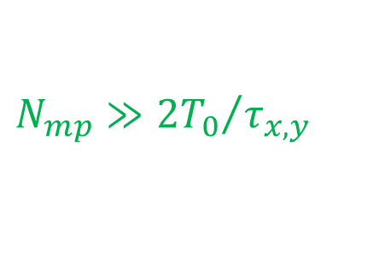
Simulation of beam-beam collision
Luminosity evaluation using simplified lattice, in which arc transformation is represented by 6x6 transfer matrix. Effect of lattice is discussed later.
Weak-strong (WS) simulation
  One (strong) beam is fixed charge distribution (Gaussian).
  The other (weak) beam is represented by macro-particles.
Strong-strong (SS) simulation
  Two beams are represented by macro-particles.
  Equilibrium charge distribution of two beams are determined self-consistently.
  Coherent instability can be treated.
  Noise due to statistics for macro-particle number. The statistical noise should be smaller than radiation excitation.
$$N_{mp}≫{{2T}_{0}}/{τ_{x,y}}$$

Slide 5
Strong-strong simulation using BBSS code
Arbitrary beam distribution is treated using Particle In Cell Poisson solver.
Available for very flat beam, using integrated Green function.
Longitudinal slice and potential interpolation
Beamstrahlung
Shifted Green function for collision with large separation, collision between head of one beam and tail of the other beam.
50x50x4(TLEP-Z) collision solving Poisson equation per beam-beam crossing.
Other choice for collision simulation: Gaussian approximation, combination of PIC and Gaussian collision

Slide 6
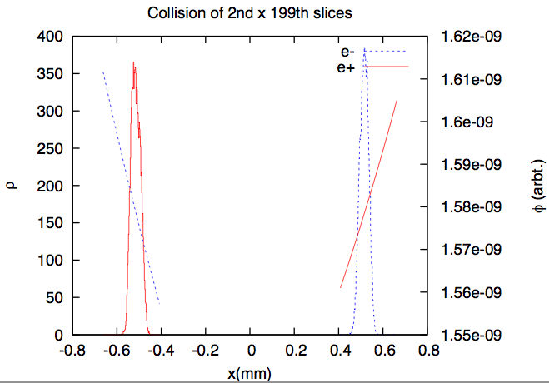
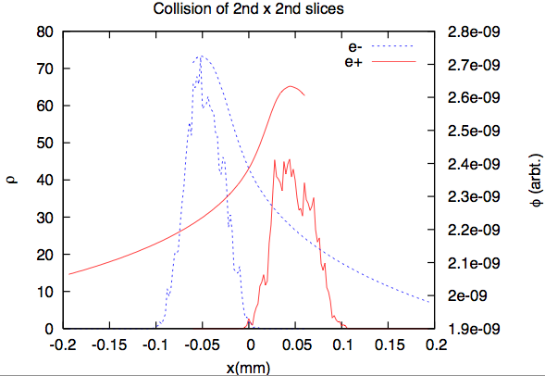
Shifted Green function
Beam distribution and potential
Neglect parallel translation to x
x
s
σz+>σz-
SuperKEKB 200 slices
2nd x 2nd
2nd x 199th

Slide 7
TLEP-t (strong-strong sim.)
Evolution of Lum and beam sizes, σ_{y}, σ_{z}.
No oscillation in <xz>. Dynamic <xz> due to BB is seen.
Cases with current ambalance were plotted.

Slide 8
TLEP-H (strong-strong simulation)
Evolution of Lum and beam sizes, σ_{y}, σ_{z}.
Fluctuations in Lum. and beam sizes are seen.
Fluctuation of <xz> is the origin.

Slide 9
Coherent motion in <xz> at tune (ν_{x}, ν_{y})=(0.54,0.61)
<xz> oscillate in-phase (σ(xz) mode) for e⁻ and e⁺ beam.
Luminosity degradation is not very strong in H, but the motion is bad sign.
Gaussian strong-strong gave similar results.

Slide 10
Coherent motion in <x> at tune (ν_{x}, ν_{y})=(0.51,0.57)
<x> oscillate out-phase (π(x) model) for e⁻ and e⁺ beam.
Luminosity degradation is not very strong in H, but the motion is bad sign.
Both of π(x) and σ(xz) modes are seen in (0.52,0.59).
Gaussian strong-strong gave similar results.

Slide 11
Trials with several tune operating points
The coherent motion is not recovered by choice of tune.
The motion has not seen in KEKB nor SuperKEKB simulations. ξ~0.1 for finite crossing angle.
Separation of ν_{x} (0.53-0.54) did not work.
ξ∼0.15 of TLEP may be too high.

Slide 12
TLEP-Z (strong-strong sim.)
High Piwinski angle φ_{c}σ_{z,tot}/σ_{x}=7.9
Shifted Green function is used for potential calculation for collision between separated slices
The coherent motion is seen for TLEP-Z. Lum. is degraded by the motion
Coherent motion in <xz>/σ_{z}~σ_{x} is seen.
Simulation using shifted Green function and combination of ordinary Green function and complex error function (Δx>5σ_{x})

Slide 13
Summary for beam-beam studies using strong-strong simulation
Coherent motion (instability) is seen H and Z, probably in W.
Collision with crossing angle and high beam-beam parameter may induce the coherent motion.
The coherent motion is bad sign.
The coherent motion is not seen in simulations of KEKB and SuperKEKB.

Slide 14


Electron cloud effects in FCC-ee
Photons are emitted by positron/electron beam.
Number of photon per revolution
Critical energy
Electrons are produced at the chamber wall due to photo-emission. Quantum efficiency Y₁=0.1-0.2.
Electron production by a bunch per m passage.
n_{e,pri}= N_{γ} Y₁ N_{p} (m⁻¹)
Secondary electron
$$N_{γ}=\frac{5π}{\sqrt{3}}αγ$$
$$u_{c}=\frac{3ℏc}{2}\frac{γ^{3}}{ρ_{bend}}$$

Slide 15
Synchrotron radiation
Number of photon per meter, proton
ρ_{bend}=11.3km(TLEP), 6km(CEPC)
Critical energy
Quantum efficiency of electron production, Y₁=0.1-0.2
Electron production by a bunch per m passage.
Chamber cross section 0.005 m⁻² (tentative)
Electron density exceeds ρ_{e,th}=7.8x10⁹ m⁻³ even in a bunch passage.
Antechamber and other cures are necessary.
n_{e,pri}= N_{γ} Y N_{p} (m⁻¹)

Slide 16
Simulation of electron cloud build up in TLEP
TLEP-Z
TLEP-W
TLEP-H
TLEP-t

Slide 17
CEPC electron cloud build-up for partial double ring scheme
Bunches are injected in 3000m area in circum. 50km. Bunch spacing is about 50m for 50 bunches.
Electron cloud density for δ_{2max}=1.8 and 2.2.
ρ_{e} can be threshold 1x10¹² m⁻³.

Slide 18
Electron cloud effects in FCC-ee
TLEP-Z
N_{b}=90300, L_{b-b}=1.1m
N_{p}=3.3x10¹⁰, <β>=100m, σ_{x}=95μm, σ_{y}=10μm
ω_{e}=2πx127GHz, ω_{e}σ_{x}/c=13
ρ_{e,th}=7.8x10⁹ m⁻³. Threshold is very weak density.
KEKB 5x10¹¹, SuperKEKB 1x10¹¹

Slide 19
Parameters related to EC instabilitiy
 |  | CEPC | TLEP-Z | TLEP-W | TLEP-H | TLEP-t
Circumf | C (km) | 54 | 100 | 100 | 100 | 100
Energy | E (GeV) | 120 | 45.5 | 80 | 120 | 175
No. bunches | N_{b} | 49 | 90300 | 5162 | 770 | 78
Bunch pop | N_{p} (10¹¹) | 3.8 | 0.33 | 0.6 | 0.8 | 1.7
Beam l-density | λ (10¹⁰m⁻¹) | 0.74 | 3.0 | 0.3 | 0.06 | 0.0013
Beam size (av.) | σ_{x}/σ_{y} (μm) | 583/32 | 95/10 | 164/10 | 247/11 | 360/16
Bunch length | σ_{z,tot}(mm) | 2.6 | 5.0 | 3.0 | 2.4 | 2.5
Synch. tune | ν_{s} | 0.18 | 0.015 | 0.037 | 0.056 | 0.075
γ prod. rate | N_{γ} (/m/e⁺) | 0.28 | 0.059 | 0.10 | 0.16 | 0.23
e⁻ prod. rate | n_{e,prod} (10¹⁰m⁻¹) | 1.1 | 0.020 | 0.062 | 0.12 | 0.39
Electron freq. | ω_{e}/2π (GHz) | 137 | 127 | 171 | 174 | 171
Electron osci. | ω_{e}σ_{z,tot}/c | 7.5 | 13 | 11 | 8.7 | 9.0
Thr. density | ρ_{e,th} (10¹⁰m⁻³) | 104 | 0.78 | 3.4 | 7.7 | 15
Tune shift | Δν at ρ_{e,th} | 0.034 | 0.0025 | 0.0061 | 0.0092 | 0.012

Slide 20
Simulation for TLEP-Z
Growth of emittance Coherent motion in
y₊(z), y₋(z),σ_{y+}(z)
Threshold is ρ_{e,th}=0.8x10¹⁰ m⁻³ , agree with the analytic formula 0.78x10¹⁰.

Slide 21
Ion instability in FCC-ee (TLEP-Z)
N_{b}=90300, L_{sp}=0.75m(2.5 ns)
N_{e}=3.3x10¹⁰,<β>=50m, σ_{x}=67μm, σ_{y}=7μm
Dispersion increases σ_{x} , assume 2^{1/2} times controlled by ε_{x} in simulation.
ε_{x} =0.09nm, ω_{i}=2πx103MHz, ω_{e}L_{sp}/c=1.61<- critical for trap in the bunch train,
ε_{x} =0.18nm, ω_{i}=2πx88MHz, ω_{e}L_{sp}/c=1.38
Ion production rate for CO, n_{i} =0.045 Ne P(Pa),
n_{i} (10⁻⁸ Pa)= 14.9 (/(m.e⁻)).

Slide 22
Simulation results for P=10⁻⁸ Pa
Ions are trapped partially for ε_{x}=0.09nm
Growth does not depend on train length.
Bunch-by-bunch Feedback G=0.1(10 turn) is necessary.

Slide 23
Coupled bunch instability observed in SuperKEKB
SuperKEKB started from Feb. 2016. (no collsion)
I(e+)=260mA, I(e-)=200mA in early April.
e+ beam is unstable only in the early stage (Mar16), but is stable in Apr. Antechamber works well.
Ion instability is observed in e- beam. The growth becomes weak gradually.

Slide 24
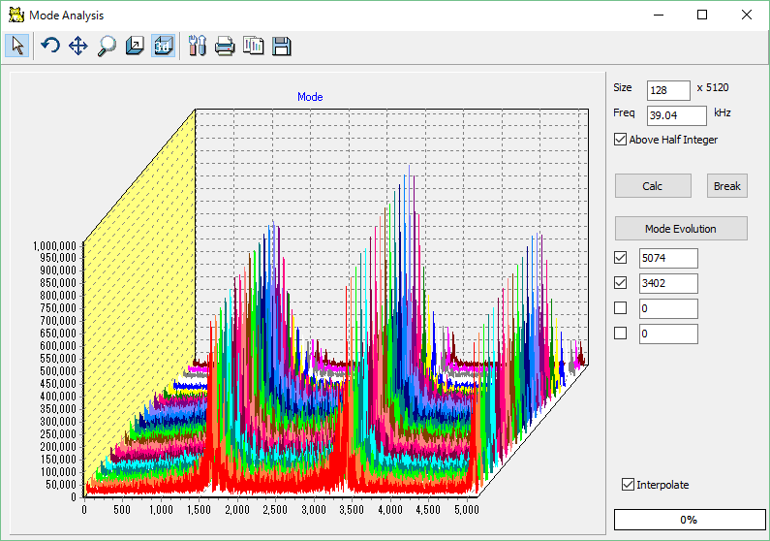
Mode analysis (Tobiyama)
Correspond to 5120−ω_{i}/ω₀
Vertical beam size seems several times higher than the design at present.

Slide 25
Growth and mode change slightly day-by-day
ω_{i}/ω₀=140 for the design beam size
ω_{i}/ω₀=70-80 at present.
ω_{i}~(σ_{x}σ_{y})^{1/2}. σ_{y} is 4 times of design.
5120−ω_{i}/ω₀

Slide 26
Summary
Beam-beam effects and luminosity expectation have been studied for FCC-ee’s, CEPC and TLEP.
Beamstrahlung and lifetime issue are evaluated.
Design tools for beam-beam study are ready.
Design parameters are achieved in weak-strong simulation, but are not in strong-strong simulations, because beam-beam coherent instability in <xz> is seen in H and Z.
Electron cloud and ion instabilities in TLEP-Z are challenging issues.
Threshold of electron density was given for FCCee’s.
Required vacuum pressure and feedback power were given preliminary.

Slide 27
Thank you for your attention

Slide 28
Schematic view of the simulation
Calculate trajectory interacting with colliding beam.
Particles emit synchrotron radiation due to the momentum kick dp/ds.
z_{i}
z_{i+1}

