Slide 1


Beam-Beam Study strategy
T. Pieloni
J. Barranco, X. Buffat, P. Jorge, W, Herr, D. Schulte
Laboratory of Particle Accelerator Physics, EPFL
CERN/Beam-Beam teams
Acknowledgements: L. Rivkin, R. Tomas, Beam Dynamics Group members
FCC week Workshop
11-15 April 2016 Rome, Italy

Slide 2
Initial Beam Parameters
Baseline and Ultimate Scenarios
Baseline parameter document delivered to EU
 | FCC-hh Baseline | FCC-hh Ultimate
Luminosity L [10³⁴cm⁻²s⁻¹] | 5 | 20-30
Background events/bx | 170 (34) | <1020 (204)
Bunch distance Δt [ns] | 25 (5)
Bunch charge N [10¹¹] | 1 (0.2)
Fract. of ring filled η_{fill} [%] | 80
Norm. emitt. [μm] | 2.2(0.44)
Max ξ for 2 IPs | 0.01 (0.02) | 0.03
IP beta-function β [m] | 1.1 | 0.3
IP beam size σ [μm] | 6.8 (3) | 3.5 (1.6)
RMS bunch length σ_{z} [cm] | 8
Crossing angle [σ’] | 12 | Crab. Cav.
Turn-around time [h] | 5 | 4
Baseline: 1.25ab⁻¹ per 5 year cycle
considering shutdowns, stops, MDs, …
= 2fb⁻² per day
Ultimate: 5ab⁻¹ per 5 year cycle
= 8fb⁻² per day
Total 17.5ab⁻¹
Focus on ultimate parameters
Injection energy 3.3TeV

Slide 3
Initial Beam Parameters
Baseline and Ultimate Scenarios
Baseline parameter document delivered to EU
 | FCC-hh Baseline | FCC-hh Ultimate
Luminosity L [10³⁴cm⁻²s⁻¹] | 5 | 20-30
Background events/bx | 170 (34) | <1020 (204)
Bunch distance Δt [ns] | 25 (5)
Bunch charge N [10¹¹] | 1 (0.2)
Fract. of ring filled η_{fill} [%] | 80
Norm. emitt. [μm] | 2.2(0.44)
Max ξ for 2 IPs | 0.01 (0.02) | 0.03
IP beta-function β [m] | 1.1 | 0.3
IP beam size σ [μm] | 6.8 (3) | 3.5 (1.6)
RMS bunch length σ_{z} [cm] | 8
Crossing angle [σ’] | 12 | Crab. Cav.
Turn-around time [h] | 5 | 4
Baseline: 1.25ab⁻¹ per 5 year cycle
considering shutdowns, stops, MDs, …
= 2fb⁻² per day
Ultimate: 5ab⁻¹ per 5 year cycle
= 8fb⁻² per day
Total 17.5ab⁻¹
Focus on ultimate parameters
Injection energy 3.3TeV
LHC scaled versus Challenging scenario
Need to guarantee the Baseline and work hard to reach the Ultimate!

Slide 4
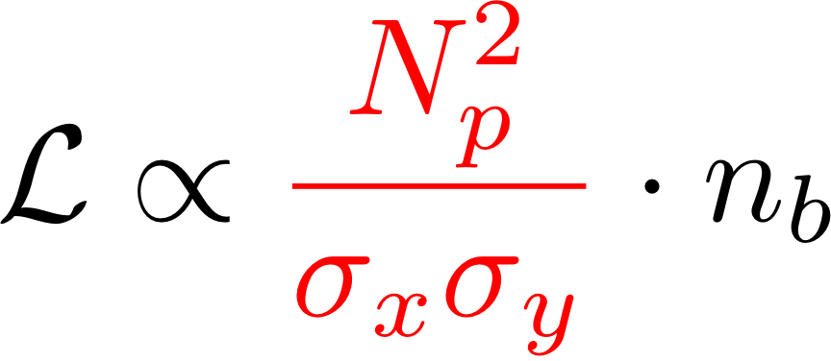
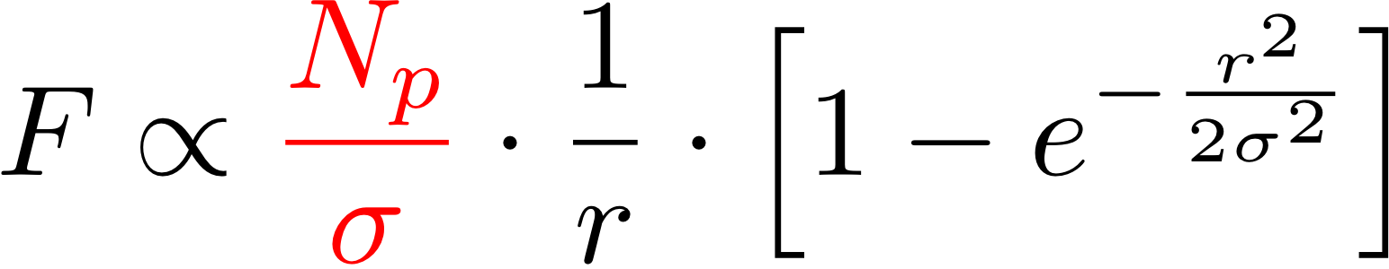
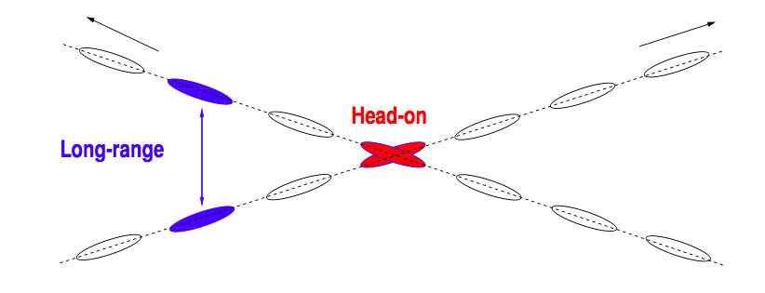
Beam-Beam Interactions
Luminosity
Beam-Beam Force
FCC collider: bunches
2 Experiments with Head-On collision
Separation is typically 12-14 σ
Scaled from LHC
10600 bunches…
25 ns bunch spacing → beams will meet every 3.75 m
For L*45m 60 beam-beam Long Range encounters per experiment
Several localized long range interactions
Need local separation (crossing angle)

Slide 5
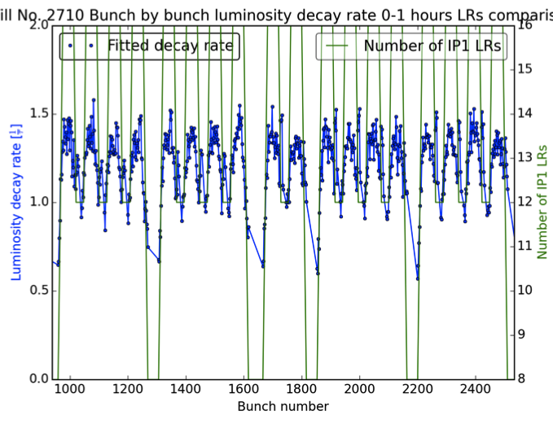
LHC Experience Not Controlled Beam-Beam effects
Regular Physics Fill of 2012 RUN LHC 4 TeV
0.6 h lifetimes
Clear Long Range pattern in the Luminosity Decay rates
→ BB can change integrated luminosity reach significantly!
Particle Losses
Emittance growth
2 h lifetimes
A. Esmail-Yakas (EPFL)
Beam-Beam dynamics defines particle losses and emittance evolution
→ Integrated Luminosity (emittances evolution) and machine protection (100TeV beams)!

Slide 6
LHC Experience 2015 Weak Beam-Beam Effects
LHC Physics Fill of 2015
22 h lifetimes
M. Crouch (Manchester Uni)
Beautiful Luminosity lifetimes…
No evident beam-beam signature in luminosity and spec lumi lifetimes
→ Low losses and negligible emittance blow-up

Slide 7
First Phase: feedback for IR design
Study type
Start with a solid baseline scenario scaling from LHC and HL-LHC studies and first estimates
  intensities, emittances
  optics (round versus flat)
  crossing angles
  Optics distortion (dynamic beta)
  Crossing schemes HV HH VV
  Orbit effects, chromaticity, tune shifts
  Multipolar errors effects
  Working point sensitivity
  Modulation
  Crab Crossing with cavities
Single particle dynamics →Dynamic aperture, magnets multipolar errors
Optics distortions
  →tune shifts, spread
  →orbit effects
→ dynamic beta
→ PACMAN bunches
Feedback for design
IR design
Machine protection/collimation
Magnets Field quality
Luminosity reach
Assumptions: HV crossing, L*=45m, round optics 30cm b*

Slide 8
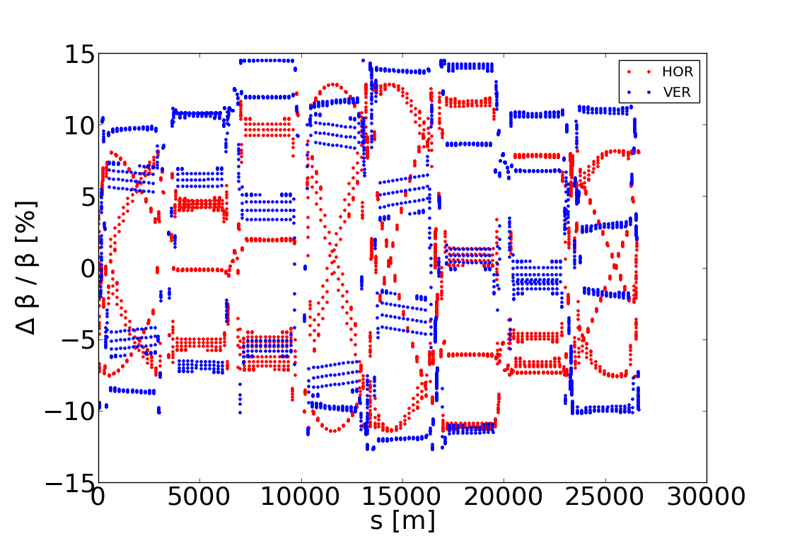
Optics distortions and implications
Example HL-LHC lattice
Synergy with optics group
Experimental test of local correction in the LHC (R.Tomas et al.)
P. Jorge (EPFL student) implications of BB beating, optics dependency, phase advance and impact on collimation and performances
Study On-going

Slide 9
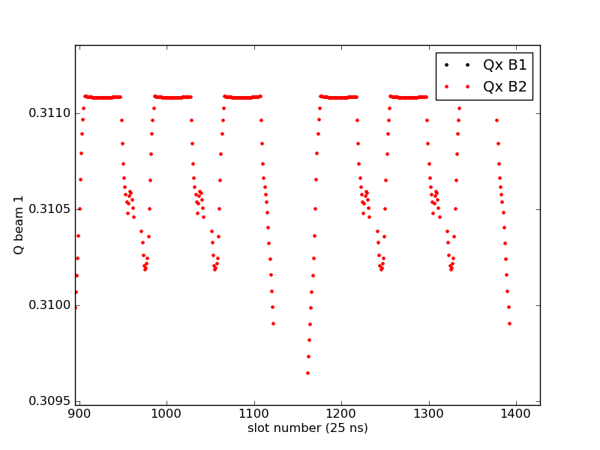
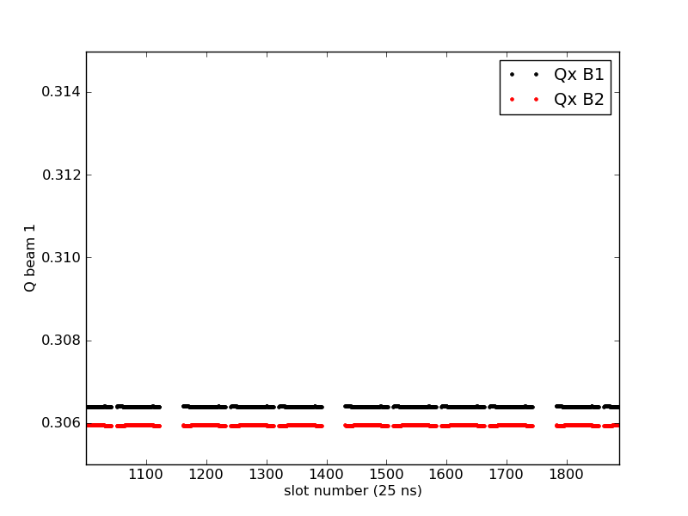
Crossing schemes: HV-HH-VV mixed
H crossing scheme versus HV crossing
Horizontal-Vertical crossing used in the LHC
Provides passive compensation of long-range tune shifts, chromaticity!
Important to explore alternative schemes HH, VV or mixed 45’…..
Study On-going: tool modification

Slide 10
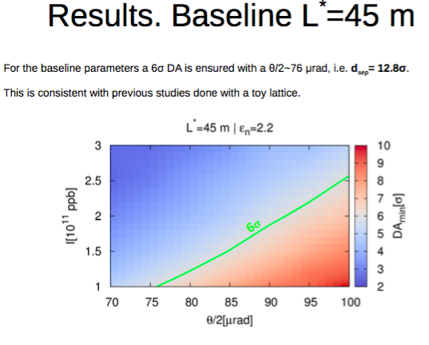
Crossing angle set-up
Dynamic Aperture studies for round optics
Parameter space
Spectrometer impact
Round/flat Optics
Crab Cavities
Magnets multipolar errors
Possible operational scenarios (octupoles , chroma)
Active compensators (wires, elens, octupoles)
…..
Study On-going
Talk J. Barranco (EPFL)

Slide 11
Second Phase: emittance and diffusion studies
Explore the beam-beam limit
  Intensity evolution for different BB configurations
  Emittance evolution (quantum excitation, IBS) and limitations
  External Noise from machine elements (e.g. crab cavities)
Mitigation techniques (wires, e-lenses, octupoles)
Stability and Collective effects:
  Beam stability studies: Landau damping
  Impedance driven instabilities and Beam-beam (with impedance model)
  Operational scenario.
Study type
Single Particle dynamics and multi-particle studies
→Need major development of numerical tools and models
Feedback for design
Machine protection/collimation
Noise tollerances/spec
Intensity limitations
Luminosity reach
Predictive power on this subjects not yet satisfactory

Slide 12
Noise on colliding beams at injection
Preliminary
Injection Energy: introduce white noise with different amplitudes
Single bunches with different BB parameter in collision
Big discrepancy Model-Experimental data

Slide 13
Noise on colliding beams at injection
Preliminary
Factor 2-3 on noise amplitude
Higher Noise level?
Limits of models?
Missing ingredients in the model, beam-beam dependency consistent with expectations!
To be understood to estimate HO limits!

Slide 14
Models and Tools
  Sixtrack single particle tracking for Dynamic aperture studies
    DA for beam-beam (crossing angles, intensity scaling, long-range wires)
  Frequency Map Analysis (from Sixtrack developed for HL-LHC need parallelization)
  COMBI (Coherent Multi Bunch multi Interaction code)
    Coherent Beam-beam
    Impedance and beam-beam interplay
    Landau Damping
    Beam Intrinsic noise (quantum excitation, IBS…) → BB Limit
    Emittance evolution studies
  TRAIN code → self consistent orbit, tune and chromaticity computations
  MADX code → optics distortions: tune shifts, particle detuning with amplitude, dynamic beta and beating
Standard tools for Beam-Beam studies at CERN need extensions and modifications to model FCC dynamics

Slide 15
Summary
Start with a solid baseline scenario scaling from LHC and HL-LHC studies and first estimates
  intensities, emittances
  optics (round versus flat)
  crossing angles
  Optics distortion (dynamic beta)
  Crossing schemes HV HH VV
  Orbit effects, chromaticity, tune shifts
  Multipolar errors effects
  Working point sensitivity
  Modulation
Explore the beam-beam limit
  Intensity evolution for different BB configurations
  Emittance evolution (quantum excitation, IBS) and limitations
  External Noise from machine elements (e.g. crab cavities)
Mitigation techniques (wires, e-lenses, octupoles)
Stability and Collective effects:
  Beam stability studies: Landau damping
  Impedance driven instabilities and Beam-beam (with impedance model)
  Operational scenario.
Tools and Models development and extension
Benchmark to experimental results: LHC machine development program

Slide 16
Summary
Start with a solid baseline scenario scaling from LHC and HL-LHC studies and first estimates
  intensities, emittances
  optics (round versus flat)
  crossing angles
  Optics distortion (dynamic beta)
  Crossing schemes HV HH VV
  Orbit effects, chromaticity, tune shifts
  Multipolar errors effects
  Working point sensitivity
  Modulation
Explore the beam-beam limit
  Intensity evolution for different BB configurations
  Emittance evolution (quantum excitation, IBS) and limitations
  External Noise from machine elements (e.g. crab cavities)
Mitigation techniques (wires, e-lenses, octupoles)
Stability and Collective effects:
  Beam stability studies: Landau damping
  Impedance driven instabilities and Beam-beam (with impedance model)
  Operational scenario.
P. Jorge (EPFL till July 2016)
J. Barranco (EPFL Post-doc)
T. Pieloni 25% (CERN)
X. Buffat 10% (CERN)
2 PhD students (EPFL)
1 Post-doc (EPFL)
Tools and Models development and extension
Benchmark to experimental results: LHC machine development program

Slide 17
Thank You!

Slide 18
Complications
PACMAN bunches
72 bunches
….
Pacman:
miss long range BBI
(120-40 LR interactions)
Different number of long-ranges → Different bunch families

Slide 19
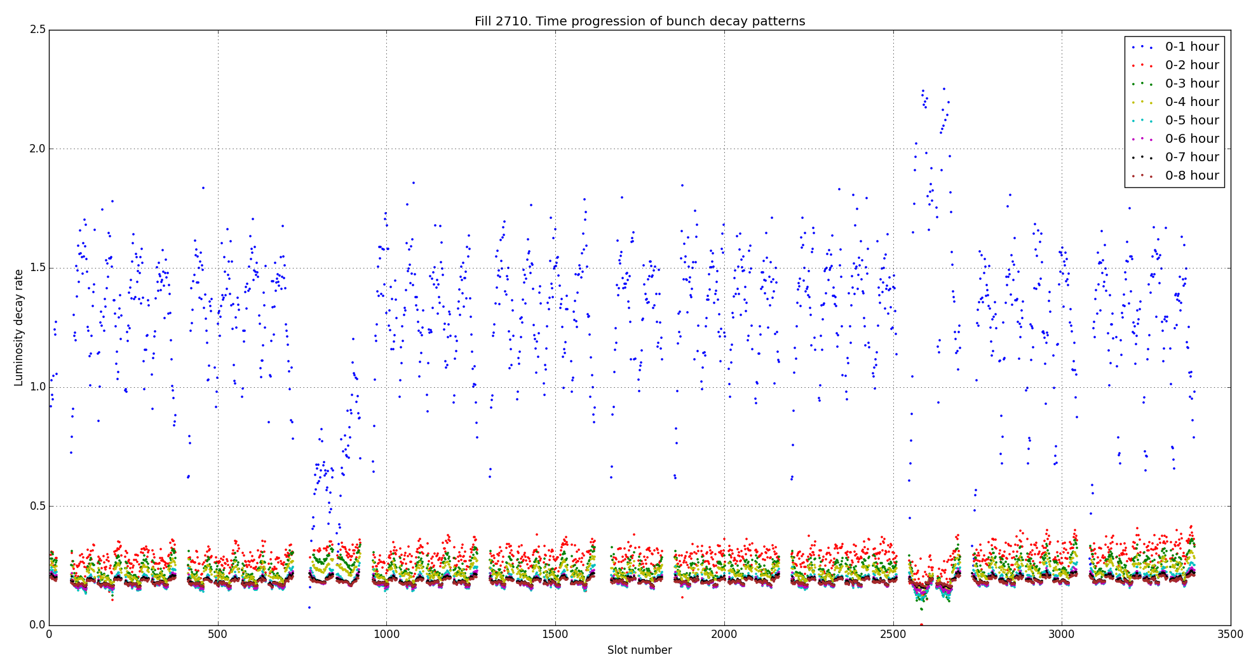
Long Range effect 2012
Regular Physics Fill of 2012 RUN LHC
A. Esmail-Yakas
Clear sensitivity to IP2 and IP8 (tune shift/spread)
Beam-Beam pattern visible in first 2 Hours of physics fills
Also special IP2 and IP8 effects visible missing head-on collision and/or long ranges

Slide 20
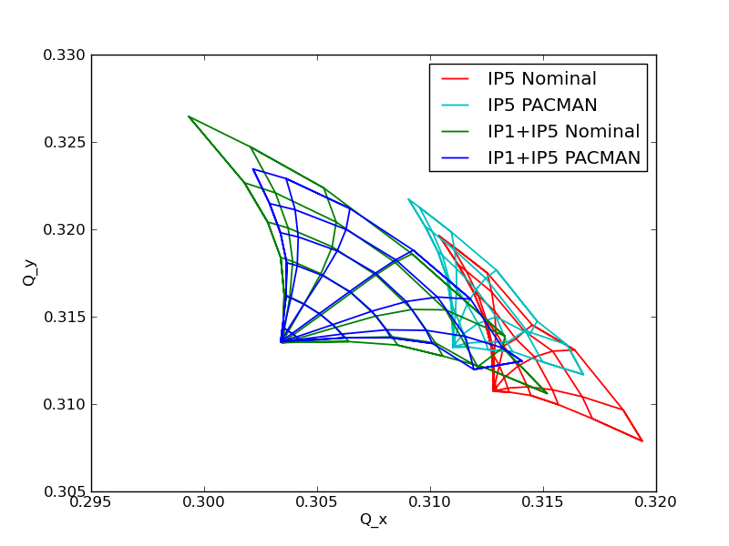
Crossing schemes: HV-HH-VV mixed
HV crossing scheme versus H crossing
+
-

