Slide 1



Collimation System Optics
A.Lachaize CNRS/IPNO
With many inputs from :
J-Luc Biarrotte CNRS/IPNO
P.Bambade, A.Faus-Golfe, J.Molson CNRS/LAL
R.Bruce, B.Holzer, M.Fiascaris, S.Redaelli, D.Schülte CERN

Slide 2
Outline
Options under considerations for collimation system
optics for betatron collimation
Optics for momentum collimation
First aperture and optimisations

Slide 3
Outline
Options under considerations for collimation system
Optics for betatron collimation
Optics for momentum collimation
First aperture and optimisations
General layout of the Straigth Section

Slide 4
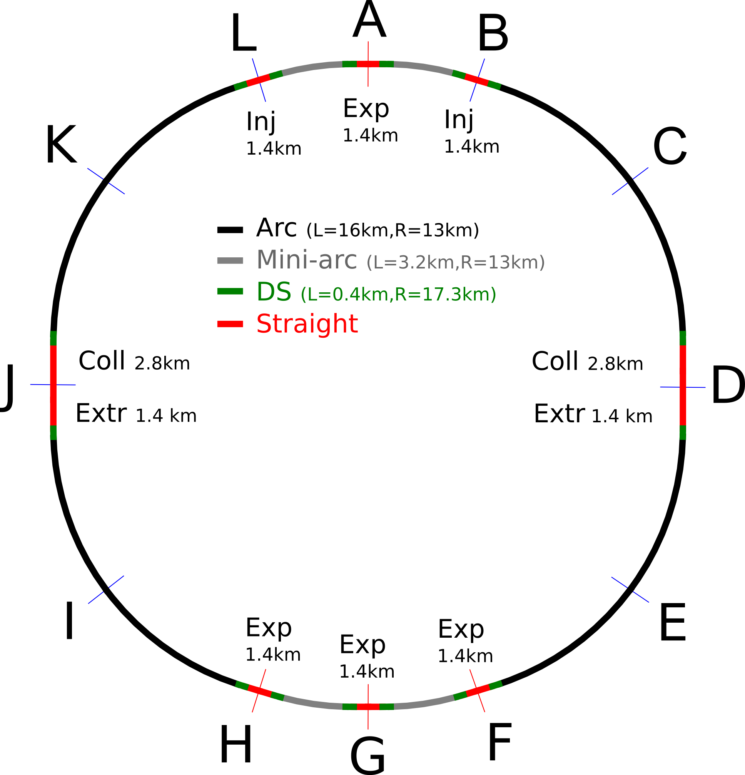
Options under considerations for collimation system
Colllimation system is installed in Extended Straight Sections D and J
Their length is 2.8/4.2km

Slide 5
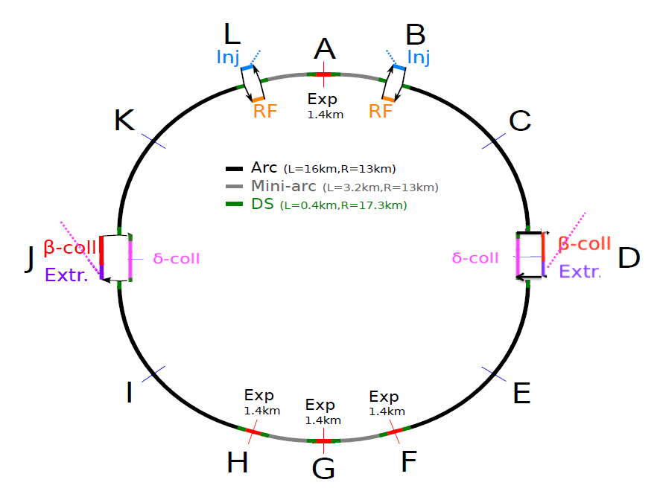
Options under considerations for collimation system (Option 1)
Different options are under consideration for collimation system layout. The first option, called
Option 1, consists on betatron collimation installed just after extraction section, to protect
machine from badly extracted beam.
Momentum collimation in same SS, for counterclokwise beam.

Slide 6
Options under considerations for collimation system (Option 2)
Option 2 : Both extraction lines are installed on the same side of the ring, and both betatron and momentum collimation section are installed on the other side of the ring.

Slide 7
Options under considerations for collimation system (Option 1)
At this time of the study ; the first option has been studied and results will be presented here.
Other options studies will come after Rome.

Slide 8
Outline
Options under considerations for collimation system
Optics for betatron collimation
Optics for momentum collimation
First aperture and optimisations
General layout of the Straigth Section

Slide 9
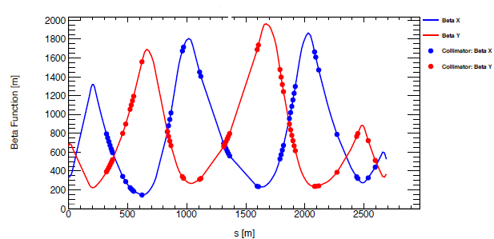
Optics for betatron collimation
Guideline for betatron collimation optics design :
request from collimation team to have collimator gap in FCC similar to collimator gap in LHC.
Same magnet sequence has been used for FCC, with beta function (and sequence length) scaled
be a factor five to compensate for energy change. Sigma settings have been scaled also to
compensate for emittance change.
FCC betatron collimation section
Length 2.5km
Beta functions at location of collimator are multiplied by 5 and phase advances between
collimators remain as in LHC.

Slide 10
Outline
Options under considerations for collimation system
Optics for betatron collimation
Optics for momentum collimation
First aperture and optimisations
General layout of the Straigth Section

Slide 11
Optics for momentum collimation
As for betatron section, collimation team asked to have a starting point which is a scaled version
from LHC. Its optical function have been scaled by sqrt(50/7). Its length is 1.4km.
2 different versions have been defined :
One with same dispersion than LHC at location of primary collimator. (~2.2m)
One with higher dispersion than LHC at location of primary collimator. (~4m) to improve
normalised dispersion.
For both versions same number of collimators than in LHC have been installed :
1 primary
4 secondaries
4 absorbers
They have been installed at same place (phase advance) than in LHC
The dispersion peak has been obtained using natural dispersion coming from arcs and optimised
only by quad matching in order to have the peak of normalised dispersion at entrance of the primary collimator.

Slide 12
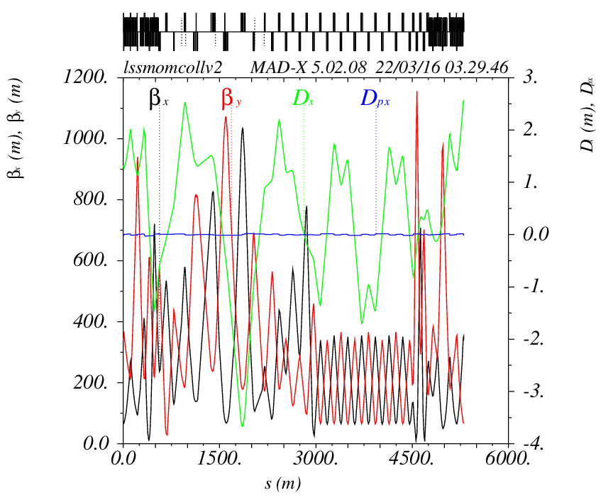
Optics for momentum collimation
Collimation section
Dispersion
suppressor
Dispersion
suppressor
Fodo canal
Location of
primary
collimator
NormDisp at
primary
collimator :
0.11

Slide 13
Optics for momentum collimation
In order to test influence of the dispersion a second sequence has been optimised.
The natural dispersion coming from arc has benn improved in order to obtain an higher .
Normalised dispersion at location of the primary collimator, with careful check that normalised
dispersion peak is located at entance of the primary collimator.
As for previous case, a fodo canal has been added to fill the 4.2km of the ESS.
As for previous case collimators have been installed at same phase advance than in LHC.

Slide 14
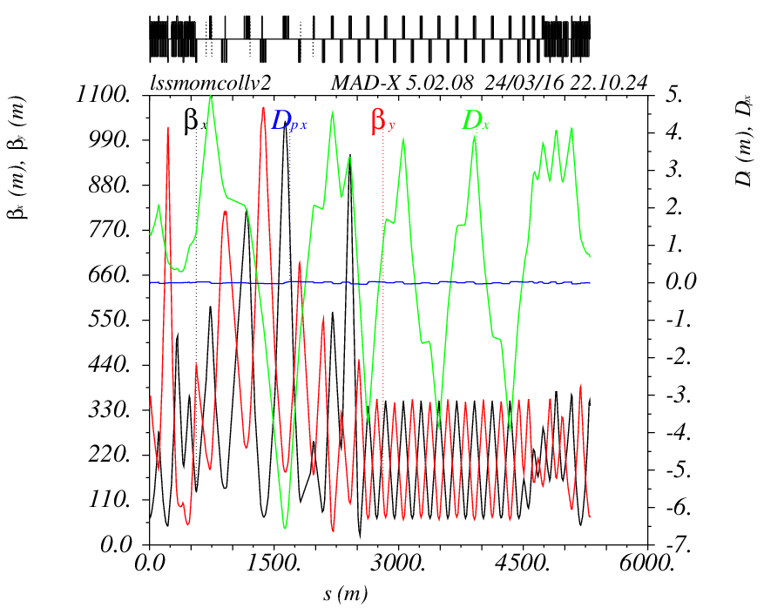
Optics for momentum collimation
Collimation section
Dispersion
suppressor
Dispersion
suppressor
Fodo canal
Location of
primary
collimator
NormDisp at
primary
collimator :
0.215

Slide 15
Optics for momentum collimation
Using LHC collimation sequence for FCC is a good starting point but why not taking our chance to
design a completely new sequence, simple but fully optimised for our purpose ?
in this way another sequence has been developed, only based on fodo cells for momentum
collimation.
This sequence is based on warm quads.
The required length to install all collimators is now ~1.1km (ELL length : 4.2km)
As for previous version using LHC scaled optics, it is worth noting that no additional dipoles are
used, collimation section are pure straight sections.
The value of normalised dispersion at entrance can easely be adjust by quads matching.

Slide 16
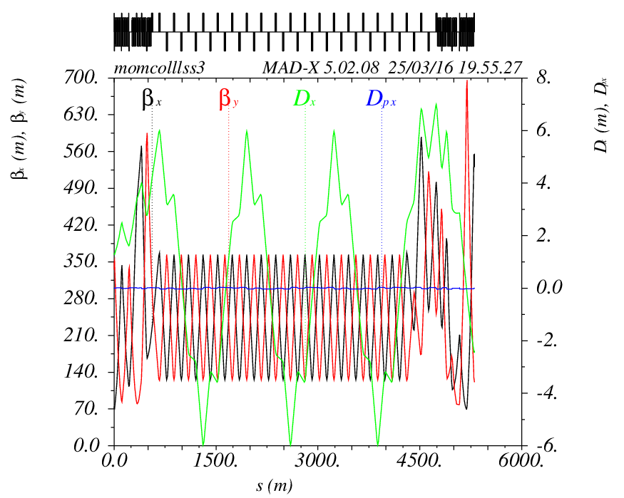
Optics for momentum collimation
Collimation section
Dispersion
suppressor
Dispersion
suppressor
Fodo canal
Location of
primary
collimator
NormDisp at
primary
collimator :
0.314

Slide 17
Outline
Options under considerations for collimation system
Optics for betatron collimation
Optics for momentum collimation
First aperture and optimisations
General layout of the Straigth Section

Slide 18
First aperture calculations
First aperture calculations have been done on momentum collimation sections.
Indeed, the present beam separation is 250mm. and in ESS D and J seqence of each beam
will be different so we would like to know if the present beam separation is large enough to
install all extraction/collimation elements.
For that first study I calculated apertue using sigma=18. This nimber corresponds to the minimum guaranted aperture in LHC (at triplet at high energy and in arcs at injection).
This number also includes off-momentum effects, errors, misalignements, etc..
I also assumed a vacuum chamber thickness of 2mm.

Slide 19
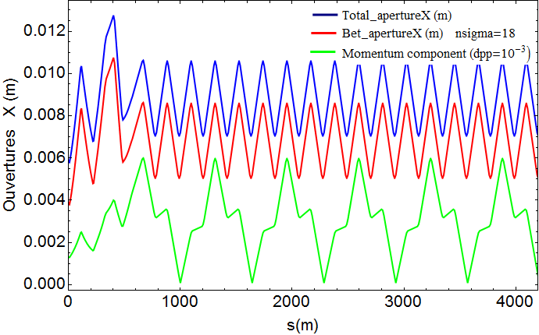
First aperture calculations
First test with pure fodo momentum collimation sequence :
Optical functions of the section
Horizontal beam size for n = 18 sgima et dp/= 10⁻ ³
Maximum aperture includin
2mm for chamber thickness
12.7mm

Slide 20
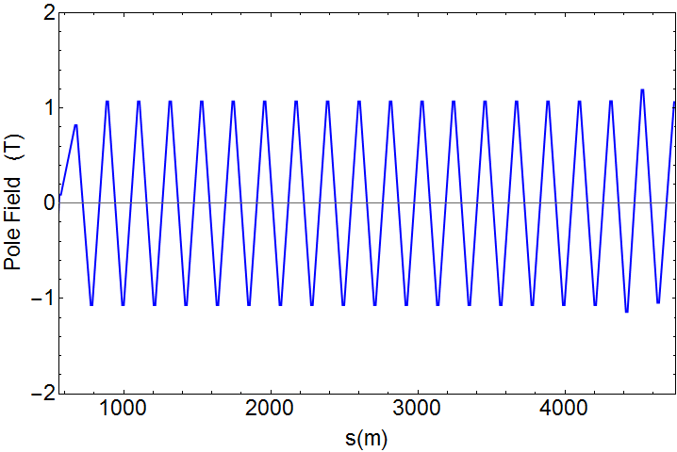
First aperture calculations
One can see that the optcal funtions peaks are located in the Dispersion Suppressors or in the
matching section but in the collimation section itself the optical function remains low.
Maximum aperture in the DIS : 12.7mm
Maximum aperture in the collimation section: 10.6mm
Assuming the same aperture for all section magnets the pole field can easely be calculated :
Maximum field : 1.07T
Pole field for quads of the collimation
section beased on fodo cells assuming
the maximum aperture un the DIS
(12.7mm)
If assuming the maximum aperture of
the fodo section (10.6mm) the pole
field is only 0.9T

Slide 21
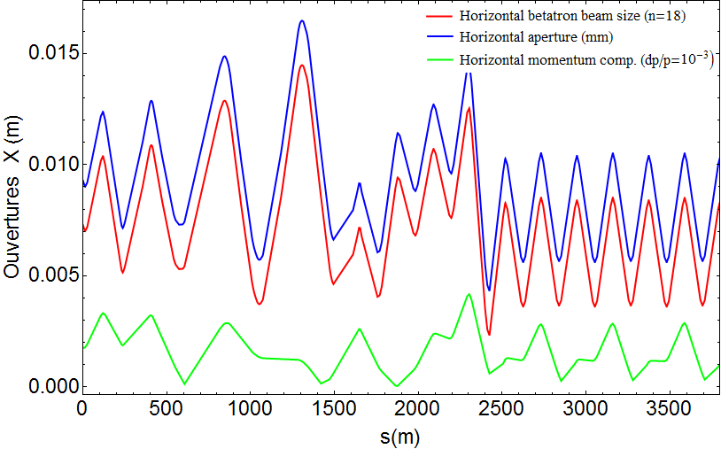
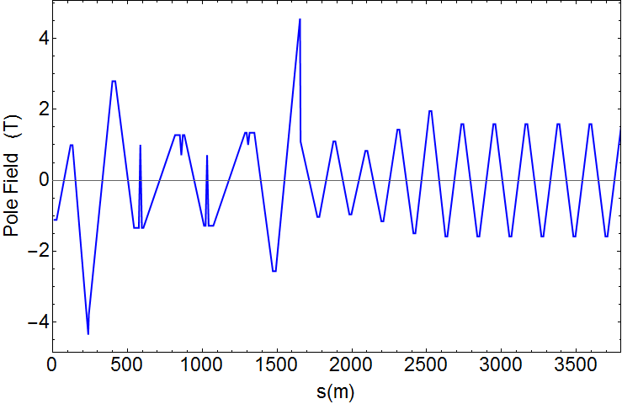
First aperture calculations
Same calculation have been made for momentum collimation section based on LHC scaled
sequence.
This sequence is more complicated and is composed of much differents quads. First calculation
of aperture and pole field shows many fields above 1T.
Many pole fields in the collimation
section are above 1T (>1.5T)

Slide 22
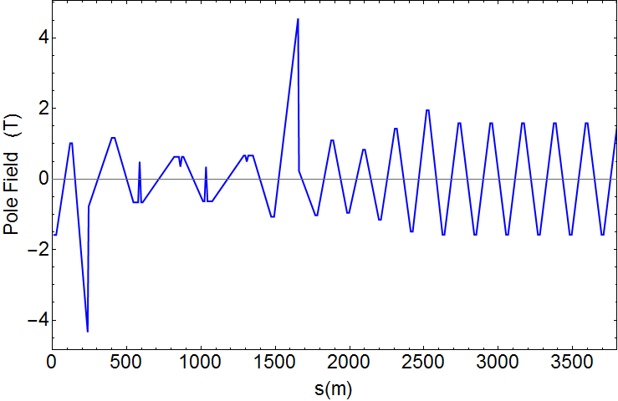
First aperture calculations
I first improvement of the quads size (length harmonization and increase to limit the pole field)
has been made, escpecially in the collimation section wich requires warm quads.
Others quads in th section can remain cold at this time of the study as they are not in the
collimation section itself.
All pole field in the collimation section are below or colse to 1T.

Slide 23
Conclusion and Outlook
The baseline option for FCC-hh collimation system, consisting on extraction followed by
betatron collimation for beam one and momentum collimation for beam 2 has been
developed.
Several sequences have been proposed for efficiency simulations, base on LHC collimation
sequences or defined using new sequence.
All these sequences fullfill requirements for collimation at this time of the study and the offer
a great variability of parameters (dispersion).
It is worth noting that all is done WITHOUT any additional dipole in the straigth section, all the
dispersion management in done only with quads matching, which represents a clear advantage
for ring geometry.

Slide 24
Conclusion and Outlook
Next step will consists on studying other options for collimation sequence, especially option 2
whitin both momentum and betatron collimation are on same LSS (mixed sequences or not)
and both extractions on the other side of the ring.
First tests for option 2 show that is it technically feasible but with a non-negligible impact on
ring geometry.
According to first tests made for this second option, with first momentum collimation then
betatron one in the same LSS. In this case a DS (at least 10 cold dipoles) is needed after
momentum collimation in order to have a zero-dispersion area for betatron collimation,
inducing a big bend then a change in geometry.
The length of the LSS is 4.2km, 1.1km is needed for momentum collimation, 2.7km for betatron
one.
This leads around 400m (2 cells) to cancel dispersion between momentum and betatron
collimation
Option with first betatron then momentum collimation section would maybe be more easy to
integrate. In this case a chcane will be used to create dispersion for the momentum section
and a chicane is probably more integrable in terms of geometry than a DS.

