Slide 2

Septa requirements and suitable septa topologies for FCC
Miroslav Atanasov, CERN, TE/ABT
With input from W. Bartmann, J. Borburgh, F. Burkart, A. Lechner, L.S. Stoel, D. Barna, A. Sanz Ull
Septa topologies for FCC beam dump
M. Atanasov
13/04/2016

Slide 3

Contents:
Main parameters for FCC extraction
FCC beam dump insertion – layout and considerations
Septum magnet topologies compatible with FCC extraction requirements
First ideas on extraction protection elements
Septa topologies for FCC beam dump
M. Atanasov
13/04/2016

Slide 4
Main parameters for FCC extraction
Beam parameters
Septa parameters (scaled up from LHC)
Parameter | Unit | LHC | FCC
Kinetic Energy | TeV | 7 | 50
Beam Rigidity | T.km | 23.4 | 166.8
B.dl | T.m | 56 | 400
Stored Beam Energy | GJ | 0.36 | 8.4
Parameter | Unit | LHC | FCC
Magnetic Field | T | 1 | 1
Deflection Angle | mrad | 2.4 | 2.4
Number of Magnets | - | 15 | 108
Total required length | m | 73 | 530
Available length | m | 74 | 245
Power Dissipation | MW | 0.42 | 3
A simply scaled up version of the LHC Lambertson septa is unsuitable, because of the required length as well as the power consumption.
Septa topologies for FCC beam dump
M. Atanasov
13/04/2016

Slide 5
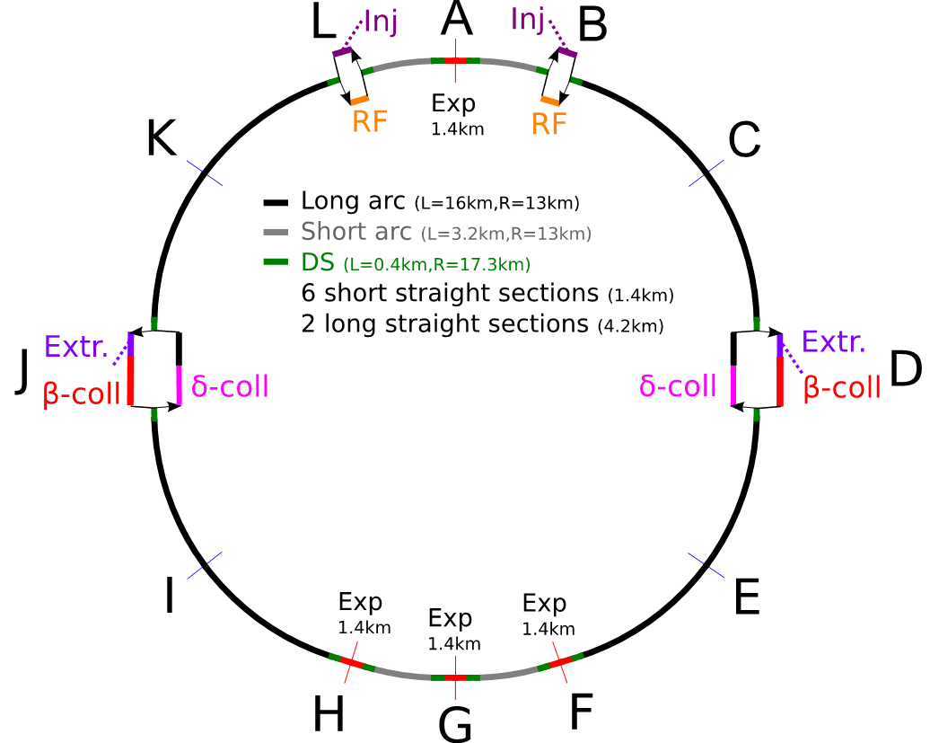
FCC beam dump insertion – layout and considerations
Extraction and betatron collimation on one beam
Betatron cleaning downstream of extraction to protect machine
Momentum collimation on the other beam
Extracting towards the outside of the ring and downwards
See talk by W. Bartmann
Septa topologies for FCC beam dump
M. Atanasov
13/04/2016

Slide 6
FCC beam dump insertion – layout and considerations
LHC like layout:
Horizontal kick (MKD), followed by a vertical deflection by the septa (MSD)
Septum and quadrupole protection elements in case of asynchronous beam dumps (See talk by B. Goddard)
Septum protection (TCDS)
Quadrupole protection (TCDQ)
QF
Dump kickers
Dump septa
QD
Septa topologies for FCC beam dump
M. Atanasov
13/04/2016

Slide 7
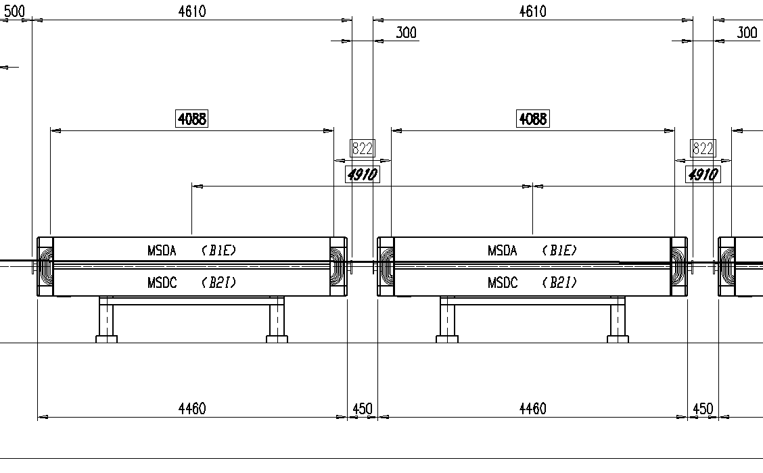
Septa baseline parameters
Parameter | FCC extraction
Available length | 245 m
Deflection Angle | 2.4 mrad
Average required field | 2 T
Effective septum thickness at entrance | 25 mm
Filling factor | 0.83
Leak field at circulating beam | 10⁻⁴
Filling factor derived from the effective magnetic length over the total physical length for the system (space reserved for vacuum flanges, pumping modules, beam instrumentation).
Initially assumed filling factor yields average magnet field to 2 T.
Two stage septa approach to reduce the length of the insertion, the number of magnet units, and the power consumption.
Septa topologies for FCC beam dump
M. Atanasov
13/04/2016

Slide 8
Pursued septa layout
Presentation D. Barna
Poster presentation A. Sanz ULL
Presentation E. Fischer
Superconducting septa
Iron-dominated septa
~1.8T
3-4T
245 m
Septum protection
QF
Dump Kickers
Dump septa
Quadrupole protection
QD
Septa topologies for FCC beam dump
M. Atanasov
13/04/2016

Slide 9
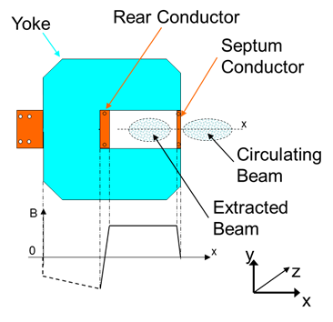
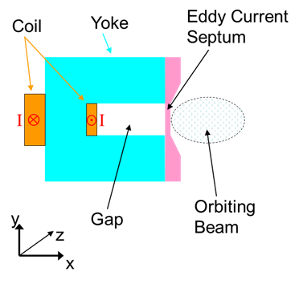
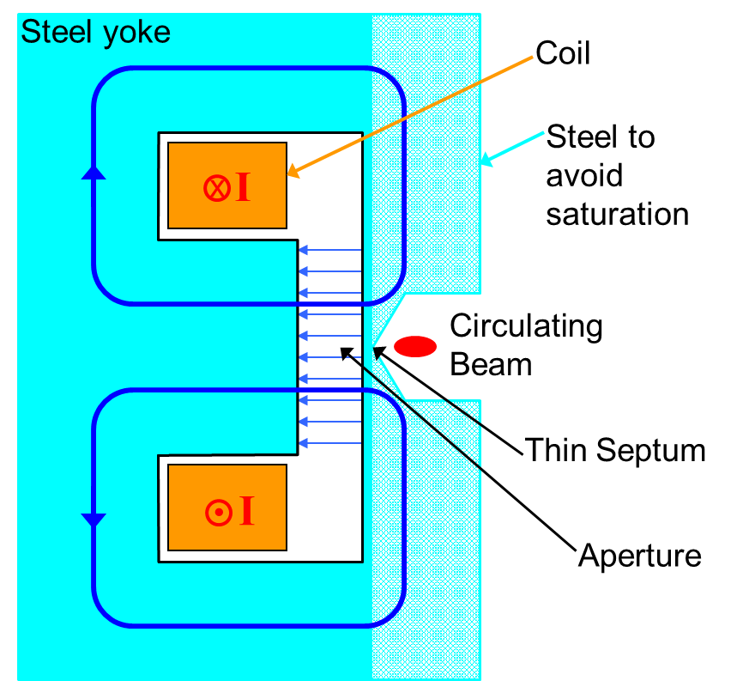
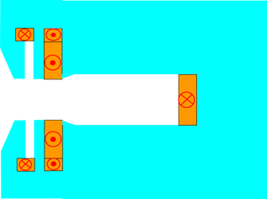

First stage septum magnet topologies considered
Current carrying septum | Eddy current septum | Massless septum | Lambertson septum
+ Thin apparent septum thickness - Power dissipation and cooling issues for DC operation | + Thin apparent septum thickness - Incompatible with DC operation | + No active parts in the path of the beam - Thick apparent septum - Gradient rather than a cut-off | + Robust design - Two-plane beam transfer - Shielding of circulating beam challenging for high B
Iron dominated, hence 2­ T maximum field
Compensation coil
Main coil
Yoke
Gap
Septum region
Beam dump septum concepts
M. Atanasov
Septa topologies for FCC beam dump
M. Atanasov
13/04/2016

Slide 10
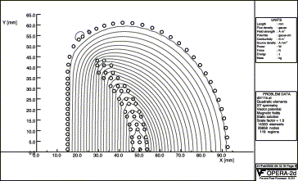
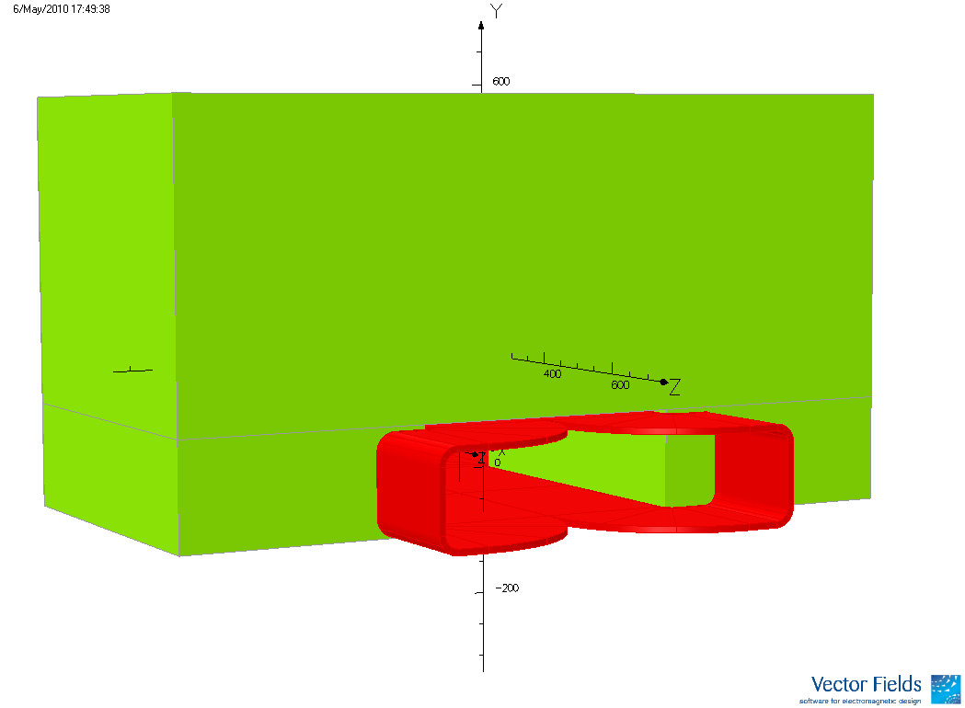

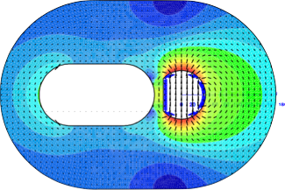
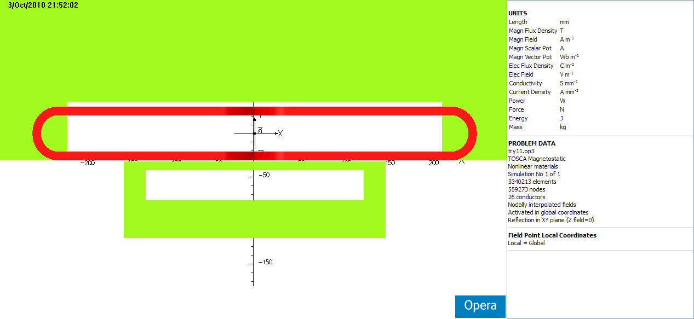
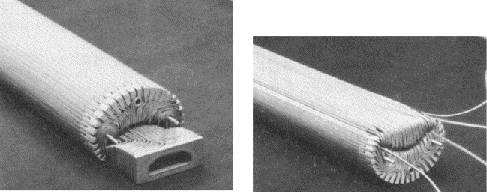
Second stage septum magnet topologies considered
Truncated double cosine (g-2) (BNL/FNAL) [1] | SIS300 proposal (GSI) [2] | Pamela proposal (BNL) [3] | Superconducting sheet topology (Wigner Institute) [4]
Used for muon beams that could traverse the coil without damaging or quenching | Both concepts rely on significant amounts of iron to shield the orbiting beam aperture. Very challenging to obtain both a thin septum as well as a low leak field. |  | Persistent currents excited in a superconducting tube by a ramped external field. Needs R&D to manufacture s.c. shields.
See presentation by D. Barna
Iron Yoke
Extracted Beam
Circulating Beam
340mm
14mm
493mm
20 mm
40 mm
Maximum magnetic field in the iron
3.45T
250 mm
40mm
350 mm
See presentation by E. Fischer
Septa topologies for FCC beam dump
M. Atanasov
13/04/2016

Slide 11
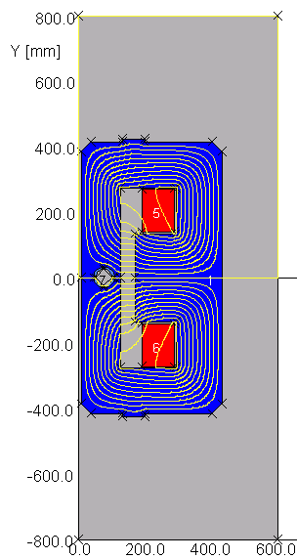
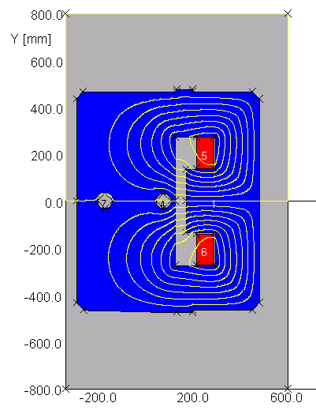
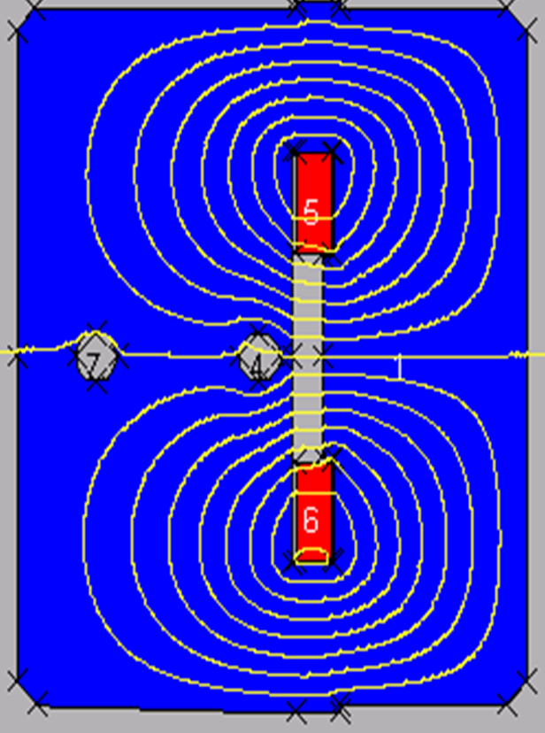
Iron-dominated topologies for FCC extraction
LHC type Lambertson septa are the baseline
Robust conservative design
Normal-conducting coils for the first units to avoid quenches caused by particle showers from the protection elements.
Pole tip saturation an issue. Can be solved with normal conducting bedstead coils in a window frame like topology.
Superferric version can be considered further downstream to reduce the power dissipation.
LHC type magnet
FCC normal conducting magnet
FCC superferric magnet
Septa topologies for FCC beam dump
M. Atanasov
13/04/2016

Slide 12
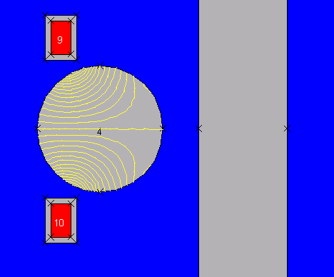
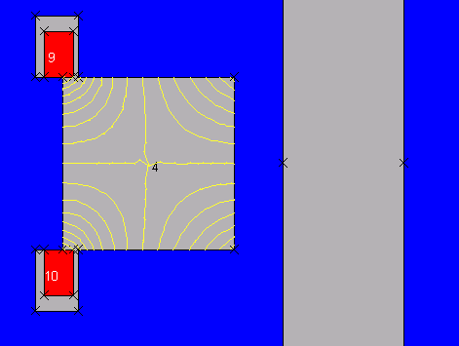
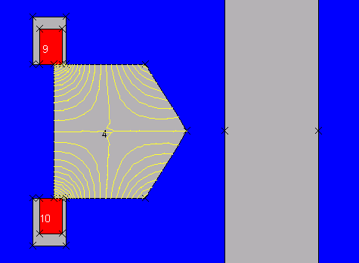
Leak field mitigation measures being explored
A challenge to keep the leak fields to an acceptable minimum at high levels of saturation (for 2 T gap field)
Fields below 2 T for the thinnest septa upstream
Poster presentation A. Sanz ULL
Compensating coils as a means of minimizing the leak field on the circulating beam, as well as different hole geometries are being studied.
Need continuous, non-linear powering of the compensation coil as a function of the main field.
Septa topologies for FCC beam dump
M. Atanasov
13/04/2016

Slide 13
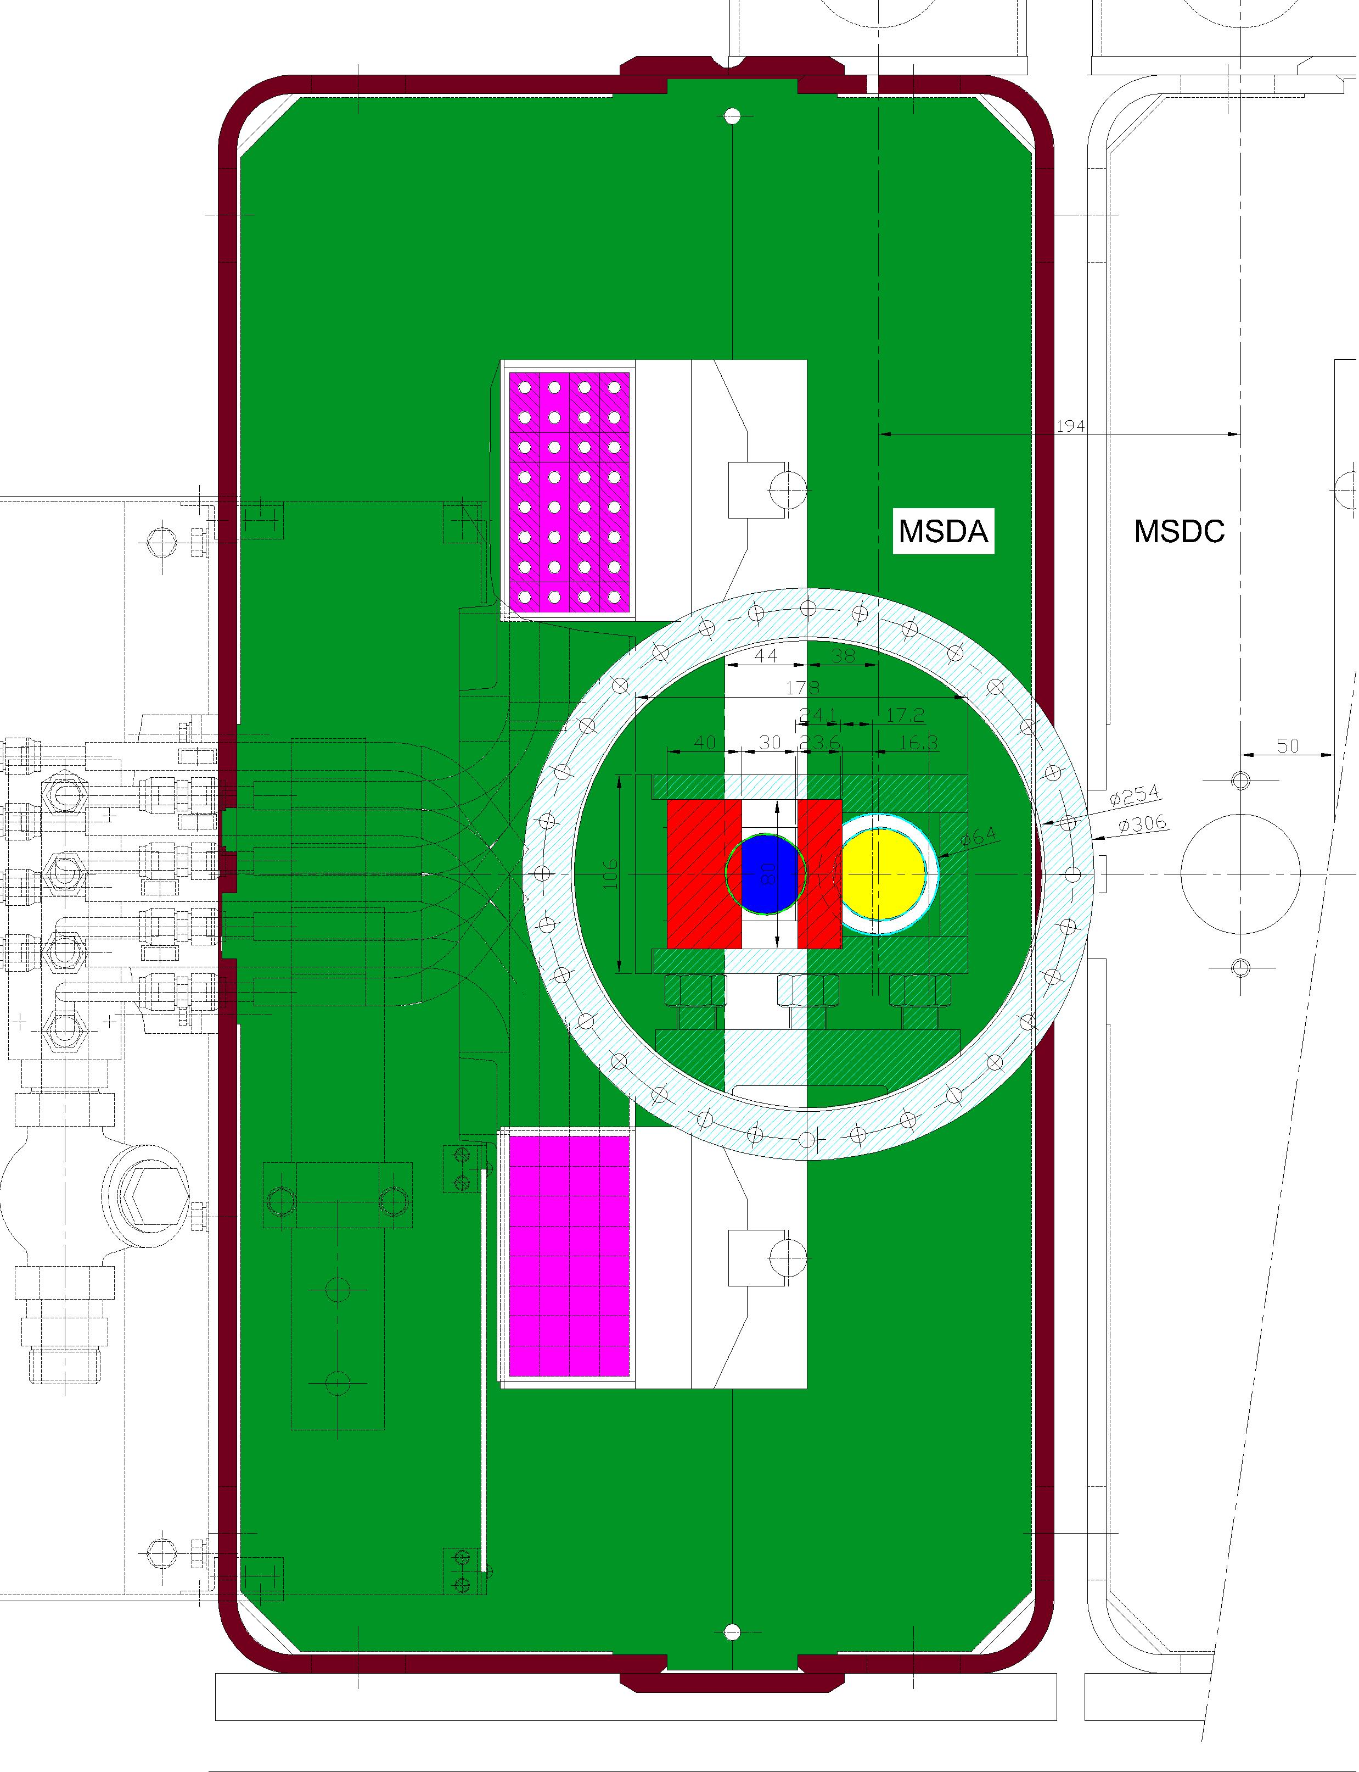
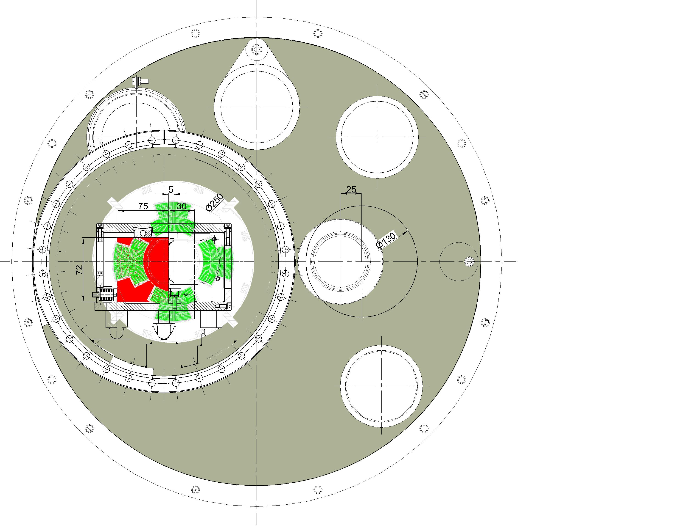
LHC Extraction protection approach
Septum protection (TCDS)
Quadrupole protection (TCDQ)
QF
MKD
MSD
QD
Septum protection element is a fixed diluter shadowing the septum magnet and its vacuum chambers
The quadrupole protection element is a moveable diluter to protect the quadrupole and other downstream elements
Same approach should be feasible for FCC, see talk by F. Cerutti, A. Lechner
TCDQ
TCDS
13/04/2016

Slide 14
FCC extraction protection needs
Space reserved for 2 types of septa protection elements:
  Upstream of Lambertson:
    equipment protection
  Upstream of superconducting septa
    equipment protection
    quench protection
Protection limits and quench levels to be determined:
  Steel limits could be increased from 100°C to 200°C
  Copper coil and vacuum chamber limits remain unchanged.
  Water cooling criteria to be studied in detail in case of coils next to gap layout.
  Quench limits to be defined, likely different for superferric and for superconducting variant.
Septa topologies for FCC beam dump
M. Atanasov
13/04/2016

Slide 15
Summary
Two stage septa approach pursued
  Lambertson topology for the start of the extraction channel
    Normal conducting units upstream due to their robustness, fields below 2 T to limit the leak field on the circulating beam
    Superferric excitation further downstream
  Superconducting 3 - 4 T septa with superconducting shielding of the circulating beam to complement the initial deflection
Requirements on the leak field at the circulating beam need to be refined
Possible implementation of a second stage septum protection device or a mask between the two septa stages
Septa topologies for FCC beam dump
M. Atanasov
13/04/2016

Slide 16
References
[1] A. Yamamoto et al., “The Superconducting Inflector for the BNL g-2 Experiment”, Nucl. Instr. and Meth., vol. A491, pp. 23–40, 2002.
[2] K. Sugita et al., “Novel Concept of Truncated Iron-Yoked Cosine Theta Magnets and Design Studies for FAIR Septum Magnets”, IEEE Trans.on Appl. Supercond., Vol. 22, no. 3, June 2012
[3] H. Witte et al., “Conceptual Design of a Superconducting Septum for FFAGs”, Proceedings of IPAC 2012, pp. 3620–3622
[4] D. Barna “Septum Concepts, Technologies and Prototyping for FCC-hh Injection and Extraction”, FCC Week 2016, Technologies R&D: Beam transfer, Magnet & Instrumentation Session
Septa topologies for FCC beam dump
M. Atanasov
13/04/2016

