Slide 1

Faster ramping of LHC as FCC-hh injector
Attilio Milanese
B. Goddard, M. Solfaroli Camillocci
W. Bartmann, L. Bottura, W. Herr, M. Lamont, M. Modena, E. Todesco, D. Tommasini, A. Verweij and L. Walckiers
13 Apr. 2016

Slide 2
A faster ramp of the LHC is an ingredient to make it a (more effective) High Energy Booster for FCC
3.3 TeV
3.3 TeV
450 GeV
450 GeV
3.3 TeV as baseline injection energy for FCC-hh here

Slide 3
A ramp in the LHC involves 1700+ electrical circuits: we focus on the limiting ones, the 13 kA
8 main dipoles (MB)
16 main quad. (MQ)
8 + 8 inner triplet quad
ramp times consider purely linear ramps with maximum slope
8 inner triplet trims 20 warm circuits
36 + 124 + 12 individually powered dipoles / quadrupoles
1468 circuits ☺
rated currents correspond to more than 7 TeV
data from electrical layout database

Slide 4
With the present settings, the ramp to 3.3 TeV takes 643 s, with an average ramp rate in the main dipoles of 7.5 A/s
Exponential129 s (20%)
Linear 327 s (51%)
PELP function
I_{inj} = 760 A
I_{flt} = 5573 A
dI/dt_{max} = 10 A/s
ΔI_{snb} = 12 A
dI/dt_{snb} = 0.9 A/s
ΔI_{p2} = 0.02 I_{flt}
B_{exp,max} = 1.6 T
from parameters used in 4 TeV and 6.5 TeV operation
decay &
snap-back
10 A/s
Parabolic 164 s (26%)
Parabolic 22 s (3%)

Slide 5
Hardware constraints for a faster ramp up (1/2)
protection diode of main dipoles
cold turn-on voltage of 6 V limits the ramp rate at ≈60 A/s
inductive voltage on the string of 154 main dipoles
at 10 A/s, the inductive voltage is 150 V
at 50 A/s 750 V
[the dipoles are tested at 1.9 kV and see ±475 V at the beginning of a fast extraction]
10 A/s corresponds to the voltage limit of the power converters
splitting each MB circuit in two implies 375 V at 50 A/s
cryogenic load from AC losses
3.3 TeV at 50 A/s is similar to 7 TeV at 10 A/s for AC loss per cycle
the power is still ≈30 times less than the design value, which assures the helium bath stays below the λ line in a fast ramp down in 80 s

Slide 6
Hardware constraints for a faster ramp up (2/2)
premature quenches
main dipoles: ok up to 100+ A/s, at high field
[no quench-back at 125 A/s during a fast extraction]
other magnets: not more limiting, including Nb₃Sn HL-LHC magnets
quench detection
possibly special corrections for MB with unbalanced apertures
possibly improved inductive compensation for circuits with no middle voltage taps – upgrade of electronics anyway likely for FCC era
field quality
snap-back in MB: slow crossing can be kept at the beginning of the ramp
eddy currents: for the MB and MQ, no significant contributions on the harmonics up to 100+ A/s, a possible impact on the transfer function

Slide 7
A maximum target for a faster ramp up is 50 A/s for the main dipoles, instead of the current 10 A/s
50 A/s on the main dipoles is dictated by the cold diode and the inductive voltage on the string
this ×5 factor is for the linear ramp, not the overall ramp
the other magnets can cope with this 5x factor
some power converters would need an upgrade
13 kA (MB, MQ) circuits
≈200 individually powered quadrupoles / dipoles and some warm circuits, which can now run 3.6x faster than MB: some will be modified for HL-LHC
the RF can already follow this ×5 increase

Slide 8
These are several options for faster ramps up to 3.3 TeV
not effective - the initial part is very slow
(the exponential is there for historical eddy currents reasons)
Parabolic-Parabolic-Linear-Parabolic instead of Parabolic-Exponential-Linear-Parabolic
PPLP, 10 A/s to 50 A/s
PELP 10 A/s
50 A/s
20 A/s
ramp | time [s] | dI/dt_{avg} [A/s]
PELP, 10 A/s | 643 | 7.5
PPLP, 10 A/s | 513 | 9.4
PPLP, 20 A/s | 279 | 17.3
PPLP, 30 A/s | 205 | 23.5
PPLP, 40 A/s | 171 | 28.1
PtLP, 50 A/s | 154 | 31.3
10 A/s
I_{inj} = 760 A
I_{flt} = 5573 A
ΔI_{snb} = 12 A
dI/dt_{snb} = 0.9 A/s
the gain is not linear with dI/dt_{max}

Slide 9
For the ramp down, a further limitation comes from the one-quadrant power converters of the main quadrupoles and individually powered quadrupoles and dipoles (6 kA)
12.5 min.
MBs driven down at -10 A/s with negative voltage
MQs left floating down with an exponential
data from 2016 beam commissioning, ramp down from 6.5 TeV

Slide 10
These are 3 possible ramp up / down scenarios – drawn to scale considering a 20 min injection into the LHC
3.3 TeV
today
(10 A/s for MB)
9 min
12.5 min
450 GeV
3.3 TeV
upgraded power converters
20 A/s for MB & negative voltage for other 13 kA – 6 kA
5 min
5 min
450 GeV
3.3 TeV
upgraded power converters
50 A/s & (possibly) splitting of MB circuits in 1/2 & negative voltage for other 13 kA – 6 kA
2.5-3 min
2.5-3 min
450 GeV

Slide 11
Conclusions
Ramping the LHC faster up to a factor × 5 is possible for the magnets, with upgraded main 13 kA and 6 kA power converters
  limited by inductive voltage
  limited during ramp down for one-quadrant converters
A ramp up / down to / from 3.3 TeV lasts
  9 min / 12.5 min current hardware, 10 A/s
  5 min / 5 min hardware upgraded to 20 A/s
  2.5-3 min / 2.5-3 min hardware upgraded to 50 A/s
Machine studies in the LHC are being proposed, for testing
  a PPLP instead of PELP scheme (Parabolic instead of Exponential)
  [the ramp to 6.5 TeV could be ≈2.5 min shorter]
  slower ramps (like 5 A/s), to scale ramp rate dependent effects

Slide 12
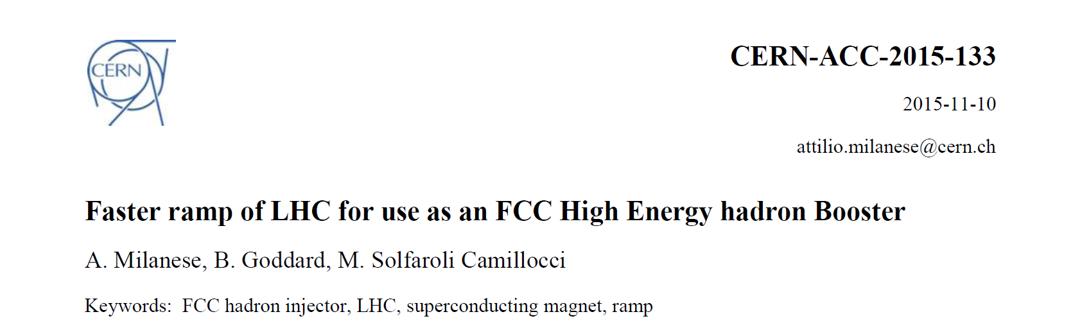
For more details
FCC-ACC/Note/2015-027 (https://cds.cern.ch/record/2057723)
(future) proceedings in FCCW2016 Special Edition of Physical Review – Accelerators and Beams (PRAB)

Slide 13
thank you

