Slide 1
Electron cloud studies
L. Mether
Many thanks to: E. Belli, R. Cimino, K. Ohmi, G. Rumolo, D. Schulte

Slide 2
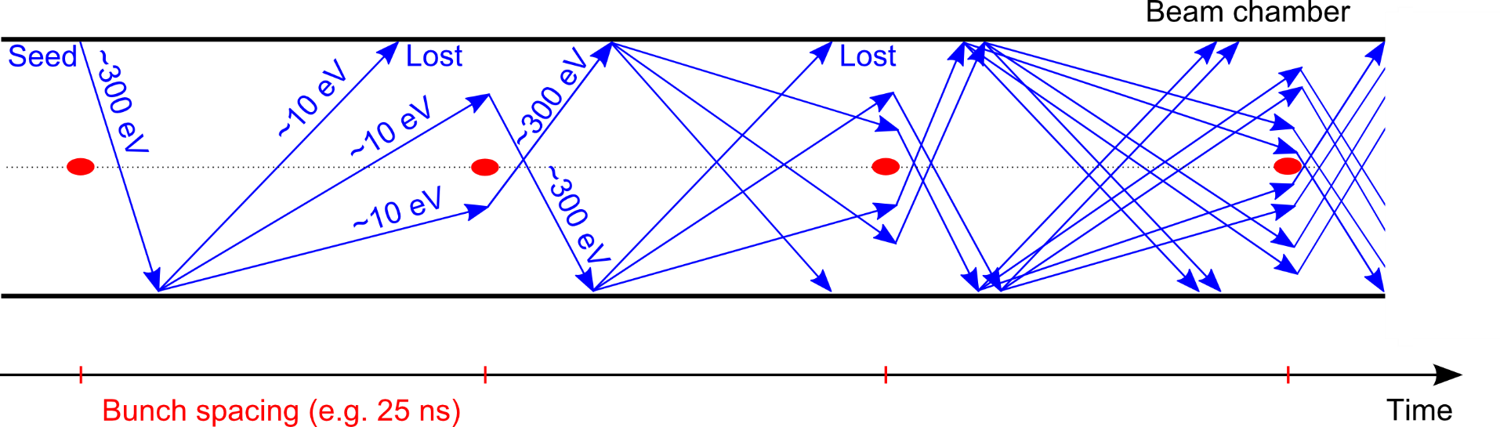
Electron cloud
Seed electrons
photoemission, gas ionization
Secondary electrons
Produced when seeds, accelerated by beam, hit the chamber wall
Multipacting
Avalanche electron production
Exponential growth of electron density
Beam interaction with dense e-cloud
Transverse instabilities
Emittance growth
Tune shift & spread
Beam losses
Electrons impacting chamber wall
Heat load on the beam chambers
Vacuum degradation

Slide 3
Electron cloud build-up studies
Standard simulation parameters
Bunch spacing [ns] | 25 ns | 5 ns
Bunch intensity [p⁺] | 10 x 10¹⁰ | 2 x 10¹⁰
Norm. emittance [um] | 2.2e-6 | 0.44e-6
Bunch length [m] | 0.08
Bunch train pattern | ( 50 b + 12 e )*4 | ( 250 b + 60 e )*4
Arc elements considered (FODO, L = 213.9 ) | Dipole 16 T, L = 171.6 m, beta_{x,y} = 175 m
 | Quadrupole 444 T/m, L = 12.6 m, beta_{x,y} = 205 m
 | Drift L = 26.6 m, beta_{x,y} = 175 m
Beam screen shape [mm] | LHC type (r_{x} = 15, r_{y} = 13.2)
Parameter scans
Secondary emission yield (SEY)
Photoelectron emission yields
Injection energies
Bunch intensity

Slide 4
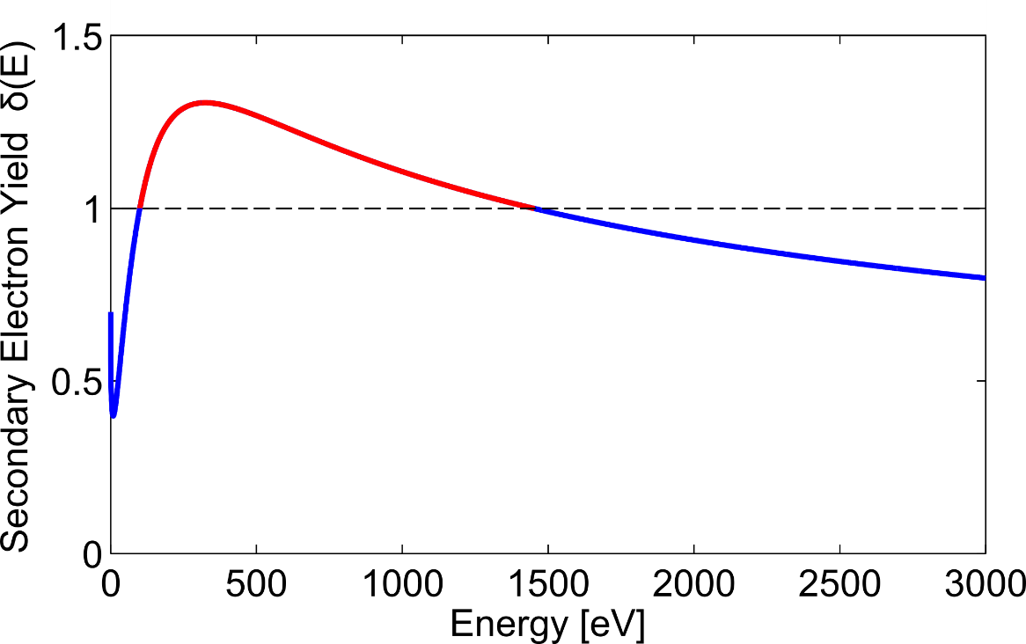
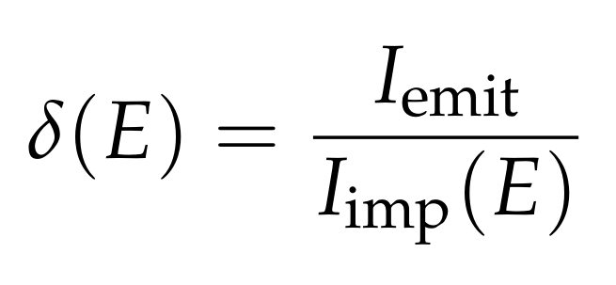
Secondary electron emission
  Simulation studies of e-cloud build-up (PyECLOUD)
    With uniform initial electron seeding
  Effect of secondary electron emission
  Model based on experimental data of LHC beam screen*
  Threshold SEY (δ_{max}) for multipacting
  Heat loads on beam screen
  Electron density around beam
SEY:
* G. Iadarola, “Electron cloud studies for CERN particle accelerators and simulation code development”, PhD Thesis, 2014

Slide 5
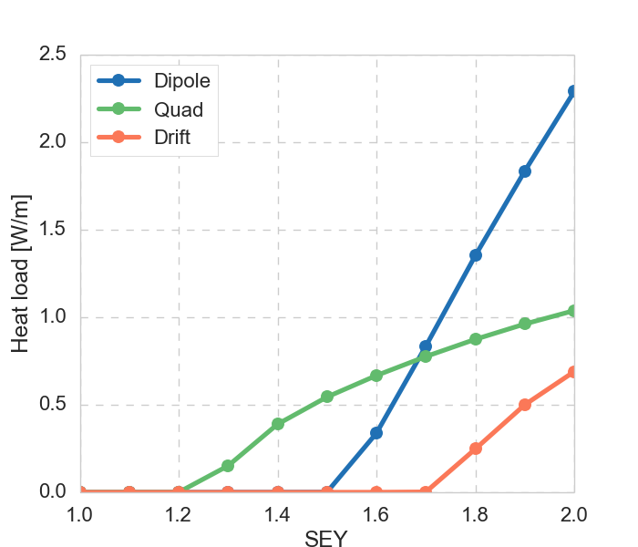
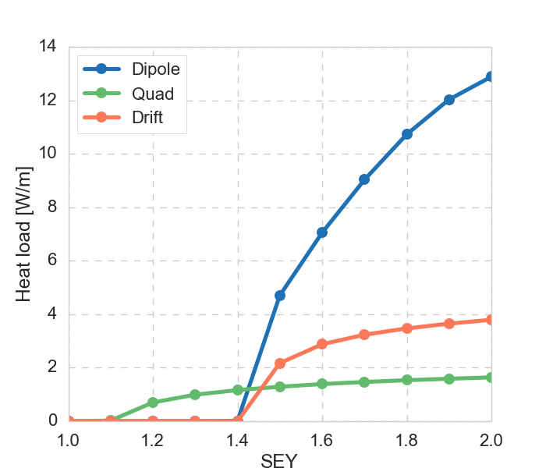
Heat load
Heat loads at 50 TeV, normalized relative to element length in arc cells
  Multipacting threshold in dipole: 1.4 – 1.6, quadrupole: 1.1 – 1.3
  For 5ns beam thresholds slightly lower, and heat load up to 5 x larger
For comparison, normalized heat load from synchrotron radiation = 22 W/m
25 ns beam
5 ns beam

Slide 6
Single bunch head-tail instability
Analytical estimate of threshold electron density for instability*
  with
  At 3.3 TeV: ρ = 4.4 x 10¹⁰ m⁻³, and 50 TeV: ρ = 5.7 x 10¹¹ m⁻³
    Beam more prone to instability at low energies
First simulation studies of instability at 50 TeV*
  Show no, or only very slow, emittance growth at ρ ~ 6 x 10¹¹ m⁻³
  Strong emittance growth around ρ ~ 2 x 10¹³ m⁻³
  Effect of radiation damping?
More simulation studies of instability needed for complete picture
and
* K. Ohmi et al, “STUDY OF ELECTRON CLOUD INSTABILITIES IN FCC-hh ”, Proceedings of IPAC2015

Slide 7
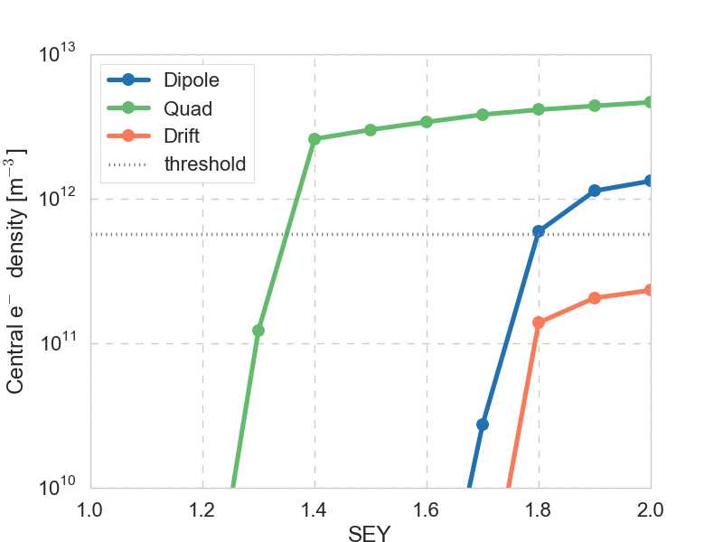
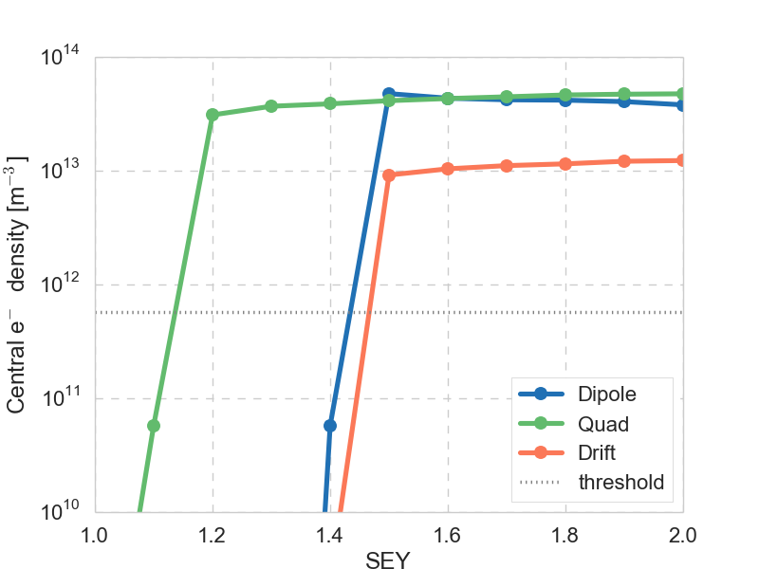
Central electron density
Central densities at 50 TeV, normalized relative to element length in arc cells
  For 25 ns beam, analytical threshold crossed for SEY > 1.3
    If instability threshold is closer to 2 x 10¹³ 25 ns, beam may be stable
  For 5ns beam, analytical threshold crossed for SEY > 1.1
    Even if threshold is around 2 x 10¹³, still prone to instability for SEY > 1.1
25 ns beam
5 ns beam

Slide 8
Photoelectron yield and e-cloud build-up
  E-cloud build up depends on photoelectron yields
    Total yield (mainly in drifts), and yield from scattered photons (in magnetic fields)
    Depend on photon energy and angle of incidence, surface roughness etc.
    Need to be measured experimentally
    Modeled in PyECLOUD through photon reflectivity R, and photoelectron yield Y
F. Schäfers, R.Cimino, Proc. ECLOUD12, CERN-2013-002

Slide 9
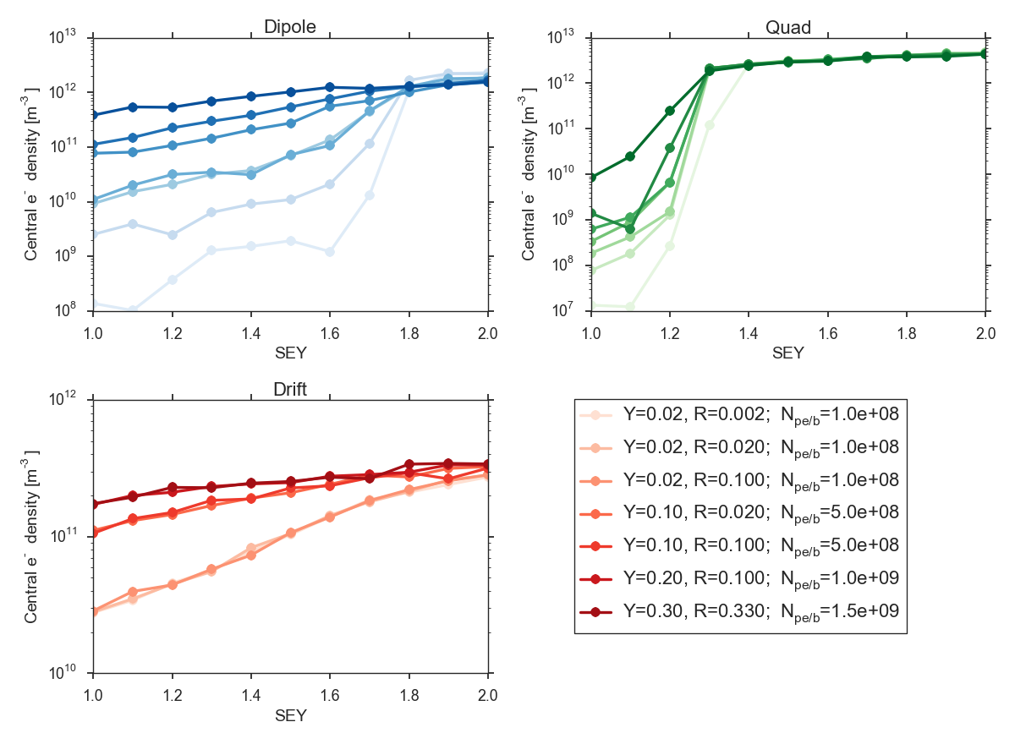
Effect of photoelectrons on central density
Dipole
With relatively large photoelectron yields, central densities can reach close to instability threshold density, even for SEY = 1
Quadrupole
Drift
25 ns beam at 50 TeV

Slide 10
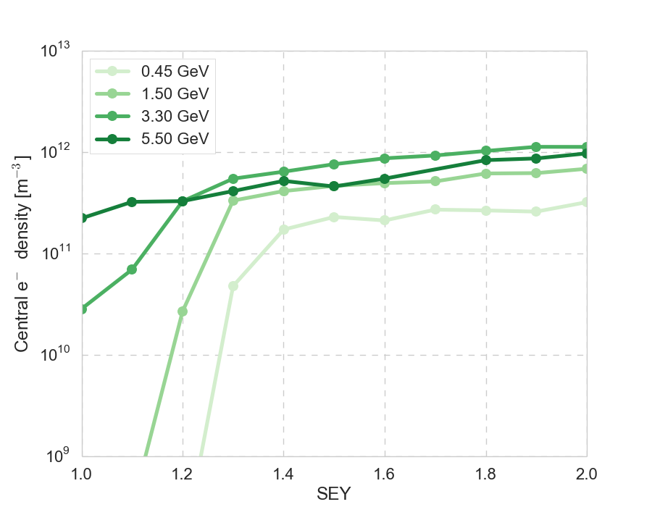
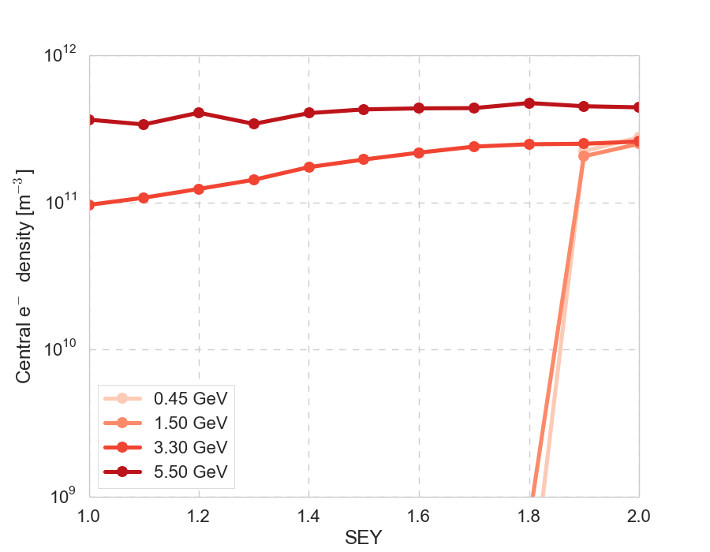
E-cloud build-up at injection
Studied effect of photoelectrons on build-up for various injection energies
  At lower energies, threshold density for instability is lower (1.6e10 for 450 GeV)
  For FCC, however, synchrotron photons at injection have low energies, with only a fraction above Cu work function ~4.5 eV
  Here assuming very conservatively: N_{e} = N_{γ}(E > 4.5 eV), R = 1
  For 450 GeV and 1.5 TeV only gas ionization
Dipole very similar
Quadrupole
Drift

Slide 11
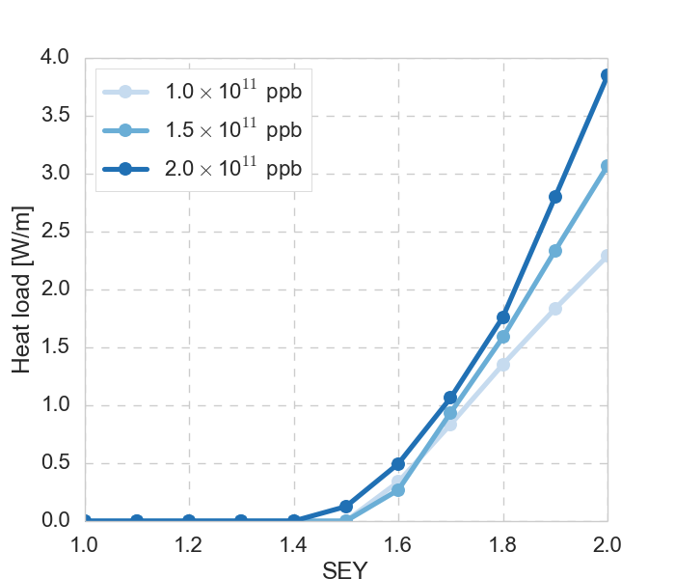
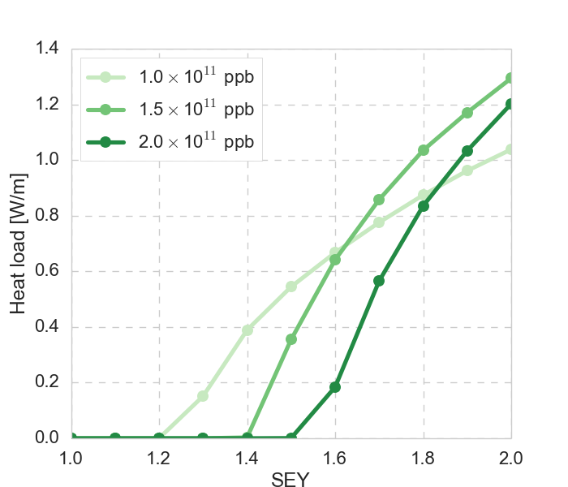
High intensity
The option of increasing the bunch intensity up to a factor 2 has been explored
For 25 ns bunch spacing, the situation is actually improved!
  No important effect in the dipole (nor drift)
  The quadrupole multipacting threshold is higher
  Central densities are similar to nominal intensity or lower
25 ns, 50 TeV
Dipole
Quadrupole

Slide 12
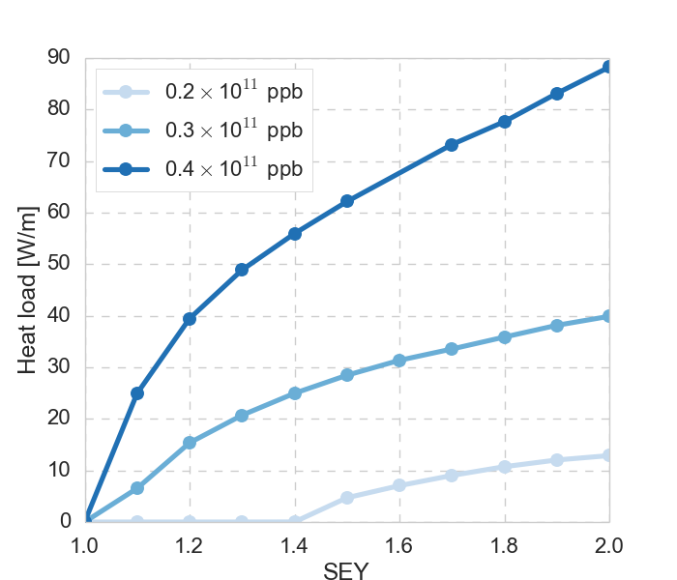
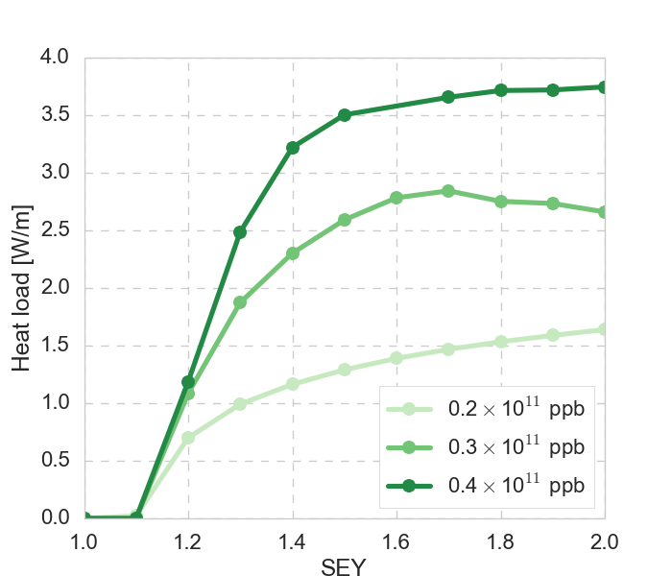
High intensity
The option of increasing the bunch intensity up to a factor 2 has been explored
For 5 ns bunch spacing, the situation gets much worse!
  The threshold in dipoles (and drifts) approaches SEY ~ 1
  Heat load in dipoles (and drifts) is very high
  Central densities are similar to nominal intensity or lower
5 ns, 50 TeV
Quadrupole
Dipole

Slide 13
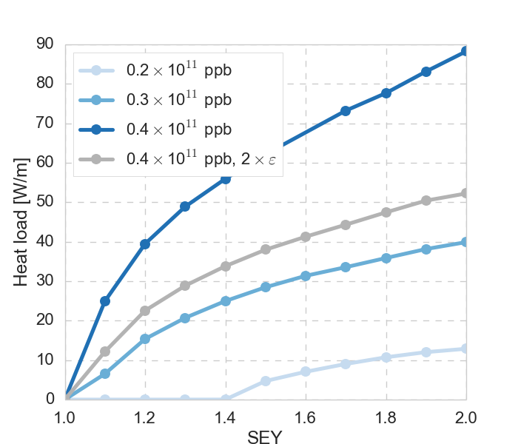
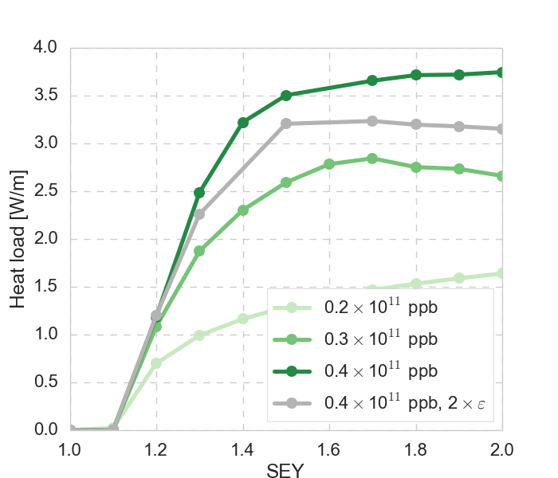
High intensity with larger emittance
The option of increasing the bunch intensity up to a factor 2 has been explored
If the emittance is also increased by a factor 2
  For 25 ns beam, the emittance plays no significant role
  For 5 ns beam, there is a only slight improvement in the quantitative behavior
5 ns, 50 TeV
Quadrupole
Dipole

Slide 14
Conclusion
To run the machine without electron cloud, SEY needs to be kept < 1.1
  Heat loads for moderately low SEY may be tolerable
  Central electron density problematic already for SEY = 1.2
Photoelectrons may be dangerous even for SEY <= 1, if no mitigation
  To improve accuracy of build-up estimates, detailed measurement data on photoelectron yields for FCC specific case would be very useful
Higher intensity up to 2 x nominal, with or without larger emittance
  Seems feasible for 25 ns
  Very difficult for 5 ns, unless SEY <= 1
More studies needed to clarify precise instability thresholds
  Coupled build-up and instability simulations

Slide 15

Thank you!

