Slide 1
Interaction Region optics solutions
A.Bogomyagkov, E. Levichev, K. Oide, P.Piminov,
D. Shatilov, S. Sinyatkin
Many thanks to M. Benedikt, H. Burkhardt, B. Haerer, B. Holzer, M. Koratzinos, P. Vobly, F. Zimmermann

Slide 2
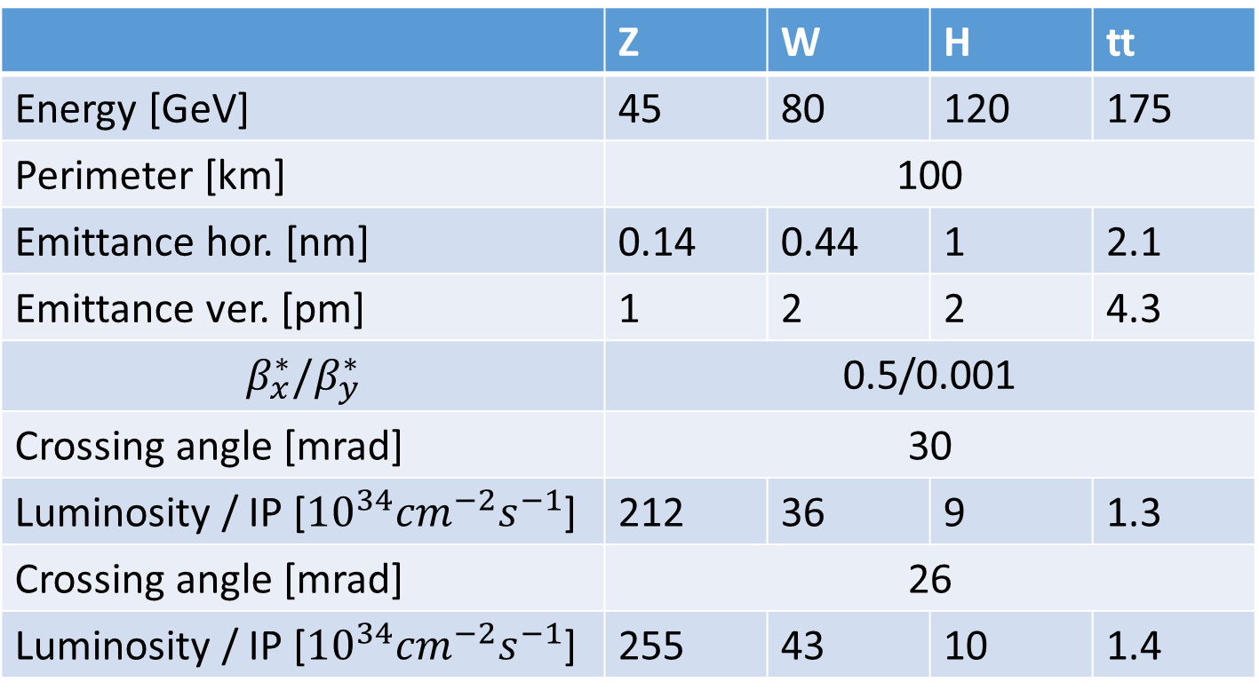
Luminosity vs beam energy
(theoretical estimations)
 | Z | W | H | tt
Energy [GeV] | 45 | 80 | 120 | 175
Perimeter [km] | 100
Emittance hor. [nm] | 0.14 | 0.44 | 1 | 2.1
Emittance ver. [pm] | 1 | 2 | 2 | 4.3
$$β_{x}^{∗}/β_{y}^{∗}$$ | 0.5/0.001
Crossing angle [mrad] | 30
Luminosity / IP [${10}^{34}{cm}^{−2}s^{−1}$] | 212 | 36 | 9 | 1.3
Crossing angle [mrad] | 26
Luminosity / IP [${10}^{34}{cm}^{−2}s^{−1}$] | 255 | 43 | 10 | 1.4

Slide 3
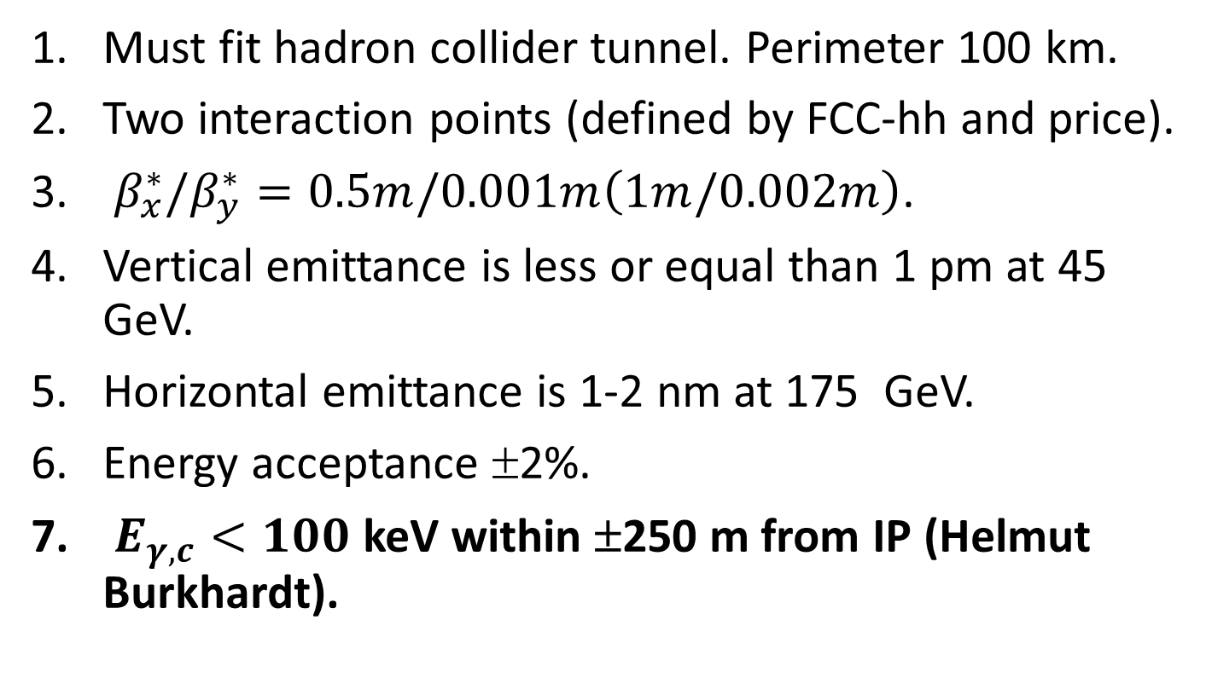
Requirements
Must fit hadron collider tunnel. Perimeter 100 km.
Two interaction points (defined by FCC-hh and price).
$β_{x}^{∗}/β_{y}^{∗}=0.5m/0.001m\left(1m/0.002m\right)$.
Vertical emittance is less or equal than 1 pm at 45 GeV.
Horizontal emittance is 1-2 nm at 175 GeV.
Energy acceptance ±2%.
$E_{γ,c}<100$ keV within ±250 m from IP (Helmut Burkhardt).

Slide 4
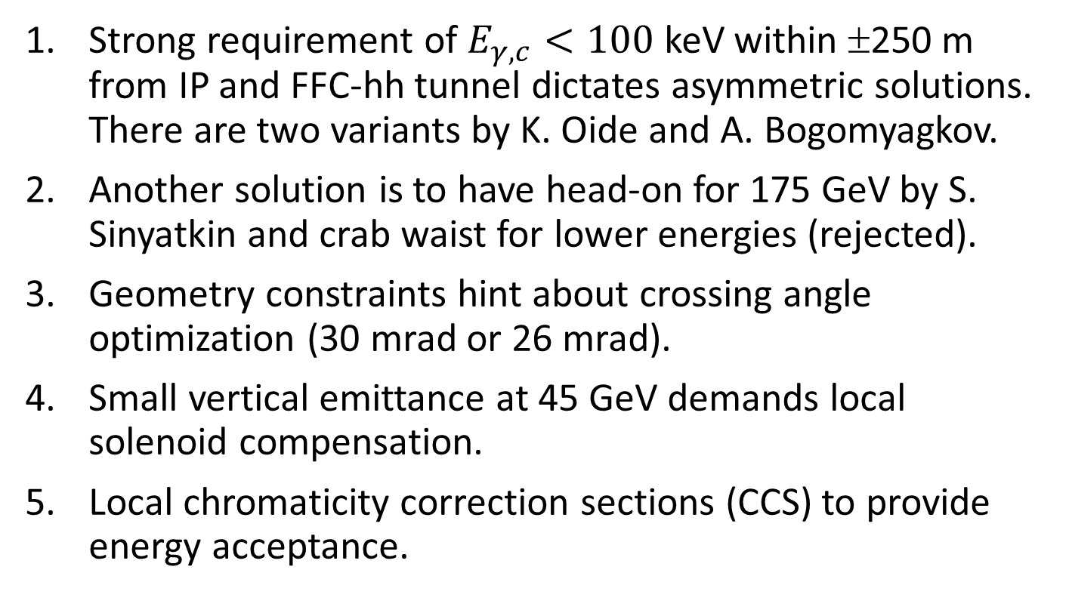
Solutions
Strong requirement of $E_{γ,c}<100$ keV within ±250 m from IP and FFC-hh tunnel dictates asymmetric solutions. There are two variants by K. Oide and A. Bogomyagkov.
Another solution is to have head-on for 175 GeV by S. Sinyatkin and crab waist for lower energies (rejected).
Geometry constraints hint about crossing angle optimization (30 mrad or 26 mrad).
Small vertical emittance at 45 GeV demands local solenoid compensation.
Local chromaticity correction sections (CCS) to provide energy acceptance.

Slide 5
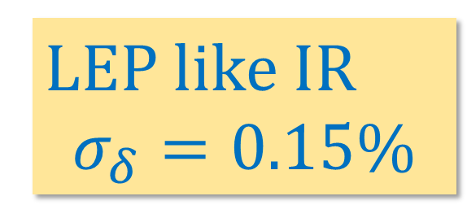
The reason for chromaticity sections
LEP like IR
$$σ_{δ}=0.15\%$$

Slide 6
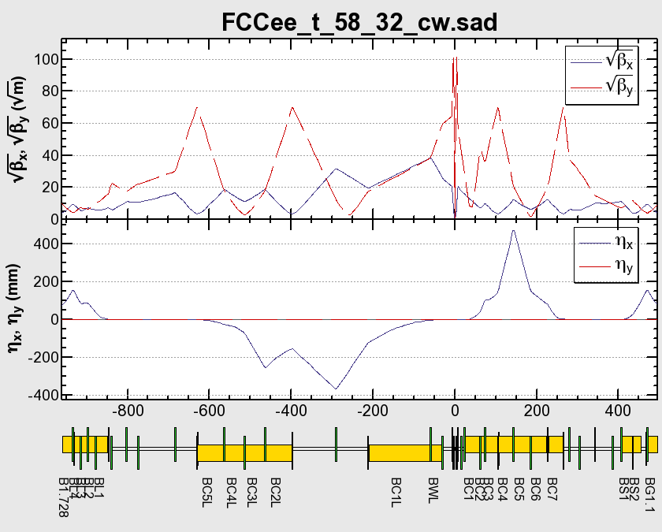
IR1: asymmetric by KO, 30 mrad
Local CCS +
Crab Waist (*)
Local CCS +
Crab Waist
IP
uc(keV): 100 100 742

Slide 7
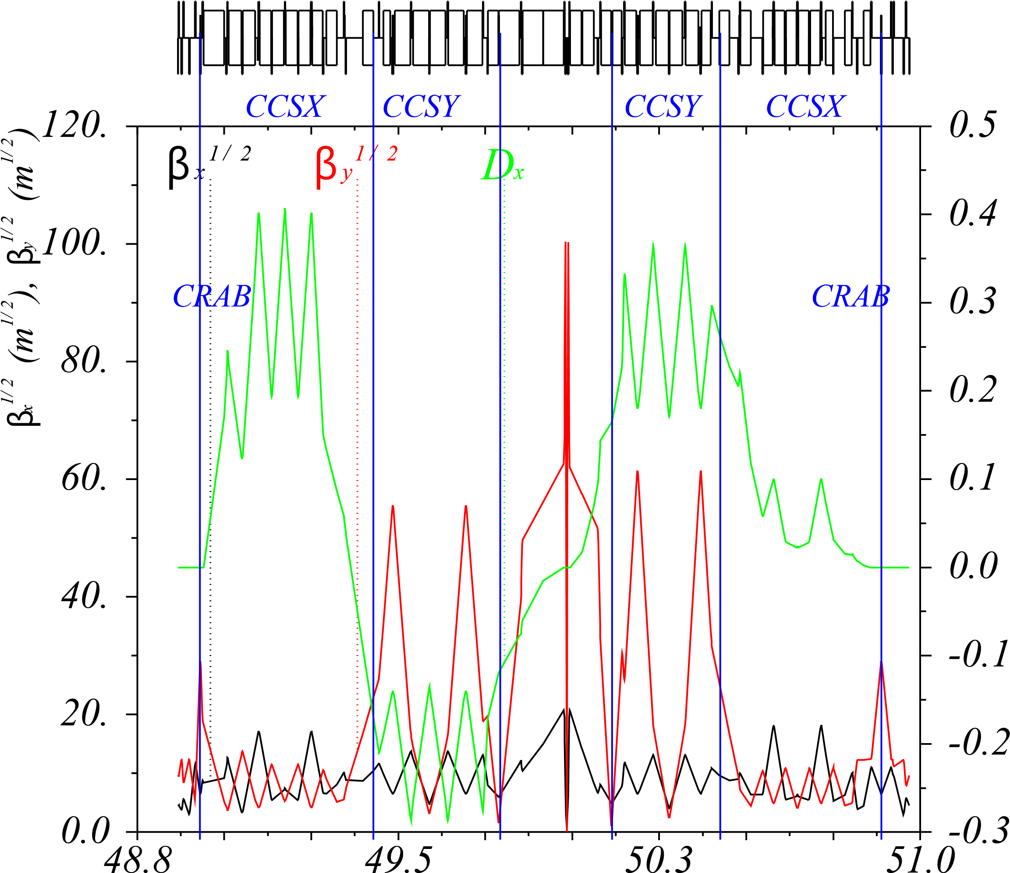
IR2: asymmetric AB, 26 mrad
Dx (m)
IP
s (km)

Slide 8
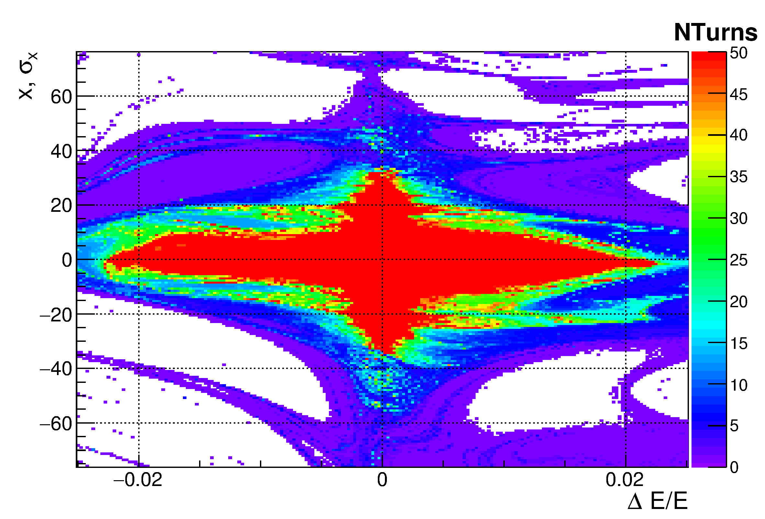
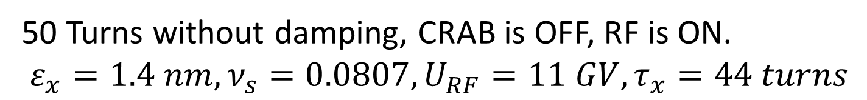
Dynamic aperture: AB, 26 mrad
50 Turns without damping, CRAB is OFF, RF is ON.
$$ε_{x}=1.4 nm, ν_{s}=0.0807, U_{RF}=11 GV, τ_{x}=44 turns$$

Slide 9
Synchrotron radiation towards IP
Dipole | L, m | S(end), m | Ec, keV
IR1: asymmetric by KO, 30 mrad (v.58-32)
BWL.2 | 37 | 76.5 | 100
BC1L.2 | 105.7 | 186 | 100
IR2: asymmetric by AB, 26 mrad (v.9-5)
B0 | 59 | 67.5 | 100.8
B1 | 59 | 127 | 100.8
B2 | 59 | 195.2 | 201.5
B3 | 30 | 226.4 | 310.5
B4 | 45 | 287.2 | 494

Slide 10
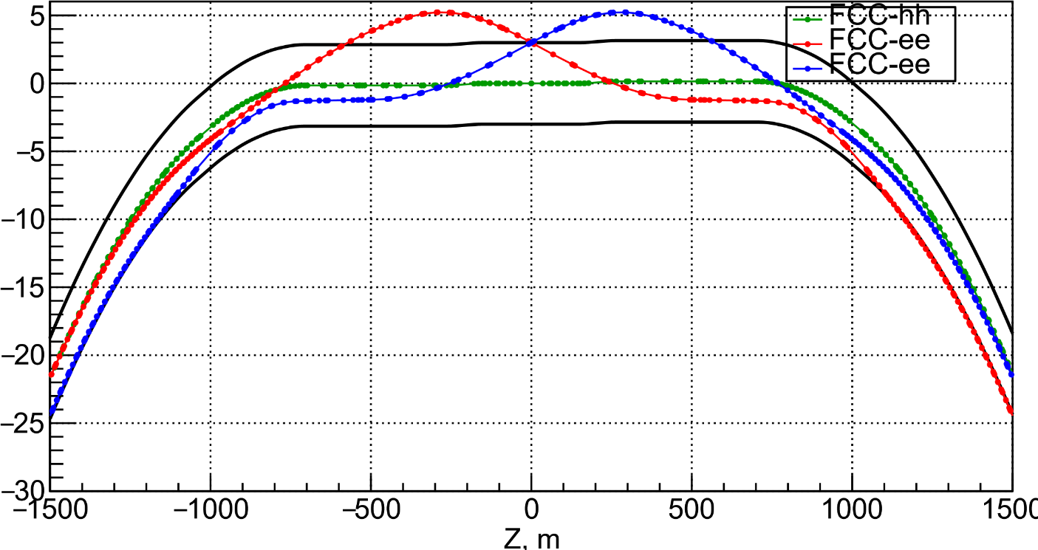
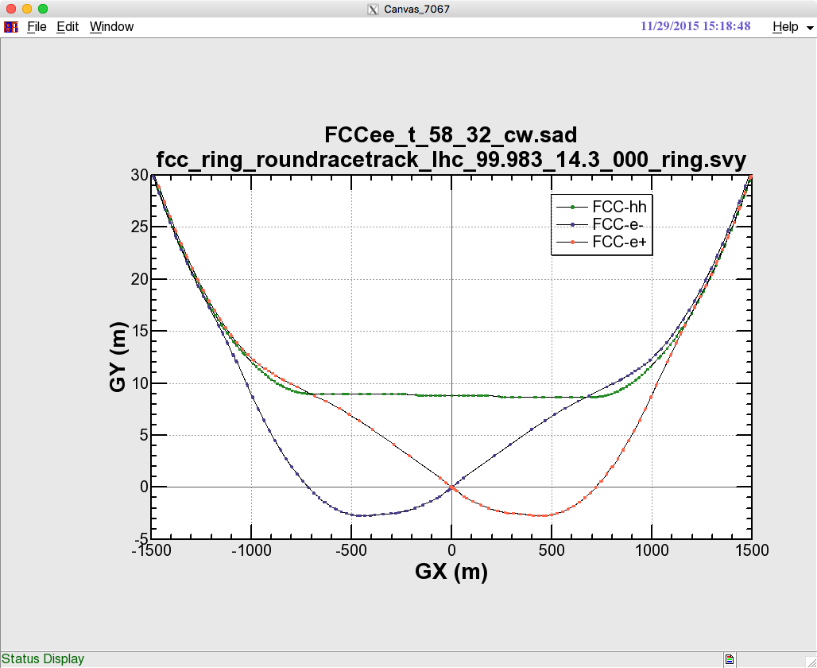
Layout: KO 30 mrad and AB 26 mrad
5.3 m
X, m
8.7 m
11.6 m
Wide tunnel: ±1,150 m

Slide 11
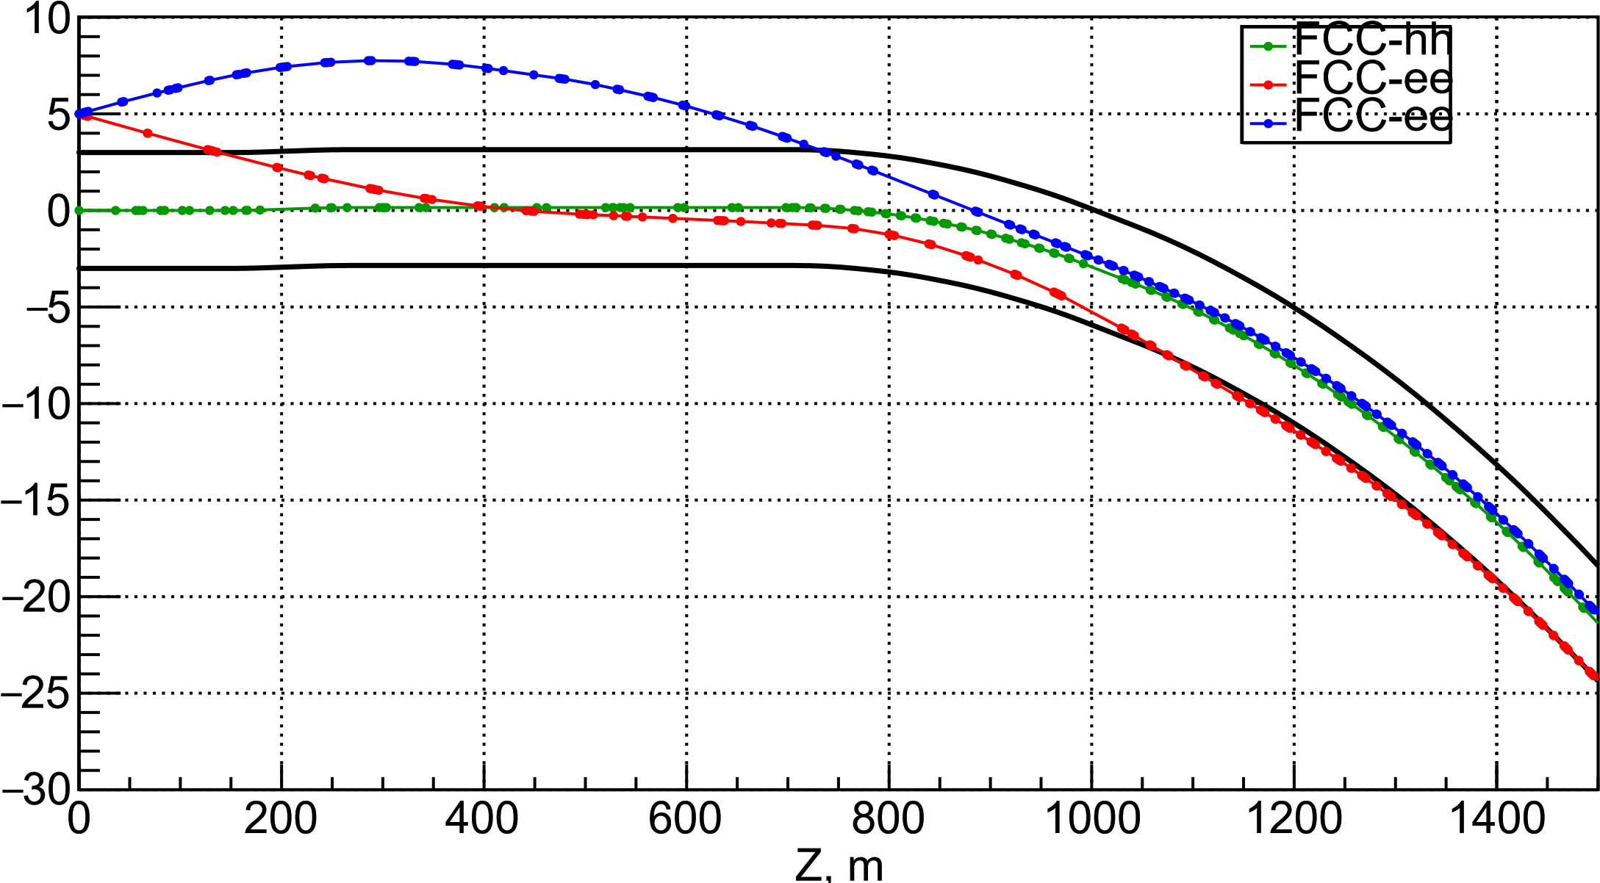
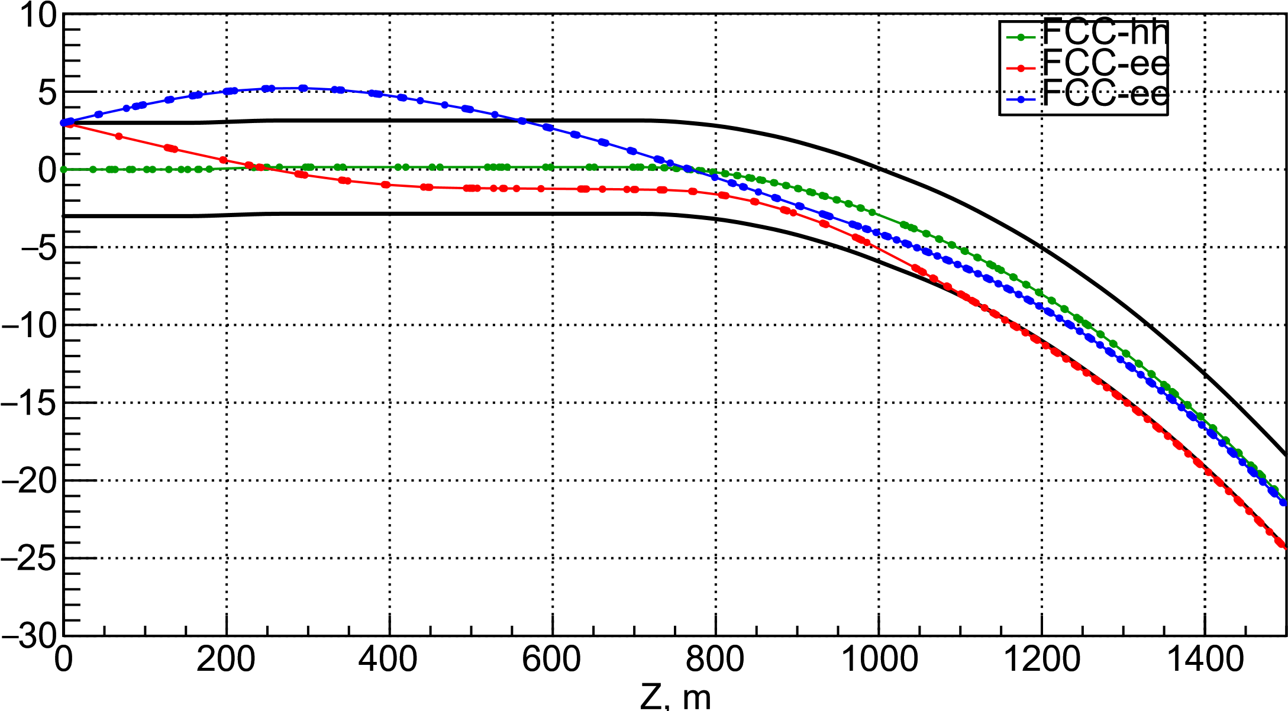
Layout: AB 30 mrad and AB 26 mrad
7.8 m
30 mrad
X, m
5.3 m
26 mrad
X, m

Slide 12
IP trajectories 1

Slide 13
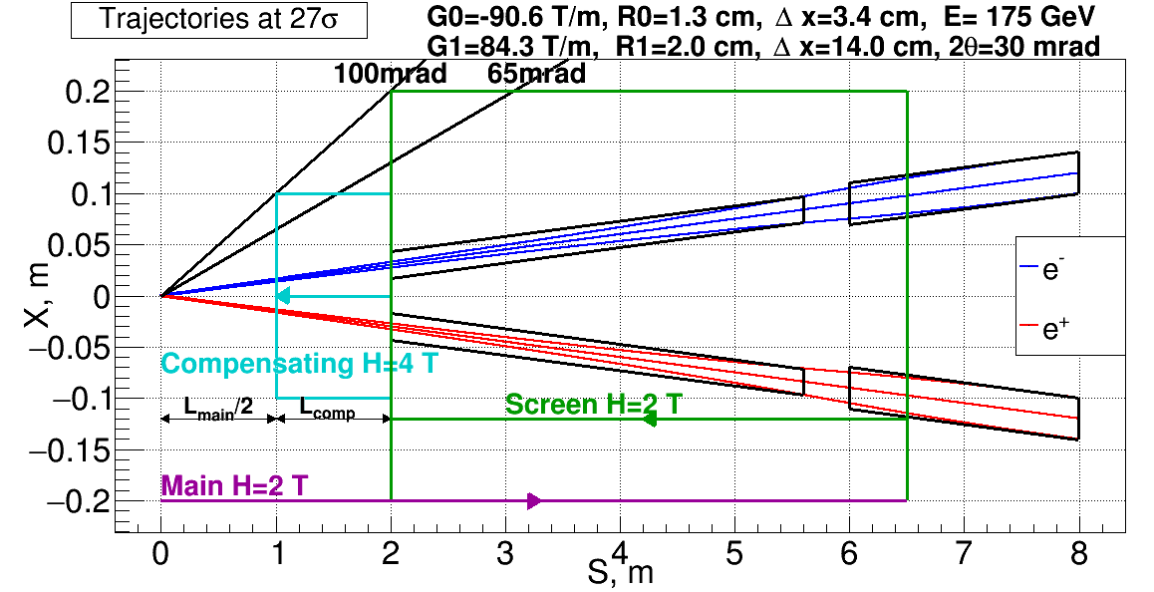
Solenoid compensation for IP1
Compensating solenoid R = 0.1 m, screening solenoid R = 0.2 m.

Slide 14

Emittance vs Lcomp: E=45 GeV, IP1
$$ℒ≈\frac{ℒ_{design}}{\sqrt{ε_{y}\left[pm\right]}}$$

Slide 15
IP trajectories 2

Slide 16
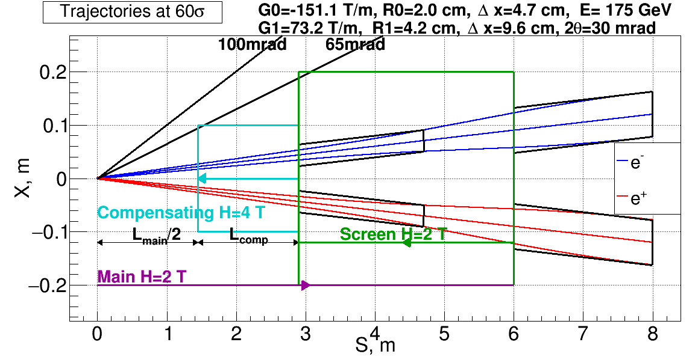
Solenoid compensation for IP2
Compensating solenoid R = 0.1 m, screening solenoid R = 0.2 m.

Slide 17
Emittance vs Lcomp: E=45 GeV, IP2
$$ℒ≈\frac{ℒ_{design}}{\sqrt{ε_{y}\left[pm\right]}}$$

Slide 18
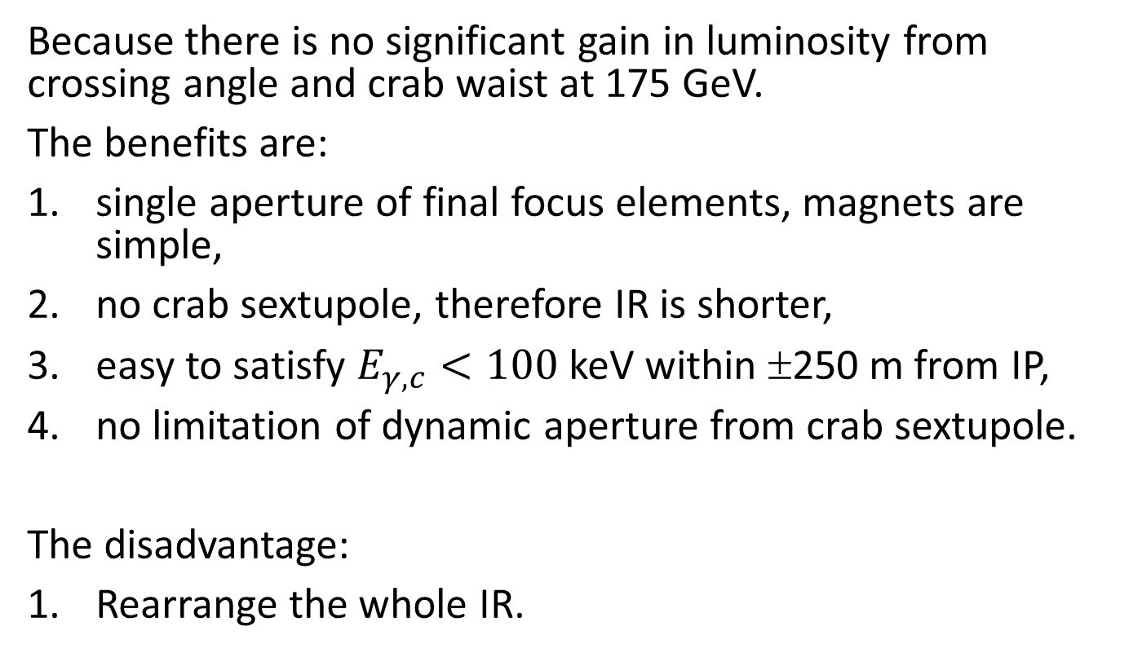
Head-on at 175 GeV (rejected)
Because there is no significant gain in luminosity from crossing angle and crab waist at 175 GeV.
The benefits are:
single aperture of final focus elements, magnets are simple,
no crab sextupole, therefore IR is shorter,
easy to satisfy $E_{γ,c}<100$ keV within ±250 m from IP,
no limitation of dynamic aperture from crab sextupole.
The disadvantage:
Rearrange the whole IR.

Slide 19
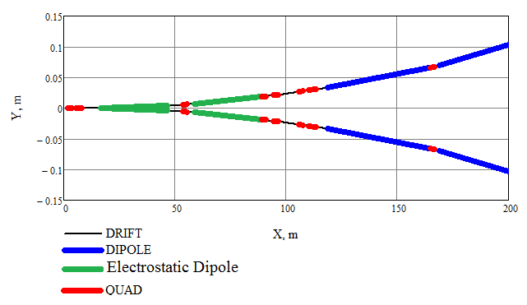
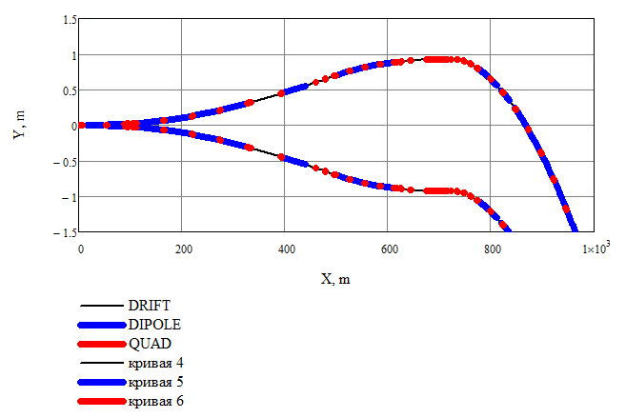
IR3: head on
E_{γ} = 100 keV within 500 m.
1.8 m

Slide 20
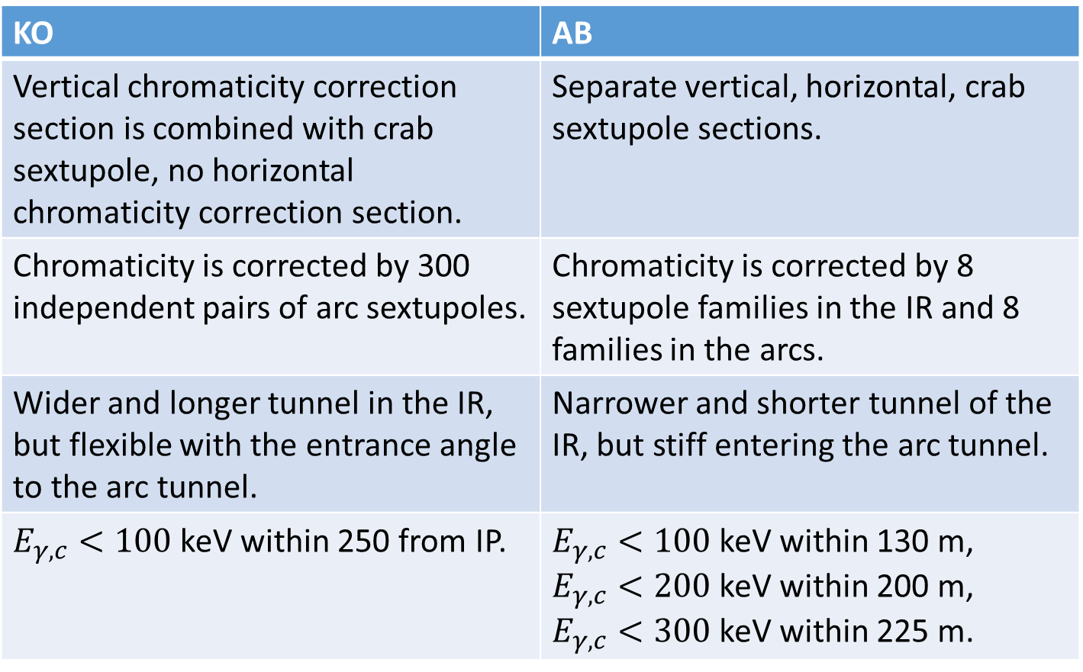
Comparison
KO | AB
Vertical chromaticity correction section is combined with crab sextupole, no horizontal chromaticity correction section. | Separate vertical, horizontal, crab sextupole sections.
Chromaticity is corrected by 300 independent pairs of arc sextupoles. | Chromaticity is corrected by 8 sextupole families in the IR and 8 families in the arcs.
Wider and longer tunnel in the IR, but flexible with the entrance angle to the arc tunnel. | Narrower and shorter tunnel of the IR, but stiff entering the arc tunnel.
$E_{γ,c}<100$ keV within 250 from IP. | $E_{γ,c}<100$ keV within 130 m, $E_{γ,c}<200$ keV within 200 m, $E_{γ,c}<300$ keV within 225 m.

Slide 21
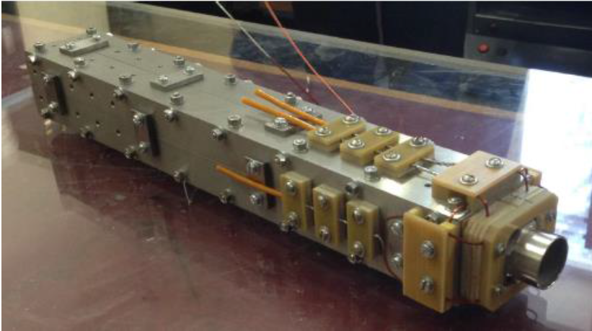
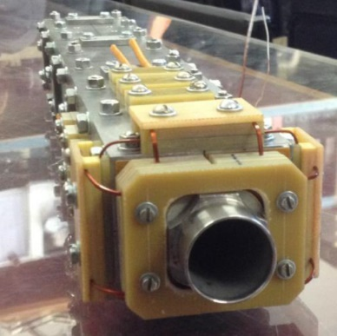
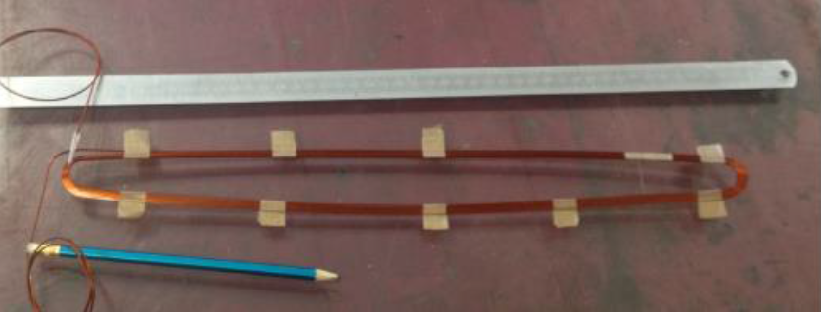
QD0 prototype 100 T/m
New version of QD0 was developed at BINP recently and a single-aperture prototype was manufactured.
Main parameters:
Max.gradient 100 T/m
Max.current 1100 A
Length 40 cm
Aperture 2 cm
NbTi 1.8 x 1.4 mm²
Saddle-type coils
During the first cryo-test (01.02.16) the current of 1060 A was achieved after 3 quenches.

Slide 22
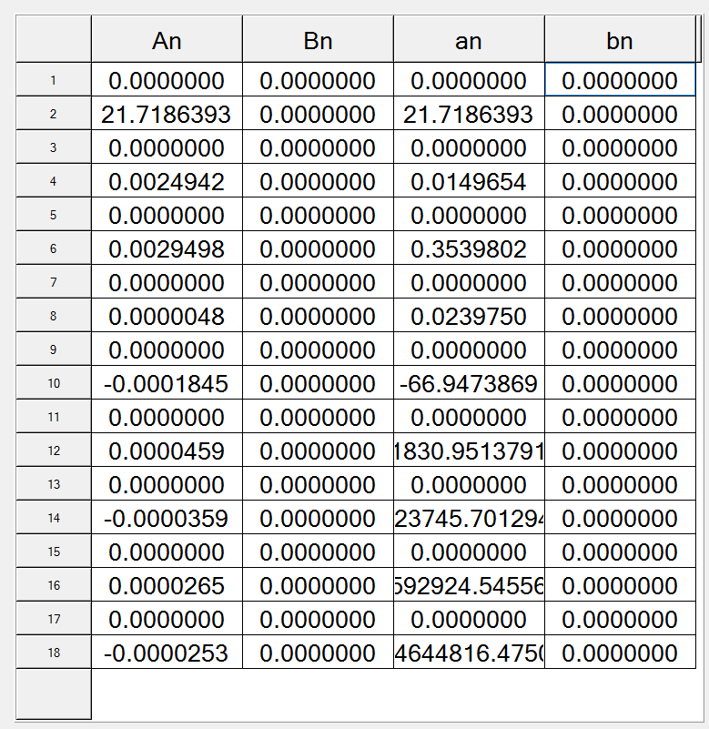
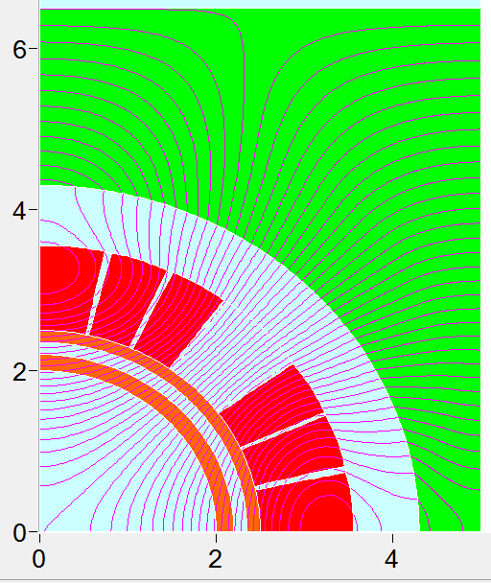
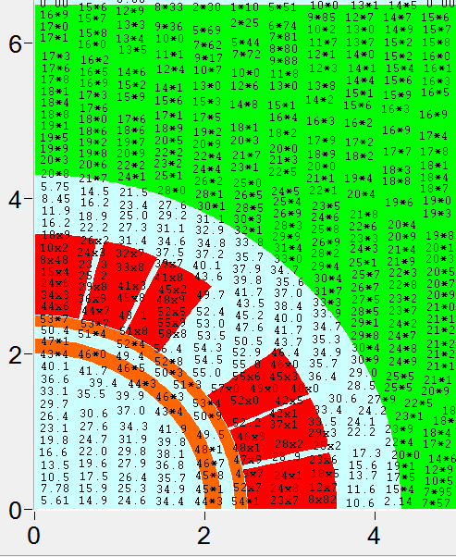
QD0 design 200 T/m
Pros | Cons | Main parameters
Larger aperture to avoid higher order HOMS SR hitting the walls | Higher SR | Maximum gradient 217 T/m. Length 180 cm.
More room for luminometer |  | Radius 2 cm.

Slide 23
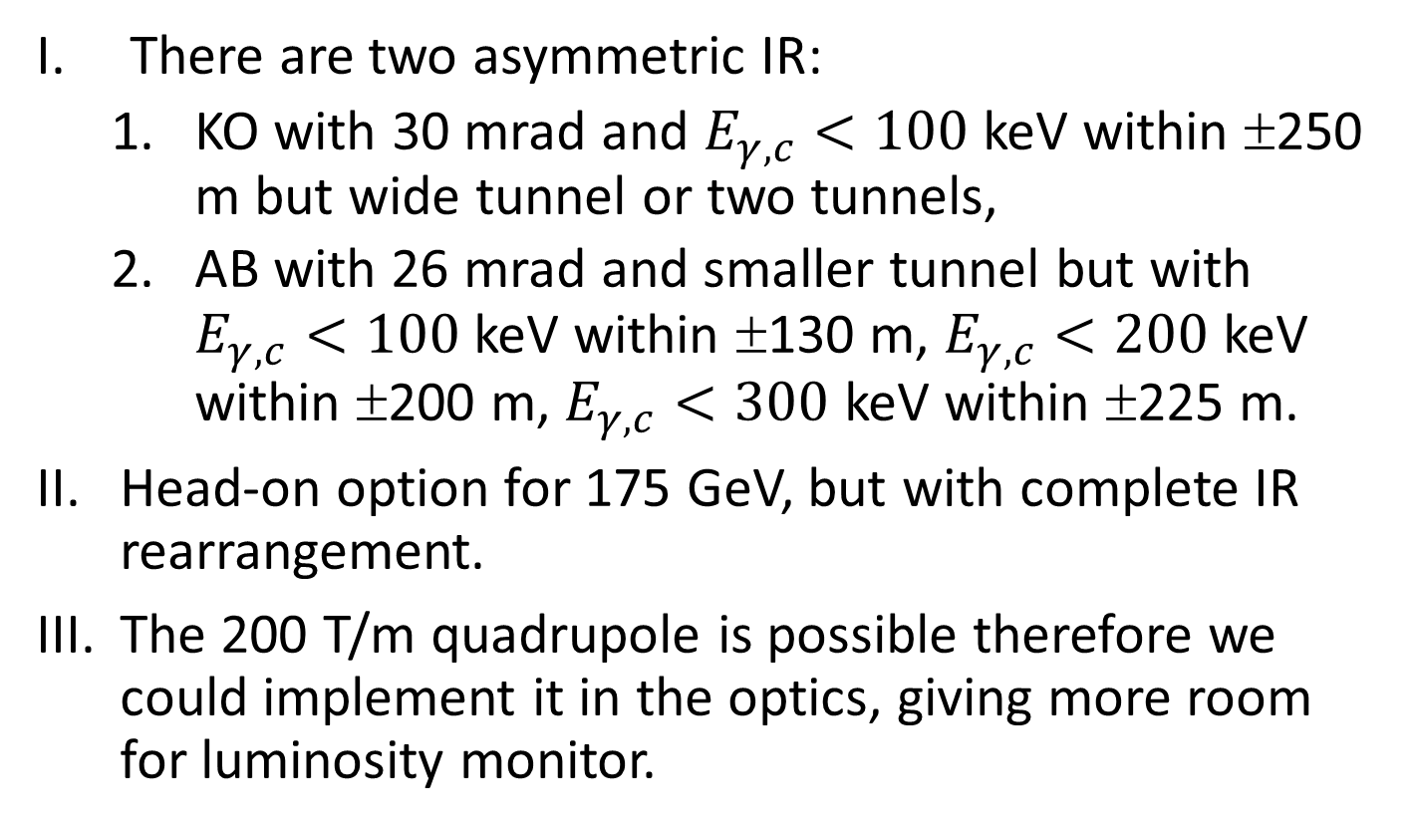
Conclusion
There are two asymmetric IR:
  KO with 30 mrad and $E_{γ,c}<100$ keV within ±250 m but wide tunnel or two tunnels,
  AB with 26 mrad and smaller tunnel but with $E_{γ,c}<100$ keV within ±130 m, $E_{γ,c}<200$ keV within ±200 m, $E_{γ,c}<300$ keV within ±225 m.
Head-on option for 175 GeV, but with complete IR rearrangement.
The 200 T/m quadrupole is possible therefore we could implement it in the optics, giving more room for luminosity monitor.

