Slide 2
General Safety studies and considerations for FCC
A. Henriques¹, S. La Mendola¹, M. Plagge¹, R. Trant¹, S. Arias²
FCC Week 2016
14th April 2016
¹CERN
²Lund University

Slide 3
Topics
Status & Overview
FCC layout used for the studies
Safety Studies (‘conventional risks’) for FCC
  Fire Safety
  Evacuation
  Air management
  Cryogenic Safety
Future studies and contributions

Slide 4
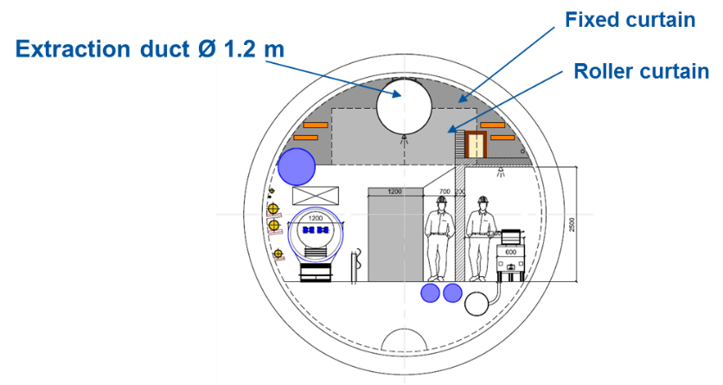
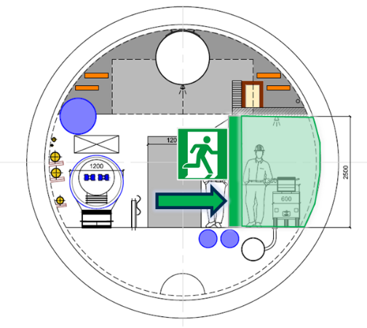
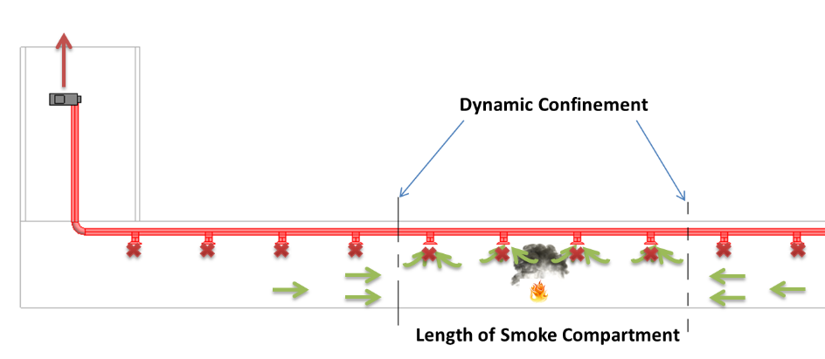
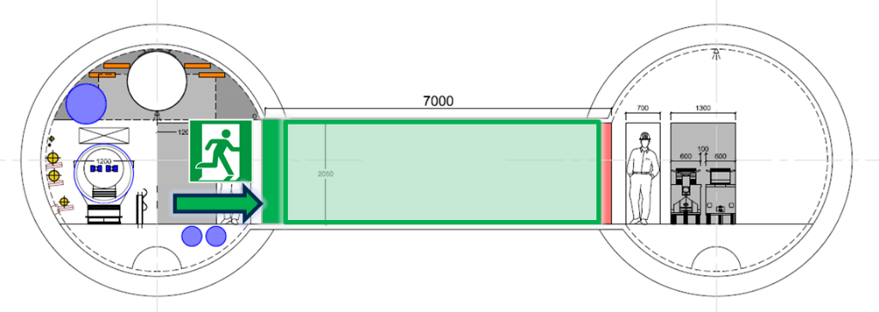
Status & Overview
FCC Week 2015
FCC Week 2016
  Smoke extraction concept:
  Safe Zone:
Optimisation
+
new studies
Notes:
For pdf version split this slide in 2 (change a bit the colors)

Slide 5
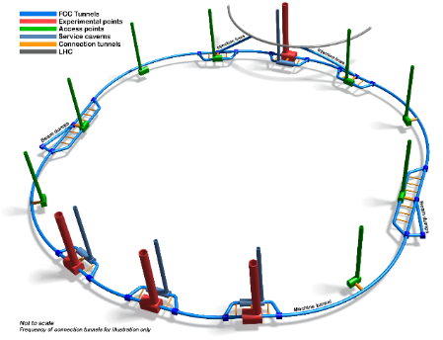
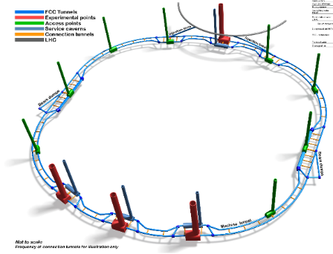
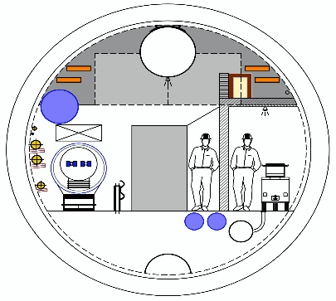
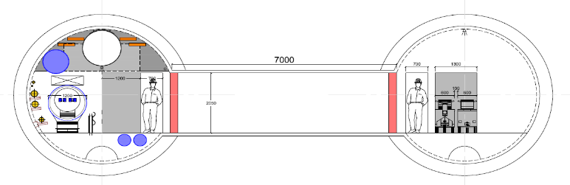

FCC Layout
For the safety studies, both single and double tunnel solutions are considered:
C. Cook, J. Osborne

Slide 6
Safety Studies

Slide 7
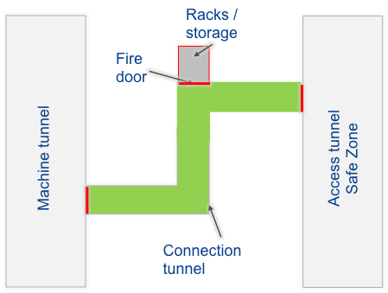
Fire risk in safe zones
Limit the fire risk in the safe zones to absolute minimum (e.g. presence of lighting, signs, transportation)
For single tunnel, equipment with high fire load installed in machine zone or surface (e.g. power transformers, racks)
A possible solution for double tunnel:
See Radiation Protection, M. Widorski
Notes:
Fire risk = fire load and ignition sources (if some load is necessary, e.g. transport, limit the ignition sources)

Slide 8

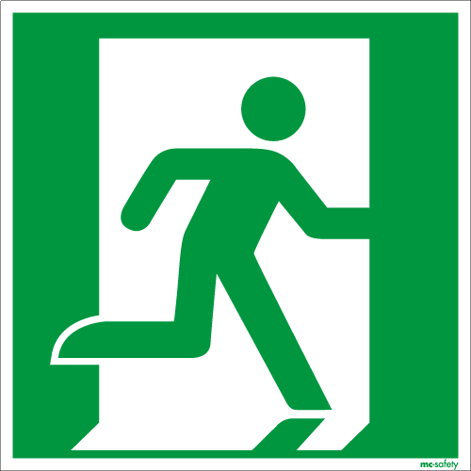




Scenario description
Maximum distance between accesses from machine to safe zone – in standard arc
t
If the walking speed (not affected by visibility) is > v, occupants can walk away from the smoke front. If it is < v they have to walk in the smoke.
t = t₂
X_{CO,HCN}(x,t₂)
Smoke front
v
X_{CO,HCN}(x,t₁)
t = t₁
v₁ < v
v₂ > v
v = ventilation velocity
t = 0
d
x
S. La Mendola
Notes:
Smoke front = 2 Variables (toxicity and visibility). This study only looks into toxicity smoke front.
Picture below shows the location of two occupants and the qualitative concentration X of considered toxic species (CO and HCN) at three different time instants.
1D standard arc – not RP ‘ hot’ areas like collimation

Slide 9
Maximum distance between accesses from machine to safe zone – in standard arc
If Fractional Effective Dose (FED) = 0.3 is targeted (§5.2.1 of ISO 13571), the maximum walking time and distance can be calculated.
Results for both configurations (single and double) are reported in the table below.
Main assumptions:
At t = 0 a fire starting next to an escape door;
Smoke propagates with (conservative) ventilation speed v = 1.5 m/s;
Polyethylene fire grows following an curve (medium) up to 5 MW;
A minimum walking speed of 0.95 m/s has been assumed.
Quantity | Unit | Single tunnel | Double tunnel
Hydraulic diameter | m | 4.5 | Assumed 3.5
Distance d | km | 1.4 | 1.2
✓
1 km distance should be considered as baseline for both solutions
S. La Mendola
Notes:
A minimum walking speed of 0.95 m/s has been assumed
In the single tunnel option, the tunnel cross-section area is higher so the toxic species are more diluted than in the double tunnel one. This results in a higher maximum distance d for the single tunnel option.
Simplified models: 1st rough estimate to have an order of magnitude. If you want to lower the V below ventilation speed than other variables shall be considered (like visibility, fatigue, panic, operational constrains)
Scenario in the worst case scenario

Slide 10
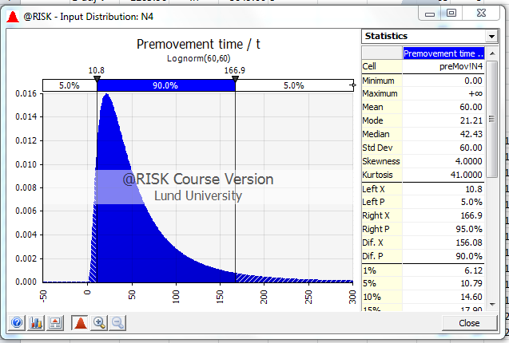
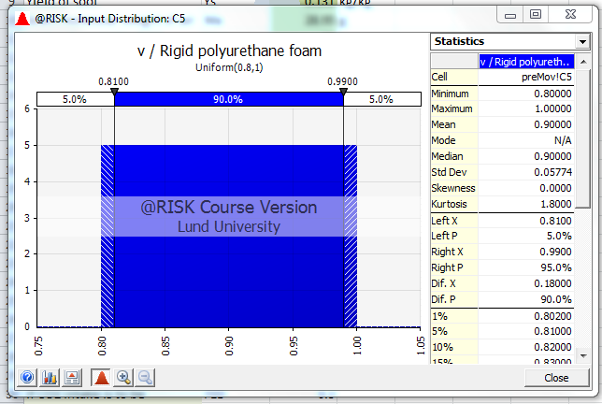
Maximum distance between accesses from machine to safe zone – in standard arc
Refined modeling
New additional assumptions:
‘Pre-movement’ time (lognormal distribution):
  detection time, either by people or devices
  decision making by those in direct vicinity of the fire (e.g. attempts to extinguish it)
A walking speed (uniform distribution) from 0.8 to 1 m/s
S. Arias
Notes:
A minimum walking speed of 0.95 m/s has been assumed
In the single tunnel option, the tunnel cross-section area is higher so the toxic species are more diluted than in the double tunnel one. This results in a higher maximum distance d for the single tunnel option.
Simplified models: 1st rough estimate to have an order of magnitude. If you want to lower the V below ventilation speed than other variables shall be considered (like visibility, fatigue, panic, operational constrains)
Scenario in the worst case scenario
Lognormal comes from experiments made. Social science explanation (follow the leader approach). Gauss distribution is not suitable…
Walking speed follows linear distribuition (0.5 to 1 m/s)
Visibility as a function of the walking speed – corralation between the max distance one can see and the decreasing walking speed

Slide 11
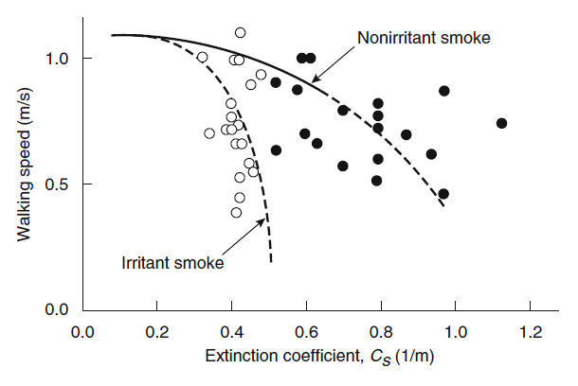
Maximum distance between accesses from machine to safe zone – in standard arc
New additional assumptions:
Adjusted for walking speed reduction due to reduced visibility
Ventilation speed [m/s] | Maximum distance (mean value Monte Carlo sim.) [km]*
1 | 2.0
1.5 | 0.73
2 | 0.61
*preliminary results
« Underground air speed between 0.7 and 1.4 m/s »
Cooling and ventilation plants, M. Nonis
e.g. SFPE Handbook
1 km baseline value validated
Optimisation once ventilation speed is fixed
S. Arias
Notes:
A minimum walking speed of 0.95 m/s has been assumed
In the single tunnel option, the tunnel cross-section area is higher so the toxic species are more diluted than in the double tunnel one. This results in a higher maximum distance d for the single tunnel option.
Simplified models: 1st rough estimate to have an order of magnitude. If you want to lower the V below ventilation speed than other variables shall be considered (like visibility, fatigue, panic, operational constrains)
Scenario in the worst case scenario
Lognormal comes from experiments made. Social science explanation (follow the leader approach). Gauss distribution is not suitable…
Walking speed follows linear distribuition (0.5 to 1 m/s)
Visibility as a function of the walking speed – corralation between the max distance one can see and the decreasing walking speed

Slide 12
Tenability limits for FCC occupants
Extract from ISO 13571: tolerable limits of thermal radiation and convection
Mechanism | Intensity/Temperature | Tolerable time
Thermal radiation | 10 kW•m⁻² | Pain after 4 s
(on skin) | 4 kW•m⁻² | Pain after 10 – 20 s
Convective heat | < 40˚C (if H₂O saturated) | > 30 min
CFD modeling of 3D mass and heat transfer allows to compare different tunnel geometries with known tenability limits.
Further optimization, e.g. in terms of ventilation, smoke and helium emergency extraction follows.
M. Plagge
Notes:
Red volume in the picture denotes a layer of 2.5 metres, that shall be kept below 40 degreee Celsiusin order to ensure proper evacuation.
Objective: to optimise the smoke extraction system (preliminary design) not to oversize it.
steady 4 MW heat release rate.
The red box in the video shows a height level of 2 m,
The simulation is still running but up to now I don't see any interference with the 1 km approach based on FED models

Slide 13
Evacuation modeling
Main Assumptions (based on LHC Long Shutdown 1 studies)
Max. occupant density in FCC tunnel – same as LHC (4 occ. /100 m)
Max. occupation in FCC experimental cavern – LHC x 1.5 (~150 occ.)
Max. occupation in FCC experimental service cavern – LHC x 1.5 (~75 occ.)
Lift travel time – same as LHC (3 x dist. – 3 x faster)
Distance between connection to safe zones – 1 km
Access to machine is denied during beam
Access to the service cavern is allowed during beam

Slide 14
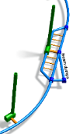
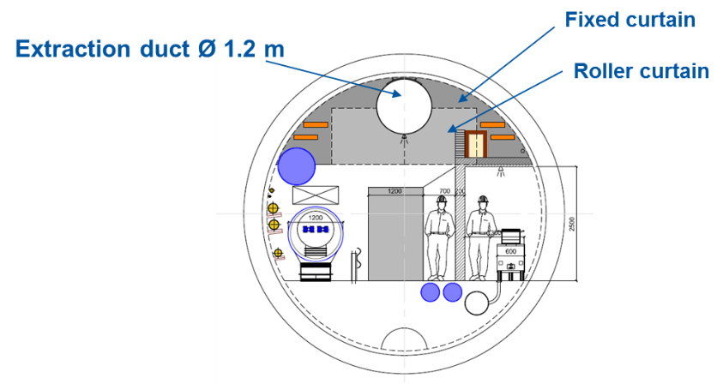
Evacuation modeling
General concepts on evacuation safety assessment
Personnel transportation means necessary for evacuation
Smoke compartmentalization
Audible alarms
Light emitting guidance systems to indicate right evacuation direction
Training of staff
~10 km distance
S. Arias

Slide 15
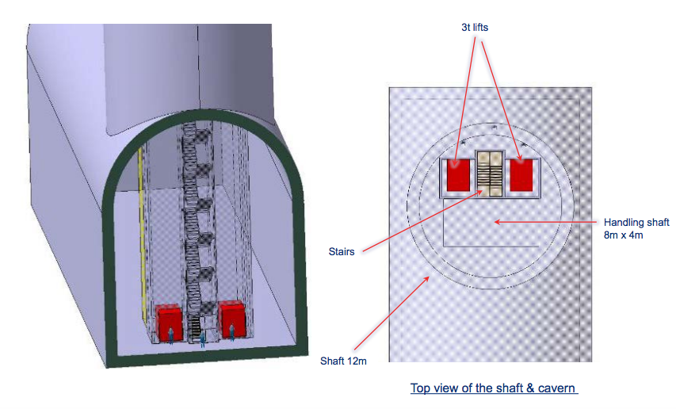
Evacuation modeling
General requirements for access shafts
At least 2 distinct evacuation paths are required
Only 1 access shaft per access point is acceptable
At least 2 elevators per shaft for redundancy
Protected staircase may be used as a safe area to reduce elevator ‘ lobby area’ – to shelter all occupants
D. Lafarge, B. Feral
Stairs may be used as ultimate evacuation mean and access of emergency intervention teams – present assumption, to be studied further
S. Arias
Notes:
X and x meters will need to have a resting area. Studies will say the x value due to the tiredness
– pressurization requirements to be discussed
Capacity of the lifts to be discussed. (more than 20)

Slide 16
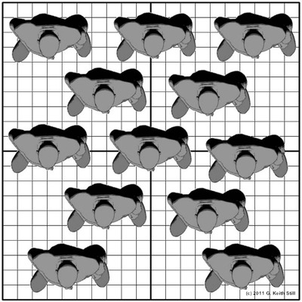
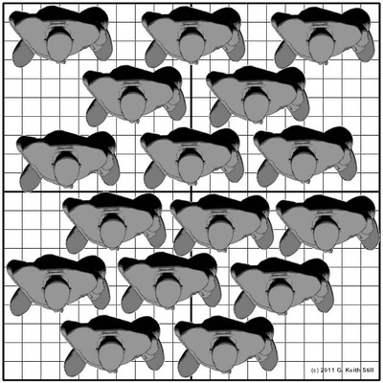
Evacuation modeling
General requirements for access shafts
Maximum density in safe area (‘ lobby area’ ):
  2 people/m² (long waiting times)
  3-4 people/m² (nominal scenario)
Nominal value 3 persons/m²
4 persons/m²
3 ≤ d ≤ 4
^{Tolerated only}
^{for very short periods}
d < 3
^{Acceptable}
d > 4
^{Not acceptable}
Art. L 3 of the ERP regulation fixes a maximum crowding of 3 persons/m² for people attending an event in a room without chairs or benches.
3 persons/m²
4 persons/m²
S. Arias, S. La Mendola
Notes:
X and x meters will need to have a resting area. Studies will say the x value due to the tiredness
– pressurization requirements to be discussed
Capacity of the lifts to be discussed. (more than 20)

Slide 17
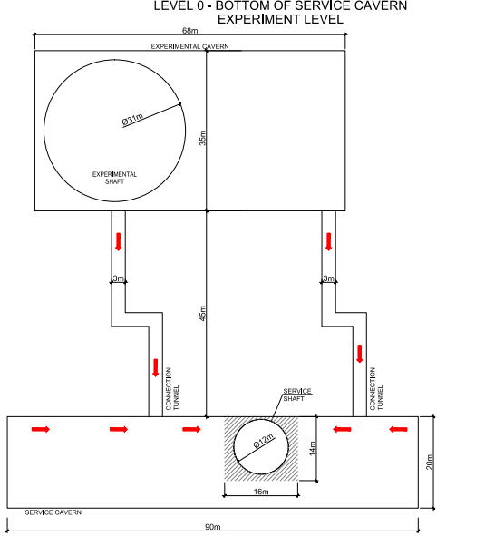
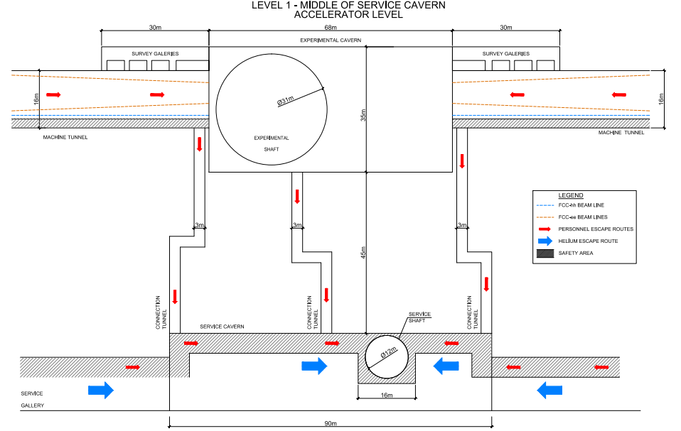
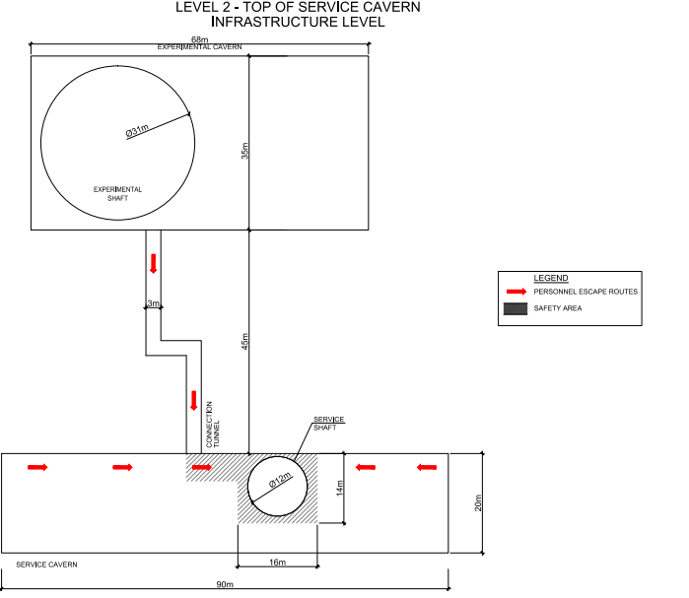
Evacuation modeling
In addition to the general requirements to experimental/service caverns:
  Capacity of the lifts are adapted (more occ. than machine tunnel)
  At least 2 distinct connections to the access shaft
  Separate He release path (MCI case) – access to service cavern during beam
  Access ‘flow’ of personnel is separate from machine (e.g. by floor levels)
C. Cook, J. Osborne
Notes:
Access can be grated to the service cavern during the operation of the machine

Slide 18
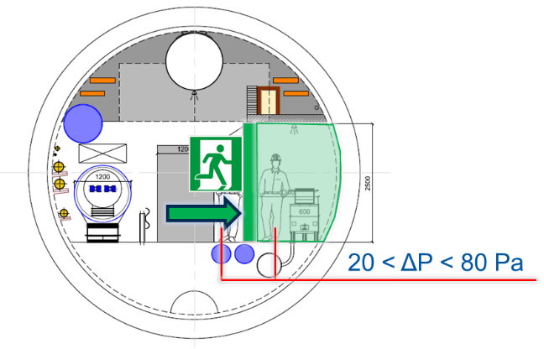
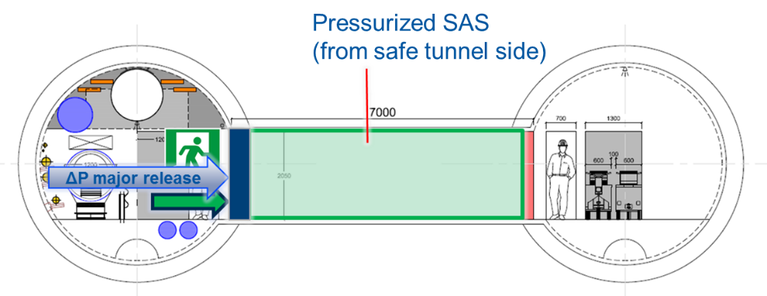
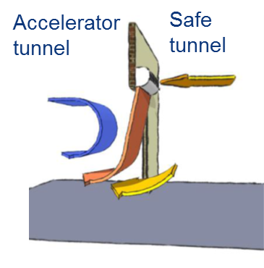
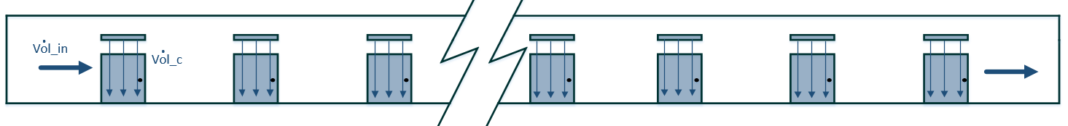
Air management
Provide fresh air during access
Provide dynamic confinement between “machine zone” and “safe zone” for protection of occupants in nominal and accidental scenarios
Technical solution:
Air locks and air curtains to maintain ΔP
See Cooling and ventilation plants, M. Nonis
Notes:
Scenarios (RP, fire, ODH)

Slide 19
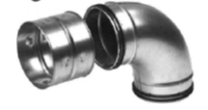
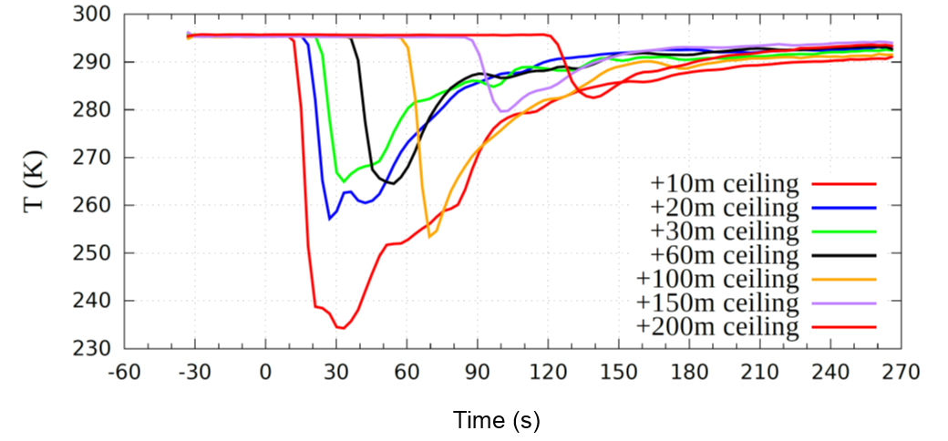
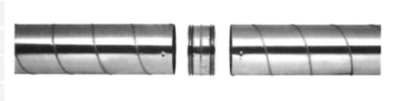
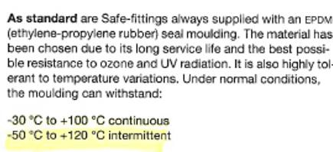
Accidental Helium extraction
Use smoke extraction system to cope with an accidental He release, during access mode
FCC Week 2015 – the system’s capacity can cope up to ~1 kg/s release
Mechanical properties of the ducts/supports can withstand low temperatures?
~ -40ºC
✓
OK
T. Koettig - ICEC ICMC 2014

Slide 20
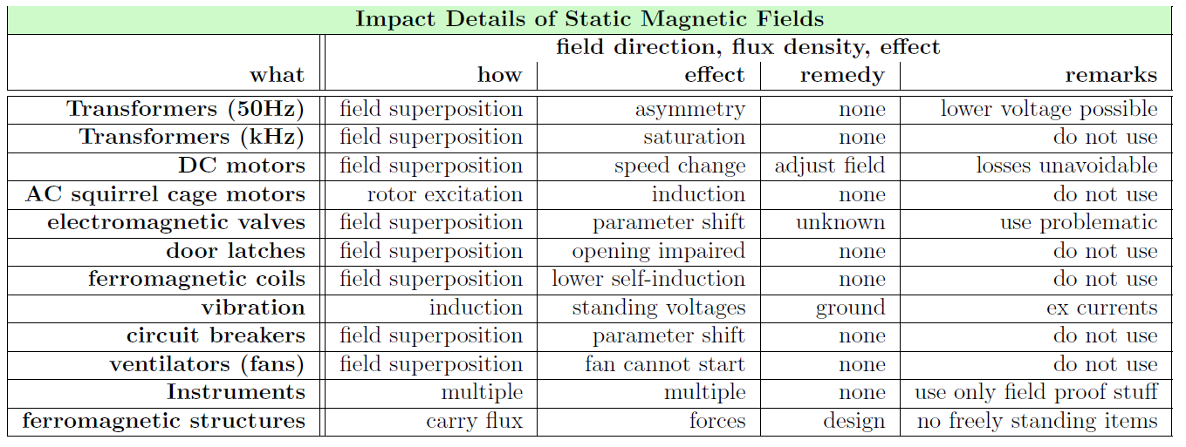
Magnetic field in Experimental caverns
Technical Impact of Magnetic Stray Fields (HSE-DI/fs-FCC/2016-001)
Stray flux density of 200mT assumed:
  The hazards are of technical nature:
F. Szoncsó
Notes:
The hazards are of technical nature – means not a big hazard to people exposure

Slide 21
Final Remarks
Limit the fire risk in the safe zones to absolute minimum
Maximum distance between connection to safe zone: roughly 1 km
Smoke extraction system capable to extract He gas in case of accidental release during access mode
At least 2 distinct evacuation paths are required
1 shaft with 2 separate elevators and staircase are required per access point
The hazards due to stray flux density, arising from magnetic fields, in experiments are of technical nature

Slide 22
Further Studies
Optimisation of smoke extraction following results of tenability limits
Optimisation of evacuation modeling and new cutting-edge approaches including virtual reality and ascending evacuation experiments
Studies of automated transportation for occupants – may have impact on the size of the safe zone
  Safety considerations of the proposed electrical network
  Continue safety considerations of the proposed cryogenic installation
Other studies following the needs and advancement of the FCC study project
Support all FCC WGs on Safety issues
Notes:
Further optimisation safe area
- tenability – how much the body can resist to the fire circumstances

Slide 23
Thank you very much
for your attention
Acknowledgements:
C. Cook, S. La Mendola, V. Mertens, M. Nonis, J. Osborne, M. Plagge, R. Trant, M. Widorski

Slide 25
Spare Slides

Slide 26
Maximum admissible crowding in safe zones
Nominal value 3 persons/m²
4 persons/m²
3 ≤ d ≤ 4
^{Tolerated only}
^{for very short periods}
d < 3
^{Acceptable}
d > 4
^{Not acceptable}
Art. L 3 of the ERP regulation fixes a maximum crowding of 3 persons/m² for people attending an event in a room without chairs or benches.
3 persons/m²
4 persons/m²
At 3.8 persons/m² movement ceases
These figures have been tested for a number of fire scenarios.
S. La Mendola

Slide 27
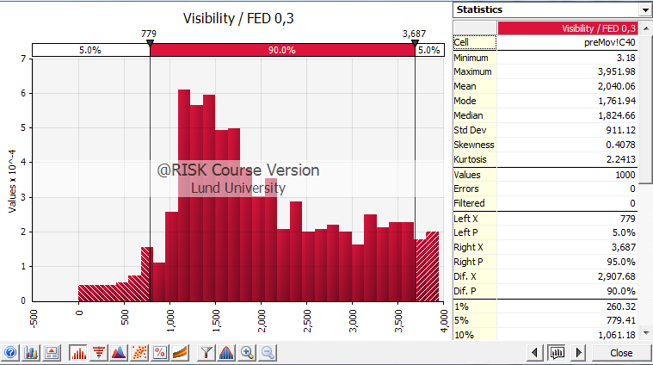
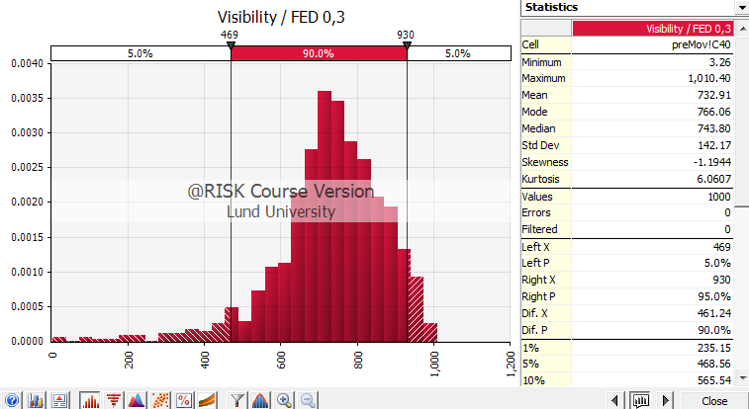
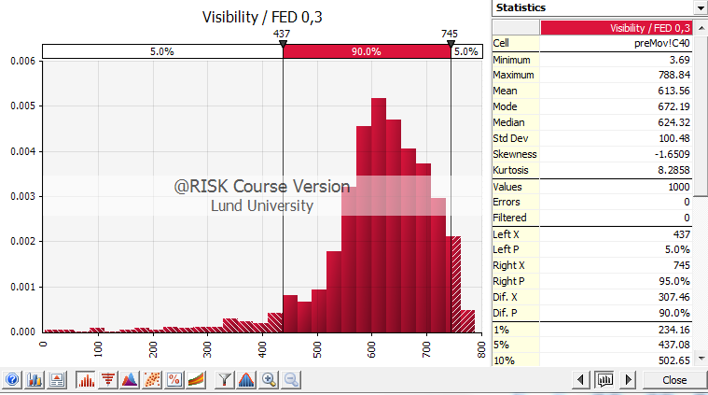
Maximum distance between accesses from machine to safe zone – in standard arc
v = 1 m/s
v = 1.5 m/s
v = 2 m/s
S. Arias
Notes:
A minimum walking speed of 0.95 m/s has been assumed
In the single tunnel option, the tunnel cross-section area is higher so the toxic species are more diluted than in the double tunnel one. This results in a higher maximum distance d for the single tunnel option.
Simplified models: 1st rough estimate to have an order of magnitude. If you want to lower the V below ventilation speed than other variables shall be considered (like visibility, fatigue, panic, operational constrains)
Scenario in the worst case scenario
Lognormal comes from experiments made. Social science explanation (follow the leader approach). Gauss distribution is not suitable…
Walking speed follows linear distribuition (0.5 to 1 m/s)
Visibility as a function of the walking speed – corralation between the max distance one can see and the decreasing walking speed

Slide 28
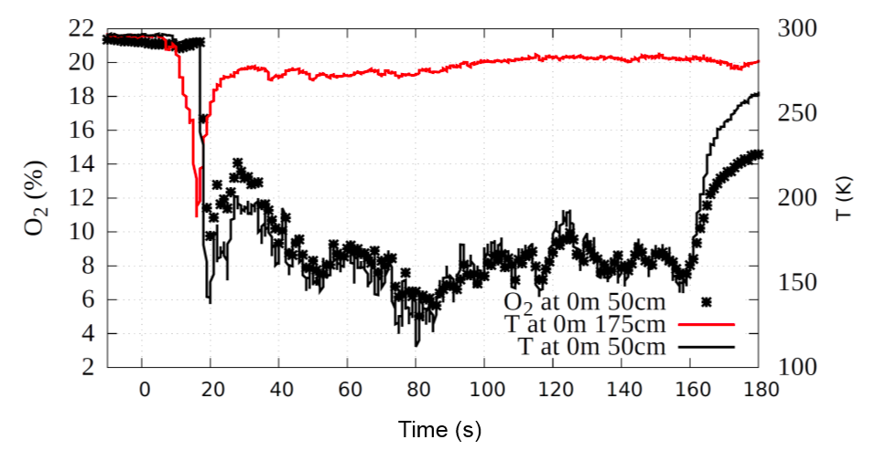
He Spill test – temperatures @ celling level
~ -40ºC
~ -80ºC
T. Koettig - ICEC ICMC 2014

Slide 29
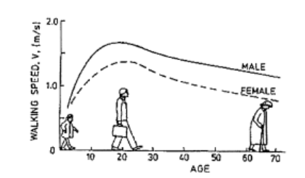
Walking speed as a function of age
Source: www.wpi.edu

