Slide 1
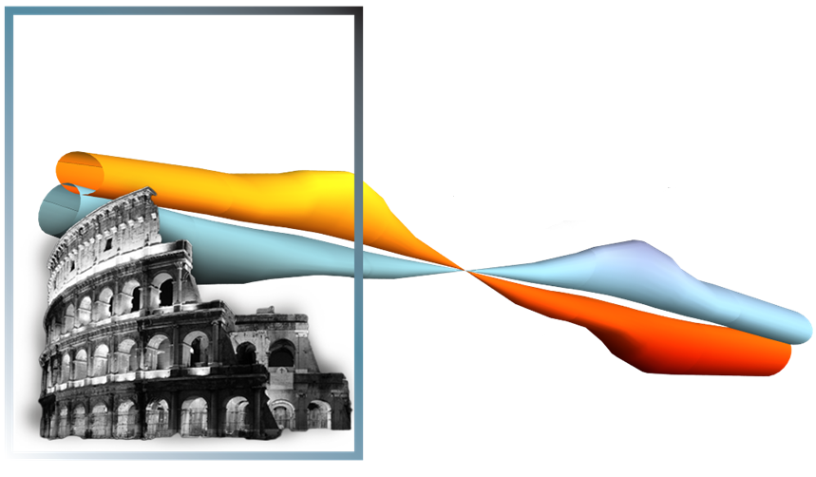
Development of 60-mm aperture 15-16 T Nb₃Sn dipole at Fermilab
E. Barzi, A.V. Zlobin
FCC meeting in Rome
11-15 April 2016

Slide 2
Premise
  In the plenary talk «The Steps Towards 16 T FCC Magnets» we heard two contrasting messages: on one hand, the speaker stressed how complex of a technology Nb3Sn is, on the other flat coils without aperture producing 16 T on the conductor were considered representative of the technology.
  In accordance to the clear concept presented by Fabiola Gianotti in her plenary talk, we should focus in developing/producing systems ready for implementation and operation ➔ i.e. A magnet is a system for beam bending/focusing and of course should have (at least) one aperture.
  The present magnet statistics show that Bruce is right when he speaks of a «14 T brick wall» for Nb3Sn magnets.

Slide 3
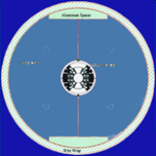
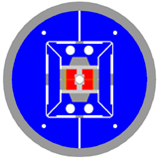
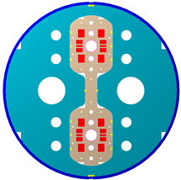
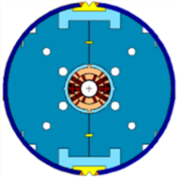
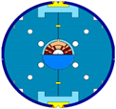
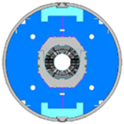
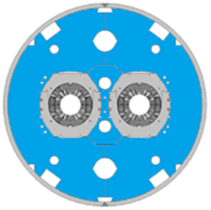
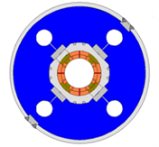
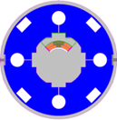
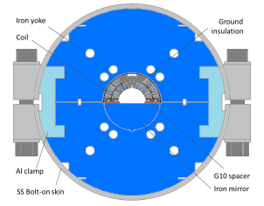
Program Timeline
FCC
Record field 13.8 T
VLHC
LARP
HL-LHC
D20 (LBNL)
50 mm dipole
13.5 T (1997)
HD2 (LBNL)
35 mm dipole
13.8 T (2008)
HFDA HFDM-LM 43.5 mm Dipole mirror
10 T dipole
TQC TQM-LQM
90 mm 200 T/m Quadrupole quadrupole mirror
MBHSP MBHSM
60 mm 11 T dipole Dipole mirror
MBHDP
60 mm 11 T dipole
HFDC (R&W)
40 mm 10 T dipole

Slide 4
Current HFM R&D Program
As a part of the National HFM collaboration develop accelerator magnets with world record parameters
  Small-aperture 15-16 T Nb₃Sn dipole suitable for VHEppC (phase I)
    background field for small 1-2 T HTS inserts
  Large-aperture 15 T Nb₃Sn dipole with stress management (phase II)
    background field for 5+ T HTS inserts
Magnet cost optimization
Superconductor and structural material R&D for 15-20 T accelerator magnets
  Nb₃Sn composite wires
  Large Rutherford cables

Slide 5
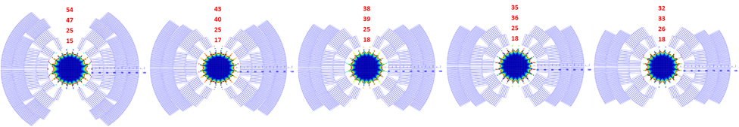
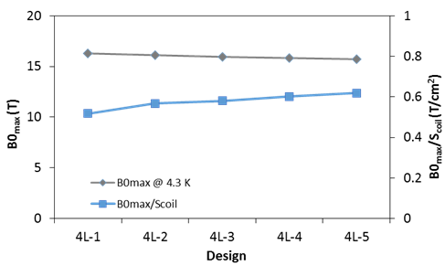
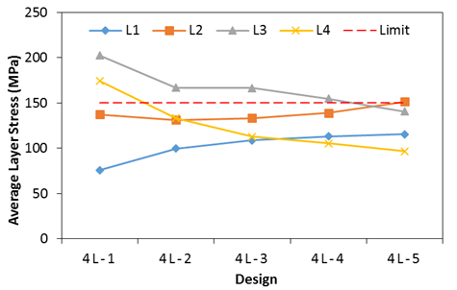
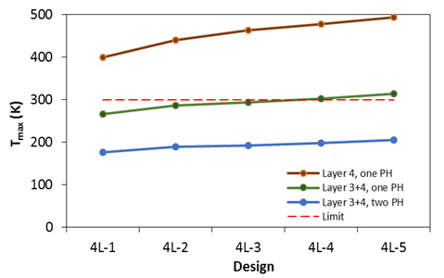
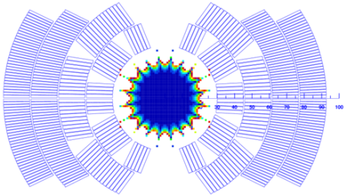
Coil Design Study
4L-1
4L-2
4L-3
4L-4
4L-5
Coil aperture: 60 mm
Coil cross-section: modified cosθ,4 layers, graded
Design parameters: B_{max}, field quality, coil volume, azimuthal stress, quench protection
Design choice: 4L-5

Slide 6
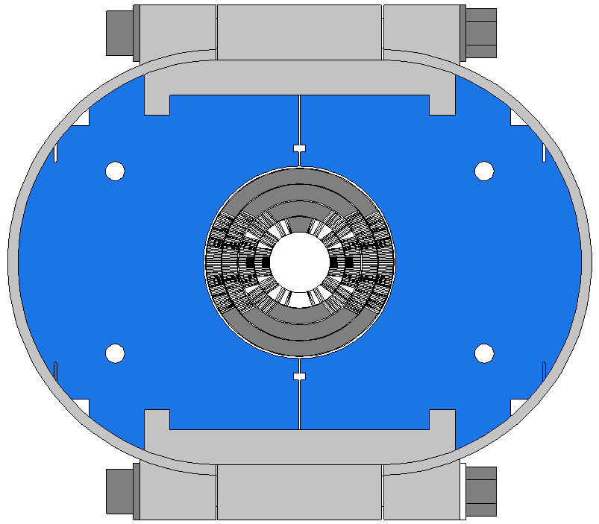
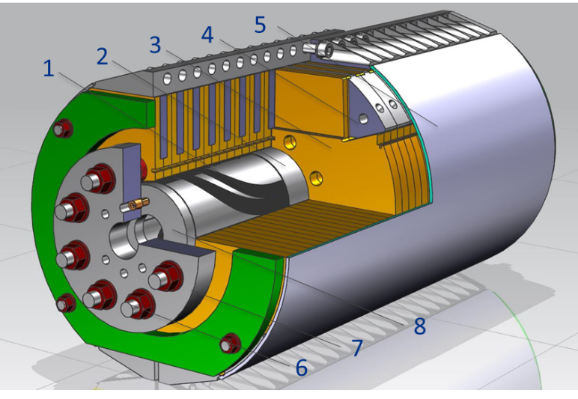
Mechanical Structure
Thin coil-yoke spacer (no collar)
2-piece vertically split yoke
Yoke clamp
  Stainless steel C-clamps (v.1)
    this approach with Al clamps was used in previous FNAL magnets
  Aluminum I-clamps (v.2)
Skin
  Bolted skin from 11 T dipole (v.1)
  New thick bolted or welded skin (v.2)
Cold mass OD<610 mm
  VMTF Dewar limit
Axial support
  Thick SS rods and end plates

Slide 7
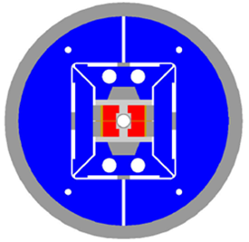
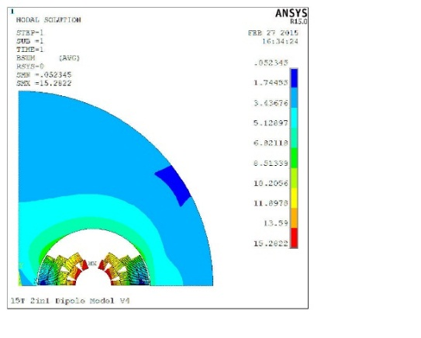
Use of HD2 or HQ structure
45-mm HD2:
  cold mass OD=705 mm
  Al shell thickness 40 mm
120-mm HQ:
  cold mass OD= 570 mm
  Al shell thickness 25 mm

Slide 8
Magnet Design Parameters at 4.3 K
Parameter | Units | v.2
Bore field at short sample limit | T | 15.61
Peak field at short sample limit | T | 16.25
Current at short sample limit, I_{c} | kA | 11.34
Inductance at I_{c} | mH/m | 25.61
Stored energy at I_{c} | MJ/m | 1.65
Horizontal Lorentz force per quadrant at I_{c} | MN/m | 7.36
Vertical Lorentz force per quadrant at I_{c} | MN/m | -4.50
J_{c}(12T, 4.2K)=2500 A/mm²

Slide 9
FCC-hh Magnet target parameters
 | B / G (T) / (T/m) | B_{peak} (T) | Bore (mm) | Length (units x m)
MB | 16 | 16.4 | 50 | 4500 x 14.3
MQ | 450 | 13 | 50 | 800 x 6
MQX | 225 | 13 | 100
D1 | 12 | 13 | 60 | 4x2 x 12
D2 | 10 | 10.5 | 60 | 4x3 x 10
Inter-aperture distance ≈ 250 mm
Yoke diameter ≤ 700 mm
Stray field ≤ 100 mT
FNAL dipole parameters are close to MB and also D1, D2

Slide 10
FNAL Dipole coils in 2-in-1 configuration (MB)
Number of apertures | 2
Aperture(mm) | 60
Aperture spacing (mm) | 250
Coil current (kA) | 11.1
Operating temperature (K) | 4.3
Max bore field at 4.3 K (T) | 16.4
Max coil field at 4.3 K (T) | 16.9
Yoke ID (mm) | 190.8
Yoke OD (mm) | 650
1 m OD “cryostat” envelope
Operation margin can be increased by using wires with higher J_{c}
or operation at 1.9 K

Slide 11
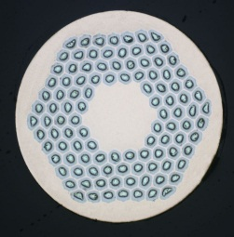

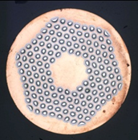
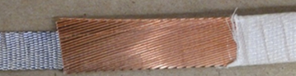

Strand and Cable
Outer coil (layer 3 and 4)
  Cable: Rutherford-type, 40-strands, 11mm wide 0.025 mm thick SS core
  Strand: 0.7 mm RRP108/127
  Cable available from 11 T Dipole program
Inner coil (layer 1 and 2)
  Cable: Rutherford-type, 28-strands, 11mm wide 0.025 mm thick SS core
  Strand: 1.0 mm RRP150/169
  ~450 m long cable piece is available
Cable insulation
  E-glass tape
  12.7mm wide 0.075 mm thick
  2 layers with ~50% overlap
RRP108/127
RRP150/169

Slide 12
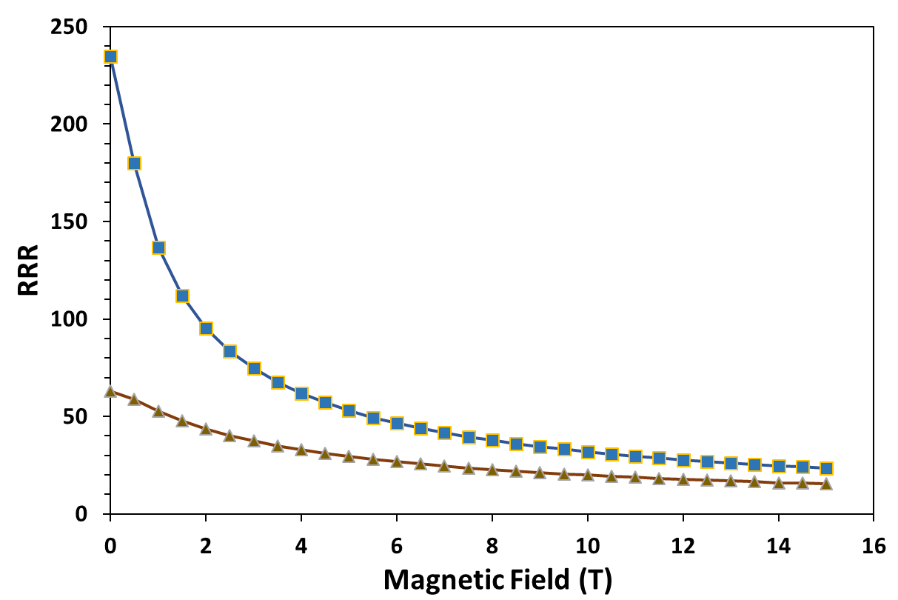
Cable performance optimization
Cable PF~87%
I_{c} degradation <4%
RRR retention ~60-85%
RRR at 15 T ~ always 20-30

Slide 13
A Prospectus of Parameters Effect on Stability
J_{S} (4.2K) vs. subelement size for RRP® round wires of 0.5 to 1 mm diameter. The samples in the RRR<60 set had RRR values down to 11 and J_{c}(12T,4.2K) between 2.45 and 2.92 kA/mm². The samples in the RRR>60 set had RRR values up to 300 and J_{c}(12T,4.2K) between 2.38 and 3.13 kA/mm².
“Research and Development of Nb₃Sn Wires and Cables for High-Field Accelerator Magnets”, Emanuela Barzi, Alexander V. Zlobin, REVIEW paper on PAC 50th anniversary issue, IEEE Transactions on Nuclear Science: http://ieeexplore.ieee.org/xpl/articleDetails.jsp?arnumber=7410112&newsearch=true&queryText=2500440

Slide 14
Magnet Short Sample Limit
Magnet short sample estimated based on the cable test data:
  11.1 kA (B_{ap}=15.3 T) at 4.5 K
  12.2 kA (B_{ap}=16.7 T) at 1.9 K

Slide 15
Coil magnetization and iron saturation
LHC 11 T dipole
Coil magnetization effect was calculated using RRP-150/169 1 mm strand and RRP-108/127 0.7 mm strand parameters

Slide 16
RRP Strand R&D (with OST)
Goal: increase J_{c}(15T) with an ultimate target of 2000 A/mm² for a 169 stack strand at 1.0 mm (D_{s}~58 µm)
  the present subelement design - average J_{c}(15T)~1500 A/mm²
Approach: modifications to the subelement designs
Chemical optimization
  Produce a half height high-J_{c} subelement billet having Nb and Nb-Ti filaments with a Nb-Ta diffusion barrier
  Deliver ~45 kg of 1 mm wire
Local Area Ratio (LAR) optimization
  Produce two half height high-J_{c} subelement billets having Nb and Nb-Ti filaments with variable LAR from annulus to barrier
  Deliver ~90 kg of 1 mm wire
  Wire sample diameter: 0.8, 0.9, 1.0, 1.1 and 1.2 mm
  Next: 1-1.2 mm RRP-217 stack design.

Slide 17
Conclusions
R&D of 60-mm aperture 15 T Nb₃Sn dipole demonstrator for future HC has started at Fermilab:
  Magnet design study phase is complete
  Cable samples for the inner coils were fabricated and tested
  Practice coils are being presently wound
  Magnet engineering design is in progress
  Magnet fabrication and first tests are planned for 2016-2017
  Schedule is coordinated with CERN FCC Design Study Report
The work on optimization of Nb₃Sn RRP wires for 15-16 T accelerator magnets continues in collaboration with industry and universities:
  To produce further J_{c} increase at 15 T
  For larger wire D and smaller D_{eff}
  Wire cost reduction through flux pinning enhancement research

