Slide 1
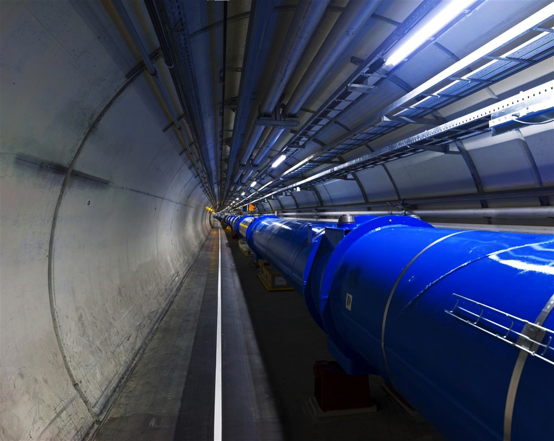
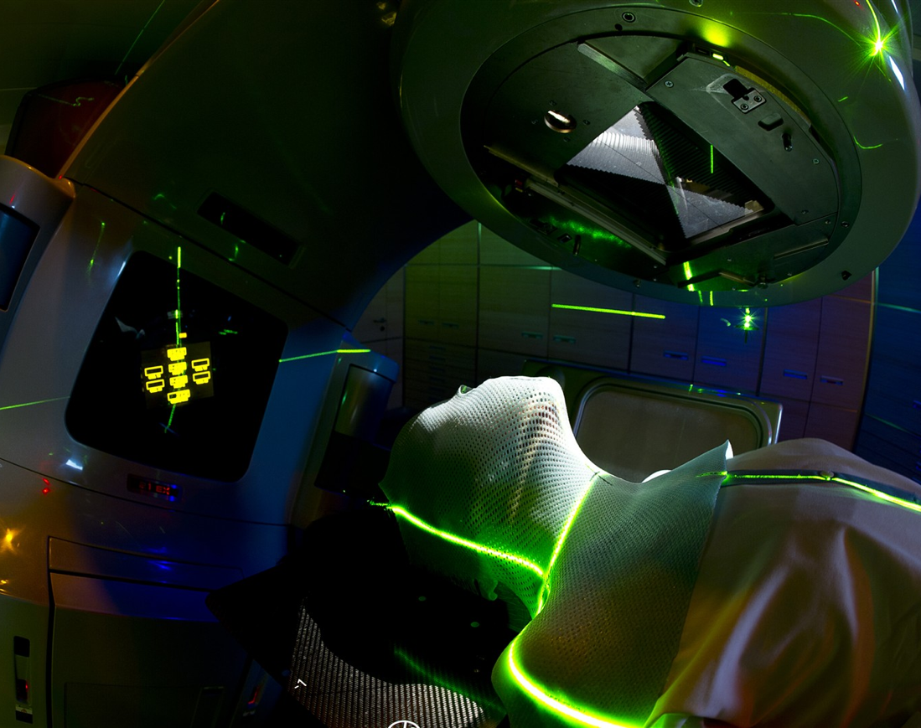
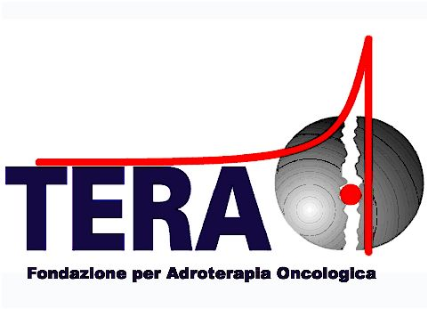

Medical applications of particle physics
Giovanni Porcellana
TERA Foundation
Credits: Manuela Cirilli (CERN), Martina Bucciantonio (TERA Foundation)

Slide 2
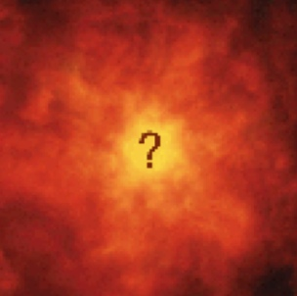

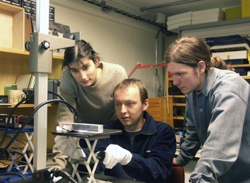
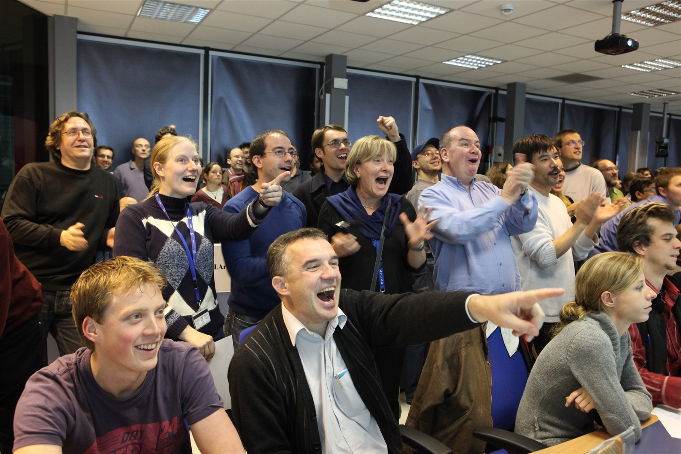
CERN’s mission
RESEARCH
INNOVATION
EDUCATION
UNITING PEOPLE

Slide 3
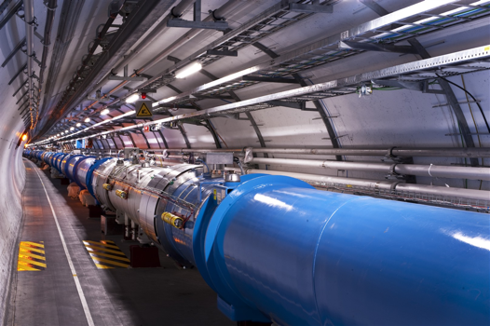
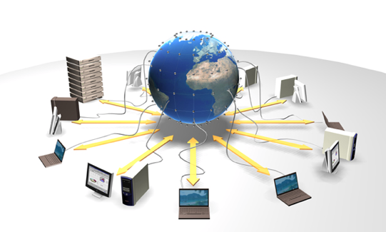
HEP technologies
Particle Accelerators
Boost particles to high energies and make them collide
Gigantic instruments that observe and record the results of the collisions
(particle trajectories, energy, charge..)
Detectors
Collect, store, and send around the world the big quantity of data received from the detectors for data analysis
Computing

Slide 4

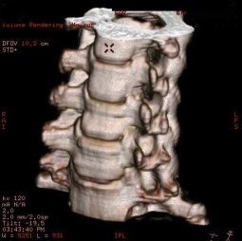
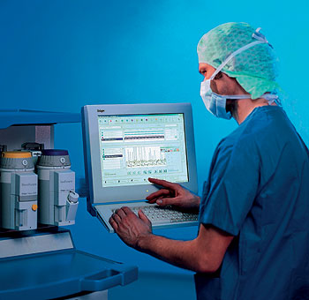
HEP technologies fighting cancer
Tumour target
Particle Accelerators
Radiotherapy
Detectors
Medical imaging
Grid computing
for medical data management and analysis
Computing

Slide 5
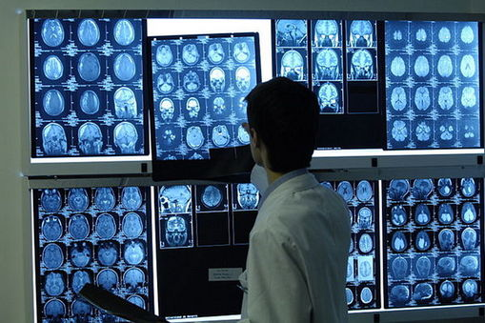
Medical imaging

Slide 6
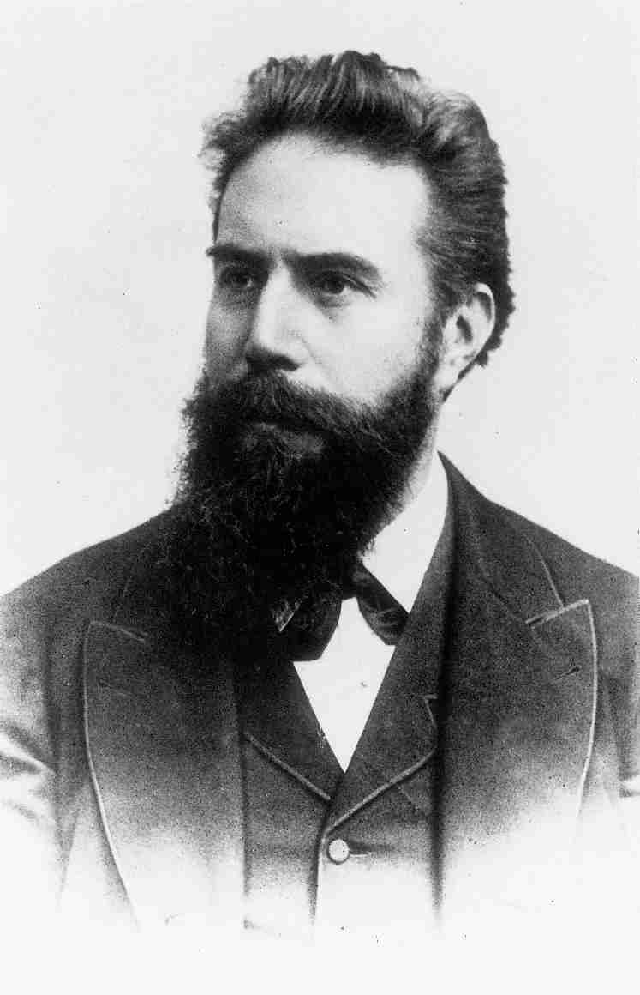
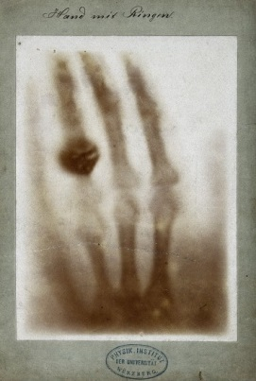

X-rays
Courtesy of Roentgen museum
  8 November 1895:
  X-rays discovery
  22 December 1895:
  first radiography
Wilhelm Röntgen
(1845–1923)
1901: Nobel prize

Slide 7
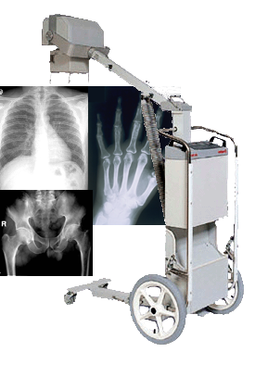
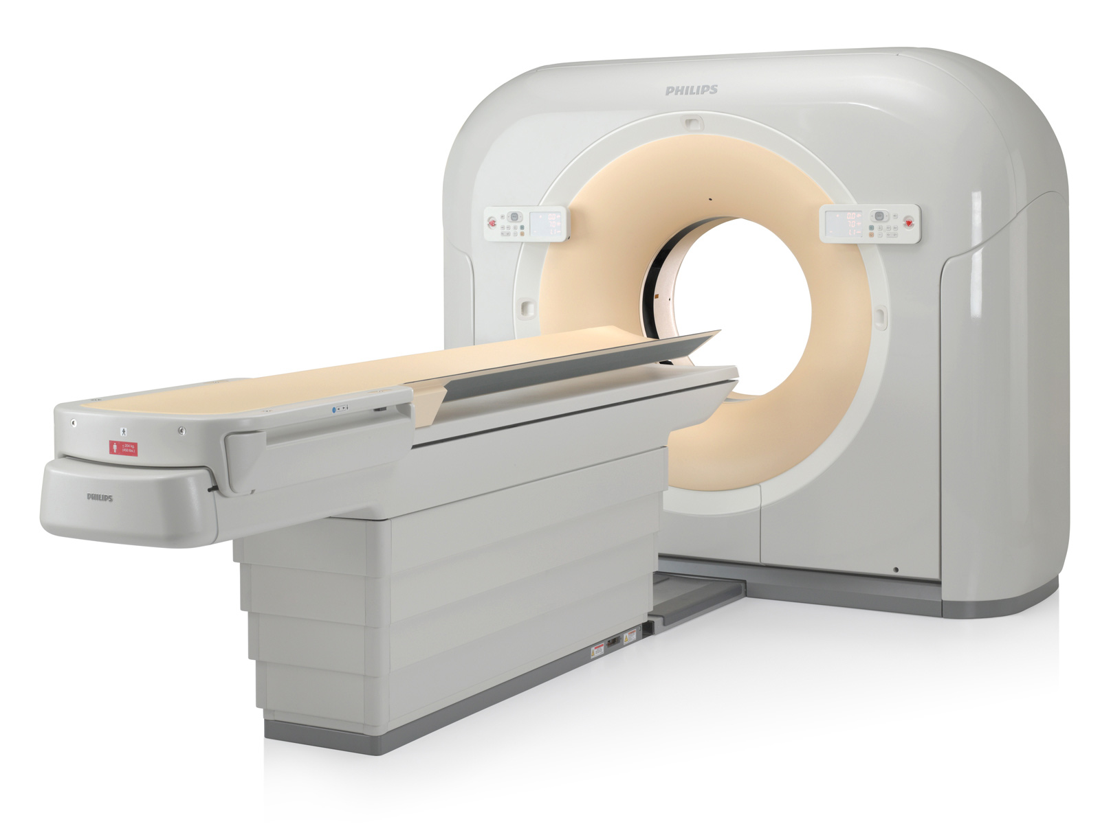
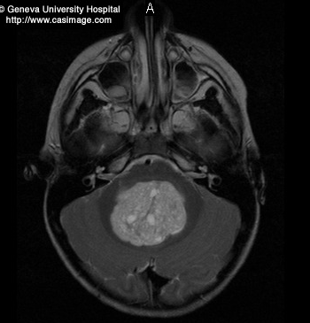
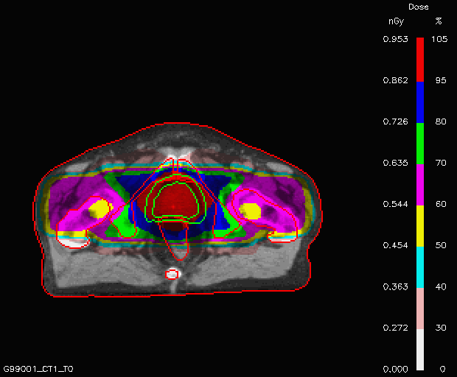
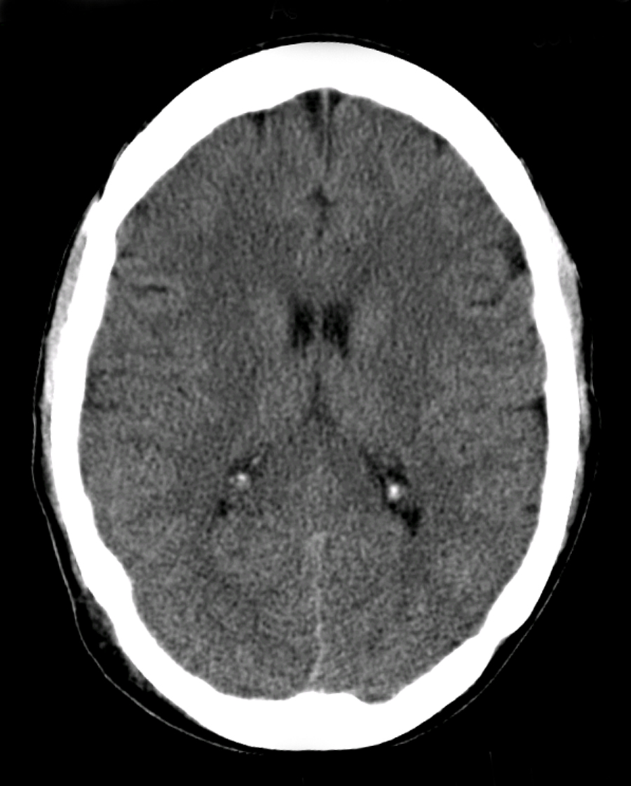
X-rays evolution
Diagnosis
Cancer treatment
Courtesy of Philips

Slide 8
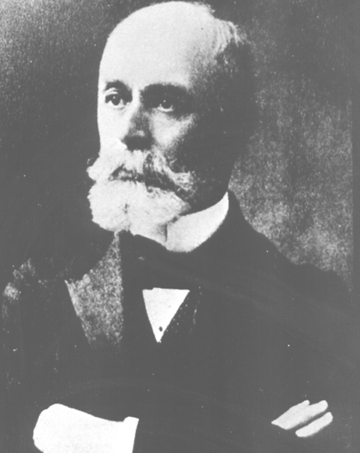
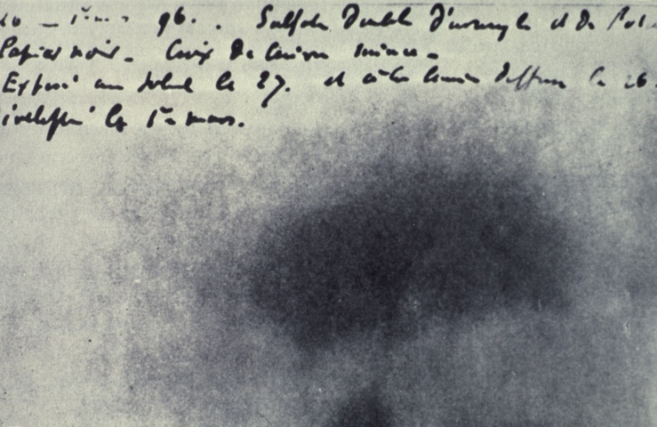
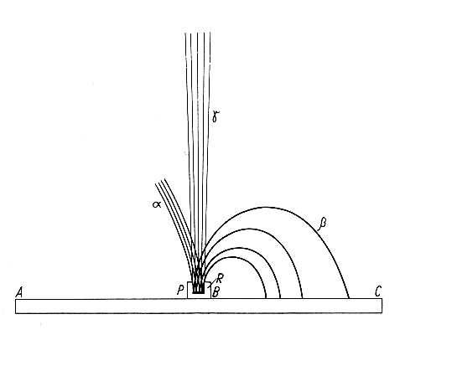
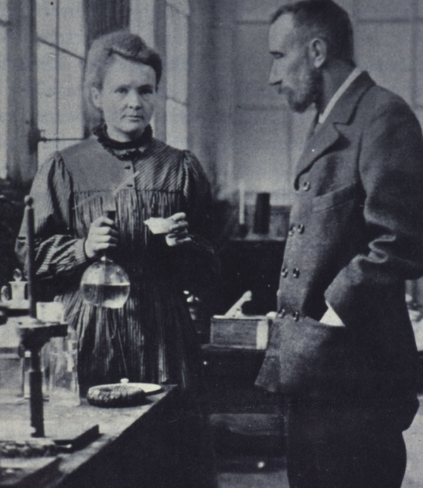
Birth of medical physics
1896 - discovery of natural radioactivity
Henri Becquerel
1898 - discovery of Radium (used for “brachytherapy”)
1903 - Becquerel, Pierre e Marie Curie share the Nobel prize in Physics
1911 - Marie Curie wins the Nobel prize in Chemistry
Mme. Curie thesis – 1904
α, β, γ in magnetic field
Pierre and Marie Curie

Slide 9

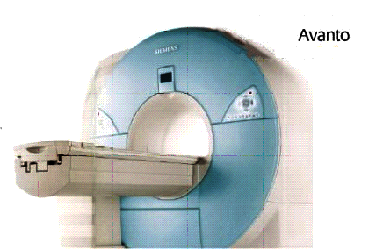
Magnetic resonance Imaging
1946 – Purcell
shows that matter absorbs energy at a resonant frequency
1946 – Bloch
demonstrates that nuclear precession can be measured in detector coils
1952 – They share Nobel prize in Physics
1972 – Damadian
patents idea for large NMR scanner to detect malignant tissue
1924 – Pauli
suggests that nuclear particles may have angular momentum (spin)
M R I
1920 1930 1940 1950 1960 1970 1980 1990
1937 – Rabi
measures magnetic moment of nucleus. Coins “magnetic resonance”
wins Physics Nobel prize
1973 – Mansfield and Lauterbur independently publish gradient approach to MR
2003 – They share the Nobel prize in Physics
MRI scanners become clinically prevalent

Slide 10
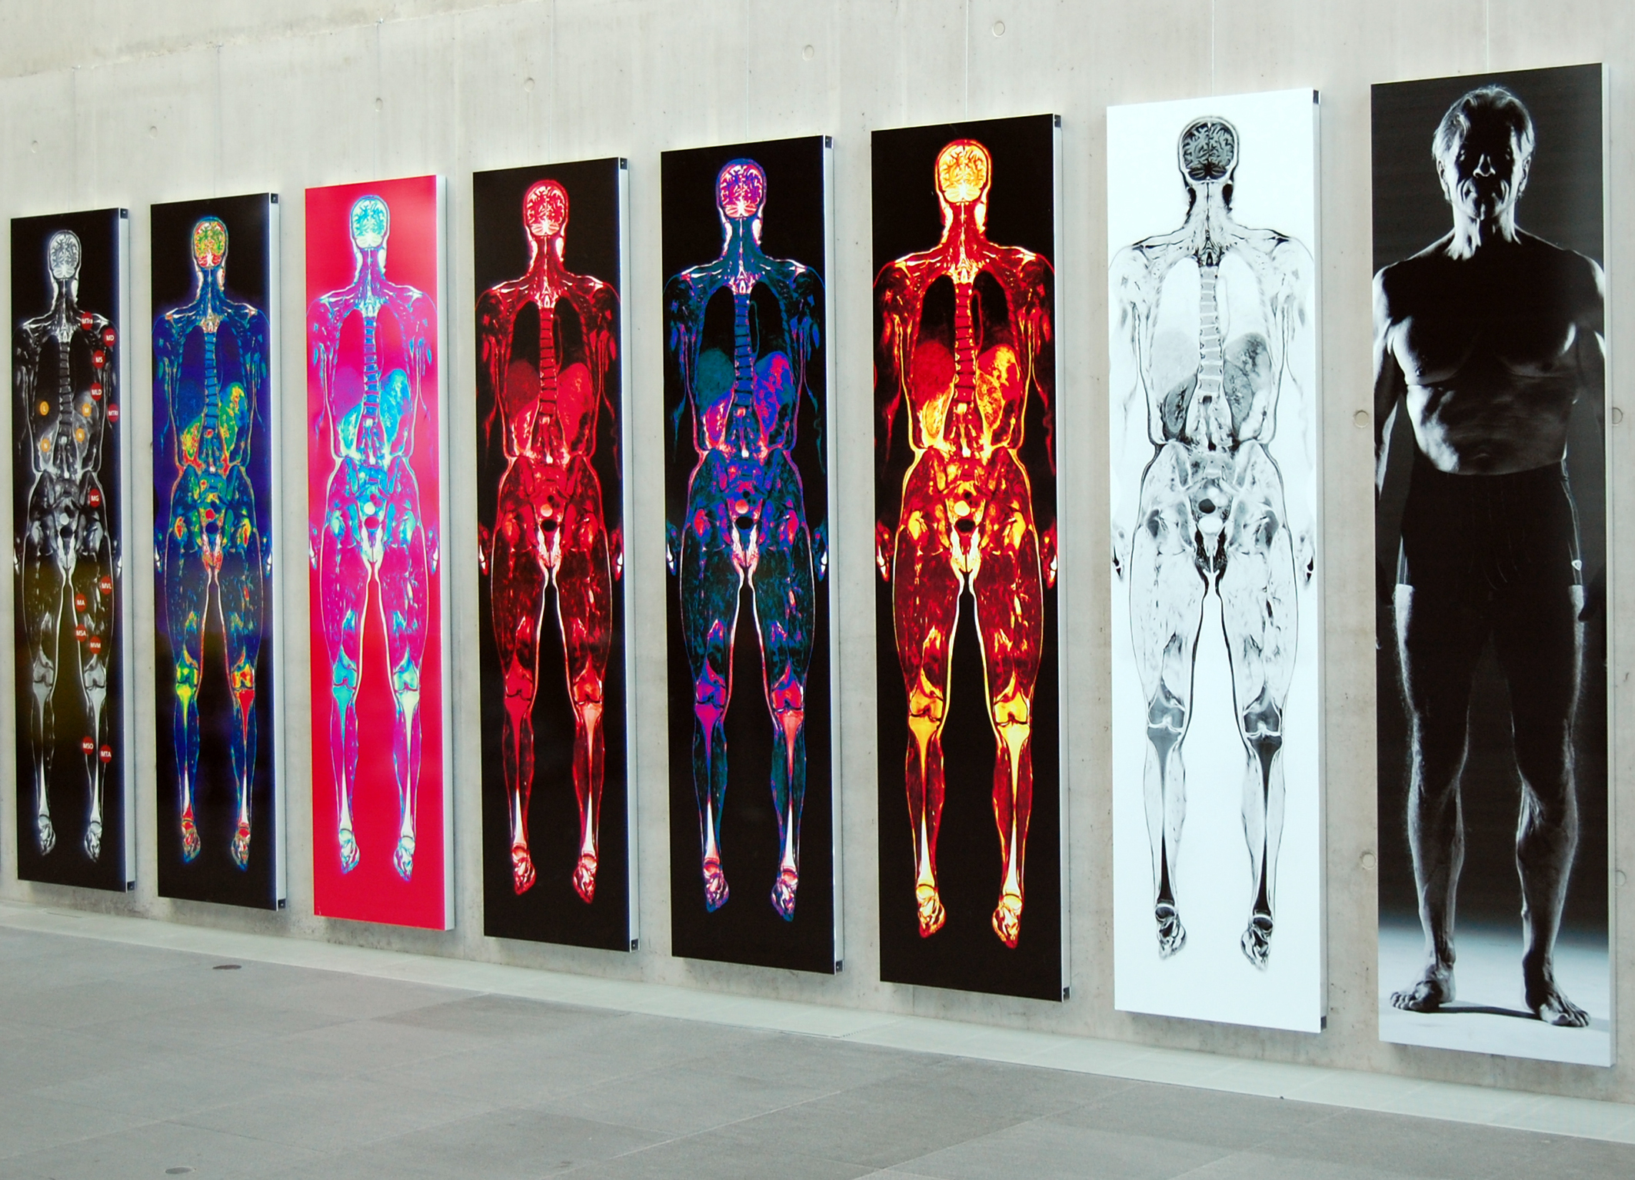
More and more details
Images courtesy of Dr. F. Fellner

Slide 11

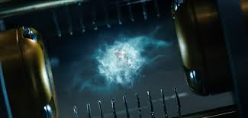
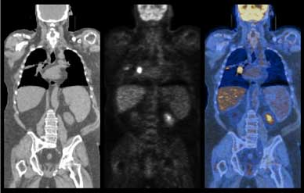
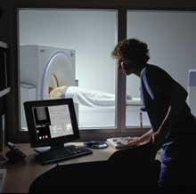
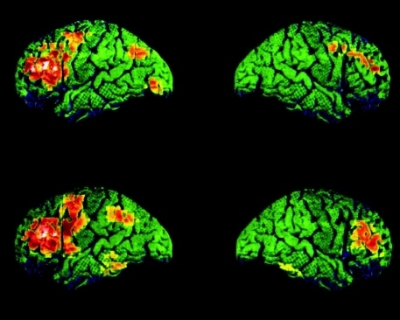
Antimatter – science fiction?
Positrons are used daily in oncology
PET = Positron Emission Tomography

Slide 12
PET: How it works
Drug, labelled with positron
(β+) emitting radionuclide, is injected into the patient
Drug localizes in patient according to metabolic properties of that drug
Trace (pico-molar) quantities of drug are sufficient
Radiation dose fairly small
(<1 rem = 0.01 Sv)

Slide 13
PET: Detection
Neutron-deficient
radioisotope
p n + e⁺ + ν_{e}
n
n
p
p
n
detector
p
p
n
p
Positron range
n
Photon (511 keV )
e⁺
e⁻
~180º
detector
Positron
+
photon
Photon (511 keV)
Electron
-
photon

Slide 14
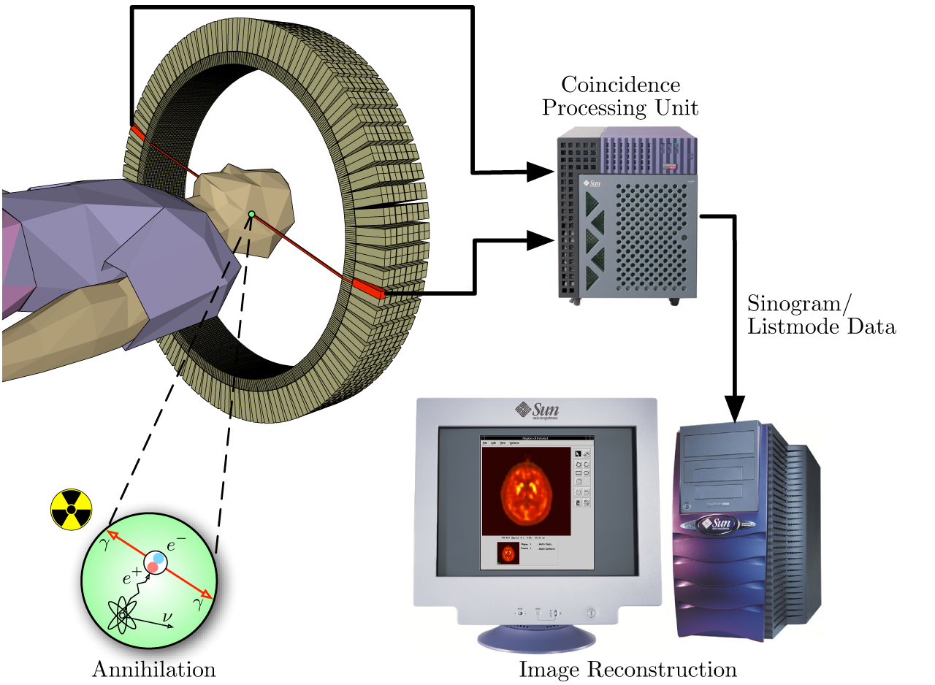

PET scan

Slide 15
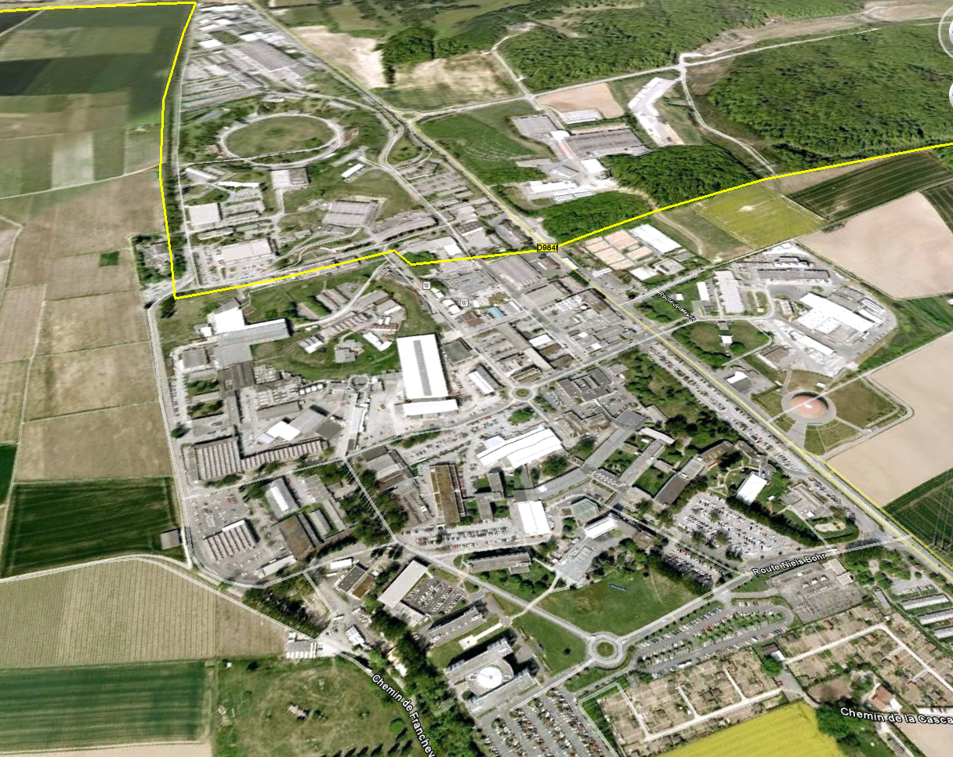


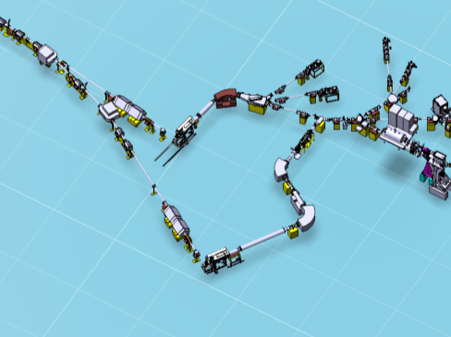
ISOLDE at CERN
MEDICIS
Innovative isotopes for detection (PET, SPECT,… ) and
treatment (Brachitherapy)
1.4 GeV protons
from PSBooster
Beam lines
GPS
In collaboration with
University Hospital Geneva
HRS separator
(90, 60 deg)
HRS Target station

Slide 16
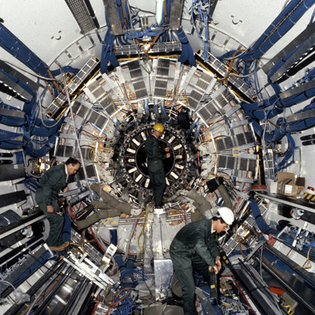
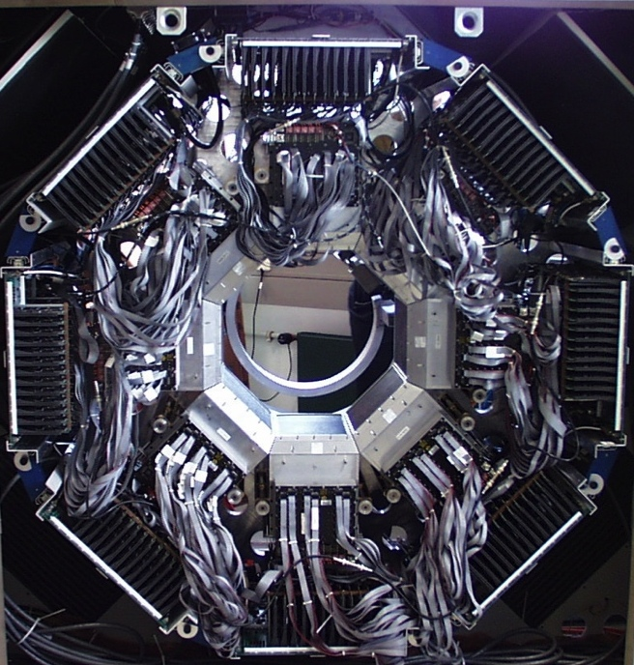
Medical imaging and particle physics:
The same challenge?

Slide 17
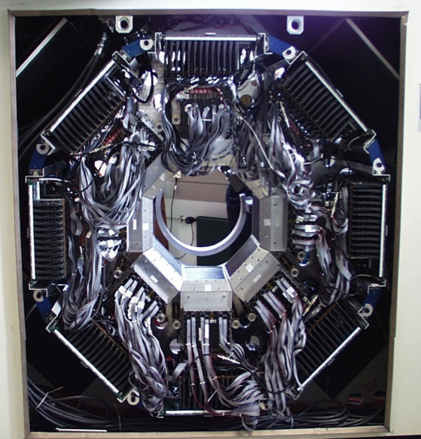
Similar challenges
New scintillating crystals and detection materials
Compact photo-detectors
Highly integrated and low noise electronics
High level of parallelism and event filtering algorithms in DAQ
Modern and modular simulation software using worldwide recognized standards
HEP Calorimeter
PET Camera

Slide 18
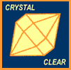
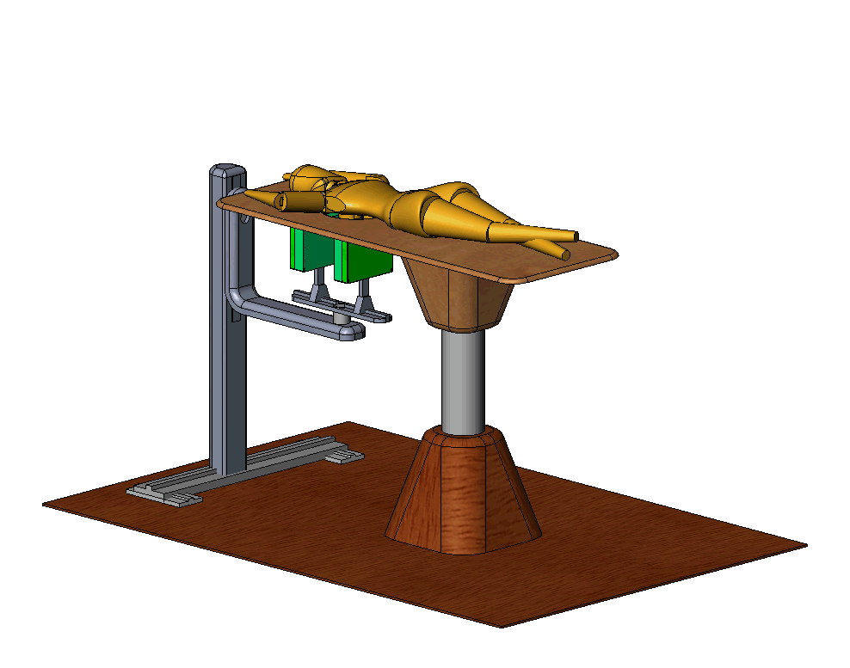
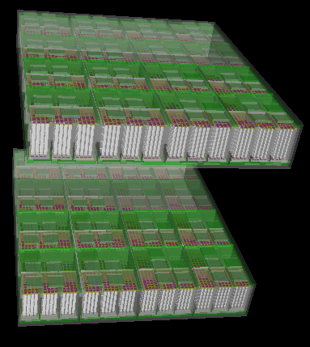
Crystal PEM
PET detector dedicated to breast cancer screening
  extremely sensitive to small tumour masses
Spatial resolution1-2 mm
High counting sensitivity
Short PET exam
Coupled to ultrasound

Slide 19
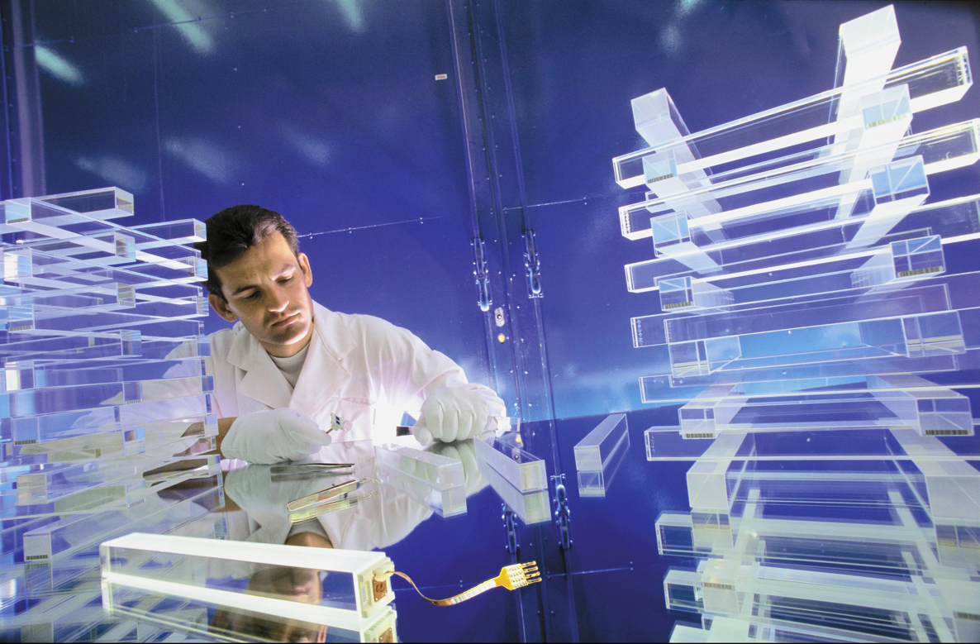
Crystal Clear
New scintillating materials
  LuAP, phoswich LuAP-LSO (CERN patent)
  other crystals
New photodetectors (Avalanche PhotoDiodes)
New low noise electronics
New intelligent DAQ systems with pipeline and parallel architectures
Better simulation GEANT 4
Better reconstruction algorithms

Slide 20
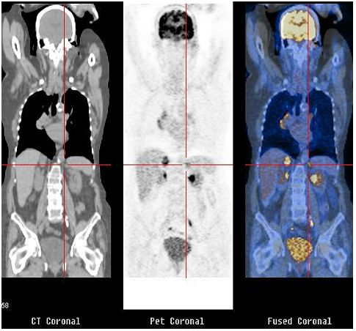
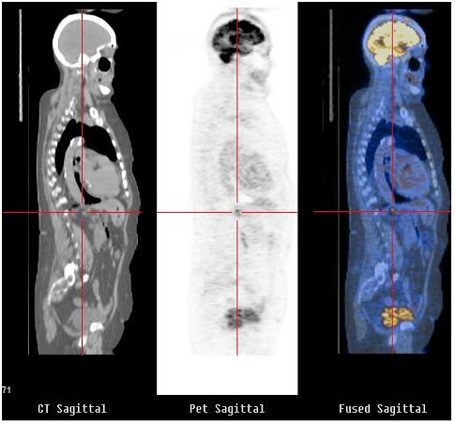

Multimodal imaging: PET/CT
CT
PET
Combining anatomic and functional imaging
morphology metabolism
David Townsend, CERN Physicist

Slide 21
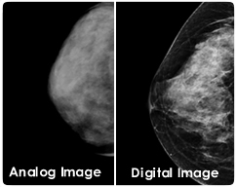
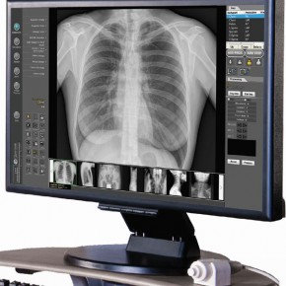
Towards digital imaging
High contrast => accurate diagnosis
Low dose
Screening opportunities
Access to preventive healthcare
Storage, easy-access, sharing images

Slide 22
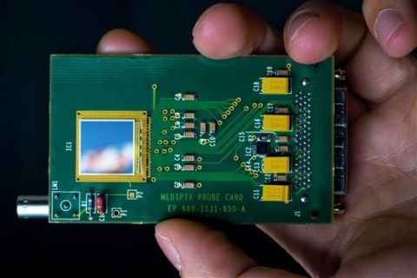
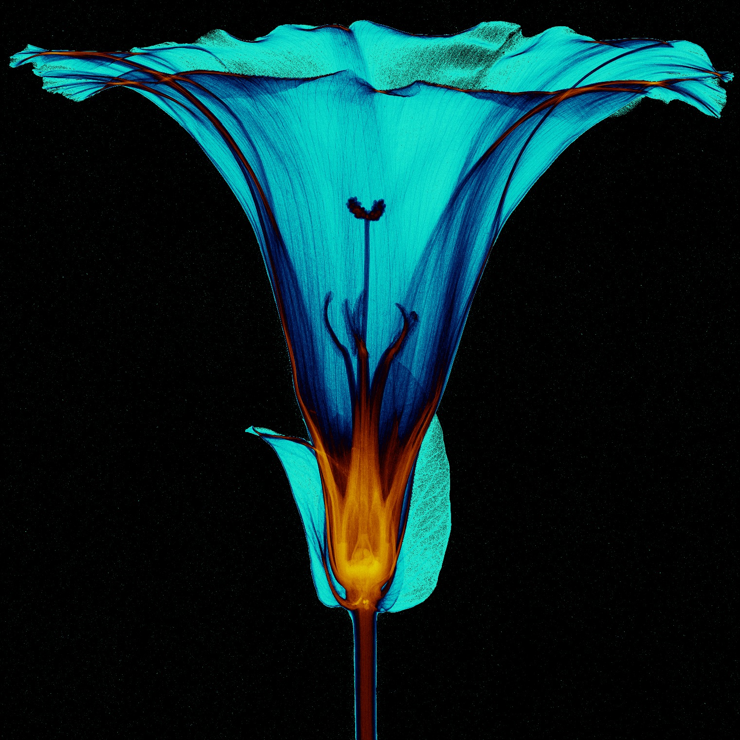
MediPix
High Energy Physics original development:
  particle track detectors
Main properties:
  fast fully digital device similar to the electronic chip in a digital camera but sensitive to X-rays instead of visible light
  good conversion efficiency of low energy X-rays
  it can create the first true colour images with X-rays

Slide 23
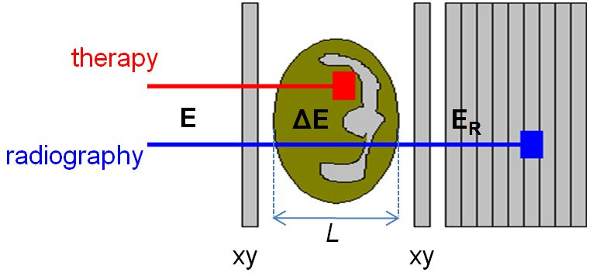
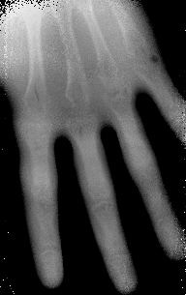
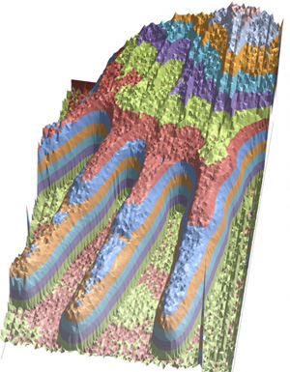
Proton radiography
Terapy
+
Radiography
- Early studies in the 70s
- High-rate medical diagnostics fully digital=> increase in the recording speeds in medical diagnostic tools, leading to faster scanning and lower body doses than X-rays.
Images courtesy of H. Sadrozinski

Slide 24

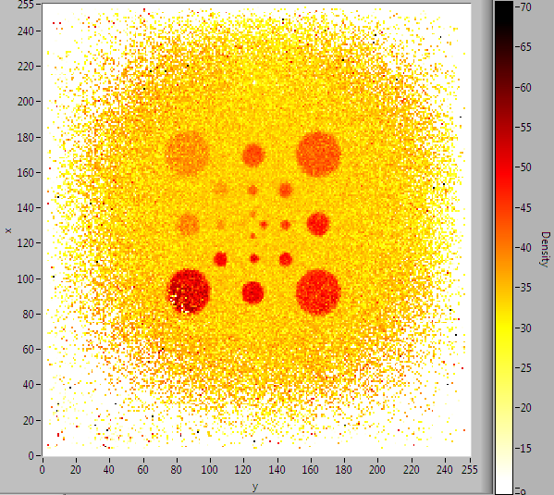
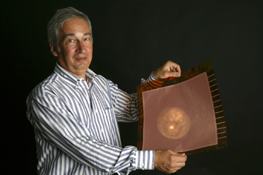
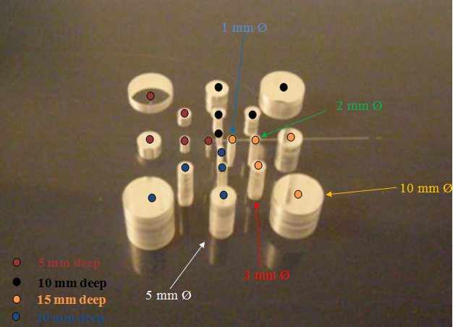


Proton radiography
TERA Foundation
GEM – Gas electron multiplier
1996: Fabio Sauli at CERN
for HEP experiments

Slide 25


Computing for medical applications
Grid
Sharing
Storage
Connect
Access
Data and Resources

Slide 26






Mammogrid
A grid mammography database
Second Opinion
Cancer Screening
Education and Training
Reference Database / Repository
Oncology
Breast Cancer (micro-calcifications and masses)
From: David MANSET, CEO MAAT France, www.maat-g.com

Slide 27


Simulation

Slide 28













Enlight
Importing Physics collaboration philosophy into
a medical environment
Create common multidisciplinary platform
Cancer treatment
Identify challenges
Share knowledge
Share best practices
Harmonise data
Provide training, education
Innovate to improve
Lobbying for funding
Coordination of several EU projects
https://cds.cern.ch/record/1611725

Slide 29

Accelerators for cancer treatment

Slide 30
Cancer and its treatments
Every year millions of new cases globally every year
Second most common cause of death in Europe, Canada, US
Conventional
Non Conventional
Surgery
Chemotherapy
Radiotherapy (X, IMRT)
Immunotherapy
Hyperthermia
Hadrontherapy …
Local control
Survival
Quality of life

Slide 31

The 3 Cs of radiotherapy
Cheap:
  the least expensive cancer treatment method (around 5% of total cost)
Cure:
  good cure rate (30-40%)
Conservative:
  generally non-invasive, fewer side effects

Slide 32


Conventional radiotherapy
dominated by linear accelerators
electrons
Linac for electrons
@ 3 GHz
5-20 MeV
X
X
Courtesy of Elekta
Multileaf collimator
tumour
20 000 patients per year every 10 million inhabitants
  1 linac every < 250 000 inhabitants
32

Slide 33



Alternatives
1932: Cyclotron by Ernest Lawrence
1946: article by Robert Wilson on using protons for therapy
  Birth of hadrontherapy
1954: first patients treated in Berkeley

Slide 34

Hadrontherapy

Slide 35

Protons vs X-rays
X-rays
Protons
Courtesy of MedAustron

Slide 36
Protons vs X-rays (2)
Hadrons:
  Critical areas
  Children
  Radio-resistant tumours (carbon ions)

Slide 37

Proton Treatment
Raster scanning technique

Slide 38
Particle therapy: a short history
Proposed by R.R. Wilson
MedAustron (Austria)
1st patient at Berkeley by Lawrence et al
CNAO, Pavia (Italy)
1st patient in Europe at Uppsala
HIT (carbon), Heidelberg (Germany)
1984
1989
1990
1991
1992
1993
1994
1996-2000
2002
1946
1954
1957
2009
2011
2015
PSI, Switzerland
PIMMS
Eye tumours, Clatterbridge, UK
GSI carbon ion pilot, Germany
ENLIGHT
CPO (Orsay), CAI (Nice), France
Loma Linda (clinical setting) USA
Boston (commercial centre) USA
NIRS, Chiba (carbon ion) Japan

Slide 39


PIMMS at CERN (1996-2000)
Proton Ion Medical Machine Study
linacs for
carbon ions
and protons
400 MeV/u synchrotron
p
p
p
C
C
RF cavity
Resonance sextupole
Sextupole horiz. chromaticity
Sextupole vert. chromaticity
Betatron
core
Circumference C = 76.84 m
Tune horizontal Q_{x} = 1.67
Tune vertical Q_{z} = 1.72
Sextupole vert.
chromaticity
Sextupole horiz. chromaticity
Electrostatic septum
CERN - TERA - MedAustron
Injection septum
Extraction septum

Slide 40



CNAO, Pavia (Italy)
TERA design from PIMMS
with CERN coordination
First patient with
- protons in September 2011
- C-ions in November 2012

Slide 41


MedAustron, Wiener Neustadt (Austria)
From PIMMS to MedAustron
1400 patients to be treated annually
First patients planned for 2016

Slide 42

GSI, Darmstadt (Germany)
Pilot project in Europe for cabon ions
GSI – Darmstadt (1997 – 2008)
G. Kraft (GSI) & J. Debus (Heidelberg)
450 patients treated with carbon ions

Slide 43




HIT, Heidelberg (Germany)
First patient in 2009
Beam transport line
Ion source
Quality control
Synchrotron
LINAC
Gantry
Treatment rooms Siemens Medical

Slide 44

TERA Programmes: PERLA
treatment room
rotating gantry
linac
cyclotron
Protontherapy and Exotic Radioisotopes
from Linked Accelerators

Slide 45

CERN: LEIR as a bio-medical facility
Proposal to use LEIR as a bio-medical facility
Low Energy Ion Ring provides ions for LHC and SPS target experiments
Time-sharing
between LHC ion runs
and medical research
Requires only small modifications
“Over 200 scientists from 26 countries, mostly from the European Union but also from Australia, Canada, Colombia, India, Mexico, Russia and USA, attended the brainstorming meeting.” - Manjit Dosanjh (2014)

Slide 46

Hadrontherapy facility: a virtual tour
http://cern.ch/virtual-hadron-therapy-centre

Slide 47

The collaborative spirit of particle physics and medical applications
Thanks for your attention!!!

Slide 48
Useful links
Medipix http://medipix.web.cern.ch/medipix/
AXIAL PET https://twiki.cern.ch/twiki/bin/view/AXIALPET/WebHome
Crystal Clear http://crystalclear.web.cern.ch/crystalclear/
→ ClearPET http://www.raytest.de/index2.html?/pet/clearPET/clearPET.html
LEIR biomedical facility http://cdsweb.cern.ch/record/1462262
PIMMS http://public.web.cern.ch/public/en/people/Amaldi-en.html
→ CNAO http://www.cnao.it/en/chi-siamo/la-storia-del-centro/
→ MedAustron http://cdsweb.cern.ch/record/1221064
Enlight http://enlight.web.cern.ch/

