Slide 1
Multiple diffraction theory of elastic pp scattering, with applications to 7 TeV pp data
T. Csörgő^{1,2}, R. J. Glauber³, F. Nemes¹, J. Velasco⁴
¹ Wigner RCP, Budapest, Hungary
² KRF, Gyöngyös, Hungary
³ Harvard University, Cambridge, MA, USA
⁴ IFIC, University of Valencia, Valencia, Spain

Slide 2
Introduction to Diffraction
Glauber-Velasco model
Some Old-New Results
Non-exponential behaviour of dσ/dt at low-t
Analysis of TOTEM/LHC p+p @ 7 TeV
New results, generalized Glauber & Velasco
Imaging with shadow profile functions
from ISR to LHC
Summary
arxiv:1306.4217
arxiv:1311.2308
+ manuscirpt in prep.
Note: Paper on the „real extended” Bialas-Bzdak model
F. Nemes, T. Cs, M. Csanád
arXiv:1412.0813
To be published in IJMPA

Slide 3
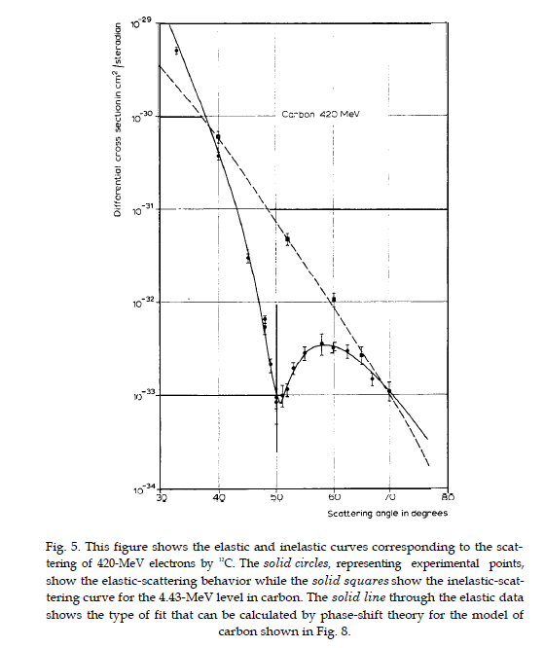
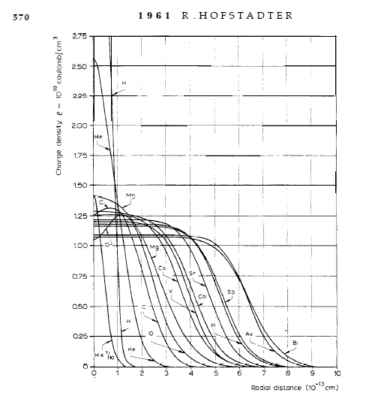
Diffraction – Hofstadter, Nobel (1961)
Diffractive electron scattering on nuclei and the resulting charge density distributions, images of spherical nuclei

Slide 4
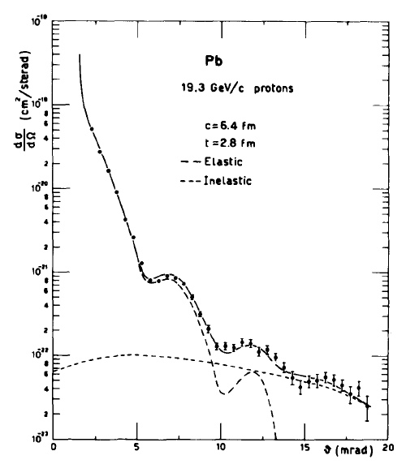
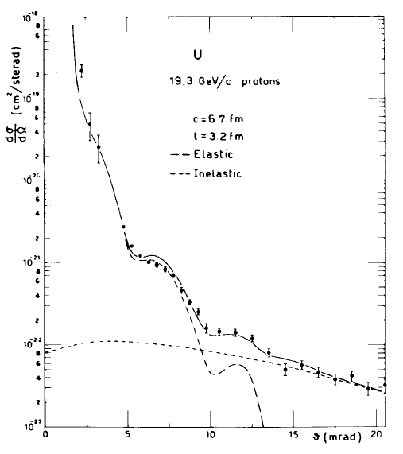
Diffraction in pA,
Glauber and Matthiae, NPB21 (1970) 135
Diffractive proton scattering on nuclei confirms the charge density distributions of spherical nuclei

Slide 5
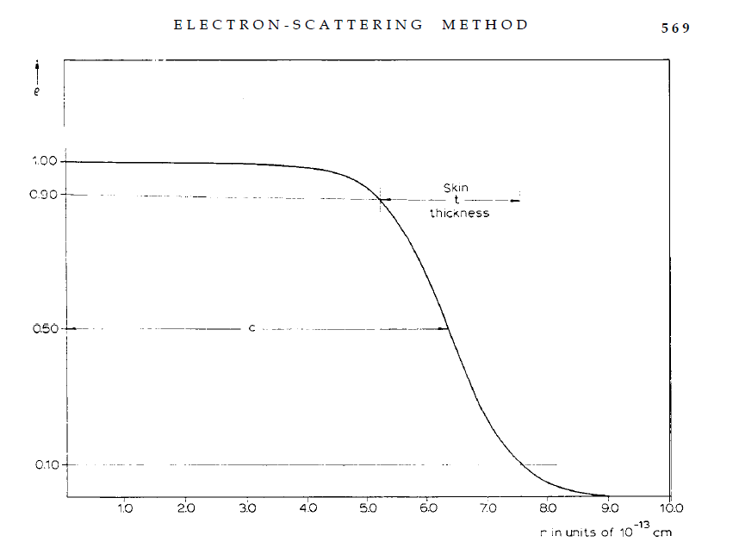

Diffraction – What have we learned?
The volume of spherical nuclei is proportional to A
The surface thickness is constant, independent of A
→ Central charge density of large nuclei is approx constant
R. Hofstadter, Nobel Lecture (1961)

Slide 6
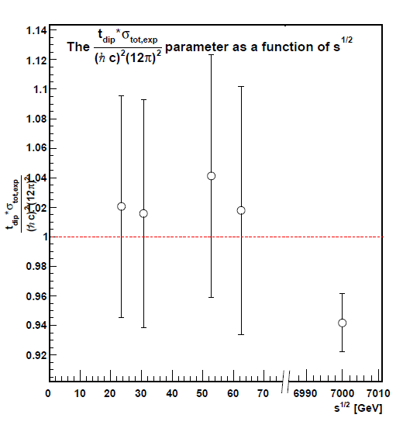
What have we learned since 2013?
t_{dip} σ_{tot} ~ C
geometric scaling at LHC
C = 54.8 ± 0.7 mbGeV² (data)
C ≠ 35.9 mbGeV²
(black disc)
NOT in black disck limit
arxiv:1311.2308
BEL effect expected:
proton becomes
Blacker,
Edgier,
Larger,
with increasing √s

Slide 7
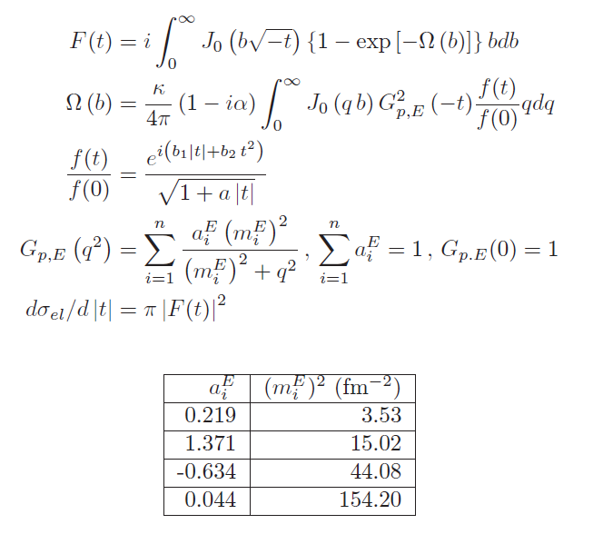
Glauber – Velasco model summary
F(t): f. sc. amplitude
Ω(b): opacity, complex
f(t): cluster averaged parton-parton scattering amplitude
-t = q²: momentum transfer
b: impact parameter
dσ/dt: diff. cross-section
elastic pp scattering
R.J. Glauber and J.Velasco
Phys. Lett. B147 (1987) 380
BSWW EM form factors G_{E}

Slide 8
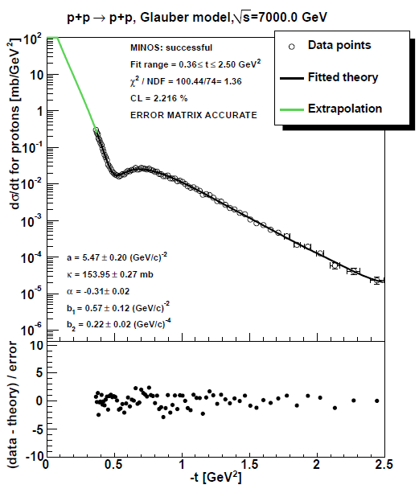
First results @ Low-X 2013: GV works for dσ/dt dip
Glauber-Velasco (GV)
(original)
describes dσ/dt data
Both at ISR and
TOTEM@LHC
in the dip region
arxiv:1311.2308
Note: at low-t
GV is ~ exponential
Really?
Lower energies?

Slide 9
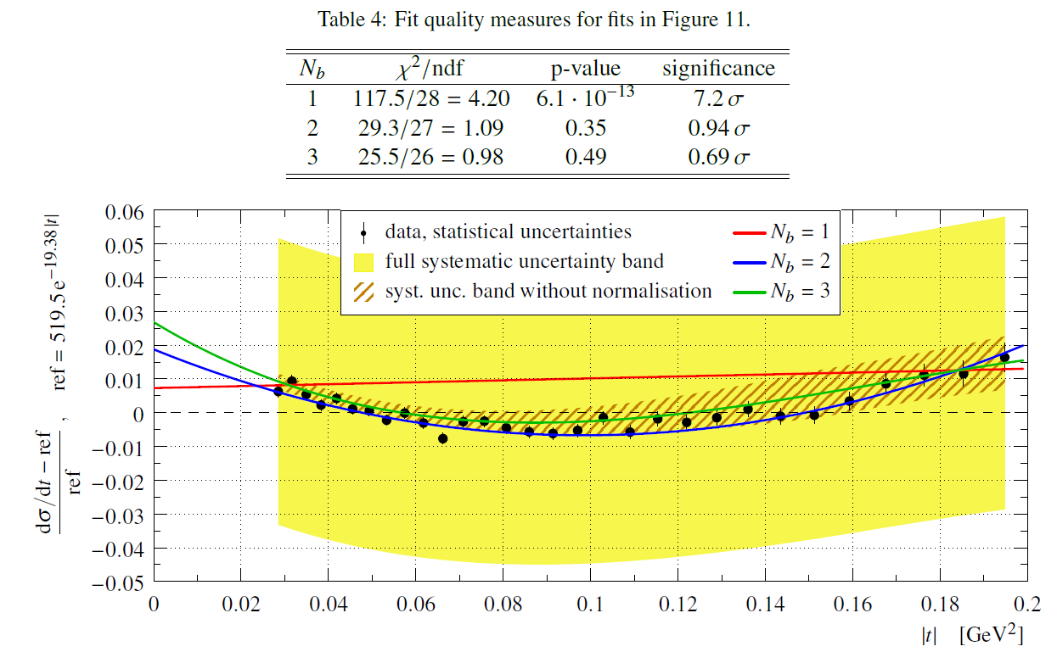
TOTEM news from arxiv:1503.08111:
non-exponential at low-t, NPB in press

Slide 10
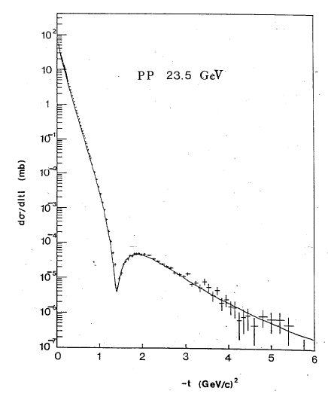
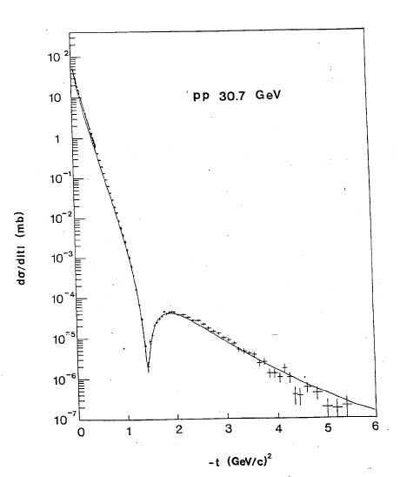
Diffraction in pp @ ISR,
Glauber and Velasco, PLB147 (1984) 380
Glauber and Velasco,
Phys. Lett. B147 (1984) 380
Glauber and Velasco,
IFIC preprint, 1996,
unpublished
Illustration: elastic pp at the ISR energy range
13.7 – 62.7 GeV well described by Glauber-Velasco

Slide 11
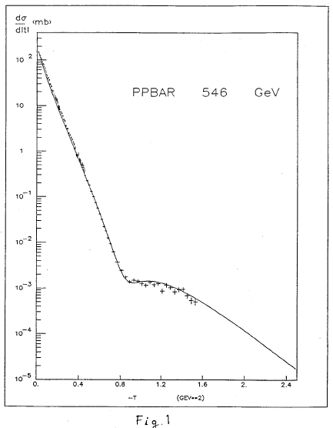
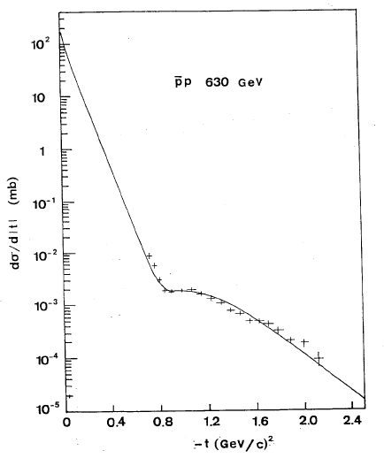
_
Diffraction in pp @ ISR
Glauber and Velasco, PLB147 (1984) 380
Glauber and Velasco,
Phys. Lett. B147 (1984) 380
Glauber and Velasco,
IFIC preprint, 1996,
unpublished
_ _
Illustration: elastic pp at the SppS energy range
546-630 GeV well described by Glauber-Velasco

Slide 12
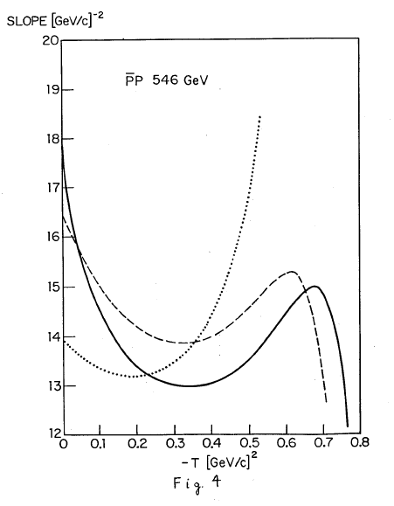
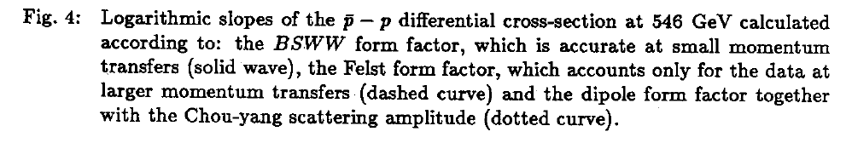
_
Non-exponential pp in GV model
Figure 4 from
Glauber-Velasco
PLB 147 (1984) 380
Slope is not quite
exponential
(for femtoscopy:
a non-Gaussian behaviour)

Slide 13
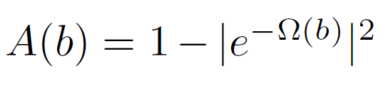
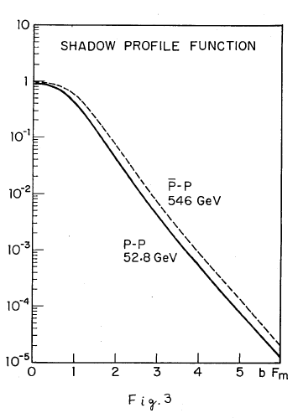
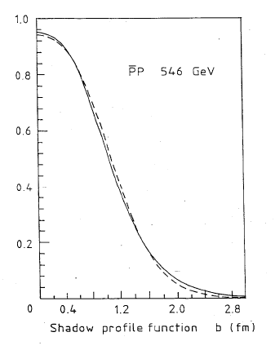
Imaging with shadow profile
Glauber and Velasco,
Phys. Lett. B147 (1984) 380
Glauber and Velasco,
IFIC preprint, 1996,
unpublished

Slide 14
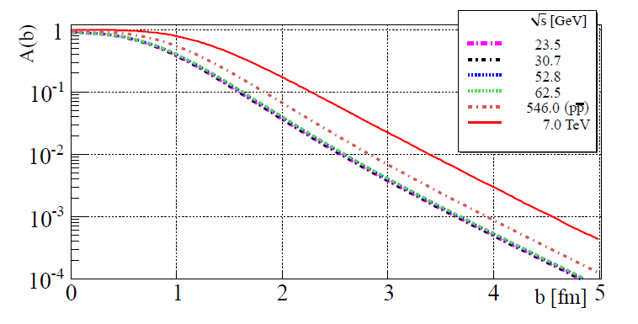
Saturation from shadow profiles
at 7 TeV
proton becomes
Blacker, but
NOT Edgier,
and Larger
BEL BneL effect
apparent saturation:
proton is ~ black at LHC
up to
r ~ 0.7 fm
ISR and SppS:
R.J. Glauber and J.Velasco
Phys. Lett. B147 (1987) 380 b₁,b₂ fixed
see also Lipari and Lusignoli,
arXiv:1305.7216

Slide 15
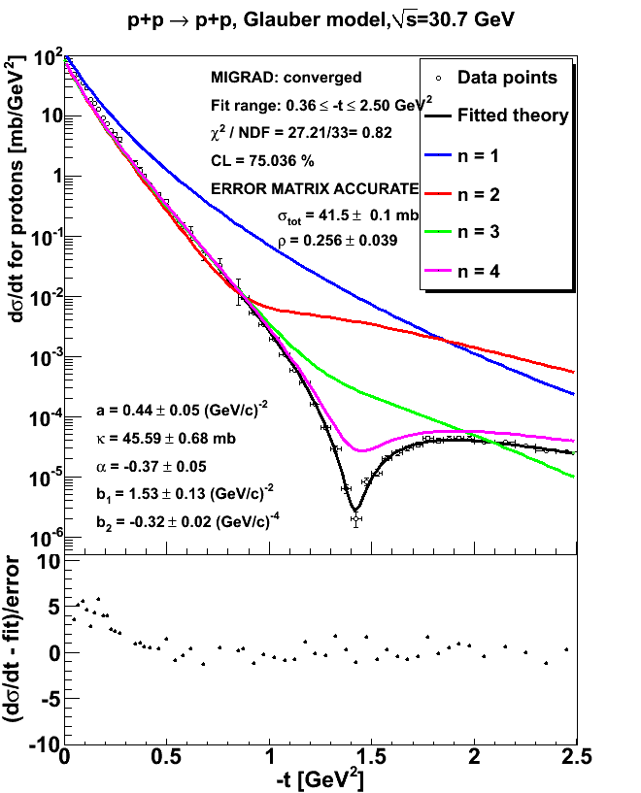
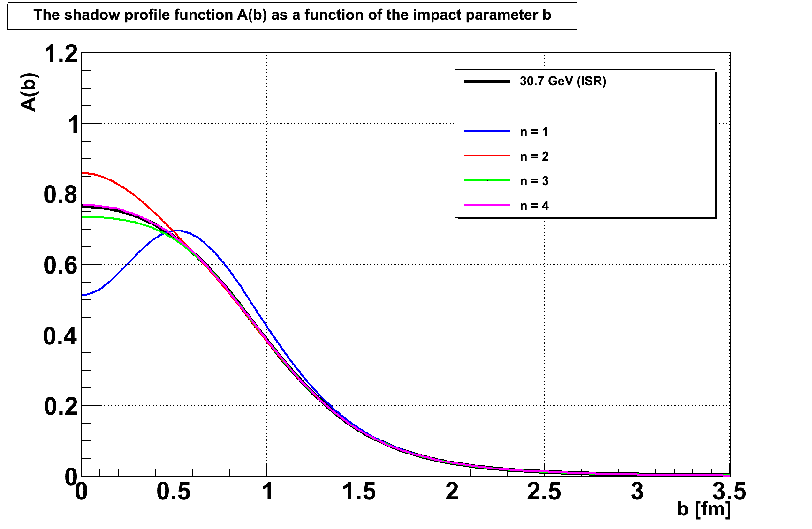
Shadow imaging in p+p at ISR
Opacity expansion of order n: exp(-Ω) = 1- Ω + Ω²/2! − ...
Proton image: gray (n=1) edge, dark (n~3) center

Slide 16
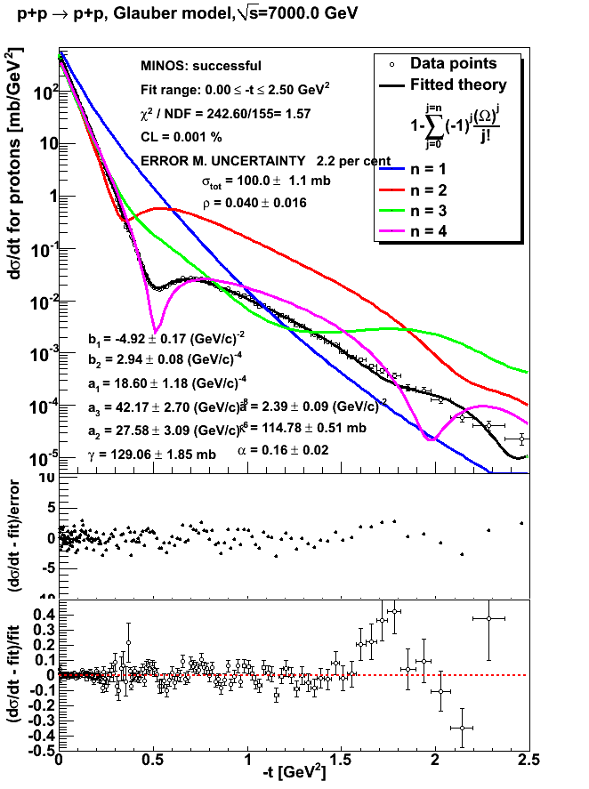
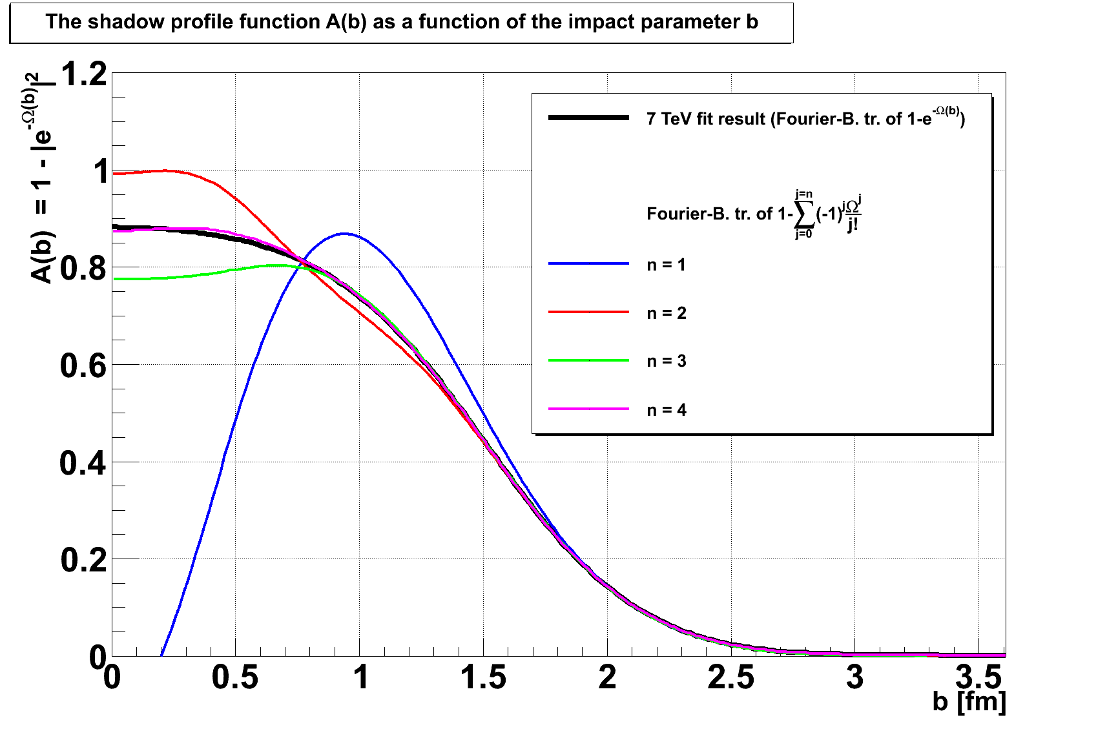
Shadow imaging in p+p at LHC
Simple choice for the generalization of GV:
f(t)/f(0) = exp(i b₁ |t| + i b₂ |t|² ) /
sqrt( 1 + a t)
→
f(t)/f(0) = exp(i b₁ |t| + i b₂ |t|² ) /
sqrt( 1 + a|t| + a₁ |t|² + a₂ |t|³ + …)
More systematic expansions and further improvements are under investigation.
Opacity expansion of order n:
exp(-Ω) = 1-Ω + Ω²/2! − ...
Proton at 7 TeV: gray (n=1) edge, very dark (n ≥ 4) center

Slide 17
Summary
Investigation of Glauber-Velasco model
works well in the dip region at LHC
but needs extension in low-t
TOTEM: non-exponential behaviour
geometric scaling
but not in the Black Disc limit
generalized Glauber-Velasco
works well at low-t
also at dip-t, but …
from BEL to BneL effect
Grey at r~ 1 fm,
black up to r~0.7 fm

Slide 18
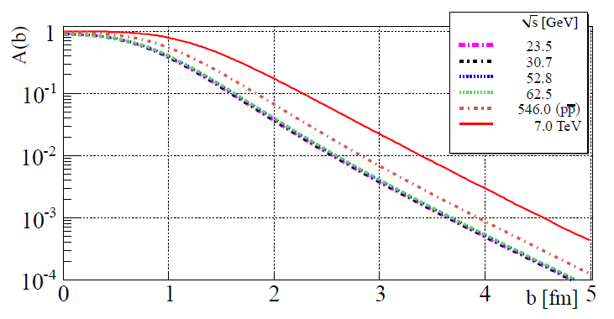
Shadow imaging in p+p at LHC
The BneL effect.
Thank You!

Slide 19
Backup slides

Slide 20

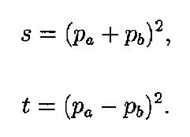

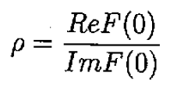


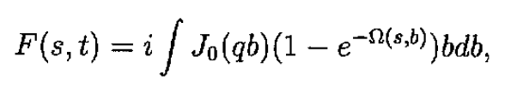
Multiple Diffraction Theory of Elastic proton-proton scattering
Definitions and derivations from
(1) Glauber and Velasco, Harvard Print 88-0344,
Phys. Lett. B147 (1984) 380
(2) Glauber and Velasco, IFIC preprint, 1996, unpublished

Slide 21
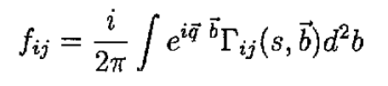

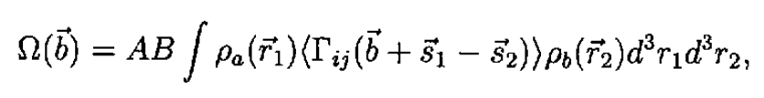
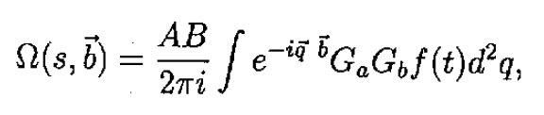
Multiple Diffraction Theory of Elastic proton-proton scattering: Glauber-Velasco
(1) Glauber and Velasco, Harvard Print 88-0344,
Phys. Lett. B147 (1984) 380
(2) Glauber and Velasco, IFIC preprint, 1996, unpublished

Slide 22

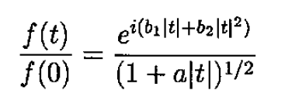

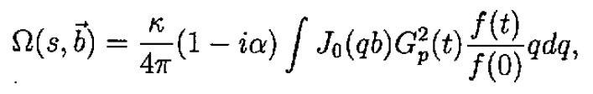

Multiple Diffraction Theory of Elastic proton-proton scattering: Glauber-Velasco
(1) Glauber and Velasco, Harvard Print 88-0344,
Phys. Lett. B147 (1984) 380
(2) Glauber and Velasco, IFIC preprint, 1996, unpublished

Slide 23
Figures from
(1) Glauber and Velasco, Harvard Print 88-0344, PLB 147(1984) 380 and
(2) Glauber and Velasco, IFIC preprint, 1996, unpublished
Figure 1 from (1)

Slide 24
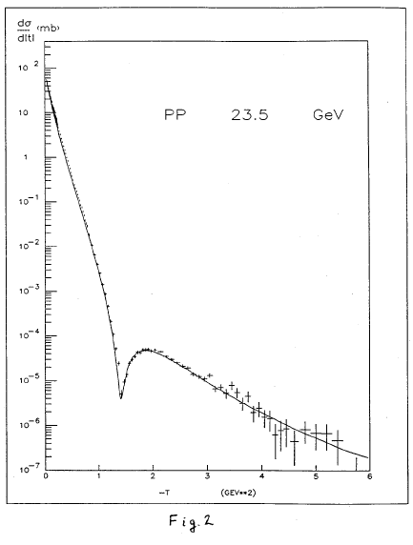
Figures from
(1) Glauber and Velasco, Harvard Print 88-0344, PLB 147(1984) 380 and
(2) Glauber and Velasco, IFIC preprint, 1996, unpublished
Figure 2 from (1)

