Slide 1

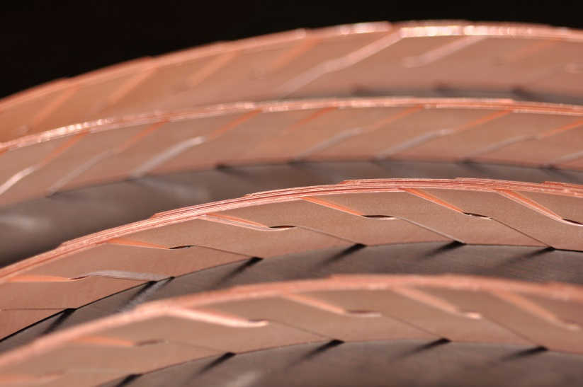
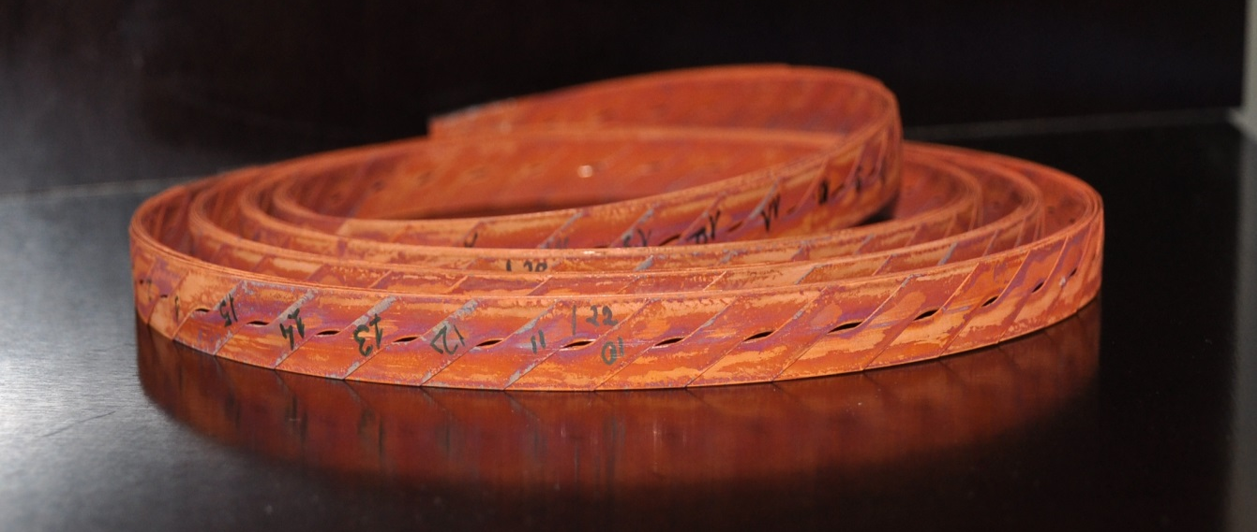
Roebel Cable R&D
Kario, S. Otten, A. Kling, W. Goldacker
Institut for Technical Physics

Slide 2
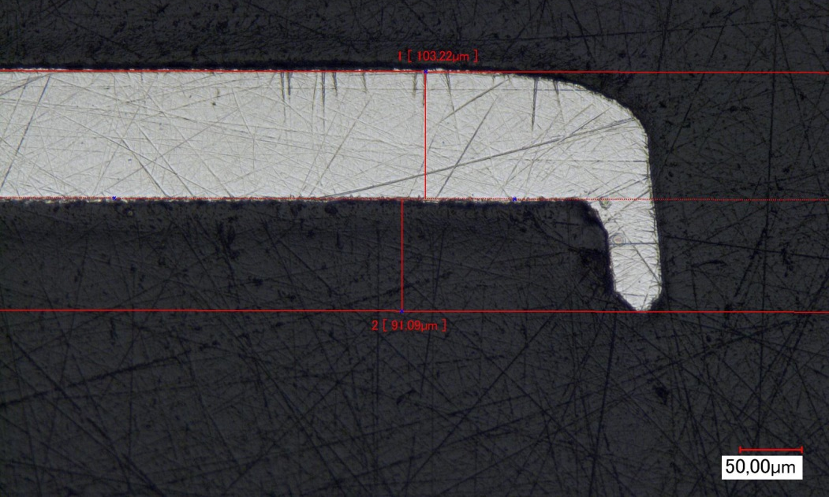
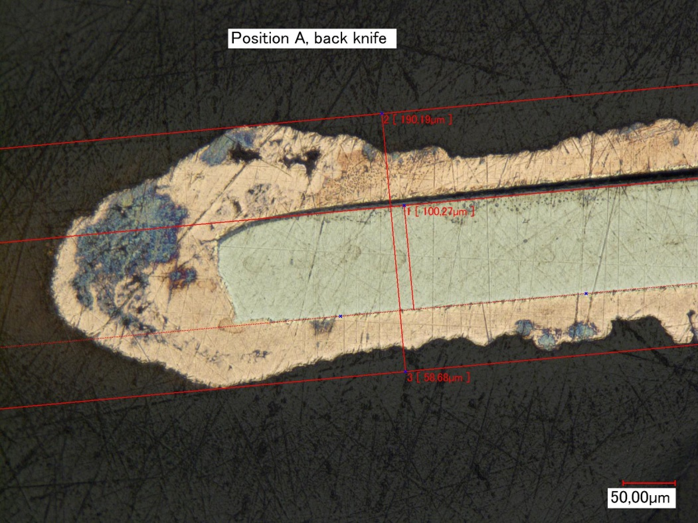
Bruker tapes for punching and coating :
103 µm
Problem with punching
tool.
Punched tapes:
E2B-15-T283D – 30 +4 m
E2B-15-T284D – 25 m
Burr removed at Bruker
Roebel strands from tape 283D electroplated at Bruker
No delamination from edge side observed
91 µm
190 µm

Slide 3

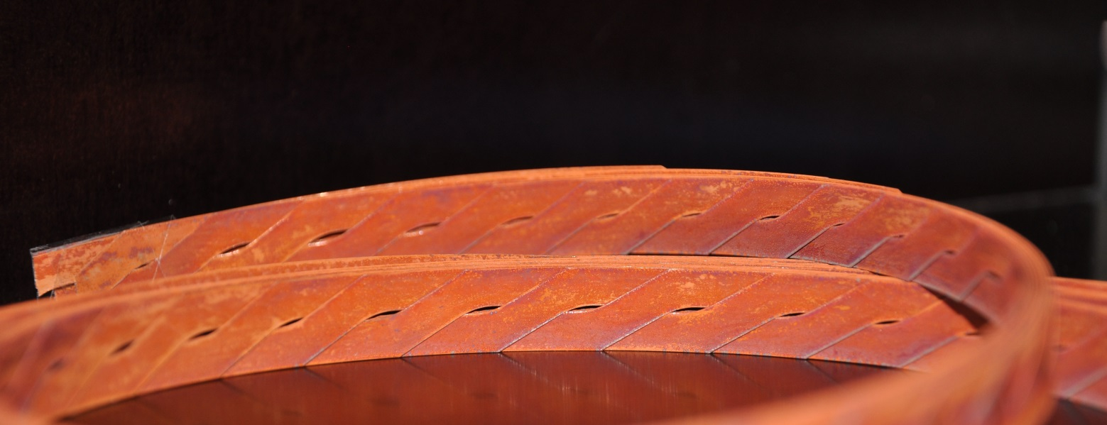
Roebel cable for FRESCA (2 m):
Roebel cable: 226 TL, 15 strands
Punch + Coat
Assembled
2 m long
283 D tape

Slide 4
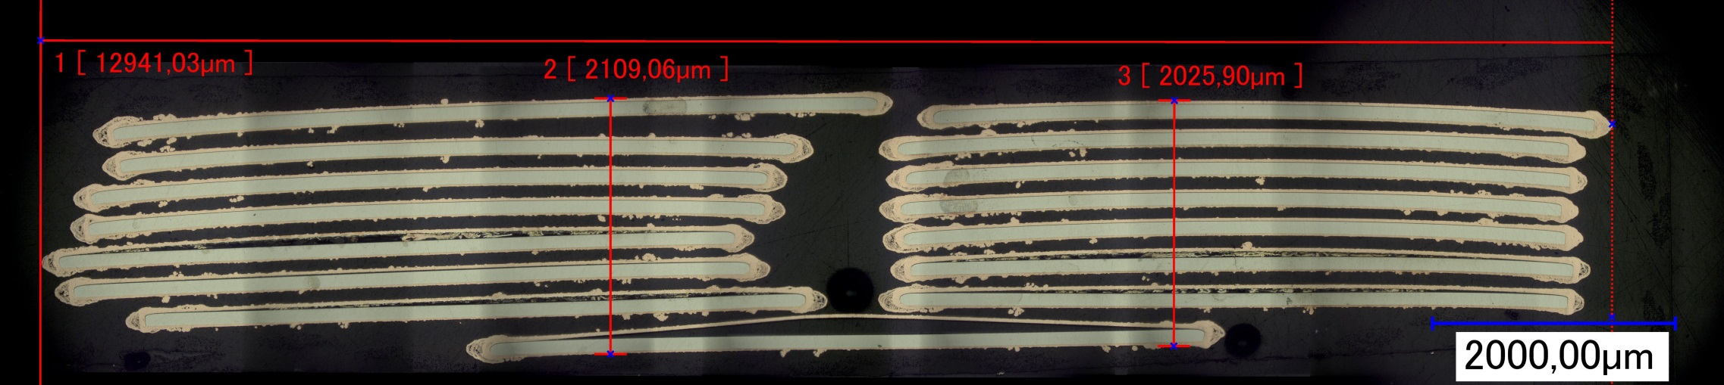
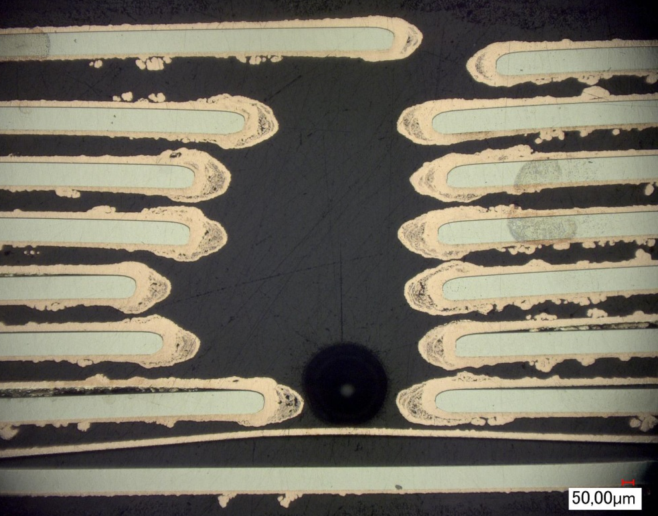
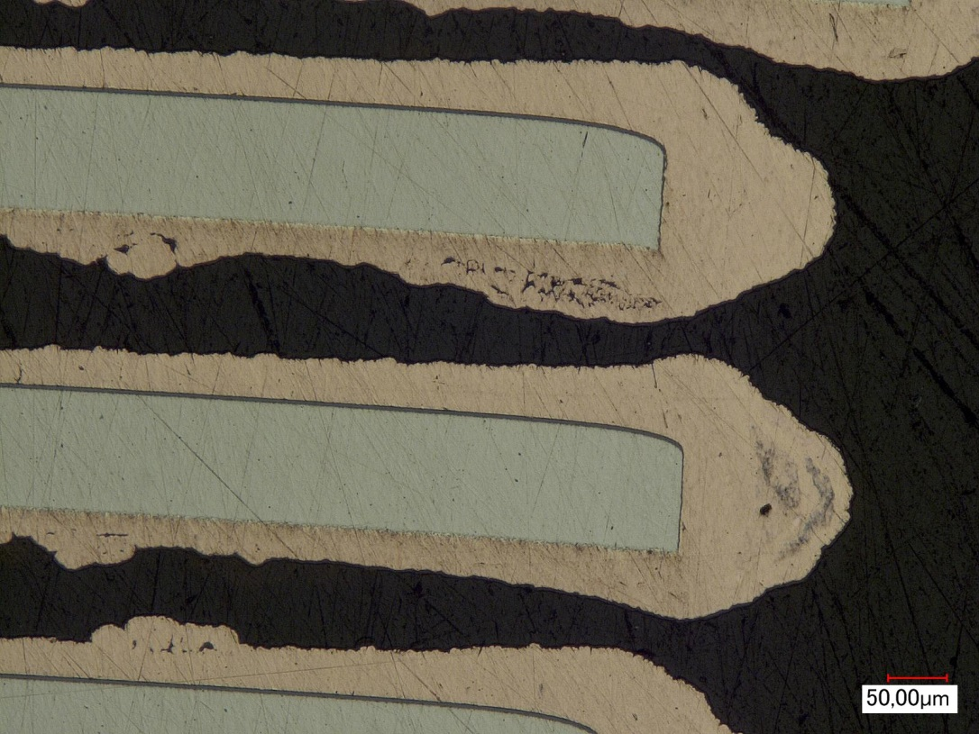
Roebel cable for FRESCA (2 m):

Slide 5
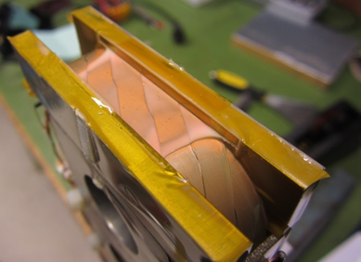
U. Twente + KIT transversal stress experiments:
Roebel cable: 226 TL, 15 strands:
1. SuperPower CC + KIT impregnation
2. SuperPower CC + CERN impregnation
3. Bruker CC + CERN impregnation
1. SuperPower CC + KIT impregnation
2. SuperPower CC + CERN impregnation
3. Bruker CC + KIT impregnation
Old experiment:
Roebel cable: 126 TL, 10 strands
SuperPower tape, 20 µm Cu (per site)
KIT impregnation

Slide 6
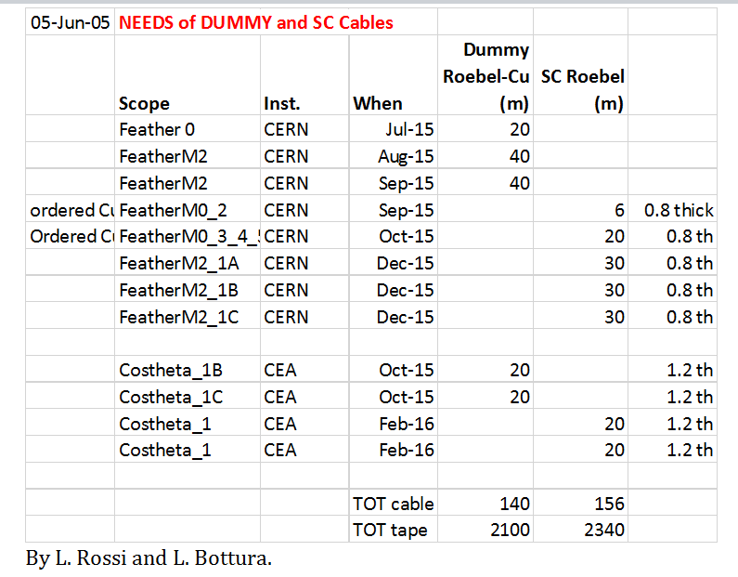
Last meeting - list of deliveries:
Nothing delivered – we wait for Bruker Cu plated substrate !!!
Which tape is it and when it will be delivered?

Slide 7
Summary:
Cable dummy deliveries:
No dummy tape available.
Transverse pressure resistance:
Decision about impregnation material / type of cable required.
Bruker tape need to be delivered.
Tape qualification for Roebel cable:
We need specifications for tapes from other producers for setting-up punching tool (substrate material, thickness, Cu thickness and technique).

Slide 8
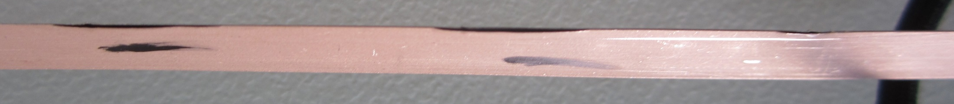
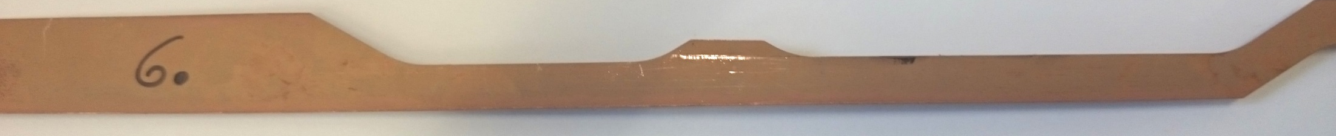
Punching of the delivered Bruker tapes:
Bruker tape | Tape length (m) | Defects punching | Number of strands | Ic strand (average, 77K)
254 D | 14.1 | delamination | 2 | 51.5
255 D | 18 | delamination | 3 | 52.6
270D-1 | 13 | delamination | 2 | 61.1
270D-2 | 22.1 | delamination | 4 | 56.9
281D | 23.2 | - | 4 | 62.8
Defect examples:
16 mm
16 mm
5 mm
5.5 mm

Slide 9
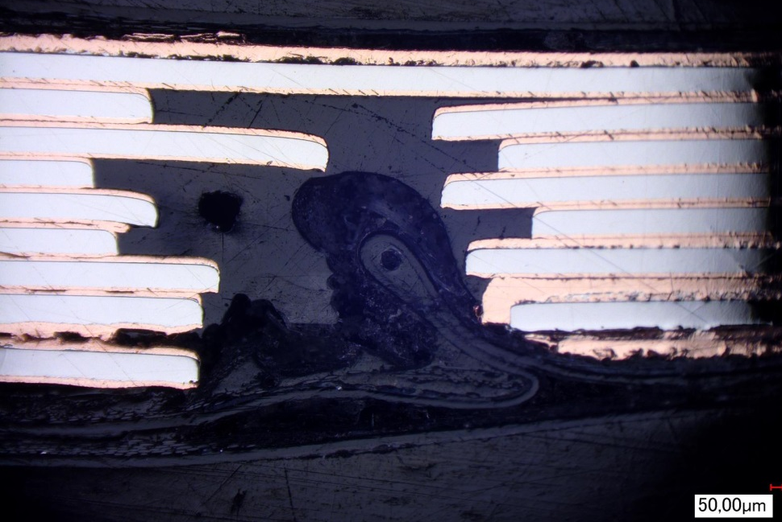
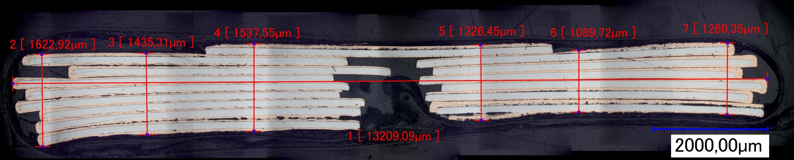
Cross-section of the Roebel cable:
Roebel I_{c} design (sum of all strands at 77 K, s. f.) - 861 A
Roebel I_{c} predicted (with s.f., 77 K) – 749 A (13 % s. f. reduction)
Roebel I_{c} predicted (with s.f., 77 K) – 603 A (30% s. f. reduction)

