Slide 1
13 kA Energy Extraction
LHC machine
Gert Jan Coelingh – Knud Dahlerup-Petersen – TE/MPE/EE

Slide 2
Components of an EE system: switches, drivers (powering and control electronics), current distribution system, extraction resistors, supervision electronics, cooling facility, Interlock system, Data Acquisition electronics and auxiliary systems (e.g. over-current detectors, snubber capacitor banks, electrical protection.
Basic Requirements: Reliability of the release systems, continuous availability, low losses and radiation tolerance.
Some Key Figures:
  The 32 high current and 202 low current EE facilities in the LHC represent 310 tons of equipment.
  All main components are tailor-made to the application, off-the-shelf equipment did not meet the CERN specification.
  The total reference cost of the systems was 19 MCHF.
Store Energy:
      RB: 1’236 MJ at ultimate current -RQF/RQD: 24 MJ at ultimate current.
      600 A corrector circuits: up to 150 kJ
Locations:
  Even points: all eight UA galleries (RB, QF/QD, correctors)
  Odd points: all six RR tunnel extensions (RB, correctors), tunnel (RB power systems in R34, R37), UJ33 (RB controls, correctors).

Slide 3
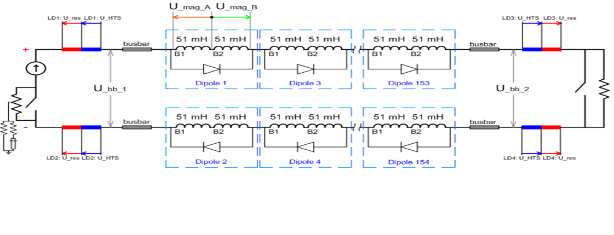
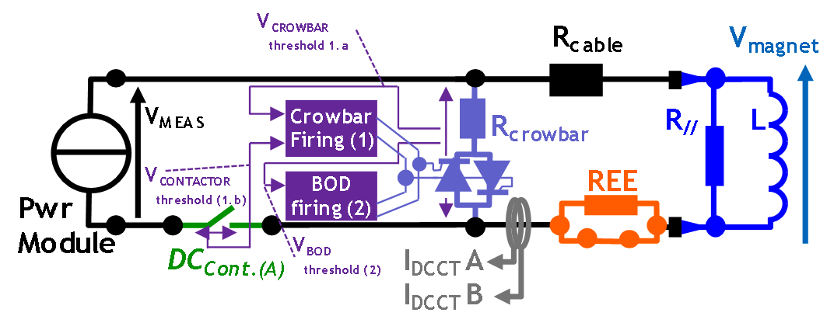
RB circuit with two series-Inserted EE
systems
Only series extraction used in LHC
General lay-out with one series-inserted EE system. Ex: RQF/RQD
EPC – Y. Thurel

Slide 4
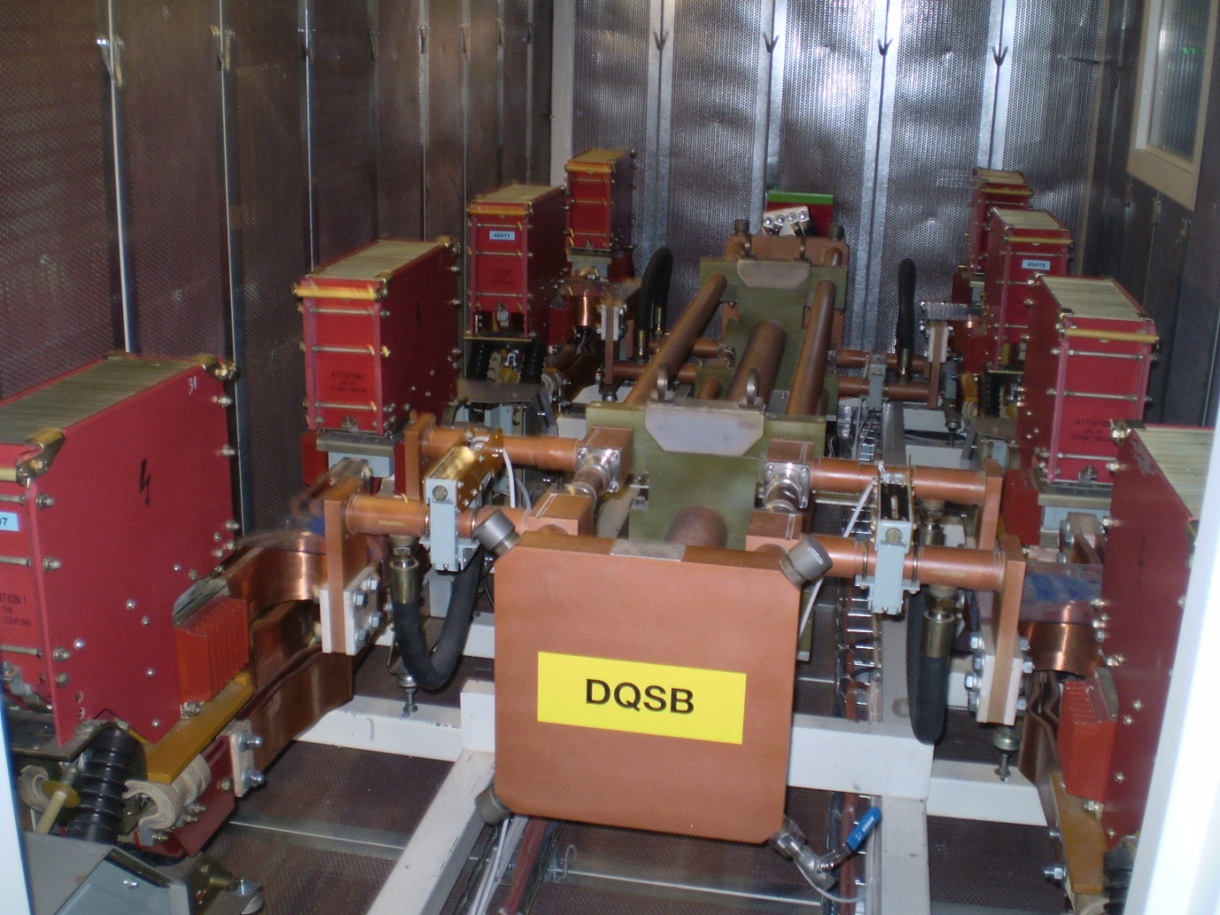
Dipole Switch array ~ 12 m² ~ 24m³

Slide 5
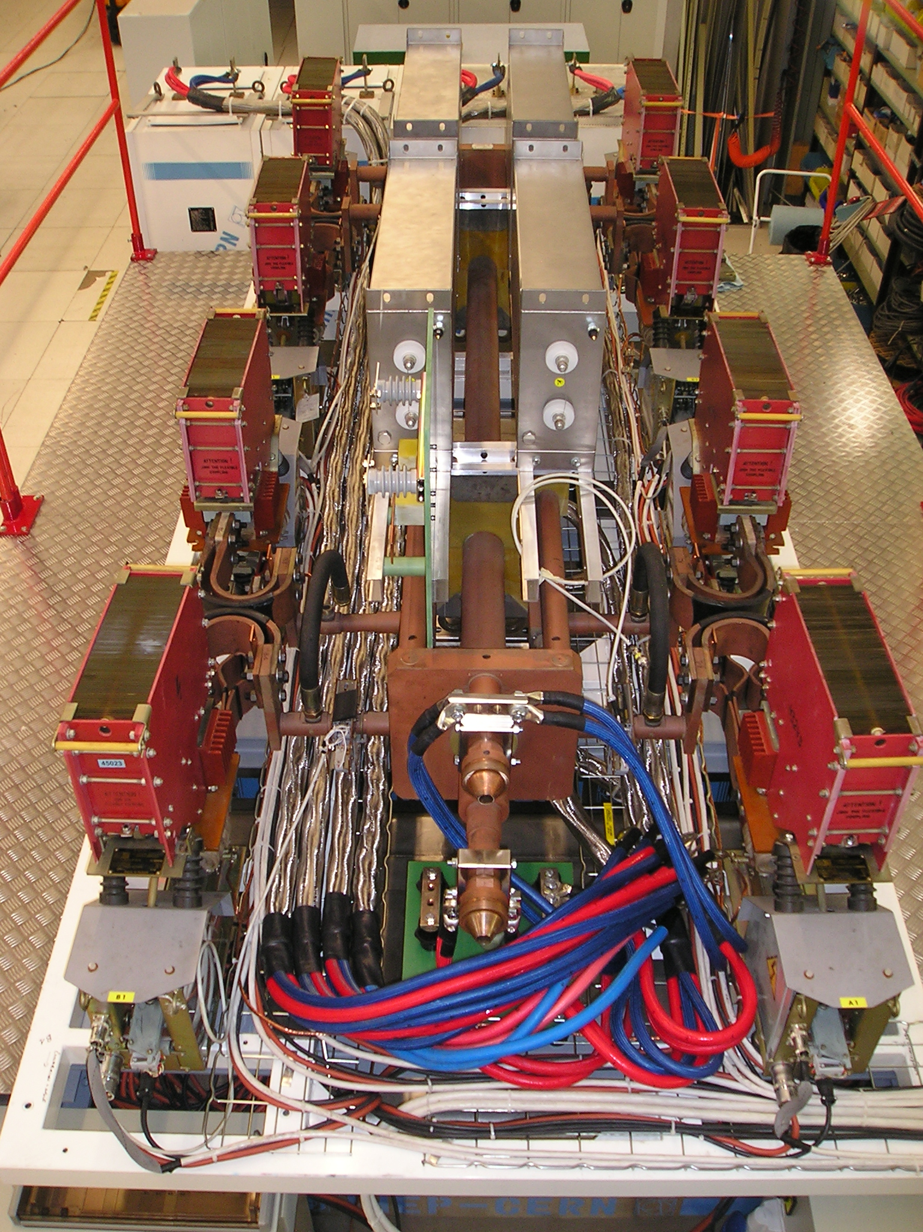

Slide 6
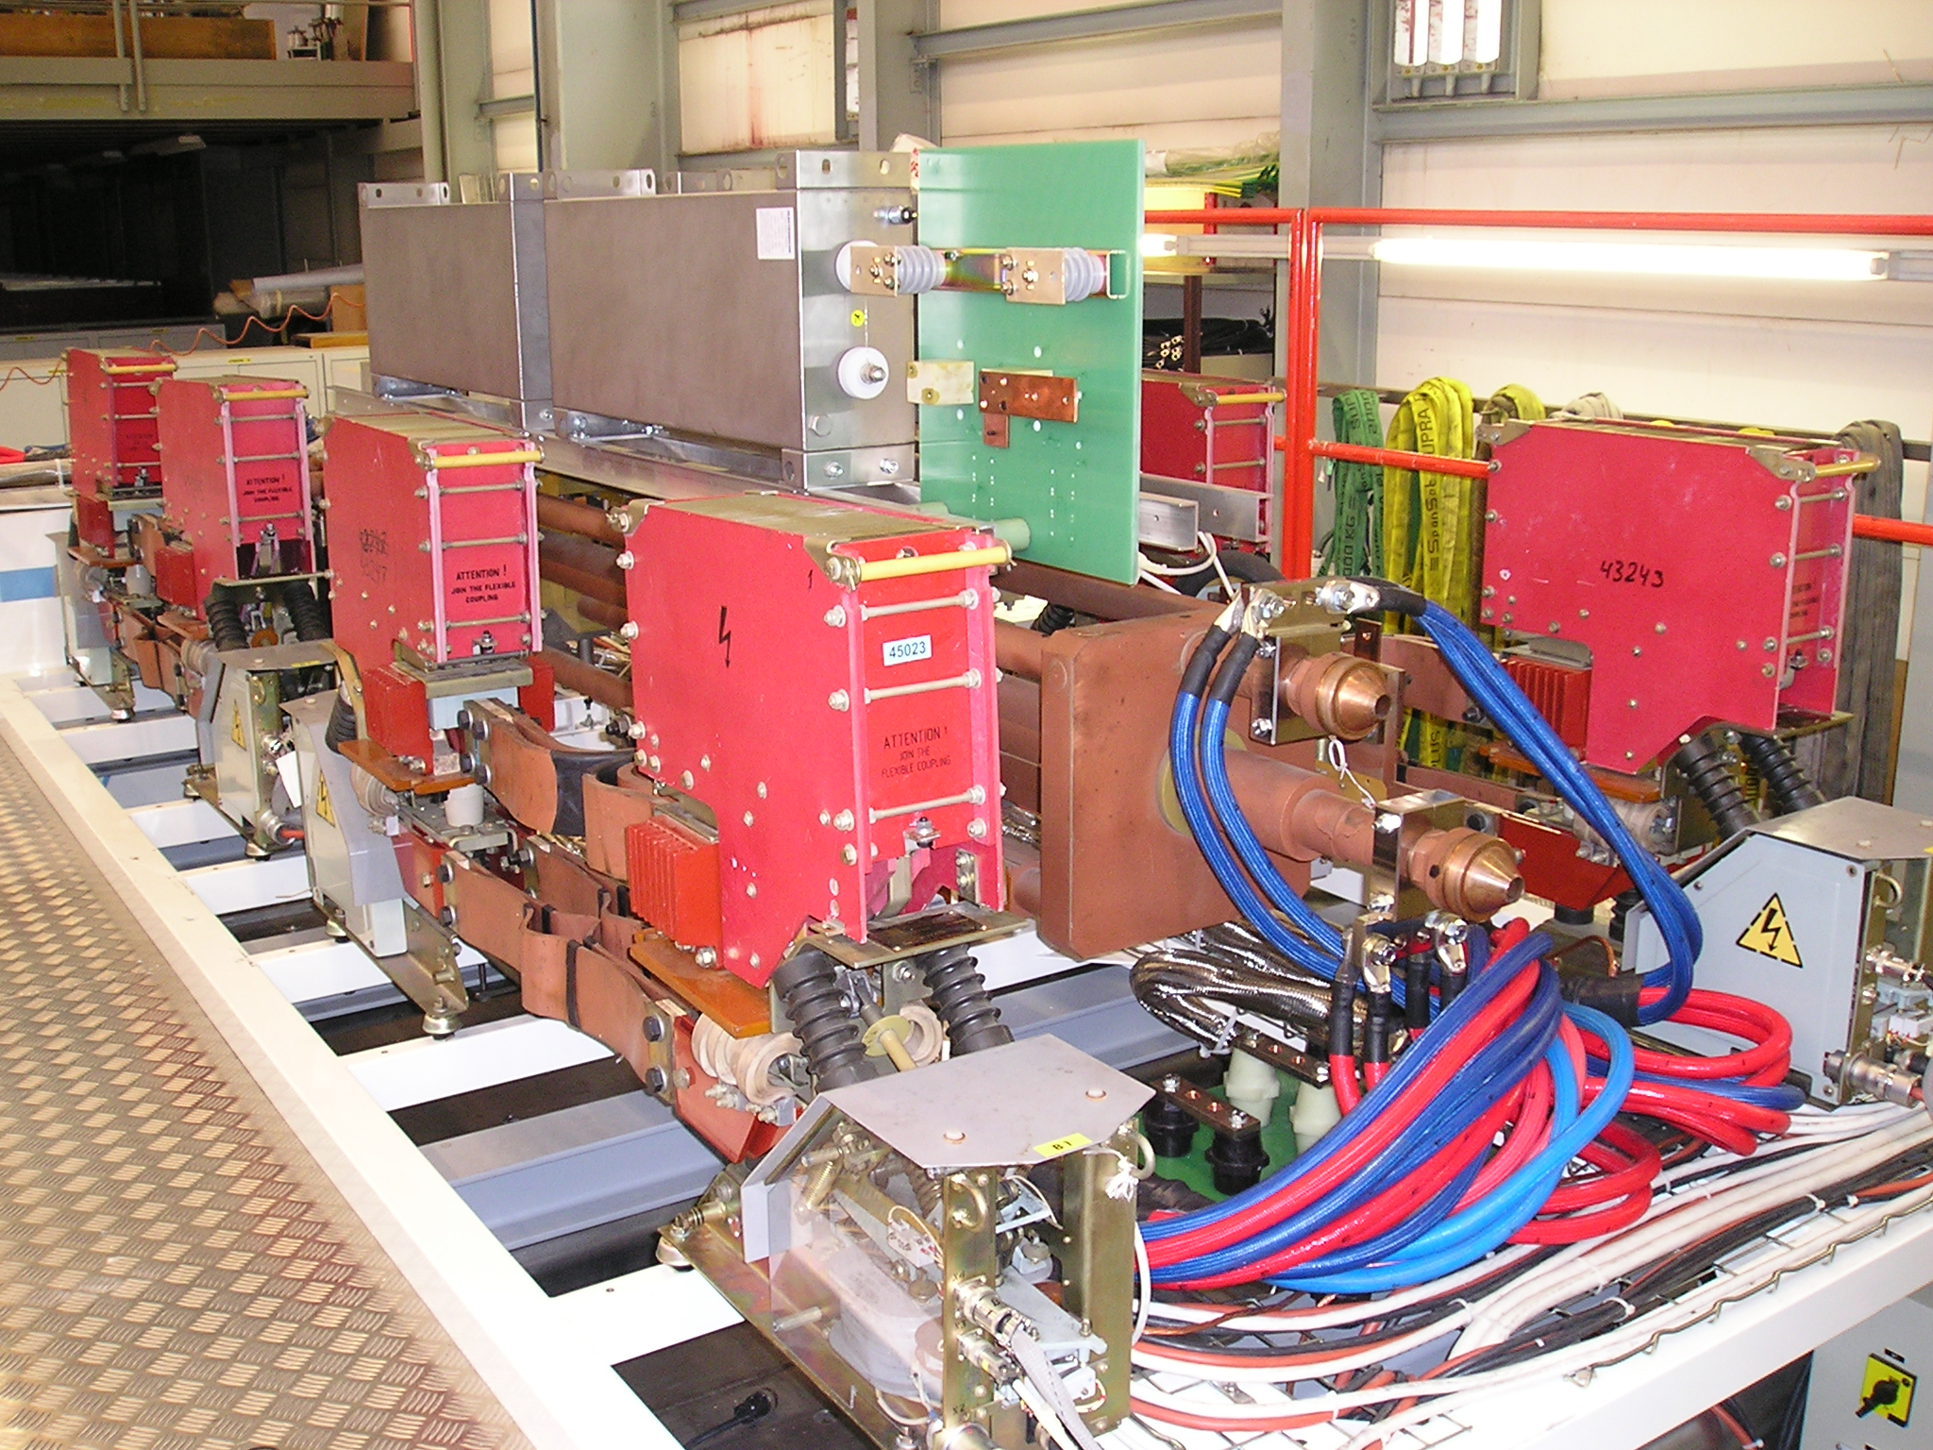

Slide 7
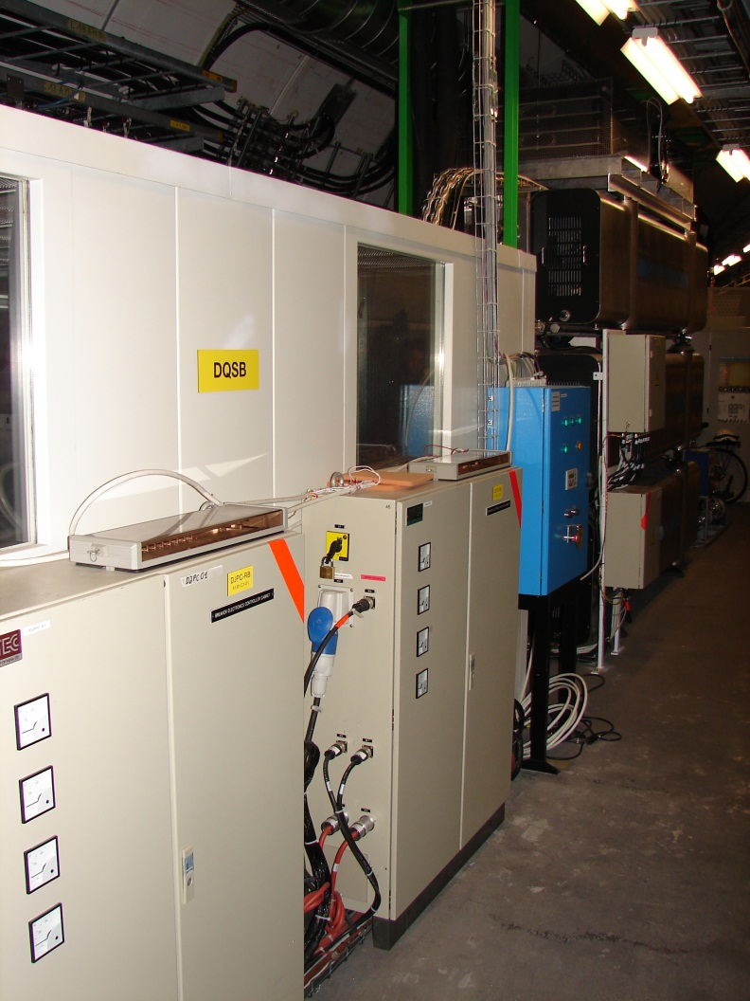
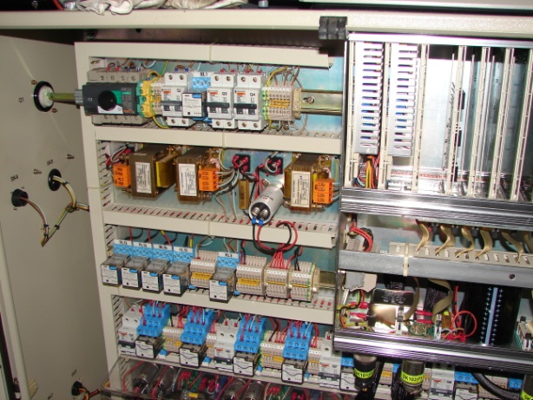
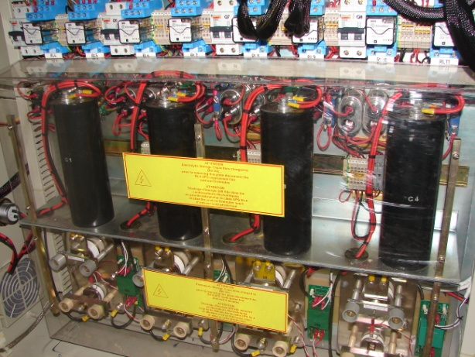
Control Power Electronics: 2 x 0.5m²; < 1m³

Slide 8
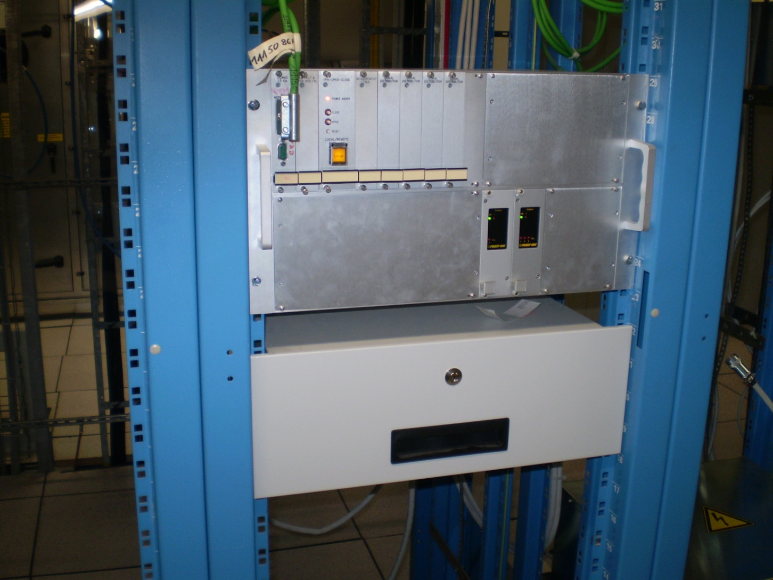
Interface Electronics & Daq&M – 19 inch 6U crate

Slide 9
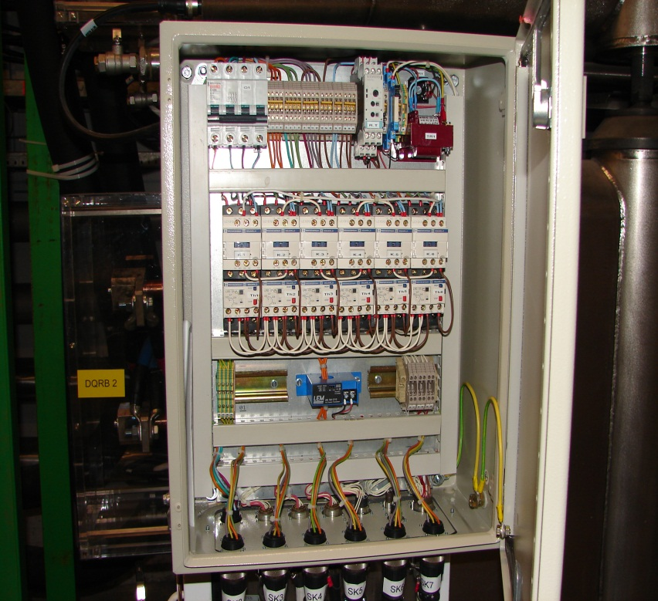
RB Resistor Controls Module
Temperature monitoring,
Ventilation controls and monitoring,

Slide 10
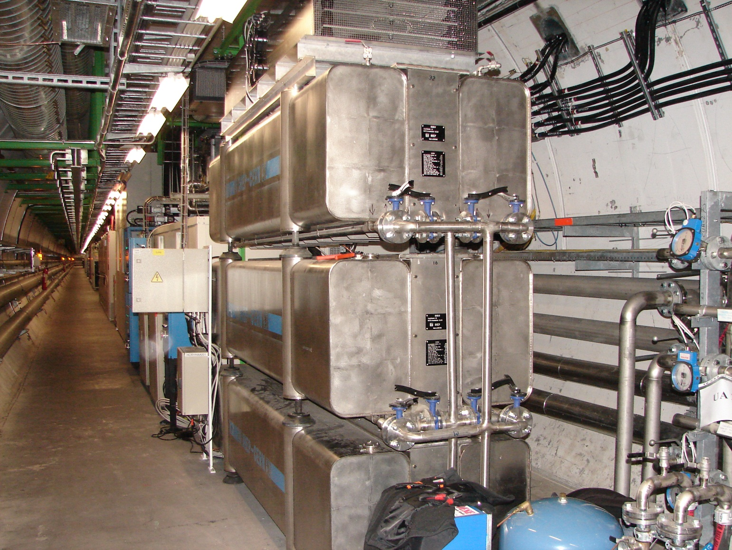
DQRB 1 - DQRB 2 - DQRB 3 oo 6

Slide 11
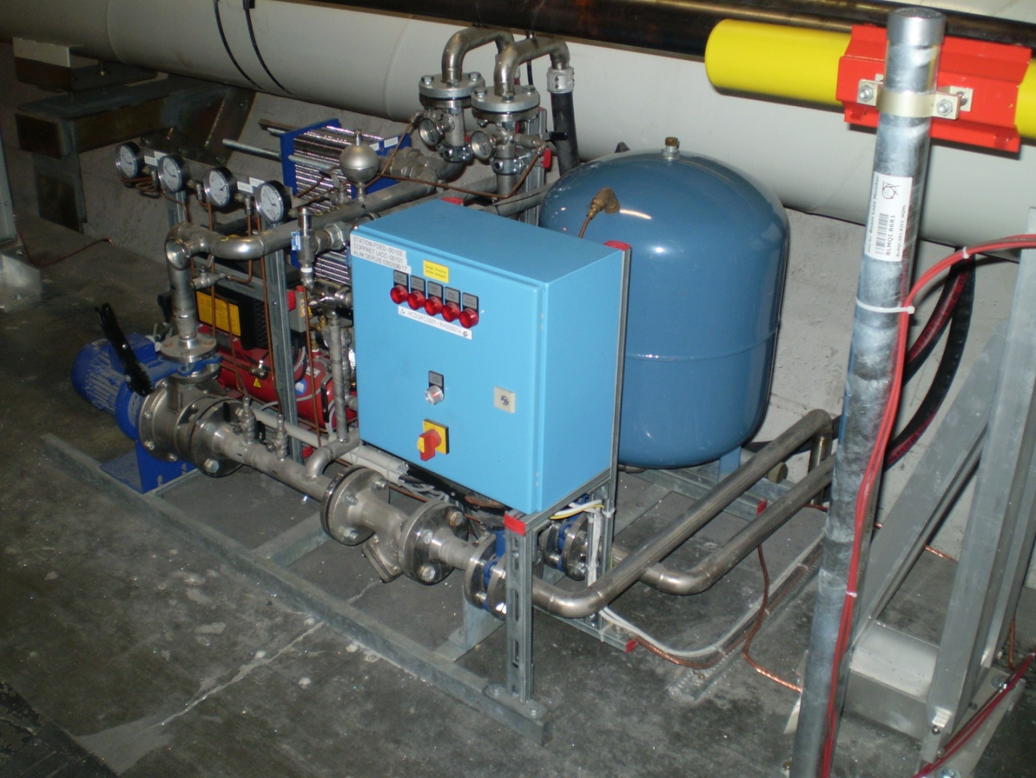
Secondary water cooling system (low pressure)

Slide 12
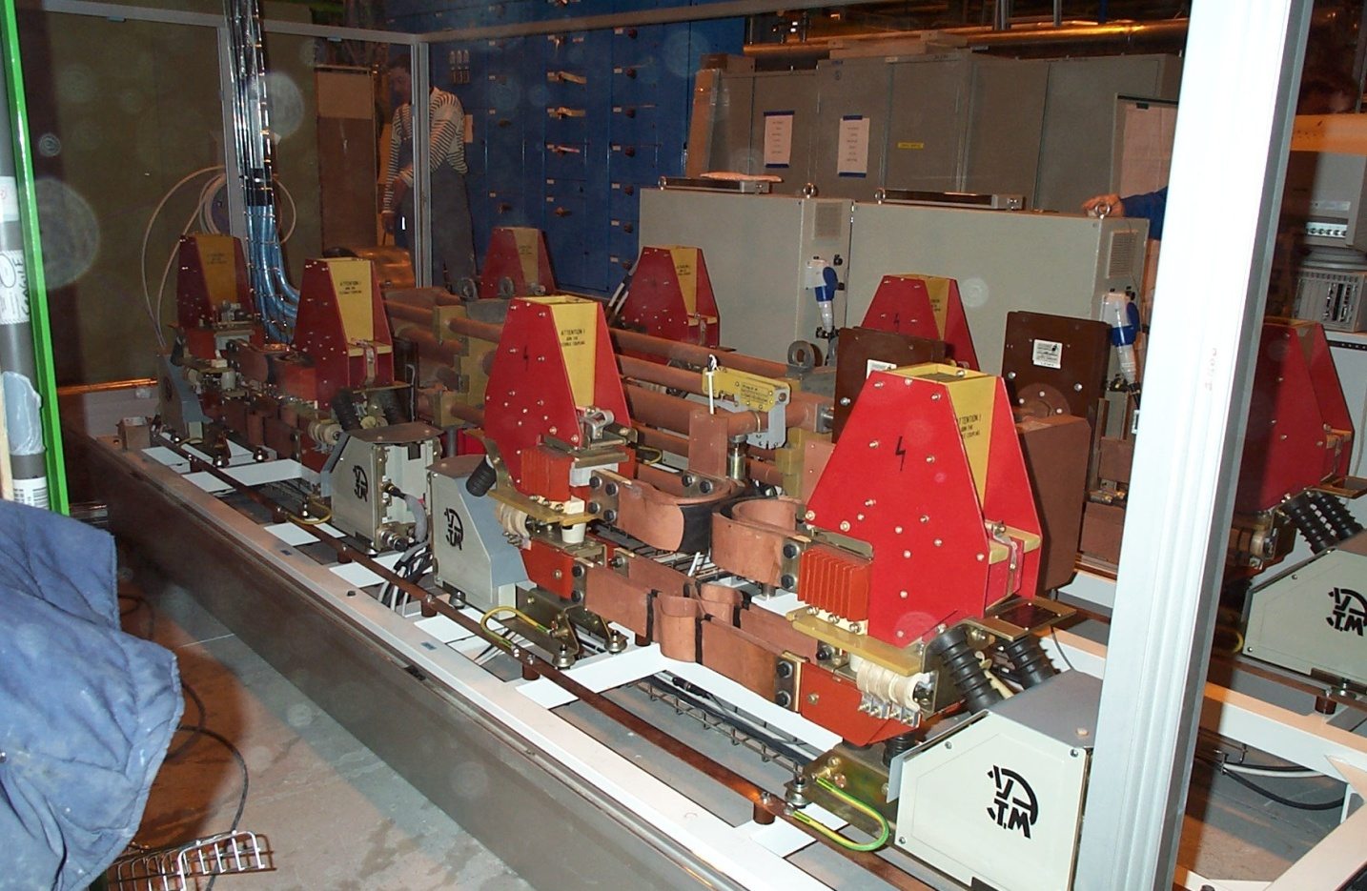
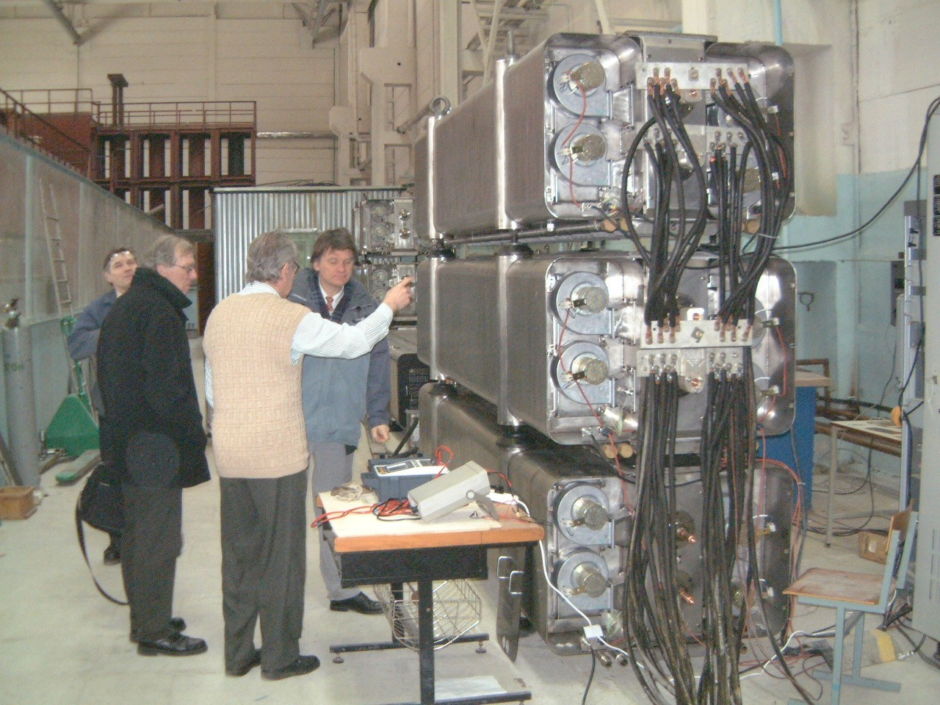
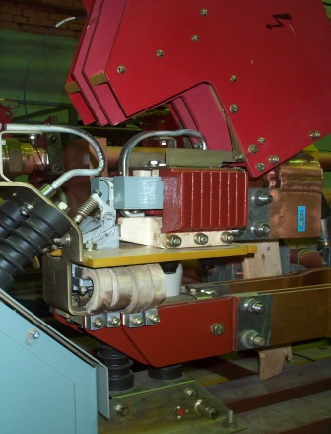
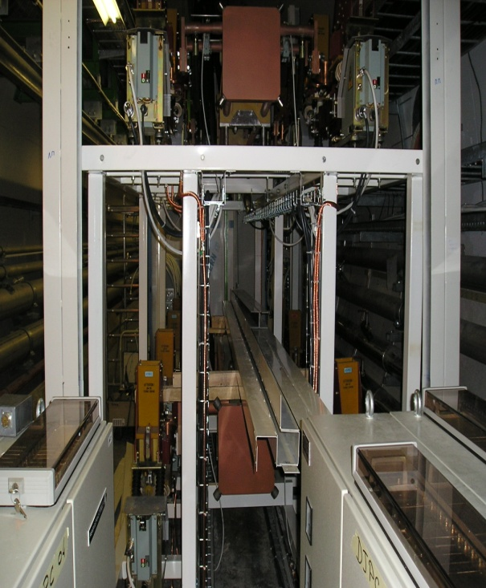
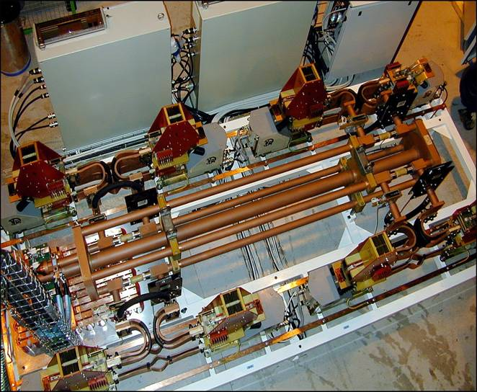
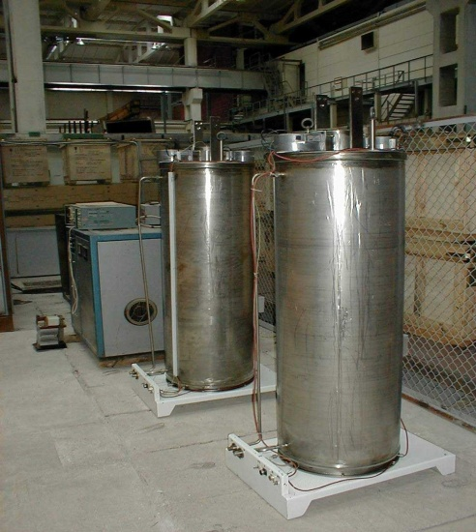
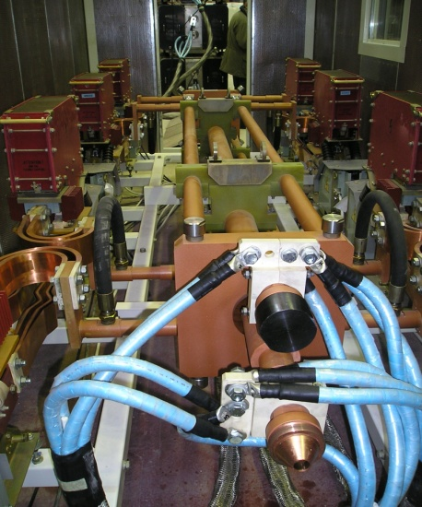
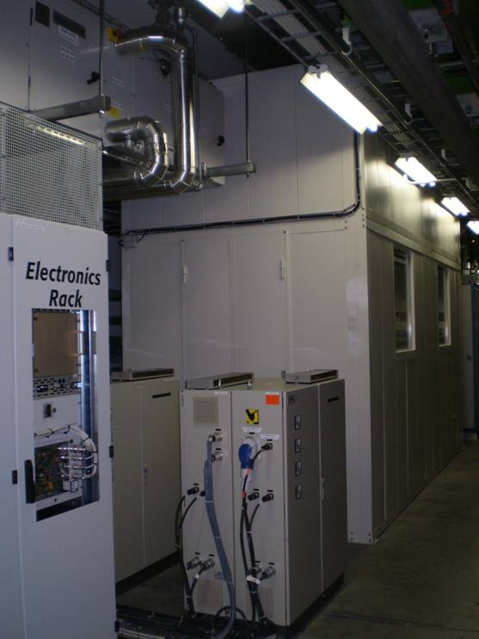
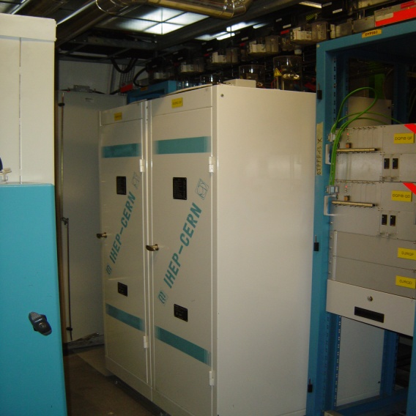
Extraction switch assemblies for the main circuits
VAB49
Dipole DQR’s
Extraction resistors for the main circuits
Quad DQR’s
Distribution bus
Breaker controls modules and sound shield

Slide 13
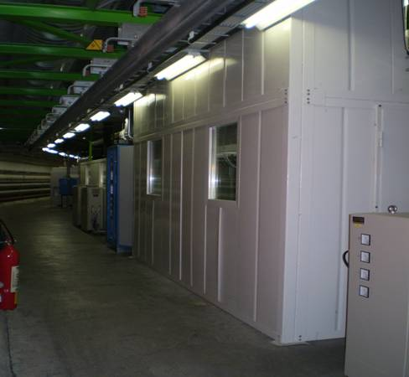
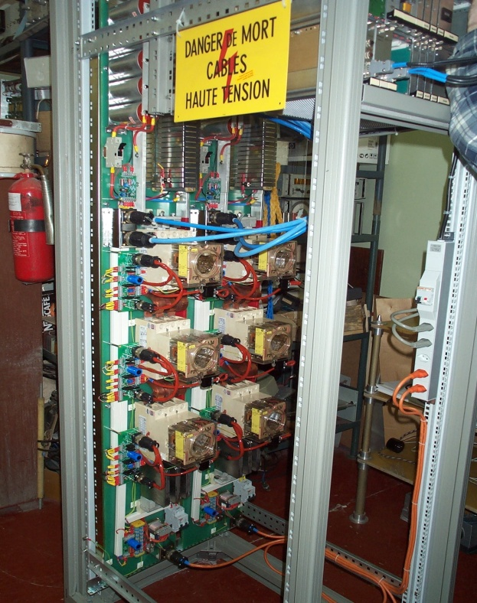
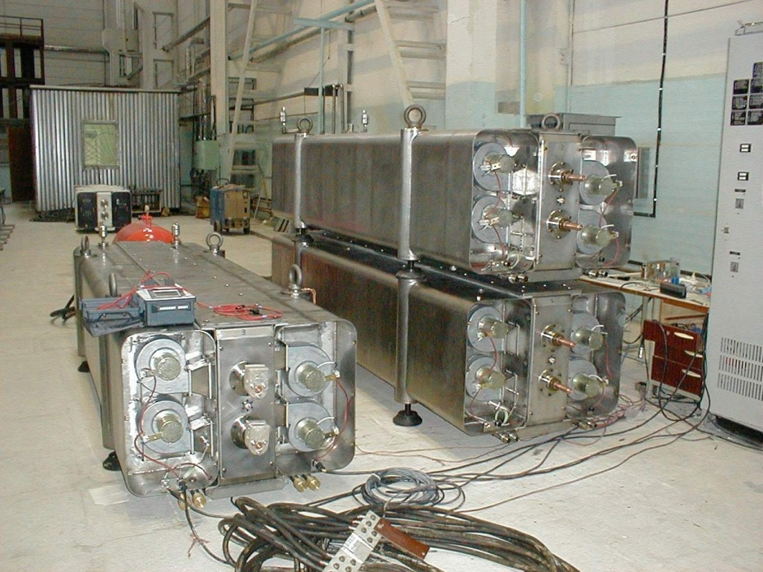
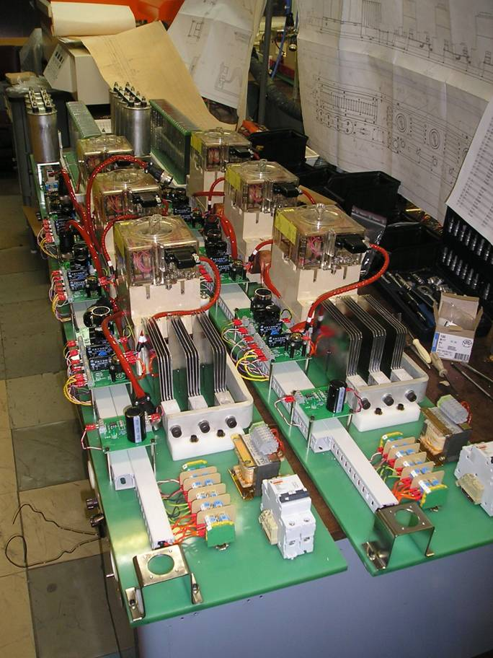
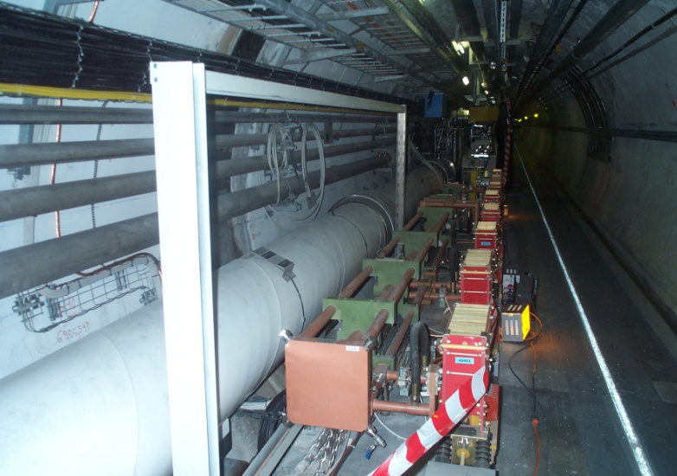
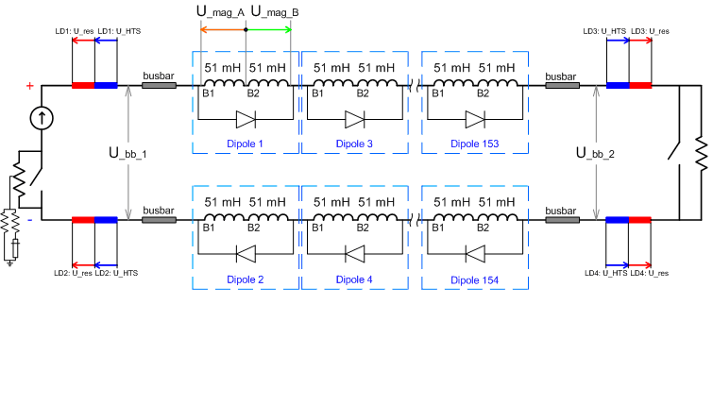
Double-storey enclosure containing DQSQF / DQSQD
Two 600A EE systems in one rack
Three Dipole DQR’s under test at IHEP, Protvino, RU
Extraction switch in point3 ‘long’ version of busway
Two 600A EE systems under test at BINP, Novosibirsk, RU

Slide 14
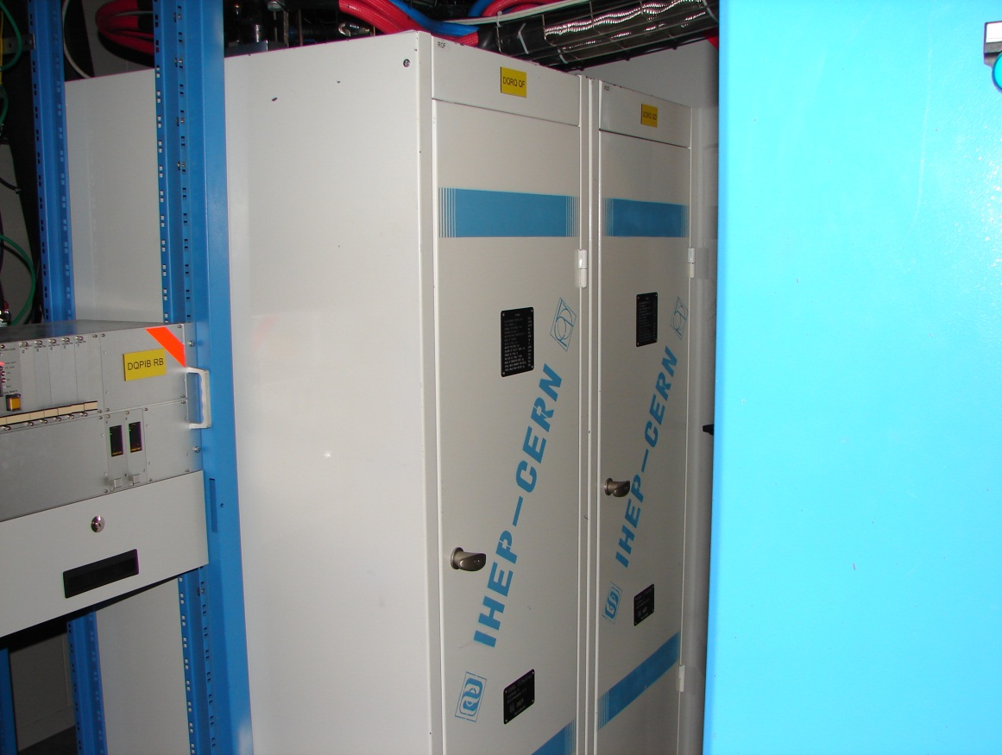
Quadrupole Resistor: < 1 m² < 2m³

Slide 15
Maintenance
Preventive maintenance (9 man-weeks/yr)
  Yearly overhaul and service on breaker contacts and springs.
  Yearly tests on individual systems
    (strong need of specialists (dying species) and expensive)
Corrective maintenance (<1/yr)
  If needed - strong need of specialists (dying species) and extremely expensive (beam dump or start-up delay)**

Slide 16
List of principal Non-Conformities observed during hardware Commissioning and Operation of the LHC 13 kA Energy Extraction Facilities:
Unit / component | Non-Conformity | Origin / Reason | Cure | Follow-up / Consequences
DQRQ quad dump resistor unit | Wrong resistance value (3.4 mΩ instead of 6.6 mΩ) | Transport damage. Choc, breaking insulating parts inside the body | Repair made at CERN after replacement | Problem eliminated Now spare unit Fully conform
DQRQ dump resistor unit | Low insulation resistance to ground | Rusty water dripping from ceiling of UA27. | Cleaned after replacement | Problem eliminated Now spare unit Fully conform
DQRCS cooling station ‘Roese’. | Several alarms from compressor supervision | Regulation out of tolerance | All 16 systems are now supplied by LHC compressed air distr. Local compressor removed | Problem eliminated
DQRB – most LHC points | Wrong voltage measurement | Unknown at the moment | By elimination, still ongoing | Test to be performed during next TS
DQSB with closing problem | Holding coil had internal short circuit | Failure of wire insulation (enamel) | Breaker replaced | Unit awaiting new coil to be delivered
DQSB/DQSQ | Two issues with μ-switches | Lack of sealing by IHEP | Component replaced | Problem eliminated
BCM switch powering module | Spurious opening by slow release RR13 (S81) | Most probably bad contact in ‘holding’ circuit | Occurred twice, disappeared after dismounting / remounting | Stopped beam injection until re-closing

Slide 17
All LHC systems’ circuit breakers
  ARE OBSELETE…
  Any new system means:
  R&D
  More for Semi-Conductor switches
  Less .. (but not negligible) for Electro-Mechanical Breakers
  Design of new systems on «Plug&Play» base for corrective maintenance
  3-5 years before version “0”

Slide 18
Need to know
Does the magnet really need external energy extraction?
(parallel resistors as in corrector circuits)
If so
is crowbar resistor in power converter enough?
(max voltage over power converter during by-pass!)

Slide 19
Need to know
EE design parameters depends on a variety of different requirements
Peak (ultimate) current & bi- or unipolar circuit
Maximum stored energy
Max time to open the switch (from conductive to isolation state) not including quench detection and verification (discrimination) time
Max admissible heat dissipation in a quenching element (and by-pass) before and during switching of the current to the absorber and during the decay (t to open and circuit time constant during EE)
the max admissible circuit voltage to ground at critical points in the circuit
sufficient margin to avoid (or to provoke) quench back
the max allowed cooling time of the absorber body (not only in the shadow of cryo-recovery!!)
impact on the correct function and performance of various other elements in the circuit
Sufficient power converter boost margin to cover semi-conductor switches (if chosen)

