Slide 1

HL-LHC: OUTLOOK ON PROTECTION FOR IR MAGNETS (WP3)
CERN, 23rd April 2015
MPE meeting
E. Todesco
CERN, Geneva Switzerland

Slide 2
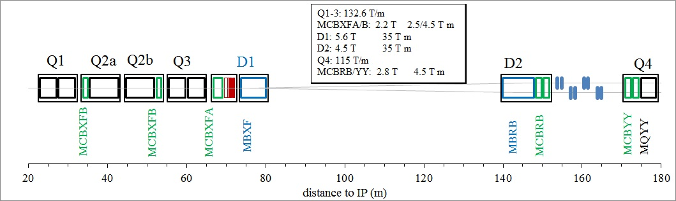
LAY OUT
A lot of information on WP3 web site
  www.cern.ch/hilumi/wp3
  and more … (look on the document page)
    Hilumi book
    Preliminary design report

Slide 3

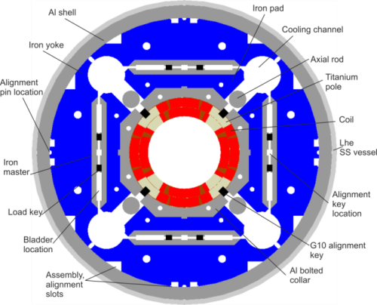
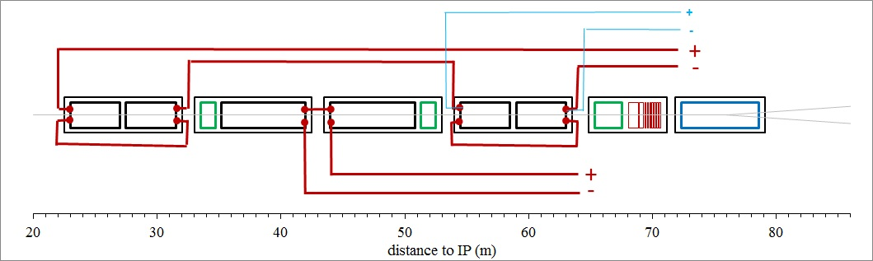
TRIPLET
Nb₃Sn (the only one in WP3), 11.5 T peak field, 7 m long
  Detection:
    Variable thresholds needed (flux jumps at low field) [R. Denz talk 2013]
    100 mV at high field is a must, 10 ms validation time
  Protection: OL quench heaters plus dump resistor
    Plus inner layer heaters and/or CLIQ to create
    redundancy
  Current: 16.5 kA, inductance ∼140/120 mH
  Energy per 7-m-long magnet is 8 MJ
  Presently two magnet in series
    Then some trims required

Slide 4

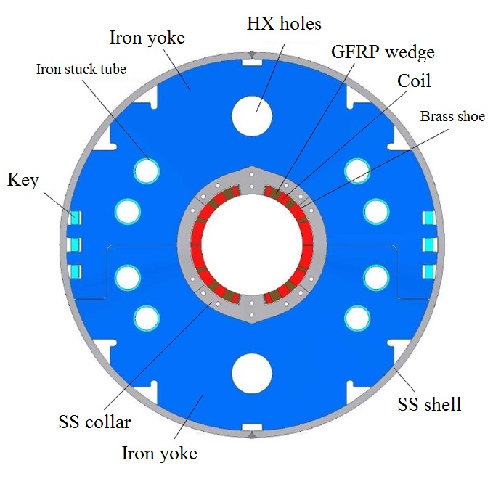
SEPARATION DIPOLE D1 (MBXF)
Nb-Ti, 5.6 T operational field, 6.2 m
  LHC dipole outer layer cable
  Detection: as in the LHC
  Protection: quench heaters (previous baseline of extraction is too expensive)
  Current: 11.8 kA, inductance ∼25 mH
    Energy per magnet is ∼2 MJ

Slide 5
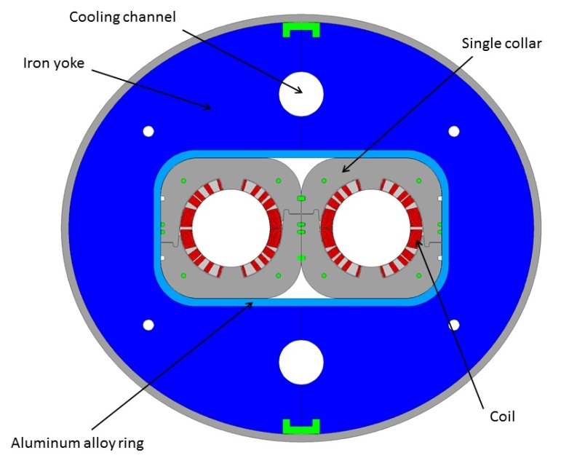

RECOMBINATION DIPOLE D2 (MBRD)
Nb-Ti, 4.5 T operational field, 7.8 m
  (two apertures in series)
  LHC dipole outer layer cable
  Detection: as in the LHC
  Protection: quench heaters
  Current: 12 kA, inductance ∼27 mH
      Energy per magnet is ∼ 2 MJ
To save on power converters we are exploring the possibility of having D1 and D2 in series
  2 M saved ! But is it possible for protection ? Two different magnet in series is a prima, I think

Slide 6
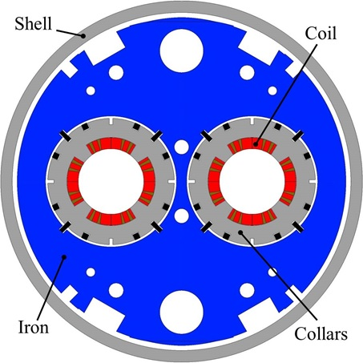

TWO IN ONE APERTURE Q4 (MQYY)
Nb-Ti, 6 T peak field, 3.8 m
  (two apertures independently powered)
  LHC dipole outer layer cable
  Detection: as in the LHC
  Protection: quench heaters
    previous baseline of extraction is too expensive
  Current: 15.6 kA, inductance ∼3 mH
    Very low inductance
  Energy per magnet (two apertures) is 0.7 MJ
Possibility of having the apertures in series
  Plus a trim to reduce PC costs

Slide 7
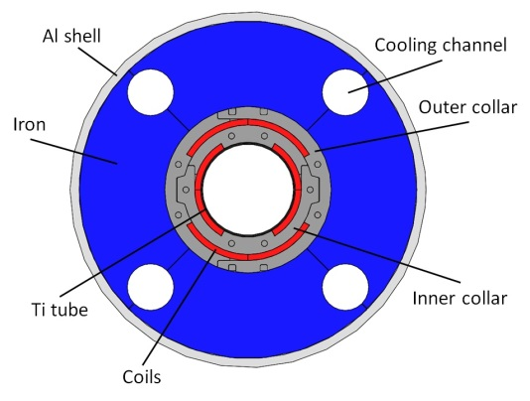

ORBIT CORRECTORS (MCBXFA MCBXFB)
Nb-Ti, nested, 2.1 T field in each plane, 2/1 m
  Each plane independently powered
  Cable used for corrector of S LHC (18 MQM strands)
  Detection: I imagine as in the LHC
    Problems related to nested ?
  Protection: quench heaters
  Current: 1.5 kA, inductance 20 to 50 mH
  Energy in 2-m-long magnet is 0.2 MJ

Slide 8
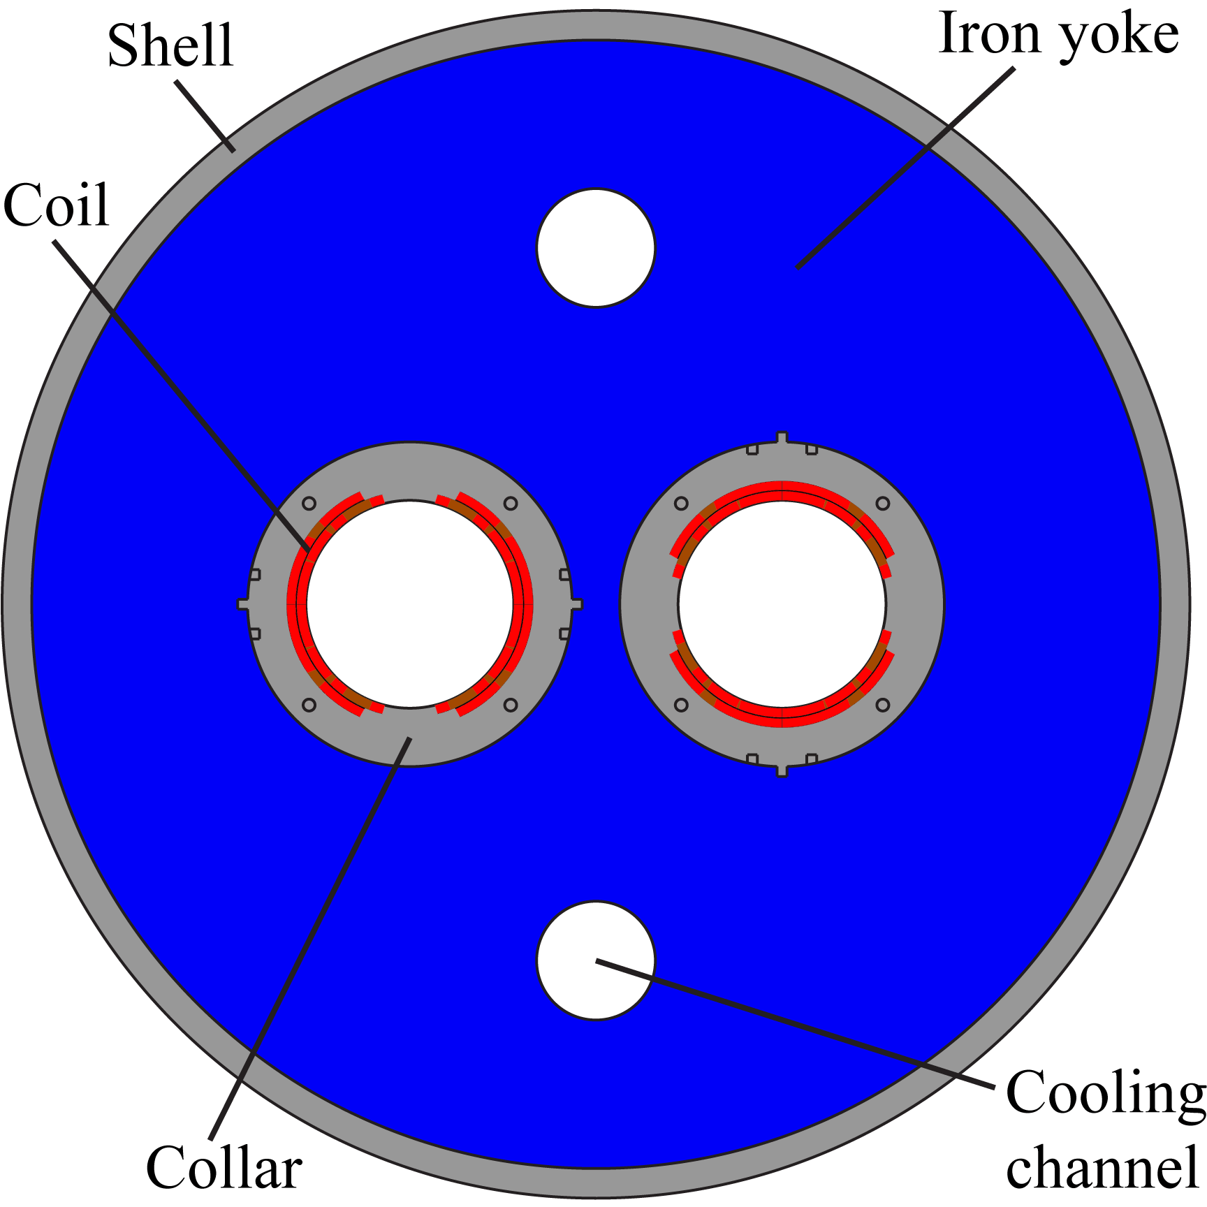
D2 ORBIT CORRECTORS (MCBRD)
Nb-Ti, 2.8 T field, 1.6 m
  Each aperture independently powered
  Cable used for corrector of S LHC (18 MQM strands)
  Detection and protection: as in the single aperture orbit correctors, but without the complication given by nested
  Protection: quench heaters
  Current: 1.5 kA, inductance 50 mH

Slide 9
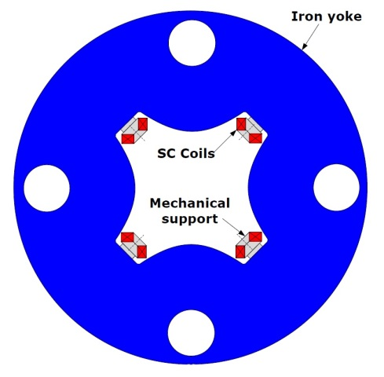
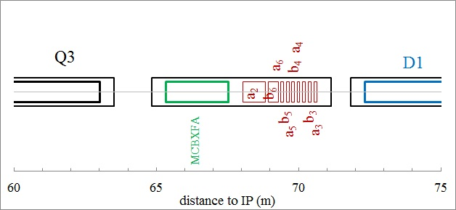

HIGH ORDER CORRECTORS
Nb-Ti superferric, 3 T peak field, 0.8 m
  Coils made with a strand
  Protection: dump is the baseline
    Not included in the budget (I guess)
    Other ways of protection ?
  Current: 0.18 kA, inductance 1200 mH

Slide 10
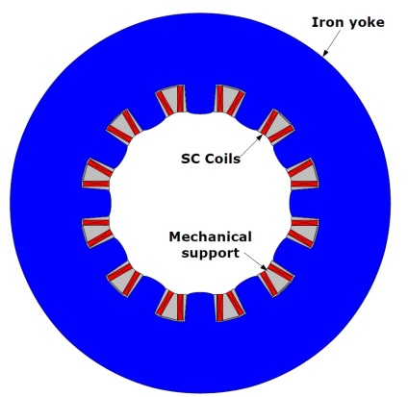
HIGH ORDER CORRECTORS
Nb-Ti superferric, 2 T peak field, ∼0.5 m
  Coils made with a strand
  Protection: dump is the baseline
    Not included in the budget (I guess)
    Other ways of protection ?
  Current: 0.17 kA, inductance 230 mH

Slide 11
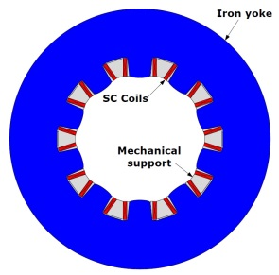
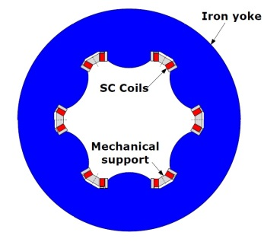
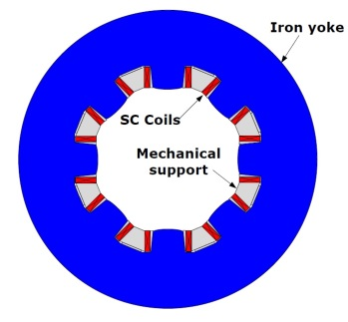
HIGH ORDER CORRECTORS
Nb-Ti superferric, 2 T peak field, ∼0.1 m
  Coils made with a strand
  Protection: dump is the baseline
    Not included in the budget (I guess)
    Other ways of protection ?
  Current: 0.12-0.16 kA, inductance 50-150 mH

Slide 12
SUMMARY
Triplet is the big challenge
  Variable threshold needed
  IL heaters needed, or CLIQ
Main magnets in Nb-Ti protected with heaters
  CLIQ as interesting alternative
  Change of baseline after budget review and feed from Daniel
Orbit correctors protected with heaters
Nonlinear correctors with extraction
  Can we avoid this?

