Slide 1


Single Aperture Orbit Corrector:
Progress on MCBXFB design
WP3 Meeting
June, 2nd 2015
J. García, F. Toral (CIEMAT)
P. Fessia (CERN)

Slide 2
Index
Requirements & specifications.
Summary last WP3 meeting (January 2015).
Magnetic design & field quality.
Detailed mechanical design & assembly tests.
Conclusions & Planning.

Slide 3
Requirements & specifications

Slide 4
MCBXFB orbit corrector requirements
Technical specifications
Magnet configuration | Combined dipole (Operation in X-Y square)
Minimum free aperture | 150 mm
Working temperature | 1.9 K
Working point | < 65%
Nominal current | < 2500 A
Iron geometry | MQXF iron holes
Field quality | < 10 units (1E-4)
Fringe field | < 40 mT (Out of the Cryostat)
Integrated field | 2.5 Tm
Physical length | < 1.505 m
Vertical dipole field
Combined
dipole field
(Variable orientation)
Horizontal
dipole field
Magnetic length | 1.2 m
Baseline field for each dipole | 2.1 T

Slide 5
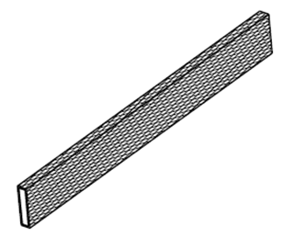
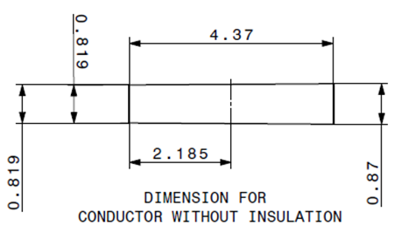
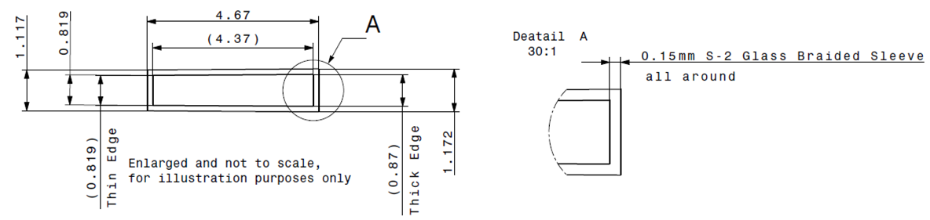
Strand & Rutherford Cable
Strand parameters
Cu:Sc | 1.75
Strand diameter | 0.48 mm
Metal section | 0.181 mm²
Nº of filaments | 2300
Filament diam. | 6.0 µm
I(5T,4.2K) | 200-210 A
Jc | 2800-3300 A/mm²
Cable parameters
No of strands | 18
Metal area | 3.257 mm²
Cable thickness | 0.845 mm
Cable width | 4.370 mm
Cable area | 3.692 mm²
Metal fraction | 0.882
Key-stone angle | 0.67 deg
Inner Thickness | 0.819 mm
Outer Thickness | 0.870 mm
Insulation: Fibre glass sleeve
Easier magnet assembly than using polyimide tape.
Need validation test of a suitable binder (double layer coil).
0.135 mm (real measurement)

Slide 6
Summary last WP3 meeting (January 2015)

Slide 7
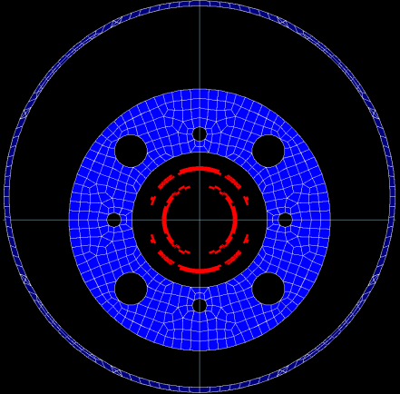
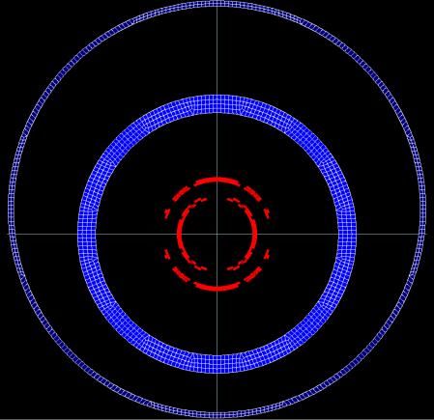
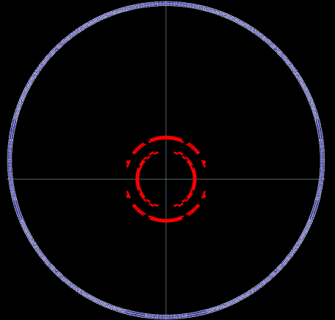
Due to the sextupoles variation with the current, several iron geometries were tested in order to evaluate the problem and minimize this effect.
The difficulty comes because the field changes in two ways depending on the powering scenario: Orientation and intensity.
Finally, we had to choose between:
  High fringe field or…
  High variation of the multipoles with the current (when magnetic materials become saturated).
Taken this into account whole iron option was chosen despite the worse field quality. Currently under evaluation by the beam dynamics group.

Slide 8
Since then…
A refined magnetic design has been calculated, including coil ends keeping the thickness of the collars.
A field quality study has been performed for the beam dynamics groups (WP2).
Mechanical detailed design has been performed at the collars, testing all stages of the assembly process.

Slide 9
Magnetic design & field quality

Slide 10
Cross section
Inner dipole (ID) & Outer dipole (OD) parameters | Units | ID | OD
Nominal field 100% (ID) | T | 2.11 | 2.23 *
Nominal Field (Modulus, 100% ID & 100% OD) | T | 3.07
Nominal current | A | 1600 | 1470
Coil peak field (Modulus, 100% ID & 100% OD) | T | 4.13 (ID)
Working point (Modulus, 100% ID & 100% OD) | % | 50.1
Inductance/m | mH/m | 46.77 | 99.1
Stored energy/m | KJ/m | 59.87 | 107
Torque | Nm/m | 120000
Aperture | mm | 156.2 | 230
Iron yoke Inner Diam. | mm | 316
Iron yoke Outer Diam. | mm | 614
Max fringe field, 20 mm out of the cryostat (Modulus, 100% ID + 100% OD) | mT | 29
Number of conductors (1st quadrant) | - | 139 |  | 187
* Higher field necessary to compensate the longer coil end at the outer dipole.

Slide 11
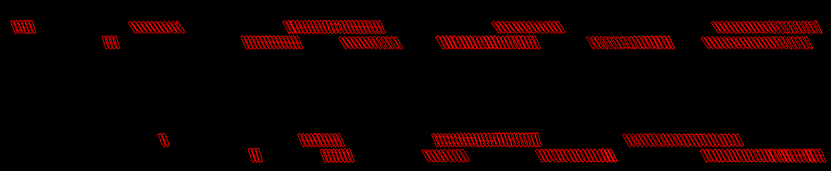
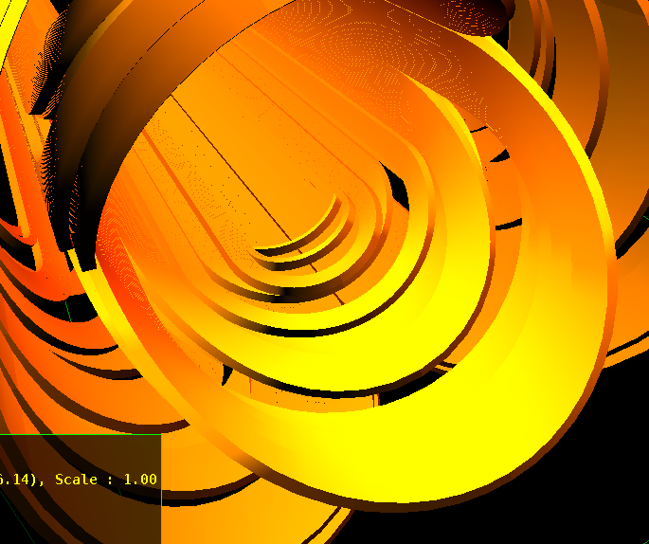
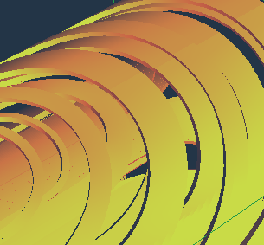
Coil ends
260 mm long (50 mm less at Inner Dipole)
Some additional end spacers to ease manufacturing: de-keystoning, dimension accuracy...

Slide 12
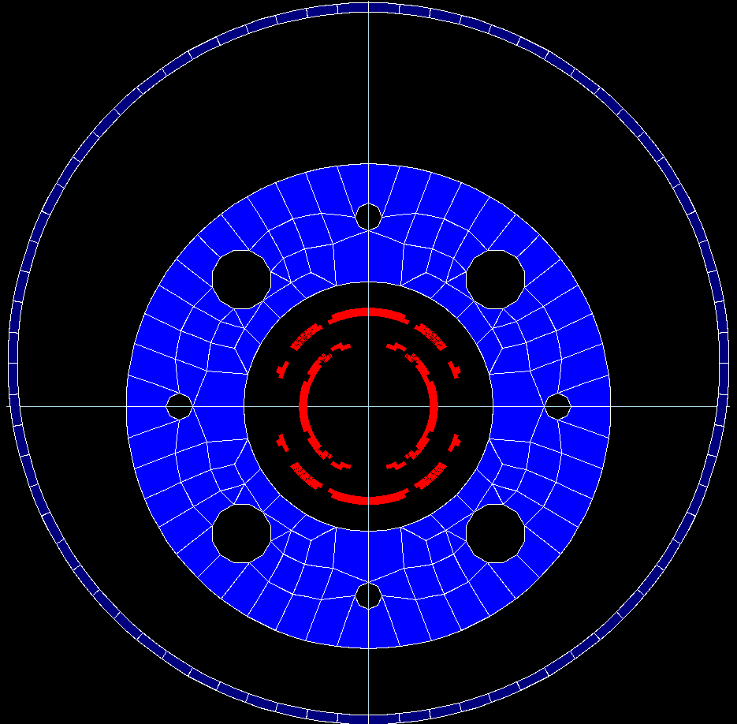
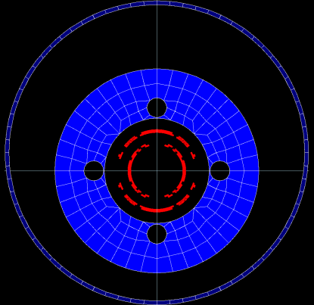
Integrated field quality at I_{N}, both dipoles powered simultaneously
Field quality achieved, except for the sextupole variation caused by iron saturation.
Results below corresponding to I_{N} on both dipoles, iron & cryostat included.
Same cross section and coil ends in both magnets.
MCBXFB
Inner Dipole (ID) & Outer Dipole (OD) parameters | Units | MCBXFB (Short Magnet) | MCBXFA (Long Magnet)
Inner dipole current | A | 1600 | 1525
Integrated field B1 (ID) | T | 2.49 | 4.5
Integrated b3 | units | 17.37 | -16.65
Integrated b5 | units | 2.49 | -0.35
Integrated b7 | units | 0.62 | 0.98
Integrated b9 | units | -0.75 | 0.07
Integrated b11 | units | 3.6 | 4.3
Outer dipole current | A | 1470 | 1395
Integrated field A1 (OD) | T | 2.52 | 4.54
Integrated a3 | units | -10.33 | 20.12
Integrated a5 | units | -3.6 | -3.04
Integrated a7 | units | -3.26 | -3.98
Integrated a9 | units | -0.58 | -0.62
Integrated a11 | units | 0.12 | 0.02
MCBXFA

Slide 13
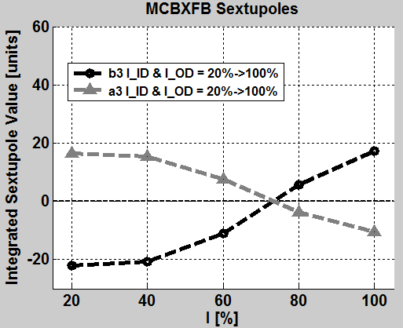
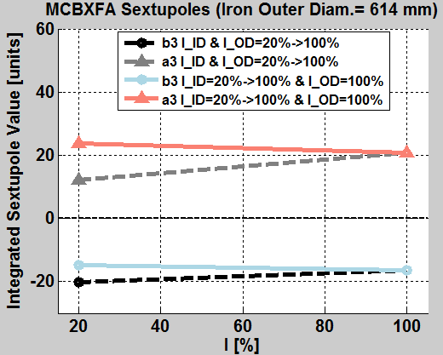
Integrated sextupole variation with the current
It is not possible to centre the sextupole variation simultaneously on both magnets with the same cross section and coil ends.
Shifting a MCBXFB sextupole moves that sextupole in the same direction for MCBXFA.

Slide 14
Detailed mechanical design & assembly tests

Slide 15
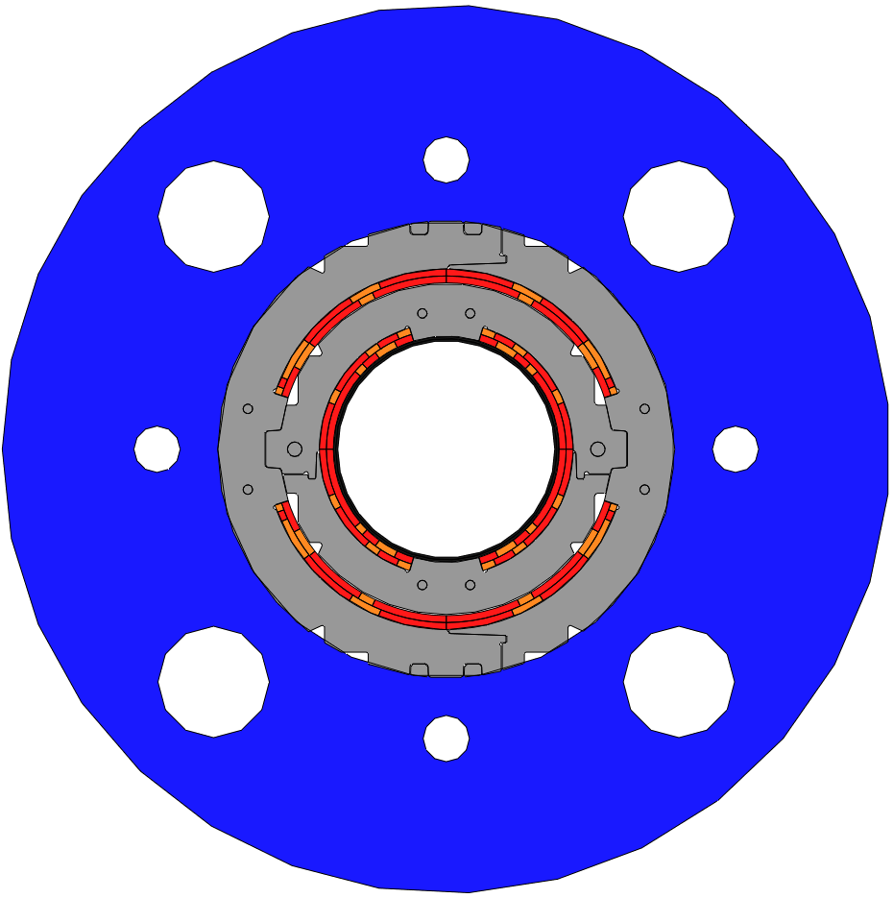
Cooling channel
Wedges
Outer collar
Iron
Ti tube
Coil blocks
Inner collar

Slide 16
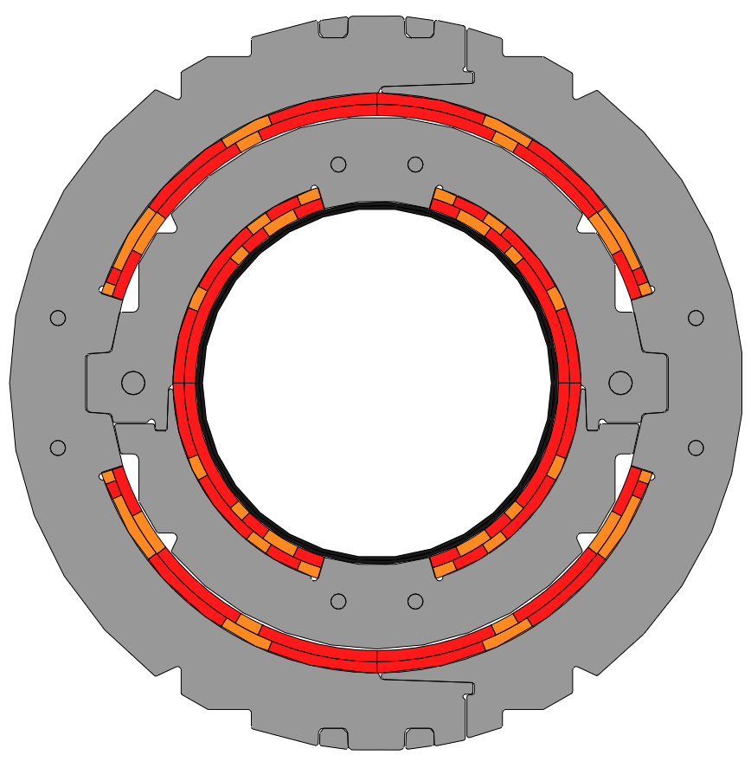
Self-supporting collars
Inner collar outer diameter = 230 mm (Thickness = 27 mm)
Outer collar outer diameter = 316 mm (Thickness = 33 mm)
1
Handling supports
Outer Keys
Rivets
3
Interference
Inner keys
2
Torque locking
Torque locking
4
Titanium tube
Press supports

Slide 17
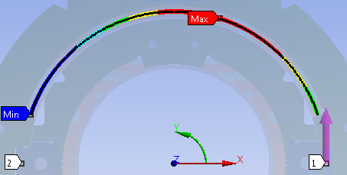
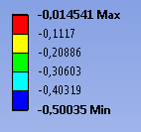
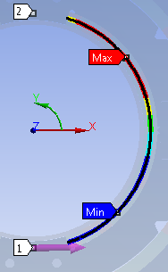
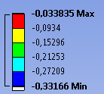
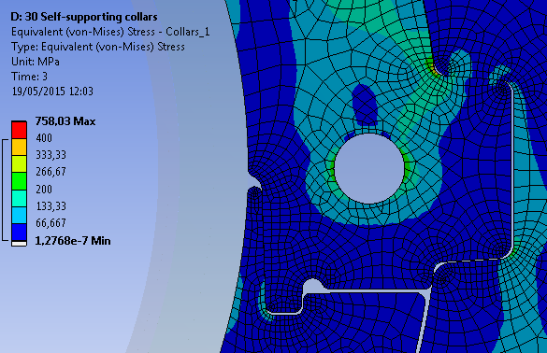
Results (108 % I_{N})
Outer
dipole
Inner
dipole
1
Looking at the difference between maximum and minimum radial deformation at the coils:
Inner dipole: 0,3 mm -> 0,36% of the diameter
Outer dipole: 0,49 mm -> 0,42% of the diameter
Successful torque locking
2

Slide 18
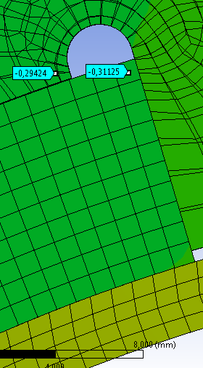
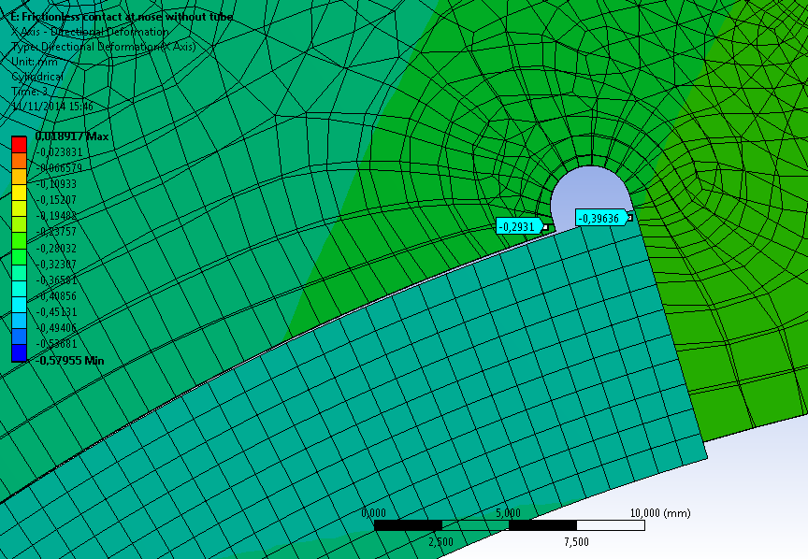
Results (108 % I_{N}): Radial inward forces at inner dipole
With Tube VS Without tube
4
Inner titanium tube
(low contraction factor):
Decrease radial inward movement of the coil.
Prevention of sudden slipping movements that could trigger a quench.
Still under discussion if it is necessary for the final assembly.
Frictionless contact
between coil and collar nose
(worst possible scenario)

Slide 19
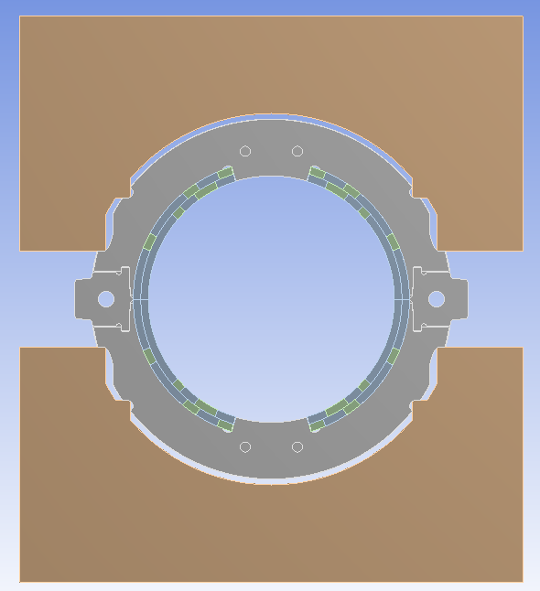
Assembly tests
Things to be checked:
Stress concentration at filet radii.
Maximum stress over the coils depending on press support location.
Feasibility of the assembly looking at clearances and tolerances needed.

Slide 20
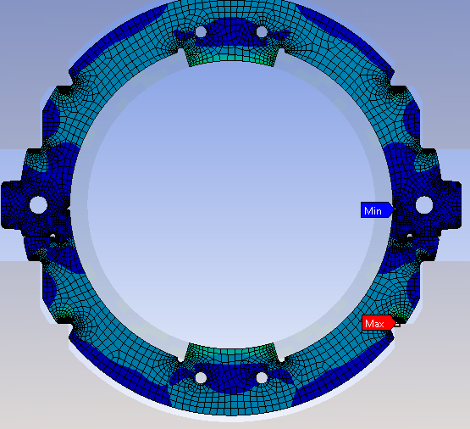
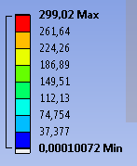
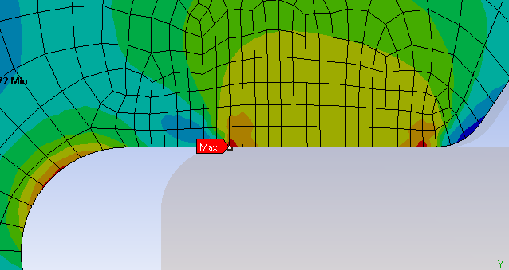
Inner dipole collaring (Collars)
First calculations suggests that inner dipole collaring process will require:
MCBXFB -> 450 ton
MCBXFA -> 800 ton.
Max (Von-misses) Stress= 300 Mpa
Probably due to numeric error

Slide 21
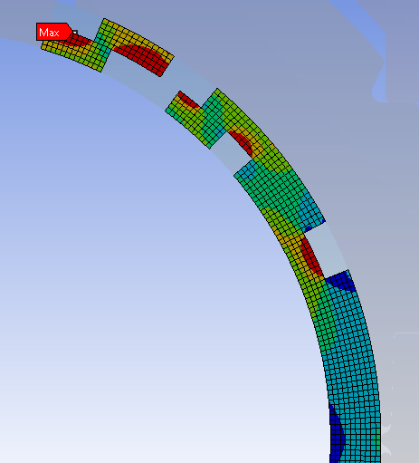
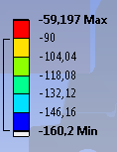
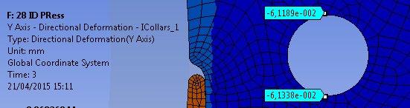
Inner dipole collaring (Coils)
For 0,12 mm play
Max azimuthal Stress= 160 Mpa

Slide 22
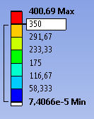
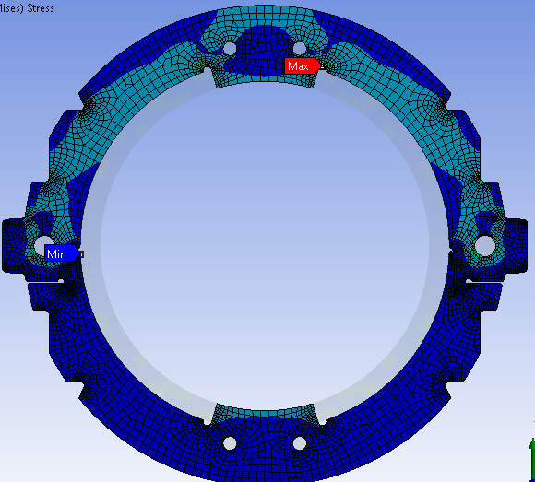
Inner dipole spring back (Collars)
Fillet radius [mm] = Ø4 Ø3
Max (Von-misses) Stress [MPa] = 400 MPa 460 Mpa

Slide 23
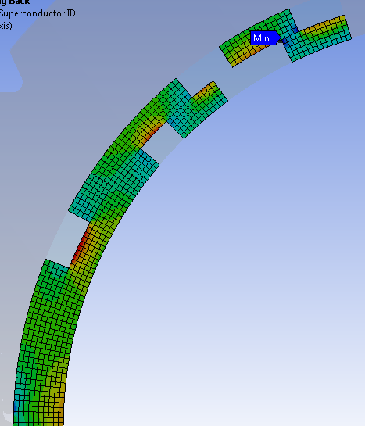
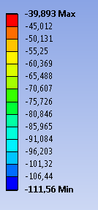
Inner dipole spring back (Coils)
Max azimuthal Stress= 112 Mpa

Slide 24
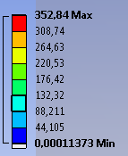
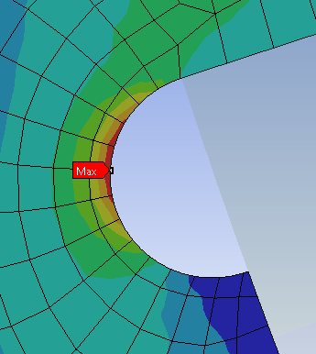
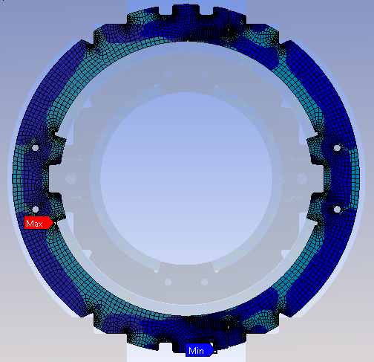
Outer dipole collaring (Collars)
Fillet radius [mm] = Ø4 Ø3
Max (Von-misses) Stress [MPa] = 353 MPa 400 Mpa

Slide 25
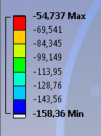
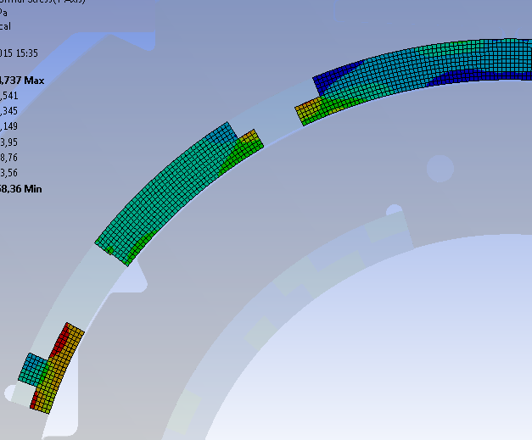
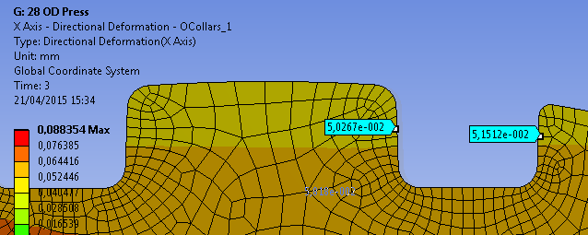
Outer dipole collaring (Coils)
For 0,1 mm play
Max azimuthal Stress= 158 Mpa

Slide 26
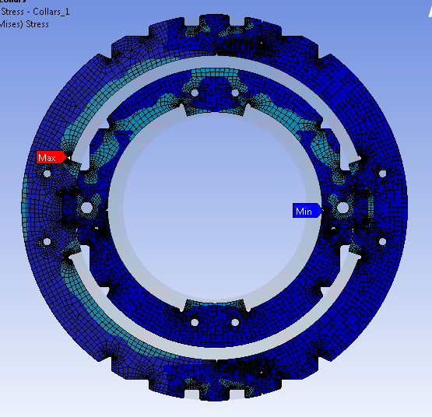
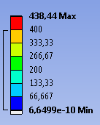
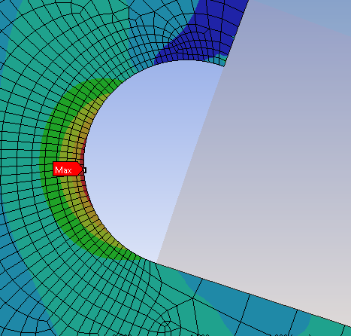
Outer dipole spring back (Collars)
Fillet radius [mm] = Ø4 Ø3
Max (Von-misses) Stress [MPa] = 440 MPa 500 Mpa

Slide 27
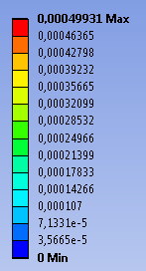
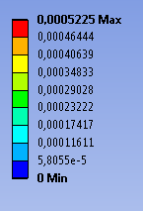
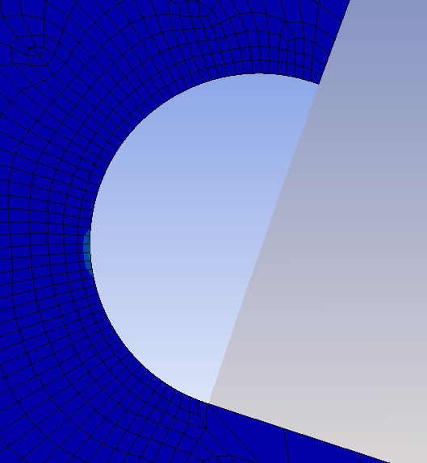
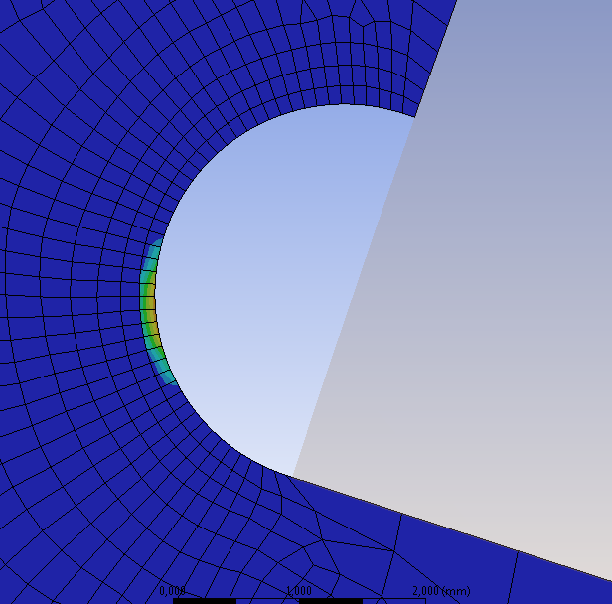
Outer dipole spring back (Collars)
Plastic behaviour was simulated for this case (with subsequent cooling and powering) without major changes in the assembly deformations.
Equivalent plastic strain (mm/mm)
Ø4
Ø3

Slide 28
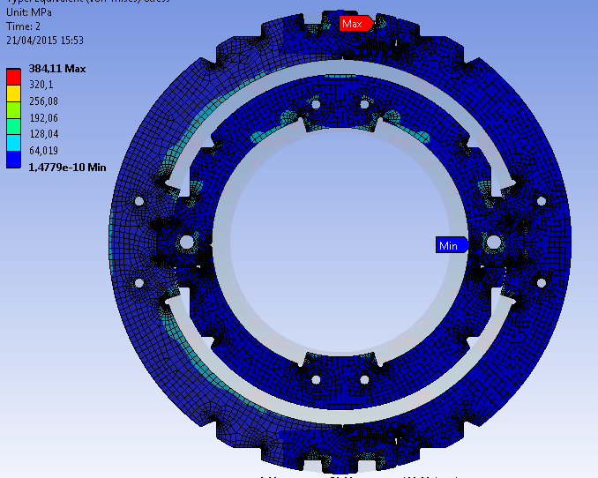
Cooldown (Collars)
Max (Von-misses) Stress= 384 Mpa

Slide 29
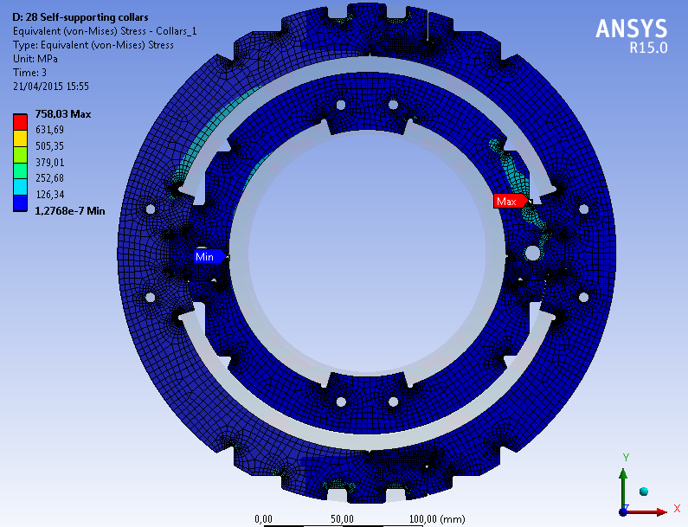
Powering to 108% I_{N} (Collars)
Max (Von-misses) Stress= 758 Mpa
Only 110 MPa of azimuthal compression at coils

Slide 30
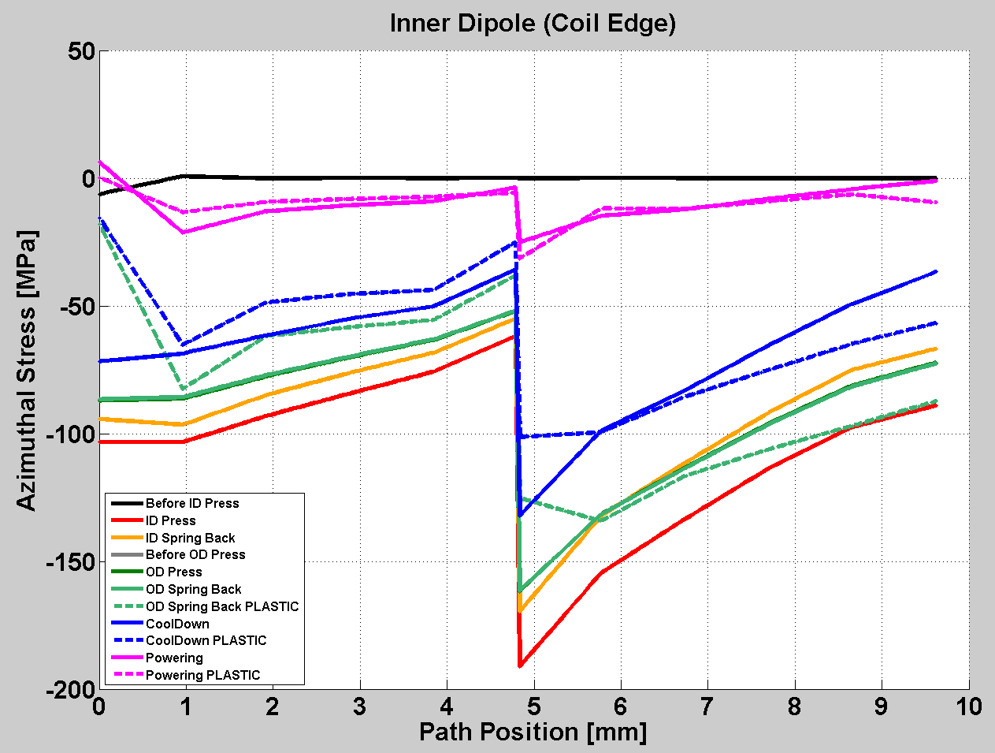
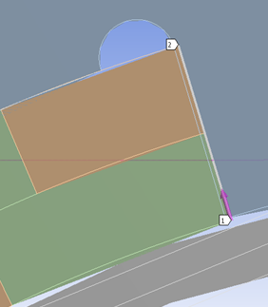
Azimuthal pressure at coil edges (Inner Dipole)
Interference at coil/collar nose interface keep
the coils stuck to the collars in both dipoles at every scenario
3

Slide 31


Azimuthal pressure at coil edges (Outer Dipole)
Interference at coil/collar nose interface keep
the coils stuck to the collars in both dipoles at every scenario
3

Slide 32


Assembly gaps evolution
A
G
B
I
H
Inner collars play = 0,12 mm
Outer collars play = 0,1 mm
All values in mm
C
J
F
D
Gap | Original gap | ID Press | ID Spring Back | Before OD Press | OD Press | OD Spring back | Cool- down | 108% Power.
A | 0,2 | - | - | opens | 0,13 | opens | opens | 0,08
B | 0,1 | - | - | opens | 0,08 | 0,08 | 0,085 | contact
C | 0,5 | - | - | opens | 0,47 | opens | opens | 0,4
D | 0,55 | 0,42 | opens | opens | opens | opens | opens | opens
E | 0,3 | 0,18 | opens | opens | opens | opens | opens | opens
F | 0,03 | ≅0,03 | contact | contact | contact | contact | contact | contact
G | 0,7 | - | - | opens | 0,55 | opens | opens | opens
H | 0,6 | - | - | opens | 0,45 | opens | opens | opens
I | 0,03 | - | - | contact | contact | contact | contact | contact
J | 0,5 | - | - | 0,43 | 0,47 | 0,46 | 0,465 | opens
E

Slide 33

Torque at the coil ends
Collars extended till the last sector of the central post (first end spacer).
Additional support could be necessary.

Slide 34
Conclusions & planning

Slide 35
Conclusions
Main design challenges:
  Large aperture.
  Magnetic field quality under different coil powering schemes.
  Hard-radiation resistant torque clamping.
Final conceptual design:
  Double layer cosine-theta magnet.
  Sextupole variation with current is unavoidable: under study by beam dynamics group.
  Mechanical clamping by means of self-supported collars. Possibly additional support will be needed at coil ends.
  No quench heaters required.
Detailed design:
  Mechanical analysis of the collars to assure assembly feasibility and admissible stresses at all stages.
  Magnetic analysis: real thickness of the cable, connection side coil ends.
  Quench simulations with improved cable model.

Slide 36
Planning
Design | Detailed mechanical calculations | Jul-15
 | Short mechanical model | Oct-15
 | Fabrication drawings | Dec-15
Fabrication | Cable MCBXB H+V delivered (4+4 unit lengths) | Jun-15
 | First winding test | Oct-15
 | Cured coils | Nov-16
Test | Magnet prototype in vertical cryostat | Dec-16

Slide 37
Thanks for your attention

Slide 38
Annexes

Slide 39
Single layer & Double layer designs VS old MCBX (same central field comparison)
Inner coil (ID) & Outer Coil (OD) parameters | Units | Single layer design | Double Layer design (Small Collars) | Double Layer design (Large Collars) | Old MCBX (Series Model, both coils powered )
Nominal field 100% (ID) | T | 2.13 | 2.13 | 2.13 | 2.13
Nominal field 10% (ID) | T | 0.214 | 0.214 | 0.218 | 0.2156
Non-linearity (ID) [B_{100%}-10∙B_{10%}]/10∙B_{10%}∙100] | % | -0.47% | -0.61% | -2.29% | -1.2%
Nominal field 100% (OD) | T | 2.11 | 2.12 | 2.12 | 2.12
Nominal field 10% (OD) | T | 0.212 | 0.2154 | 0.219 | 0.2156
Non-linearity () [B_{100%}-10∙B_{10%}]/10∙B_{10%}∙100] | % | -0.47% | -1.58% | -3.2% | -1.67%
Nominal current (ID) | A | 2450 | 1250 | 1560 | 362.5x8=2900
Nominal current (OD) | A | 2150 | 1036 | 1340 | 331.25x8=2650
Coil peak field | T | 4.27 | 3.95 | 3.93 | 3.817
Working point | % | 60% | 44.7% | 48.1% | 39.54%
Torque using Roxie Forces | 10⁵ Nm/m | 0.92 | 0.98 | 1.19 | -0.455
Torque using Analytical Equation | 10⁵ Nm/m | 0.93 | 1.03 | 1.13 | 0.45
Difference Roxie vs Analytical Eq. | % | +1.68% | +4.13% | -4.72% | -1.1%
Conductors height (h) | mm | 4.37 | 2x4.37 | 2x4.37 | 13.2 (8)
Mean radius (ID) | m | 0.0775 | 0.08 | 0.0825 | 0.0518
Mean stress at the coil and collar nose interface | MPa | 135 | 70 | 82 | 38
Aperture (ID) | mm | Ø150 | Ø150 | Ø156,2 | Ø90
Aperture (OD) | mm | Ø180 | Ø200 | Ø218 | Ø116.8
Iron yoke Inner Diam. | mm | Ø230 | Ø250 | Ø300 | Ø180
Iron yoke Outer Diam. | mm | Ø540 | Ø540 | Ø610 | Ø330
Number of conductors used (1st quad) | - | 162 | 357 | 324 | 800

Slide 40
Considerations on a MCBXFB design based on a canted cosine-theta coil configuration
Comparing the main challenges in the case of MCBXFB design for both designs:
  The torque between nested dipoles:
    It will be the same for both designs.
  The separation of the pole turn from the collar nose due to the Lorentz forces:
    It does not happen in the CCT dipole (azimuthal forces support).
    In the pure cosine-theta it can be overcome with a small interference between the collar nose and the pole turn of the coil.
  The elliptical deformation of the support structure under Lorentz forces:
    In a CCT dipole the outer formers should hold the outwards radial forces coming from the inner layers, which complicates significantly the assembly and fabrication.
    The assembly of two nested collared coils is not easy, but seems more affordable.
The CCT configuration has not been broadly used up to now, so other open questions are:
  The handling of the axial repulsive forces between layers.
  The influence of the cable positioning accuracy on the field quality.
  The training of a large and high field superconducting dipole.
  The protection of the magnet in case of quench.
  Formers materials to be used (insulation, stiffness and easily machining required).
  Coils impregnation.

Slide 41
Mechanical design: Challenges to face
As a combined dipole that requires a square range of operation in X and Y axis, a large torque arises when both coils are powered.
Due to the expected radiation dose a solution based on mechanical clamping is required to mechanically fix the coils and guarantee the magnet performance.
Other major challenges:
Mechanical model
  Powered with 108% of nominal current for sizing purposes.
  Material properties used:
Challenge | Solution proposed
Large radial deformations of the assembly | Large self-supporting collars
Large azimuthal displacements of the coils | Azimuthal interference at collar noses
Radial inward forces at the inner dipole | Inner titanium tube
 | Material | E [Gpa] | u [-] | CTE [K⁻¹]
Coils & spacers (Impregnated) | NbTi+Cu | 40 | 0,0032 | 1.1*10⁻⁵
Collars | StainlessSteel | 193_{293K}/210_{4.3K} | 0,0028 | 0.983*10⁻⁵
Inner tube | Ti | 130 | 0,0017 | 0.603*10⁻⁵

Slide 42







Some useful expressions to understand where mechanical stresses come from
$$I_{T}=\int_{−π/2}^{π/2}{J\text{dl}}=\int_{−π/2}^{π/2}{J_{0}\cos{θ}R\text{d}\text{θ}}={2J}_{0}R$$
$$J_{0}={I_{IC}}/{2R}$$
J[A/m]=J₀cosθ
$$\vec{m}$$
d=2Rcosθ
dl
$$\frac{T}{l}=\frac{\vec{m}×\vec{B}}{l}=\frac{B_{OC}}{l}\int_{−π/2}^{π/2}{S∙I}=B_{OC}\int_{−π/2}^{π/2}{2R_{IC}\cos{θ}}J_{0}\cos{θ}R_{IC}\text{dθ}$$
R
θ
B_{OC}
$$T/l=\frac{μ_{0}π}{8}I_{IC}I_{OC}\frac{R_{IC}}{R_{OC}}\left(\frac{{{{R_{Y}}^{2}+R}_{OC}}^{2}}{{R_{Y}}^{2}}\right)$$
*
$$T/l=\frac{π}{2}R_{IC}B_{OC}I_{IC}$$
-I_{IC}
I_{IC}
* Linear Iron
h
F
$${σ_{θ}}_{cond}=\frac{F}{A}=\frac{T/{2R}}{lh}=\frac{T/l}{2Rh}$$
T
R
R
F

Slide 43
Model settings and convergence challenges
2D Ansys Workbench model.
  0.5-mm-thick shell elements at the collars.
  1-mm-thick shell elements for the rest of the assembly.
Load steps.
  t=0-1: Contact offset (pre-stress).
  t=1-2: Assembly cooldown.
  t=2-3: EM forces (exported from Maxwell, 108% Nominal current).
Convergence/stability challenges
  No symmetry boundary conditions can be used. DOF more difficult to constrain.
  Many parts involved and linked by contact. Frictional contacts showed better performance that frictionless ones.
  Techniques used to achieve convergence:
    Adding extra boundary conditions.
    Tuning up contact settings at problematic zones (Stabilization dumping factor, Normal stiffness, ramped effects...).

Slide 44
Materials
Cable, wedges and inter-layer insulation: glass fibre sleeve impregnated with binder treatment as hardener (PVA to be studied).
Wedges: machined from ETP copper.
End spacers: 3D printed in stainless steel.
Ground insulation: Polyimide sheets
Vacuum impregnated coils, radiation hard resin (cyanate-ester blend).
Collars: Machined by EDM in stainless steel.
Iron: To be evaluated.
Connection plate: Hard radiation resistant composite, like Ultem.
End plates: Stainless steel.
Inner pipe: Titanium grade 2 if grade 5 is not available.

Slide 45
Winding
Customized winding machine lent by CERN
  New beam: 2.5 m long.
  Electromagnetic brake.
  Horizontal spool axis.
Winding process
  Stainless steel mandrel protected with a polyimide sheet.
  Binder impregnation and curation.
  Outer layer will be wound on top of the inner one with an intermediate glassfiber sheet for extra protection.
  Vacuum impregnation with hard radiation resin.

Slide 46
Assembly
Collars placed around the coils with a vertical press (custom tooling required).
Layer of protection between both dipoles, likely a glass fibre sheet
Innermost turn of the coils will be protected by a stainless steel sheet from the collar nose sliding.
Iron laminations around the coil assembly.

Slide 47
Protection

Slide 48
CIEMAT in-house developed code based on finite difference method :
Optimistic assumptions of the model
Rutherford cable is modeled as a monolithic wire with the same metallic area, discarding the voids or internal volumes filled with resin.
The wedges are not modeled.
Quench origin is placed at the innermost turn, although it is not where the peak field is placed when both coils are powered.
A uniform magnetic field is assumed in the wires, equal to the peak field.

Slide 49
MCBXFB: No damping resistance included
Preliminary

Slide 50
MCBXFB: Damping resistance = 0.3 Ω (0.1 s delay)
Preliminary
No quench heaters seem to be necessary

Slide 51
MCBXFA: No damping resistance included
Preliminary

Slide 52
MCBXFA: Damping resistance = 0.3 Ω (0.1 s delay)
Preliminary

