Slide 3
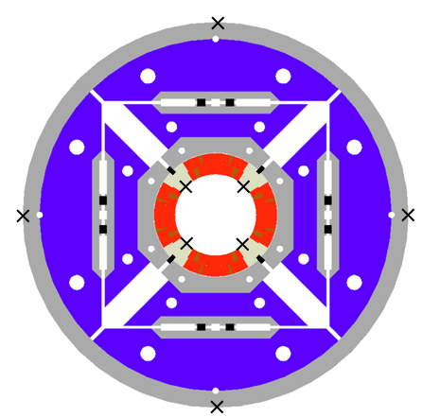
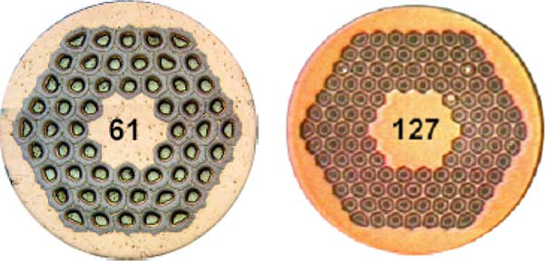
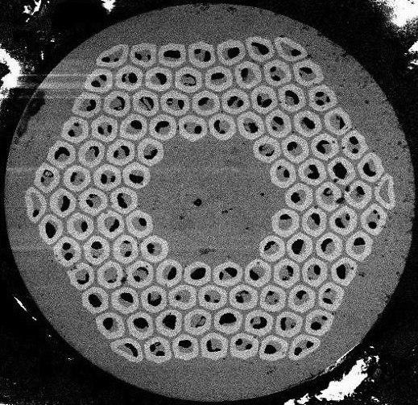
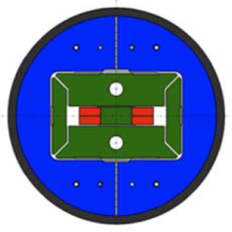
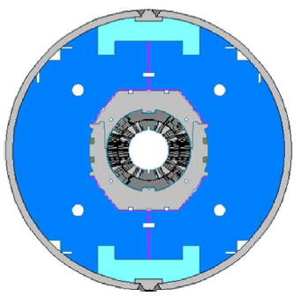
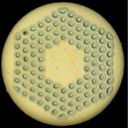
HQ01e: C5, C7, C8, C9
HQ02: C15, C16, C17, C20
RRP 54/61 and 108/127
RRP 108/127 (j_{c} >2800)
[P. Wanderer 2009]
[A. Godeke, 2014]
SMC-11T: C1, C2
MBHSP: C105, C106, C108
RRP 108/127
[B. Bordinini, 2014]

Slide 4
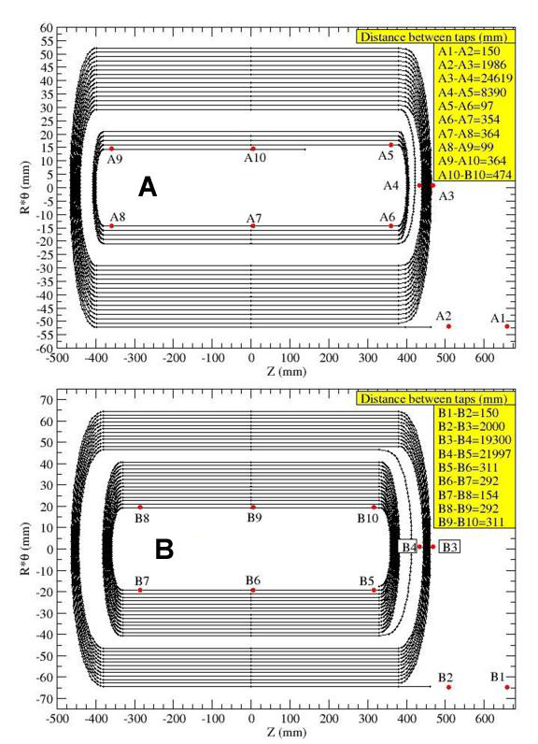
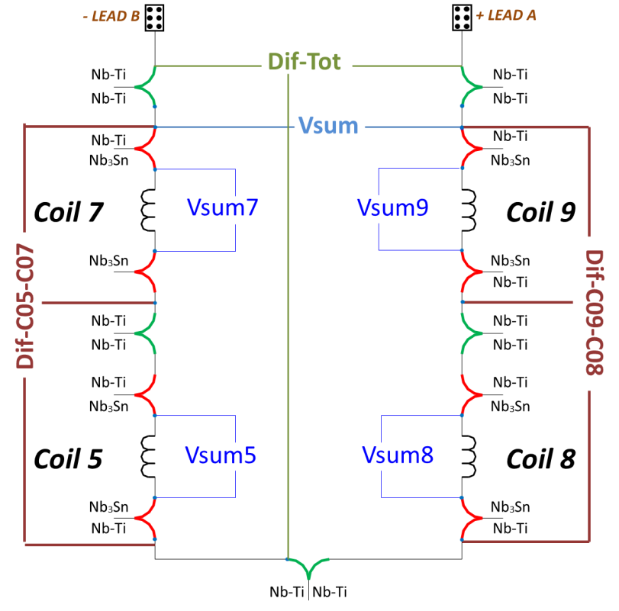
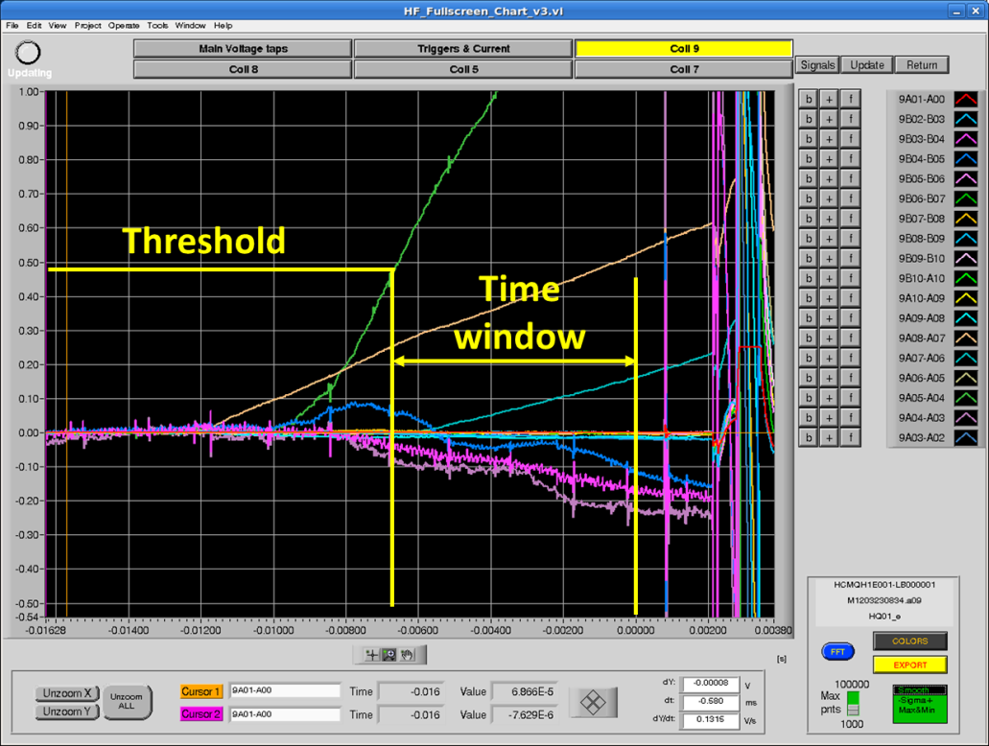
7 voltage signals can triggered the protection scheme (redundancy)
Typical time windows and threshold:
V_sum and Dif : V_{max} = 100 mV for 10 ms
Splices V_{max} = 10 mV for 8 ms
Leads V_{max} = 80 mV for 500 ms

Slide 5
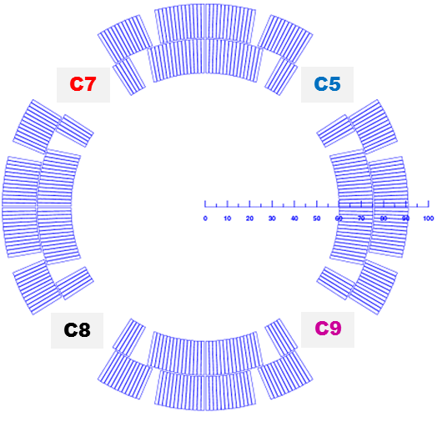
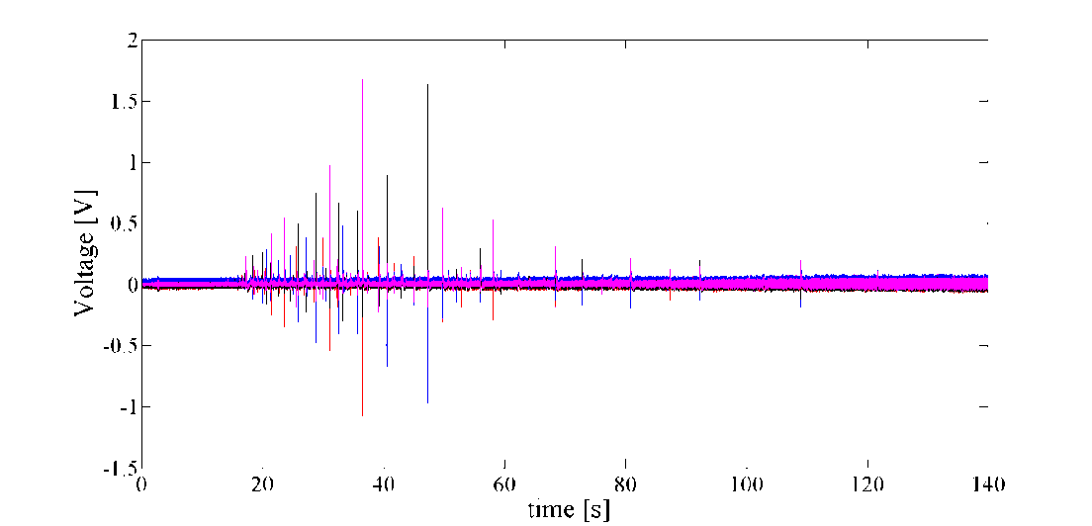
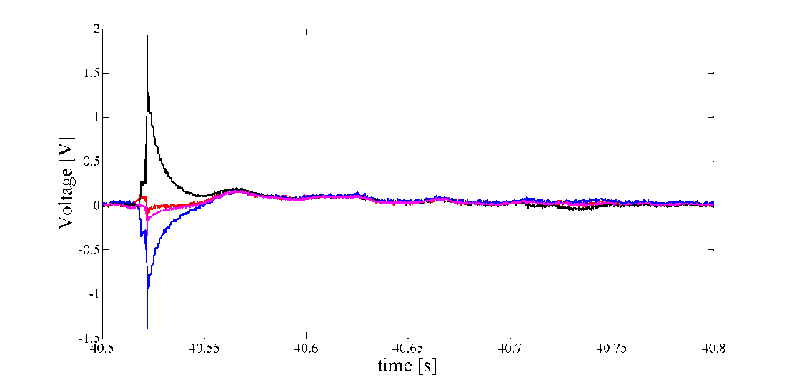
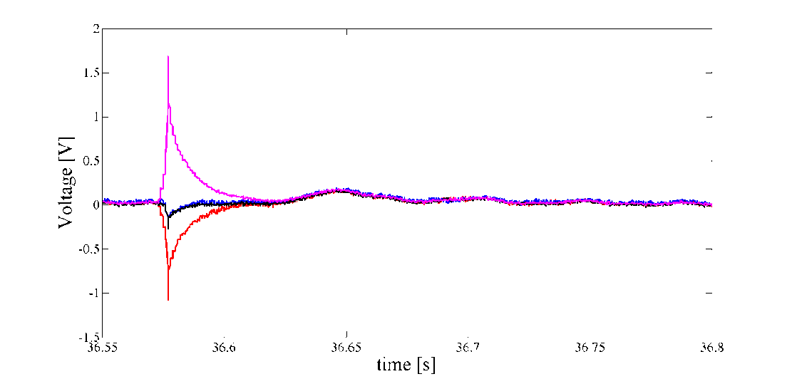
On the direct signal
HQ01e: C5, C7, C8, C9
RRP 54/61 and 108/127

Slide 6
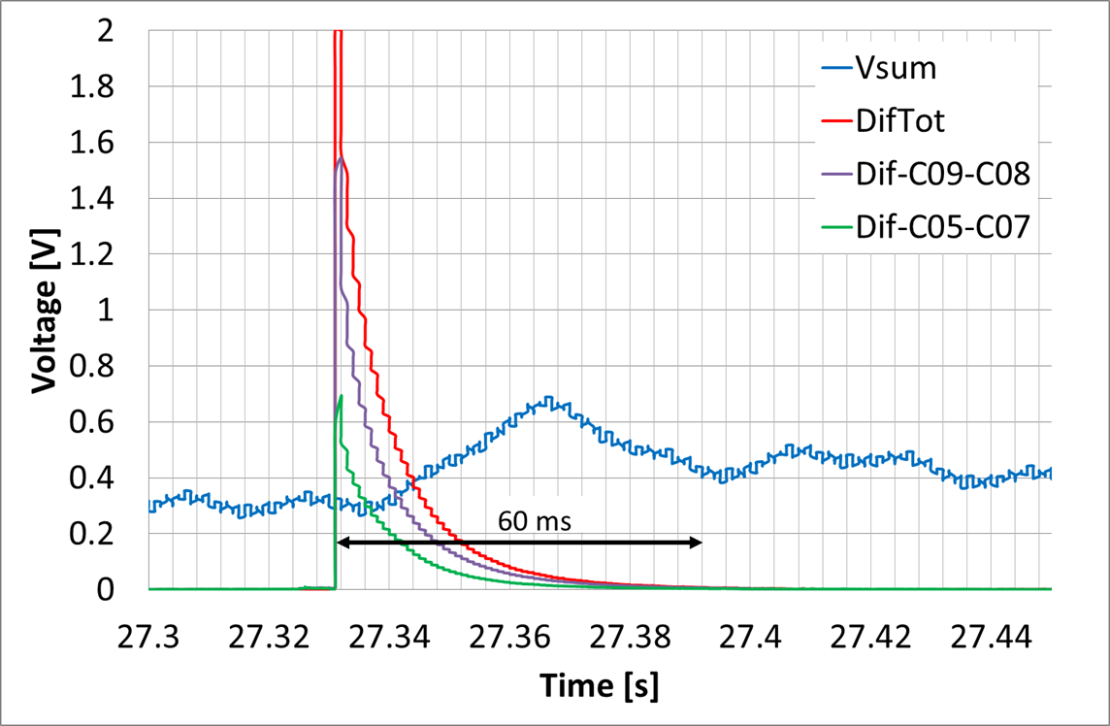
On the direct signal
HQ01e: C5, C7, C8, C9
RRP 54/61 and 108/127
Amplitude up to 2 V and duration between 5 to 60 ms: Trip of the protection

Slide 7
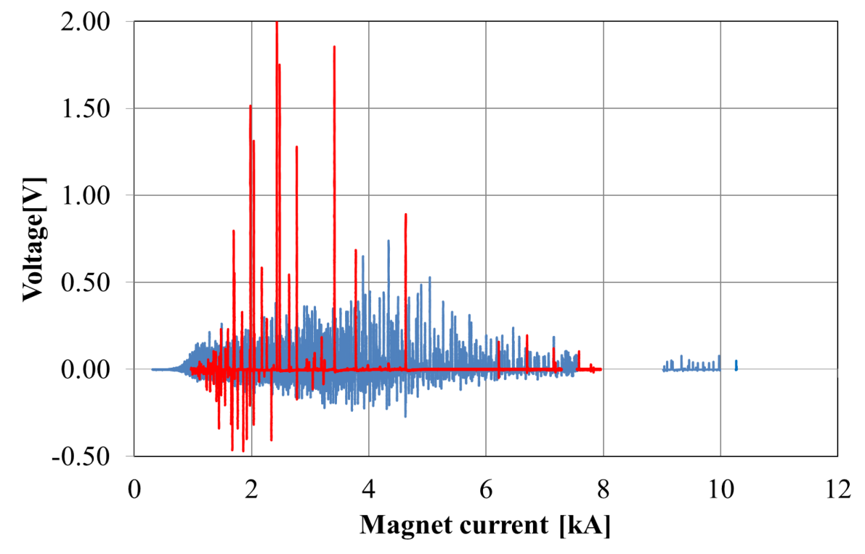
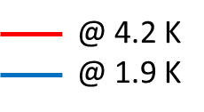
On the differential signal
HQ01e: C5, C7, C8, C9
FJ amplitudes higher @ 4.2 K than @ 1.9 K
FJ frequency lower @ 4.2 K than @ 1.9K
Amplitude up to 2 V at 4.2 K and 750 mV at 1.9 K.
Need to adapt threshold to pass flux jump occurrence current range

Slide 8
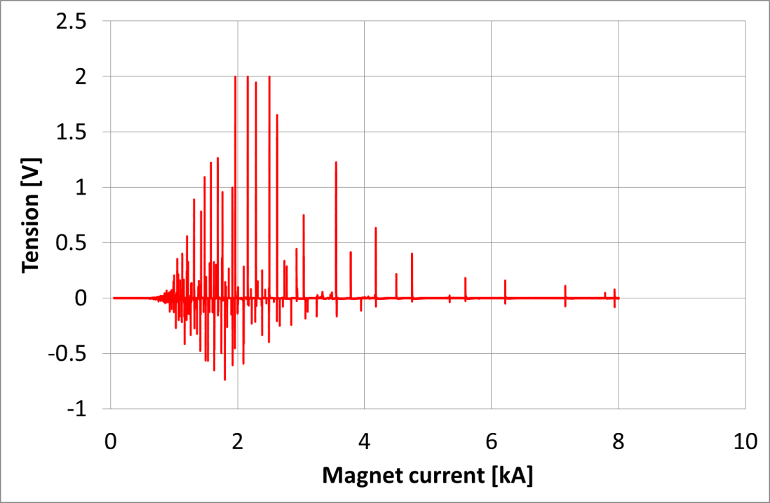
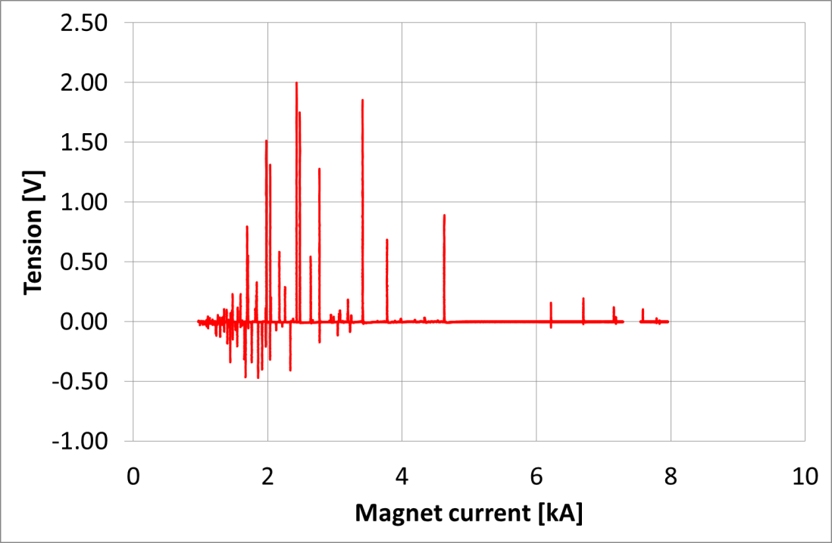
@ 4.2 A/s
Effect of the Ramp Rate
10 A/s
50 A/s
Voltage
Voltage
The higher ramp rate, the lower the flux jump frequency.

Slide 9
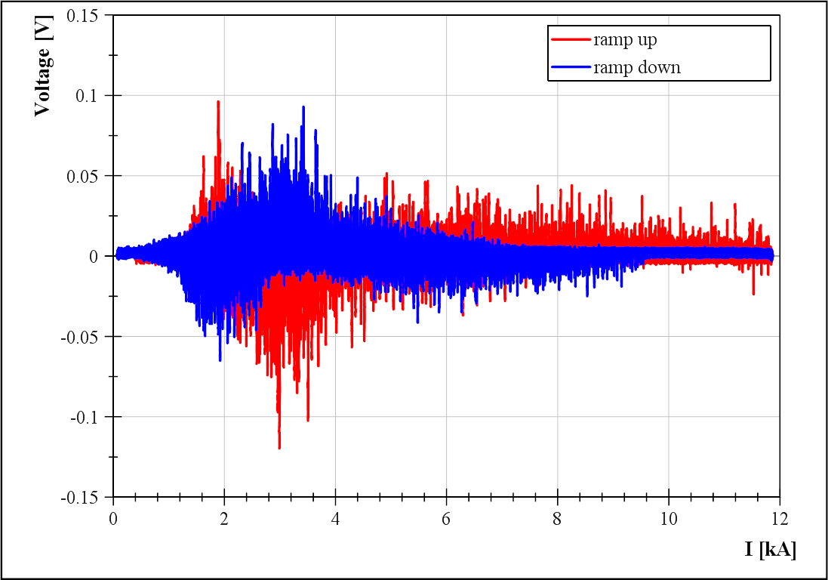
HQ02: C15, C16, C17, C20
RRP 108/127 (j_{c} >2800)
MBHSP: C105, C106, C108
Flux Jumps amplitude → at the limit of the detection (100 mV / 10 ms)
1.9 K measurement
Very similar behavior between
RRP (HQ vs.11T)

Slide 10
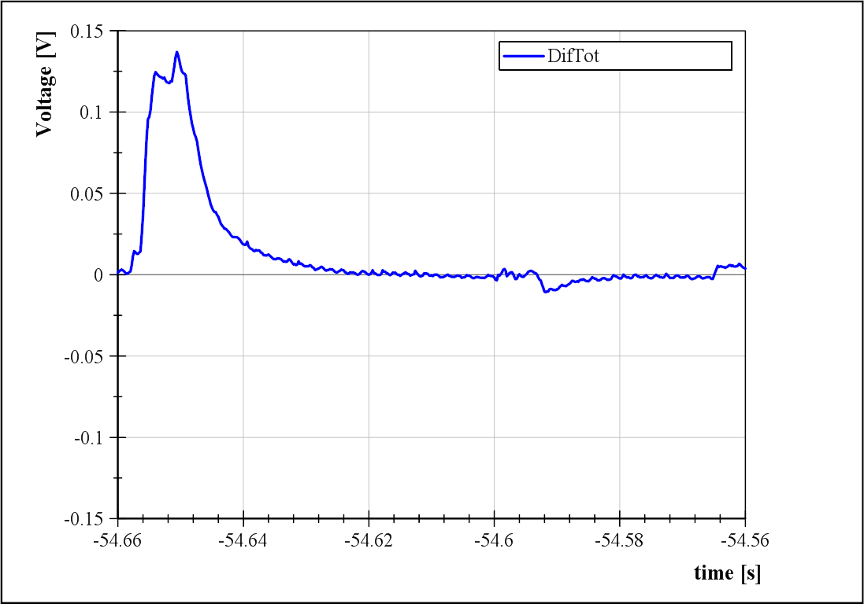
HQ02: C15, C16, C17, C20
RRP 108/127 (j_{c} >2800)
MBHSP: C105, C106, C108
Flux Jumps amplitude → at the limit of the detection (100 mV / 10 ms)
→ 200 mV / 5ms
100 mV
7 ms

Slide 11
The occurrence of the spike depends on the cable RRP filament size.
The amplitudes of the spike is higher at 4.2 K.
The frequency of the spike is higher at 1.9 K.
The frequency of the spikes is lower at higher ramp rate.
First HQ generation: issue with regard to voltage spikes with amplitude and duration within our «reference» quench detection setting (100 mV, 10 ms).
Second HQ generation: voltage spikes below our criteria if (200 mV, 5ms). No trip of the detection system

Slide 12
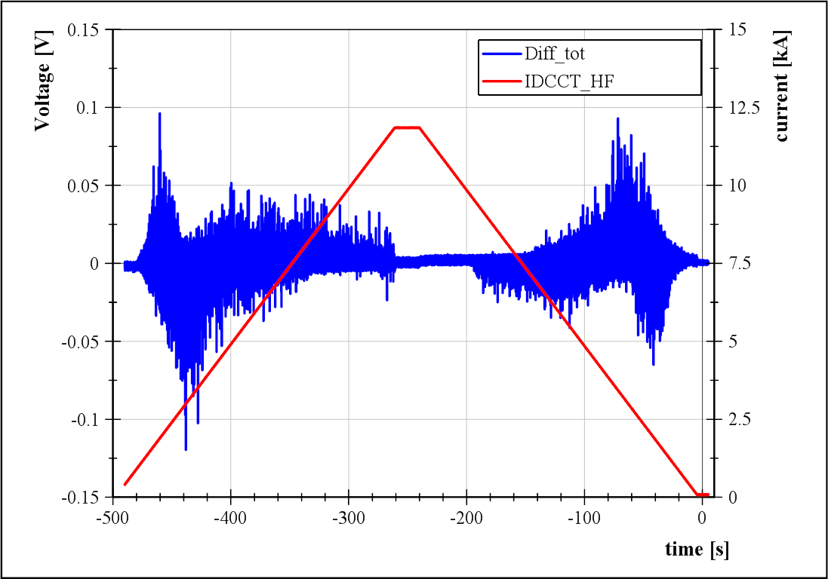
RRP 108/127 1.9 K

Slide 13
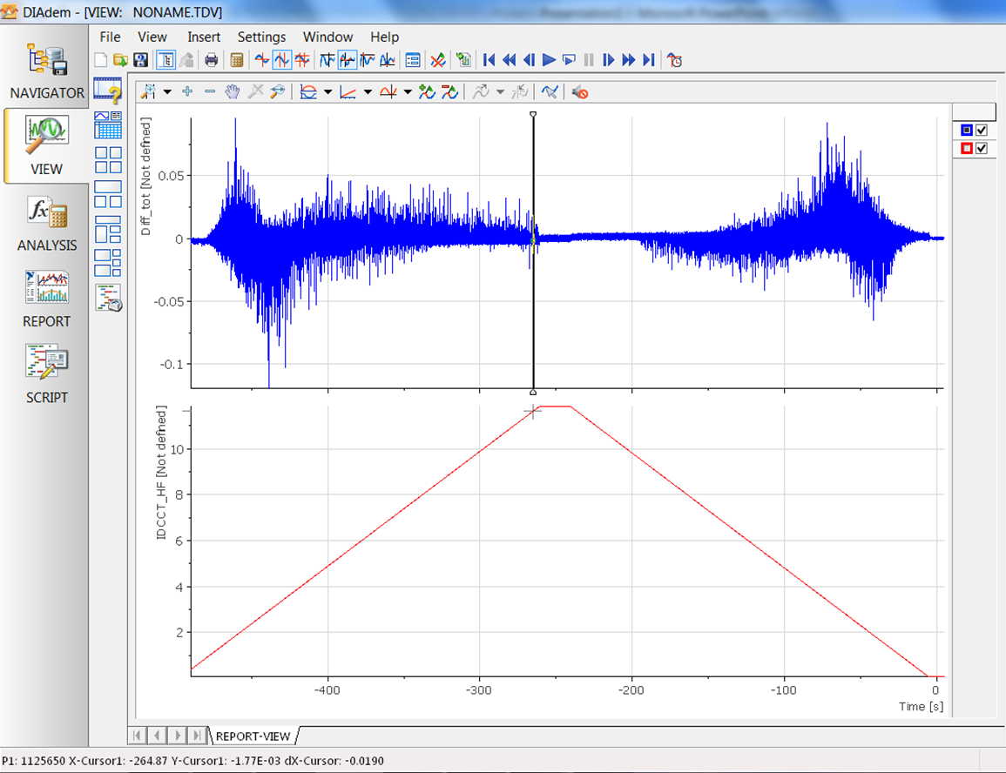

Slide 14
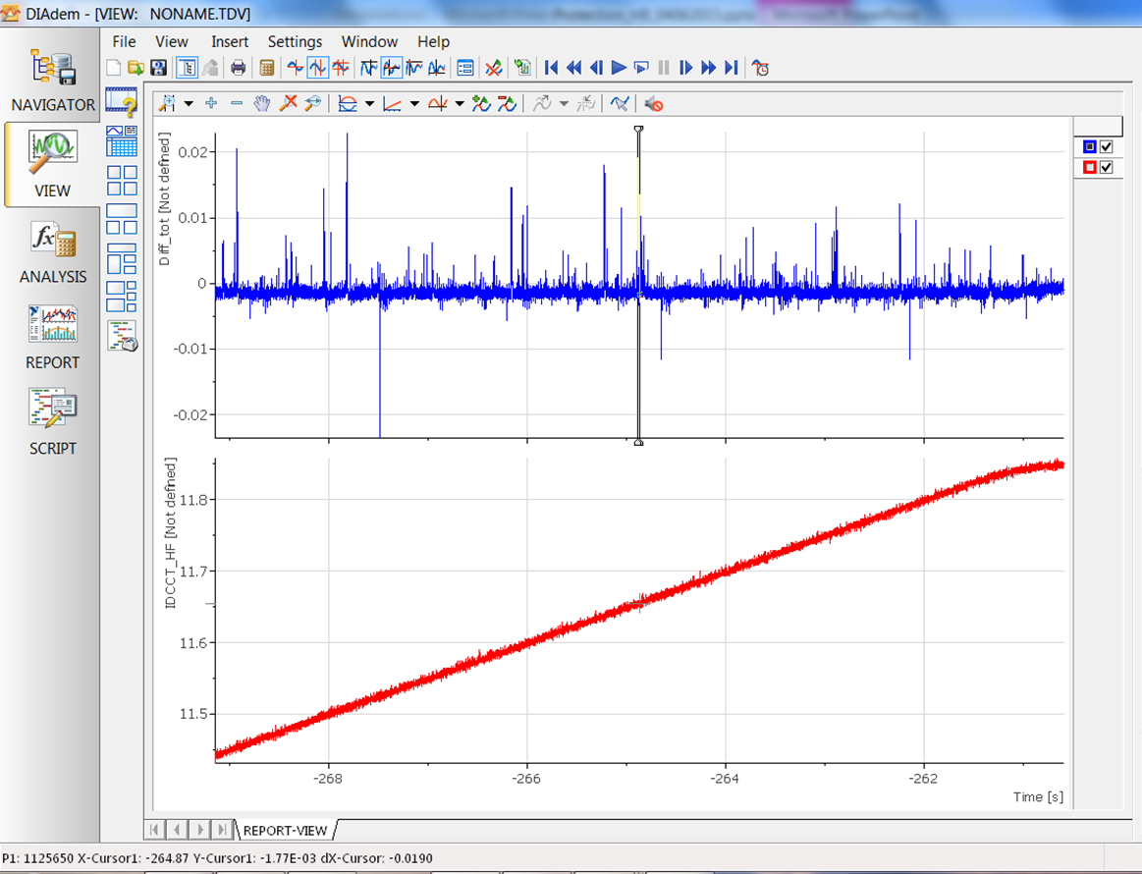

Slide 15
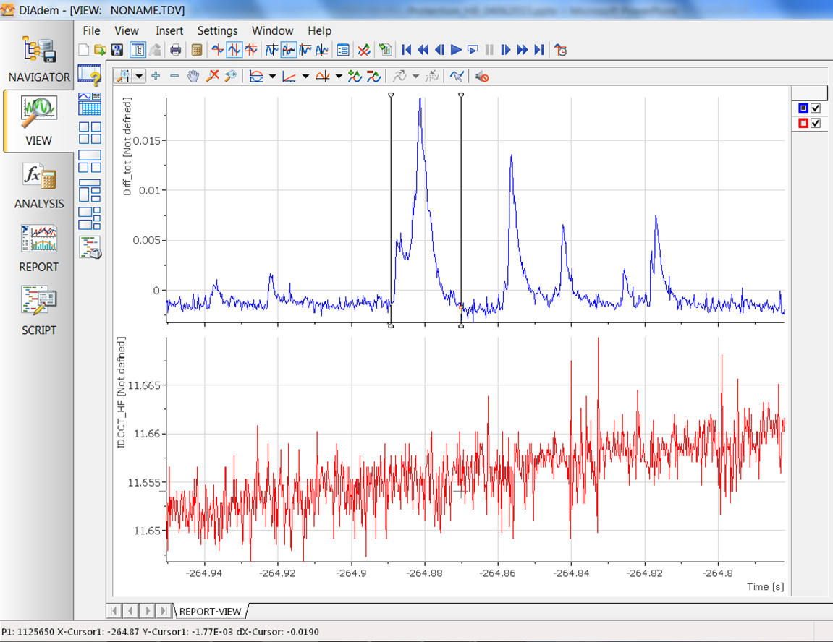

Slide 16
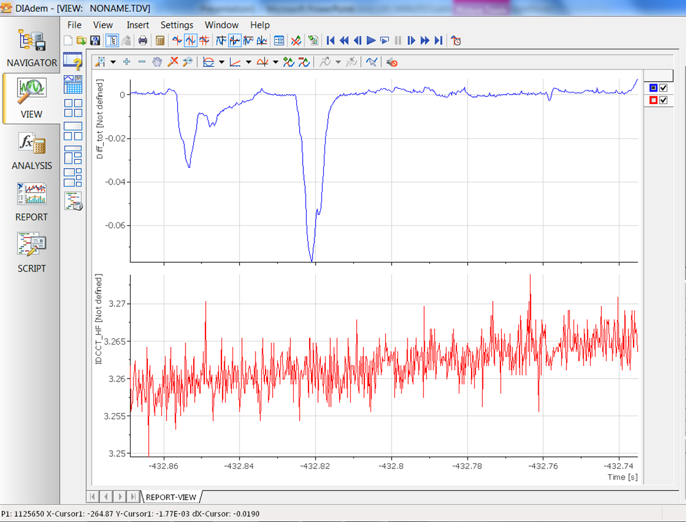

Slide 17
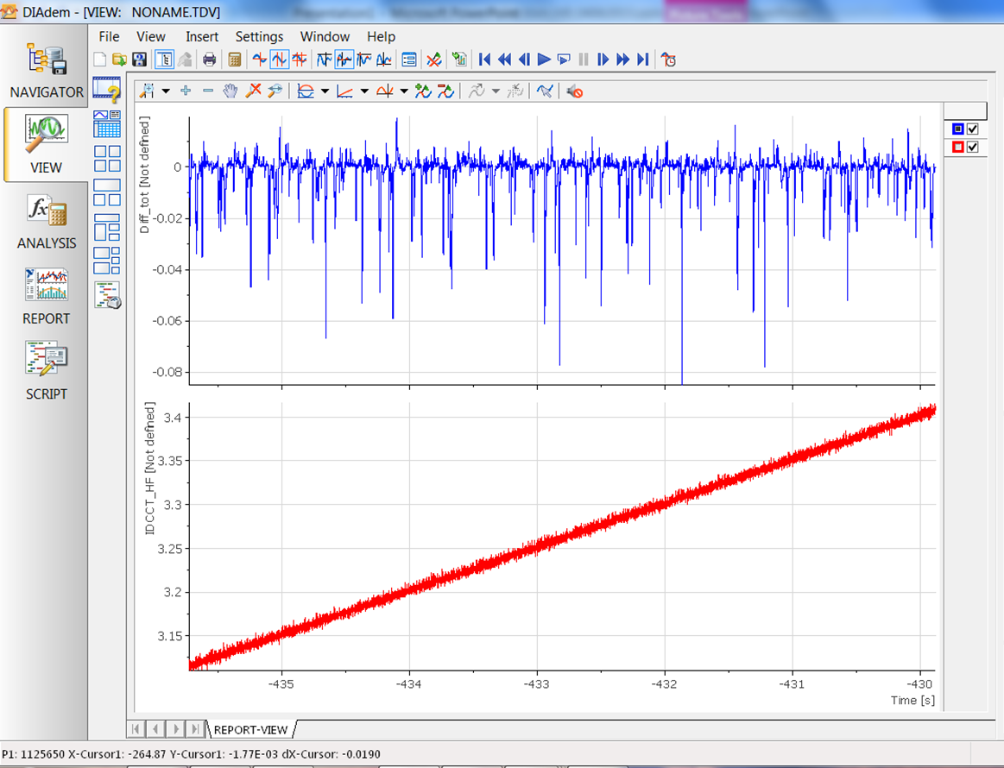

Slide 18
