Slide 2
Overview of Quench Protection Systems in the LHC
B. Auchmann, L. Bortot , thanks to F. Rodriguez-Mateos,
HL-LHC WP3 Meeting, 27.5.2015

Slide 3
Overview
What we protect
Protection elements (pictures)
Detection
Protection strategies
Recurrent problems

Slide 4
What we protect
Magnets
(minimize peak temperature and voltage)
Busbars (cold and warm)
(minimize peak temperature)
Current leads
(prevent quenches, abort in HTS’s current-sharing regime)
Power converters
(e.g., water-cooling fault)

Slide 5
What we protect against
Magnet quenches
  Training
  Beam-induced
  Thermal propagation
  Due to internal short
Busbar quenches
  Thermal propagation from magnet quench
  Thermal coupling (Line-N)
  Bad splices
  Wrong He levels in busbar lines/DFBs
  He-bubble in SC link
Current-sharing in HTS leads
  Defective temperature sensors, bad regulation
PC failures

Slide 6
Magnets and current levels
Mains: 12 kA
MB, MQ
ITs (Inner triplets): 7/12 kA
MQXA/B
IPDs (Individually powered dipoles, separation dipoles): 4-7 kA
MBX, MBRC, MBRS, MBRB
IPQs (Individually powered quads): 4-6 kA
MQM, MQY
600-A circuits
MCD, MCS, MO, MQT, MS, MCBX, MQSX
80-120 A circuits
MCO, MCBC, MCBY, triplet correctors
60-A circuits
MCB
Notes:
Cu/Sc ratios
SYMQ protection?

Slide 7
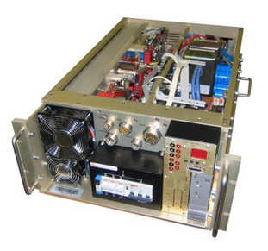
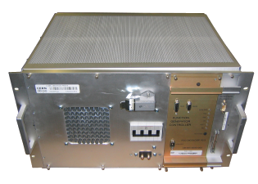
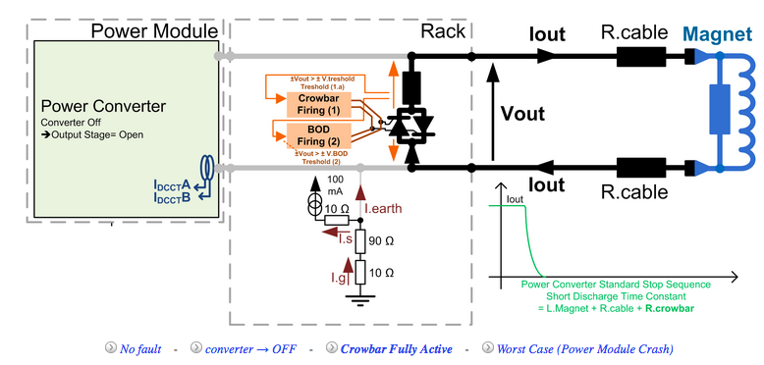
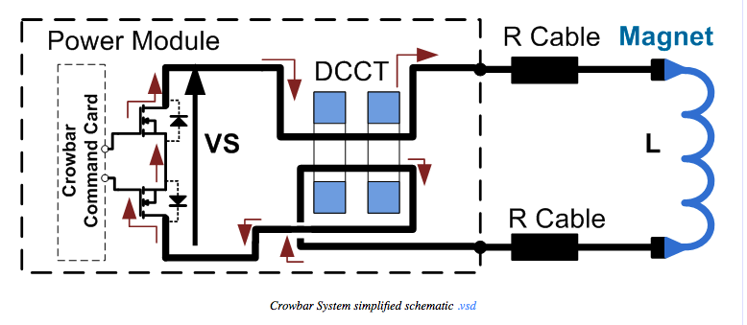
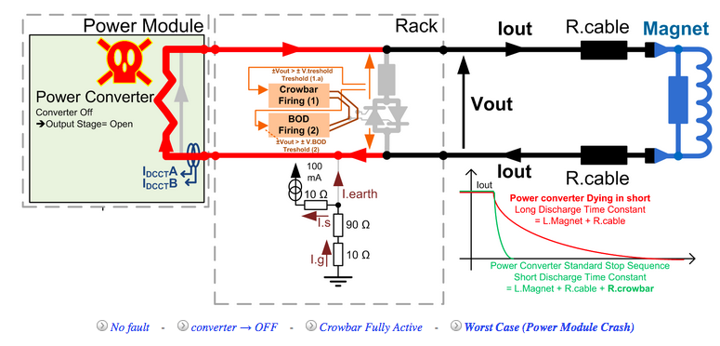
Means of protection 60/120 A
Busbar voltage is monitored by PC,
abort at 150 mV.
http://te-epc-lpc.web.cern.ch/te-epc-lpc/general.stm

Slide 8
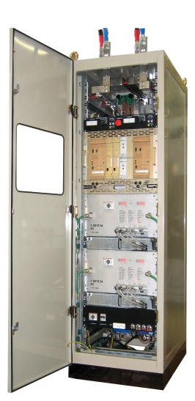
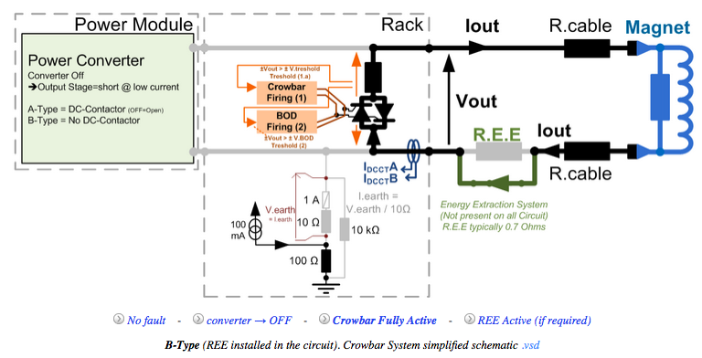
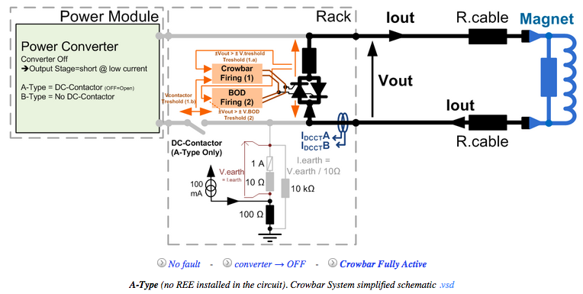
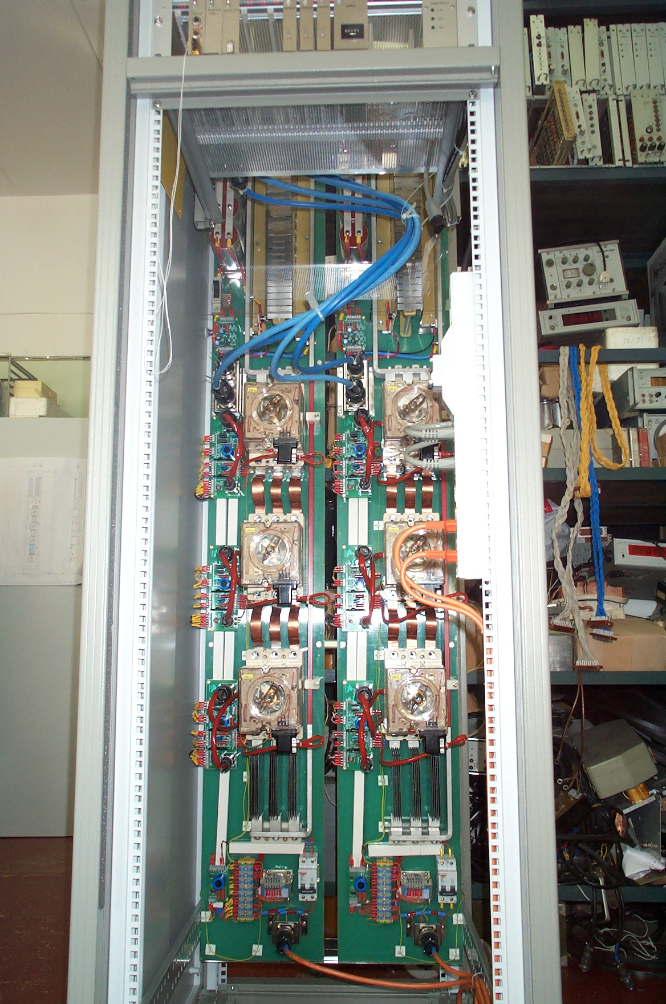
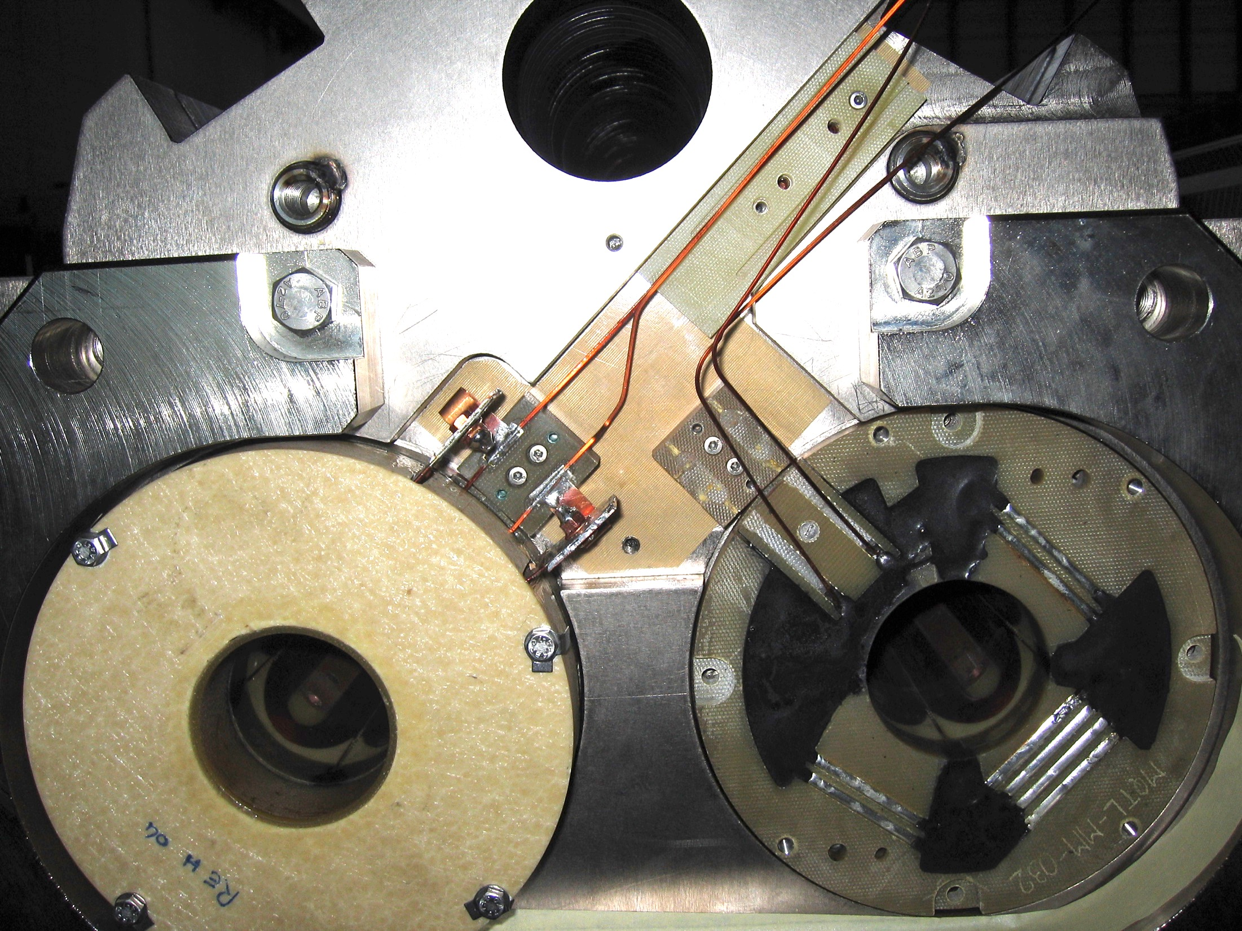
Means of protection 600 A

Slide 9
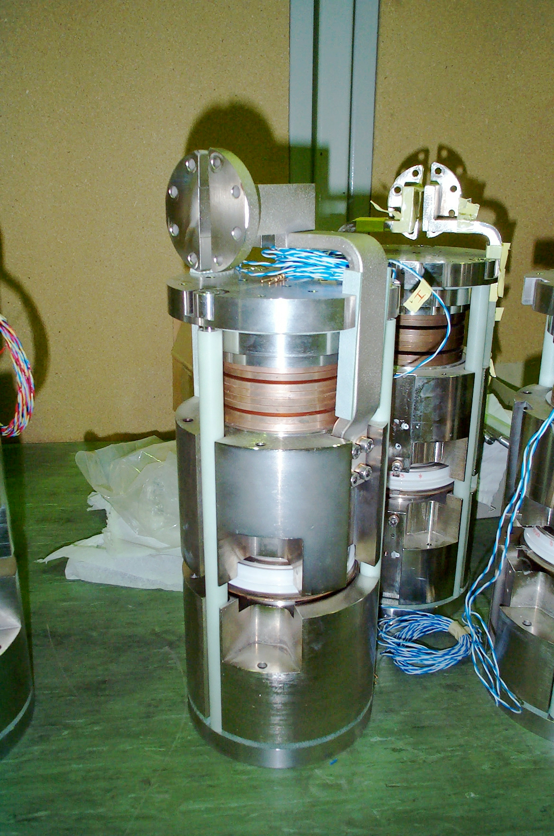
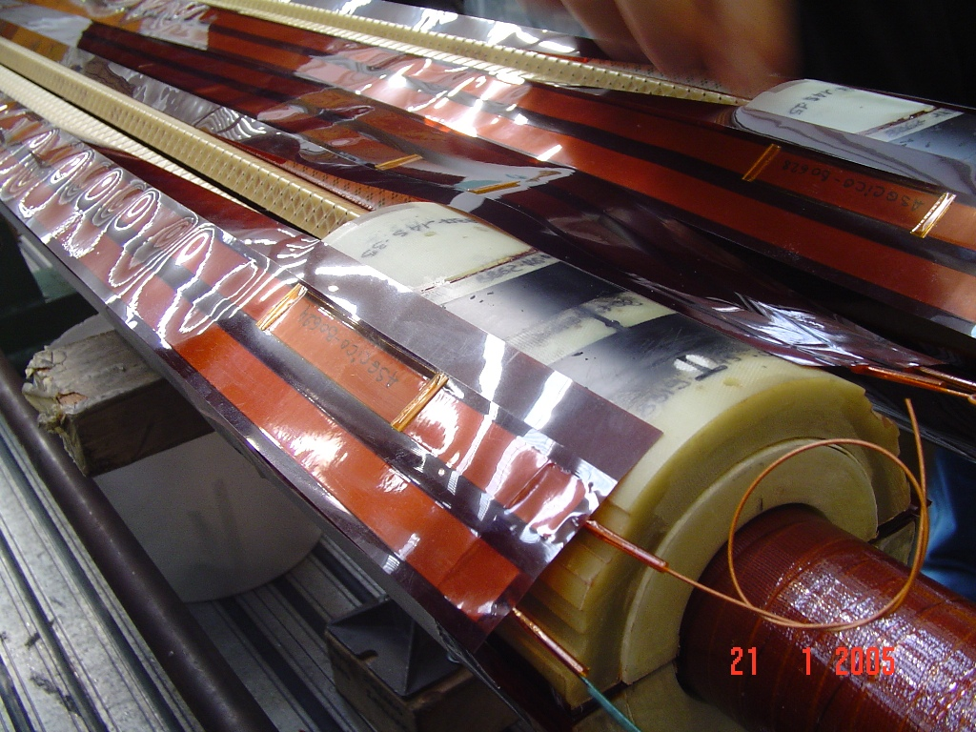
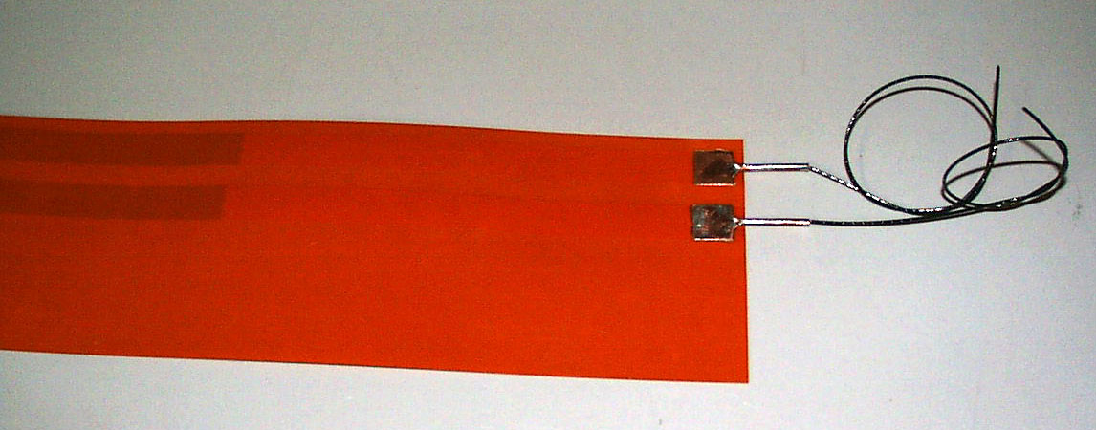
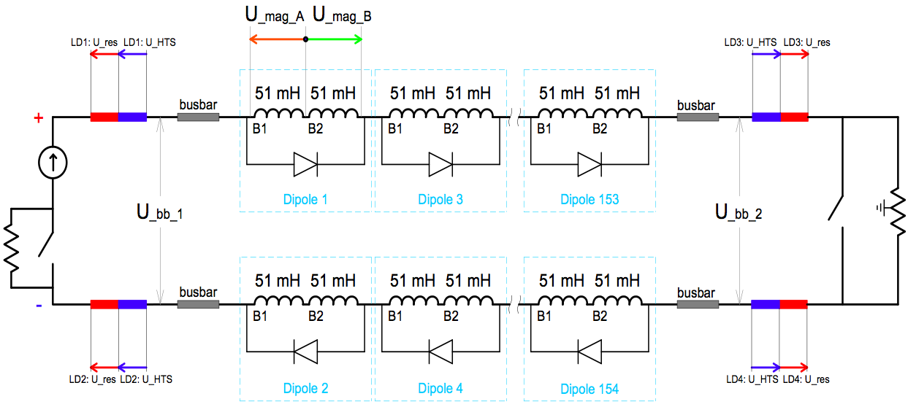
Means of protection Mains 1/4
from: Mishra, J. K. "Basics of SM18 Operation,
An Introductory Guide (Graybook).”, CERN,
Geneva, Switzerland, Bhabha Atomic Research Centre, Mumbai, India, 2005.
Diodes absorbe several thousand MIITs
during fast power-abort.
Sensitive in closing direction →
100 mΩ parallel resistor.

Slide 10
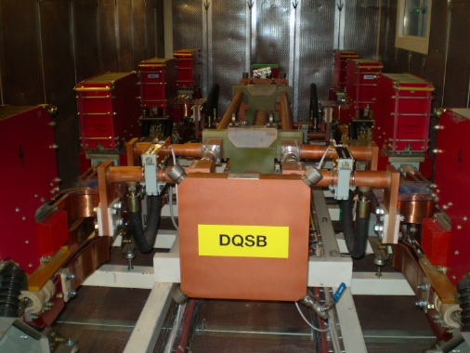
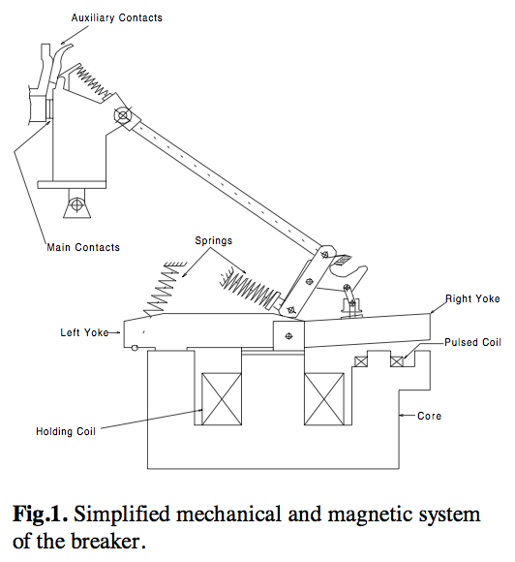
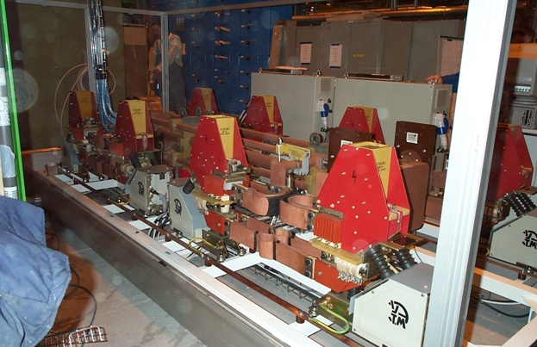
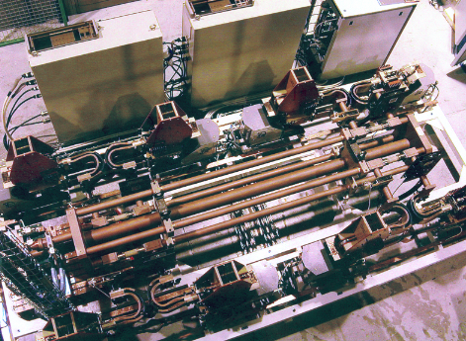
Means of protection Mains 2/4
LHC RB switch
breaker unit
LHC RQ switch
http://cern.ch/te-mpe-cp
V. Anushat, et al., Modeling and computer simulation of the pulsed powering of mechanical D.C. Circuit breakers for the
CERN/LHC superconducting magnet energy extraction system, Proc. of ICAP 2000, Darmstadt, Germany, Sep 2000.

Slide 11
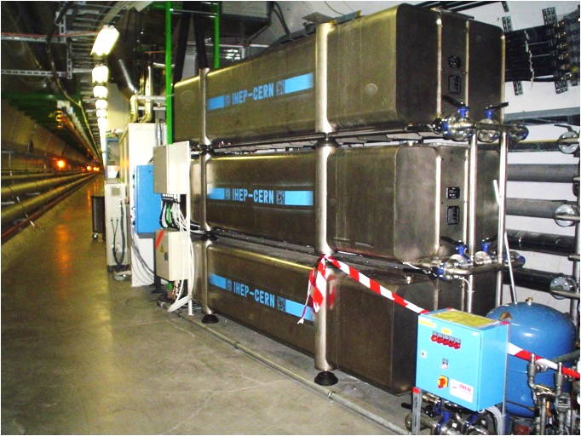
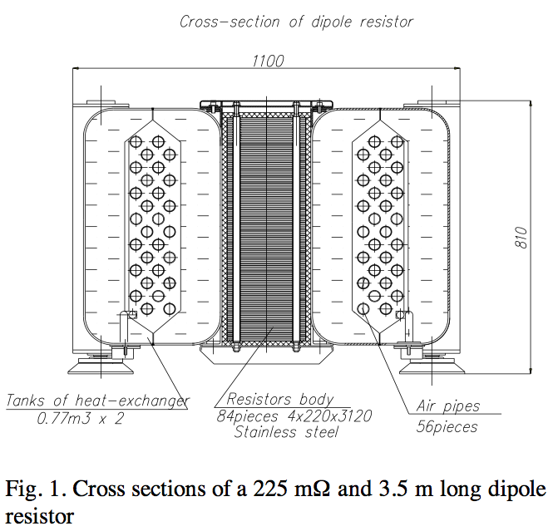
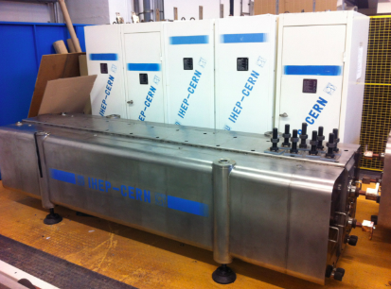
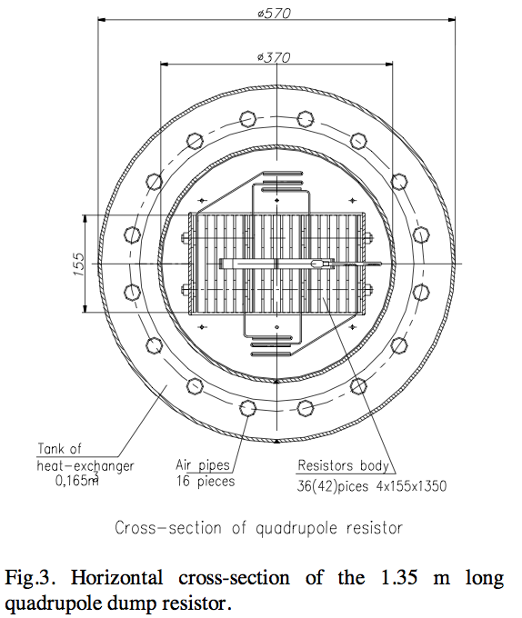
Means of protection Mains 3/4
http://cern.ch/te-mpe-cp
K. Dahlerup-Petersson, Energy extraction resistors for the main dipole and quadrupole circuits of the LHC,
Proc. of EPAC 2000, Vienna, Austria, 2000.

Slide 12
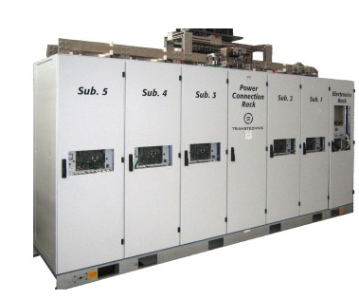
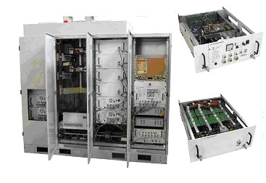
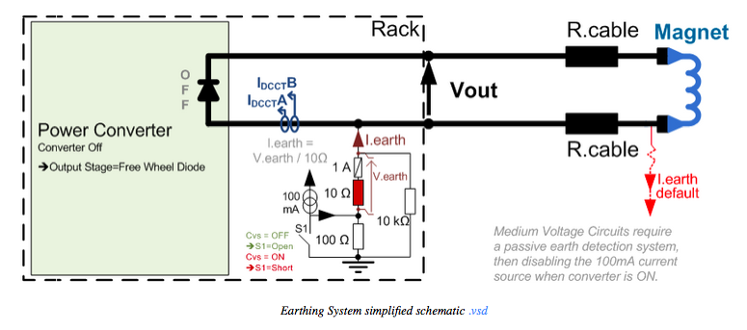
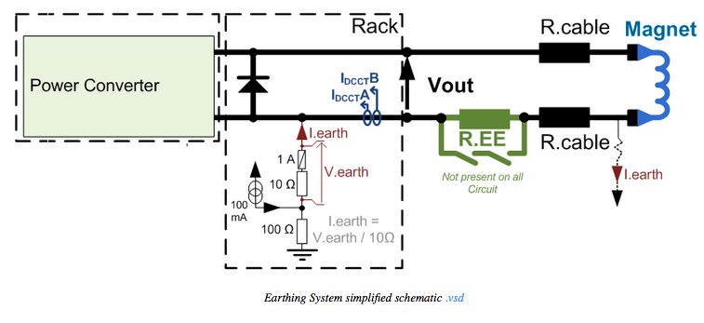
Means of protection Mains 4/4
Notes:
Do they have crowbars? What’s their value?

Slide 13
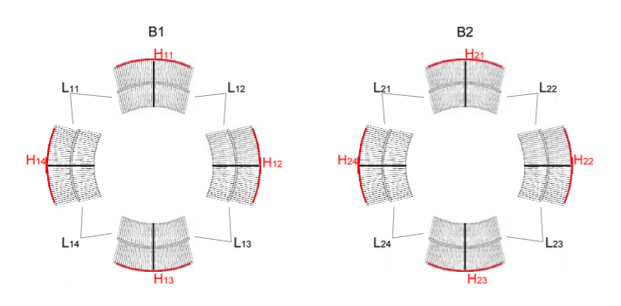
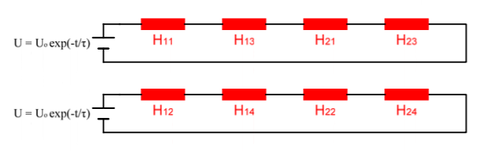
A word on heater redundancy
MBs: Unused low-field heaters as spares
MQs, ITs, IPQs, IPDs (except D3?): two heater circuits, each covering every coil/pole in the magnet. Up to 8 heater circuits per IPQ circuit.
Source: A. Erokhin

Slide 14
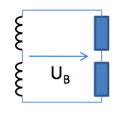
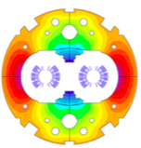
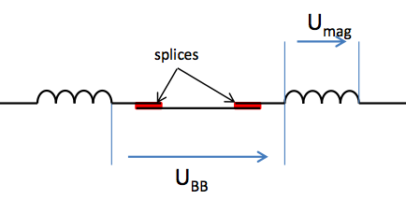


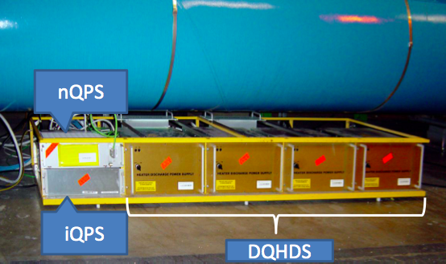
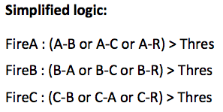
Detection RB circuit
iQPS: U_{th} = 0.1 V, t_{val} = 10 ms
nQPS busbar protection U_{th} = 500 µV, t_{val} = 10 s
inductive compensation by DSP
nQPS symmetric quench protection
U_{th} = 0.5/0.9 V, t_{val} = 20 ms
adaptive thresholds, ‘sunglasses’
J. Steckert, QPS electronics, CERN PH-ESE electronics seminar, Nov 2011
Notes:
Jens: more on detection types
Adaptive thresholds
Sunglass duration 500 ms?

Slide 15
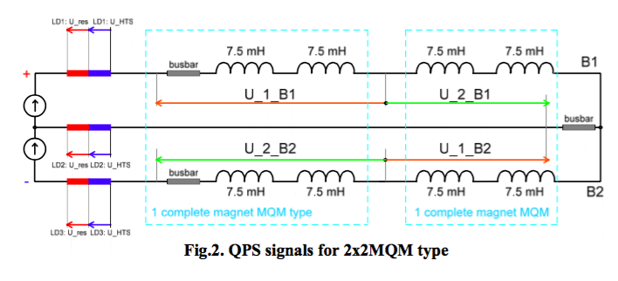

Detection quadrupole circuits
MQs
  Compare voltage between pairs of poles.
  Have symmetric quench protection.
IPQs
  Compare voltage between same aperture of adjacent magnets (compensating for different magnetic lengths).
IPDs except D1
  compare voltages between apertures.
  No extra symmetric detection.
D1 compares upper and lower coil.
  Risk of beam-induced symmetric quench rather high.
Source: A. Erokhin

Slide 16
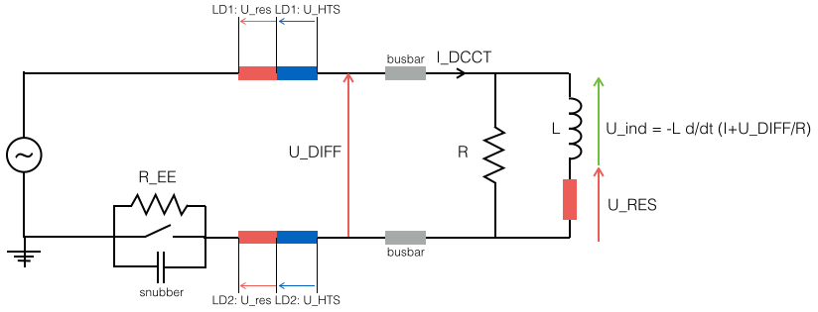
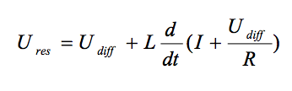
Detection 600-A circuits
600-A circuits, U_RES is calculated by FPGA

Slide 17
Protection strategies
Magnet protection
RB, RQ
heaters and diodes
IPQs, IPDs, ITs
Heaters fired in all elements
adjacent magnets act as EE.
600 A
EE where possible
Rpar if necessary
None for triplet correctors
60 A/80-120 A
None
Busbar/leads/PC protection
RB/RQ
EE
IPQs, IPDs, ITs
Heaters
600 A
EE
Rpar acts as EE in case of magnet quench.
PC off, crowbar
60 A/80-120 A
PC off/crowbar

Slide 18
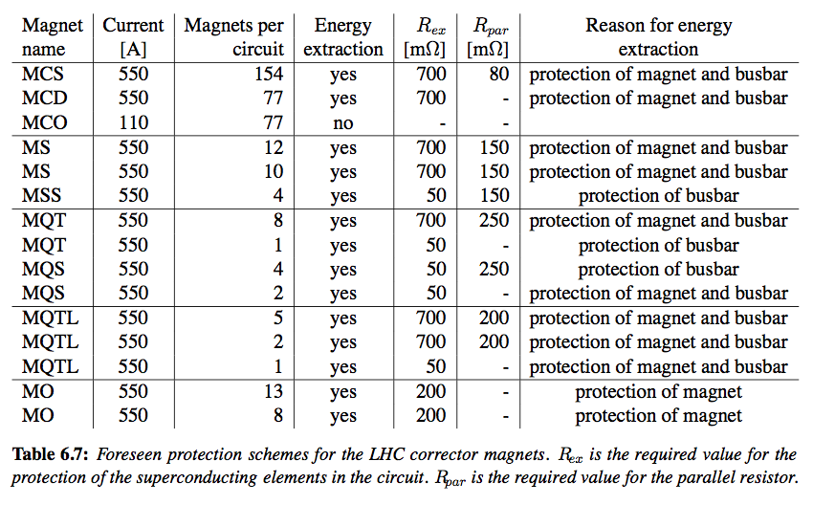
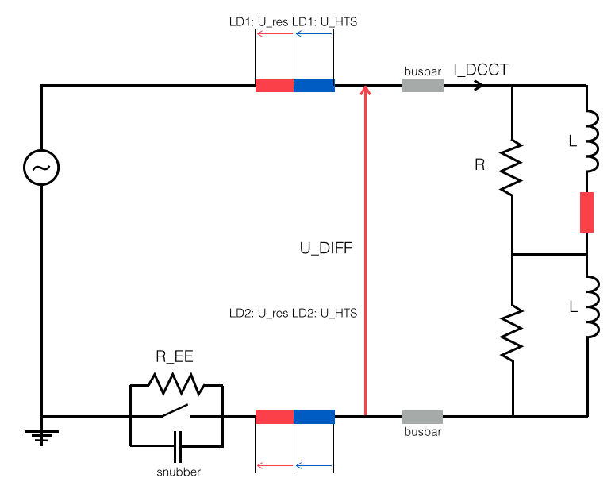
Details 600-A
EE was used to protect magnets and busbars.
Rpar was added if necessary – designed to absorb circuit energy.
Recent simulations show that Rpar protects a quenching magnet efficiently, even without EE.
Triplet correctors have no EE (larger cu/sc ratio in magnet and busbar).
Status 2001!
F. Sonnemann, Resistive Transition and Protection of LHC Superconducting Cables and Magnets. PhD thesis, 2001.
D. Egede Rasmussen, Upper Limits for QPS Thresholds of the 600A Circuits in the LHC, EDMS 1432493

Slide 19
Protection recipe?
It is difficult to extract a single rule.
Example:
MCBC orbit correctors have energy density per coil copper volume equivalent to that of MB magnets.
Yet they have no QPS.

Slide 20
Protection elements in numbers
Caveat: Quick calculation, not fully validated numbers.
Type | #circuit | #magnet | #EE | #heaters* | #Rpar
RB | 8 | 1232 | 16 | 9856 | -
RQ | 16 | 392 | 16 | 6272 | -
IT | 16 | 64 | - | 256 | -
IPQ | 76 | 220 | - | 2080 | -
IPD | 16 | 18 | - | 56 | -
600 A | 394 | 5337 | 202 | - | 3733
60-120 A | 1052 | 2268 | - | - | -
* .. active heater strips (MB LF heaters not counted)

Slide 21
Recurrent problems 1/3
QPS trips
EM compatibility
Grid instabilities/Thunderstorms
Transfer-line effects
  Unbalanced apertures
  Phase-difference between adjacent magnets
0-V crossing
Imperfect inductive compensation
Single-event upsets
Remote power resets (operator errors)
Detector drift (undulator)
Adjust thresholds
Adjust ramp rate
Improved detection
electronics

Slide 22
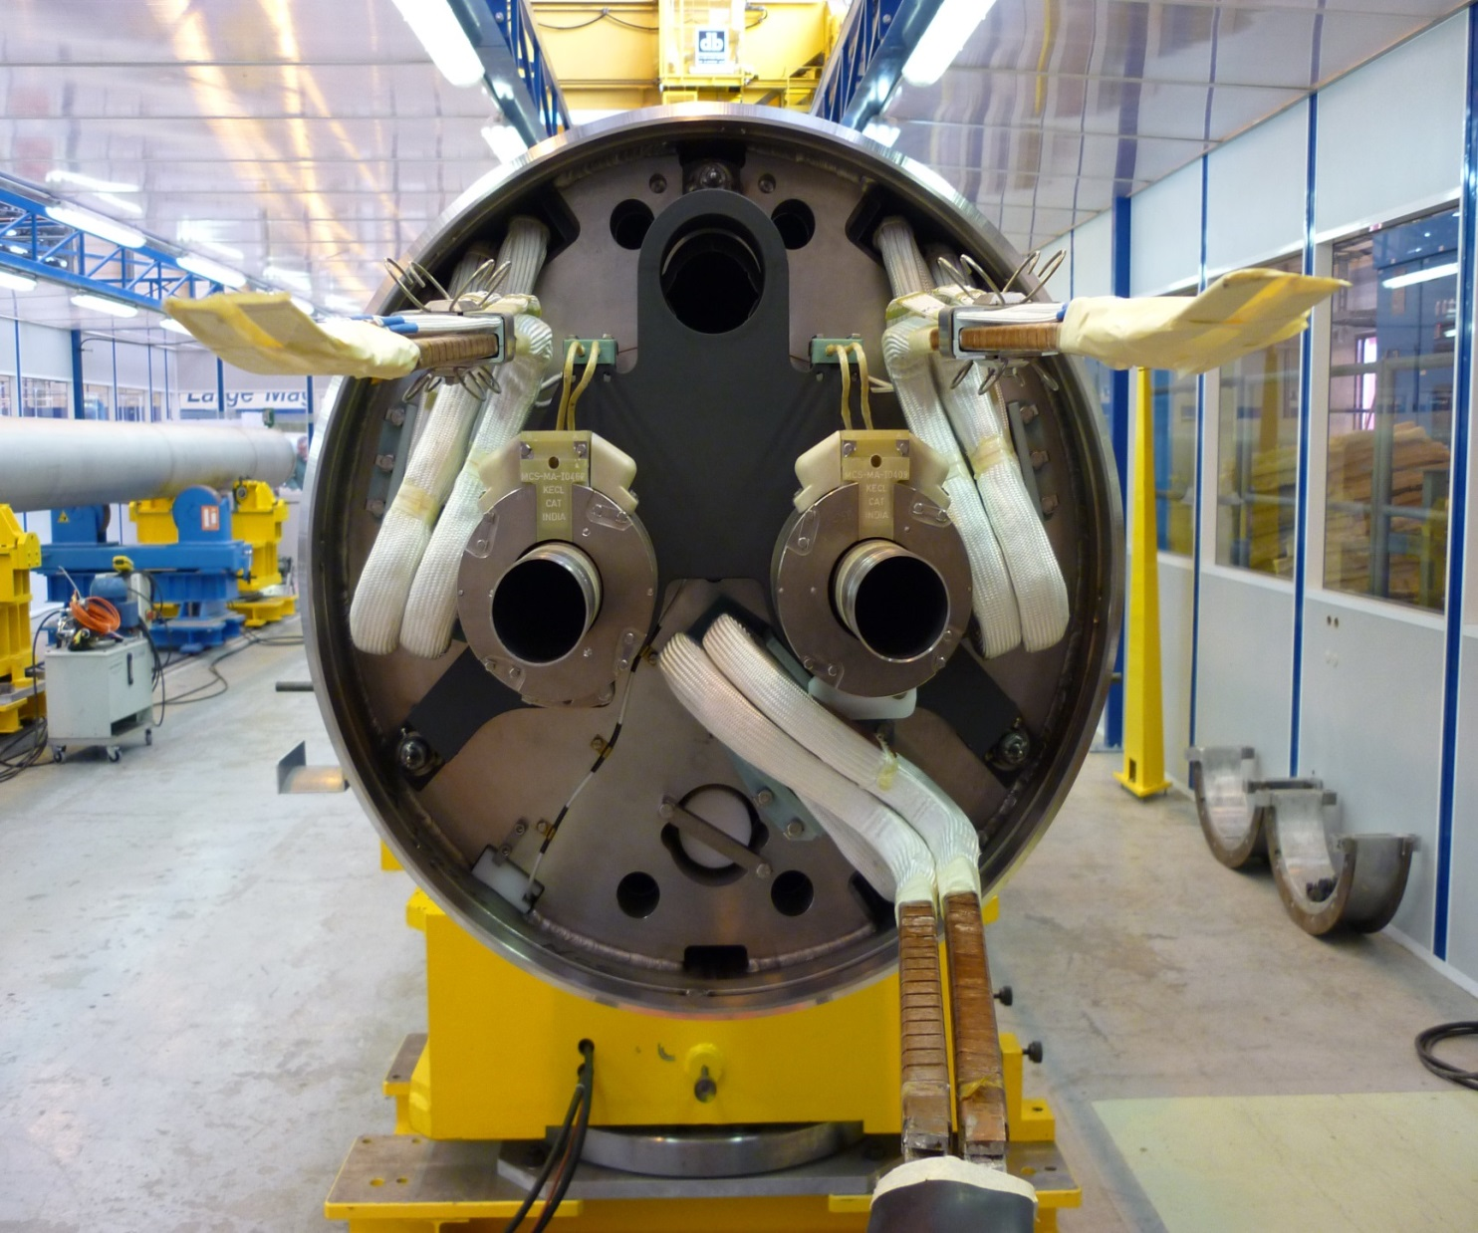
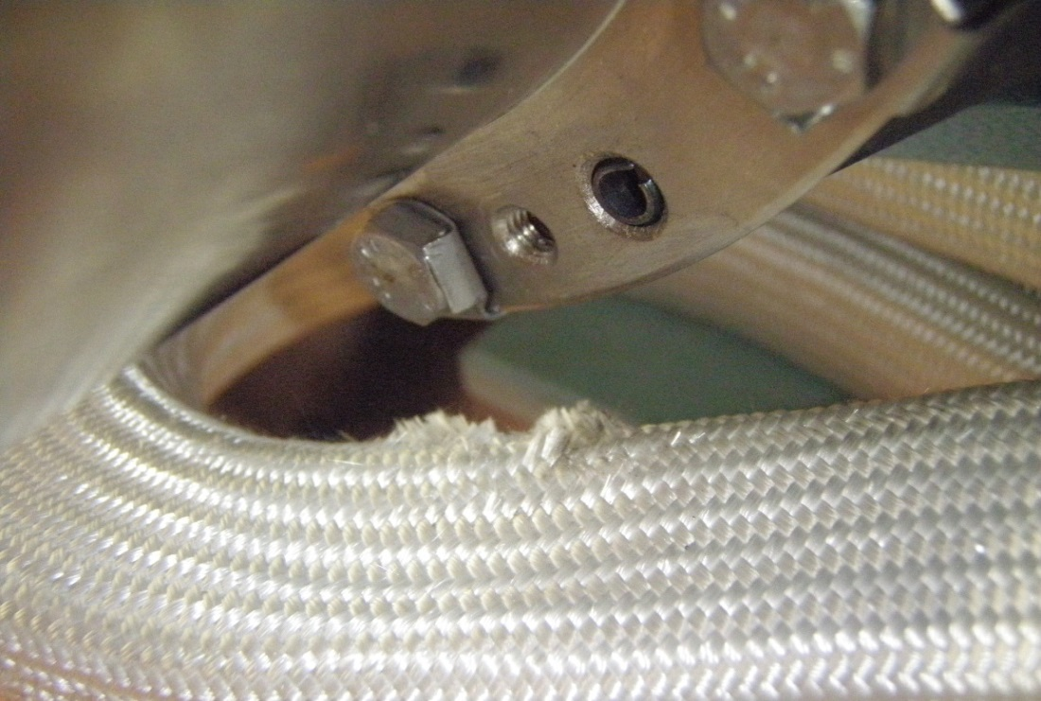
Recurrent problems 2/3
Shorts to ground
  Spiders
  Lyras vs. MCS corrector
  Warm busbars
Lack of instrumentation wires!
  Single voltage/current measurement for circuits of > 100 magnets in series!
Lack of long. and transv. quench-propagation measurements
  at various current levels for model validation
  Ideally with spot heater for controlled quench origin

Slide 23
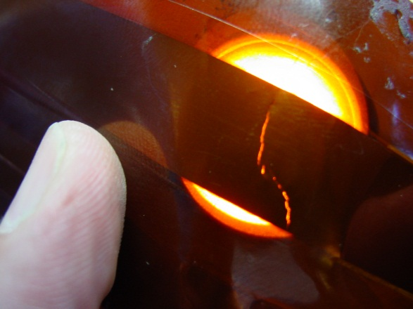
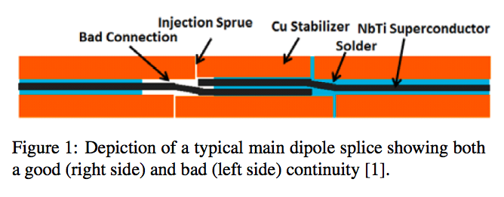
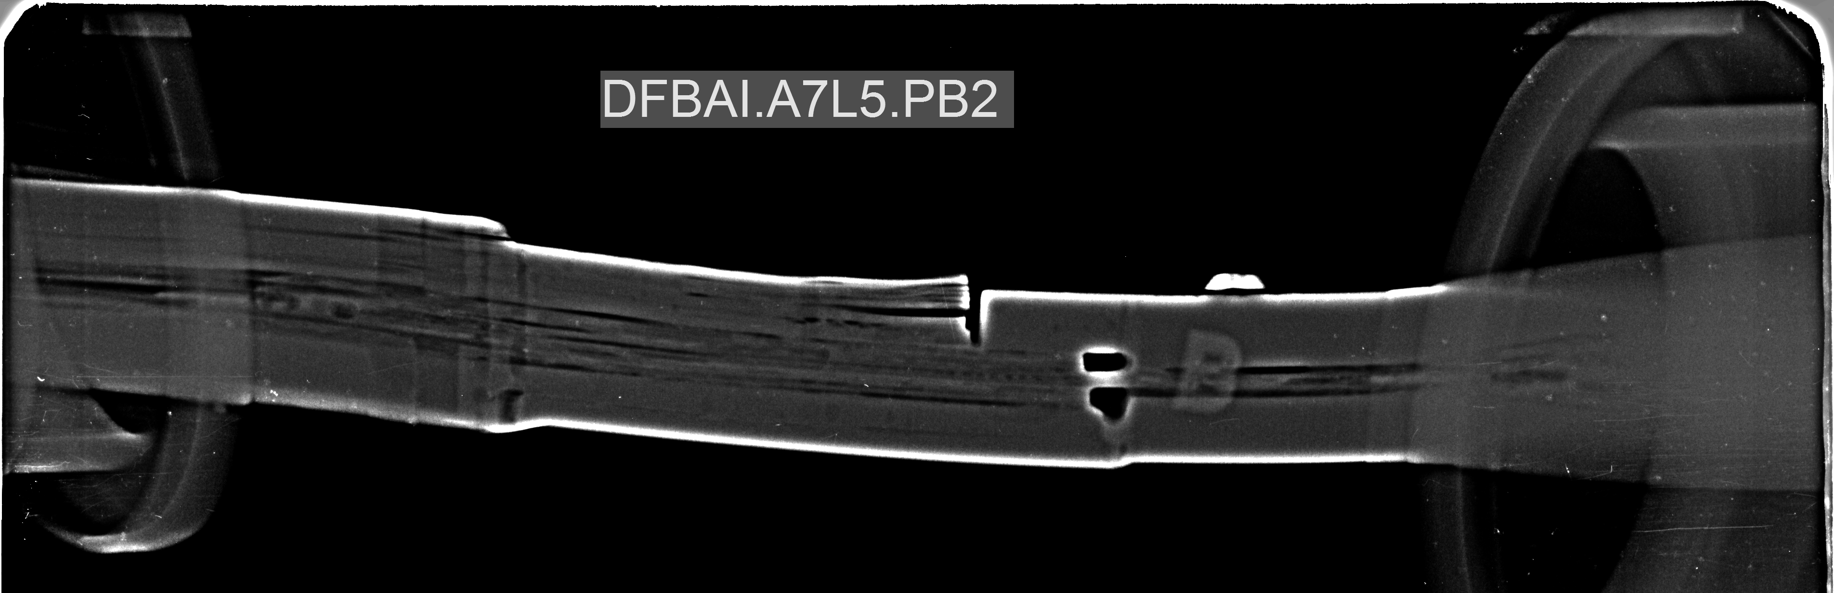
Recurrent problems 3/3
Broken heater strips or reduced HV
resistance (9 on MBs, 1 on IPDs,
1 on ITs, 2 on IPQs)
1 broken Rpar on an undulator
600-A EE switches are being replaced.
Diode lead resistances
Broken bypasses (copper foils, copper stabilizer)
Bad connection between busbar and
copper-foil bypass in DFBAI P2.

Slide 25
Extra slides on 600-A busbar protection.

Slide 26
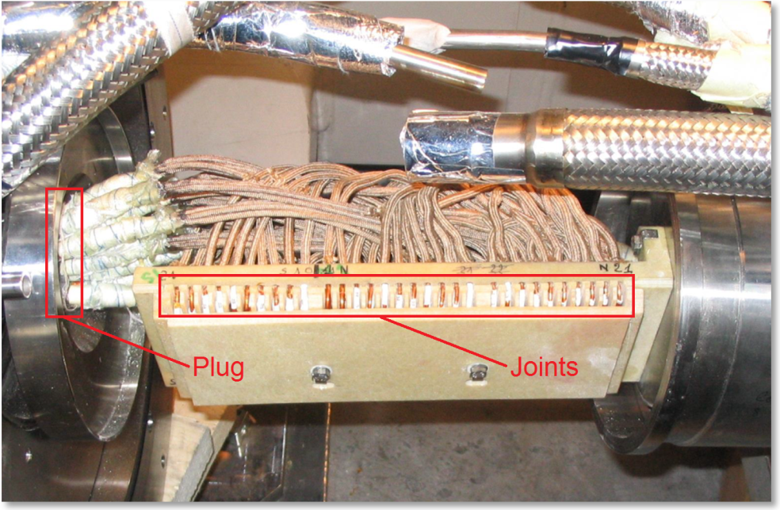
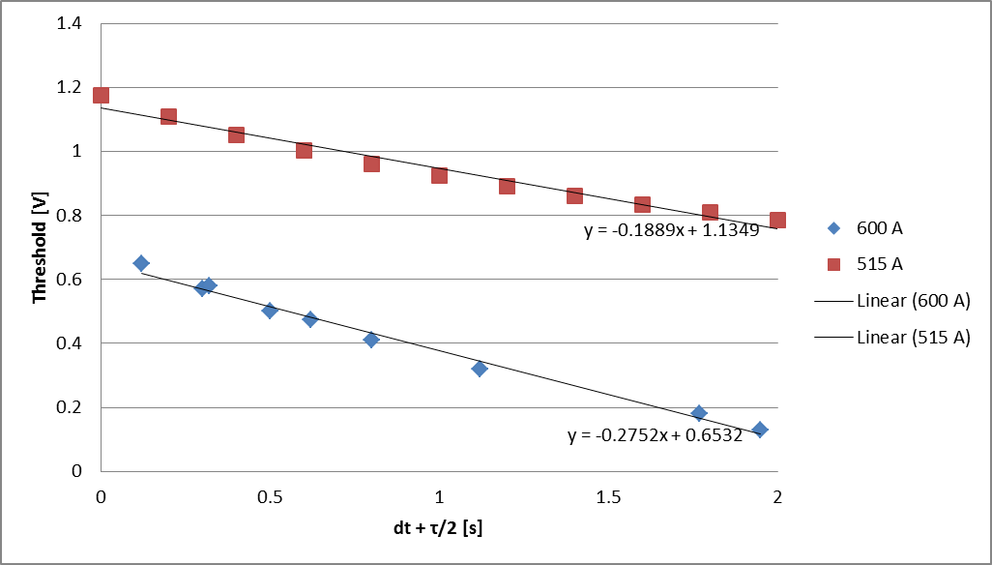
Quench in Helium-Tight Plug
Plug close to joint = quench stopper

Slide 27
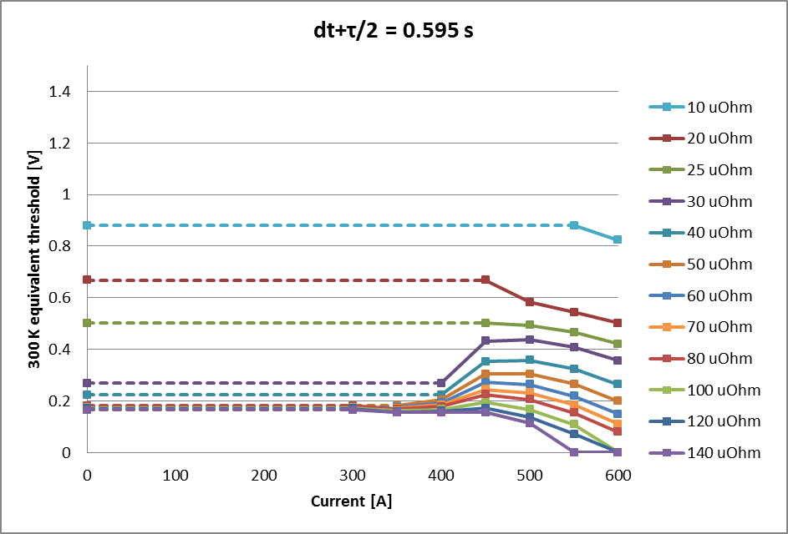
Quench Due to Joint Resistances Line-N
Dashed line: no quench propagation.
Equilibrium below 300 K.

Slide 28
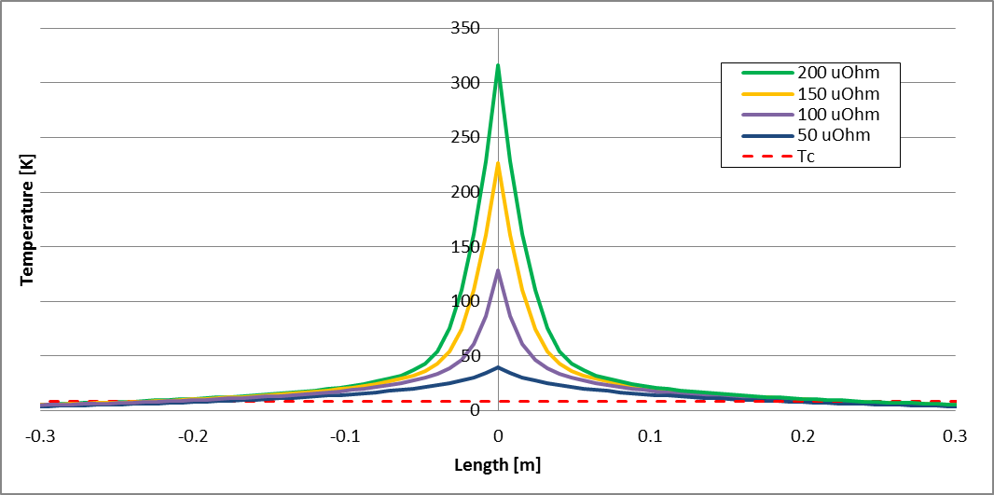
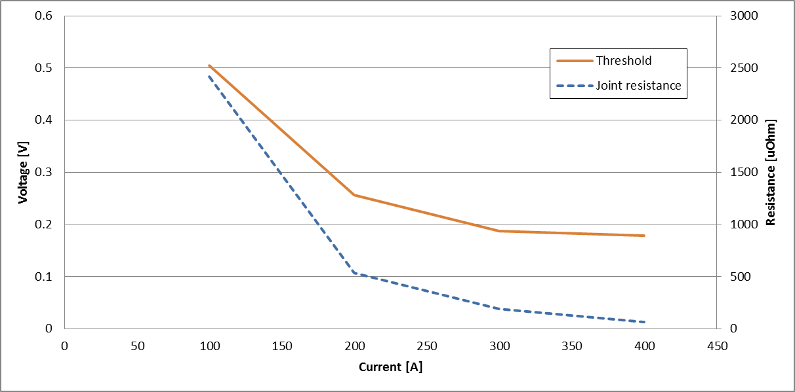
Resistive Joints in Spoolpiece Busbars
Spoolpiece busbars: Cu/Sc = 4, No EE

Slide 29
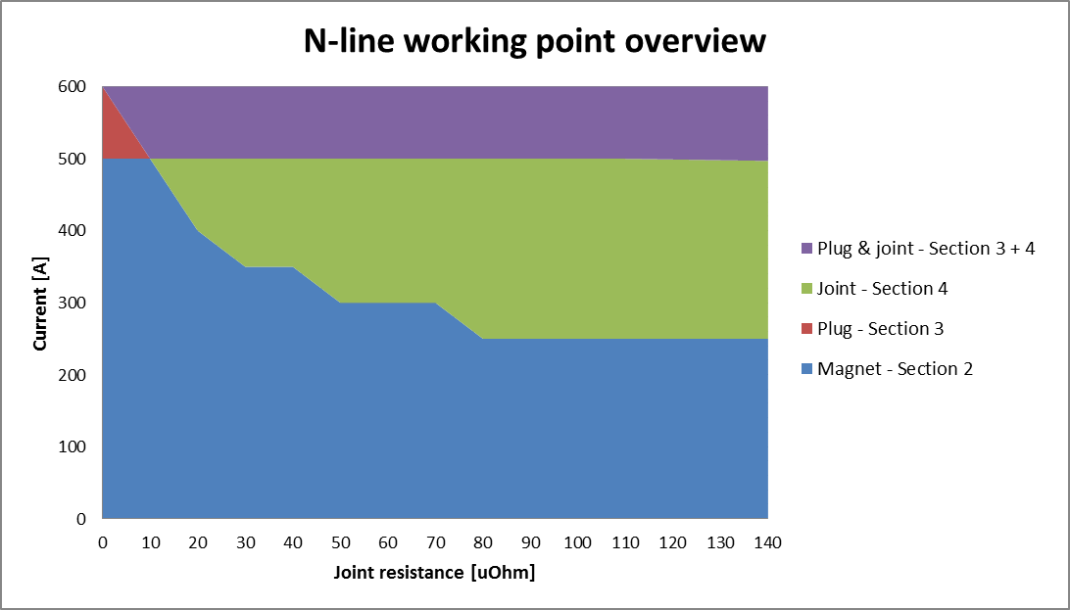
Overview of Relevant Scenarios
Once joint resistances are known, there is only one busbar scenario and one magnet scenario left.

