Slide 1
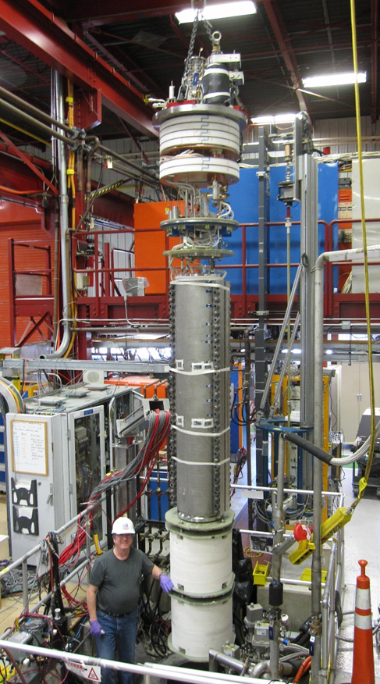
MQXFSM1 results
Guram Chlachidze
Stoyan Stoynev

Slide 2
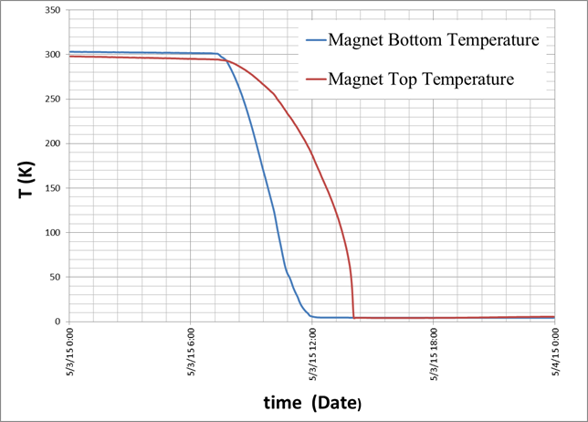
Status
The magnet was cooled down on May 3
RRR measurements and
warm up completed on
June 1st
Number of testing days: 15
Highlights
  30+ training quenches at 1.9 K,
  maximum current 19239 A
  (91.3% of SSL at 1.9 K)
  Reached 82% of SSL in 5 quenches
  but hit a limit (~90% of SSL) after 18 quenches
May 3

Slide 3
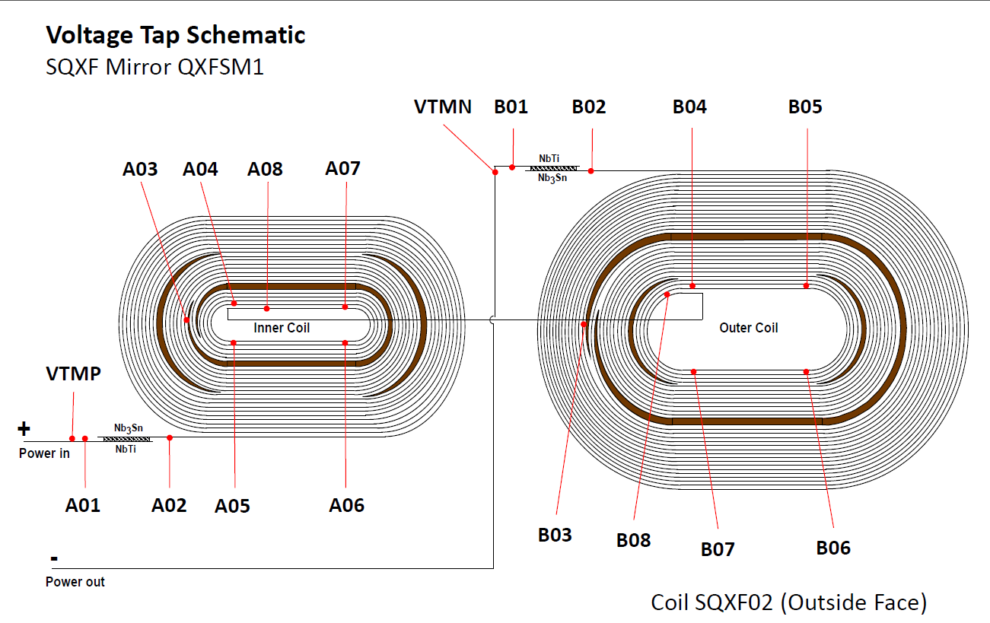
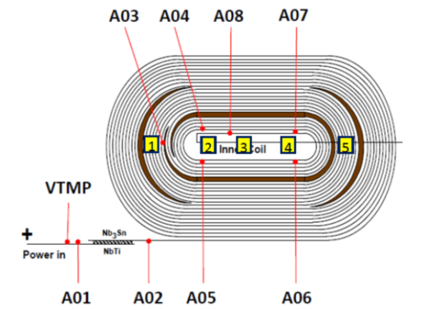
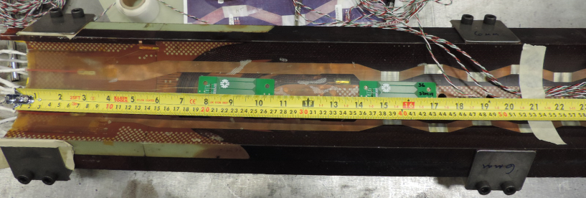
Quench detection instrumentation
Voltage taps and
quench antennas
positions
IL
OL
QA:

Slide 4
Quench location
Few days difference
4
1
1
1
1
1
1
3
1
1
1
1
1
1
1
-
1
2
1
1
1
1
-
4
(ramp rate studies;
quench protection
studies)
retraining
1
4
4
2
2
4
4
1
1
Quench antennas: 1 (LE) to 5 (RE)
All the a3_a4 and a4_a5 (after hitting the plateau) points are very similar with hard to
distinguish time difference between a3_a4 and a4_a5 (that is – it is likely a single location
quenching all the time); quench antennas support this as well – always LE ones active

Slide 5
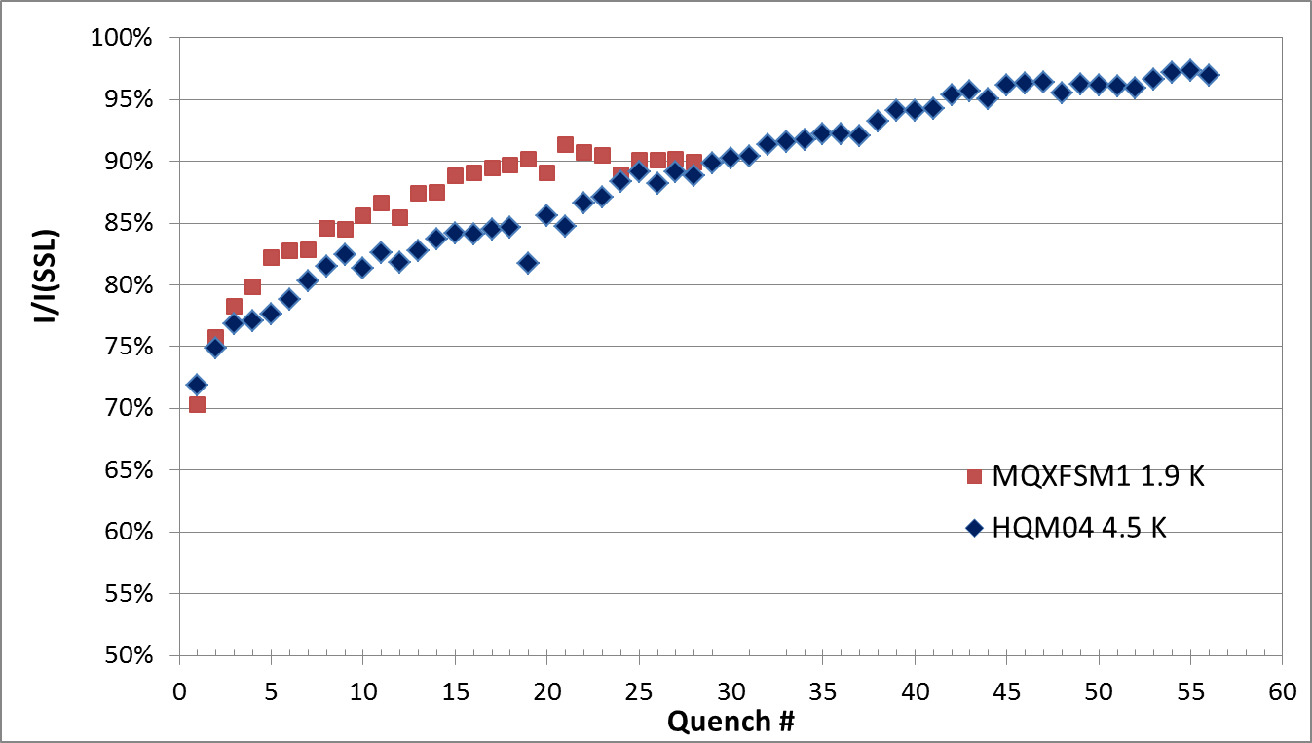
Training in terms of SSL fraction
HQM04 is another magnet we can
tentatively compare to
(it is a quadrupole mirror)
In addition to the quenches shown there were also quenches related to other studies
(like ramp rate dependence) and also few re-training ones. No improvement was observed.

Slide 6
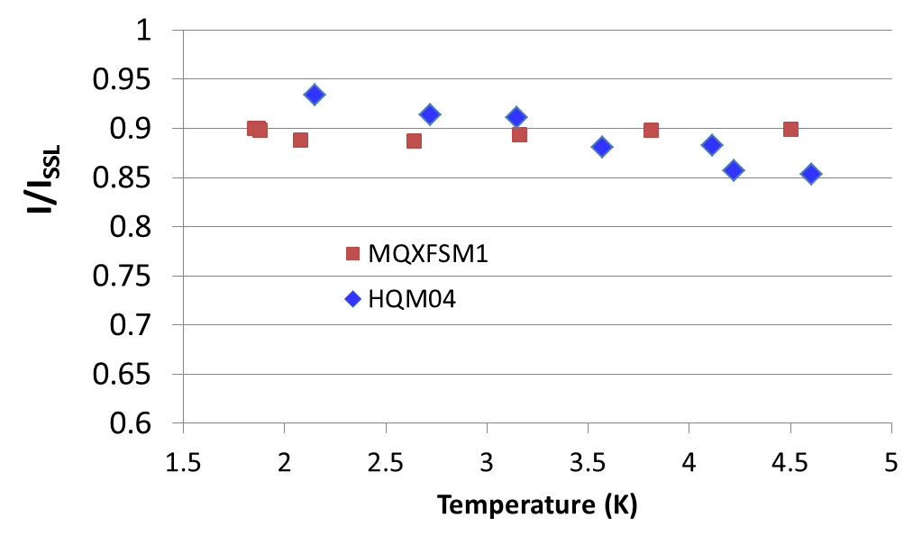
Temperature dependence
In terms of SSL fraction of the quench current there are no large variation
with temperature for MQXFSM1.

Slide 7
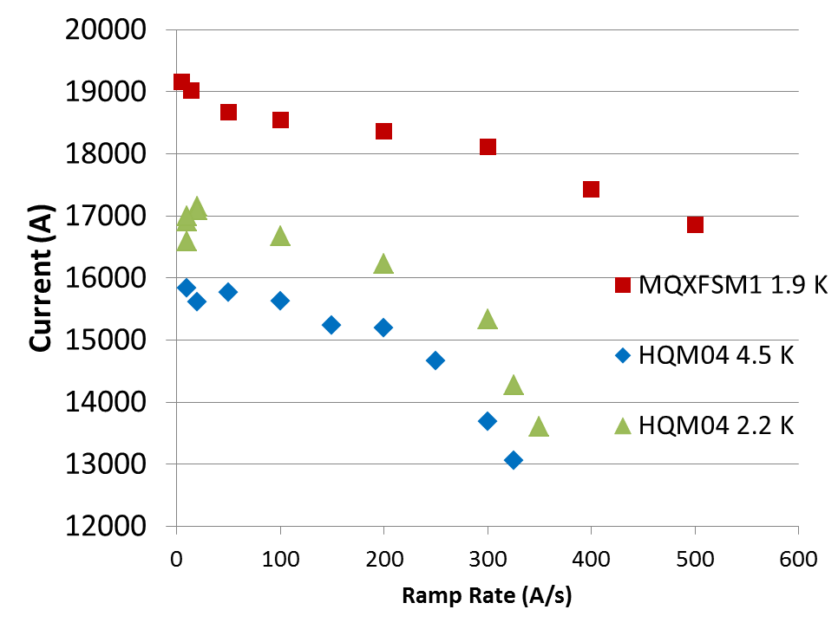
Ramp rate dependence
Quench current
The magnet did not quench at ramping down (from 18 kA) at 300 A/s

Slide 8
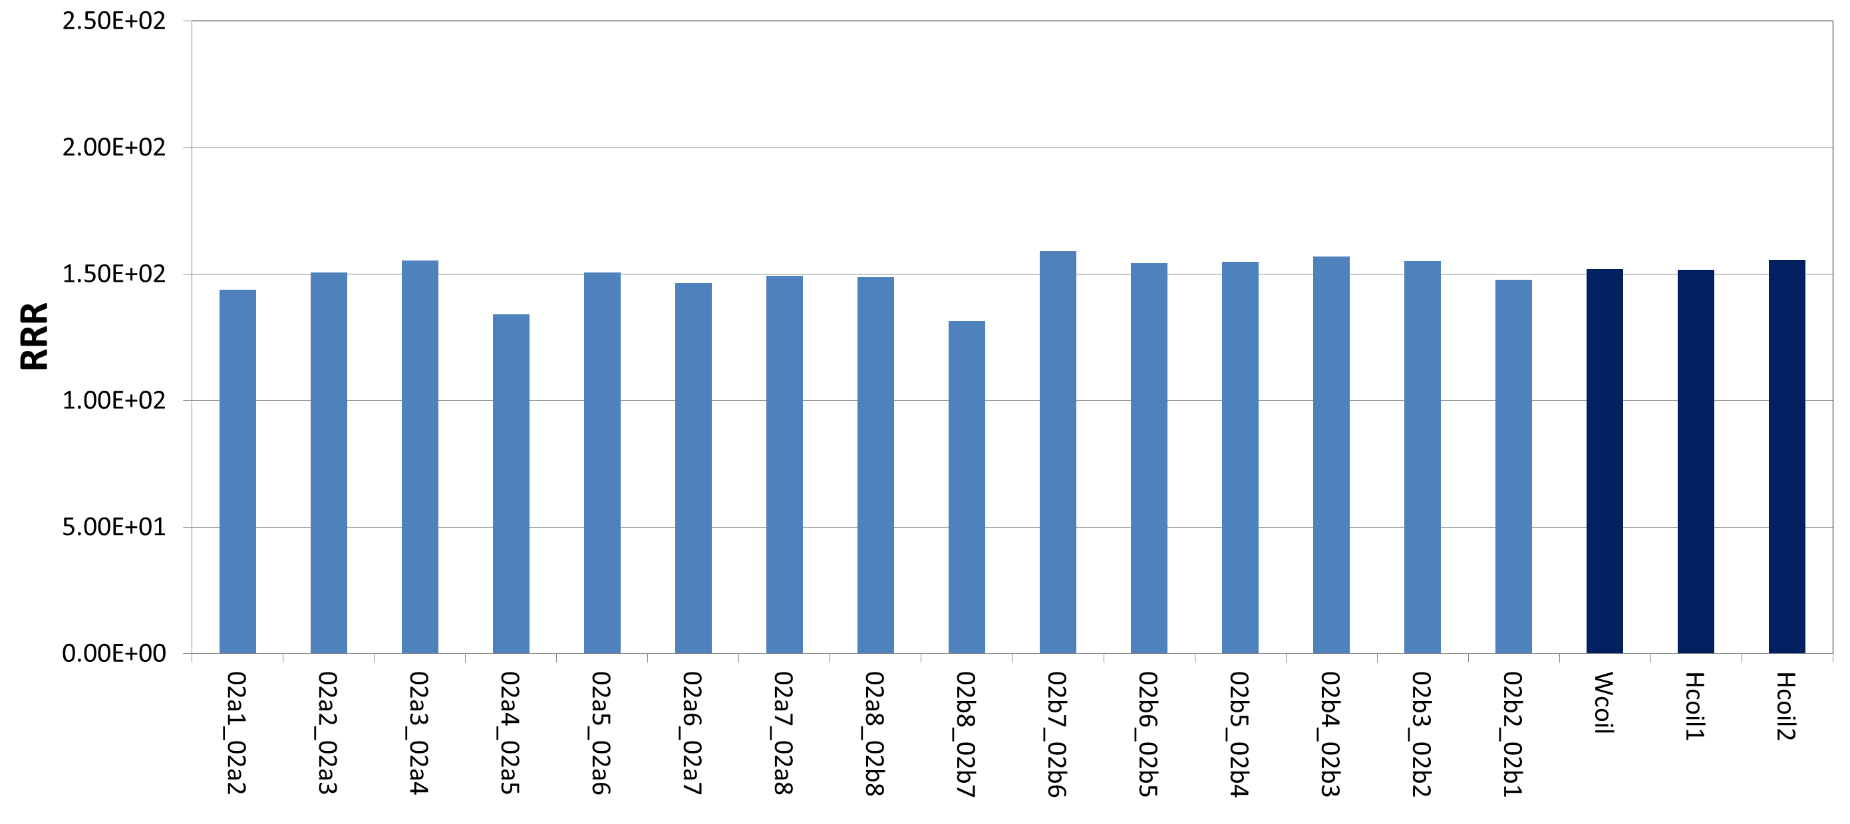
RRR
IL
OL
RRR values of 150 are typically obtained, no outliers.

Slide 9
Holding current time
The magnet was at 16.5 kA flat top for two hours at 4.5 K
The magnet was at 17.8 kA flat top for two hours at 1.9 K
However at 1.9 K it quenched during ramp down at 20 A/s (I_{q} = 17.6 kA)

Slide 10
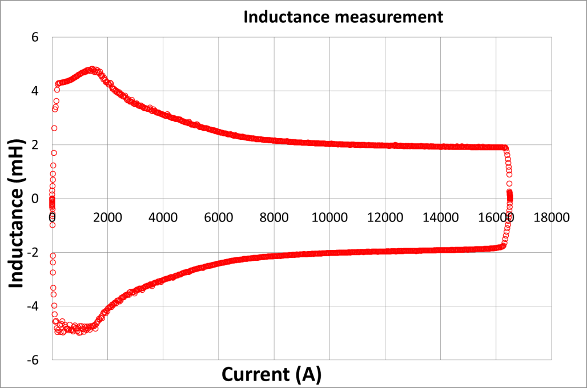
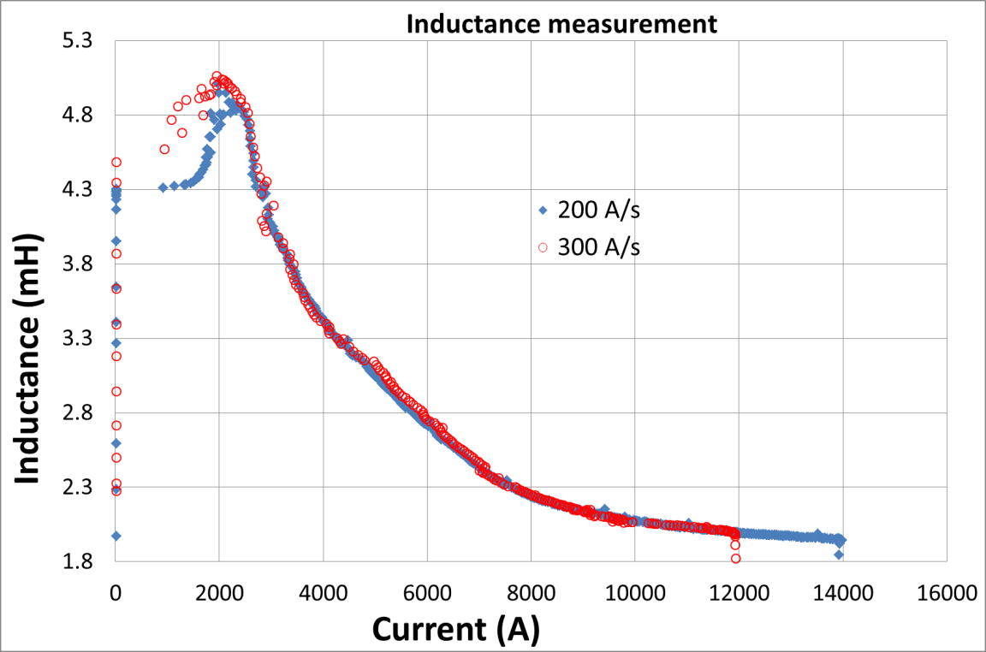
Inductance measurement
200 A/s
1.9 K
The measured inductance
at 300 K and 20 Hz is 5.2 mH
4.5 K
Measurements at 200 vs 300 A/s
(4.5 K) are consistent
(despite some technical issues)

Slide 11
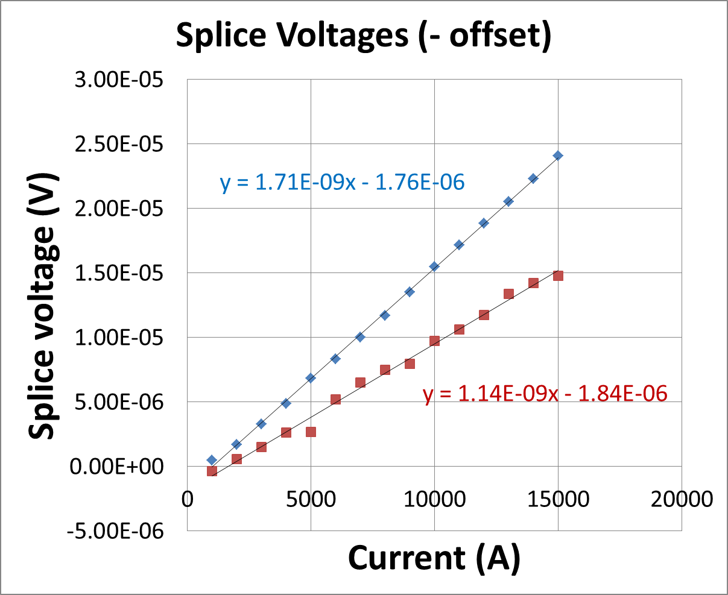
Splice resistance
IL (A)
OL (B)

Slide 12
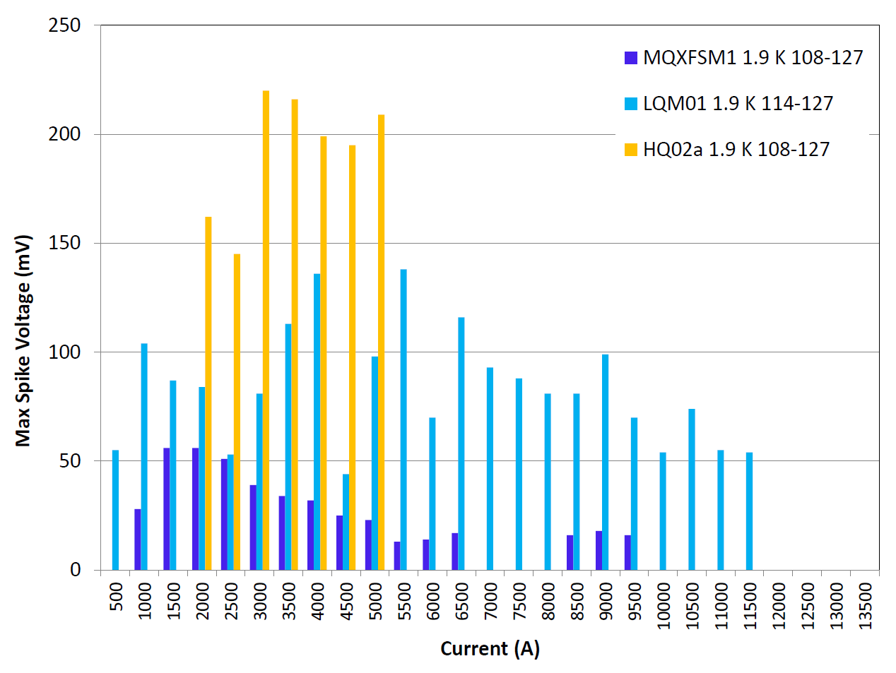
Spike analysis
(long mirror)
(quadrupole)
Spikes depend on the length and quality of cable,
there is typically a peak (magnitude, frequency of occurrence) at relatively low current

Slide 13
Quench protection studies

Slide 14
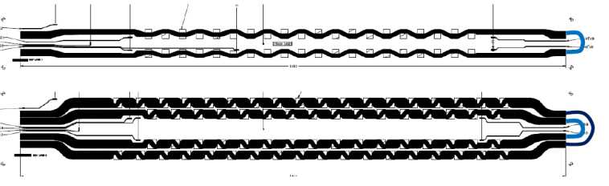
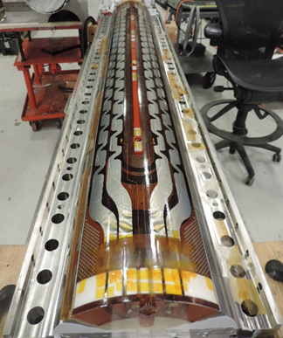
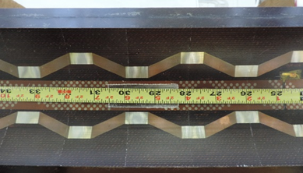
Two inner layer PH strips, as well as 2 pole and 2 mid-plane outer layer strips were connected in series internally, during the magnet assembly.
IL
OL
IL – copper cladded SS
OL
(LQ style)
The 2 OL heaters are connected in parallel or
tested/fired individually

Slide 15
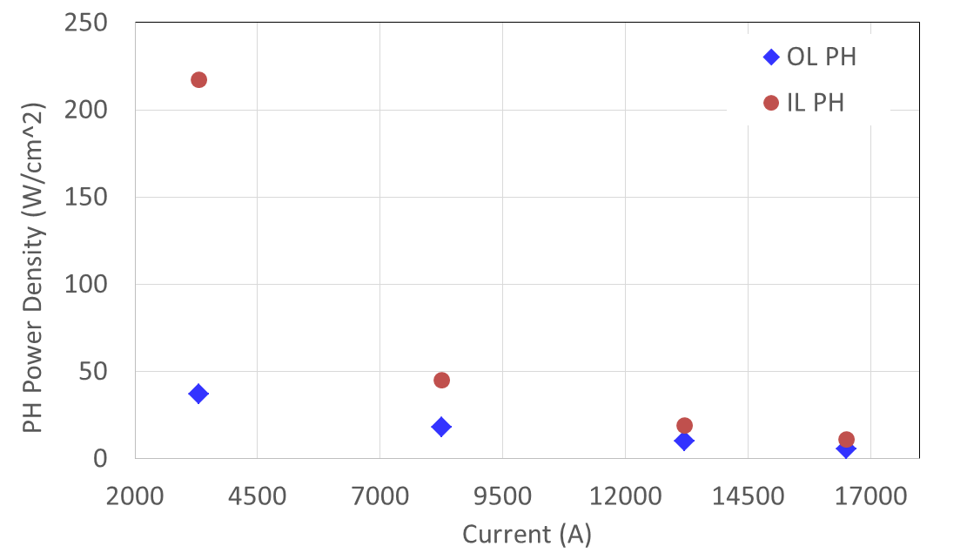
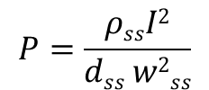
Minimum power density
Minimum heater power density
inducing a quench
Time const
τ ≈ 40 ms
$$P=\frac{ρssI2}{dss w2ss}$$
PH power density:
$\text{stainless} \text{steel} \text{resistivity}\text{ (}\text{cold}\text{)}: ρss$ = 0.5 μOhm . m
stainless steel (heater) thickness and width : $dss=0.025 mm and wss=10.0 \left(10.75\right) mm$
IL (OL)

Slide 16
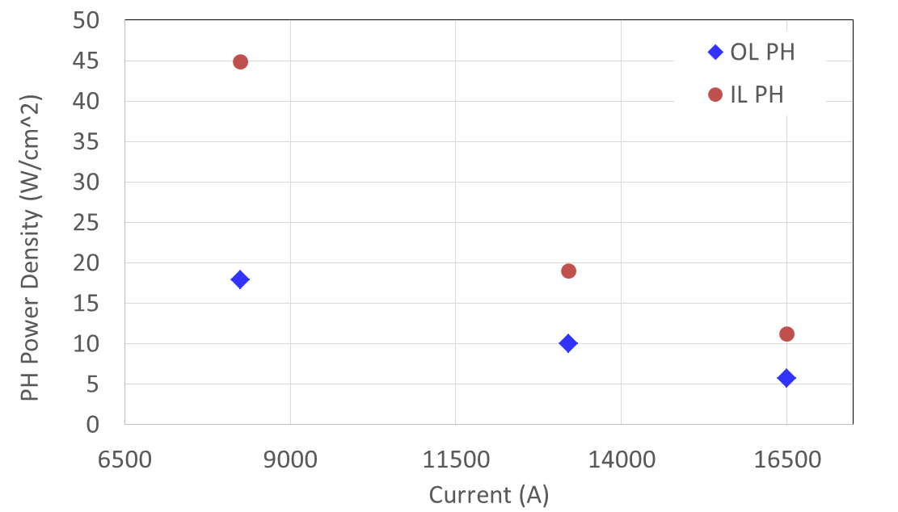
Minimum power density (2)
ZOOMED version of the previous slide’s plot

Slide 17
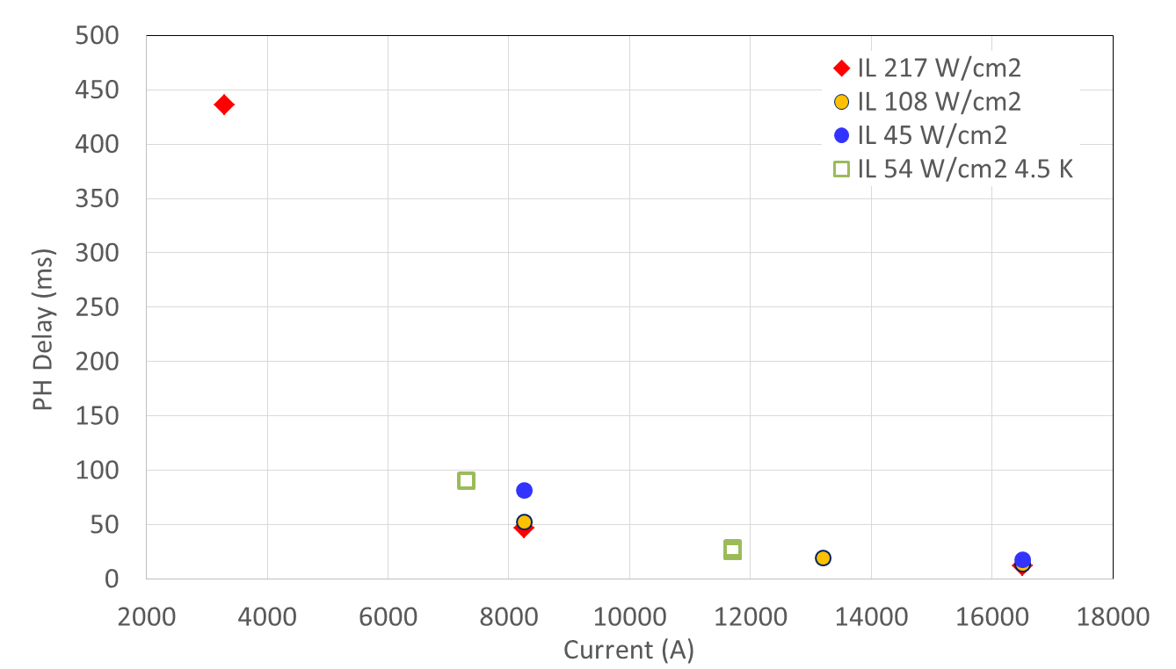
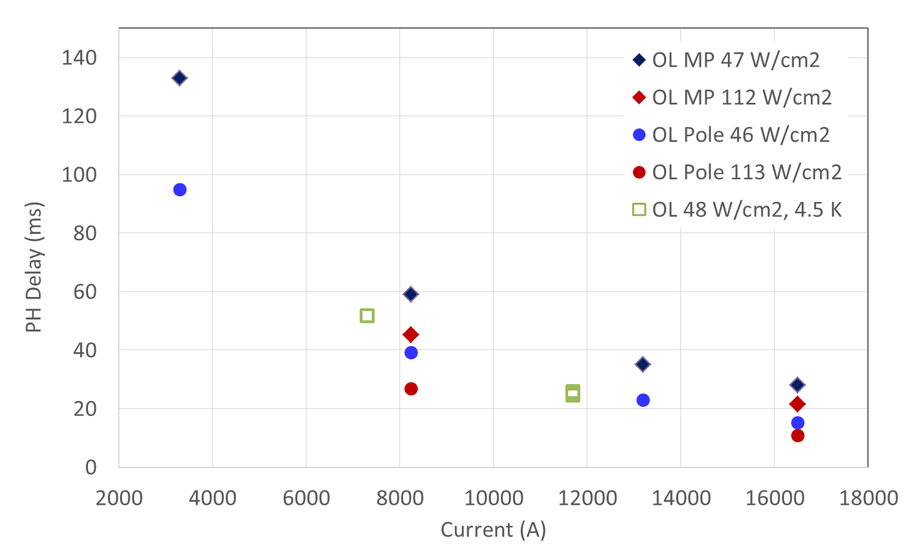
Heater delay vs current
These are the time differences between
heater firing and
the start of quench development
Reproducibility test – there are three
repeated measurements (points) here
Reproducibility test – there are three
repeated measurements (points) here
For OL pole and middle plane tests
τ ≈ 94 ms,
for IL - τ ≈ 40 ms

Slide 18
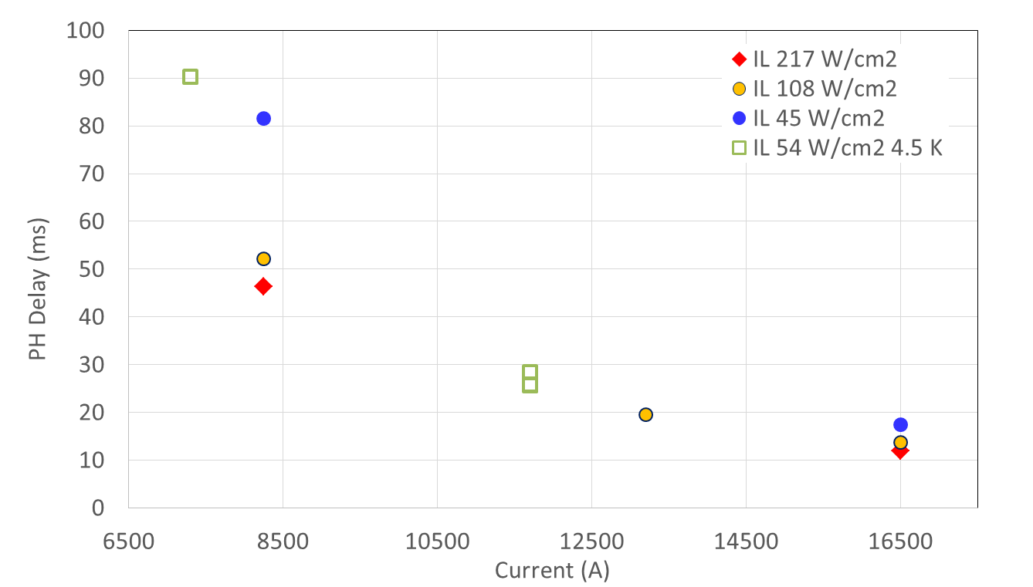
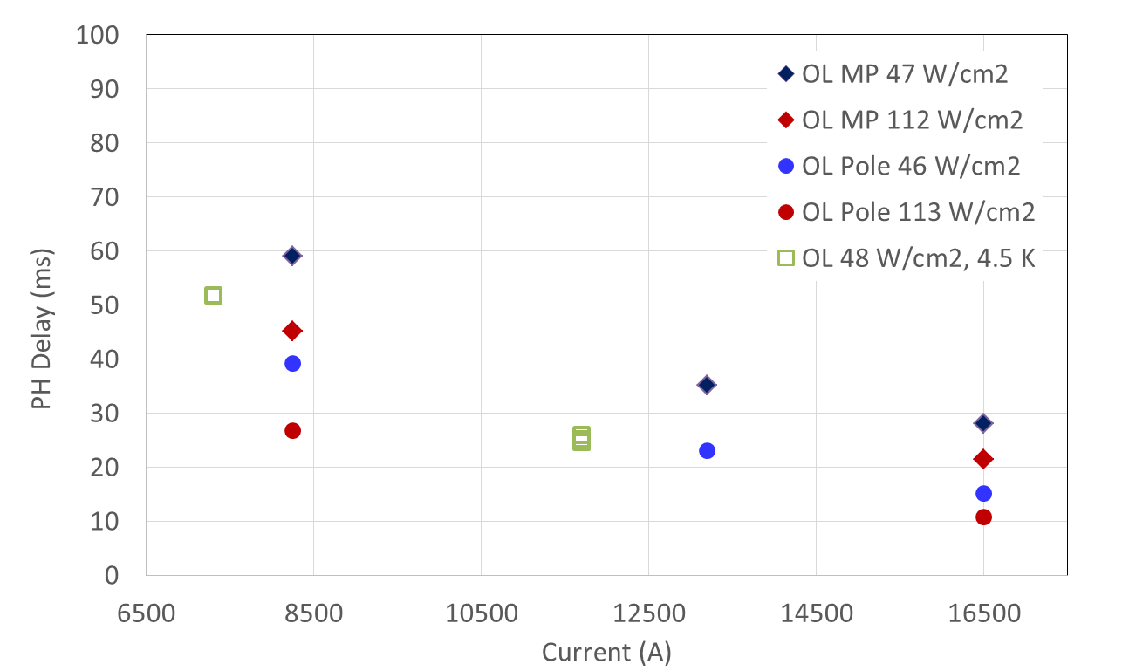
Heater delay vs current (2)
ZOOMED version of the previous
slide’s plots
Both plots here are in the same scale(s)

Slide 19
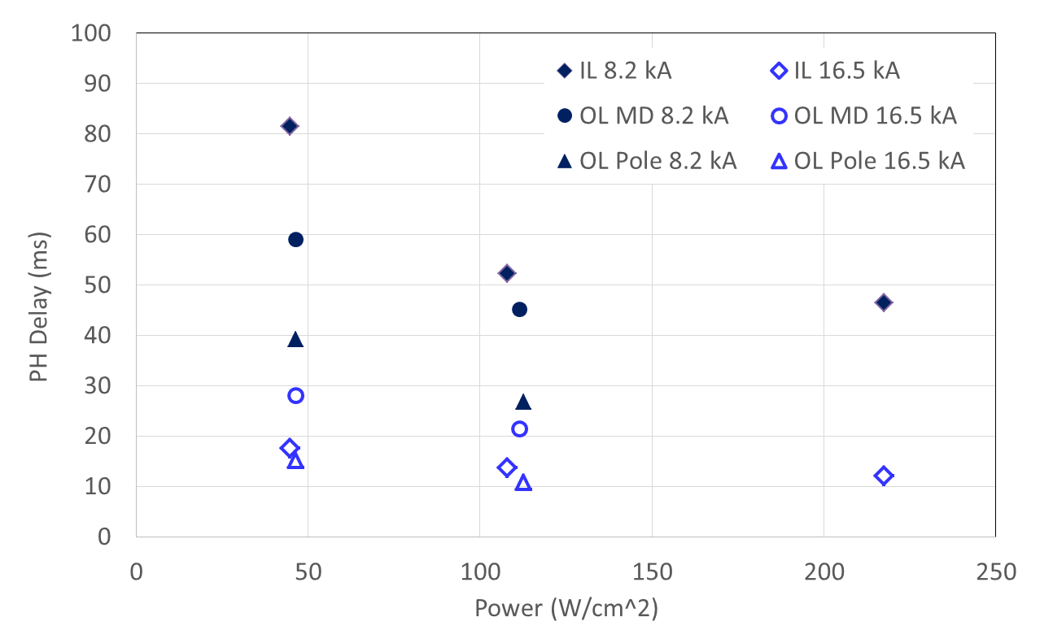
Heater delay vs peak power density
For OL pole and middle plane tests τ ≈ 94 ms ,
for IL - τ ≈ 40 ms

Slide 20
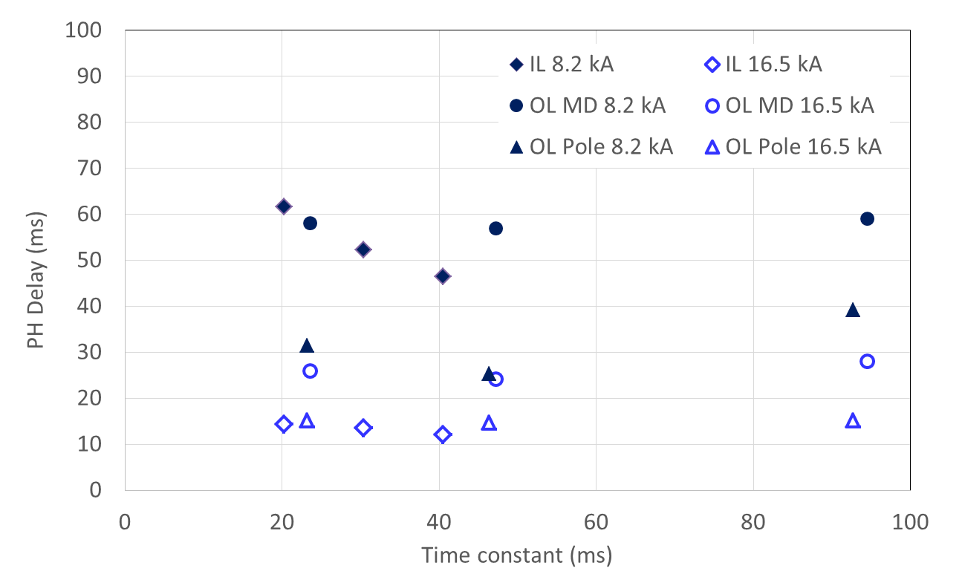
Heater delay vs decay time constant
The time constant was changed by changing the HFUs capacitance – 19.2/14.4/9.6 mF
The power density was ~ 108-113 W/cm² (same for a given set)

Slide 21
Quench propagation schematics
FOR ILLUSTRATIVE PURPOSES
Example configuration:
- IL heater to unit HFU1
- OL heater off-line
- Dump delay of 1000 ms
t_{HFU1} : heater fired
t_{q} : start quench development
t₀(≡0) : quench detected
t_{dump} : dump resistors engaged
t_{ata} : layer-to-layer
propagation time
Magnet current
t_{ata}
Quench
development
(for a given segment)
IL
OL
t_{HFU1} t’_{q} t₀(≡0) t’’_{q} t_{dump} time

Slide 22
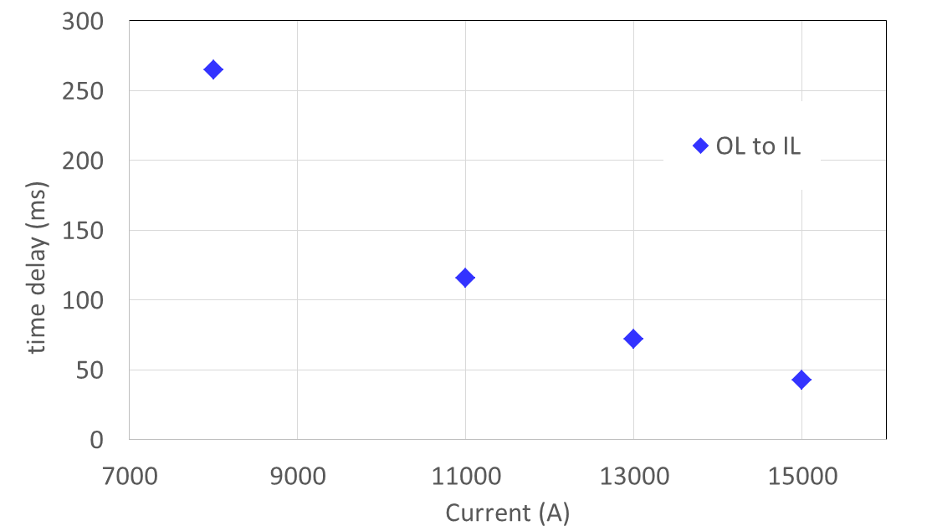
Quench propagation
Quench propagation time between layers
{ t=0 < t_{q} (layer1; heater induced) < t_{q} (layer2; propagated) }
Dump delay is large (1000 ms).

Slide 23
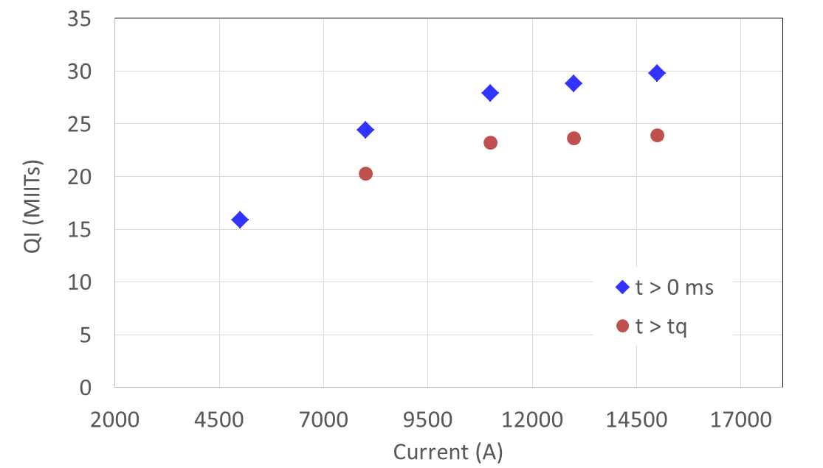
Quench integral
t = 0 ms here refers to the manual trip initiation time
t_{q} is the start of (heater induced) quench development

Slide 24
Summary
Quench training of MQXFSM1 reached 90 % of SSL
Behavior remains similar at higher temperature
Very good performance vs ramp rate
(eddy current losses well controlled by SS cored cable)
Holding current tests – stable performance
Good RRR and splice resistances
Consistent inductance measurements
Rich quench protection related data
(reproducibility checked)

