Slide 1


Search for dark photon at NA48/2, and measurement of π⁰ form factor
Mauro Raggi, Sapienza Università di Roma e INFN Roma
On behalf of the NA48/2 collaboration
KAON 2016 conference 14-17 September 2016
School of Physics and Astronomy,
University of Birmingham

Slide 2
Outline
NA48/2 experiments at CERN SPS
Search for the dark photon in π⁰ decays
Measurement of π⁰ form factor
Conclusion and prospects

Slide 3
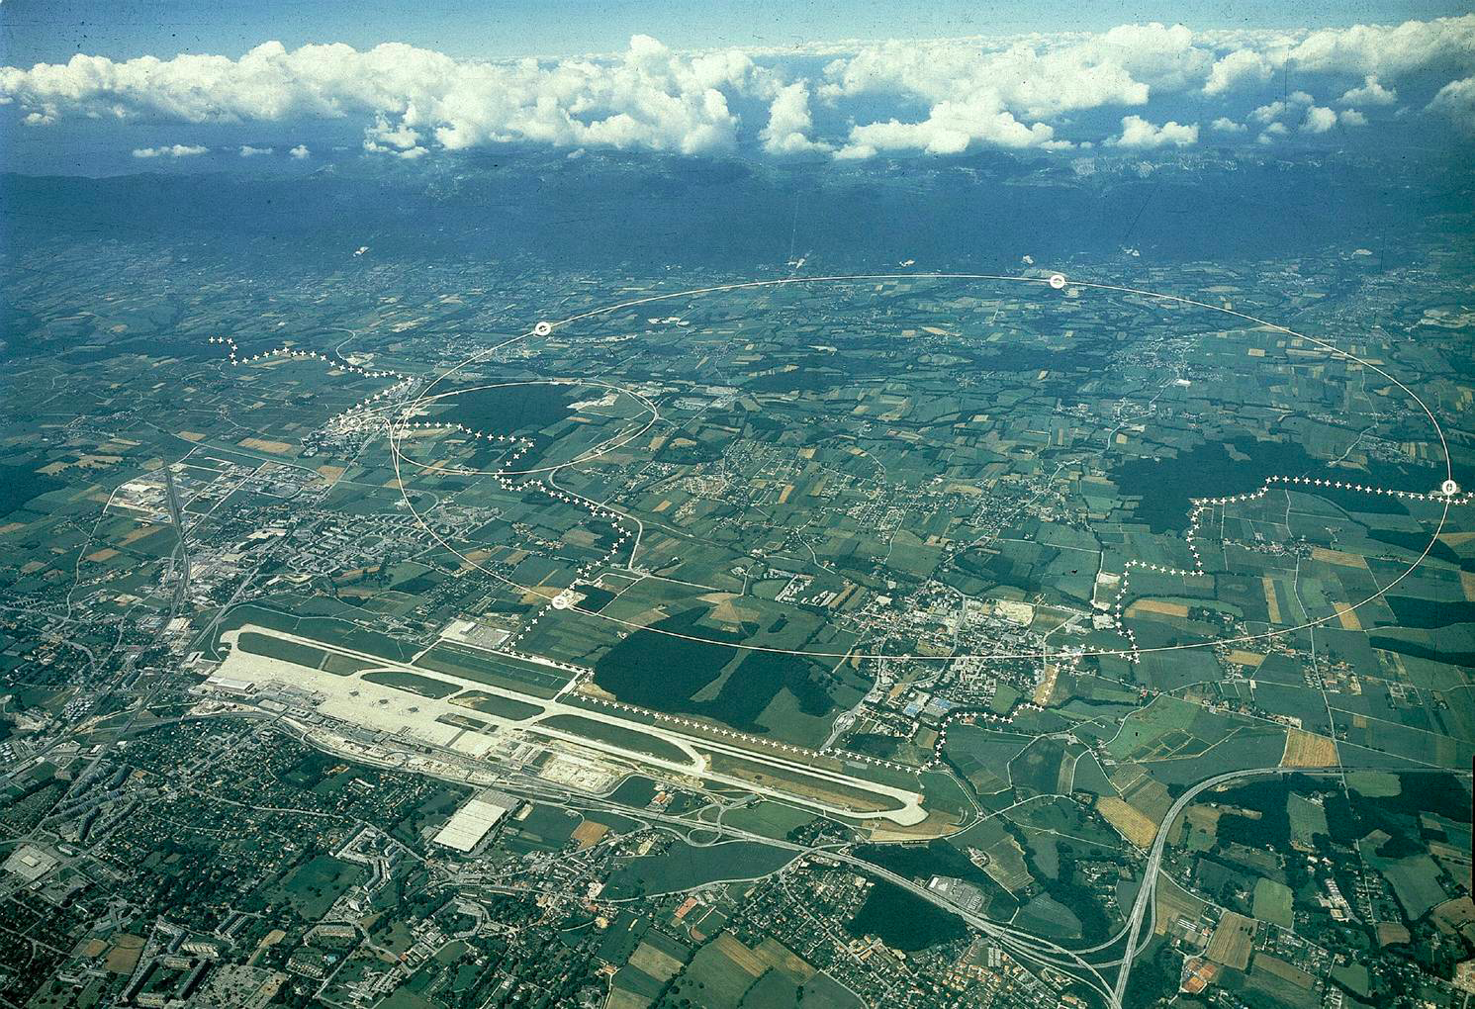
The NA48/2 and NA62 experiments @ SPS
Jura mountains
France
NA48/2 & NA62-RK
SpS
Switzerland
Geneva airport
NA48/2 collaboration: 15 institutes from 8 countries:
NA62-RK collaboration: 30 institutes from 13 countries

Slide 4
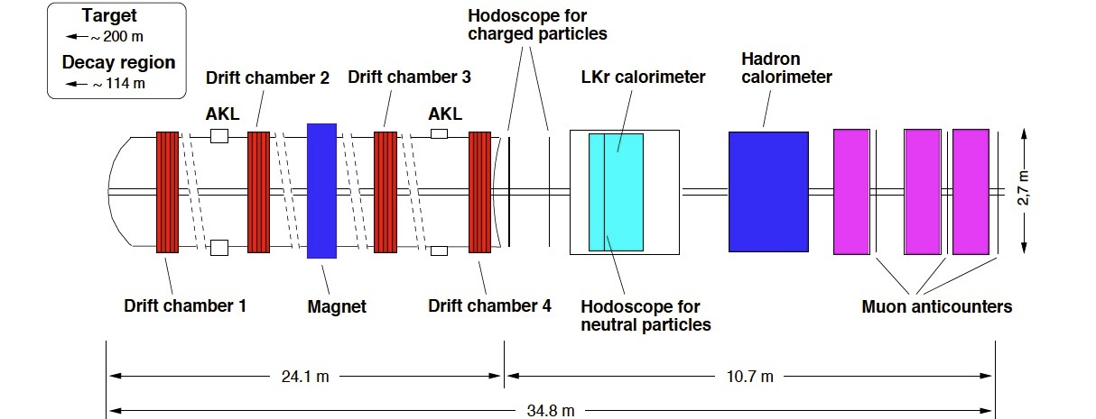
NA48/2 (2003-04) NA62-RK (2007-08)
NA48/2 data taking : 4 months in 2003-04 (K±) 60 GeV Simultaneous K± beam
NA62-RK data taking: 4 months in 2007 (K⁺) 74 GeV mostly K⁺ only beam
Magnetic Spectrometer
4 drift chambers and a dipole magnet
Liquid Krypton EM calorimeter (LKr)
- High granularity (13248 cells of 2x2 cm²)
- Quasi-homogeneous, 7m³ liquid Kr (27X₀)
p in GeV/c
E in GeV

Slide 5




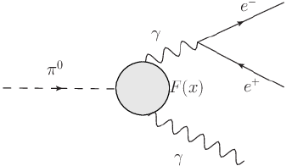
The π⁰_{D} decay form factor |F(x)|
π⁰_{D} : π⁰→e⁺e⁻γ differential decay rate:
First order Form Factor F(x):
  |F(x)|~1+ax a = FF slope parameter
  Need sample with unbiased π⁰ Dalitz decays.
A clean and large sample of π⁰_{D} can be obtained at NA62-RK:
  Source: K±→π±π⁰ tagged neutral pion (~10⁹ π⁰ →~10⁷ π⁰_{D} decays ).
  Avoid any trigger bias on the data sample (minimum bias trigger)
  NA62-RK lower statistic but much better trigger conditions wrt to NA48/2

Slide 6

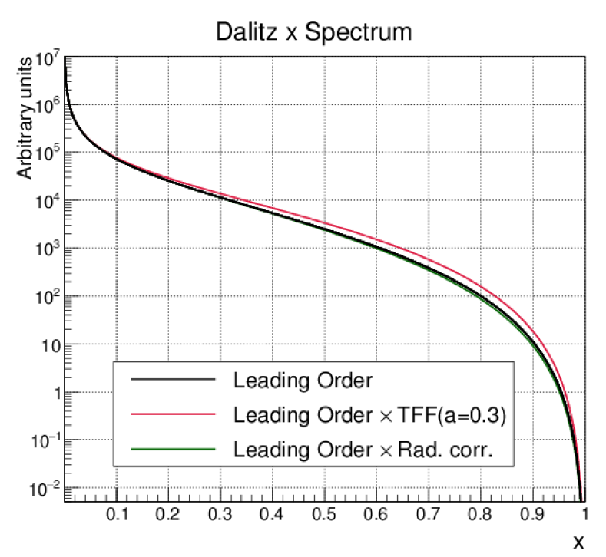
Measuring π⁰_{D} transition FF slope
Fit the differential decay width as function of x:
Theoretical expectation: a~0.03 VMD models.
FF is a tiny effect:
  Need very precise measurement of x
  Proper radiative corrections δ(x,y)
Relevant measurement to improve
precision calculation of light by light
scattering contribution to muon g-2.

Slide 7
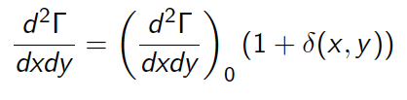
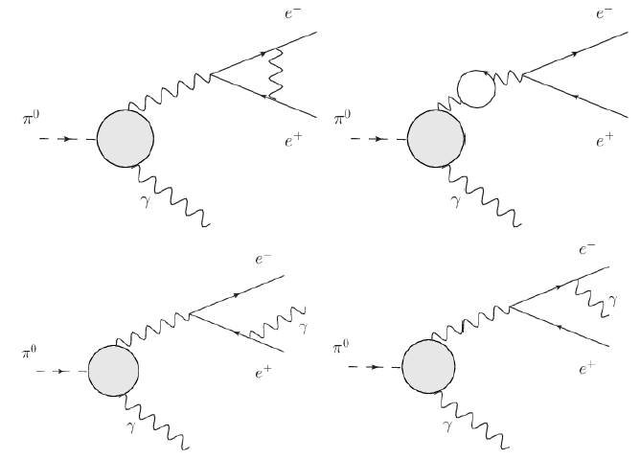
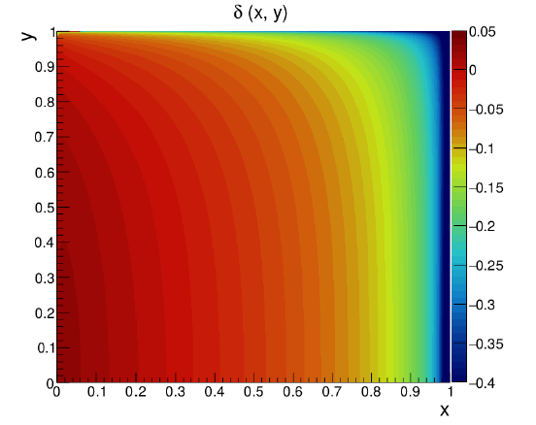
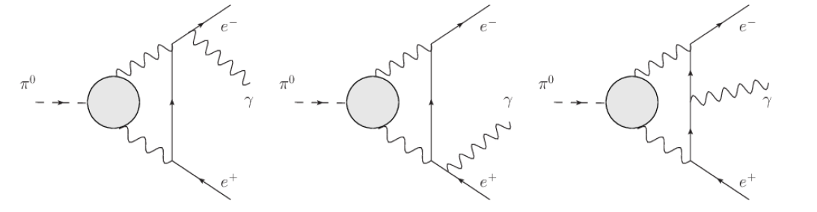
Computing π⁰_{D} radiative correction δ(x,y)
Original paper by Mikaelian and Smith:
Phys. Rev. D5(1972) 1763
Recent improvement Husek, Kampf and Novotny
Phys. Rev. D92(2015) 5, 054027
Husek, Kampf and Novotny
Parameterization introduced in MC to improve agreement with data.
Simulation includes emission of radiative photons

Slide 8
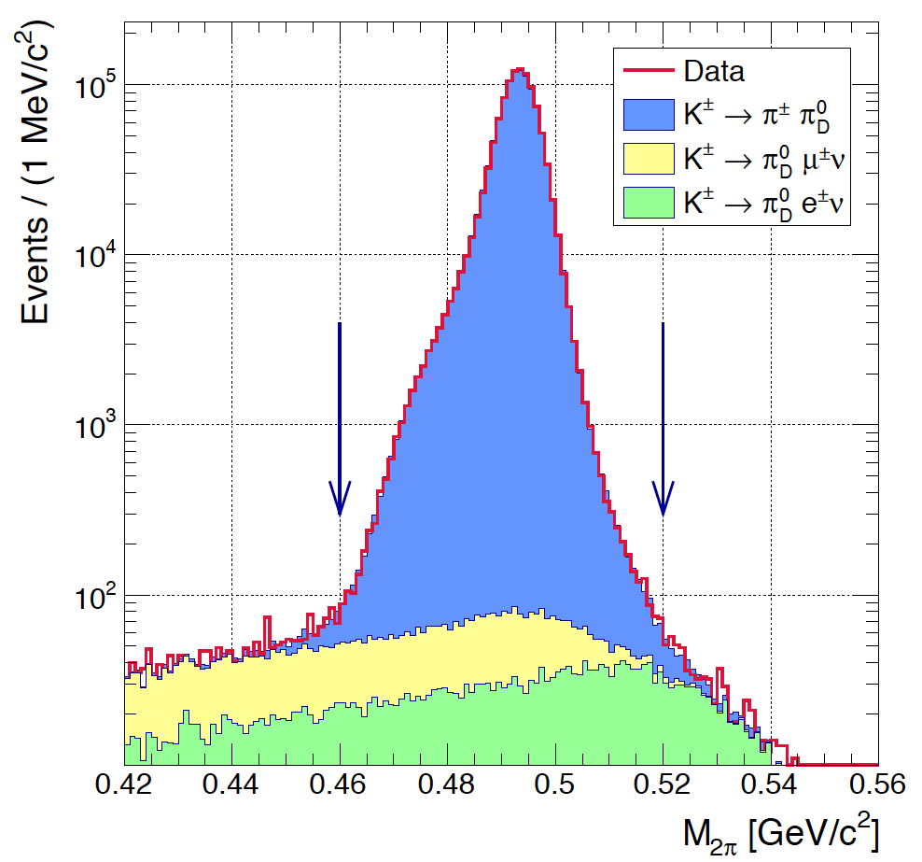
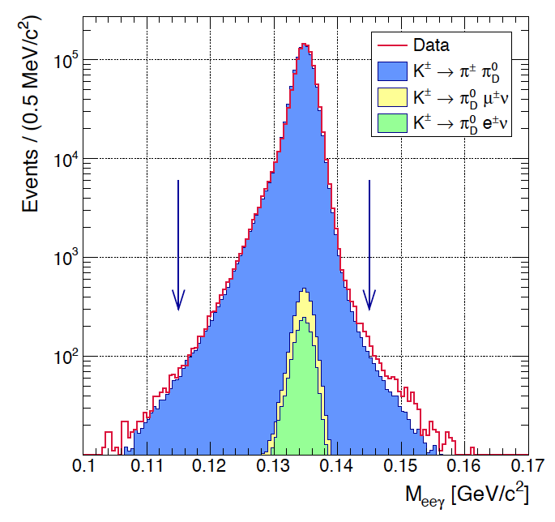
NA62-RK π⁰_{D} selection
Source K±→ π±π⁰ and K±→π⁰μ±ν
  Tag the π⁰ and select its Dalits decay
Main selection cuts:
  Three good track candidates
  One good gamma candidate
  Reconstructed e⁺e⁻γ invariant mass region:
  115MeV/c²<M_{eeγ}<145MeV/c²
  Reconstructed π⁺π⁰ invariant mass region:
  465 MeV/c² < M_{π+π0} < 510 MeV/c²
  Reconstructed Dalitz variable : 0.01<x<1
Selected data sample NA62-RK 2007:
  1.05x10⁶ π⁰_{D} candidates

Slide 9
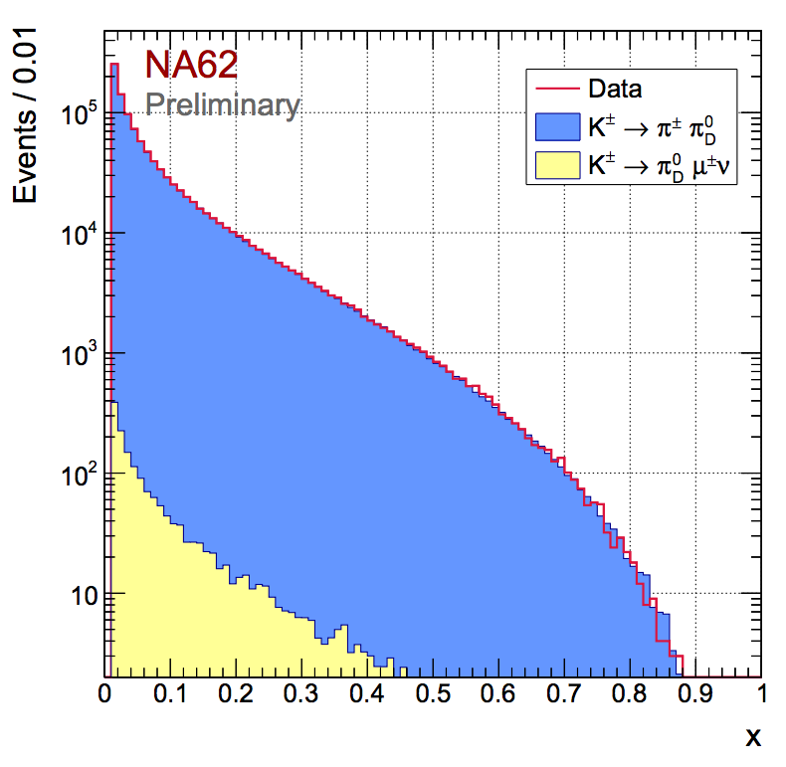

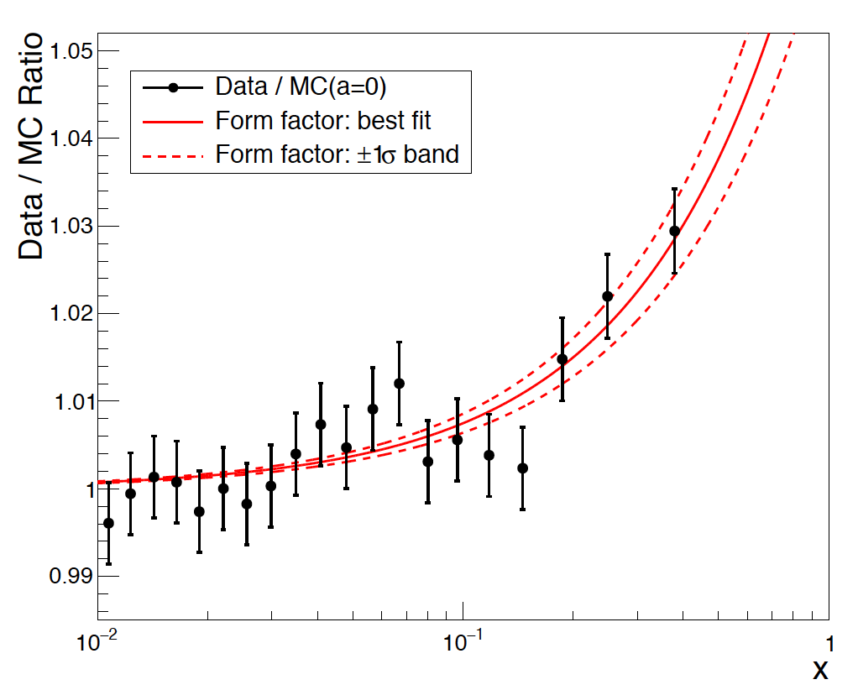
FF slope fit measurement
Split the reconstructed Dalitz x data into 20 equi-populated bins
Compare data with MC TFF slope a= 0.032
Re-weight MC events to get simulated distributions with different values of a:
Perform χ² test to extract best a
NA62-RK preliminary fit result:
a = (3.70 ± 0.53_{stat} ± 0.36_{syst})×10⁻²
χ²/d.o.f = 52.5/49

Slide 10
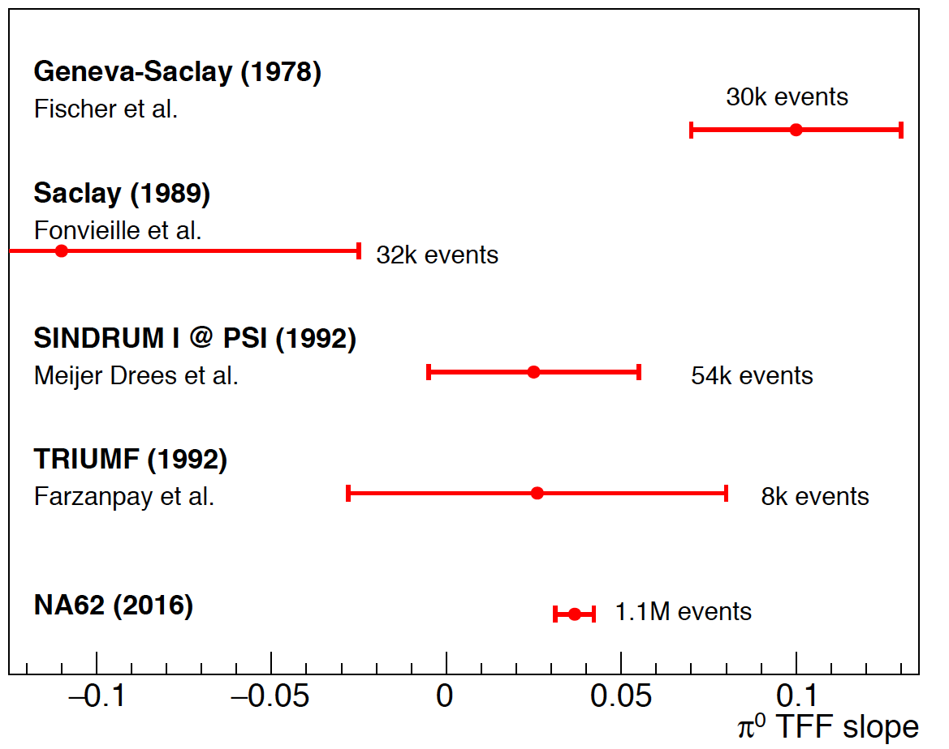
Comparison with other experiments
Theory
Theoretical expectation for FF
χPT
EPJ C46 (2006), 191
a = (2.90 ± 0.50)×10⁻²
Dispersion theory
EPJ C74 (2014), 3180
a = (3.07 ± 0.06)×10⁻²
Two-hadron saturation model
EPJ C75 (2015) 12, 586
a = (2.92 ± 0.04)×10⁻²
NA62-RK preliminary
a = (3.70 ± 0.53_{stat} ± 0.36_{syst})×10⁻²
The NA62 preliminary measurement is the most precise FF measurement to-date
Final result and paper to come soon!

Slide 11
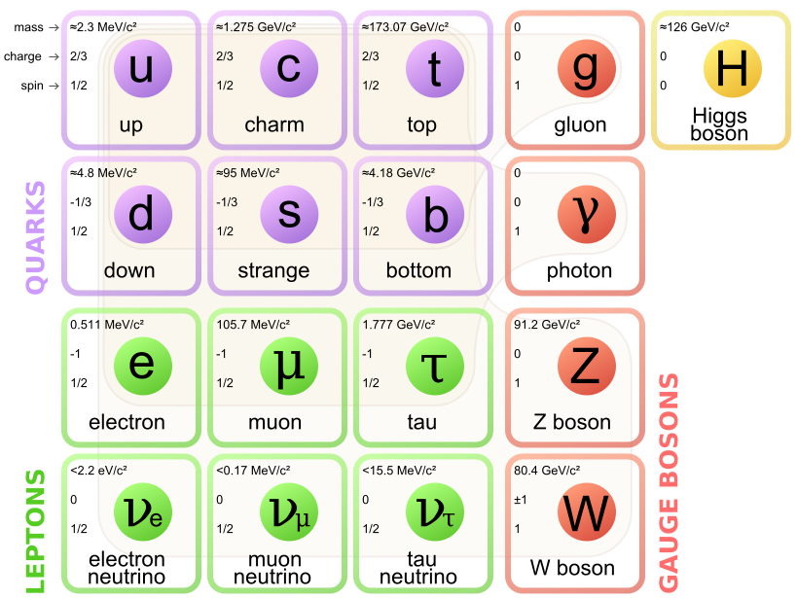
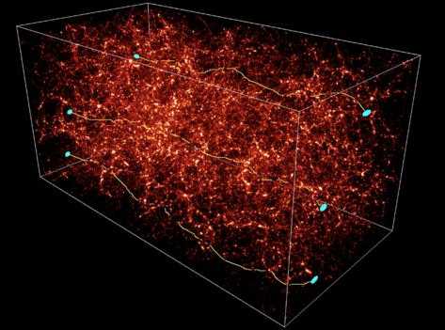
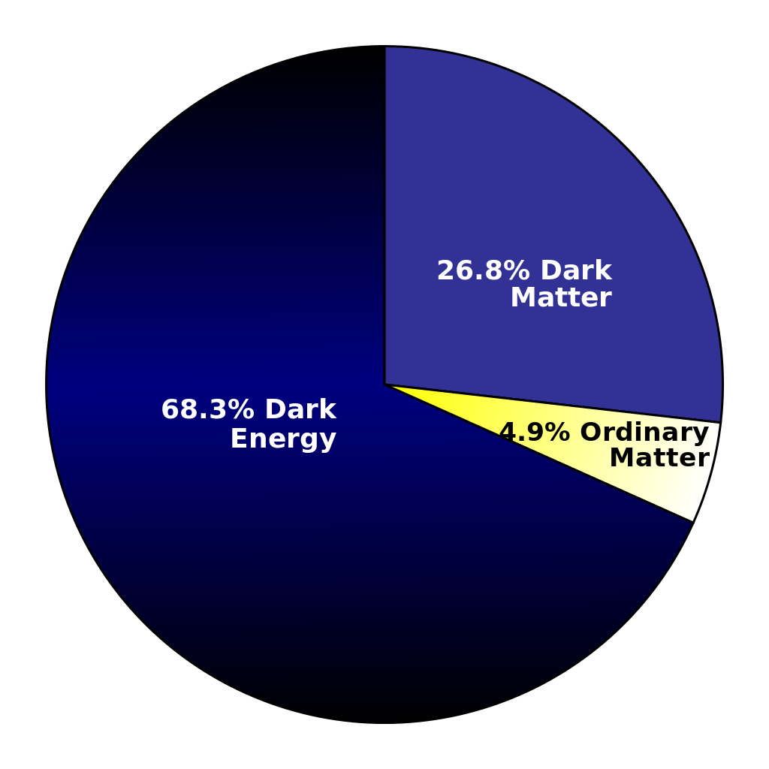
What is the universe made of?
Standard model
???Dark Sector???
h’
Dark fermions?
χ
A’
→?→
Z’
Standard model only includes <20% of the matter in the universe
  We only know dark matter interacts gravitationally
Many open questions
  What is dark Matter made of?
  How dark matter interact, if it does, with SM particles?
  Does one or more new dark force exist?
  How complex is the dark sector spectrum?

Slide 12


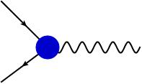
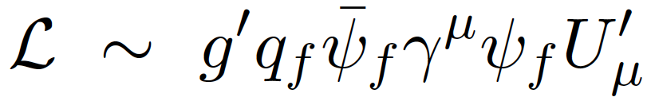
Simplest dark photon model
The simplest hidden sector model just introduces one extra U(1) gauge symmetry and a corresponding gauge boson: the “dark photon" or A’ boson.
The coupling constant and the charges can be generated effectively through the kinetic mixing between the QED and the new U(1) gauge bosons
  In this case the new coupling constant = eε is just proportional to electric charge and it is equal for both quarks and leptons.
As in QED, this will generate new interactions with SM fermions of type:
  Not all the SM particles need to be charged under this new symmetry
  In the most general case q_{f} is different in between leptons and quarks and can even be 0 for quarks. P. Fayet, Phys. Lett. B 675, 267 (2009)
γ
A’
B. Holdom Phys.Lett. B166 (1986) 196
q_{f}
A’

Slide 13
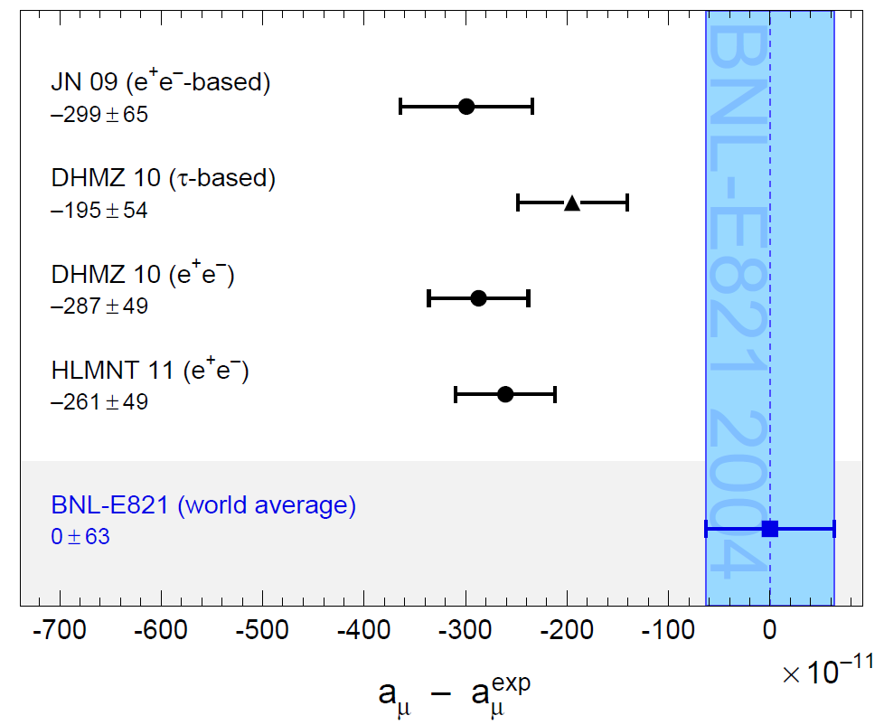
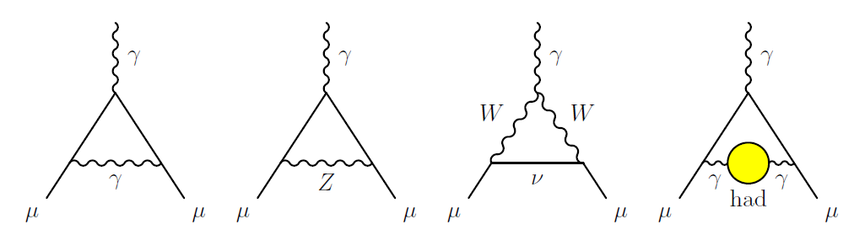
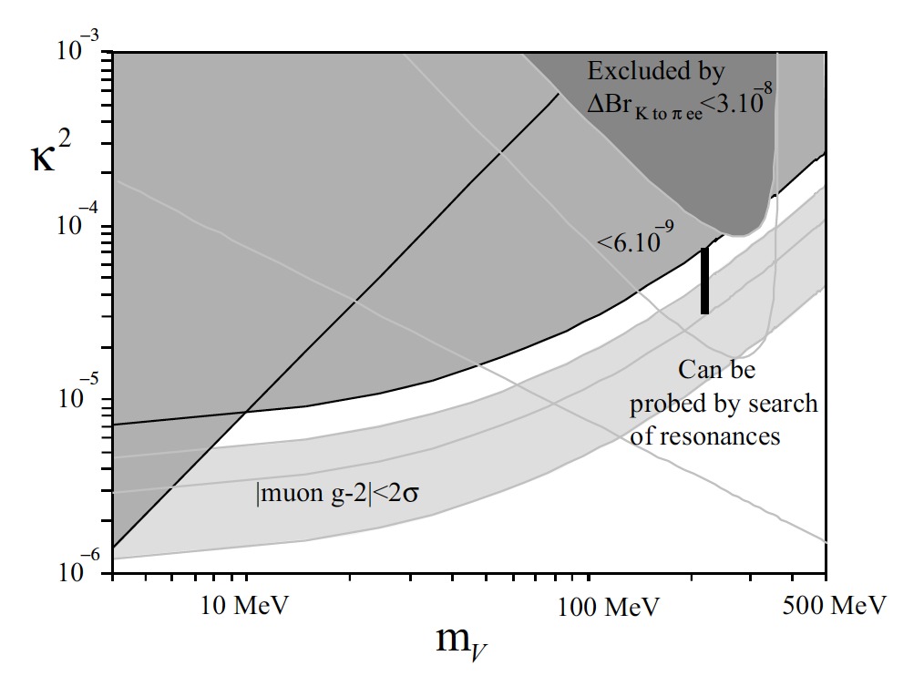
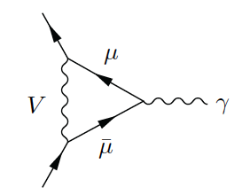
Dark photon and g-2_{μ}
g-2 in the standard model
About 3s discrepancy between theory and experiment. Could be due to hadronic uncertainties on the Light by Light scattering?
g-2 and A’
Additional diagram with dark photon exchange can fix the discrepancy!
(with sub GeV A’ masses ☺)
A’
M. Pospelov
Phys.Rev. D80 (2009) 095002

Slide 14
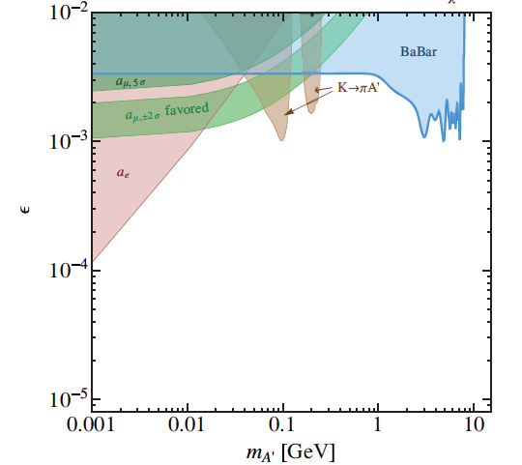
Dark photon searches status
Visible decays: A’→ ee, μμ, ππ,
  Kinetic mixed dark photons simplest model
Favored parameters values
explaining muon g-2 (green band)
  A’-boson light 10-100 MeV
Status of dark photon searches
  Beam dump experiments (grey)
  Fixed target (Apex, A1)
  Mesons decays (Babar, KLOE, Wasa)
Theoretical exclusion from g_{e}-2 g_{μ}-2
  Tight limit form α_{EM} (red filled area) PhysRevD.86.095029
Much less constraints on “Invisible” decay mode
  If M_{χ}<M_{A’}/2, A’→χχ, ε² suppression to all visible modes
  No assumption on α_{D} and no kinetic mixing
Visible decay searches 2015
Invisible decay searches

Slide 15
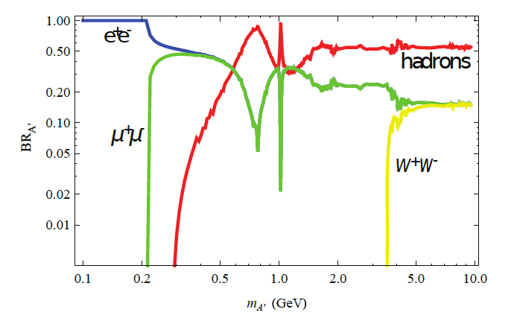
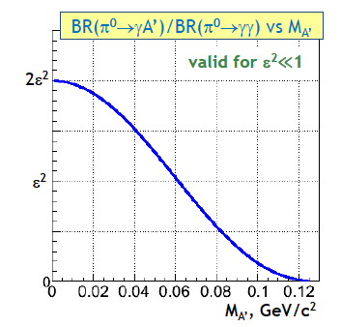
Dark photon in π⁰ decays
Production (kinetic mixing)
Decay (if no light dark sector)
Batell, Pospelov and Ritz, PHYS. REV. D 80, 095024 (2009)
M_{A’}<M_{π0} and no lighter wrt A’
dark sector particles exist BR(A’→e⁺e⁻)=1

Slide 16
NA48/2 data sample
Number of kaon decays in NA48/2 (’03/’04): N_{K} ≈ 2・10¹¹
  5・10¹⁰ π⁰ tagged decays from K±→π±π⁰ and K±→π⁰μ±ν decays
Exclusive search for the decay chain π⁰→γA’, A’→e⁺e⁻
  Search for a narrow peak in the e⁺e⁻ invariant mass.
  High efficiency trigger chain for 3-track vertices throughout all the data taking
  Very good spectrometer mass resolution: σ_{Mee} ≈ 0.012 x M_{ee}
DP final state π⁰→γA’, A’→e⁺e⁻ identical to π⁰_{D}→γe⁺e⁻;
  Main background is K±→π±π⁰_{D} : BR(K_{2pD})=2.4・10⁻³
  Sensitivity is limited by the irreducible K_{2pD} background.
Signal acceptance:
  depending on M_{A’} from 4.5% down to 0.5% for high values M_{A’}.
A total of ~1.7x10⁷ candidates collected during 2003-04 data taking

Slide 17
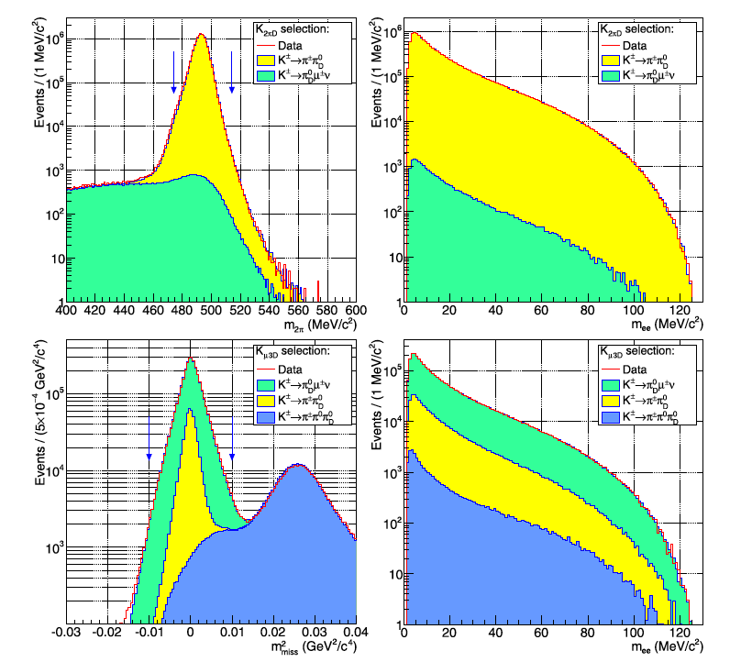
Data sample: K_{2πD} + K_{μ3D} selection
K±→π±π⁰_{D} selection
  |M_{eeγ}- M_{π0}|< 8 MeV/c²
  |M_{πeeγ}- M_{Κ}|<20 MeV/c²
  No missing P_{T}:
  < 5∙10⁻⁴GeV²/c²
K±→π±π⁰_{D}:
1.38∙10⁷ evt
K±→π±π⁰_{D}
K±→μ±π⁰_{D}ν
K±→μ±π⁰_{D} selection
  |M_{eeγ}- M_{π0}|<8 MeV/c²
  M²_{miss}< 0.01GeV²/c⁴
  missing P_{T} due to neutrino:
  5∙10⁻⁴< P_{T} < 0.04 GeV²/c²
K±→μ±π⁰_{D}ν
3.1∙10⁶ evt
K±→μ±π⁰_{D}ν
K±→π±π⁰_{D}
K±→π±π⁰π⁰_{D}

Slide 18
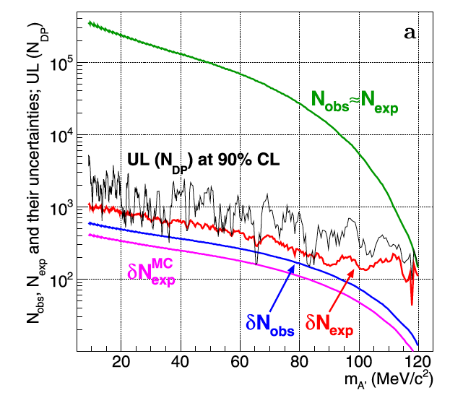
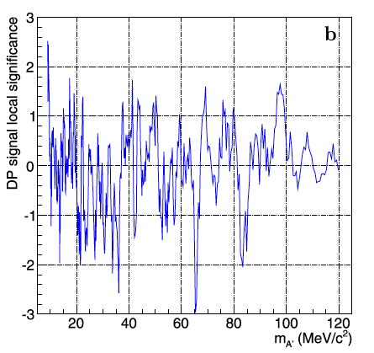
Statistical significance
Scanned DP mass range: 9 MeV/c²<M_{DP}<120 MeV/c².
  Variable DP mass step: 1.5(M_{A’}).
  DP search window: 0.5(M_{A’})
  404 DP mass hypothesis tested
Confidence intervals for N_{A’} are computed from:
  N_{exp}, N_{obs} and N_{obs} , N_{exp} in the signal mass window
  Frequentist confidence intervals Rolke-Lopez method.
Local significance never exceeds 3σ: no dark Photon signal observed

Slide 19
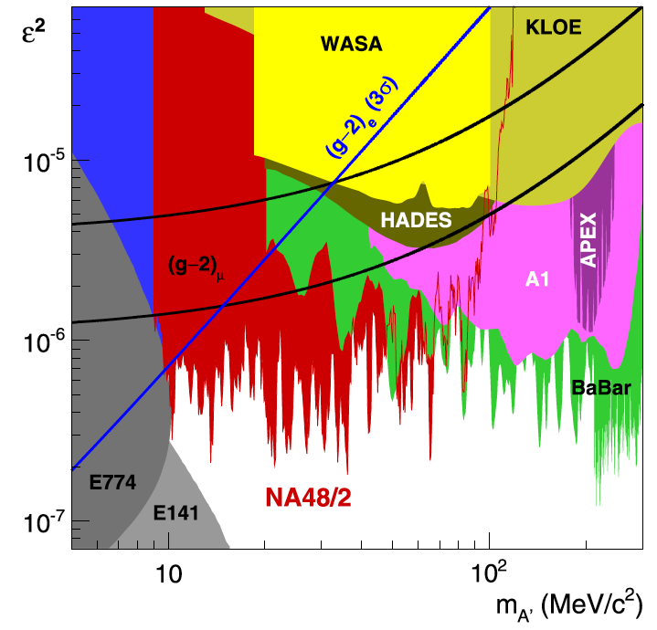
NA48/2 DP exclusion limit
DP exclusion summary
Final result: PLB746 (2015) 178
Improvement of the existing limits in the range 9-70 MeV/c².
If DP couples to SM through kinetic mixing and decays only to SM fermions, it is ruled out as the explanation for anomalous (g-2)μ.
Sensitivity limited by irreducible ⁰_{D} background: upper limit on ² scales as ~(1/N_{K})^{1/2}, modest improvement with larger data samples.

Slide 20
Impact of NA48/2 measurement
Visible decay searches early 2015
Favored region (g-2)μ still available in the low mass region.

Slide 21
Impact of NA48/2 measurement
Visible decay searches now
Favored region (g-2)μ completely excluded by NA48/2 measurement!
Final result: PLB746 (2015) 178

Slide 22
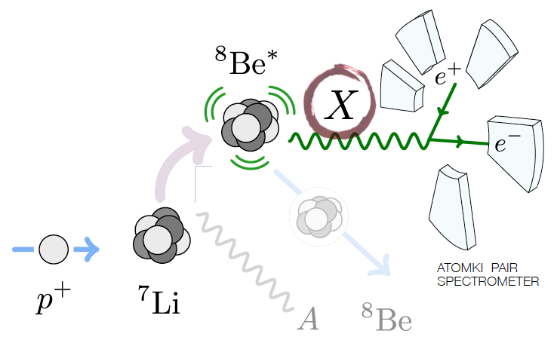
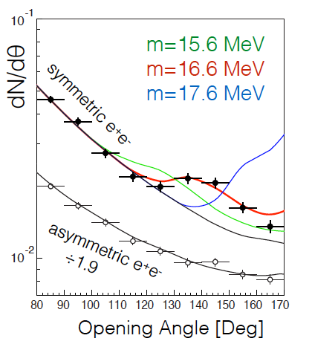
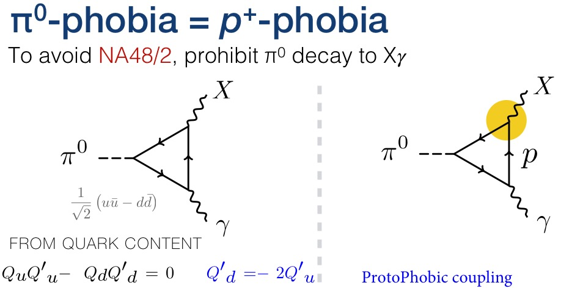
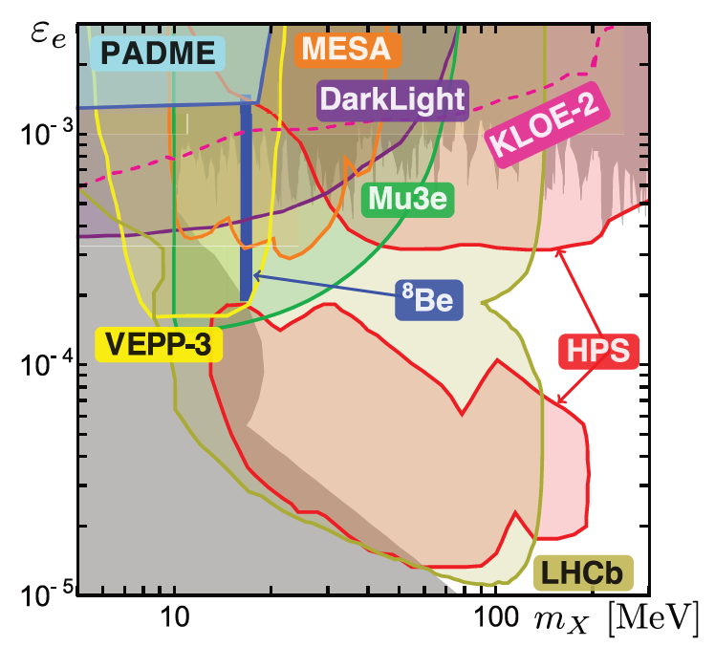
The Be⁸ anomaly and the proto-phobic fifth force
PRL 116, 042501 (2016)
NA48/2 it’s not a dark photon!
6.8σ

Slide 23
Conclusions
NA62-RK performed the most precise measurement of the π⁰ TFF
  a = (3.70 ± 0.53_{stat} ± 0.36_{syst})×10^{−2 PRELIMINARY}
  Can be used to reduced uncertainties in the light by ligth scattering contribution to the (g-2)μ
  Final results and paper in preparation
NA48/2 set a limit on the dark photon searches (PLB746 (2015) 178)
  Improvement of the existing limits for visible decays in the range 9-70 MeV/c².
  Allowed value of ε² has been pushed well below 10⁻⁶ at 90% CL
  Assuming kinetic mixing and dark photon decaying to lepton pairs only
  the whole favored by (g-2)μ region has been excluded
  Several new physics models constrained by the NA48/2 measurement

