Slide 1
NA 62 – straw detector
For the straw working group
Specifications
Chamber design
FEM calculations
Prototyping
Straw straightness
Tooling
Plans

Slide 2
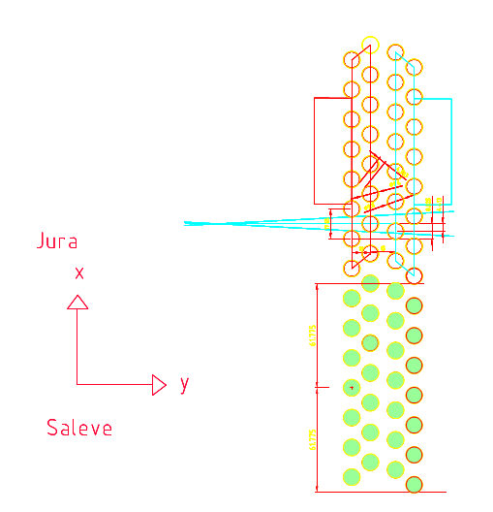
Straw tracker layout
448x16 = 7168 straws
Operate in vacuum 2.1m long D_{i} =9.8mm
Precise tracking (<120 μm)
Straw rate: up to 0.5 MHz
Non-flammable gas mixture
  CO2 (80%)+ CF4 (16%) + Isobutene (6%)
  (Test beam 2008)
For more parameters see files in EDMS:
  https://edms.cern.ch/document/837445/1
  https://edms.cern.ch/document/908415/1
4 chambers
4 views in each chamber
448 (4x112) straws in each view
448 (4x112) straws in each view
Hans Danielsson ,SPSC
04/11/2008

Slide 3
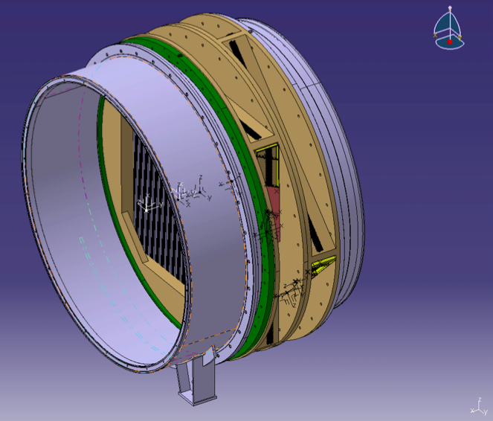
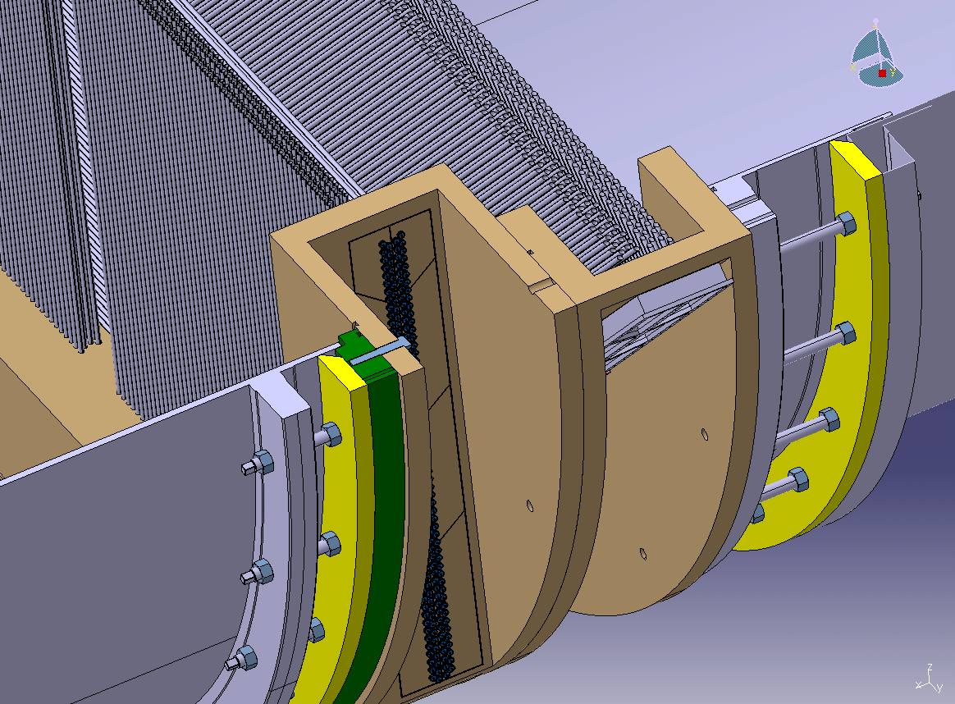
Chamber design
O-rings
Ring for sealing
04/11/2008

Slide 4
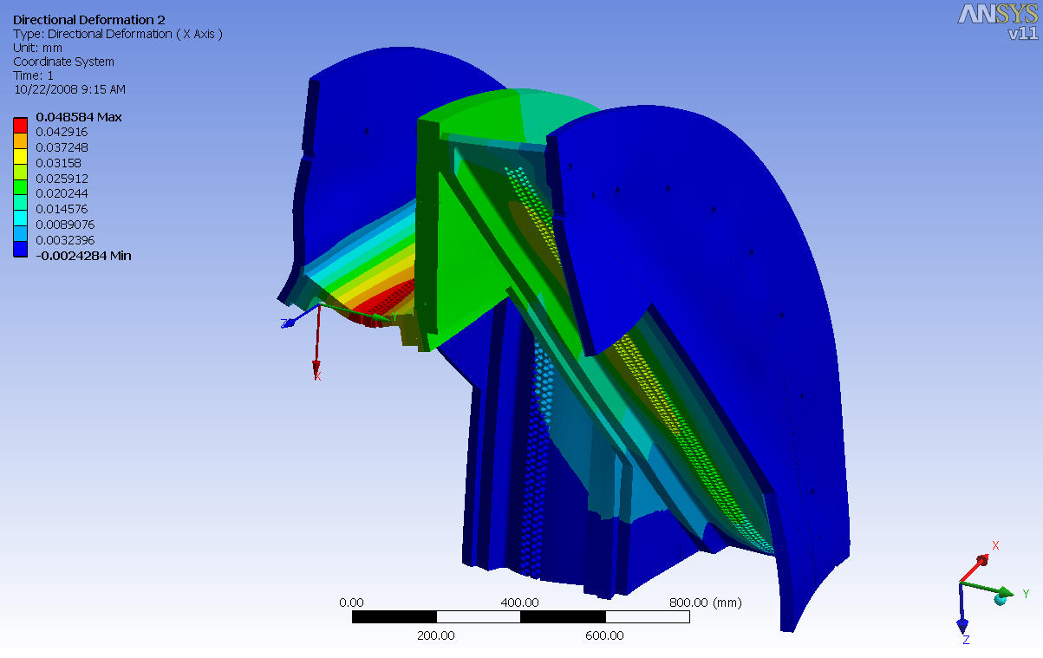
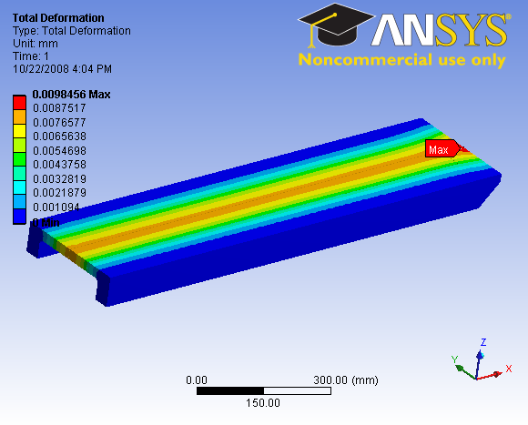
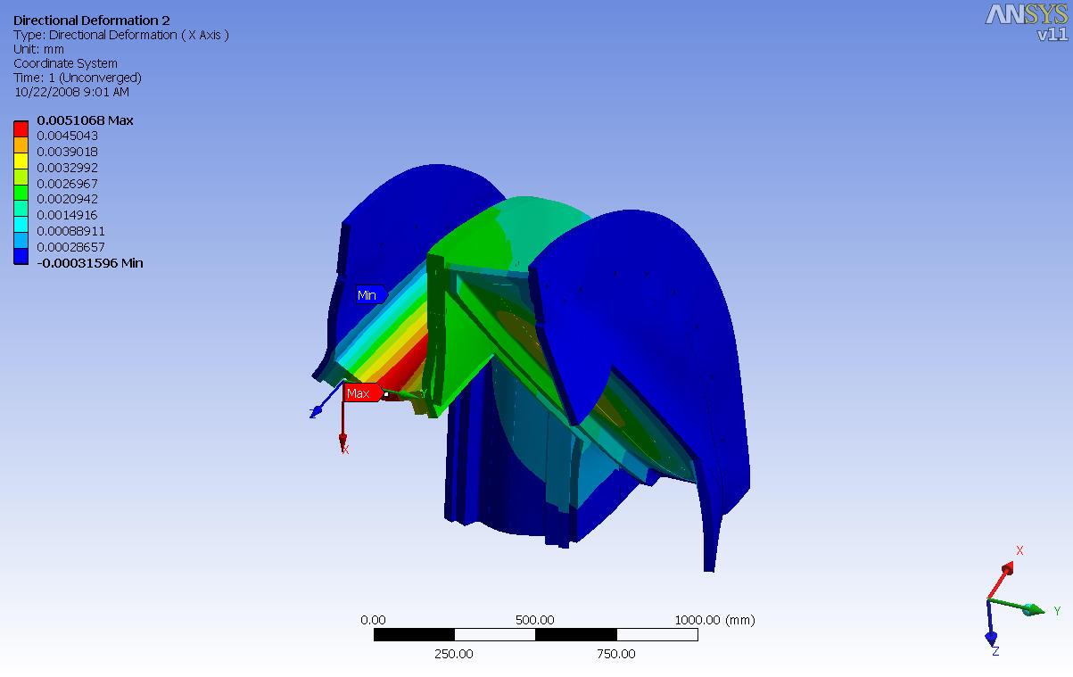
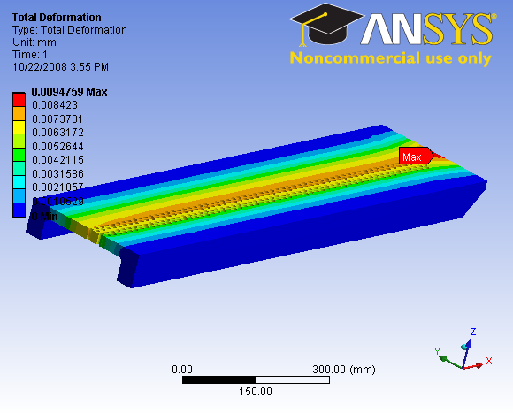
FEM calculations of the chamber

Slide 5
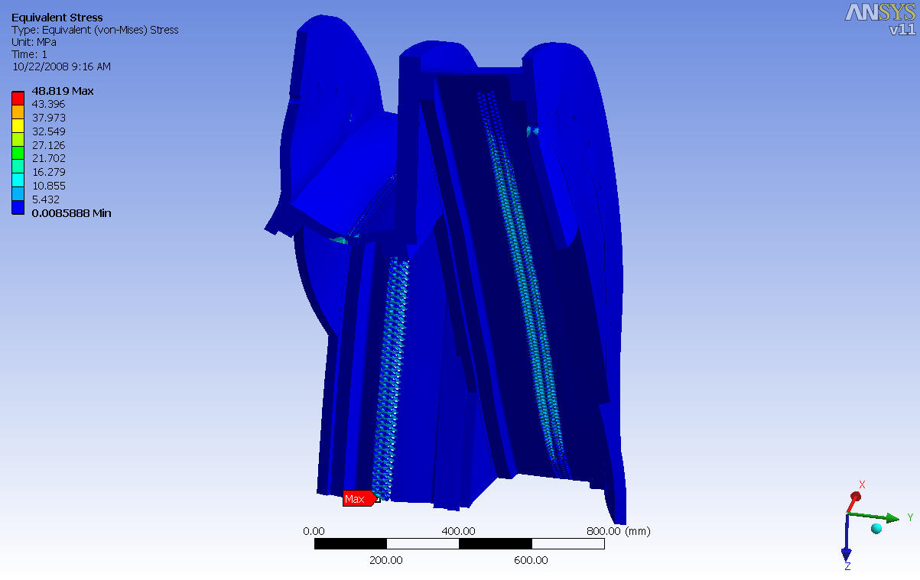
FEM calculations of the chamber
Stress levels
The model contains all the loading details: Pressure difference, pretension, fixation points to the vacuum tube etc.
We have a model to study global deformations and details e.g. stress concentration around the holes.
We are working on a model to study the deformation of individual straws.
25 mm thickness looks ok
Basis for price enquiry

Slide 6
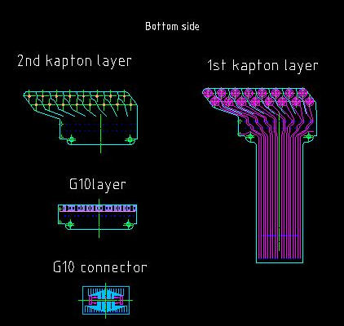
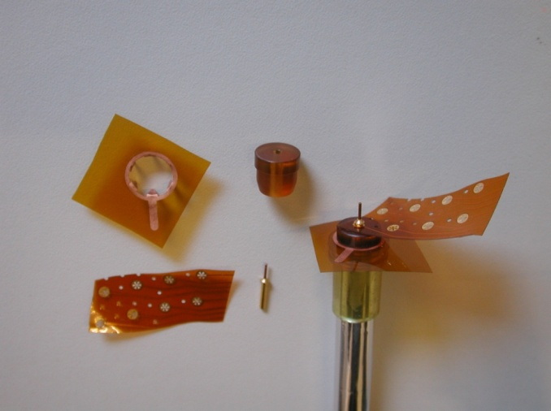
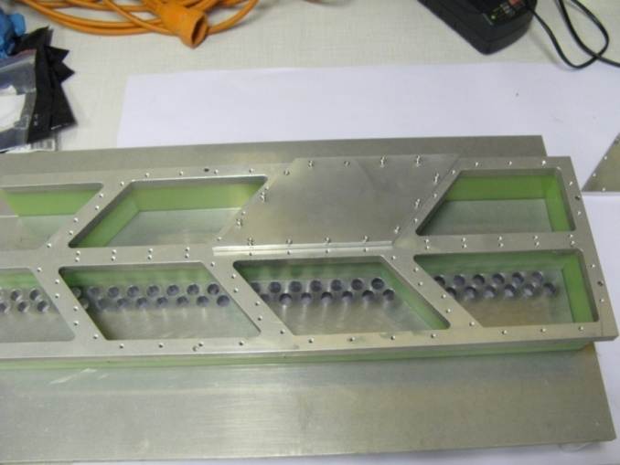
Prototypes of the gas manifold, straw connectivity and web
Questions that will be addressed are:
Type of glue
Gluing procedure
Tooling and access
Leak tightness
Electrical connection to the straws (web)
The design of the web(16 channels) is finished and a prototype is launched in the. 4– 6 weeks for production

Slide 7
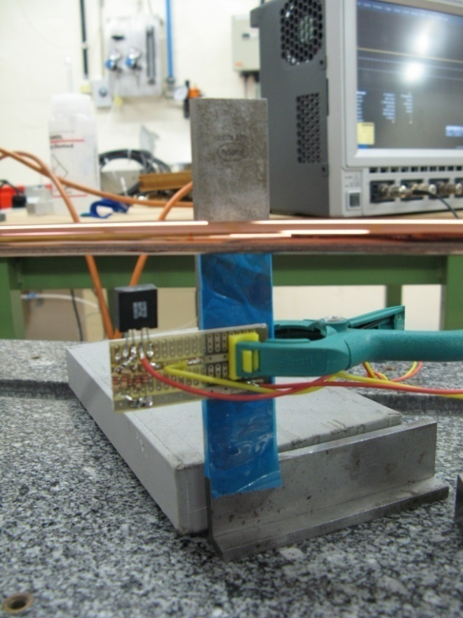
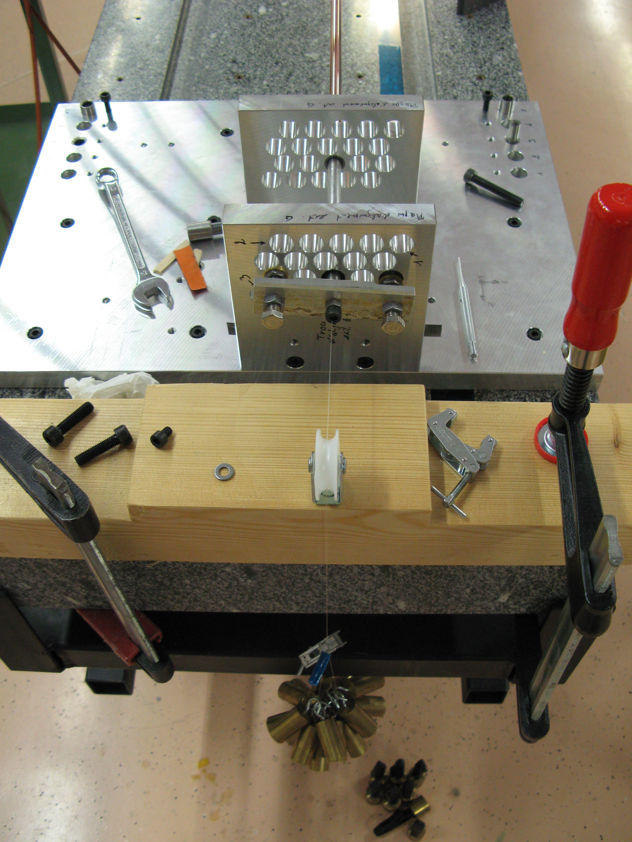
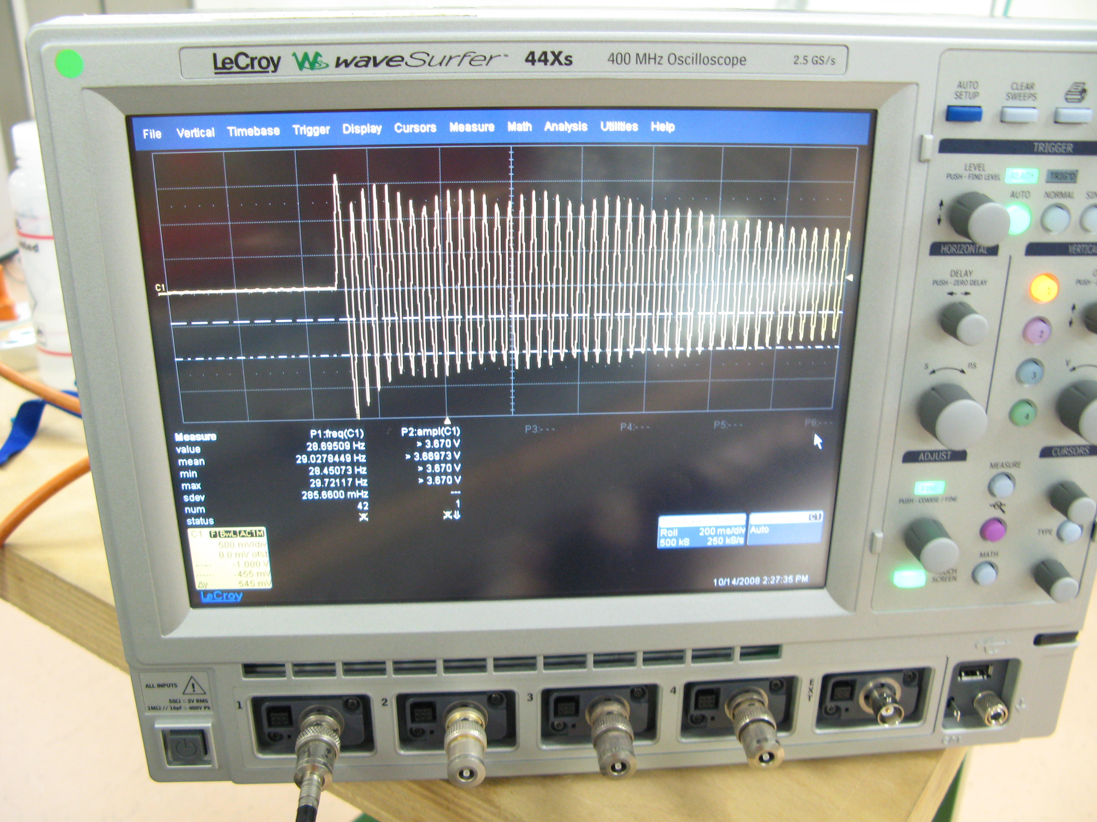
A set-up to measure the straw tension
This method was developed to study the straw straightness under tension and pressure
An IR light sensitive sensor gives a voltage proportional to the reflected IR light from the LED
Tension ∝ w×f² where w is the weight per unit length and f the frequency
To be used in the QC of the chamber production
Hans Danielsson ,SPSC

Slide 8
Deformation of the straw as a function of pressure for different pre-tension
Negative Poisson’s ratio! which results in a loss of tension when pressurized
εx=-υ×εy

Slide 9
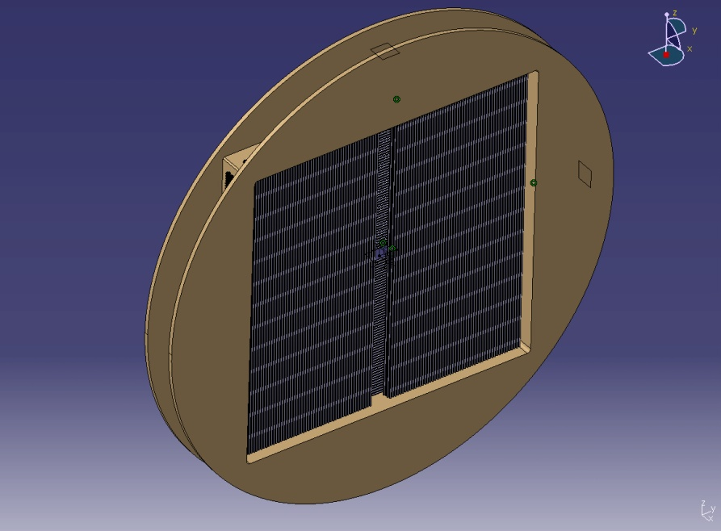
Results of the mechanical test
Negative Poisson's ratio!
The loss of tension with 1 bar is between 300g-400g
800 g of final straw pre-tension should be enough (with some safety)
1 kg is 1.2 mm deflection for a 1.85 m straw (≈ 1.75 mm for a 2.1m straw).
We need 2 supports for the straws and possibly wire guides
It is important to measure the tension after insertion
We need experimental results of the long time mechanical behavior of the straws under realistic conditions
(from 2007)

Slide 10
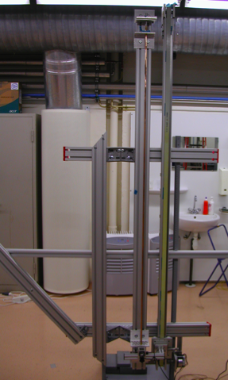
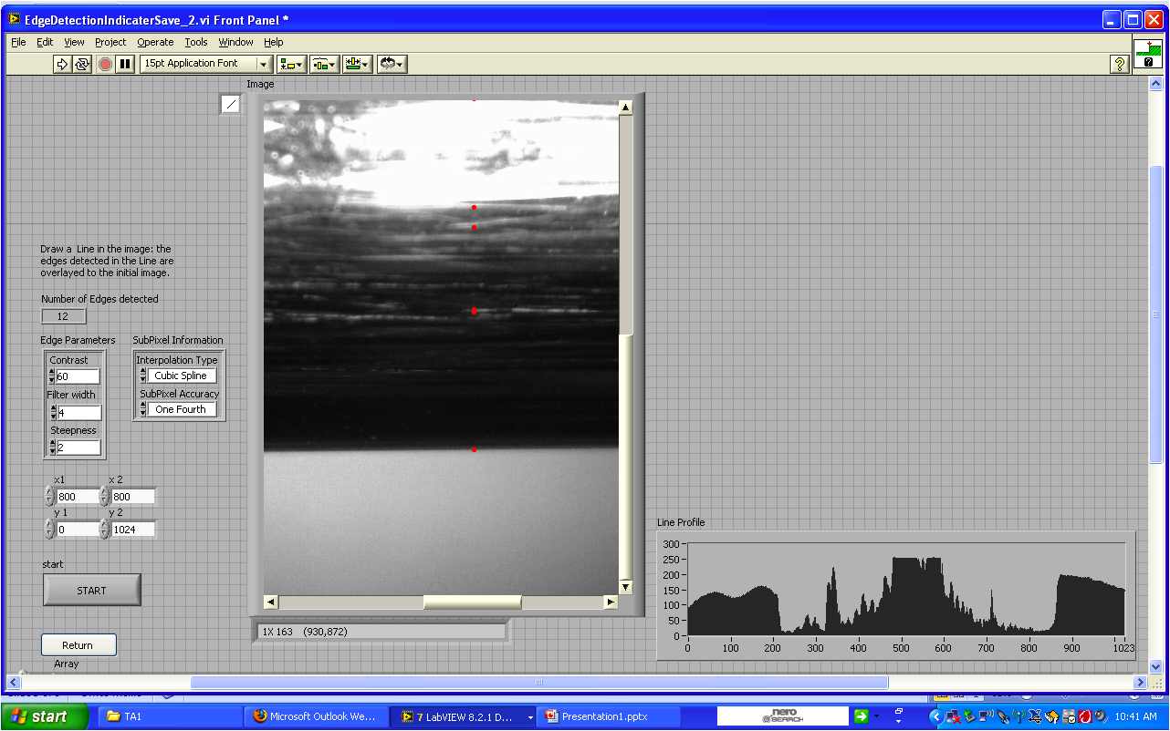
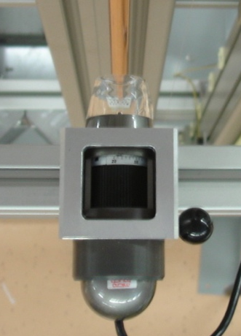
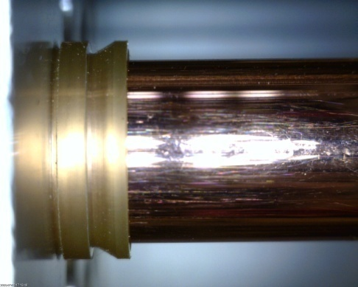
Straw straightness with 50 μm precision
LabVIEW program panel of edge detection
Edge
parameter
line profile
To be used in the QC of the chamber production
Hans Danielsson ,SPSC

Slide 11
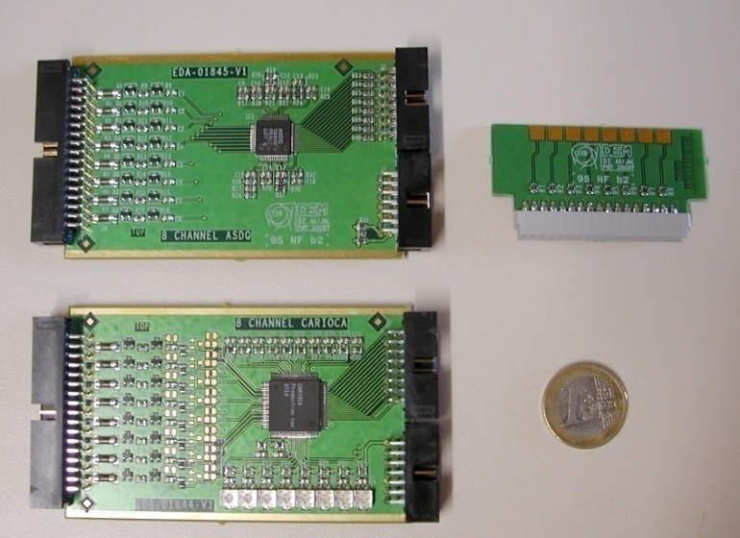
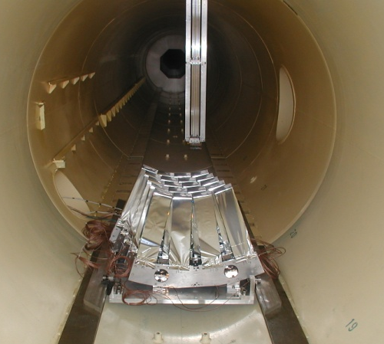
Beam test 2008
The goal was to compare two candidates for the FE chips and operate the chamber with the new non-flammable gas mixture
Same straw prototype as in 2007 was equipped with two types of FE: CARIAOCA and ASDQ. Test boards were prepared in August at CERN, for these two chips
The straw prototype was ready to take data as planned on the 2:nd of October. However, the beam was stopped on the 6:th of October.
Nevertheless, we managed to take six points with muons (different HV and threshold):
HV (kV): 2.4 , 2.5 , 2.6 ( at two different thresholds), 2.7
The off-line analysis is going on.
Since then, we have learned that:
  Only a maximum of 900 chips (7200 channels) are available of the ASDQ chip (no spare!)
  ➔ CARIOCA is the baseline for our FE

Slide 12
Example of study on the FE
FEE sensitivity measurements in June
by injection known charge Q_{in} [fC] into various points
1
2
3
Straw as a coaxial line with losses
R1=Rc
CARIOCA
R _{loss}
R2=Rc
DET gnd (cathode)
FEE gnd
Signal – current source
1 Sensitivity =16mV/fC (100%) - CARIOCA
2 Sensitivity = 8.3mV/fC (50%) – reduction due to current division
3 Sensitivity = 4.5mV/fC (~30%) – with termination on far-end (max R _{loss})
3 Sensitivity = 11.2mV/fC (70%) at open far-end
Hans Danielsson ,SPSC
04/11/2008

Slide 13
Future Plans
Terminate the detailed study on the straw material and its mechanics
Detailed FEM analysis of the structure and the straw
Finalize layout of the mechanical structure
Plan and build a new sector prototype:
  Verify mechanical support of the straws (and wire) . Measure final straw deformation and wire off-set
  New straw layout
  New connectivity
  Final electronics CARIOCA
Build a full-scale engineering prototype
Aging component validation

Slide 14
Spares

Slide 15
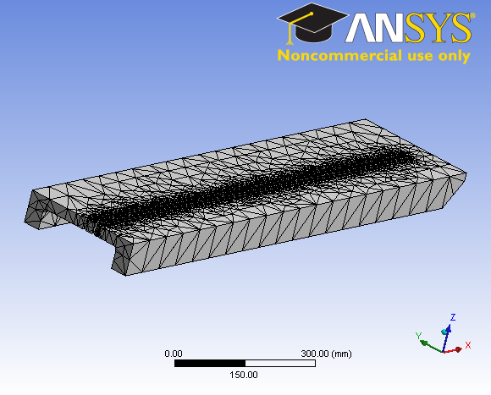
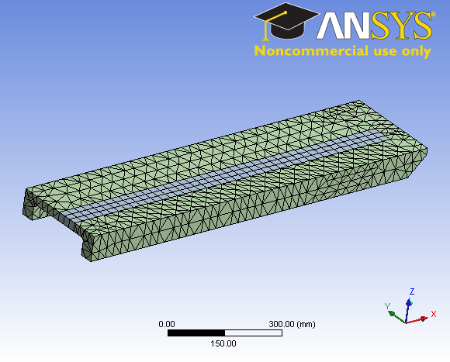
FEM calculations of the chamber

Slide 16
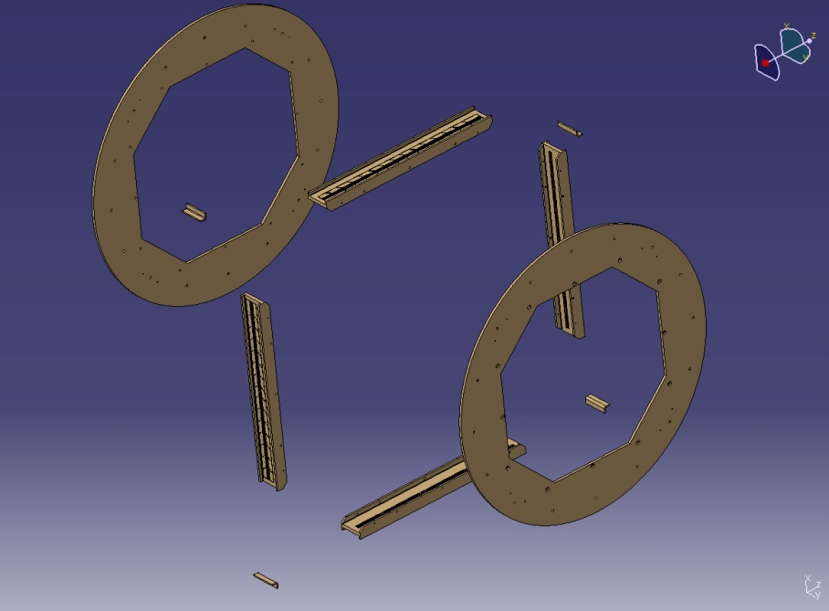
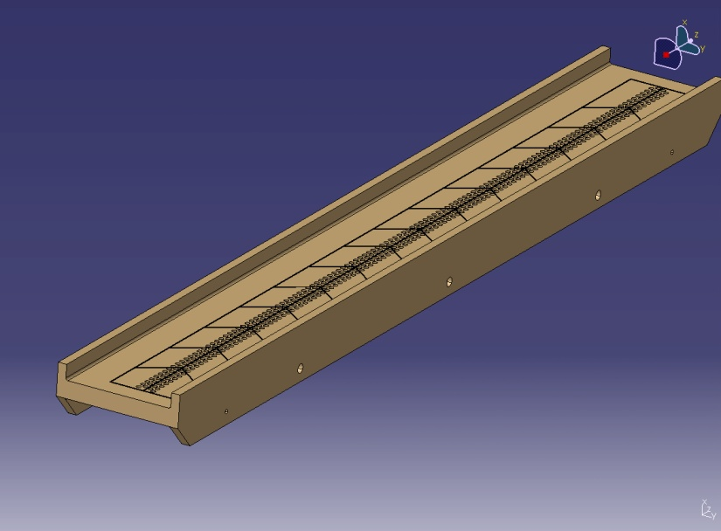
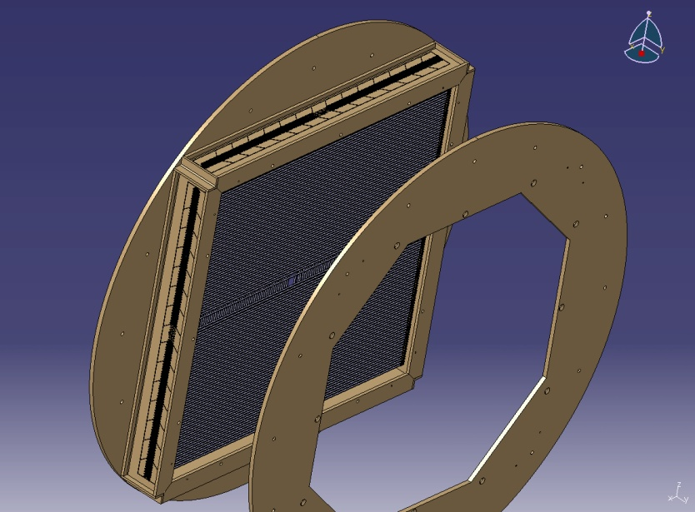
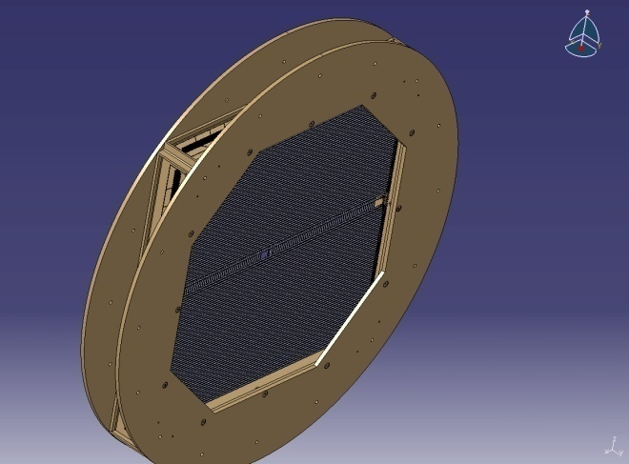
Chamber design (detail)

Slide 17
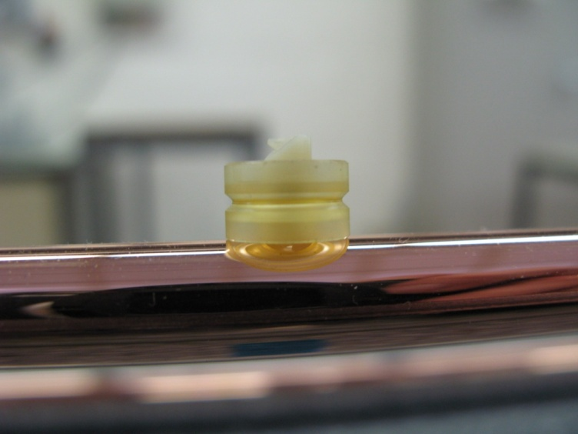
Two wire guides in the straw do limit wire off-set
Yes, it is possible in terms of added wire sag
0.23 g
0.23 g
1/3
1/3
δ = + 0.16mm
We have to see if this is necessary. It complicates the wire stringing , but reduces significantly the risk of wire-off -set in case of bent straws

Slide 18
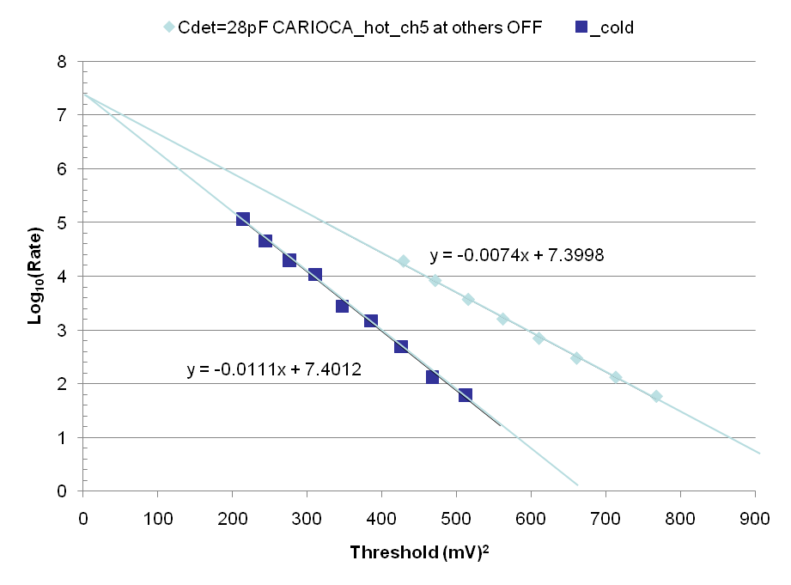
Example of test of the CARIOCA chip in the lab
 | slope | ENC (mV)
CARIOCA_cold | 0.0111 | 4.42
CARIOCA_hot | 0.0074 | 5.42
Better

Slide 19
Theoretical

Slide 20
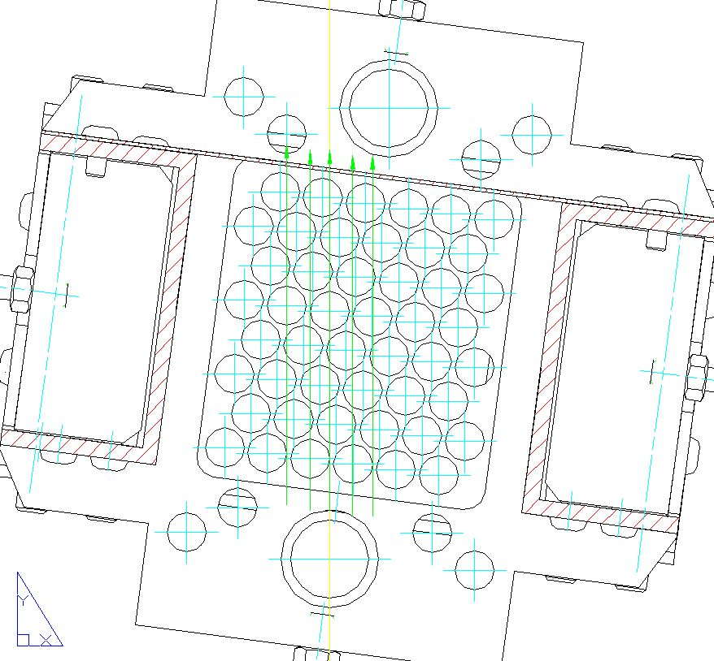
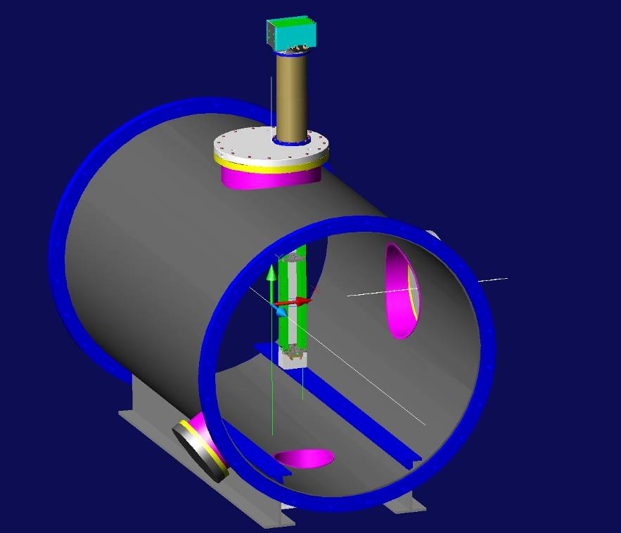
Test beam 2008
Phi=+7.5 degree
Modification of the geometry compared to 2007:
Rotating of the prototype to avoid that the wires line up with the beam axis

Slide 21
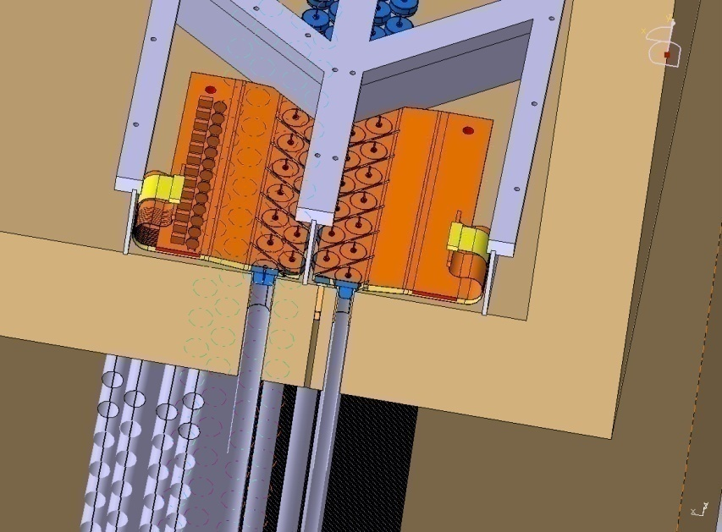
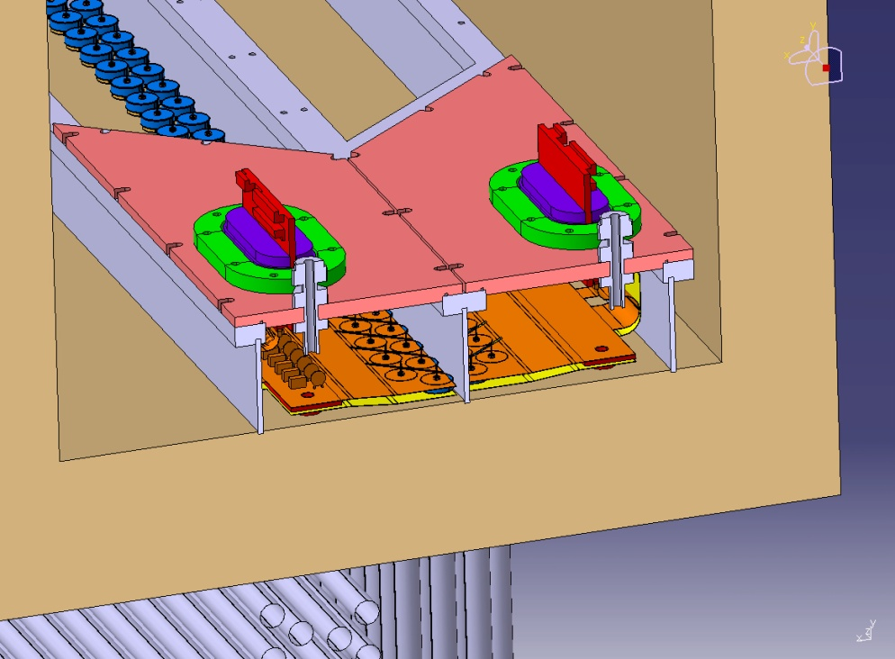
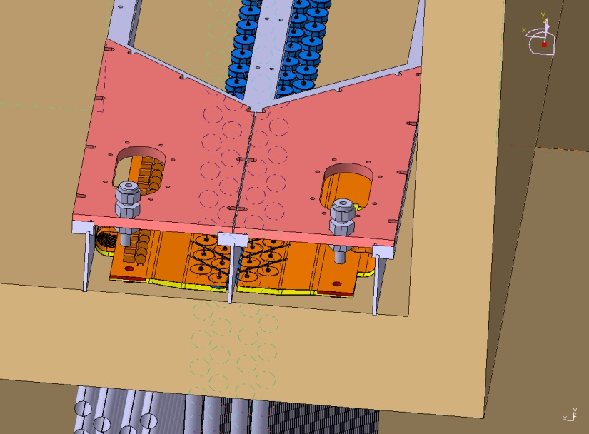
Assembly of web connection and gas manifolds

Slide 22
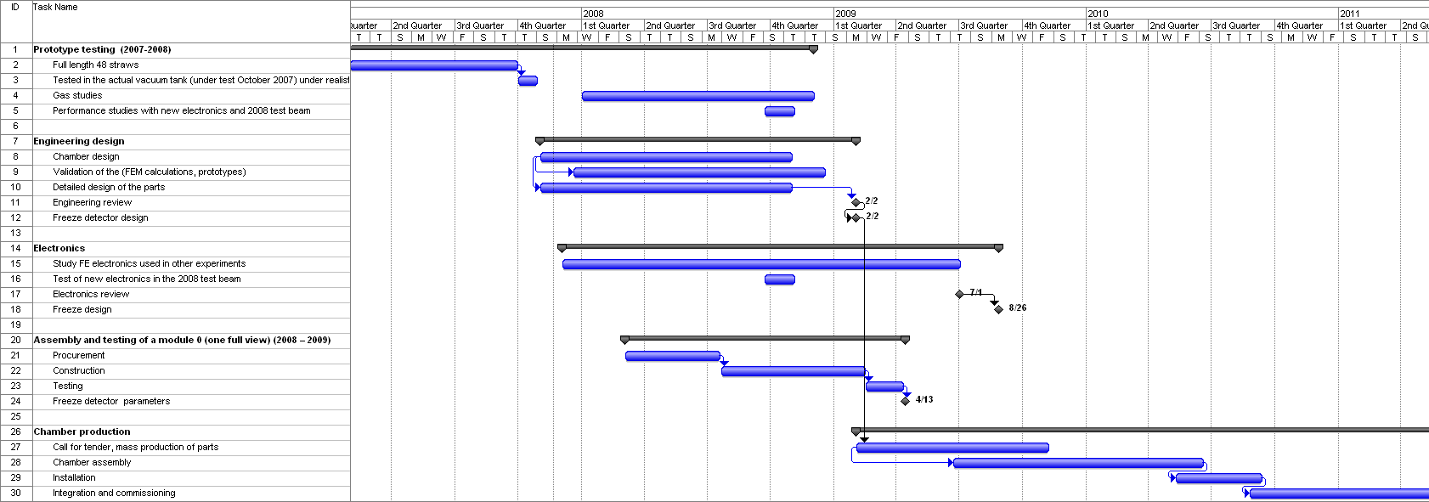
Plan

