Slide 1


Programme Objectives
Konrad Jende, UK Teacher Programme 2015

Slide 2
Programme Objectives
Konrad Jende, UK Teacher Programme 2015

Slide 3

Why do we do all this?

Slide 4
We do this because …
school students are interested in particle physics
  the field faces many unresolved problems (Elster 2007, Matthews 2007, Finlayson & Roach 2007, Christidou 2006, Lavonen et al. 2005)
  the field produces inventions and discoveries that have the potential to change the world (Elster 2007, Matthews 2007, Finlayson & Roach 2007. Christidou 2006)
school students have positive attitudes towards Science
  but (unfortunately) they do not have them towards school science (Osborne et al. 2003, Sjøberg & Schreiner 2010)
Europe and the world needs scientists and we need to educate students about ‘the major explanations of the material world that science offers and about the way science works’ (Osborne & Dillon 2008, p. 15)

Slide 5


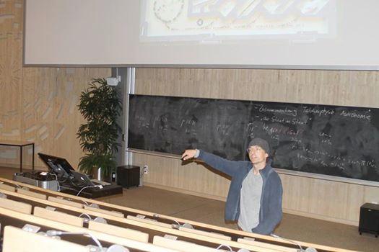
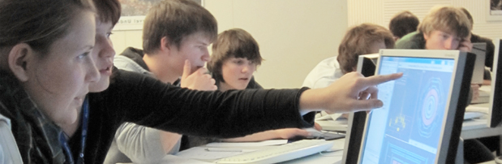
How to bring modern science into classroom?

Slide 6
How to bring modern science into classroom?

Slide 7
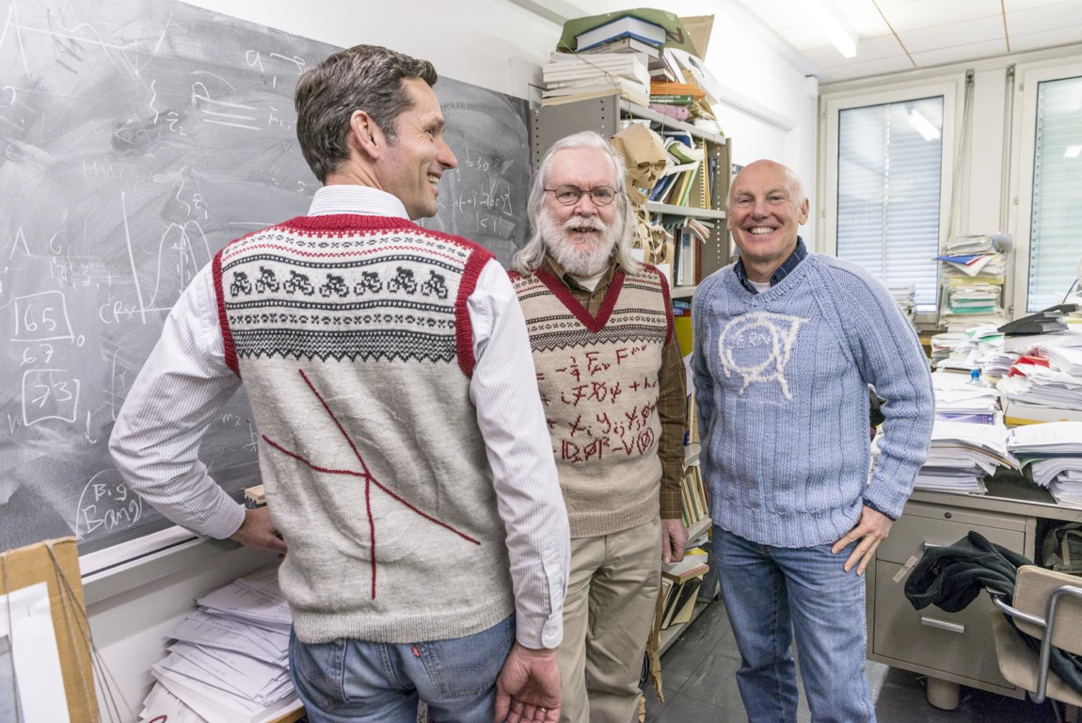

We need you!

Slide 8
Our objectives
Raise and Maintain the interest of students in moderns science
  Motivate them to continue scientific education at school
  help them to better understand the physical world
Instil a feeling of mystery and discovery potential
  Motivate students to study science/engineering at universities
Improve scientific literacy
  Prepare the future generation of scientists/engineers

Slide 9
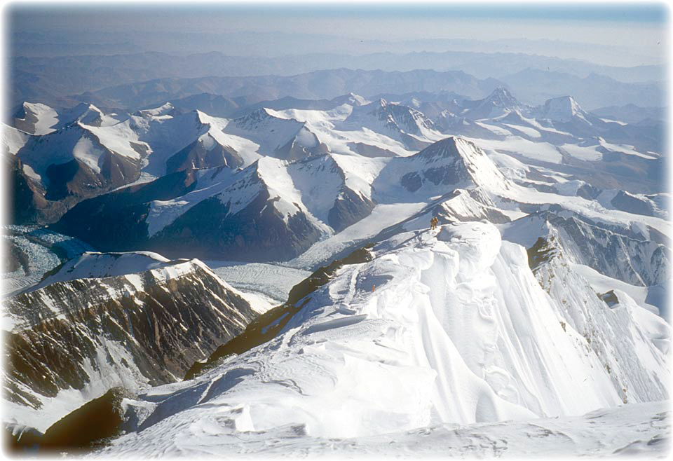
How researchers view science

Slide 10
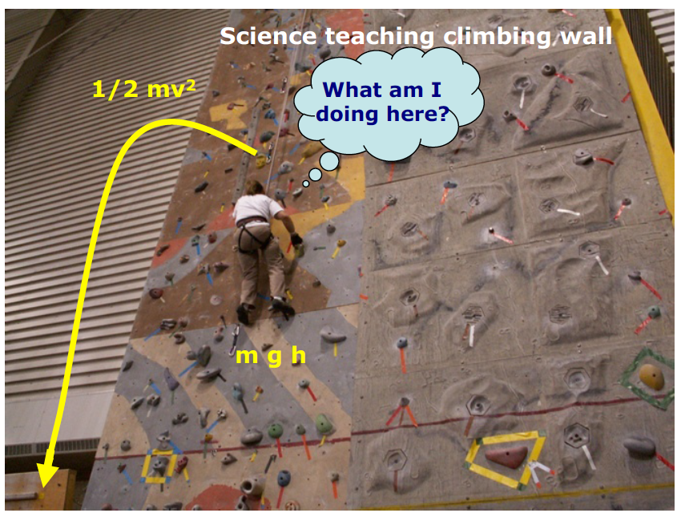
How students view science

Slide 11
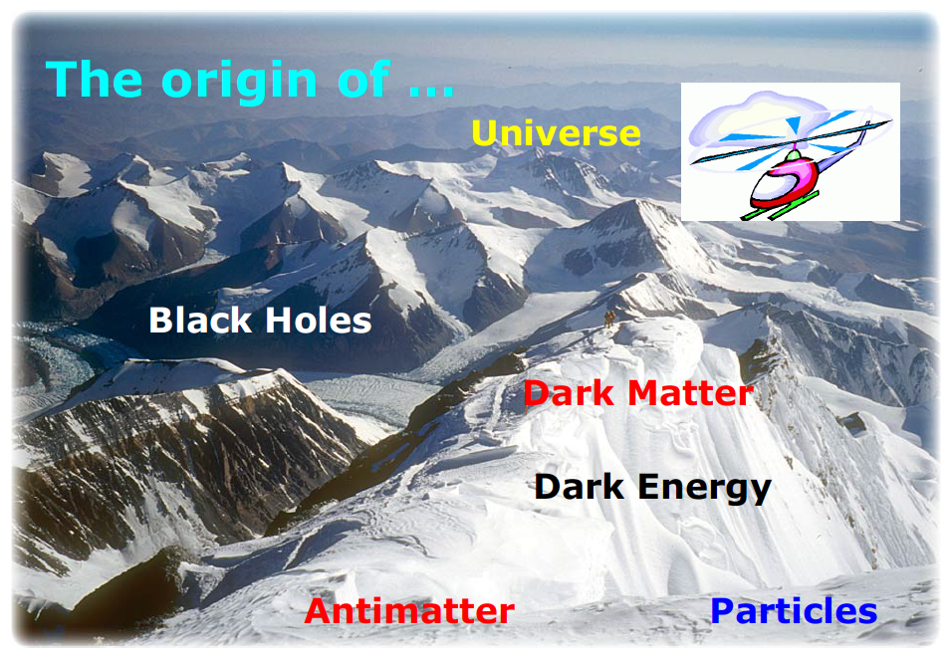
Take students on a sight-seeing tour
Link modern physics to school curriculum

Slide 12
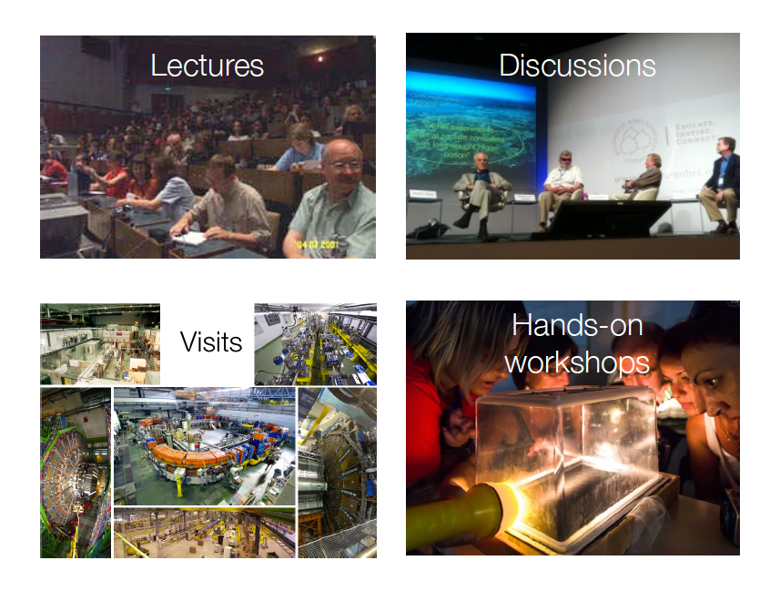
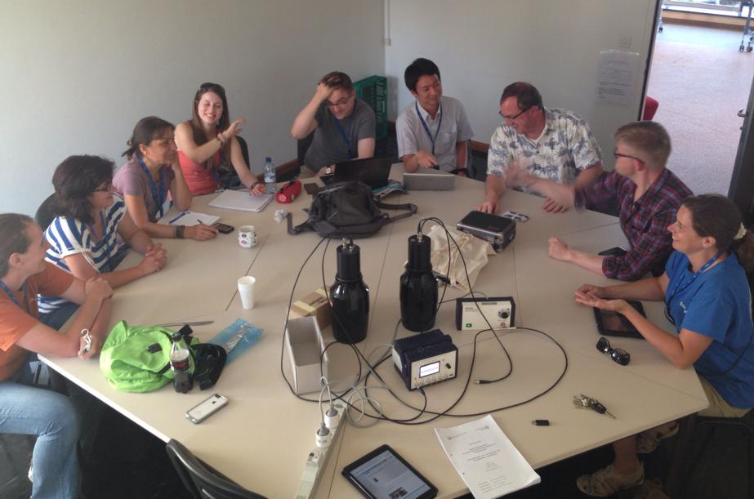
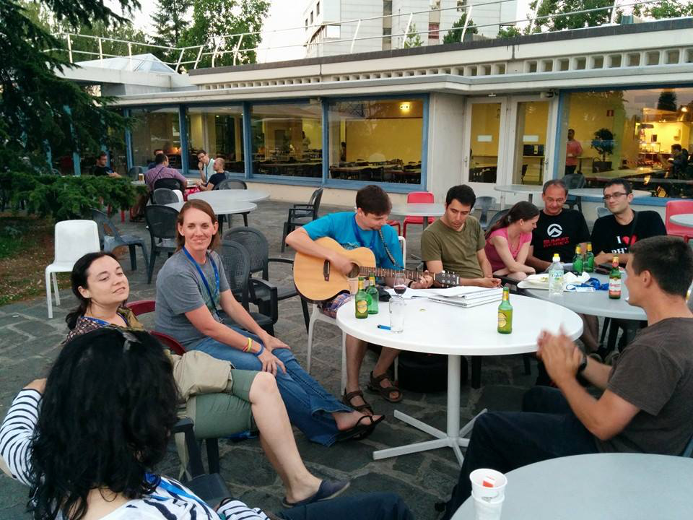
CERN’s Teacher Programmes
Work groups
Social events

Slide 13
CERN’s Teachers’ Programmes
2 days to one week long national teachers’ programmes (NTP) in native language
three week long High School Teachers Programme (HST) in English

Slide 14
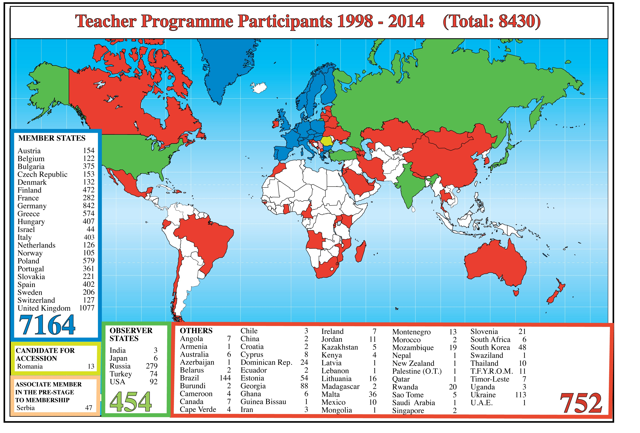
CERN’s Teachers’ Programmes - Stats 1

Slide 15
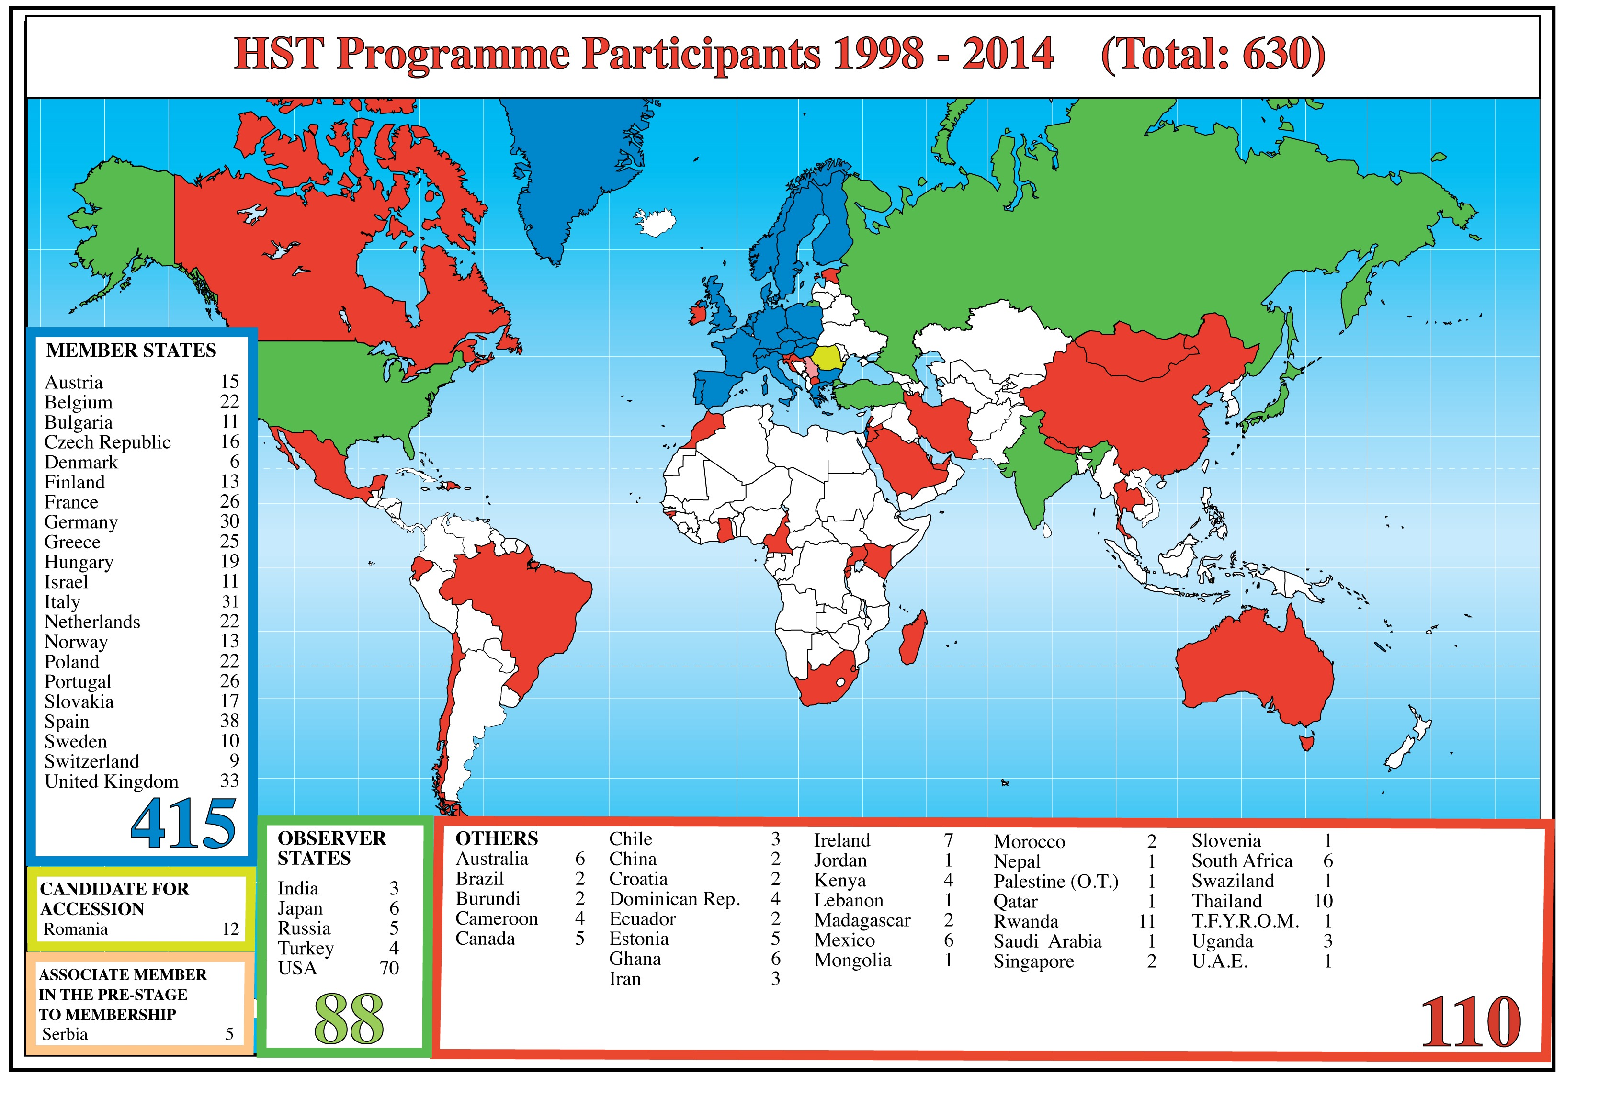
CERN’s Teachers’ Programmes - Stats 2

Slide 16
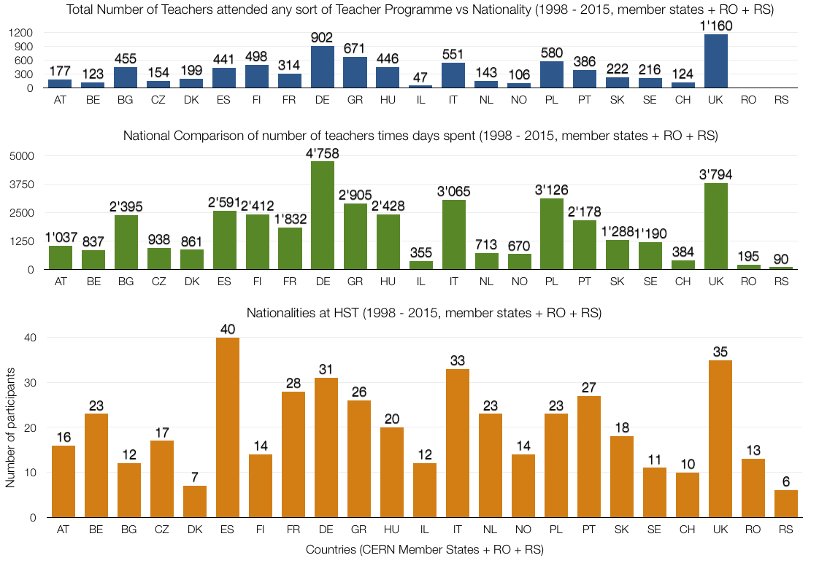
CERN’s Teachers’ Programmes - Stats 3

Slide 17
Outcome and To-Do-List
newly inspired, motivated and confident teachers
inspiring and motivating teachers
Share your experience with your students!
Share your experience with colleagues!
Share your experience with the general public!
Act as ambassador for science/engineering in general and particle physics in particular
Organize follow-up activities
Promote our programmes

Slide 18
Any questions?
Konrad Jende - konrad.jende@cern.ch
33/R-010 +41 75 411 0246

Slide 19
References
  Christidou, V. (2006): Greek Students’ Science related interests and experiences: Gender differences and correlations. IJSE, 28 (10), 1181-1199.
  Elster, D. (2007): Student interests - the German and Austrian ROSE survey. JBE, 42 (1), 5-11.
  Finlayson, M. & Roach, A. (2007): The ROSE Survey in Scotland - An Extensive Survey of Younger Pupils. Tech. rept. STEM-ED Scotland.
  Osborne, J.; Simon, S. & Collins, S. (2003): Attotudes towards science: a review of the literature and its implications. International Journal of Science Education, 25 (9), 1049-1079.
  Osborne, J. & Dillon, J. (2008): Science education in Europe: Critical reflections. A report to the Nuffield foundation.
  Lavonen, J.; Juuti, K.; Uitto, A.; Meisalo, V. & Byman, R. (2005): Attractiveness of Science Education in the Finnish Comprehensive School. In: Manning, A.; Miettinen, K. & Kiviniemi, K. (eds): Research Findings on Young People’s Perceptions of Technology and Science Education. Technology Industries of Finland.
  Matthews, P. (2007): The Relevance of Science Education in Ireland. Royal Irish Academy.
  Sjøberg, S. & Schreiner, C. (2010): The ROSE project. An overview and key findings. http://roseproject.no/network/countries/norway/end/nor-Sjoberg-Schreiner-overview-2010.pdf (Retrieved: 26 January 2015)

