Slide 1

News from IPPOG, November 5th 2015
Hans Peter Beck: IPPOG Co-chair, Bern University
Marjorie Bardeen: IPPOG Co-chair, Fermilab

Slide 2
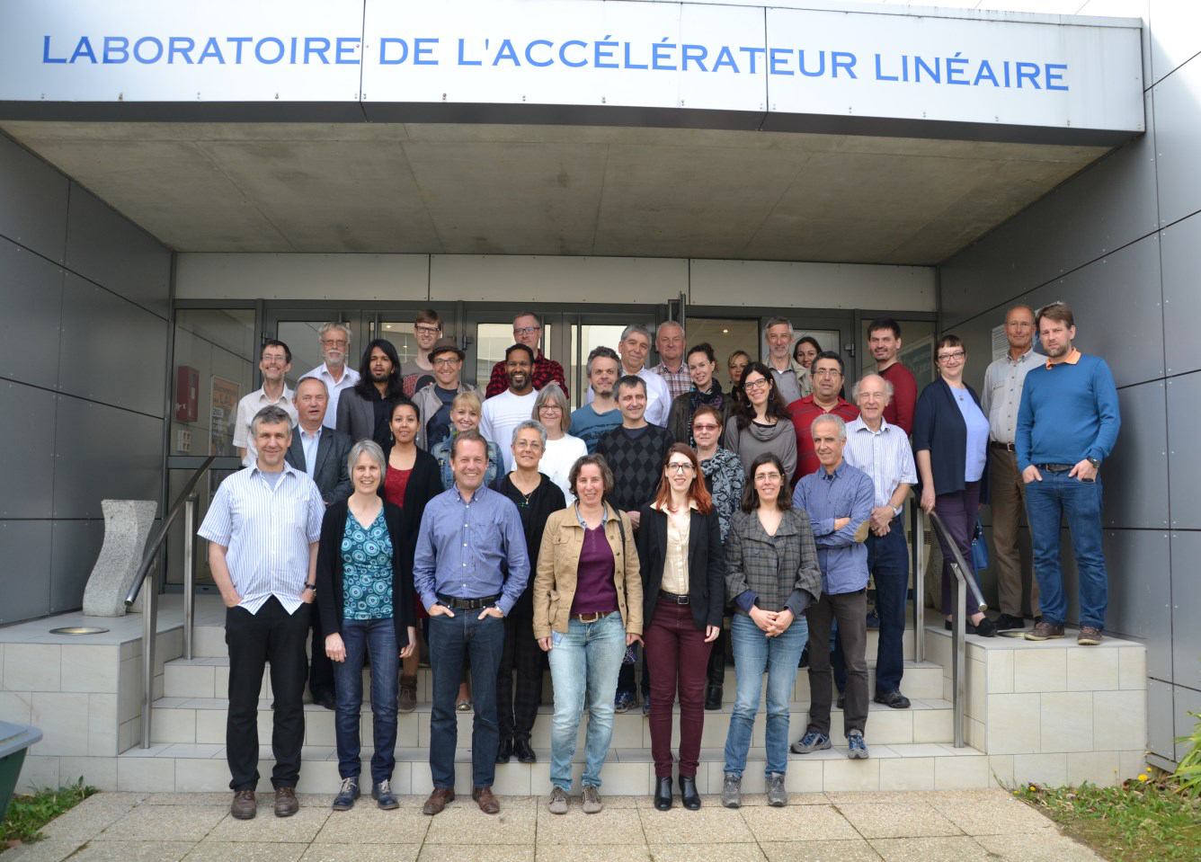
IPPOG – an International Network
34 members representing 26 countries + CERN, DESY, FNAL and 5 experiments
http://ippog.web.cern.ch
International network of (mainly) physicists who commit a fraction of their time in education and outreach.
These are your local contacts
in your country, laboratory,
and experiment when you need,
advice, help, support,
in your education and
outreach activities.
IPPOG meets twice a year
in Spring and Autumn to discuss
and exchange thoughts and
success stories, get inspirational
ideas, and getting organized world-wide.
IPPOG Spring Meeting 2015 – Paris, Orsay LAL

Slide 3
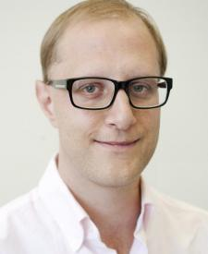
IPPOG New members - Australia
Australia voted in as 26th country in IPPOG.
Australia aims to introduce the IPPOG Masterclasses programme as part of their formal science education in high-schools in New South Wales.
  Paul Jackson
  Australian delegate to IPPOG
  paul.douglas.jackson@cern.ch
  http://ippog.web.cern.ch/members/australia

Slide 4
New people in IPPOG in 2015
New countries, laboratories, experiments engaged in all fields of particle physics are welcome to strengthen IPPOG further.
http://ippog.web.cern.ch/ippog_membership
Formal interest of China expressed to join IPPOG.
Zhi-zhong Xing, IHEP Beijing, is participating as guest/observer
Formal interest of Slovenia expressed to join IPPOG.
Andrej Gorisek , J. Stefan Institute Ljubljana, is participating as guest/observer
New IPPOG Associates
Eirik Gramstad is succeeding Maiken Pedersen as IPPOG associate member, and will continue developing ATLAS Z Path from Oslo, Norway.
Iva Maksimova Raynova ALICE science writer,
Katarina Anthony-Kittelsen ATLAS science writer
Panagiotis Charitos FCC communication

Slide 5
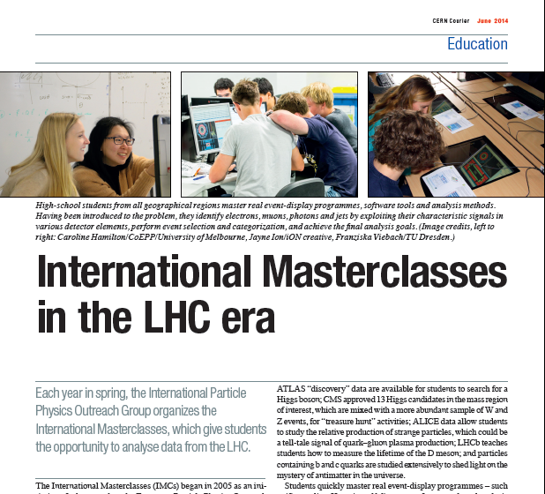
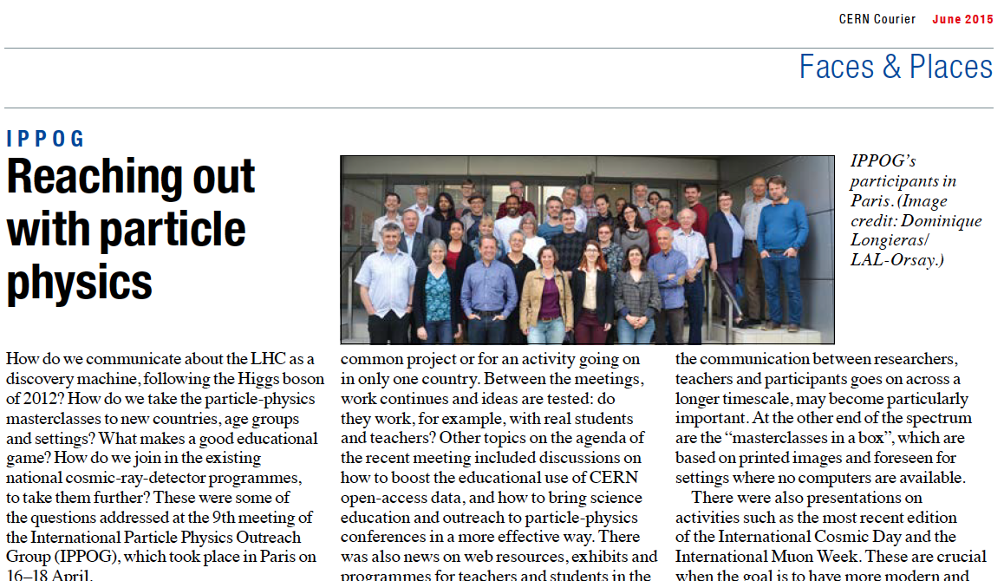
IPPOG an umbrella for making outreach global
International Masterclasses,
the flagship activity of IPPOG
trained over 10’000 students in
Spring every year !
Over 200 institutions in over 46
countries participating.
CERN Courier
June 2014 edition
    &
June 2015 edition

Slide 6
IPPOG is recognized internationally
Education & Outreach becoming an integral part in international HEP conferences
EPS HEP 2015 – Vienna
  Parallel sessions on education and outreach
  – sessions chairs are IPPOG members
  Panel discussion "IPPOG: Experts in bringing new discoveries to the public" (Michael Kobel –IPPOG Germany)
  EPS-HEP Outreach Prize (see next slide)
Lepton Photon 2015 – Ljubljana
  plenary talk “education & outreach” (Kate Shaw – IPPOG ATLAS)
ICNFP 2015 – Crete
  Invited plenary talk on “Particle Physics Outreach in the LHC Era: Higgs – What’s next?” (HPB)
CERN Council congratulates IPPOG in its 177th meeting in the
RESTRICTED SESSION - EUROPEAN STRAGEGY MATTERS
  REPORT FROM IPPOG (Item 11 of the Agenda) The Council took note of the report by the IPPOG Co-Chair, Dr H. Beck, and congratulated the group on the continuing success and rapid growth of its Masterclass programme.
…

Slide 7
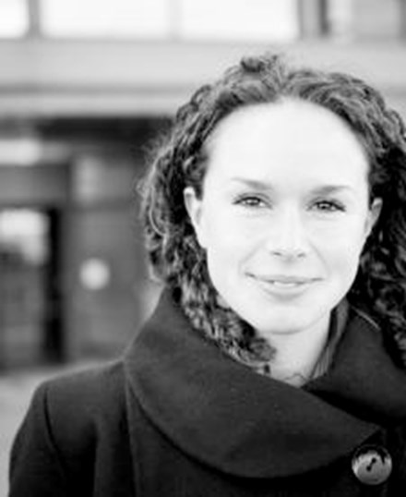
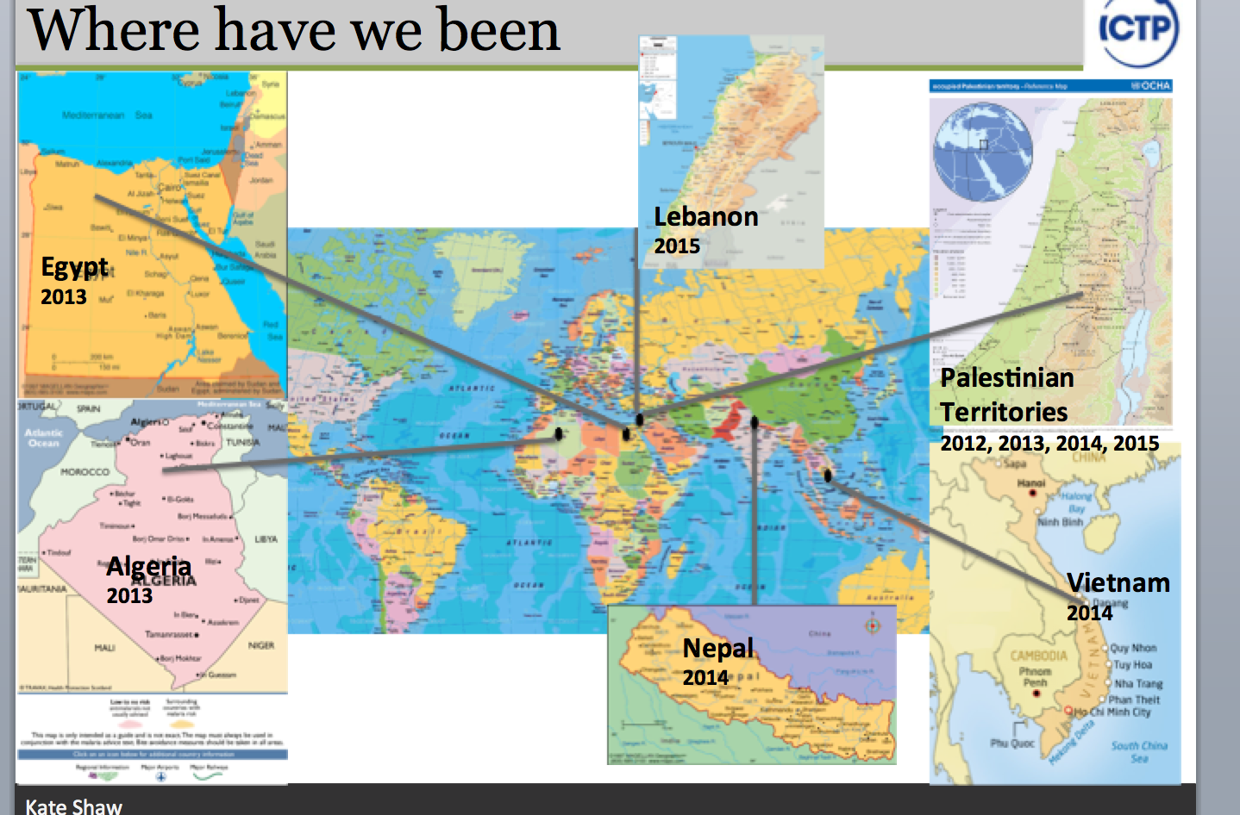
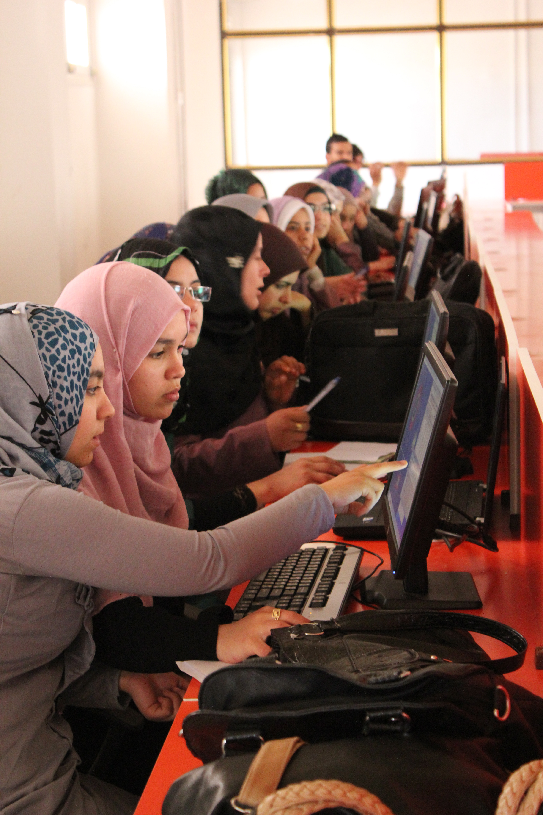
EPS-HEP 2015 Outreach Prize
Physics without Frontier
2015 Kate Shaw
IPPOG Delegate and ATLAS Outreach Coordinator
For her contributions to the International Masterclasses and for her pioneering role in bringing them to countries with no strong tradition in particle physics.

Slide 8
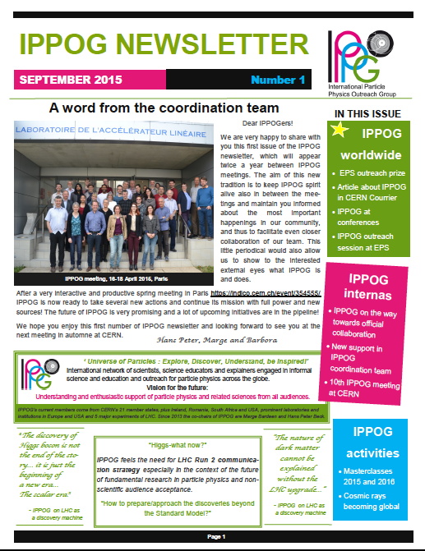
IPPOG Newsletter
Professionalizing IPPOG
Newsletter twice a year in-between IPPOG meeting.
Memorandum of Understanding between IPPOG members in an much advanced state.
Well defined IPPOG structure and tasks.
IPPOG Working groups, with action items.
All these advances would be un-thinkable without the help from Barbora !

Slide 9
Effort, Needs & Support
Support (FTEs, use of infrastructure, in-kind, ad-hoc,…) from
  CERN,
  Fermilab,
  EPS HEPP High-Energy and Particle Physics Division of the European Physical Society,
  TU Dresden,
  US National Science Foundation and the US Department of Energy.
  And the many institutes contributing to the development of Masterclass exercises
Manpower
Uta Bilow (Dresden) funded by CERN 2013-2015, and new 2016-2018
  before: Helmholtz Alliance: Physics at the Terascale 2008-2012
  Ken Cecire (Notre Dame) funded by Quarknet for US based Masterclasses
  Barbora Gulejova (CERN) IPPOG Scientific Secretary
And lots of voluntary effort
provided by IPPOG members, and local teams at universities,…
Thanks to all who are helping !!
and we need to make sure a successful story can continue.
Sharing the load among member countries, laboratories and experiments will make IPPOG efforts reliably sustainable.

Slide 10
Panel Discussions
Explaining new physics
Andrej Gorisek, Farid Ould-Saada, Jiri Rames, Jonas Strandberg, Nick Tracas, Peter Watkins, Thomas Naumann, Zhi-zhong Xing
CERN Backgrounders
Hans Peter Beck, Ivan Melo
Cosmic rays going global
Barbora Gulejova, Dirk Ryckbosch, Kenneth Cecire, Marjorie Bardeen, Nicolas Arnaud, Uta Bilow
Open data and their use
Achintya Rao, Christine Kourkoumelis, Claire Adam Bourdarios, Daniel Lellouch, David Barney, Eirik Gramstad, Pedro Abreu, Thomas McCauley
Exhibitions
Catarina Espirito Santo, Natascha Hörmann, Panagiotis Charitos

Slide 11
Panel Discussions
During the panel preparations
an intense exchange of ideas and experiences made can be made among those active/interested in a given topic.
At the panel presentation
An overview of activities/items/topics can be given to the IPPOG plenary, and conclusions/recommendations/suggestions coming out of the panel preparation can be disseminated.

Slide 12
Working Groups
Broadening of the scope of Masterclasses
Achintya Rao, Catarina Espirito Santo, Christine Kourkoumelis, Despina Hatzifotiadou, Dirk Ryckbosch, Eirik Gramstad, Kenneth Cecire, Krzysztof Wieslaw Wozniak, Natascha Hörmann, Nicolas Arnaud, Thomas McCauley, Uta Bilow
Conferences and publications WG
Claire Adam Bourdarios, Farid Ould-Saada, Hans Peter Beck, Ivan Melo, Pedro Abreu, Peter Watkins, Zhi-zhong Xing
How to assess impact of teachers & students programs
Andrej Gorisek, Barbora Gulejova, Daniel Lellouch, David Barney, Jiri Rames, Jonas Strandberg, Jean Young, Marjorie Bardeen, Nick Tracas, Rasmus Mackeprang, Riitta Rinta-Filppula, Rossana Centioni

Slide 13
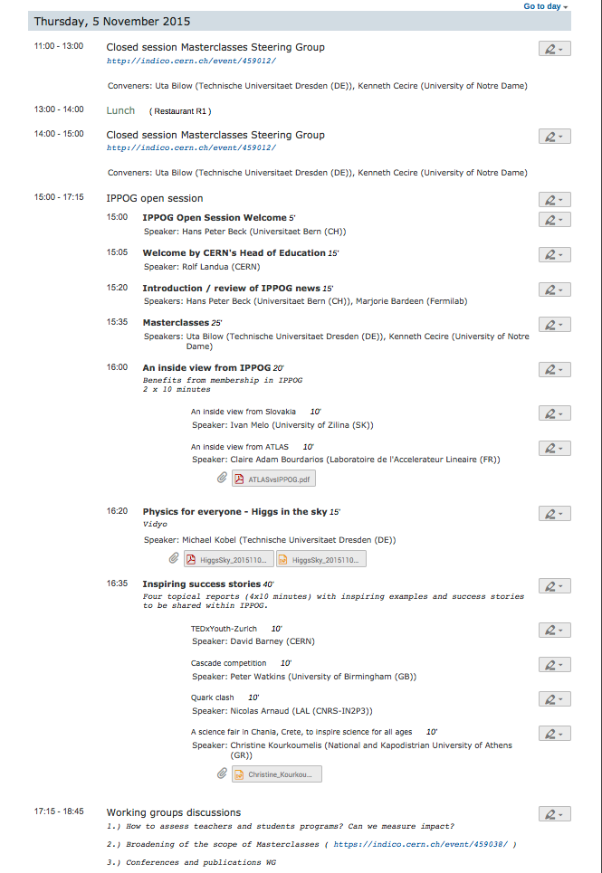
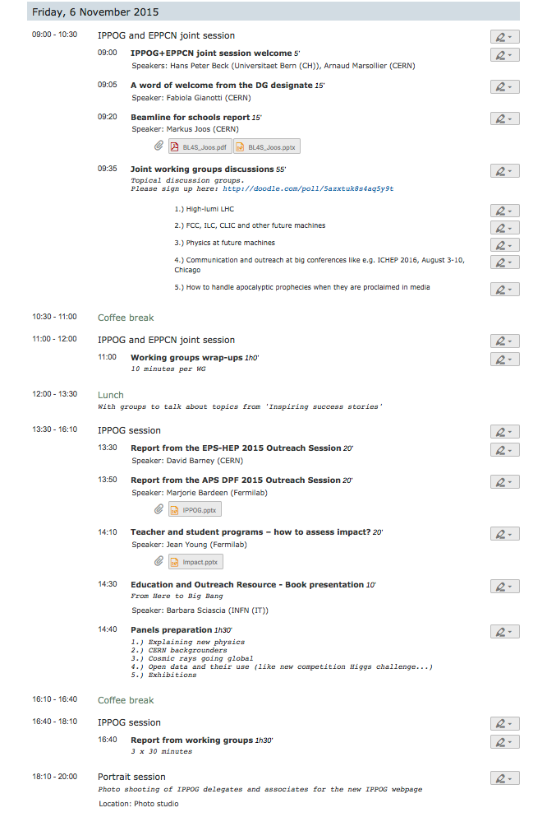
Agenda

Slide 14
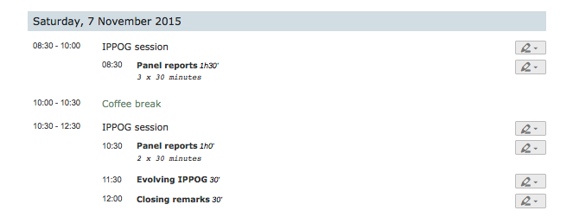
Agenda

Slide 15

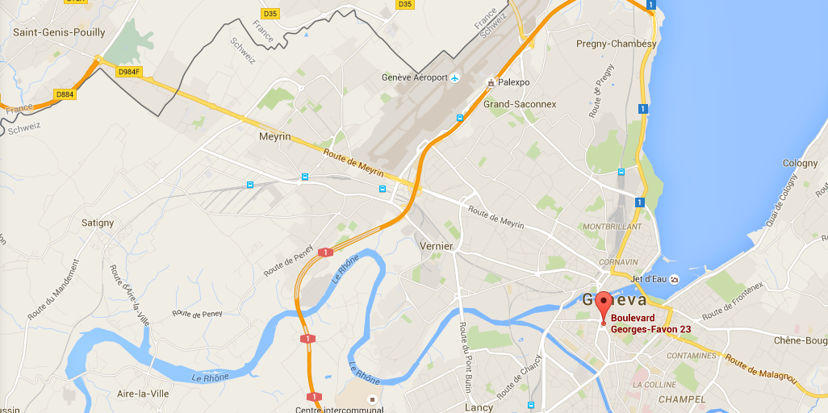
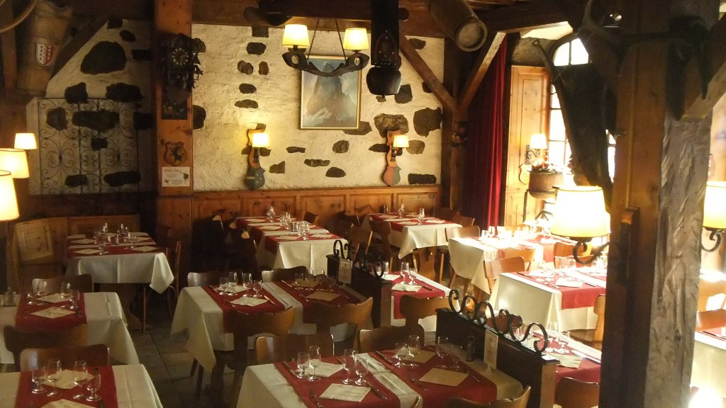
IPPOG+EPPCN joint dinner tonight
Plainpalais
bd Georges-Favon, 23
1204 Genève
Téléphone
+41 (0)22 328 12 36
http://www.chaletswiss.ch
Bus at 19:00
in front of the Hostel, bldg 39
You can also take tram 18 from CERN and exit at Plainpalais
It’s a 30’ trip

Slide 16
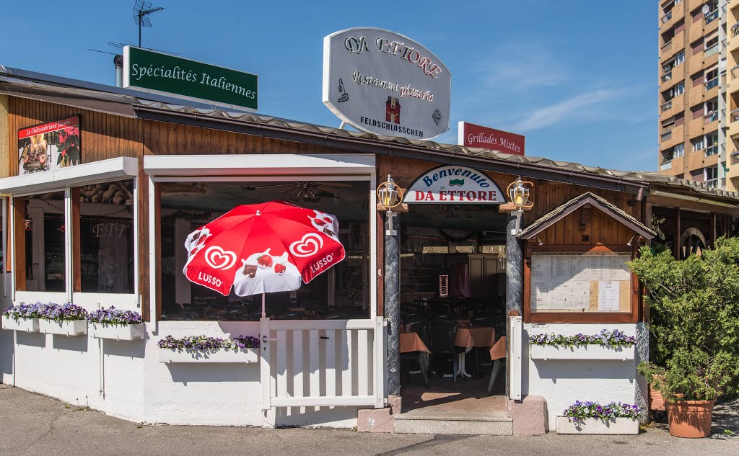
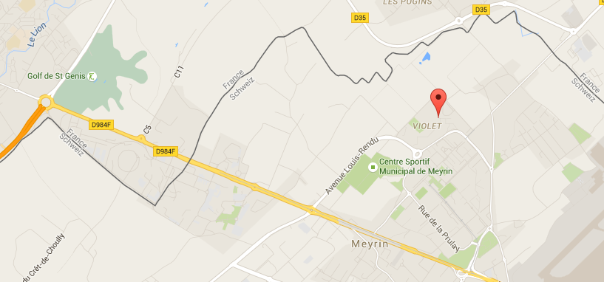
IPPOG informal dinner Friday evening
Pizzeria Da Ettore,
13, promenade des Champs-Frechets,
1217 Geneva,
Transport:
Tram 18 to Meyrin Village and Bus 57 to Champs-Frechets 4’ + 4’
or
Tram 18 to Jardin-Alpin Vivarium and Tram 14 to Meyrin-Gravière 7’ + 5’
Check http://www.tpg.ch for timetables
Those who have cars and will drive:
Please inform Barbora and me, we will then arrange further.

