Slide 1


Panel: Exhibitions
Catarina (LIP, Portugal) and Natascha (HEPHY, Austria)

Slide 2
HEPHY Austria

Slide 3
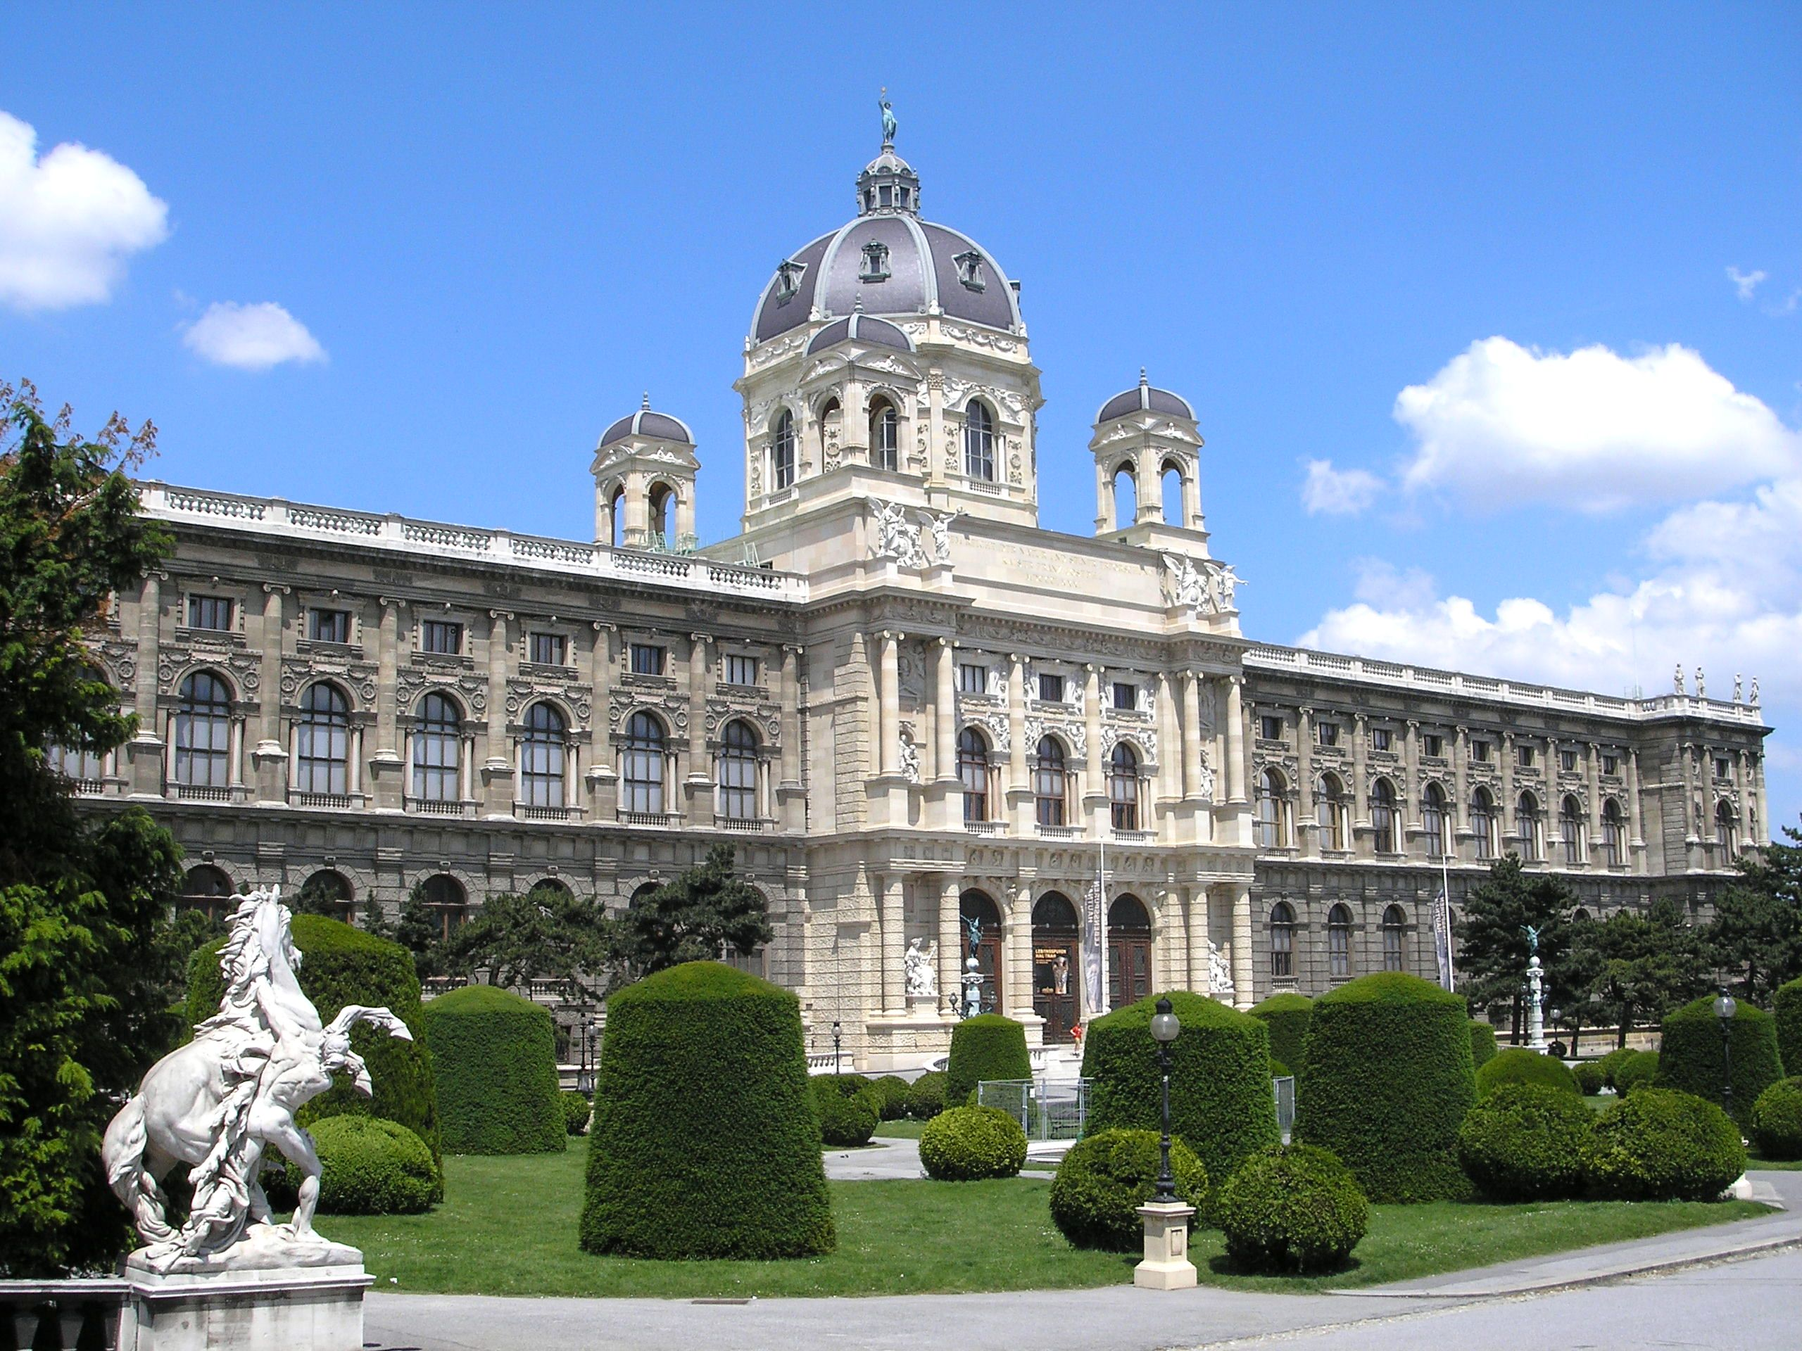
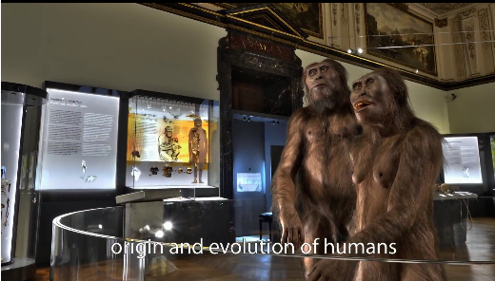
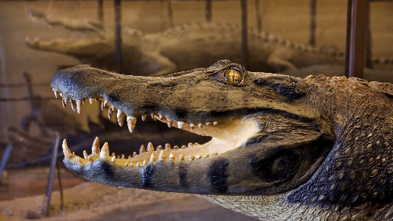
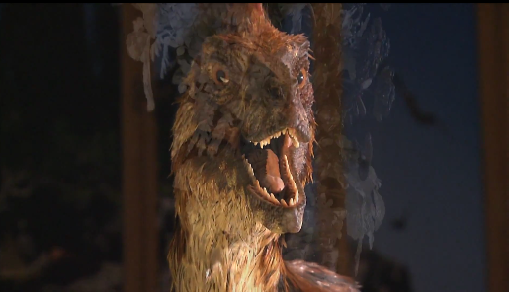
Natural history museum Vienna

Slide 4
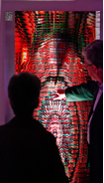
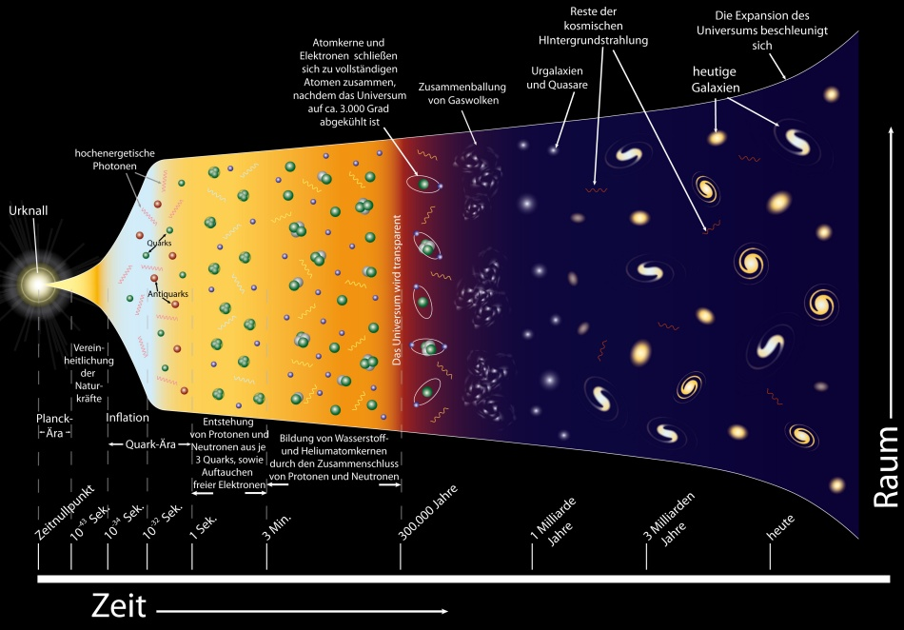

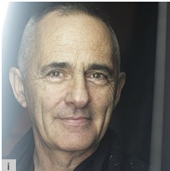
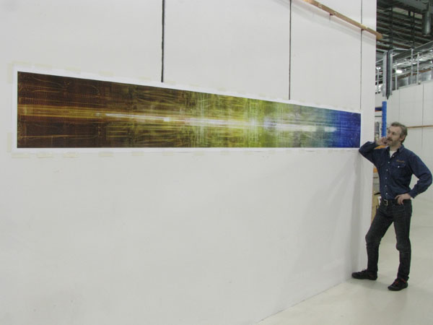
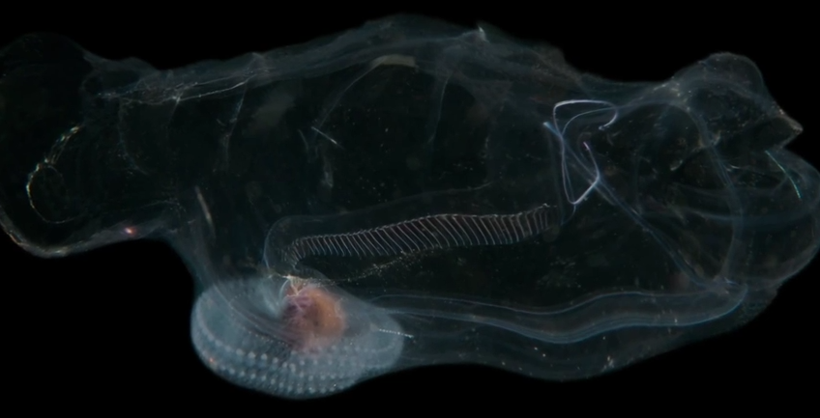
Natural history museum Vienna
Underwater pictures/animated movies
Videos / sound installations
Art installations
Room 7 the current experiments to explore the universe
Room 6 the big bang
Room 5 the dark universe
Room 3 and 4 the age of elementary particles
Room 1 and 2 the visible universe
Photo collages
Sound installation/wall sculpture

Slide 5
Natural history museum Vienna
50th anniversary of the Institute of High Energy Physics
End Sept. 2016 –
Jan. 2017
400.000 visitors expected
550 m²
space

Slide 6
LIP Portugal

Slide 7
On the 30 years of LIP...
An exhibition on the challenges in particle physics in the next decade(s)
Space
The 3 different towns where LIP is present – Lisbon, Coimbra, Braga
At the local universities – entrance halls of main buildings
Time
Inauguration in February

Slide 8
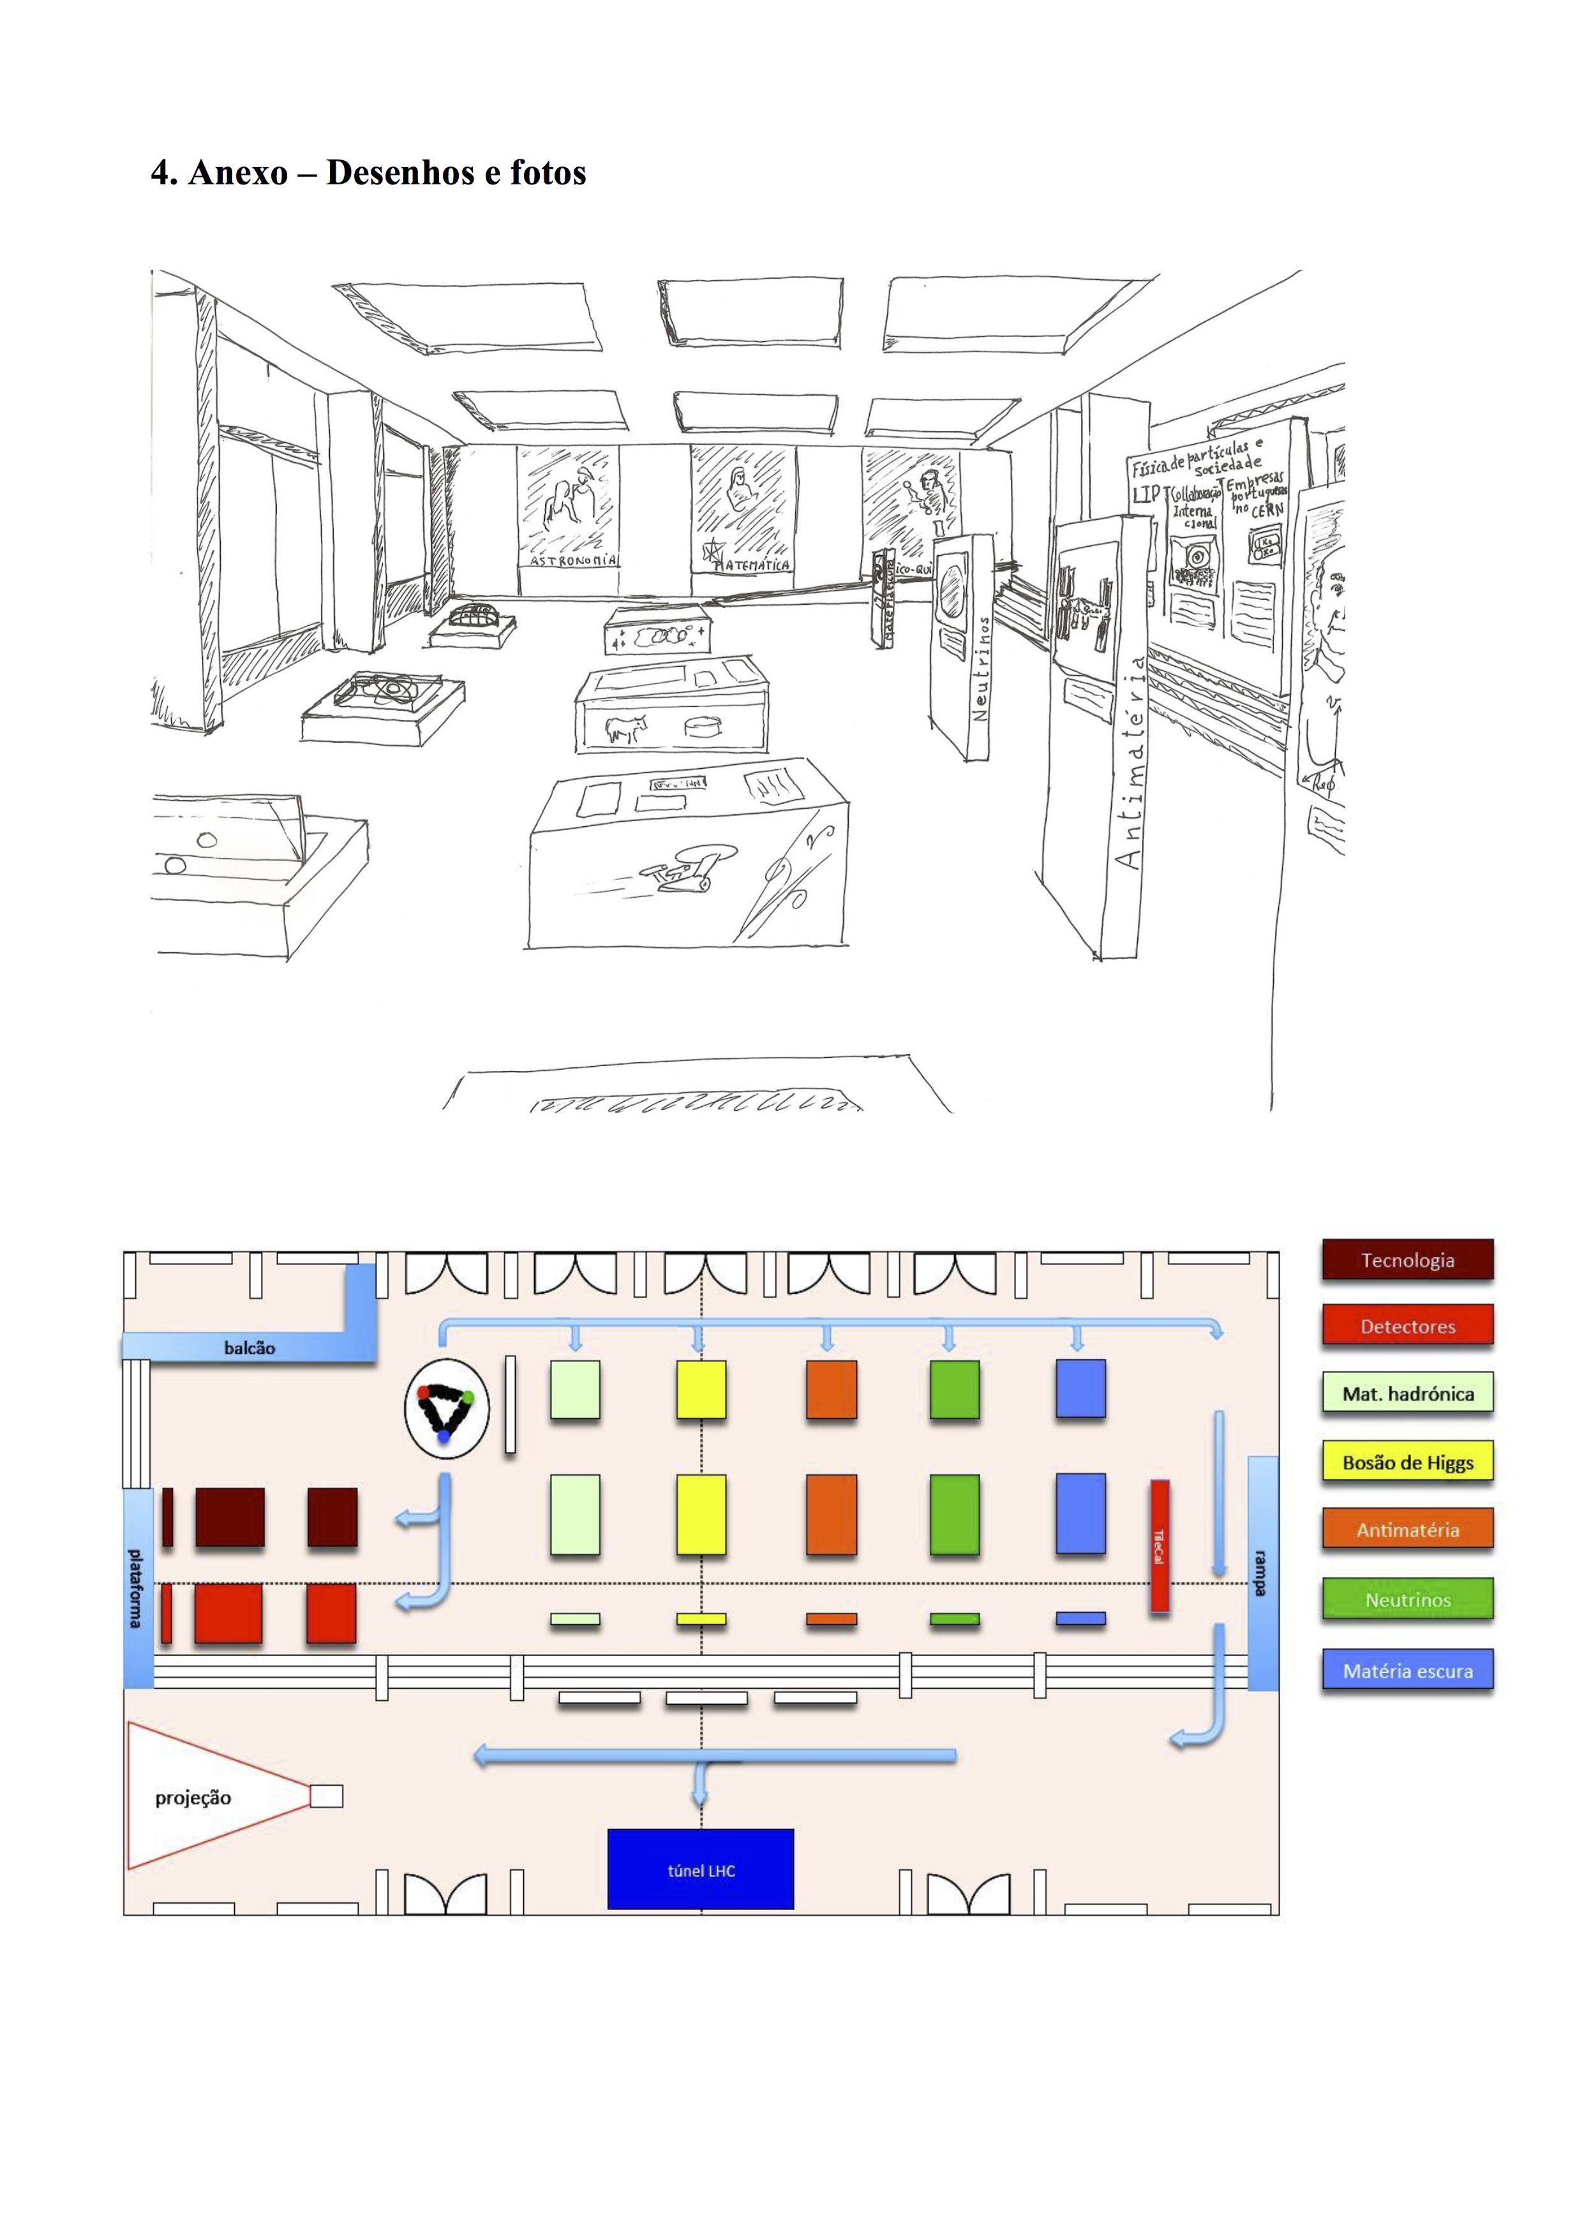
LHC tunnel
+
The challenges:
1. Hadronic matter
2. Higgs
3. Neutrinos
4. Antimatter
5. Dark matter
6. Detectors
7. Technology
+
About LIP
+
Projection area
Concept and Contents

Slide 9
LHC tunnel
+
The challenges:
1. Hadronic matter
2. Higgs
3. Neutrinos
4. Antimatter
5. Dark matter
6. Detectors
7. Technology
+
About LIP
+
Projection area
Concept and Contents

