Slide 1
Restarting the SBA -
The East Area and the North Area
Ilias Efthymiopoulos, Adrian Fabich, Lau Gatignon
IRWG, 27. August 2015

Slide 2
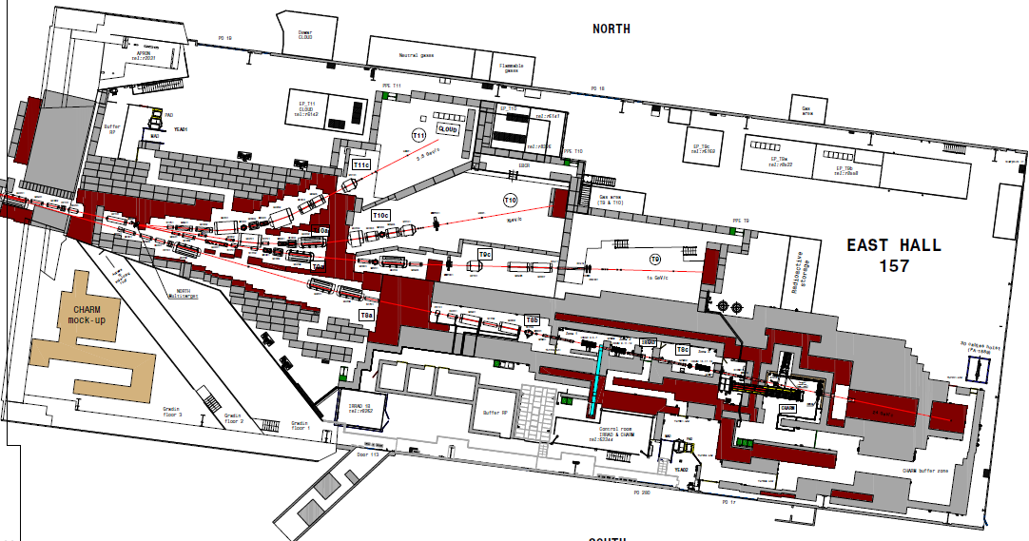
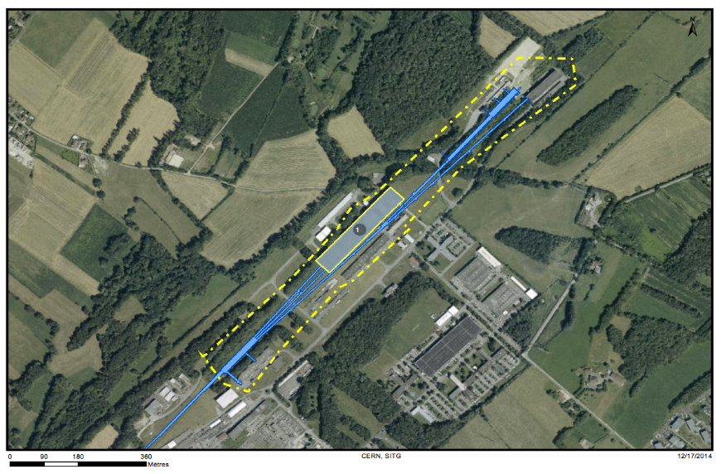
Areas covered
East Area
  From Target to North and South branches
  Auxiliary buildings
  See safety file 1273737 for complete list
North Area
  From TCC2 target including Wobble Station
  EHN1, EHN2, ECN3, transfer tunnels and auxiliary buildings
  See consolidation proposal 1456636 for complete list
Most of the SBA hardware originates from its initial implementation, which requires substantial effort for maintenance and operation.

Slide 3
LS1 activities
East Area
IRRAD/CHARM installation
Consolidation
CESAR extension for East Area
Ramses
North Area
K12 upgrade
TCC2 consolidation
  RP aspect determined the project start
GIF installation
house-cleaning
…

Slide 4
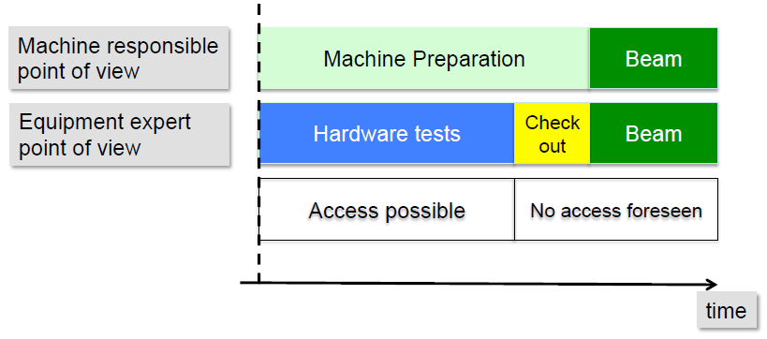
Planning of Annual Restart
Re-start (of elements) is not only after a long-shutdown
  User changes
  Beam changes (ions, secondaries, protons)
  Some elements are only used for certain configurations.
  CHECK elements in various configurations expected during the year
SBA beam commissioning
  Can only take place after the injector chain is fully in operation

Slide 5
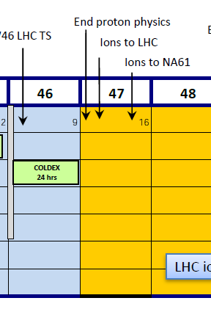
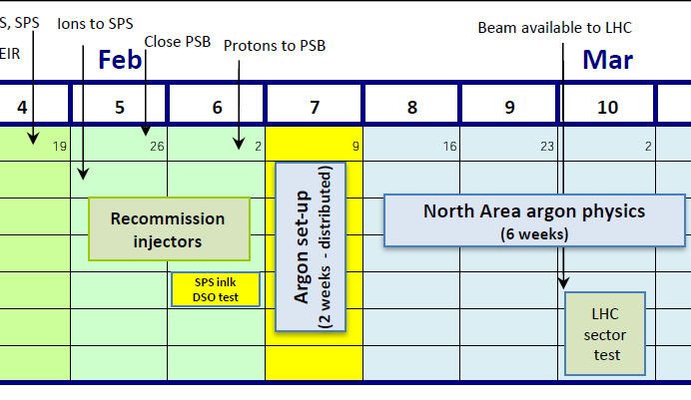
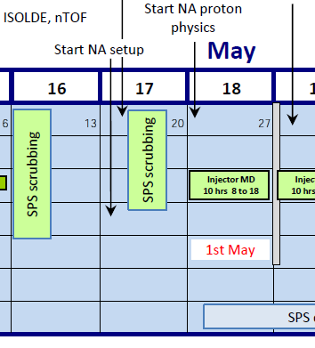
SBA beam commissioning
????
Close to
impossible
If scheduled SBA beam commission is late, users are still waiting.

Slide 6
SBA beam commissioning
Some equipment and operational aspects can only be tested with beam
  Particularly important for beam diagnostics
Important to indicate the SBA beam commissioning period in the schedule.
Beam commission effective only during working days
  Availability of equipment specialists

Slide 7
Coordinating panel
EATM (Experimental Area Technical Meeting)
Coordinating installation work and schedule for East Area, North Area (and nToF, AD, HiRadMat
  Providing beam with associated equipment
  Infrastructure for testbeams/experiments
  Assisting experiments on their equipment (installations, cryogenics, vertex magnets …)
Meeting during shut-down AND beam time
Meeting every 3-4 weeks (annual meeting schedule established in advance)
Attended by equipment representatives, experiment responsibles

Slide 8
Equipment specialists
Teams and personnel are very enthusiastic and committed.
Need to be available for starting the systems according to schedule
Priority to SBA during commissioning period
Not delaying due to other works

Slide 9
Safety integrity and documentation
Manual veto by EN/MEF (North Area only)
DSO tests
Some (safety) systems cannot be shut down
  Safety access system (for GIF)
  Alarm systems
Configuration changes
  Daily operation done by BE/OP
  USER and BEAM changes done by EN/MEF
    Largely transparent to operation
Work notifications by EN/MEF
  Planning hardware changes
  Tracing the changes
  Coherency with configuration management (BE/CO - CESAR)
  CCC has partial role in coordination

Slide 10
Examples
East Area
  First “machine” not included in LS1 coordination
  Unanticipated changes of system responsibles
  Feed-back from system responsibles welcome
    Changes in HW configuration needs to be evaluated
    E.g. removal of marguerite controls also impacted on TV screens
    Change of access safety doors – missing control of beam stoppers
  … many items, which were cured in the last minute or temporarily resolved – head-ache
North Area
  restarted well after LS1
  …
  EN/CV started well in time with the hardware commissioning of the cooling circuit, but one after the other pump broke down.
  Some beam commissioning during users’ time
    Increased coordination effort from machines

Slide 11
Beam controls – CESAR
  During LS1 there was a clean-up and development phase of CESAR.
  CESAR was continuously used in dry run and not left alone during shut-down period.
  Consideration: some systems for minimum shut-down period.

