Slide 1

Surface Brillouin scattering of transitional metal nitrides, composite oxides
Daniel Wamwangi
School of Physics

Slide 2



Projects overview:
Photovoltaic and opto-electronic properties
Light amplification approaches
Charge carrier transport and life stability
Inelastic light scattering on thin films
Thin film growth dynamics of Hard coatings
Stress evolution and relaxation in thin films
Elastic properties versus electronic/ dielectric properties
Thermal conductivity of phase change materials

Slide 3
Outline
Introduction: Dynamics of thin films growth and hard coatings
Nucleation and growth Structure Zone model (SZM)
Methods of thin film growth: instrument and conditions
Characterizations of thin films:
Surface acoustic wave propagation: Rayleigh surface acoustic
waves, phonon velocity dispersion curves, elastic constants
Case studies or examples: Nitrides, complex oxides, carbides

Slide 4
Introduction: thin films/ coatings
Unique properties, (T_{M}>1500°C), superior hardness, chemical inertness, high corrosion resistance
Protective coatings and diffusion barrier layers, magnetoelectric sensors, storage
Stress evolution and relaxation fundamental to intrinsic stress
Film microstructure versus mechanical properties of hard coatings
Epitaxial layers: strain mismatch, Reciprocal Space Mapping

Slide 5
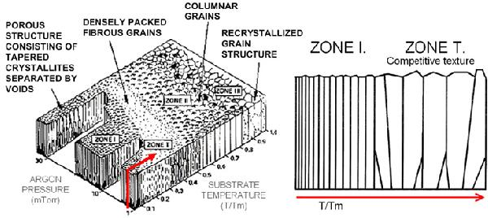
Introduction: Thornton (SZM) model

Slide 6
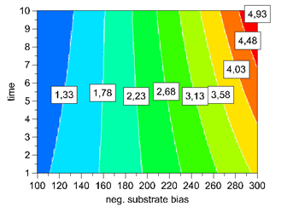
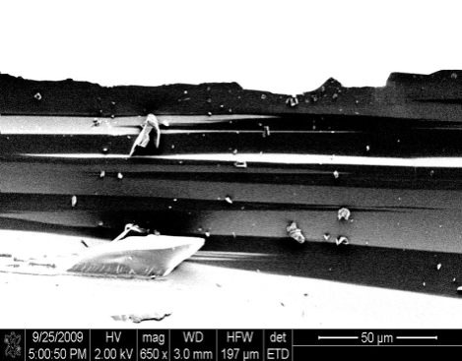
Diversity of thin film growth
DC reactive sputtering
RF magnetron sputtering
HiPIMS
Etching/ plasma cleaning: SiO₂:
P= 40W, U_{B} = - 300V t_{e}= 5 min
Film growth conditions
Sputter Power: Variable
Inert or reactive gas (Ar₂) : Pressure
Substrate bias 0 V and – 60V

Slide 7
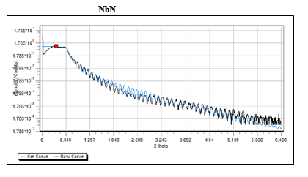
Characterization: X-ray reflectometry
total external reflection of X-rays from surface and interfaces
Incident plane
k_{in}
n = 1
θ_{c}
Limit of refraction:
cos θ_{c} = 1- δ
θ²_{c} = (2δ) = (r_{e} / π) λ² ρ_{e}
ρ_{e} = electron density

Slide 8
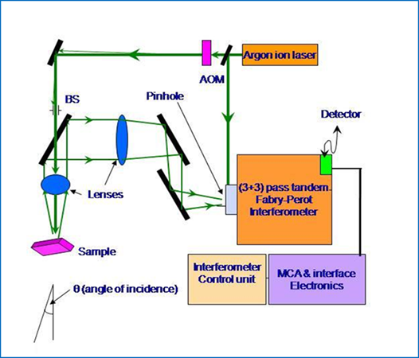
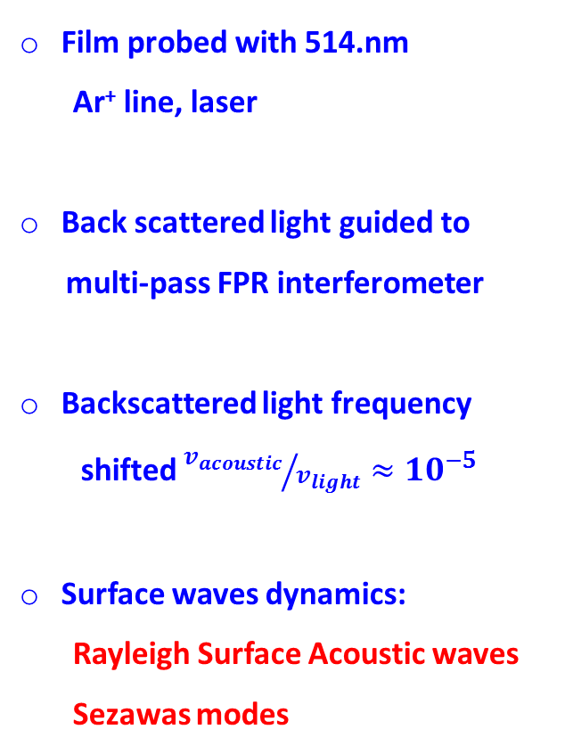
Surface Brillouin scattering:
Film probed with 514.nm
Ar⁺ line, laser
Back scattered light guided to
multi-pass FPR interferometer
Backscattered light frequency
shifted ${v_{acoustic}}/{v_{light}}≈{10}^{−5}$
Surface waves dynamics:
Rayleigh Surface Acoustic waves
Sezawas modes

Slide 9
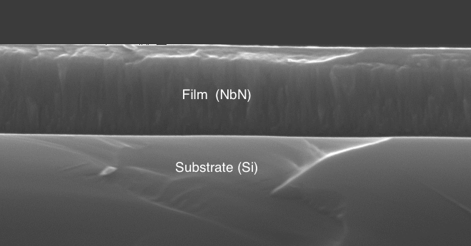
Microstructure, morphology and composition
ad atom energy effects on microstructure
ad atom energy effects on composition
Dual effects on elastic constants

Slide 10
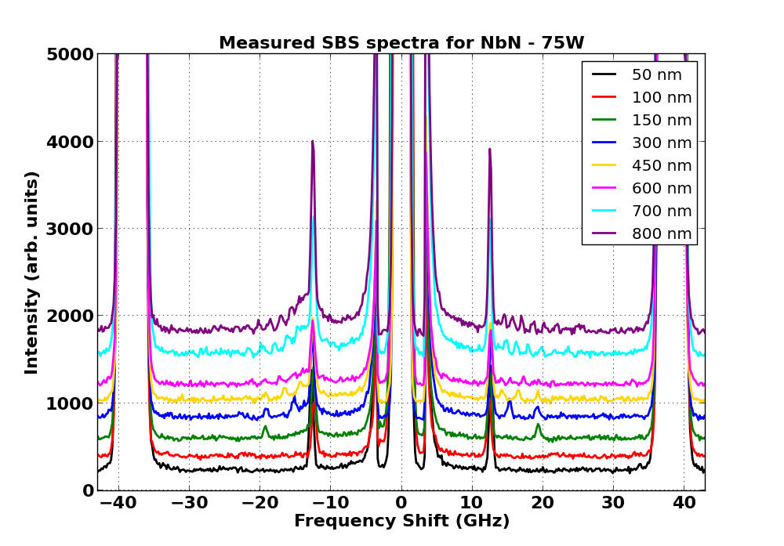
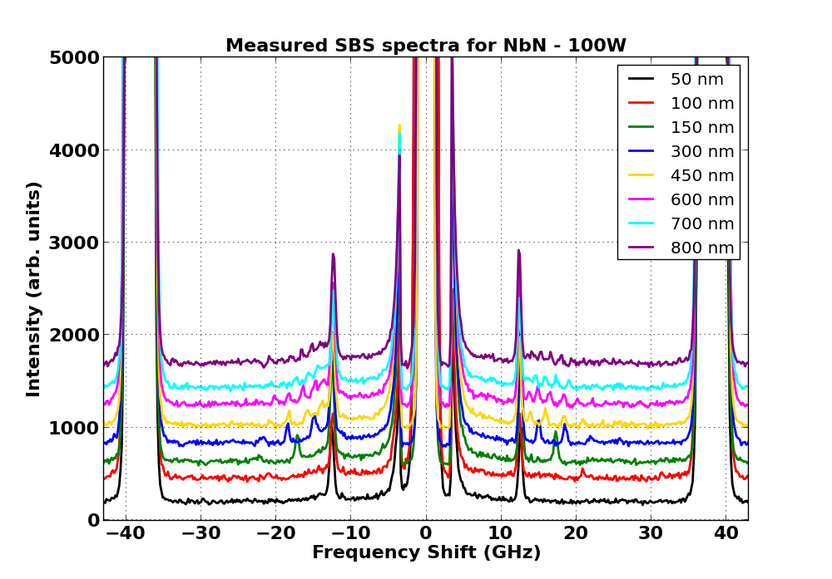
nitrides: ad atom energy variations

Slide 11
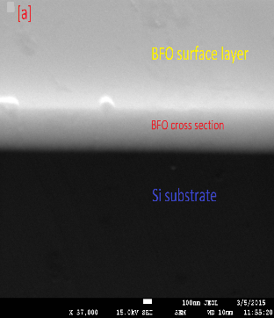
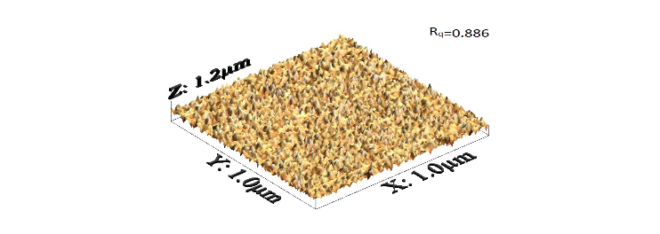
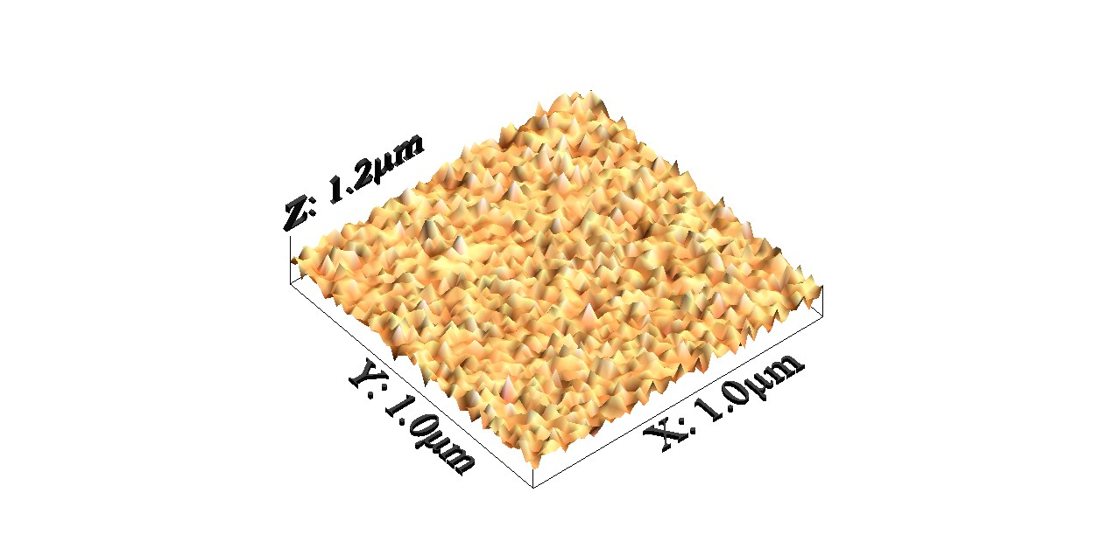
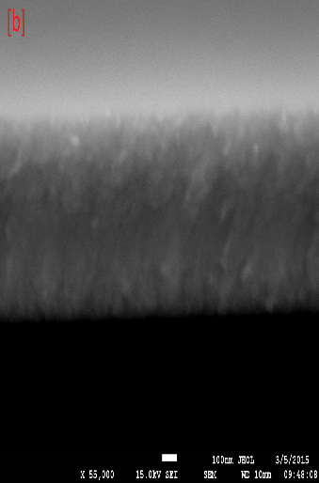
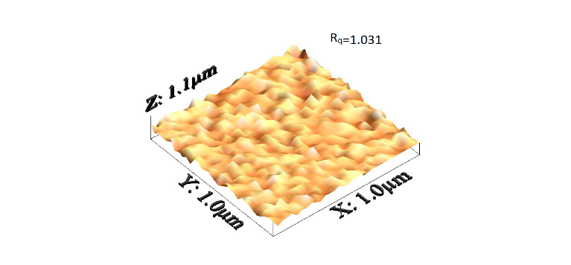
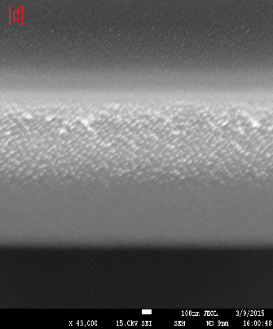
BiFeO₃: microstructure and morphology
Columnar growth
Increase in roughness

Slide 12
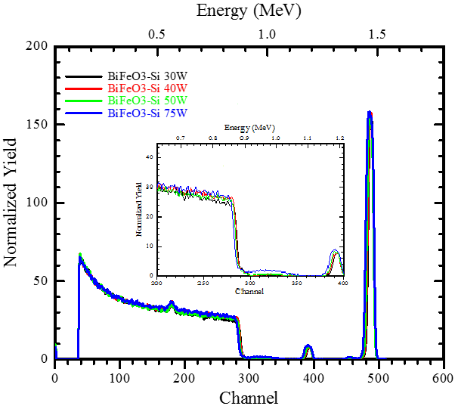
BiFeO₃: ad atom energy vs composition
Parameter Bi Fe O (At. ± 1.4%) (At. ± 1.4%) (At. ± 1.4%)
30W 25.5 10.6 63.8 40W 25.5 10.6 63.8 50W 24.4 10.8 64.8 75W 22.9 13.5 63.6
Constant composition
Varied microstructure

Slide 13
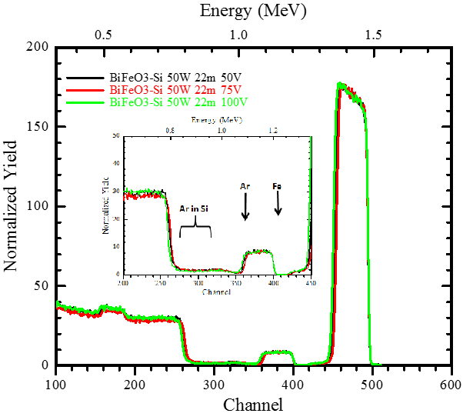
BiFeO₃: stress evolution
Substrate Bi Fe O Ar bias (At. ± 1.4%)
-25 24.4 14.3 61.2 0.1 -50 24.9 13.0 60.1 2.0 -75 26.5 12.4 57.3 3.8 -100 27.4 12.0 55.2 5.5
Coulombic effects on biasing, O²⁻ reduction
Ar⁺ incorporation
R_{O2-} < R _{Ar+} stress evolution

Slide 14
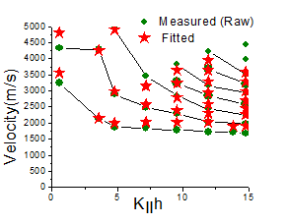
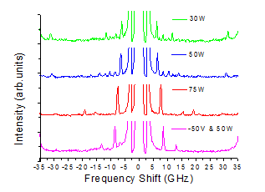
Elastic constants: microstructure
ad atom energy variation at const. thickness phonon dispersion curves

Slide 15
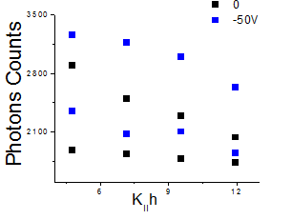
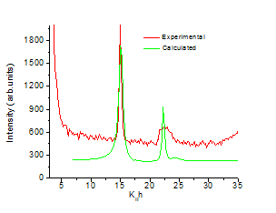
Elastic constants: stress evolution
Growth cond. | C11 (Gpa) | C12 (GPa) | C44(GPa
30 W | 188 ± 22 | 108.0 ± 2.0 | 39.0 ± 4.0
50 W | 133 ± 14 | 59.0 ± 1.0 | 37.0 ± 2.0
50 W & -50V | 171 ± 25 | 79.0 ± 10 | 63.0 ± 5.0
75 W | 90 ± 10 | 33.0 ± 1.1 | 28.0 ± 3.0

Slide 16
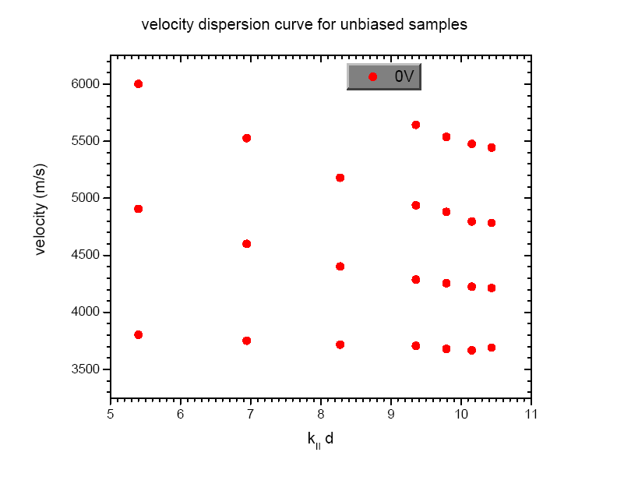
Carbides: evolution of stress

Slide 17
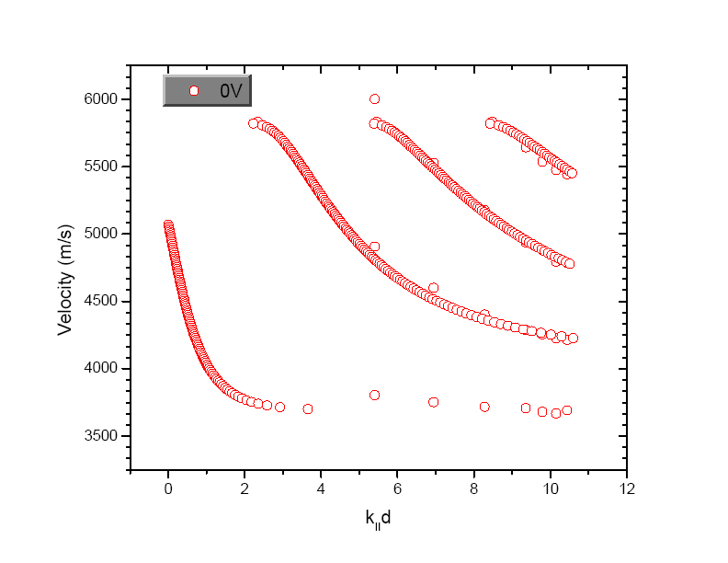
Carbides: evolution of stress
Elastic constants on iso- Hexagonal structure
c11 = 260.8 ± 9.0 GPa
c33= 267.0 ± 5.0 GPa
c13 = 83.5 ± 4.0 GPa
c55 = 88.6 ± 6.0 Gpa
c11/c33 < 1 : columnar growth
38% increase in stiffness normal to film

Slide 18
Conclusions:
Growth of diverse thin films possible: Thornton model
X-ray reflectivity techniques spectroscopy in Å dimensions
density of single and multi-layers
Phase transition not shown here
Role of microstructure and composition on elastic constants to be decoupled
Stress evolution in thin films

Slide 19
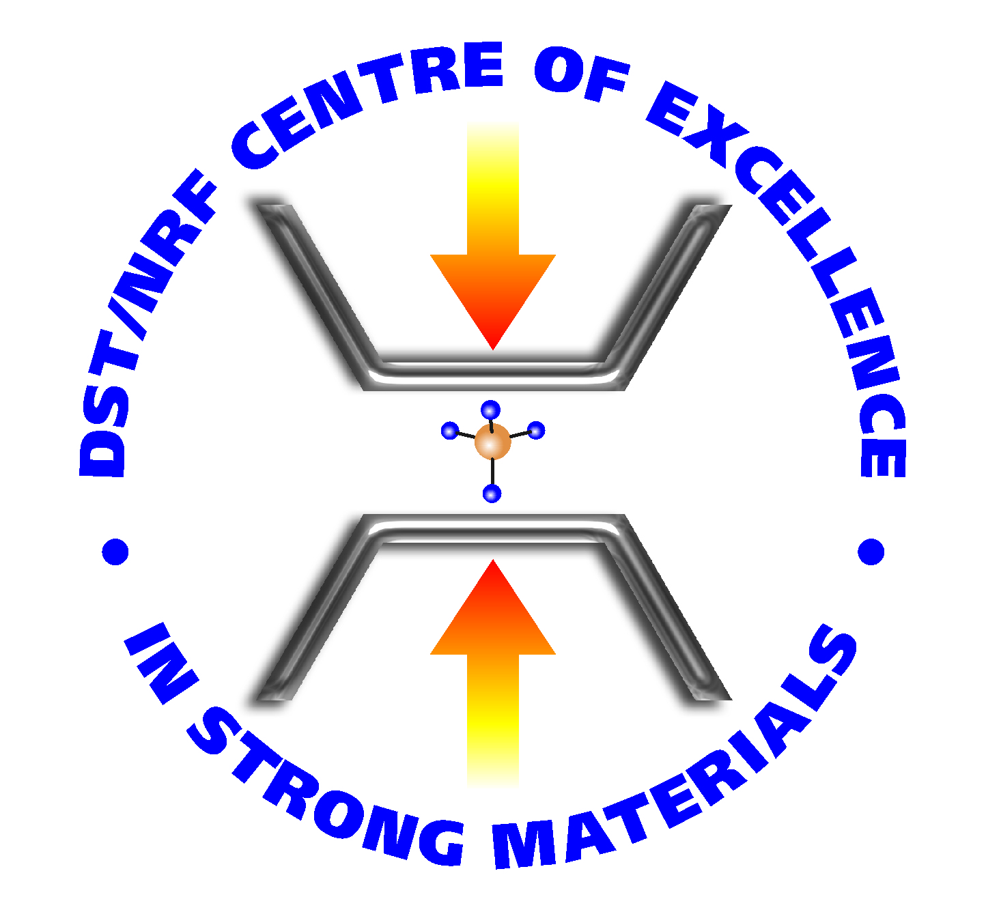



Acknowledgements

Slide 20
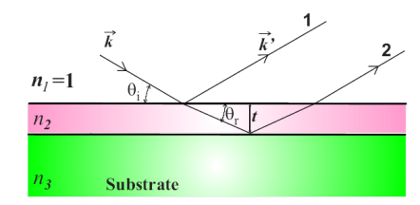


Density, thickness, roughness
Density: X-ray Reflectometry
Snell‘s law: n₁cosθ₁ = n₂cosθ_{t}
X-rays: n_{air} = 1, θ_{t} = 0°,
n= cosθ_{c}, n_{media} = 1- δ - i β,
Kiessig fringes:
θ² - α²_{c}= m² (λ/2t_{f})²
Reflectivity (background)
R(Q) ∝ q⁻⁴_{z}

Slide 21
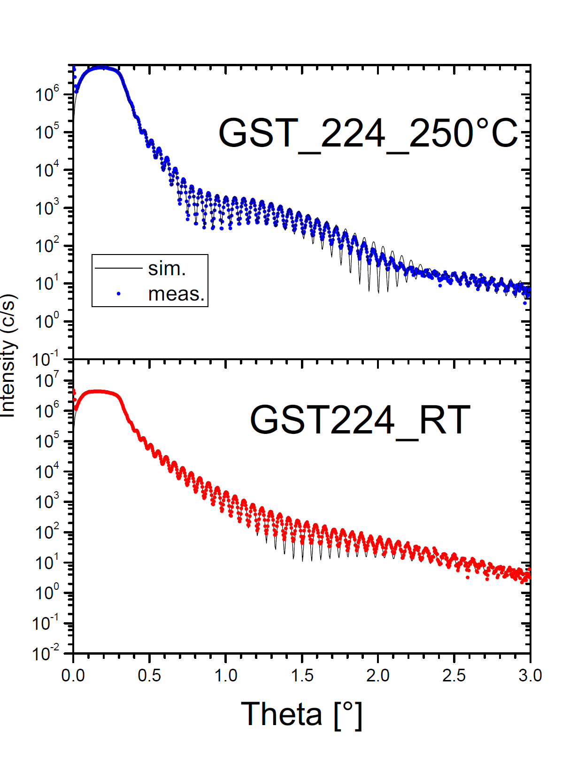
Volume change

Slide 22
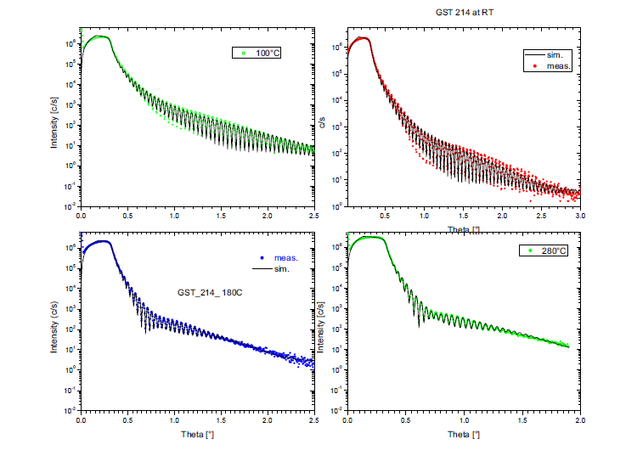
T dependence:

Slide 23
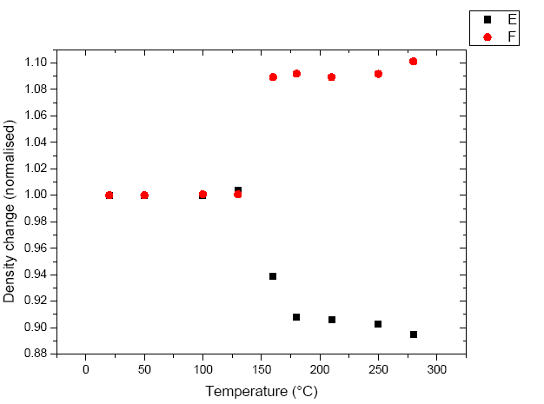
Volume change: X-ray reflectivity
Amorphous:
5.72 gcm⁻³
NaCl like:
6.23 gcm⁻³
Amorphous:
5.92 gcm⁻³
NaCl like:
6.33 gcm⁻³
Alloy | Volume change (Δρ/ρ)
Ge₂Sb₁Te₄ | 8.9%
Ge₃Sb₄Te₈ | 7.1%
Ge₂Sb₂Te₄ | 11%
NaCl like:
6.48 gcm⁻³
Amorphous:
5.84 gcm⁻³

